Slide 1
FAKE NEWS

Slide 2
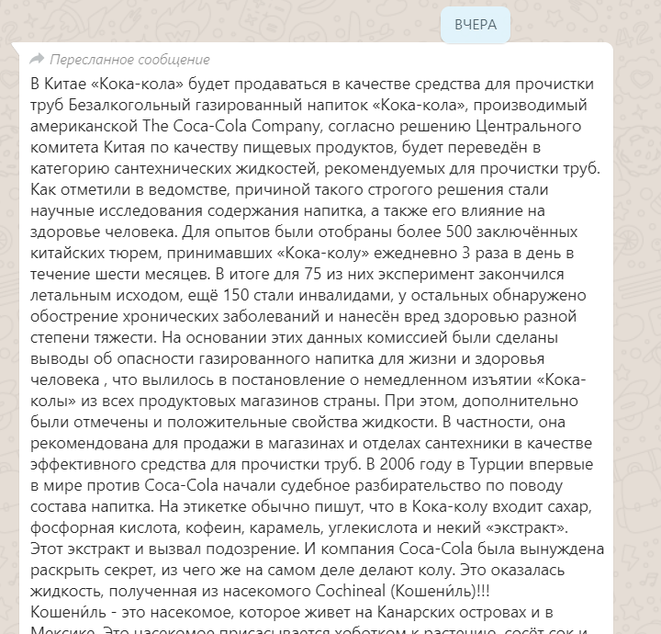

Slide 3
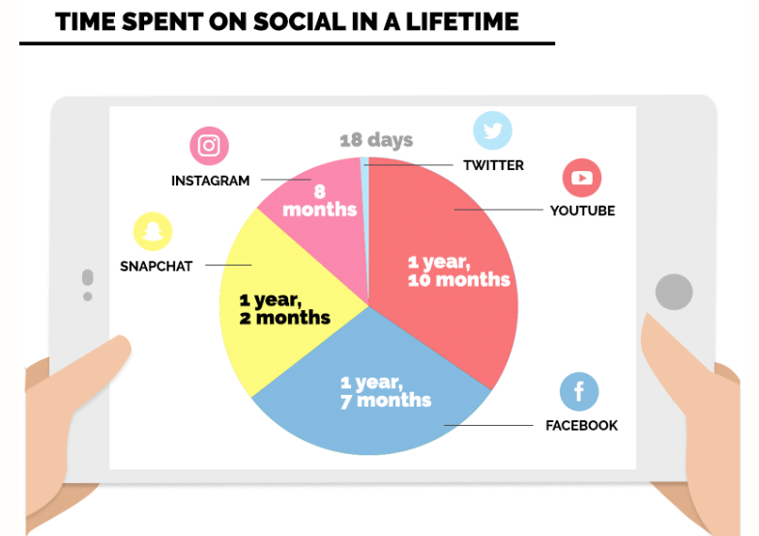


Slide 4


Slide 5
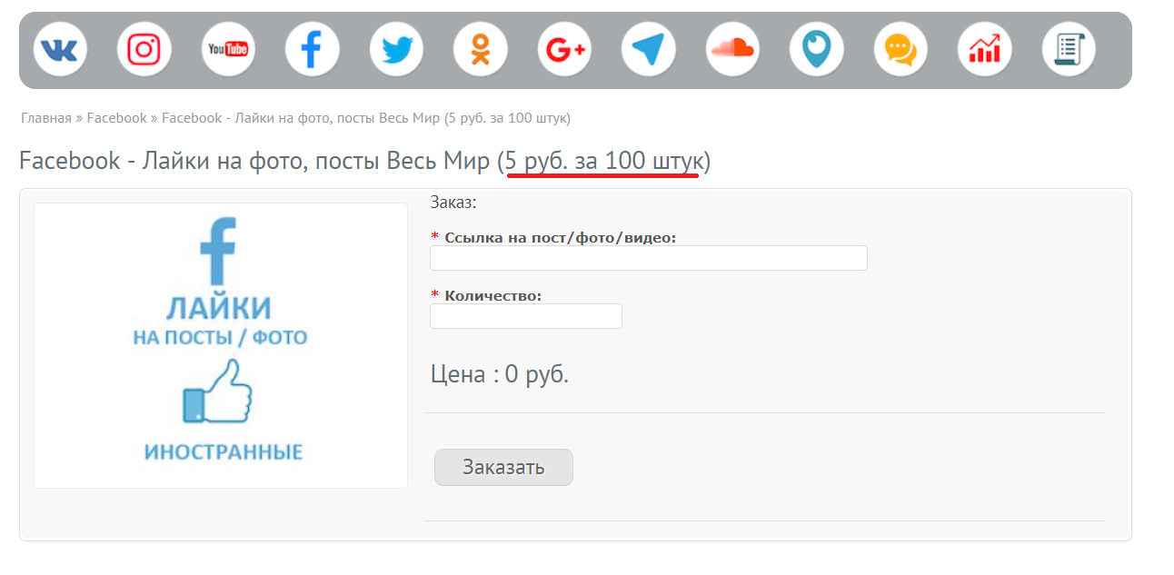


Slide 6
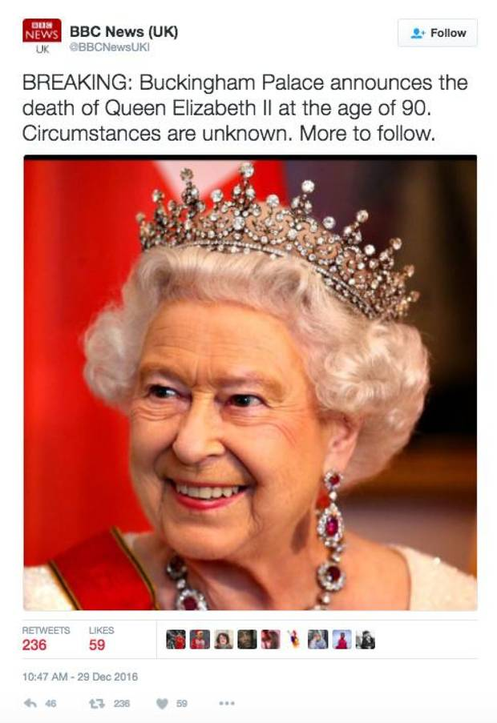

Slide 7




Slide 8
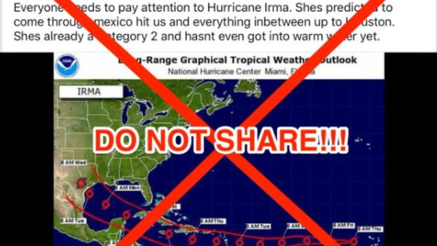

Slide 9
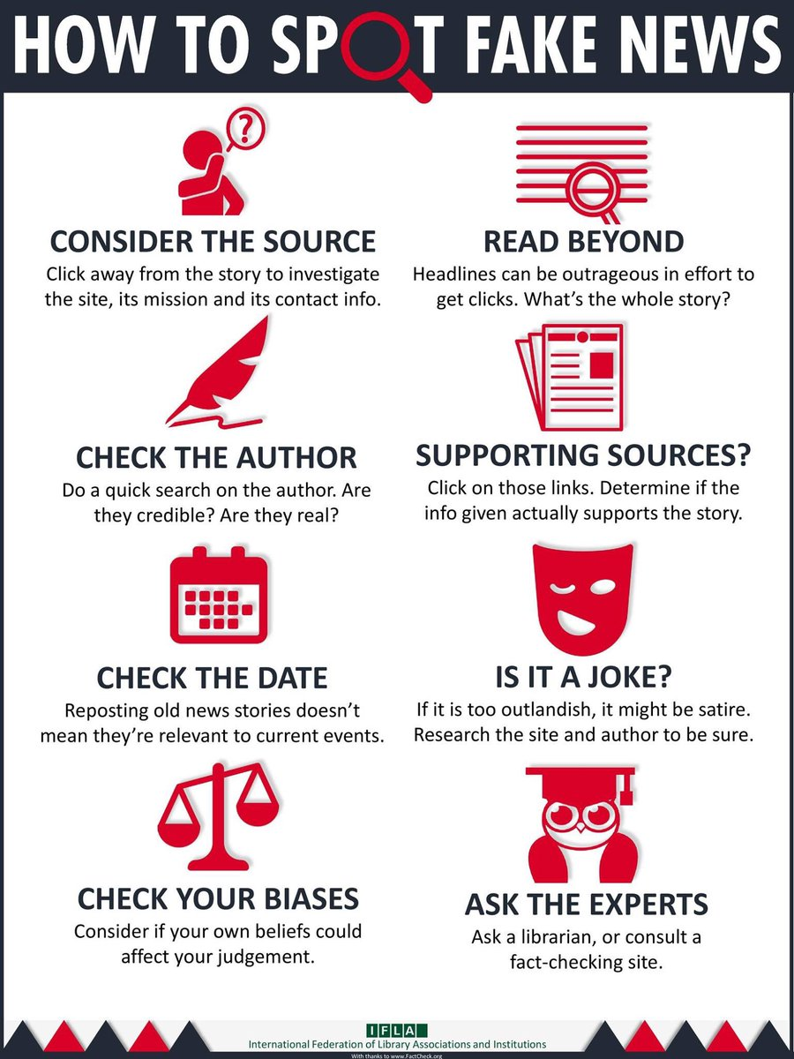

Slide 10

Thanks!
Any questions?
You can find me at:
facebook.com/marat.raimkhanov
marat.raimkhanov@gmail.com
8 707 111 2359

