Slide 1

Academic Library Sessions:
Experiences and Challenges of Nazarbayev University Library
Darya Zvonareva
Nazarbayev University Library
Joseph Marmol Yap
Nazarbayev University Library
Notes:
The Reference Department of the Nazarbayev University Library is responsible for the development and delivery of library sessions and workshops (NULITS, 2017). These are offered to support the curricular and research needs of our users, as well as to enhance their lifelong learning experience.

Slide 2
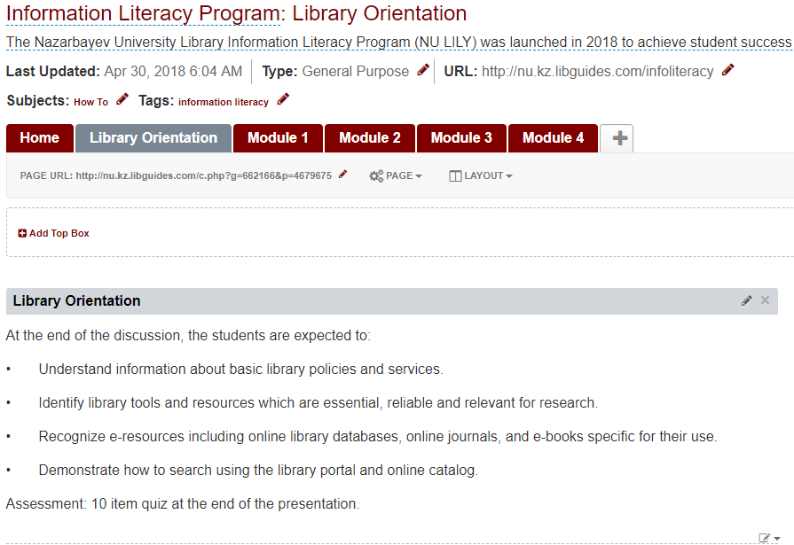
Introduction
Library sessions
  orientation
  one-shot session
  library instruction
Notes:
In 2016, changes were made in terms of the organization and management of the reference sessions. The sessions were divided into different categories and a coordinator was appointed for each. The coordinator was responsible for the organization, scheduling, monitoring, and reporting on the session. A reference librarian is expected to provide user education (sometimes referred as bibliographic instruction) programs that will support the lifelong learning experience of a library user (Liu, Lo & Itsumura, 2016). Examples of user education programs are library orientations (Liu, Lo & Itsumura, 2016), one-shot sessions (Cordell, 2013), library instruction (Nevius, Ettien, Link & Sobel, 2018), special or themed library sessions or workshops (Rinto & Cogbill-Seiders, 2015; Manuel, 2003; Giannini, 2013), and publisher sessions / subject-specific online database training (Garg & Turtle, 2003; Donlan, 2017).

Slide 3
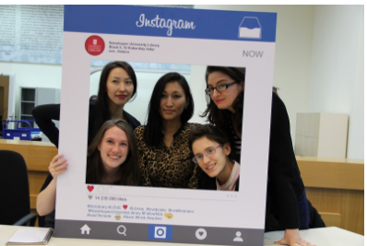
Assessing User Education Programs
Challenges of Reference Librarians
  organized educational program
  faculty and librarian collaboration
  integration into curriculum
Notes:
In order to improve any library program, there should be a uniform approach to assessment. The librarians at San Jose State University developed an online assessment tool to gauge students’ scores before and after library instruction.
Questions were reviewed to meet certain standards in conducting information literacy. Their study showed that there is a way to assess students’ learning before and after attending a library instruction session. Brage & Svensson (2011), writing about another programme, pointed out that they were able to assess the IL skills of medical students in collaboration with the medical faculty.
One major factor that hinders the establishment of a good information literacy program is a lack of a collaborative relationship between faculty member and librarian. Teaching faculties have a role to play when it comes to encouraging their students to use libraries and integrate information literacy sessions in their classes (Kavulya, 2003). The lack of coordination between faculty is a struggle when it comes to implement an information literacy program.

Slide 4
Objectives
Describe, evaluate and assess the library sessions and workshops;
Define the challenges faced by librarians in conducting the sessions;
Identify improvements for raising effectiveness in organizing and delivering the library sessions.

Slide 5
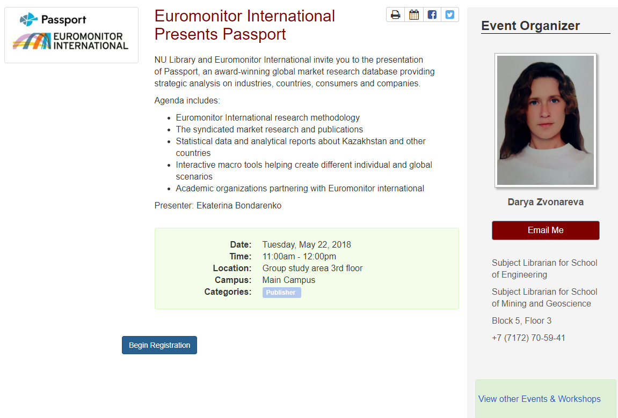
Methodology
Data from registration form
  affiliation / background
  number of registered vs actual attendance
Data from evaluation survey
  librarian / venue / technologies / materials
  knowledge application
  suggestions
Notes:
Data were gathered through the registration form and survey to assess the information sessions. A customized registration form was built on Springshare’s LibCal tool to identify the affiliation and background information of the participants.
The customized registration form gave a report on the number of registered participants versus the actual number of those who attended the sessions.
A follow-up evaluation form was automatically distributed to the registered participants one hour after the end of the library session using LibCal. The form was created using Qualtrics, an online survey platform.

Slide 6

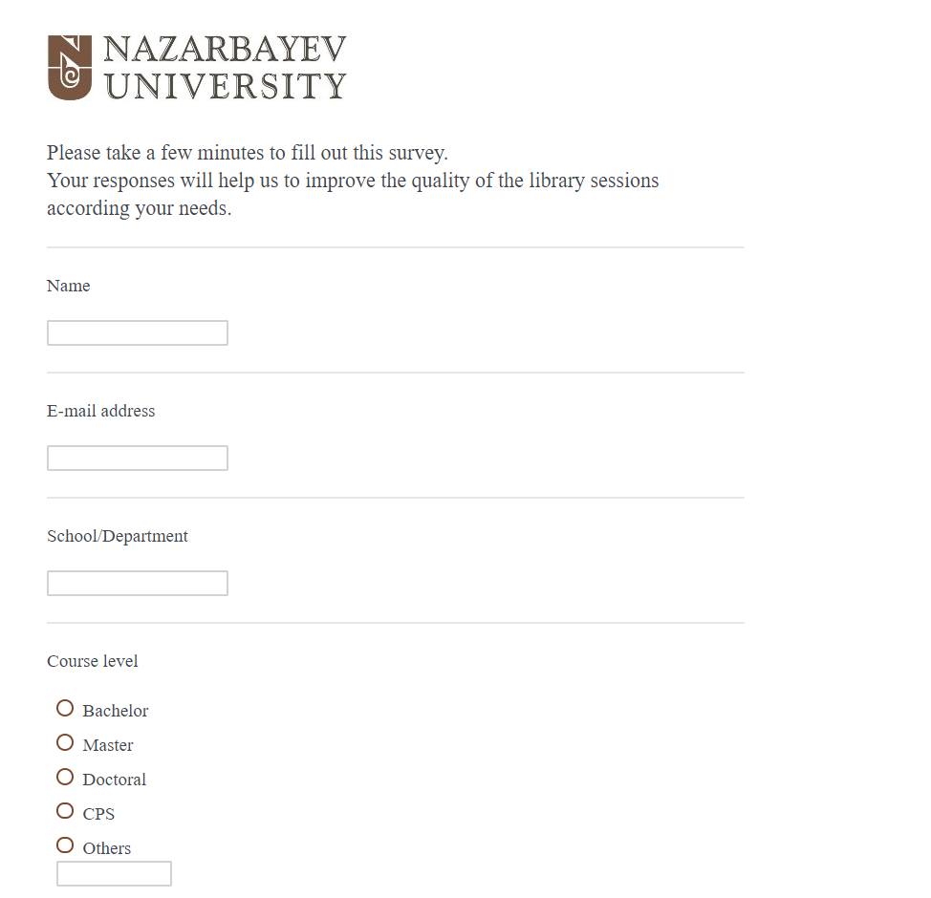
Notes:
It used a 5-item scale to measure the delivery and execution of each session from: excellent, very satisfactory, satisfactory, needs improvement, and poor. A 10-item survey questionnaire evaluating several aspects of the session was then answered by the participants. Open ended questions were asked to identify how participants hoped to apply knowledge from the session and to obtain suggestions for topics to be developed in the future as well as aspects for improvement. The survey responses could be anonymous.

Slide 7
Findings & Discussion
Library sessions organized
Open access
Multimedia
Financial literacy
Literature review tools
Patent search
Reading news and media

Slide 8
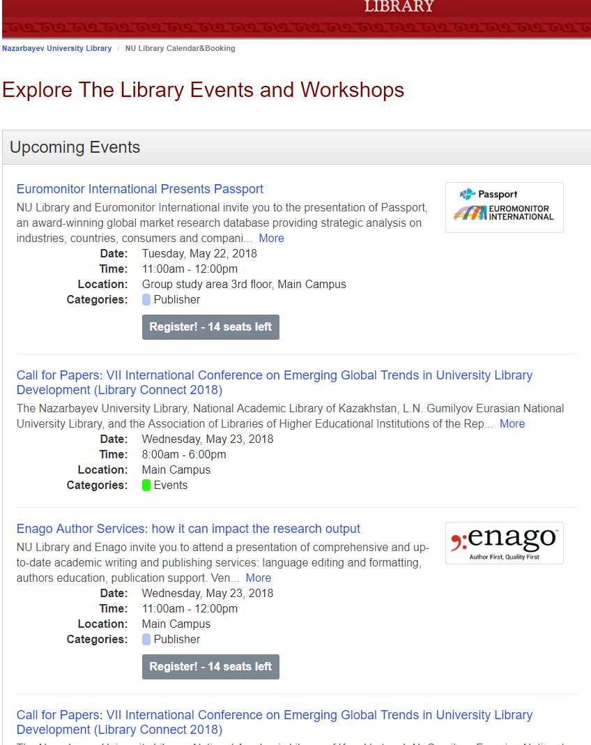
Findings & Discussion
Web Presence

Slide 9
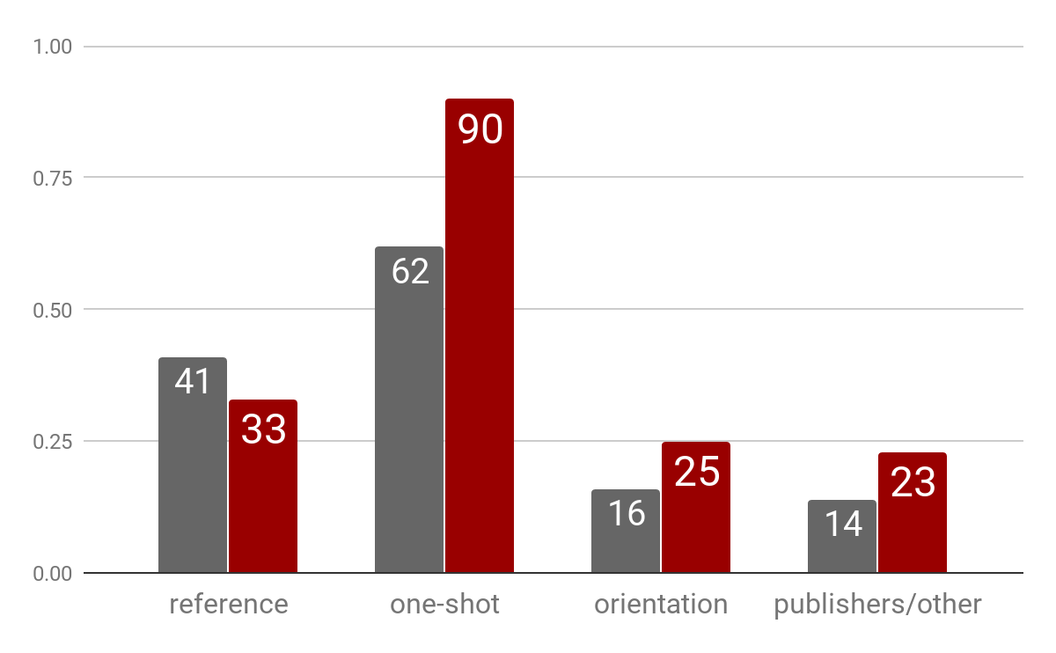
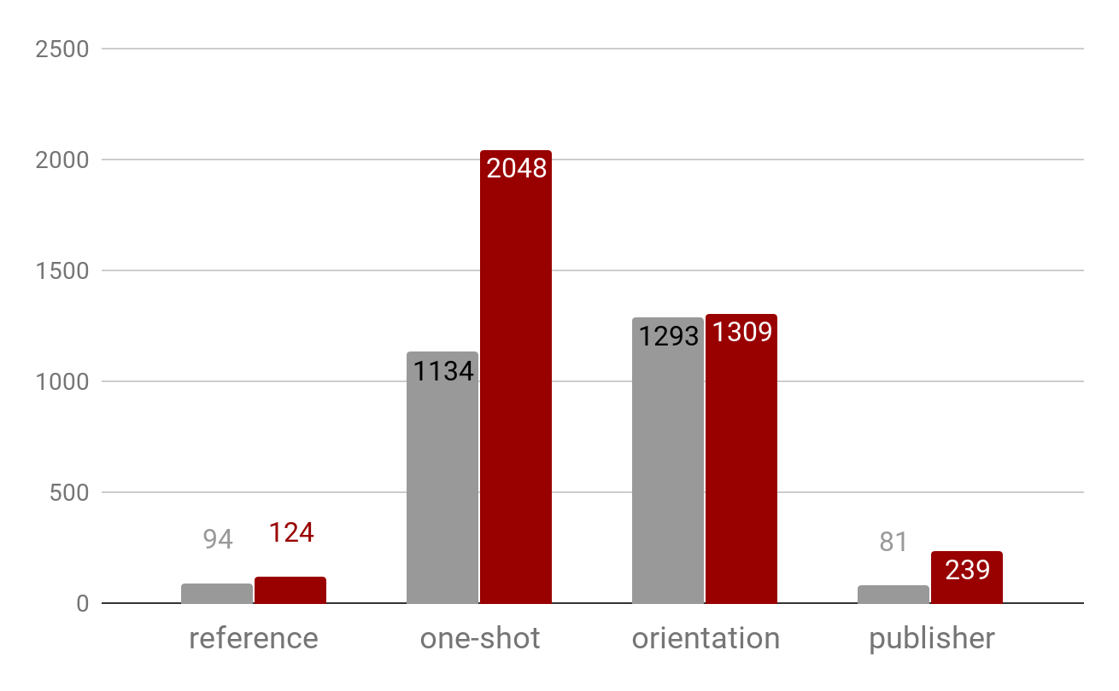
Findings & Discussion
The number of sessions
The number of attendees

Slide 10
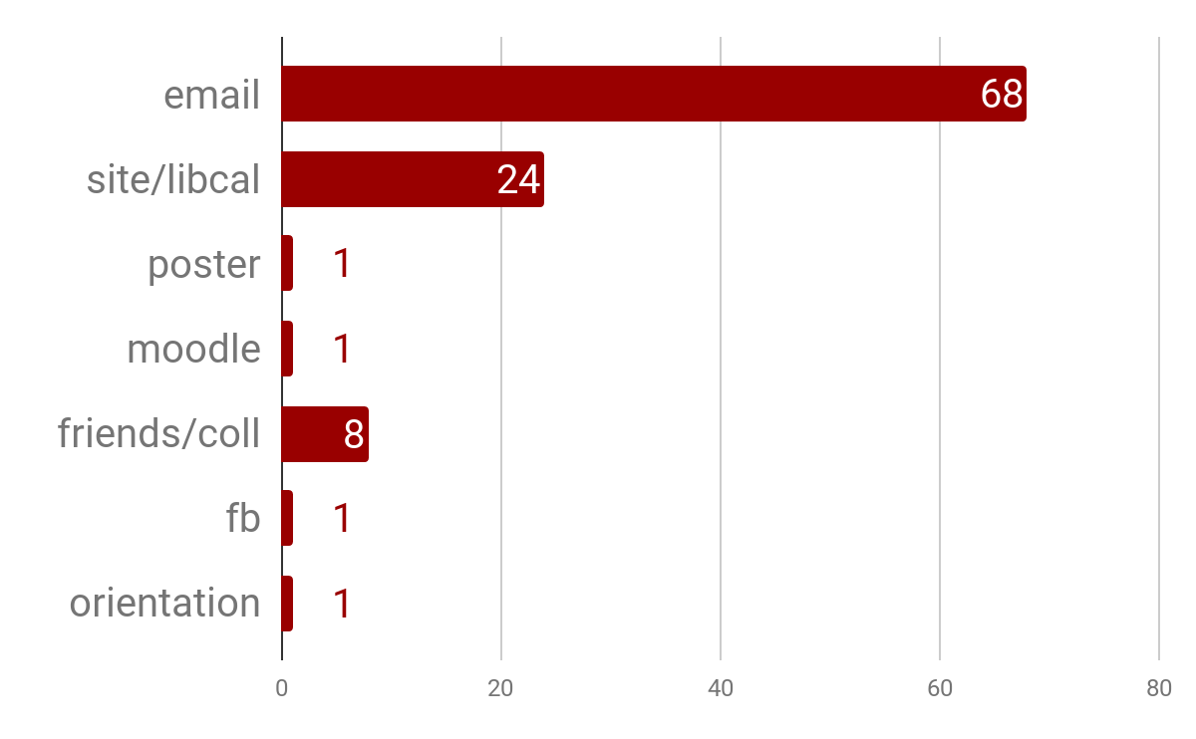
Findings & Discussion
Information delivery

Slide 11
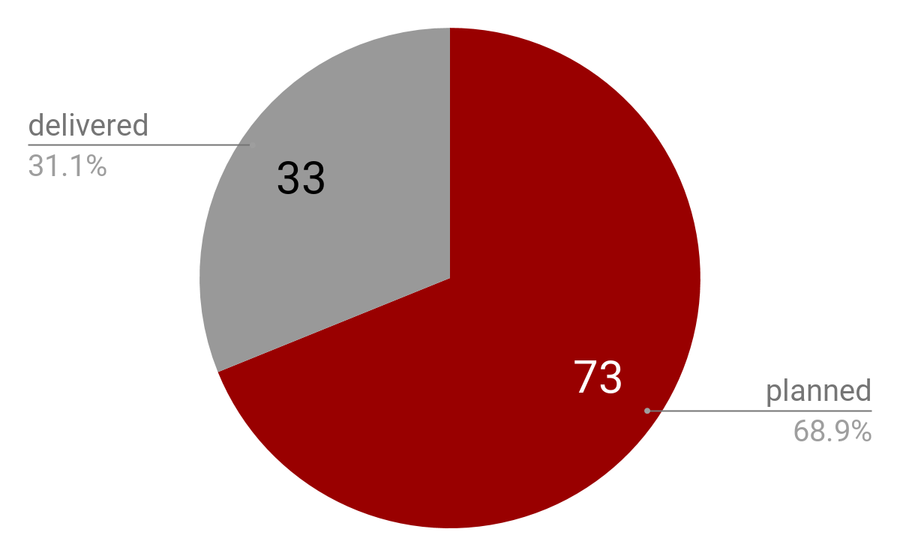
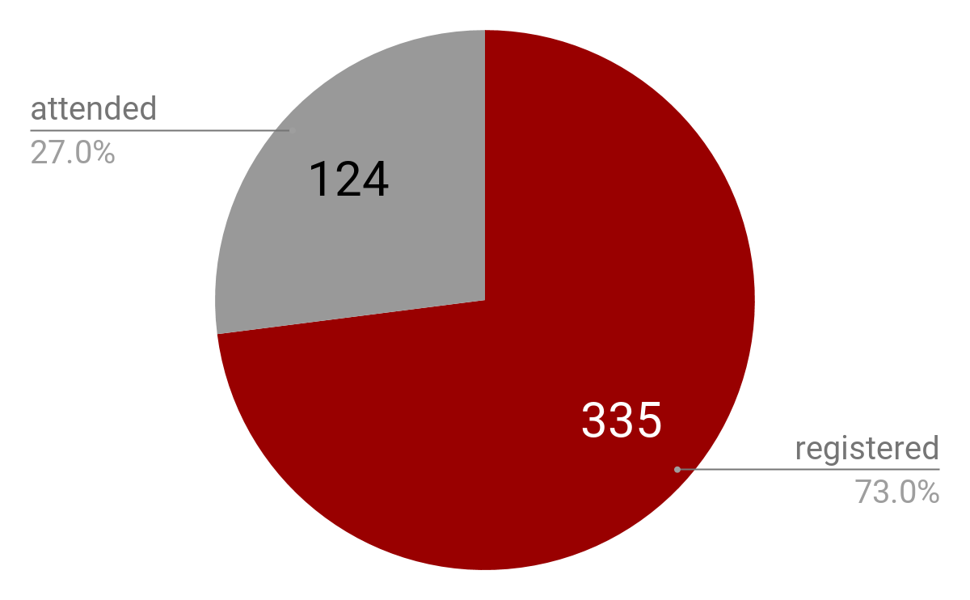
Findings & Discussion
The number of registered and attended participants
The number of planned and delivered information sessions

Slide 12
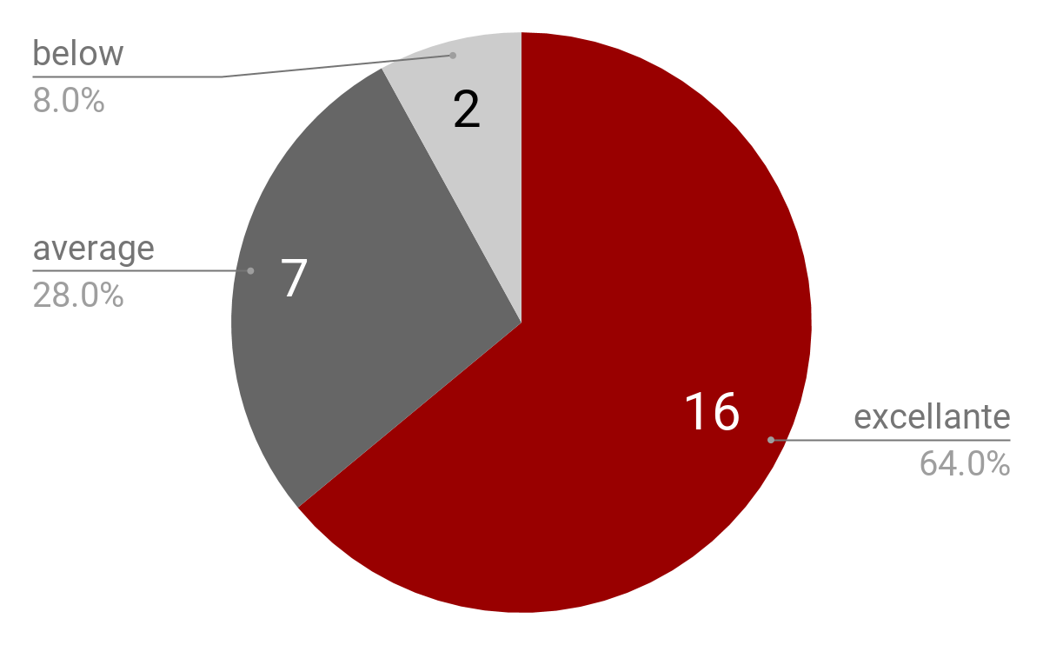
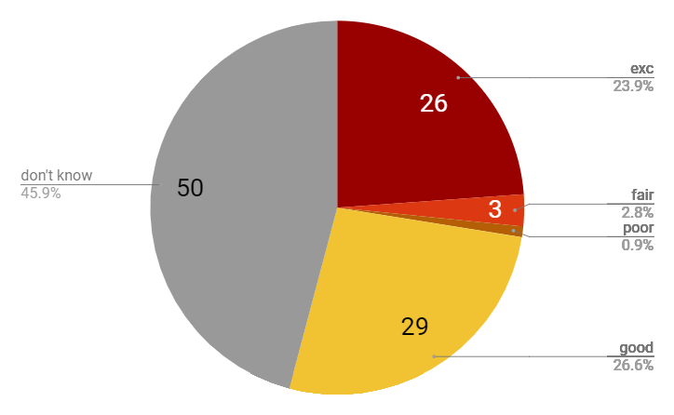
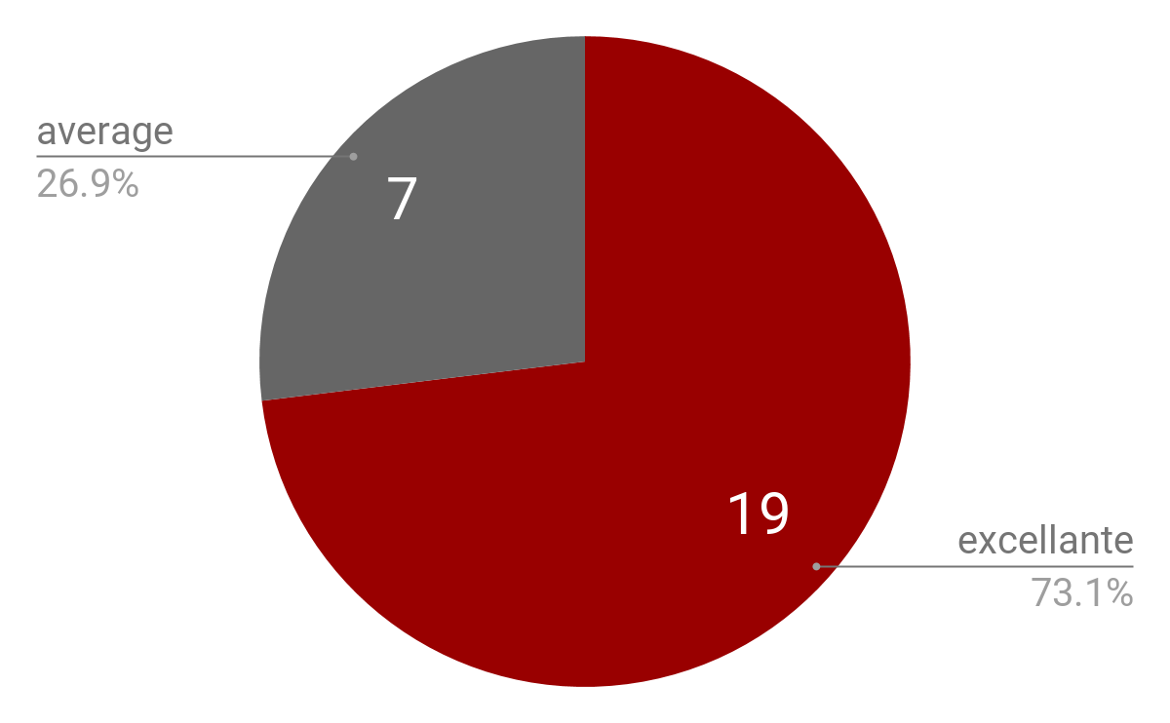
Findings & Discussion
The venue evaluation
The rating of the library sessions
The technology evaluation

Slide 13
Librarian’s Challenges
Low turnout of interested students
Need for a training room space
Identification of student’s information needs
Competing for student’s attention with other NU departments

Slide 14
Suggestions to improve the sessions
Venue
Time management
Topics
Faculty and NU departments collaboration
Marketing

Slide 15
Conclusions
User education programs attest that the role of reference librarians is very important in nurturing the information-seeking and evaluation skills of the students and even faculty members who were not yet fully acquainted with information literacy.
Users’ satisfaction with the sessions is high, although its value cannot be seen by the large number of attendees.
Following the suggestions from the patrons, the reference librarians shall listen to their needs and will try to keep-up with the recent developments in their specific subject areas.

Slide 16
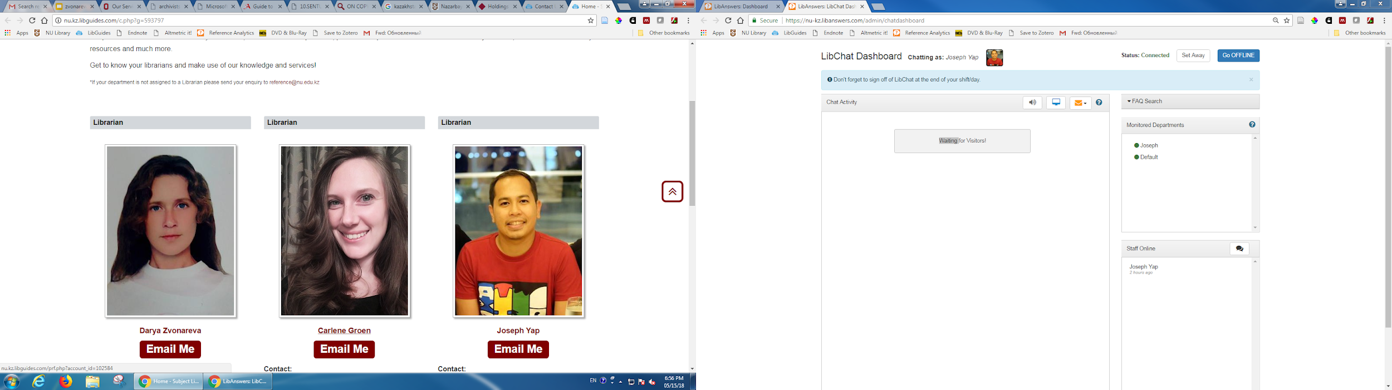
Thank you for your attention!

