Slide 1
Sequential deep learning models for human skeleton-based gait recognition
Zhanibek Darimbekov
MSc in Data Science, SEDS
Supervisor: Nguyen Anh Tu
Assistant Professor, SEDS
Co-supervisor: Min-Ho Lee
Assistant Professor, SEDS

Slide 2
Outline
Introduction
Related works
Proposed methodology
Experiments and results
Key contributions and conclusions

Slide 3

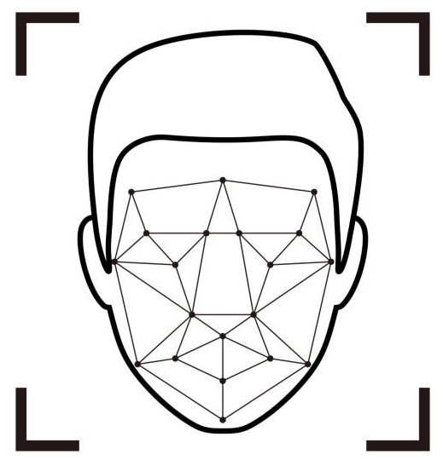


Background
Person identification based on biometrics
  Fingerprint
  Face
  Voice
  Iris
Data acquisition requires well-controlled environment and active participation of the subjects
Not applicable under uncontrolled conditions

Slide 4
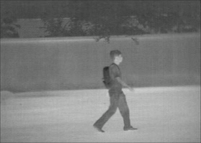
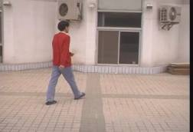
Background
Gait is a natural unique biometric
Gait is a walking posture and involves dynamics of a person
Gait recognition is a biometric identification technique that helps to identify a person by his/her manner of walking

Slide 5
Background
Gait properties:
Remote:
Gait can be captured from distance (<50m)
Unobtrusive:
Gait requires no active collaboration and attention of observed subjects
Low-resolution:
Gait information can be collected at low resolution
Hard to impersonate:
Gait includes both the body posture and activities while walking

Slide 6
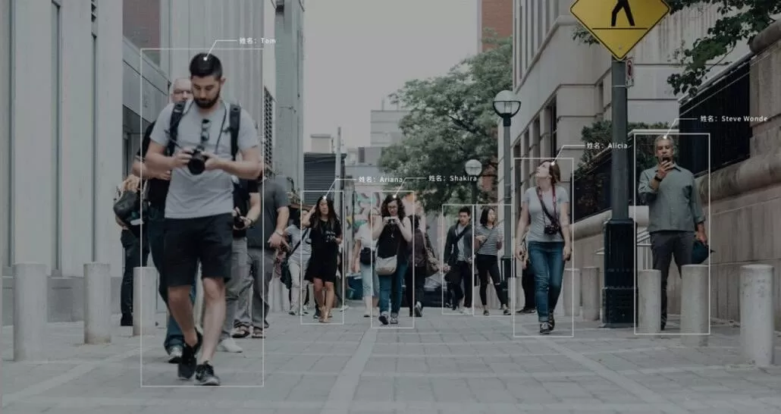
Applications
Gait Recognition for Security & Surveillance
Video surveillance in public areas for security purposes
Preempts suspicious events
Provides awareness to the security personnel
Re-identifying people after some time in other places
Notes:
The automatic analysis of data collected in surveillance camera networks enables us to preempt suspicious events and to provide real-time alarms and situational awareness to the security personnel. The security paradigm can shift from reaction/investigation of incidents to a more proactive prevention of potentially catastrophic events

Slide 7
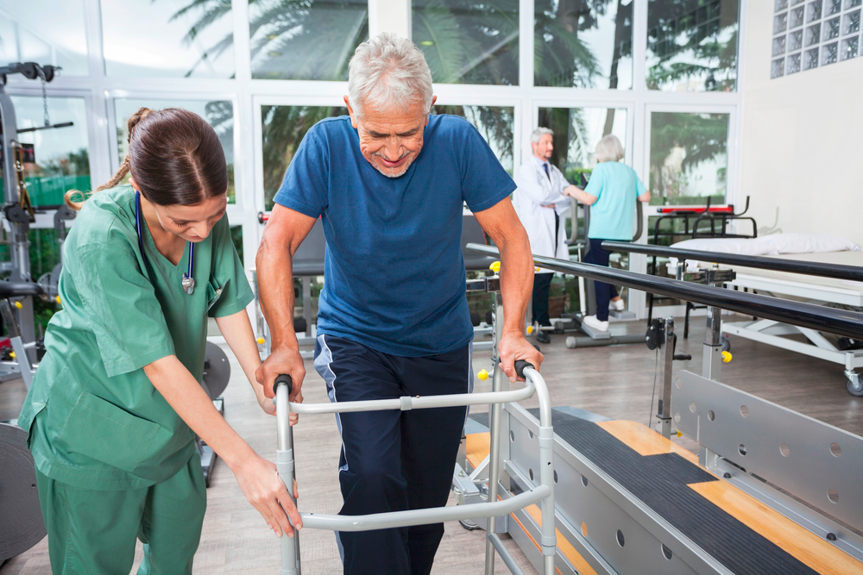
Applications
Gait Recognition for Smart Home and HealthTech
Smart home: detect movements and identify people
Nursing homes: alert if patient falls
Hospitals: diagnose neurological disorders
Notes:
The automatic analysis of data collected in surveillance camera networks enables us to preempt suspicious events and to provide real-time alarms and situational awareness to the security personnel. The security paradigm can shift from reaction/investigation of incidents to a more proactive prevention of potentially catastrophic events

Slide 8
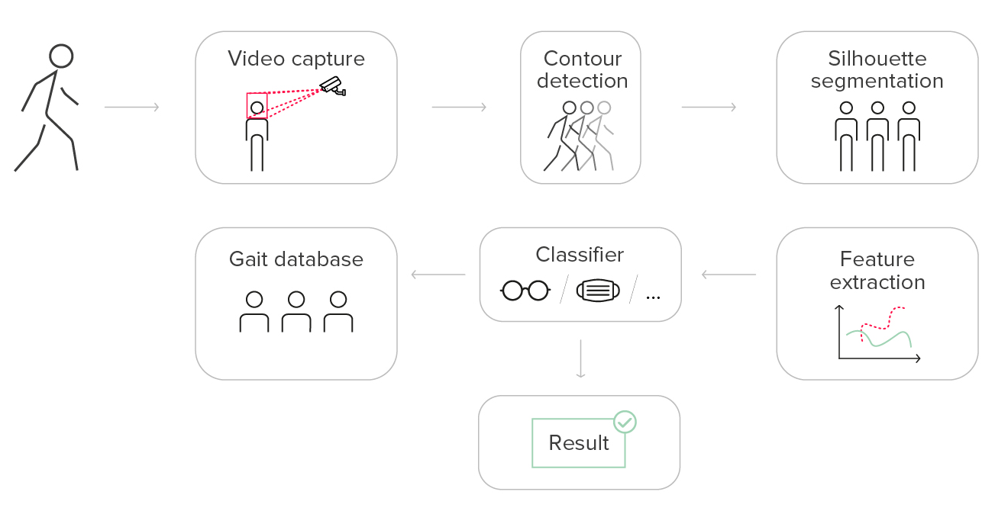
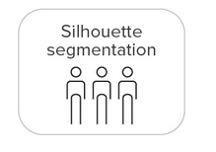
Gait recognition overview
Skeleton extraction
ID#1, ID#2, …
Source: https://recfaces.com/articles/what-is-gait-recognition
Notes:
The automatic analysis of data collected in surveillance camera networks enables us to preempt suspicious events and to provide real-time alarms and situational awareness to the security personnel. The security paradigm can shift from reaction/investigation of incidents to a more proactive prevention of potentially catastrophic events

Slide 9
Motivation: Problem Statement
Despite the advantages over other biometric-based person identification systems, gait recognition still has several issues:
Intra-class variances: clothing, viewing angle, scale, occlusions
Variations over time and place: the same person at different times and places
Goals:
Representative gait features: capturing size, view, and motion information
Lightweight i.e. simpler system, fewer hyperparams
Effective i.e. high accuracy rate
Efficient i.e. fast inference
Robust i.e generalizable and shows stable performance under various variations

Slide 10
Motivation: Objectives
Investigate different gait features
  Design a set of handcrafted gait features extracted from raw 3D joint coordinates
  Investigate predictive abilities of the derived features
Learn a person identification model
  Design gait classification models based on LSTM and Transformer architectures
  Evaluate the models’ performance against existing models

Slide 11

Related works: Silhouette based methods
Year | Model | Input type | Method | Dataset | Accuracy, %
2016 | Geinet: CNN | Silhouette, GEI | Silhouette templates over a gait cycle | OU-ISIR | 94.6
2018 | GaitSet: CNN | Silhouette | Gait as a set of silhouette frames | CASIA-B | 95.1
2020 | GaitPart: CNN | Silhouette | Process each human body part images separately | CASIA-B, OU-MVLP | 96.2
2021 | CNN w/ Attention | Silhouette | Selecting important gait features through attention mechanism | whuGait, OU-ISIR | 98.58
Sensitive to noise, image quality, view angle, speed
Some body parts can be occluded by other body parts
Lose fine-grained temporal and spatial information

Slide 12

Related works: Skeleton based methods
Year | Model | Input type | Method | Dataset | Accuracy, %
2019 | ST-CNN | Skeleton data from Kinect depth cameras | Spatial and temporal features from joint coordinates into CNN | UPCV Gait, KS20 VisLab, SDU Gait | 98.86
2021 | GaitGraph:Graph Convolutional Network (GCN) | Pose estimations from gait silhouette | Automatically model the gait as a graph-structured skeleton data | CASIA-B | 87.7
2021 | CNN+GCN+STC-Att | Skeleton, Silhouette | Process both silhouette data and skeleton data in two-branch network, GCN + CNN, followed with Attention layer | CASIA-B | 94.74
Computationally expensive and require high-quality data
Compact and efficient data for further processing steps

Slide 13
Related works: Limitations
Very few methods that process gait data sequentially e.g. using RNN/LSTM
  Especially with human skeletal data
Complexity and efficiency of previous methods can be optimized
  Many preprocessing steps, many CNN layers, stacks of CNN and LSTM/Transformer
  Training time efficiency
Attention mechanism inside CNNs
No or few methods process sequential human skeletal data directly with Attention

Slide 14
Proposed methodology
Extract rich gait features from human skeletal data
  Joint-based: joint coordinates and joint velocity
  Geometric features: joint distance and joint orientation
Augment data by flipping and rotating body joints
Learn sequential person identification model
  Learn temporal dependencies throughout the whole sequence
  Select effective features with attention
  Lightweight architecture (LSTM and Transformer)
  Faster training and inference

Slide 15
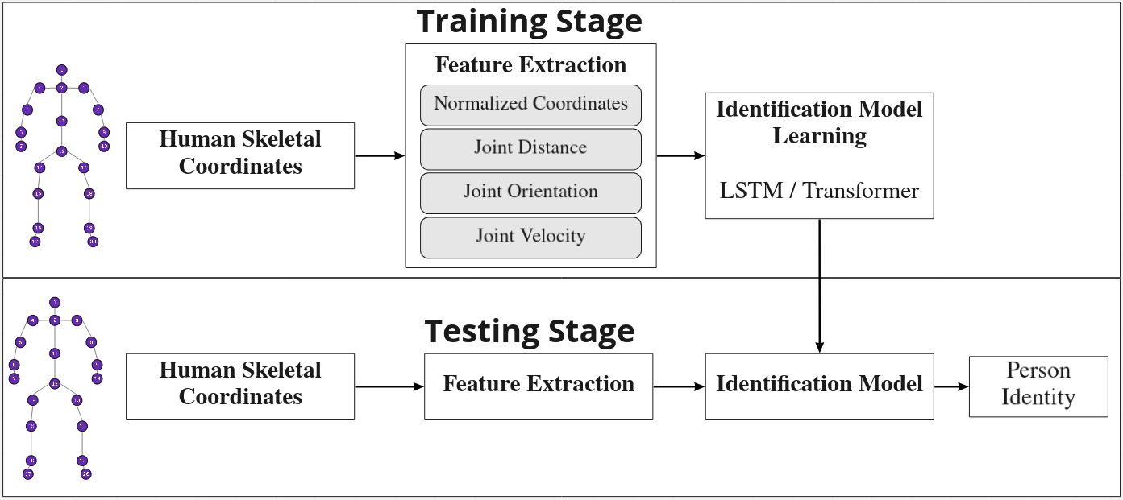
Proposed methodology

Slide 16
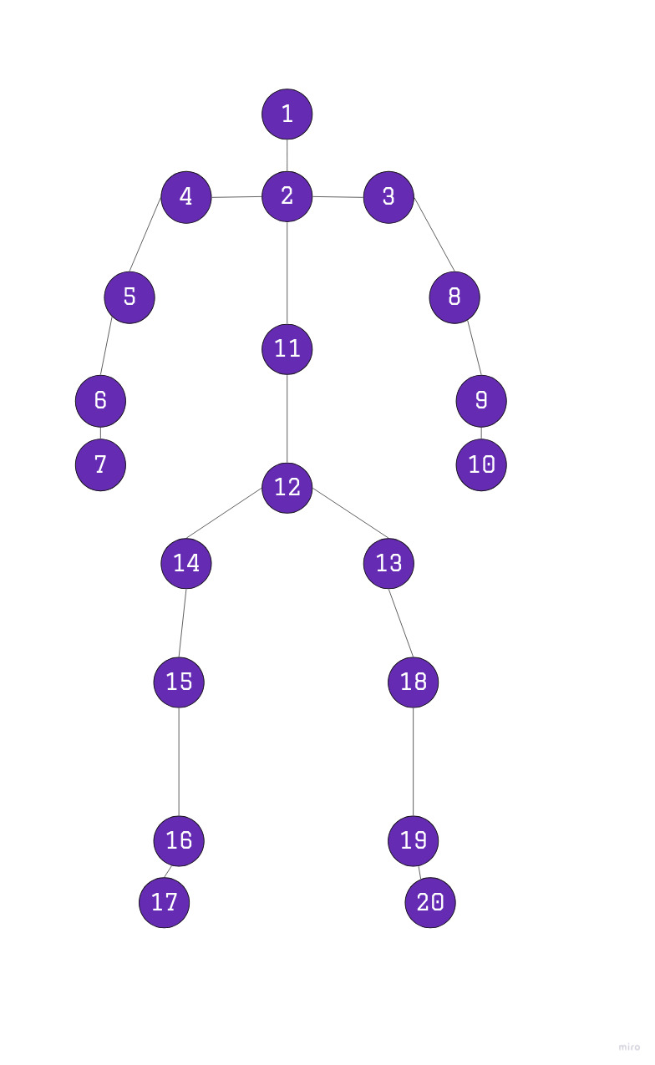
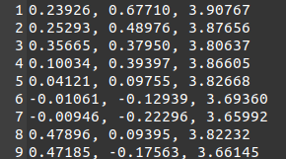
3D skeletal joint coordinates
A skeleton S is a set of body joint coordinates in 3D space:
S = { (x(j), y(j), z(j)) for joint j }

Slide 17
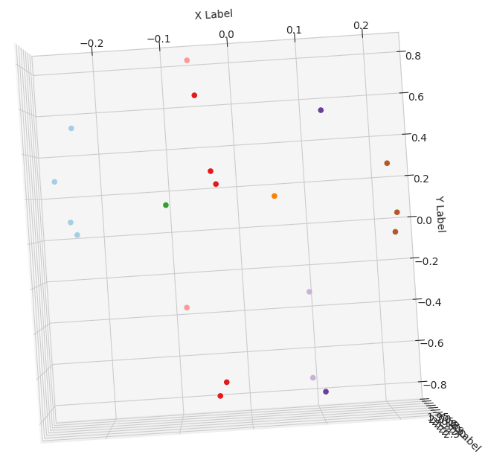
Gait features
1. Normalized 3D skeletal joint coordinates
2. Derived gait features
Joint to joint distances in 3D space
Joint-joint vector orientation
Frame-to-frame joint velocity (displacement)

Slide 18
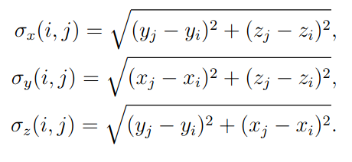
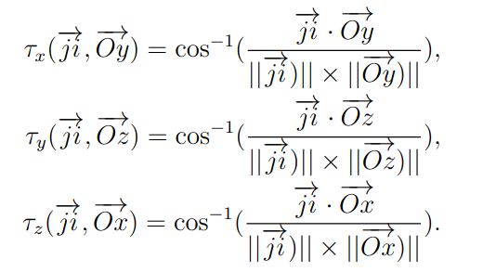
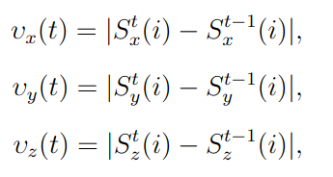
Gait features
Joint to joint distance
Joint-joint vector orientation
Joint velocity

Slide 19
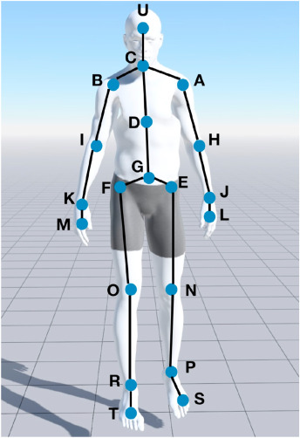
Data augmentation
Human body is vertically symmetrical, so we can double the size of the gait sequences by flipping the images with gait frames vertically
Generate a set of similar synthetic skeletons by slightly rotating the joints in 3D
→
Flipping
Rotation

Slide 20
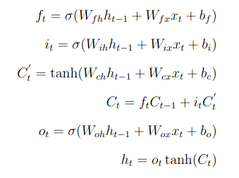
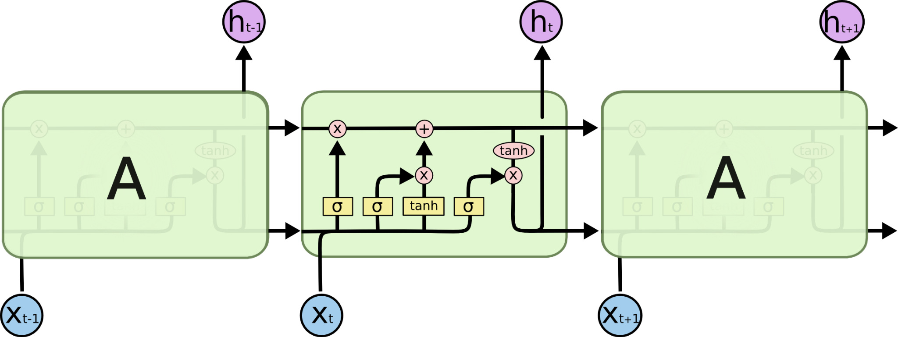
LSTM
Long Short Term Memory
introduced by Hochreiter & Schmidhuber (1997)
special kind of RNN, capable of learning long-term dependencies
learns what information should be preserved and what can be forgotten
https://colah.github.io/posts/2015-08-Understanding-LSTMs/

Slide 21
LSTM
Processes a fixed length sequence of gait features e.g. 30 frames w/ 20 joints
Features:
  Normalized skeletal joint coordinates and joint velocity, where each of the S input cells of the LSTM accepts 20 × 3 = 60 sized vectors.
  Joint Orientation and joint distance features, where each of the S input cells of the LSTM accepts 0.5 × 20 × (20 − 1) × 3 = 570 sized vectors.

Slide 22
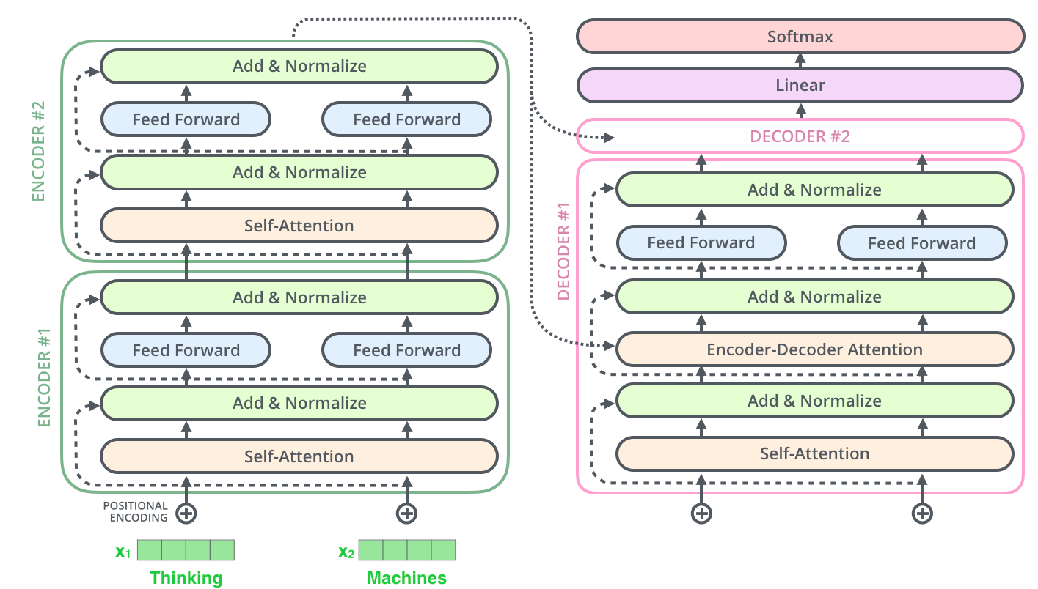
Transformer
Introduced by Vaswani et al. (2017)
Originally used for sequence-to-sequence tasks and handles long-range dependencies with ease thanks to attention mechanisms
https://jalammar.github.io/illustrated-transformer/

Slide 23
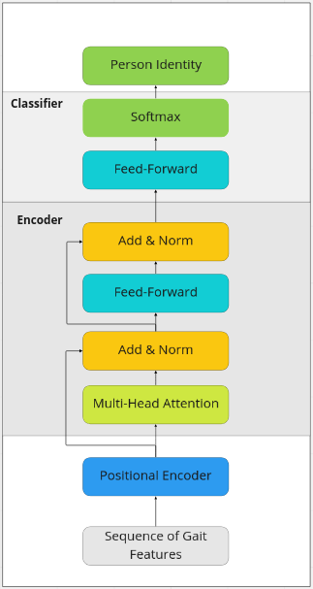
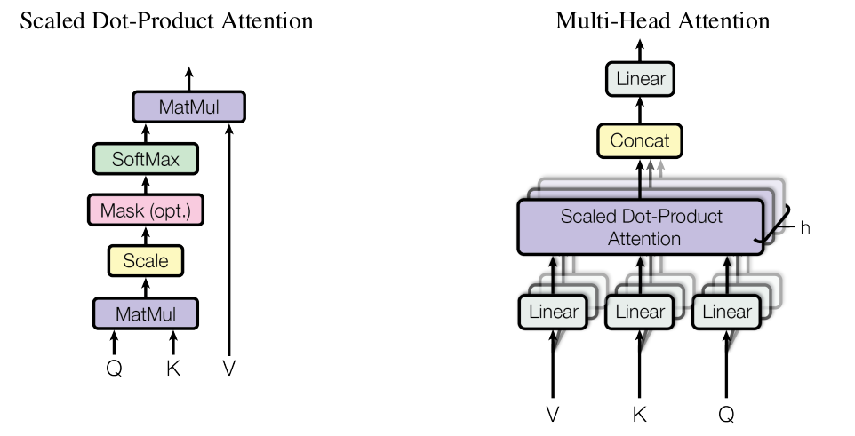
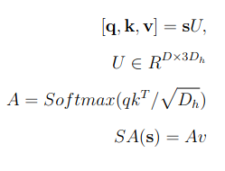
Transformer
Self-attention is a weighted sum over all values v computed for each element in an input sequence s

Slide 24
Experiments and results
Compare the identification accuracy of the proposed methods with several baselines and previous approaches on two datasets
Analyze the performance of the proposed methods under different combination of gait features
Evaluate the proposed networks' complexity and efficiency in terms of model size and training/inference time

Slide 25
Datasets
UPCV Gait
  30 identities
  Single view
  20 joint via Kinect v1
KS20 VisLab Multi-View Kinect
  20 identities
  6 views
  25 joints via Kinect v2

Slide 26
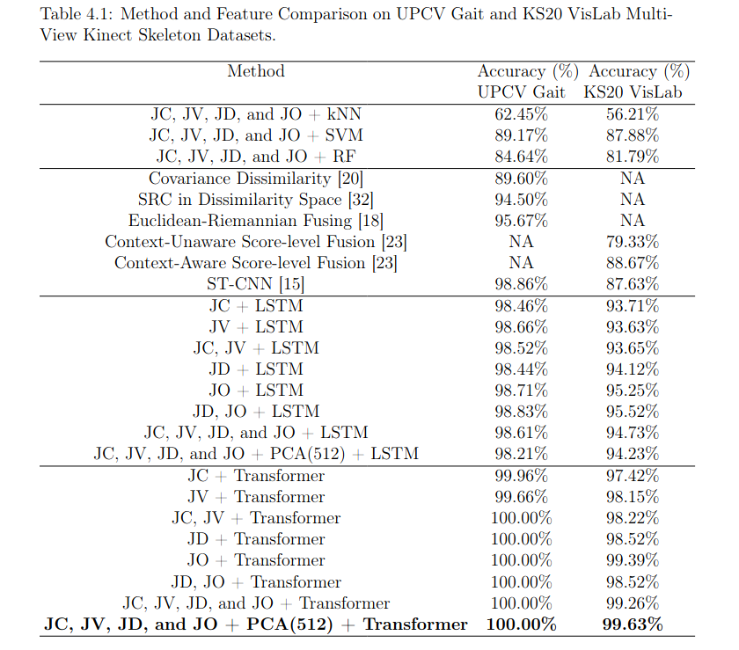
Effectiveness of the proposed methods
JC - Joint Coordinates
JV - Joint Velocity
JO - Join Orientation
JD - Joint Distance

Slide 27
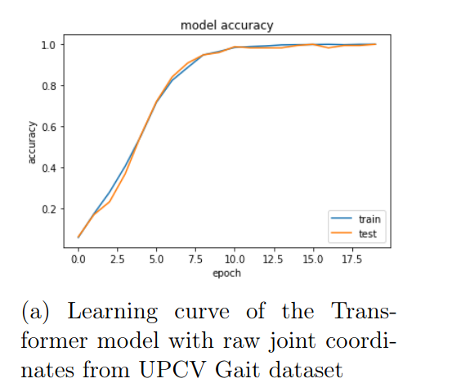
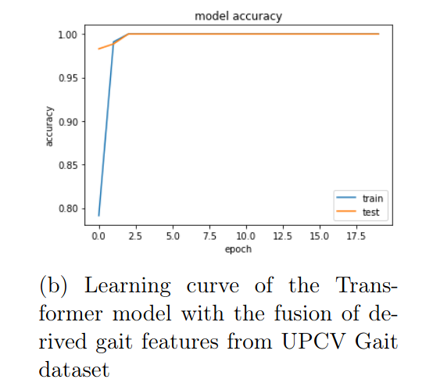
Training Transformer

Slide 28
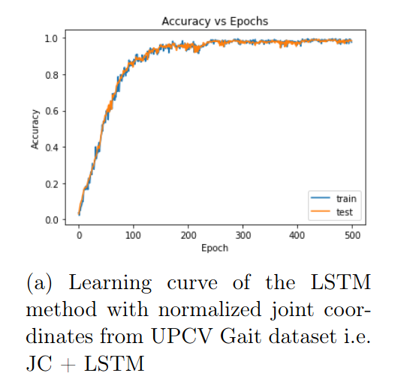
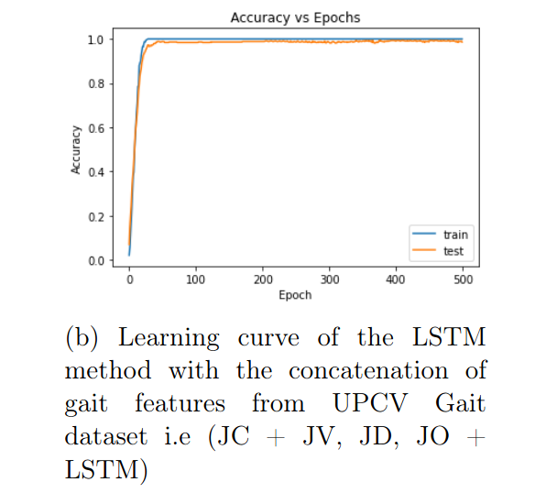
Training LSTM

Slide 29
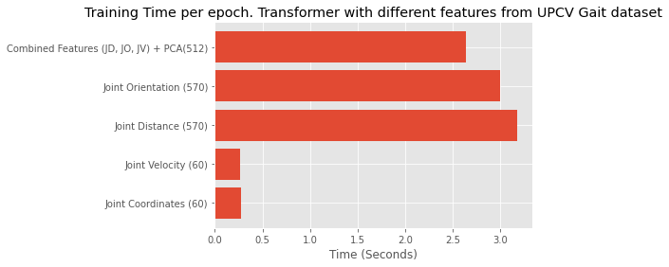
Efficiency
Sequences: 1465
Frames in a sequence: 30
Unique subjects: 30
1260 -> 512 w/ PCA

Slide 30
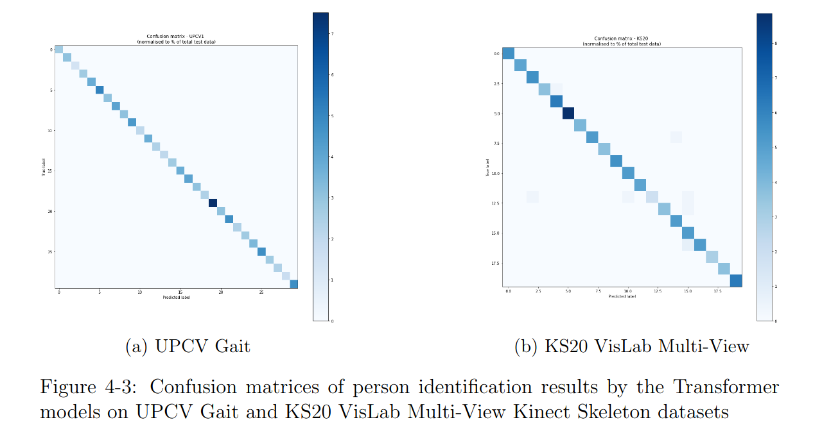
Confusion Matrices

Slide 31
Conclusion
Contributions
Investigated several gait features derived from 3D body joint coordinates
Using these gait features, trained a compact deep sequential models based on LSTM and Transformer networks.
Learn the spatial correlation of body joints within a single frame and the temporal dynamics of joints from frame to frame.
Data augmentation enriches the dataset when working with a limited number of gait sequences for an individual.
Achieved high person identification results on the UPCV Gait (100%) and KS20 VisLab Multi-View (99.23%) datasets.
Further work:
Test models on more challenging datasets e.g. 2D, multi-view, large population datasets
Involve more advanced gait features while keeping the model compact enough to stay efficient.

Slide 32
Thanks!

