Slide 1
Learning Technologies
Sara Margaret Rizzo
Humanities & Social Sciences Subject Librarian
Reference Department,
Nazarbayev University Library
sara.rizzo@nu.edu.kz
http://library.nu.edu.kz
Notes:
http://15uiuchrd472.weebly.com/

Slide 2


Slide 3


Slide 4
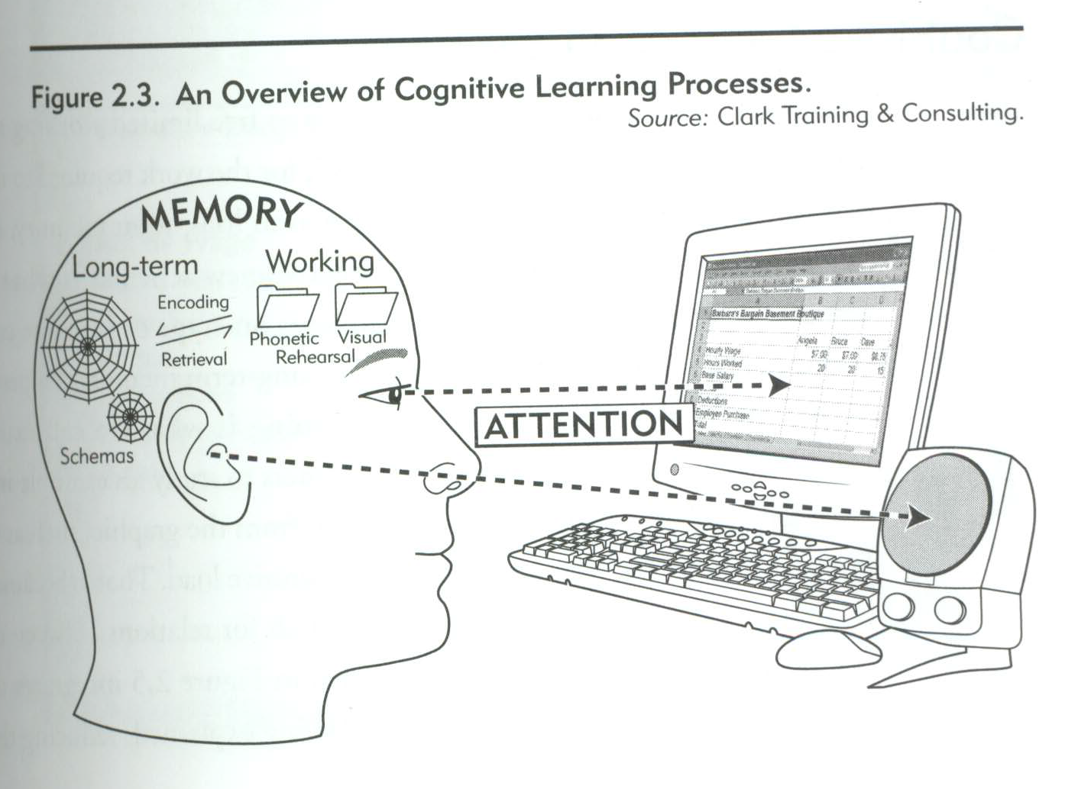

Slide 5
Efficient Learning
Reduce Irrelevant Load
Increase Relevant Load
Manage Intrinsic Load

Slide 6
Intrinsic Load
Difficulty of content
Determined by instruction goals
Element interactivity

Slide 7
Germane Load
“Relevant Load”
Diverse examples
Leads to better learning outcomes

Slide 8
Extraneous Load
Mental work that is irrelevant to learning goal
Wastes limited mental resources
Always under the control of instructor

Slide 9
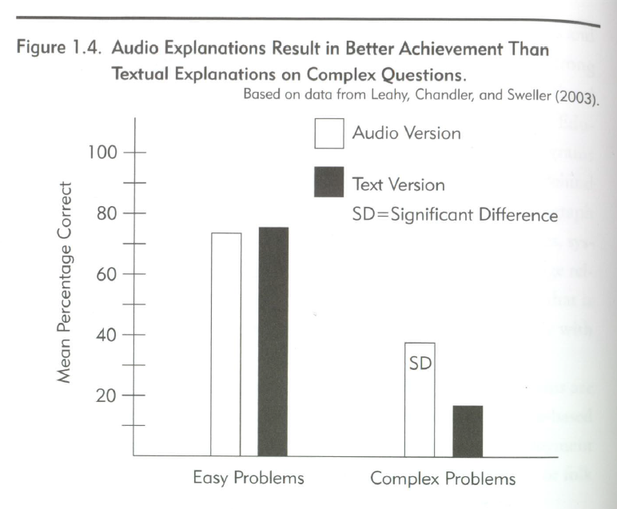
Modality

Slide 10
Focus Attention
Use Signals
Weed

Slide 12
