Slide 1
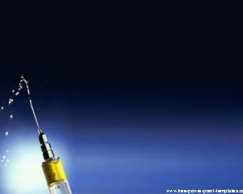
NAZARBAYEV UNIVERSITY SCHOOL OF MEDICINE
ANTI-VAX MOVEMENT AND THE
CHALLENGE FOR PRIMARY CARE PROFESSIONALS
BYRON CRAPE, PHD MSPH
DIRECTOR OF PUBLIC HEALTH PROGRAM
LEAD FOR SCIENTIFIC REASONING BLOCKS FOR MEDICAL STUDENTS

Slide 2
WHY DOES THE
ANTI-VAX MOVEMENT
NEED TO BE ADDRESSED?

Slide 3
SAFETY OF VACCINES
Risk of anaphylaxis overall for all
vaccines is estimated to be 1.3 per
million vaccine doses with no recorded
deaths. Review. McNeil MM, et al 2018
NUMBER OF LIVES SAVED
Measles vaccination saved estimated
17.1 million lives since 2000 (WHO)
12 November 2015 News Release, GENEVA
http://www.who.int/news-room/detail/12-11-2015-measles-vaccination-has-saved-an-
estimated-17-1-million-lives-since-2000

Slide 4
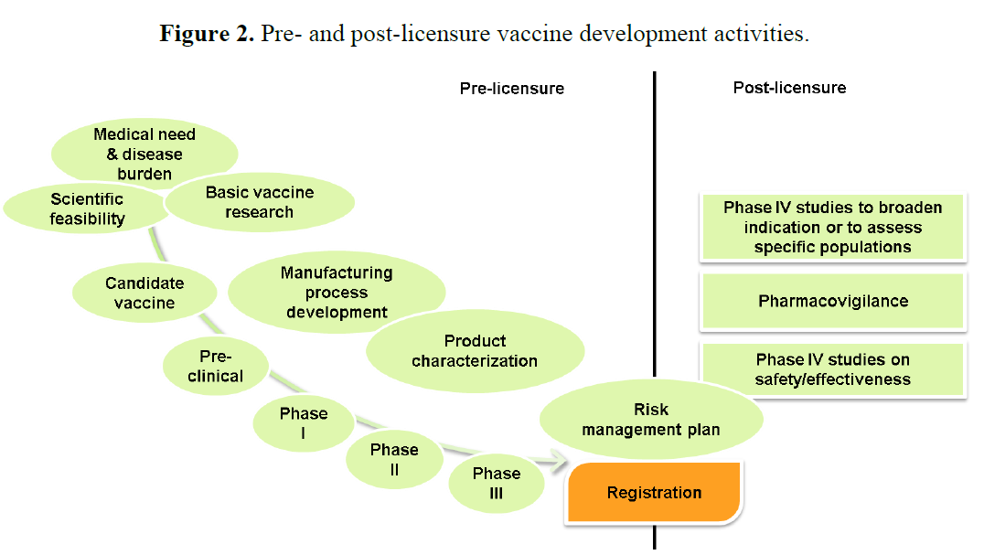
Hardt et al, 2013

Slide 5
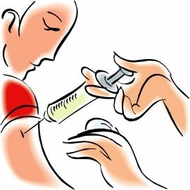
In 1999, vaccine-preventable diseases among children were at an all-time low (Center for Disease Control: MMWR 1999) but gains are seriously threatened by the Anti-Vax Movement.

Slide 6
AntiVax Movement blamed for reductions
in vaccine coverage worldwide leading to
preventable disease outbreaks & deaths:
41,000 measles cases reported in Europe in
first six months of 2018 (highest in a decade),
37 children died first 6-months this year.
https://www.guardian.com/society/2018/aug/20/low-mmr-uptake-
blamed-for-surge-in measles-cases-across-Europe
Quebec, Canada, measles outbreak of 776
reported cases in 2011; 80% not fully vaccinated
Pereira et al, 2013

Slide 7
AntiVax Movement blamed for reductions
in vaccine coverage worldwide leading to
preventable disease outbreaks & deaths:
Pertussis incidence was 10 to 100 times greater
where the DTP immunization was disrupted
by Anti-Vax movements (Sweden, Japan, UK,
Russian Federation, Ireland, Italy, West Germany,
and Australia), as compared to where high DTP vaccine coverage was maintained (East Germany, Poland, USA), 1950s-1990s
Gangarosa et al, 1998

Slide 8
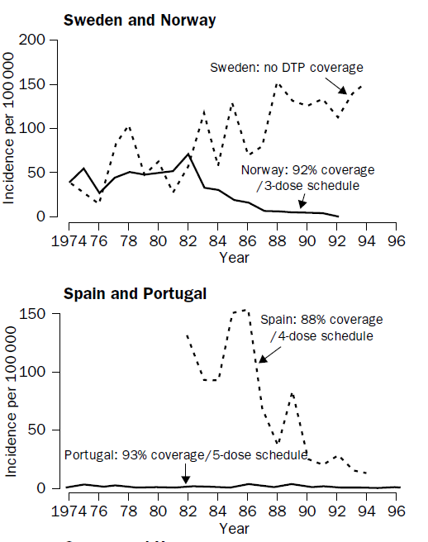
PERTUSSIS INCIDENCE IN NEIGHBORING COUNTRIES WITH
HIGH VS LOW DTP VACCINE COVERAGE
Gangarosa et al, 1998

Slide 9
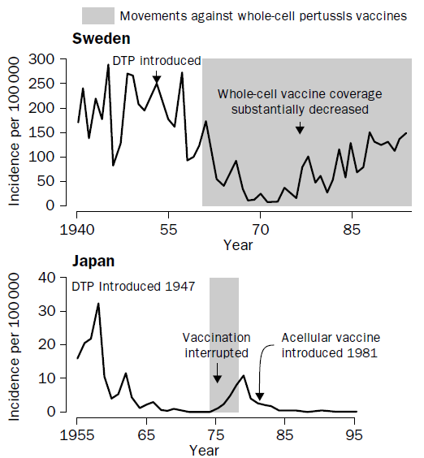
ACTIVE ANTI-VAX MOVEMENT IMPACT
ON PERTUSSIS INCIDENCE
Gangarosa et al, 1998

Slide 10
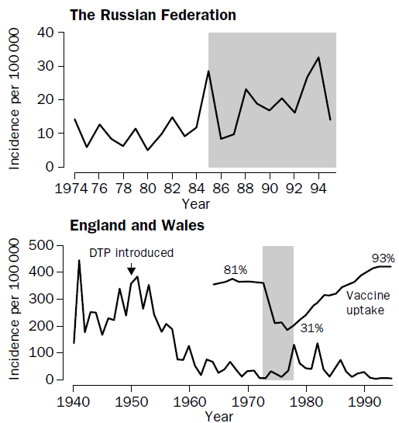
ACTIVE ANTI-VAX MOVEMENT IMPACT ON
PERTUSSIS INCIDENCE
Gangarosa et al, 1998

Slide 11
ANTI-VAX MOVEMENT
BEGAN WITH
FIRST VACCINATIONS

Slide 12

Reverend Edmund Massey in England called vaccines “diabolical operations” in a 1772 sermon, “The Dangerous and Sinful Practice of Inoculation”. He decried these vaccines as an attempt to oppose God’s punishments on man for his sins
Massey E http://name.umdl.umich.edu/N02782.0001.001. ; Bazin H, 2001

Slide 13
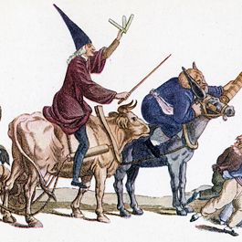
French caricature from around 1800 shows
fear of vaccination
The Historical Medical Library of The College of Physicians of Philadelphia
https://www.historyofvaccines.org/content/articles/history-anti-vaccination-movements

Slide 14
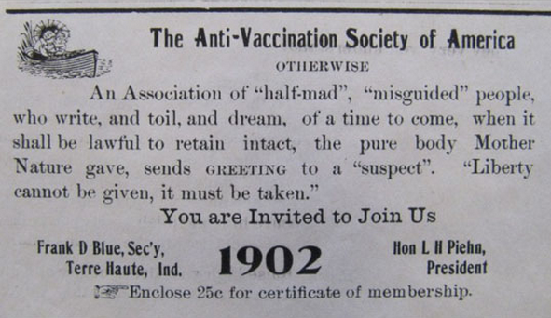
https://www.historyofvaccines.org/content/blog/anti-vaccination-society-america-correspondence

Slide 15
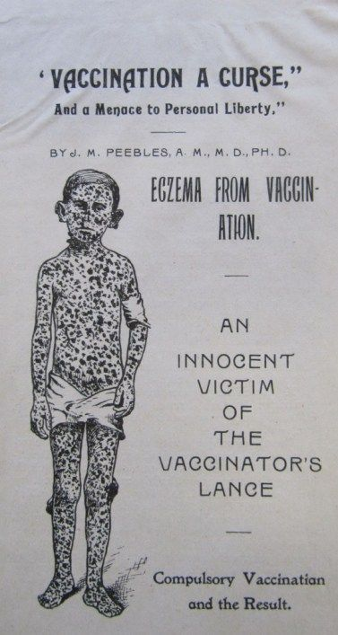
https://www.historyofvaccines.org/content/blog/anti-vaccination-society-america-correspondence

Slide 16
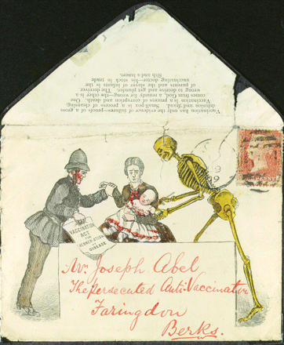
Envelope showing death vaccinating a young child and mother being held back by police
https://www.historyofvaccines.org/Death-The-Vaccinator

Slide 17
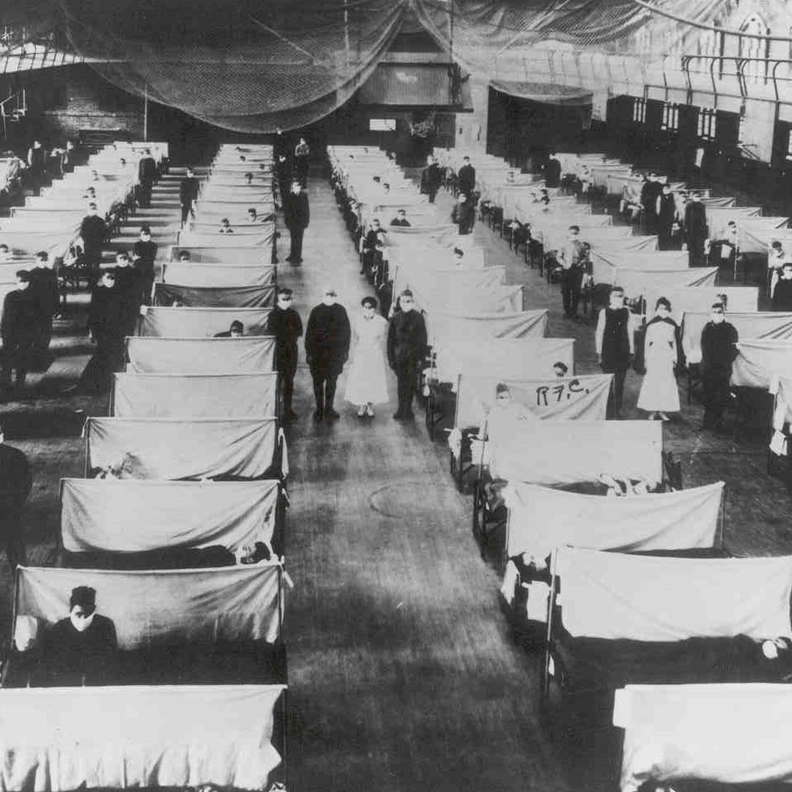
WHENEVER THERE ARE DISEASE OUTBREAKS/EPIDEMICS PREVENTABLE BY VACCINATION THE ANTI-VAX MOVEMENT DECLINES
1918 Influenza
Pandemic
https://www.cdc.gov/features/1918-flu-pandemic/index.html

Slide 18
NEW REVITALIZED
ANTI-VAX MOVEMENT

Slide 19
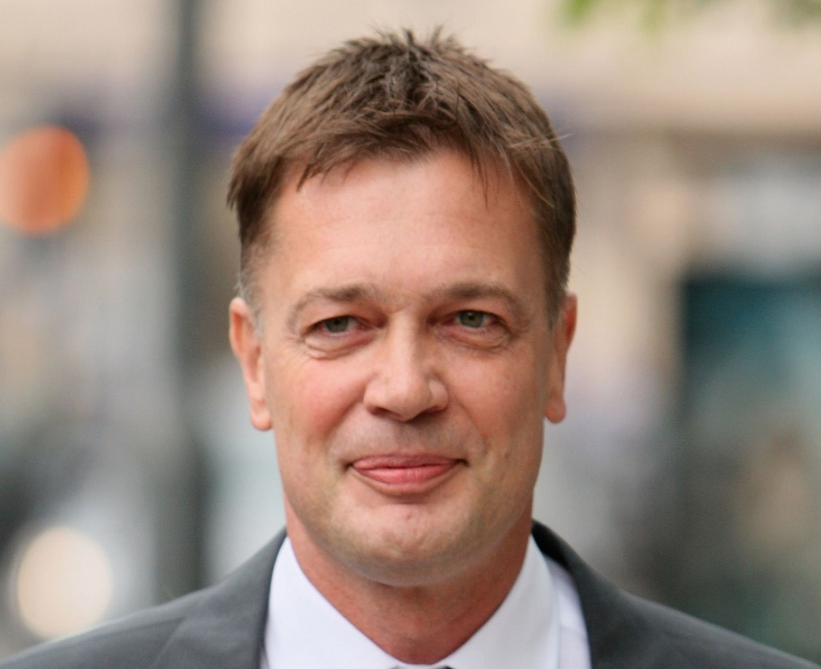
Andrew Wakefield
Former British doctor in 1998 Lancet research article claimed that twelve cases of autism demonstrated autistic symptoms after new MMR vaccine -retracted in 2010 following investigation.
https://www.independent.co.uk/news/health/andrew-wakefield-who- is-mmr-doctor-anti-vaccine-anti-vaxxer-us-a8328326.html

Slide 20
Andrew Wakefield
License to practice medicine revoked in 2010 due to dishonesty, abuse of developmentally delayed children (unnecessary invasive medical procedures and acting without ethical approval for research).
A month before medical license revoked, The Lancet retracted Wakefields’ 1998 paper, much “utterly false”, editor saying he “felt deceived”. Co-authors denounced Wakefield.
https://www.independent.co.uk/news/health/andrew-wakefield-who-is-mmr-doctor-anti-vaccine-anti-vaxxer-us-a8328326.html

Slide 21
Andrew Wakefield
Research fabrications
No research credentials
Conflict of Interest in research
Malpractice in medical practice
Impetus for modern Anti-Fax movement
Struck off the UK Medical Registry because he "abused his position of trust” and "brought the medical profession into disrepute" in the studies he carried out.’ Hussain et al, 2018

Slide 22
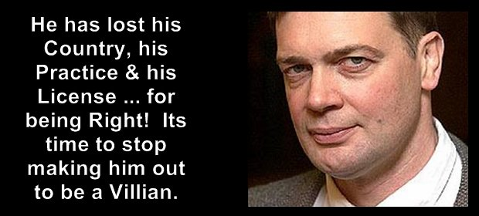
Andrew Wakefield is played as
victim in the Anti-Vax Movement
https://steemkr.com/vaccines/@canadian-coconut/dr-andrew-wakefield-a-villain-or-a-hero-here-s-what-the-mainstream-media-has-left-out

Slide 23
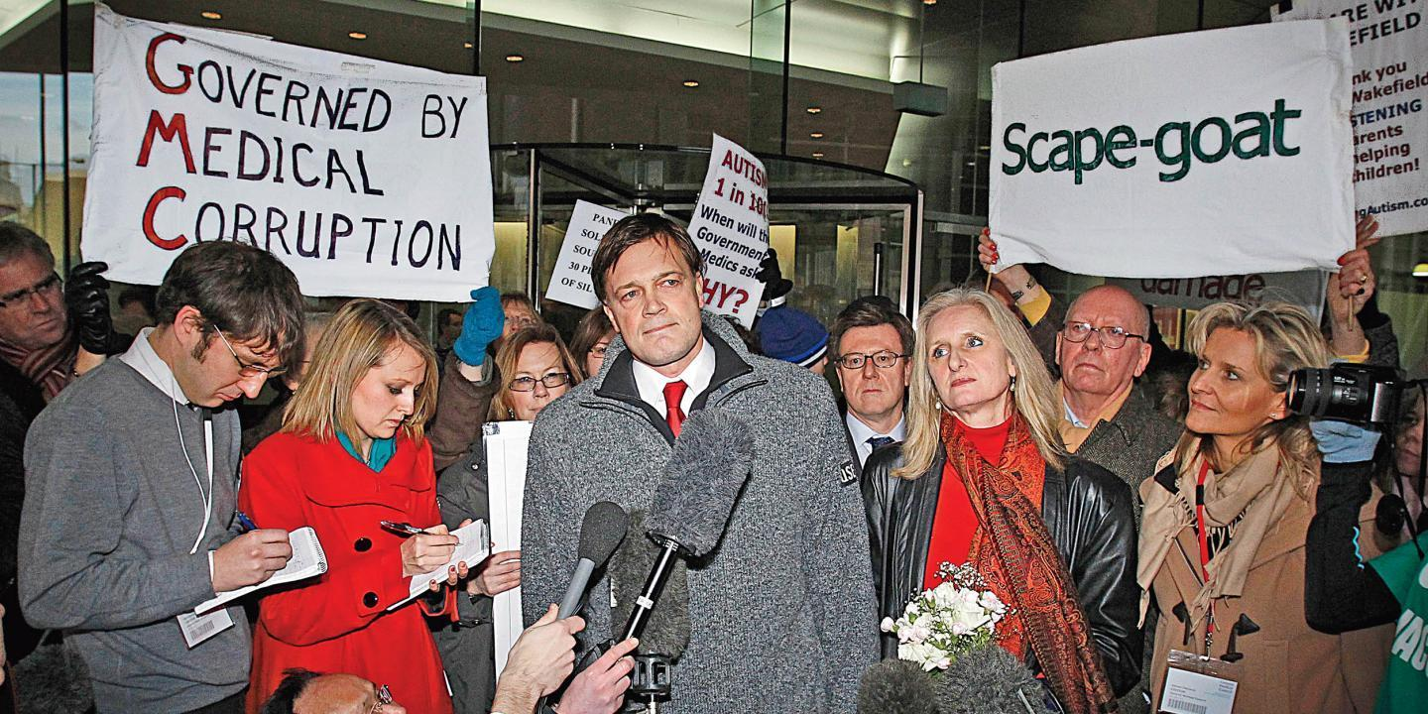
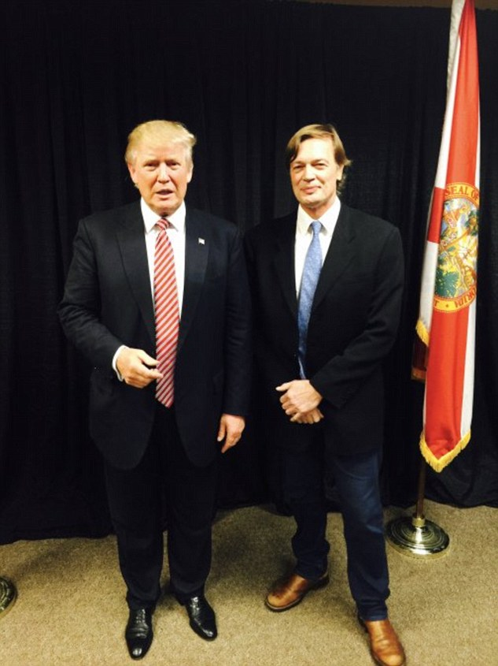
Andrew Wakefield
https://edzardernst.com/2018/07/andrew-wakefield
-donald-trump-scam-and-the-anti-vaccination-cult/

Slide 24
ANTI-VAX MOVEMENT
1. Easily accessible in all major languages on internet
2. Appeals both emotionally and intellectually
3. Establishes credibility
4. Establishes rapport
5. Plays on fear for children’s safety
6. Tells horror stories
7. Provides “scientific evidence” against vaccines & multivalent vaccines
8. Plays on conspiracy theories by Big Pharma, Govt
9. Softens persuasion by supporting “Safe Vaccines”

Slide 25
Examples of Anti-Vaccine on the Internet

Slide 26

Emotionally-Ladened Photo
https://www.thehealthyhomeeconomist.com/six-reasons-to-say-no-to-vaccination/

Slide 27
Six Reasons to Say NO to Vaccination
CONSPIRACY THEORIES
#1: Pharmaceutical Companies Can’t Be Trusted (Ever)
#2: ALL Vaccines are Loaded with Chemicals and Heavy Metals
#3: Vaccinated Children are the Unhealthiest, Most Chronically Sick Children

Slide 28
Six Reasons to Say NO to Vaccination
#4: Other Countries Are Waking Up to the Dangers of Vaccination
#5: Numerous Vaccines Have Already Had Problems/Been Removed from the Market
#6 You Can Always Get Vaccinated, But You Can Never Undo a Vaccination

Slide 29
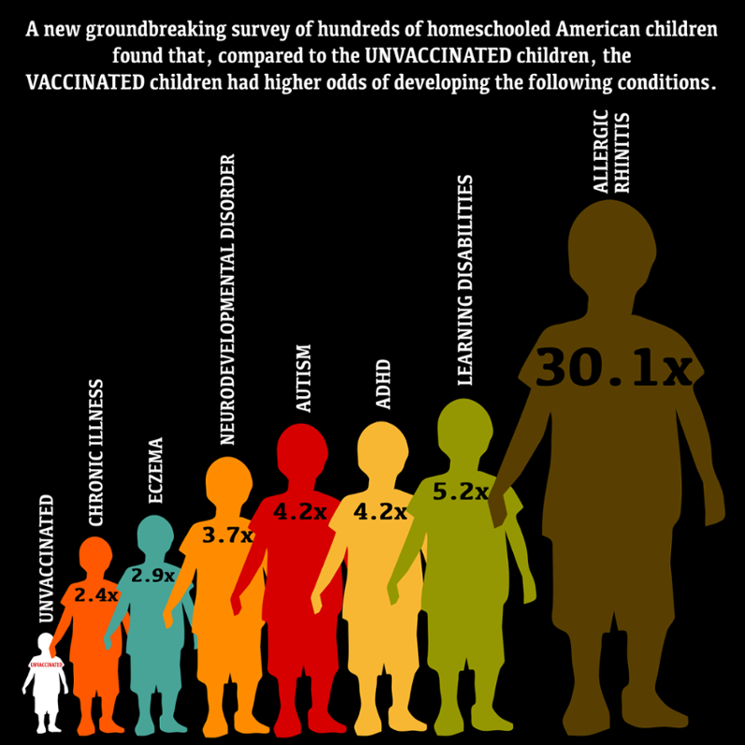
Always Underpinned with Citing Bad, Fringe or Incomplete Science or Findings Taken Out of Context

Slide 30
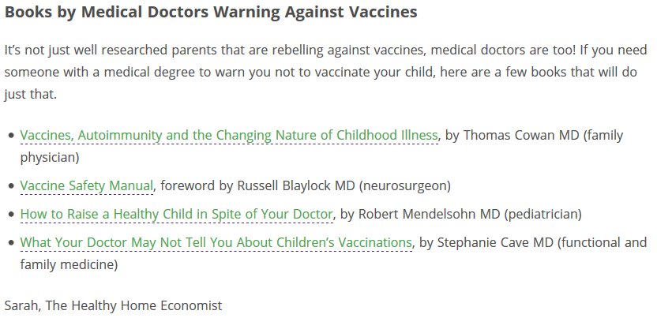
ESTABLISHING CREDIBILITY

Slide 31
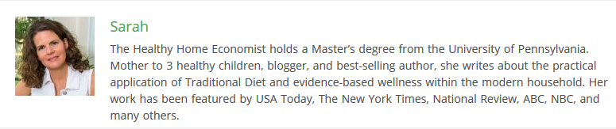
ESTABLISHING RAPPORT

Slide 32
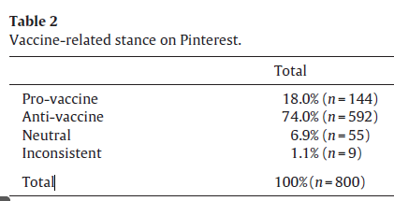
PINTEREST POSTINGS
Guidry JPD et al, 2015

Slide 33
PLAYS ON FEAR FOR CHILDREN’S SAFETY
Guidry JPD et al, 2015

Slide 34
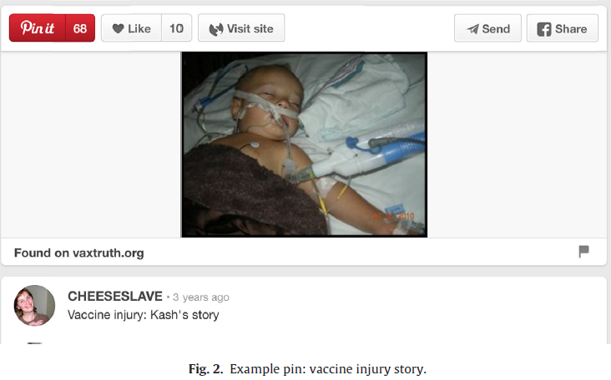
TELLS HORROR STORIES
Guidry JPD et al, 2015

Slide 35
ANATOMY OF THE ANTI-VAX MOVEMENT
No familiarity with disease that vaccinations
protect against, no disease-no concern-no fear
(Stein, 2017; Herath et al, 2018)
2. Knowing less but presuming more: Dunning-Kruger effect
(Motta et al, 2018)
3. Fear for child safety– questioning safety of vaccines
(Poland et al, 2001; Pereira et al, 2013)
4. Distrust of big pharma, govt, health system
(Jolley & Douglas, 2014; Preira et al, 2013)
5. “Free choice” (Pereira et al, 2013)
6. “Pro-safe vaccines” (Kata, 2012)
7. Pseudo-science (Kata, 2012)

Slide 36

Anti-Vax Movement spreading from high income to medium and low income countries (Hotez, 2018)
Via Internet (Hussain et al, 2018; Taduri et al, 2014; Tomeny et al, 2017; Kata, 2012)

Slide 37
NAZARBAYEV UNIVERSITY SCHOOL OF MEDICINE
MASTER OF PUBLIC HEALTH
KNOWLEDGE, ATTITUDES AND PRACTICE: VACCINATIONS
QUALITATIVE RESEARCH CONDUCTED IN ASTANA IN FALL 2017
Most reported source of information for mothers and fathers on vaccines was the internet (more than half)
2. Second most reported source of information for
mothers and fathers on vaccines was physicians/often pediatricians (more than third)
A total of under a third of mothers and more than 4 out of 10 fathers had negative or neutral attitudes towards vaccines

Slide 38
UTILIZING PRIMARY
CARE PROFESSIONALS
TO ADDRESS ANTI-VAX
MOVEMENT

Slide 39
“Because clinicians’ recommendations influence parental acceptance of preventive care, primary care clinicians play an important role in the success of immunization strategies.”
Tafuri et al, 2014
“The healthcare professional is a key element to transmit information, resolve doubts and increase confidence in vaccines.”
de Menezes Succi, 2017

Slide 40
“…public activities [of a small minority] have significantly influenced an uncertainty among the general population about both the safety of and the necessity for vaccination. Therefore, the European Academy of Pediatricians calls for greater publically available, scientifically supported information on vaccination, particularly targeted at health care providers….”
Dornbusch HJ et al, 2017

Slide 41
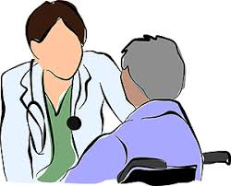
PRIMARY care providers RESPONSE to ANTIVAX
To counteract Anti-Vax Movement
1. Build trust, rapport with patients
2. Proactive
3. Persistent
4. Link to internet
5. Educate primary care physicians, nurses in knowledge and communications strategies
6. Research on Anti-Vax dynamics and counter-strategies

Slide 42
CHALLENGES
UTILIZING PRIMARY
CARE PROFESSIONALS
TO ADDRESS ANTI-VAX
MOVEMENT

Slide 43


Slide 44
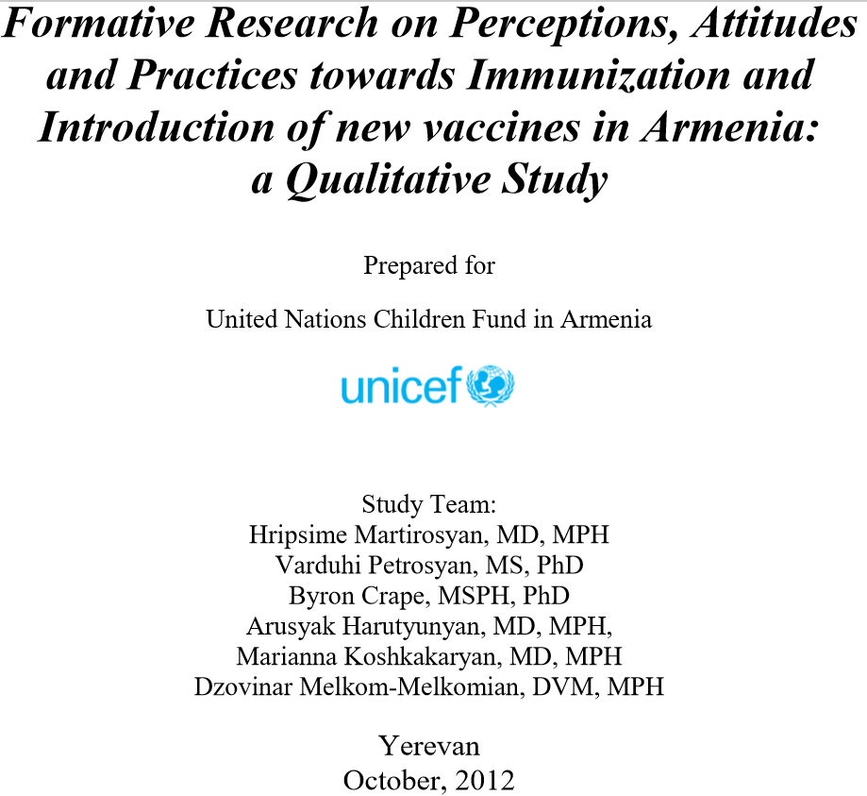

Slide 45
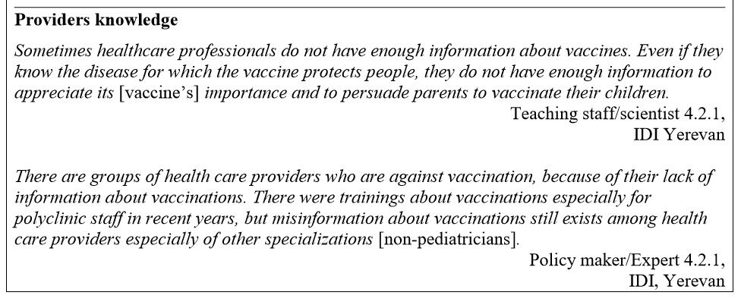
HEALTH CARE PROVIDERS LACK INFORMATION

Slide 46
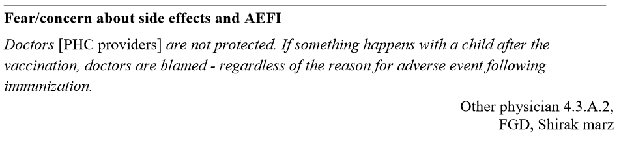
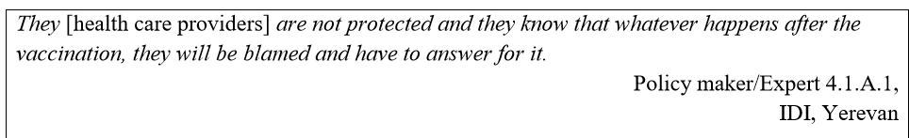
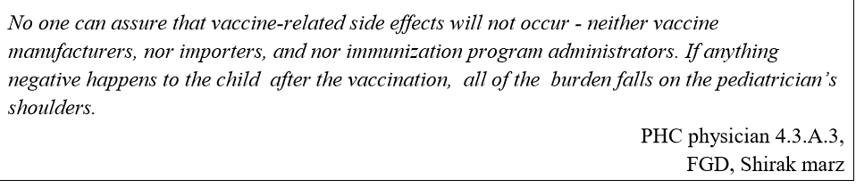
PRIMARY CARE PROVIDERS FEARS
[Adverse events following immunization]

Slide 47
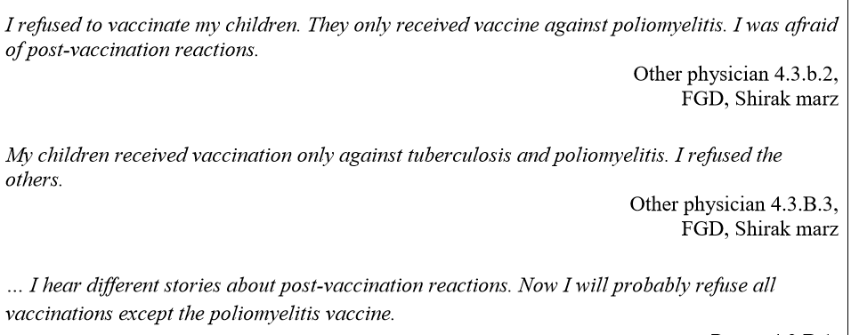

PRIMARY CARE PHYSICIANS REFUSING
OWN CHILDREN VACCINES

Slide 48
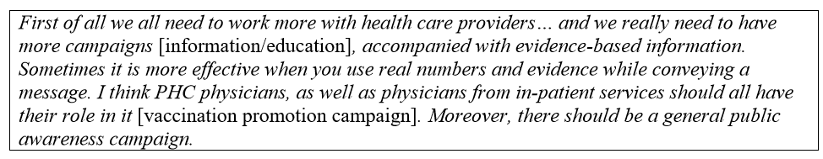

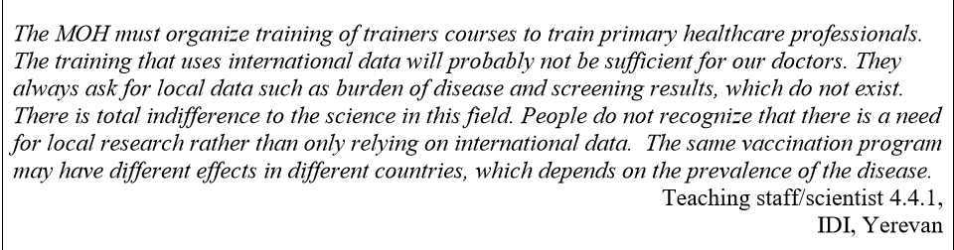

Slide 49
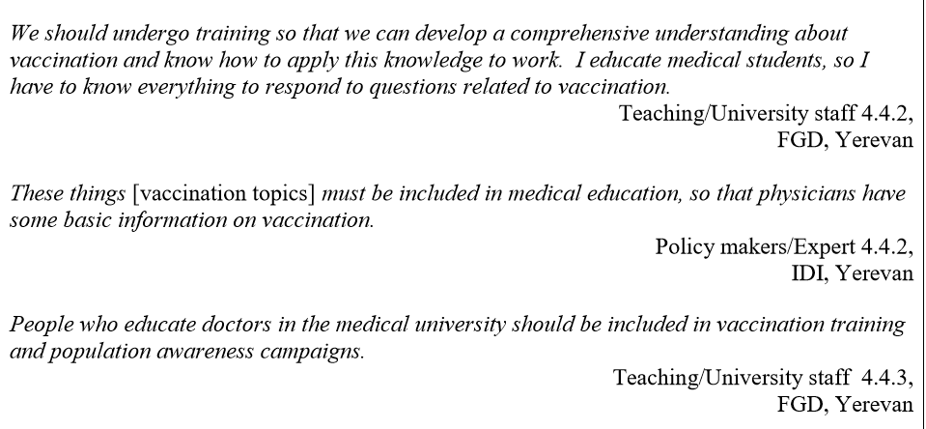

Slide 50

DON’T GIVE UP ON HOPE
MARK STARLIN

