Slide 1
Implementation of the process-based management approach:
modelling and optimization of business processes for KazTemirTrans Company
Capstone project
Master of Engineering Management
27/04/2021
Notes:
Good afternoon dear audience, dear committee
Today our team would like to introduce you the topic of our capstone project which
as you can see on the screen, is the implementation of the process-based management approach: modelling and optimization of business processes for KazTemirTrans Company

Slide 2





Capstone Team Members
Ardana Aldonggarova
B.Sc. Civil Engineering
Zauzat Zeken
B.Sc. Civil Engineering
Tomiris Abdulmanova
B.Sc. Petroleum Engineering
TEAM SUPERVISORS
COMPANY REPRESENTITIVES
Talgat Agatovich
Dzevulsky Roman
Abdikerim Daulet
Prof. Ali Turkyilmaz
Prof. Dimitrios Emiris
Notes:
First, let me start with introduction of the capstone team
Our team consist of: Ardana Aldonggarova, Zauzat Zeken and me ,Tomiris Abdulmanova
We would like to express special gratitude to our supervisors Prof. Ali Turkyilmaz and Prof. Dimitrios Emiris for tremendous mentoring during the capstone work, and also, we wish to express our appreciation to the company’s representatives, who are here today with us:
Talgat Akanovich
Roman Dzevulsky
Daulet Abdikerim

Slide 3
Relevance to MEM Program
Project Management
Business Process Management
Quality Management
Information Management
Lean Management
Business Strategy
Operations Management
Business Analytics
www.free-powerpoint-templates-design.com
Notes:
Now, let us at look at the Relations of the Selected Project to MEM Program
It should be emphasized that the considered capstone project is very relevant, since it covers such important components of the MEM program as:
Project Management
Quality Management
Lean Management
Operation Management
Business Analytics
Business Strategy
Information Management
Business Process Management

Slide 4

PRESENTATION OUTLINE
Company Background
Literature Review
Methodology
Results
Recommendations
4
Notes:
I’d now like to proceed with the outline of our presentation
In the first part we’ll discuss the overall company’s background, the main obstacles the company faced with during the transition to the process-based management as well as the key objectives that should been reached by the end of the project
Then in the second section, the literature review part will be presented, where we’ll talk about the main management approaches techniques and the methodology to deal with the acquired BP
Finally, we’ll go on to talk about the results and recommendations part where the optimization techniques for BP will be shown to the audience.

Slide 5
COMPANY BACKGROUND

Slide 6





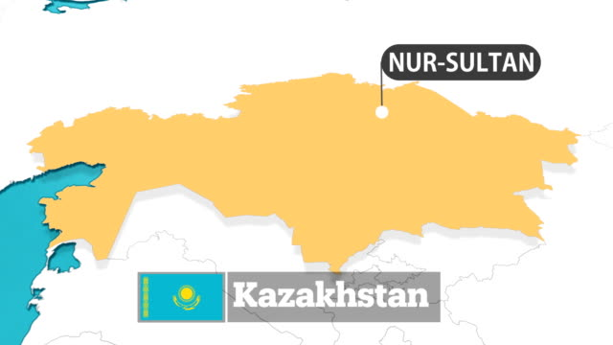
Company Background
COMPANY NAME: JSC “KazTemirTrans”
MOTHER COMPANY: JSC “Samruk Kazyna”
KazTemirTrans
Nur-Sultan,
st. D. Kunaeva, 10, 24 floor
18 YEARS
ON THE KZ MARKET
47,000
OWN CAR FLEET
8 MLN TONS
OF CARGO PER MONTH
450 EMPLOYEES THROUGHOUT KAZAKHSTAN
2003 |  |  | 2007 |  |  |  |  |  |  | 2017 |  |  | 2021
Company
Formation as
JSC“Kazzheldortrans”
Renaming
to
“KazTemirTrans”
Functional Management
Business
Transformation
Transition period
Notes:
JSC KazTemirTrans is the largest operator of cargo rolling stock of the Republic of Kazakhstan with the head office Nur-Siltan city. The company is a100% subsidiary from National Company Kazakhstan Temir Zholy. The Company’s activities cover such areas as provision of freight cars for operation, leasing of special rolling stock, storage and sale of scrap metal. Let us briefly familiarize with the history of the company. The joint stock company Kazzheldotrans was established in 2003 as a result of the reformation the railway transport of Kazakhstan. Later, due to expansion of the international activity, it was decided to rename the company to Kaztemirtrans. By 2017, JSC “Samruk Kazyna”, the mother company of KazTemirTrans, had decided to transform its daughter company’s management approach and switch from a function-based management approach to a process-based management approach. Starting from that point till now, the company is undergoing the transition period.

Slide 7
Problem Statement
The problems faced around the transition to process-based management approach:
Embarrassment in the cooperation between interdisciplinary departments
Confusion in the workflow
Difficulties with the documentation of BP
Notes:
These rapid transition in management approach has resulted in the major difficulties in communication and cooperation between the interdisciplinary departments of KazTemirTrans.
In addition, the local managers of the company have started to feel confused dealing with the making significant changes in the current workflow.
As a result of the decree made in 2017, for elimination further critical pitfalls, the Company has started to perform documentation of Business Processes.
For these reasons, our capstone team was assigned to resolve these issues.

Slide 8
Objectives
To optimize & automate provided business processes (BP) of Project management office
To enhance organizational efficiency and productivity of employees
To provide a comprehensive analysis of existing BP
To recommend the improvement techniques for BP optimization
Notes:
As a result of the analysis, the following goals have been identified:
Firstly, to optimize & automate provided business processes of the PM office
Secondly, to enhance organizational efficiency & productivity of employees
Thirdly, to provide a comprehensive analysis of existing business processes
Lastly, but not less importantly, to recommend the improvement techniques for BP optimization

Slide 9
LITERATURE REVIEW

Slide 10
Basic Concepts
Process-based Management Approach - the work of the company is viewed as a set of processes
Business Process Improvement (BPI)
- incremental changes
- limited organizational changes
- ongoing effort (Syes Najamuddin Aftab, 2020)
Business Process Redesign (BPRD)
- redesign of processes
- developing a new process (Yoo, Suh and Kim, 2007)
Process-based
optimization methods
Business Process Reengineering (BPR)
- radical changes
- greater organizational changes
- project-based effort (Timane, 2012)
Notes:
During the capstone work a comprehensive LR was done: including the analysis of the existing types of management approaches to BP, integration of ISO standards, BP features. However, due to the time constrain, let me highlight only the most essential one, which are related to the company’s approach to the problem.
Process-based management views business functions as a collection of standardized processes, managed to achieve a desired result. Where a process is a sequence of activities aimed at generating more value by transforming an input into an output, which can in turn be the input for another process. One of the basic principles of this approach is to apply holistic and systematic approach to the company’s business. This means that each individual BP should be directed to achieve strategic goals of the organization.
Let’s now proceed with methods used in process-based optimization approach.
The first tool is BPI. Business Process improvement is a continual process that aims at attaining efficiency through continual improvement by reiterating the processes. Consequently, BPI is the way to improve current as-is state.
The next method is Business process redesign,which is a complete overhaul of a company's key business processes.A BPRD improves efficiency by cutting slack and excess, reducing costs, and sharpening management.
The third and most cardinal of all methods for improving business processes is reengineering. It includes serious, sometimes radical, process innovation and assumes the most creative approach of the participants reengineering to redesign processes.

Slide 11
METHODOLOGY
Notes:
Let’s now take a look at Methodology part

Slide 12
Methodology
Data collection, identification of BPs
AS-IS
Models
Bizagi
BPMN 2.0
TO-BE
models:
KPIs
Selection of critical BP for optimization
Improvement plan: BPI, BPRD, BPR
Notes:
The proposed methodology for optimizing a business process consists of 5 main steps, that are as follow:
Data collection : in which all the acquired data provided by the company is sorted and analyzed.
Then, a certain business processes are being selected for optimization.
The next step is to draw the business process in the “as is” version in Bizagi Process Modeler.
Once the “as is” models are simulated, the improvement plan with the help of Process-based management techniques will be generated.
At the final stage the new optimized” to be “models will be presented.
So, how data collection part was done? What information was given by the company?
For more detail, I pass the flour to Ardana, who will give you the answer on these questions.

Slide 13
Data collection, identification of BPs
Selection of critical BP for optimization
TO-BE models: KPIs
Improvement plan: BPI, BPRD, BPR
AS-IS Models, Bizagi, BPMN 2.0

Slide 14
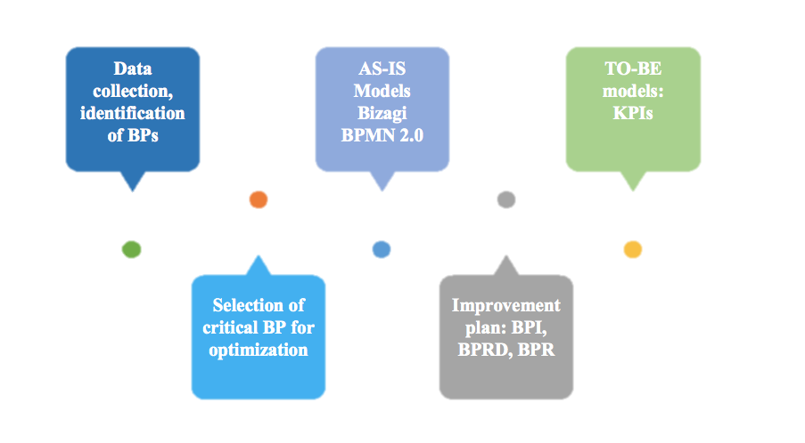

Slide 15


Data Collection
PM Guidelines issued by JSC “Samruk Kazyna”
Package of Corporate Templates
Draft descriptions of Business Processes
    Interviews and questionnaires
Notes:
Methodology
Data collection, identification of BPs overall
Selection of critical BP for opt
as is model
improvement plan: BPI, BPRD, BPR
to be model: KPIs

Slide 16
Analysis of Business Processes
Initiation
Execution
Monitoring & Control
Planning
Closure
BUSINESS PROCESSES
    Development of Agenda for Change
    Development of Project Baseline
    Development of Financial-Economic Model
    Development of Resource Plan
Communications Management
    Archiving
    Change Control
    Preparing Documents for Closure
Notes:
Thank you Tomiris! as it was mentioned our work has started from the initial data analysis and data collection. The company provided PM Guidelines issued by Samruk Kazyna, which contain principles, rules, requirements for BPs within the framework of business transformation of Samruk-Kazyna JSC and Portfolio Companies. From the beginning of work on this project, the Company requested to strictly follow the guideline. Also, the company has provided 73 corporate templates of documents for all phases of the project. Apart from this, additional data was collected through conducted interviews fill out questionnaires with PM and the PM Office. Based on the collected data, the team has identified 24 Business processes of project management office that take place at each phase of the project. Then based on the interview with project manager 8 most problematic and time-consuming business processes were identified. However, documentation and optimization of all these business processes would require more time that the capstone time frame. Therefore it was essential to identify which business processes are critical and are in need for optimization.

Slide 17
SELECTION OF BPs
FOR OPTIMIZATION

Slide 18
Selection of BP for Optimization
Step 1. Assessment of connection between BP and CSFs (importance of BP)
CSF 1 - Clear objectives and expectation
CSF 2 - High qualified and motivated team
CSF 3 - Clearly defined plan
CSF 4 - Strong committed sponsors and top management support
CSF 5 - Effective managing capabilities
CSF 6 - Effective communication
Step 2. Problematicity degree identification
Business Processes |  | CSF 1 | CSF 2 | CSF 3 | CSF 4 | CSF 5 | CSF 6 | CSF Score | Degree of problematicity
BP 1 | Development of agenda for change | + |  |  | + | + | + | 4 | A
BP 2 | Development of baseline | + | + | + | + | + | + | 6 | D
BP 3 | Development of FEM |  |  | + | + | + |  | 3 | B
BP 4 | Development of Resource Plan | + |  | + | + | + |  | 4 | C
BP 5 | Communications management | + | + | + | + | + | + | 6 | C
BP 6 | Archiving |  |  |  |  |  | + | 1 | C
BP 7 | Change Control | + | + | + |  | + | + | 5 | B
BP 8 | Operational testing |  |  |  |  | + | + | 2 | B
Name of Business Processes |  | CSF 1 | CSF 2 | CSF 3 | CSF 4 | CSF 5 | CSF 6 | CSF Score
BP 1 | Development of agenda for change | + |  |  | + | + | + | 4
BP 2 | Development of baseline | + | + | + | + | + | + | 6
BP 3 | Development of FEM |  |  | + | + | + |  | 3
BP 4 | Development of Resource Plan | + |  | + | + | + |  | 4
BP 5 | Communications management | + | + | + | + | + | + | 6
BP 6 | Archiving |  |  |  |  |  | + | 1
BP 7 | Change Control | + | + | + |  | + | + | 5
BP 8 | Operational testing |  |  |  |  | + | + | 2
Notes:
To select which business processes will be optimized, critical SuccessFactors of the project management office were needed to be identified first.
Critical SuccessFactors are objectives and performance results of PM office and as its name states they determine the success or failure of PM office. since project manager has a systematic vision of the organization and is competed in the processes taking place in PM office, he has identified following critical SuccessFactors of PM Office. He has identified that the office will succeed If PM will effectively manage the highly qualified and motivated team who have clear objectives and expectations from the project with a clearly defined plan. he also realizes that effective communication and committed sponsors and top management support are also important factors for the PM office to succeed.
The next step was to compare the business processes with the critical SuccessFactors. the main essence of the comparison is that each business process should answer the question: what are the critical SuccessFactors that this business process supports? Obviously, the importance of the business process is determined by the degree of its contribution to the achievement of the goals of PM office, therefore the more critical SuccessFactors the considered business process supports, the more its importance.
The next step was to identify the degree of problematicity of business processes, Which was assigned base it on the interview with PM. Here the A digory correspond to the perfect business process where E degee corresponds to very bad, ineffective business process that require actions for correction and optimization. Based on the links between business processes and critical SuccessFactors the final ranking matrix can be drawn.

Slide 19
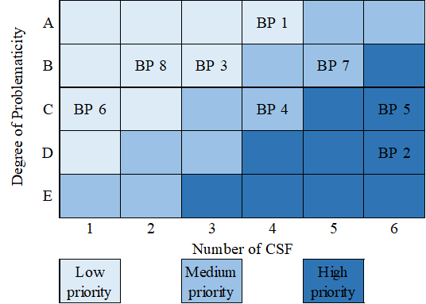
Selection of BP for Optimization (cont.)
Step 3. Priority Ranking Matrix
BP 1 - Development of Agenda for Change
BP 2 - Development of Project Baseline
BP 3 - Development of Financial-Economic Model
BP 4 - Development of Resource Plan
BP 5 - Communications Management
    BP 6 - Archiving
    BP 7 - Change Control
    BP 8 - Preparing Documents for Closure
Notes:
As you can see from the matrix business processes are prioritized in terms of importance and problematicity. Business processes located closer to the right lower corner are the most important and the most problematic which demonstrate the highest priority for optimization. And business processes with medium priority can also be selected for further optimization. As you can see we have ended up with the development process of Project Baseline and resource plan to be in high priority for optimization and development process of resource plan and change control to be in medium priority. However business processes can be very important and problematic but modifying them might be inadvisable due to the high costs or other negative influences.

Slide 20
Selection of BP for Optimization (cont.)
Step 4. Identification of possibility to make changes
    1. Group of barriers “Finance”
    2. Group of barriers “Personnel”
    3. Group of barriers “Legislation”
Business Processes |  | Barriers "Finance" | Barriers "Personnel" | Barriers "Legislation" | Total score | Normalized score
BP 1 | Development of agenda for change | 5 | 2 | 1 | 8 | 3
BP 2 | Development of baseline | 5 | 5 | 3 | 13 | 5
BP 3 | Development of FEM | 5 | 3 | 1 | 9 | 3
BP 4 | Development of resource Plan | 5 | 5 | 3 | 13 | 5
BP 5 | Communications management | 2 | 4 | 5 | 11 | 4
BP 6 | Archiving | 4 | 1 | 2 | 7 | 3
BP 7 | Change Control | 4 | 5 | 4 | 13 | 5
BP 8 | Operational testing | 5 | 2 | 2 | 9 | 3
Notes:
To assess the degree of possibility of making changes groups of barriers that may be encountered on the way of making changes are formulated:
Finance group of barriers Includes barriers that cause unnecessary financial costs for changes in business process. This include both costs incurred in the current period as well as possible investments in the new technologies and funds.
group of barriers related to personnel includes employees resistance to changes. overcoming these forces will also require financial resources and when the financial resources are eliminated, negative consequences for the organization can arise that are the departure of valuable employees , decrease in moral climate and as a result in labor productivity.
and the last but not least group of barriers legislation includes barriers that hinder the implementation of changes that arise from the side of legislation, this may also include guidelines issued by the mother company Samruk Kazyna. So the table here represents the business process ranking in terms of possibilities to make changes with the highest score that is 5 corresponds to the most possible one. all this scores of possibility of making changes in business processes were assigned in cooperation with project manager.
As a result business processes of development of Project Baseline with high priority and high possibility for changes , communications management with high priority and moderately high possibility for changes , development of resource plan with moderate priority and high possibility for changes , and change control with moderate priority and high possibility for changes were selected for further optimization.

Slide 21
Selected Business Processes
Business Processes |  | Importance (Total CFS) | Degree of Problematicity | Possibility for changes
BP 1 | Development of agenda for change | 4 | A | 3
BP 2 | Development of baseline | 6 | D | 5
BP 3 | Development of FEM | 3 | B | 3
BP 4 | Development of resource plan | 4 | C | 5
BP 5 | Communications management | 6 | C | 4
BP 6 | Archiving | 1 | C | 3
BP 7 | Change Control | 5 | B | 5
BP 8 | Operational testing | 2 | B | 3
Notes:
Now let's move on to the optimization part of business processes. the selected business processes will be discussed in terms of as is models, related problems, improvement plans and to be models. Let's start with the development process of Project Baseline.
Project Baseline is developed at the planning stage of the project and represents calendar schedule of works to be done. it's created relying on work breakdown structure list of project deliverables in working documentations. once a Project Baseline is approved it should not be subject to changes since it serves as a reference for an actual execution plan. however when critical amendments takes place in the project the revision of Project Baseline would be required.
Development of Project Baseline starts with a decomposition or tasks of work breakdown structure then dependencies and duration are set to each task. after that critical path of the project is determined. Then by establishing the start and finish date of the project the schedule baseline of the project is developed. and after allocating resources for each task is the cost baseline of the project is determined then the Project Baseline is sent to project manager and financial manager for the approval. Eve financial manager denies to approve the Project Baseline the resource allocation for each task should be reconsidered and the new cost baseline should be determined. Whilst if project manager denies the project baseline Both scope baseline and schedule baseline should be reconsidered. The output of this process is the developed Project Baseline.

Slide 22
OPTIMIZATION OF BPs
BP 1. Development of Project Baseline

Slide 23


Development of Project Baseline
    Clearly defined starting point of the Project Plan, that consists of Scope, Schedule and Cost Baselines
    Project Baseline:
    Developed at planning stage
    WBS, list of project deliverables and working documentation
    Benchmark to compare all future measurements
Notes:
Now let's move on to the optimization part of business processes. the selected business processes will be discussed in terms of as is models, related problems, improvement plans and to be models. Let's start with the development process of Project Baseline.
Project Baseline is developed at the planning stage of the project and represents calendar schedule of works to be done. it's created relying on work breakdown structure list of project deliverables in working documentations. once a Project Baseline is approved it should not be subject to changes since it serves as a reference for an actual execution plan. however when critical amendments takes place in the project the revision of Project Baseline would be required.
Development of Project Baseline starts with a decomposition or tasks of work breakdown structure then dependencies and duration are set to each task. after that critical path of the project is determined. Then by establishing the start and finish date of the project the schedule baseline of the project is developed. and after allocating resources for each task is the cost baseline of the project is determined then the Project Baseline is sent to project manager and financial manager for the approval. Eve financial manager denies to approve the Project Baseline the resource allocation for each task should be reconsidered and the new cost baseline should be determined. Whilst if project manager denies the project baseline Both scope baseline and schedule baseline should be reconsidered. The output of this process is the developed Project Baseline.

Slide 24
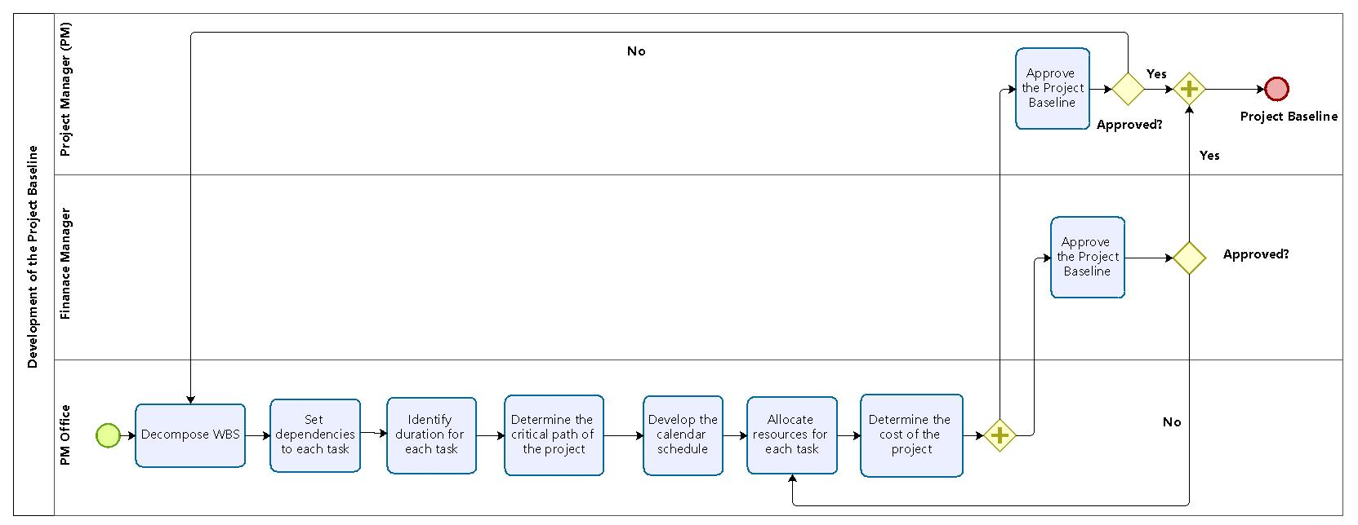
Development of Project Baseline – “as is” model
Notes:
Now let's move on to the optimization part of business processes. the selected business processes will be discussed in terms of as is models, related problems, improvement plans and to be models. Let's start with the development process of Project Baseline.
Project Baseline is developed at the planning stage of the project and represents calendar schedule of works to be done. it's created relying on work breakdown structure list of project deliverables in working documentations. once a Project Baseline is approved it should not be subject to changes since it serves as a reference for an actual execution plan. however when critical amendments takes place in the project the revision of Project Baseline would be required.
Development of Project Baseline starts with a decomposition or tasks of work breakdown structure then dependencies and duration are set to each task. after that critical path of the project is determined. Then by establishing the start and finish date of the project the schedule baseline of the project is developed. and after allocating resources for each task is the cost baseline of the project is determined then the Project Baseline is sent to project manager and financial manager for the approval. Eve financial manager denies to approve the Project Baseline the resource allocation for each task should be reconsidered and the new cost baseline should be determined. Whilst if project manager denies the project baseline Both scope baseline and schedule baseline should be reconsidered. The output of this process is the developed Project Baseline.

Slide 25

Project Baseline– Problems & Solutions
Problems
Solutions
Project Baseline is revised several times
Discrepancy between Project Baseline & Actual execution plan
Long cycle time of the process
Duplicated tasks
BPI method
Specific tasks
Feedback from project team
Derive data from Project Charter

Slide 26
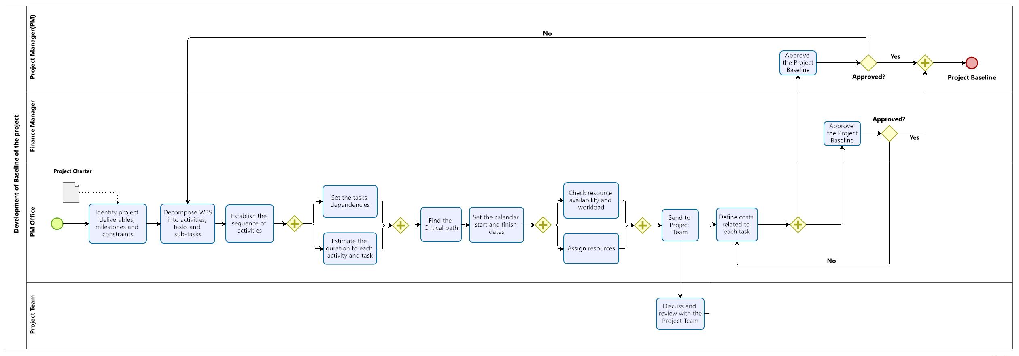
Project Baseline – “to be” model
KPIs: small discrepancy between Project Baseline & Execution plan, completion of the project within set time and budget constraints
Notes:
Analyzing the baseline content removing unnecessary activities rearranging the sequence Has resulted in the following to be model. by referring to this flow chart one can easily understand where to start and how to reach accurately developed Project Baseline this workflow can also assure the small discrepancy between Project Baseline and actual execution plan the completion of the project within the set time and budget constraints these parameters can be considered as KPI's for the future evaluation of optimization outputs

Slide 27
OPTIMIZATION OF BPs
BP 2. Communication Management

Slide 28

Communication Management
Timely Collection, Generation, Distribution and Storage of Project Information
Communication Plan:
        How and in what form the exchange of information will take place
        When and where communication takes place
        Can be formal or informal
        Detailed or generalized depending on requirements

Slide 29
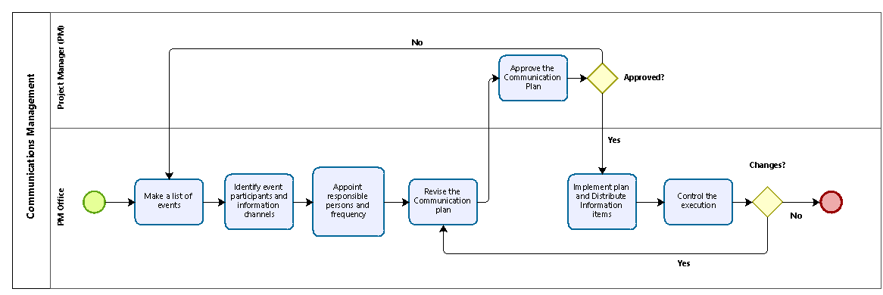
Communication Management – “as is” model
Notes:
As it can be seen from the as is model the communication plan is executed by PM office and then approved by project manager. The PM office first who pays at least of events and then identifies who are the participants and what information channels should be used to provide the certain data. Then responsible persons for each event are signed with the indication of frequency. After the communication plan is revised it is sent for approval to PM. Once the communication plan is approved PM office distributeы for implementation, afterwards the changes should be controlled. This is at is now.

Slide 30
Communication Management– Problems & Solutions
Problems
Solutions
BPI method
Revised template in a clearer version
Collaboration with the Event Participants
Feedback receival
Messy and hard to “read” Communication plan template
Template doesn’t indicate the event participants
Extra participants are assigned to the event
High number of unplanned events

Slide 31
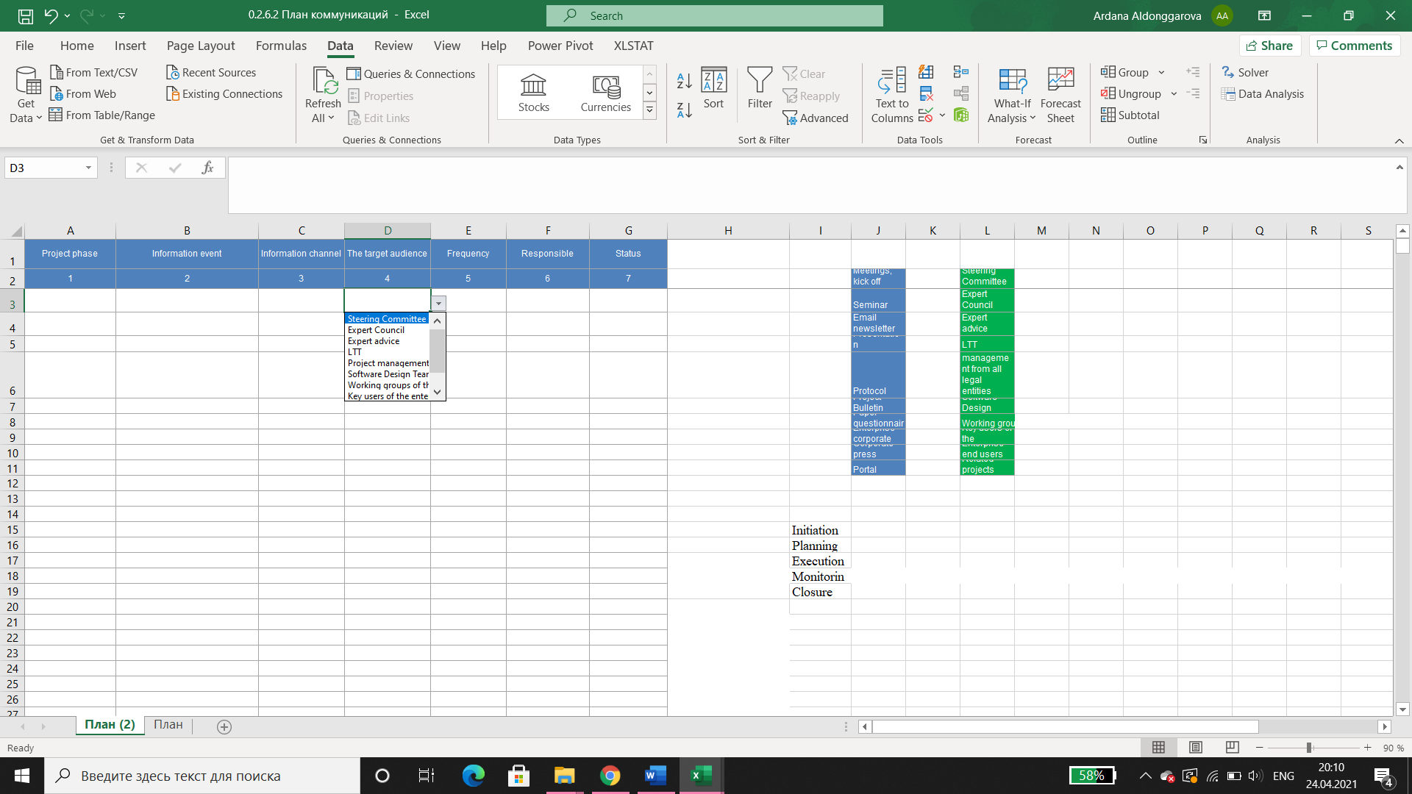
Communication Plan Template

Slide 32
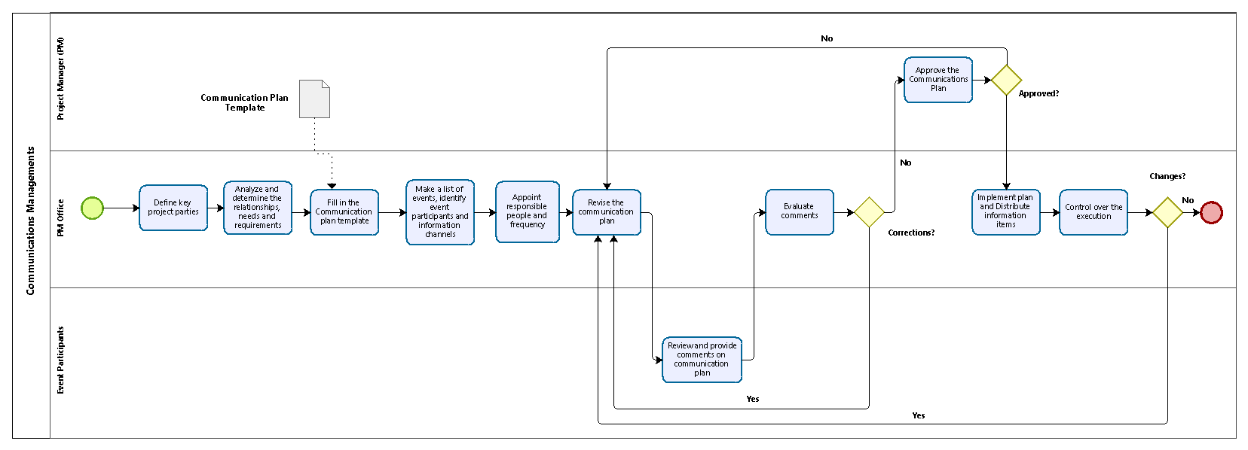
Communication Management – “to be” model
KPIs: high employee awareness, low number of unplanned events

Slide 33
OPTIMIZATION OF BPs
BP 3. Development of Resource Plan

Slide 34
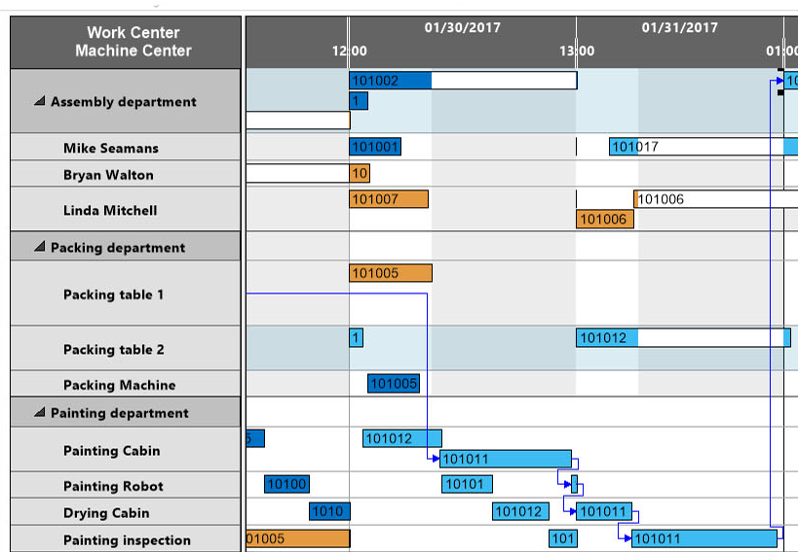
Development of Resource Plan
List of project resources distributed according to the project schedule depending on the tasks
The Resource plan enables to:
Assess the need for a specific type of resource
Plan a rational distribution
Identify project participants
Control the use of resources

Slide 35
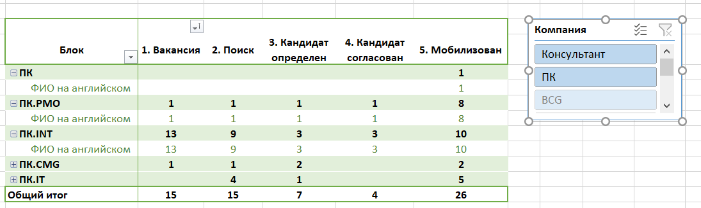
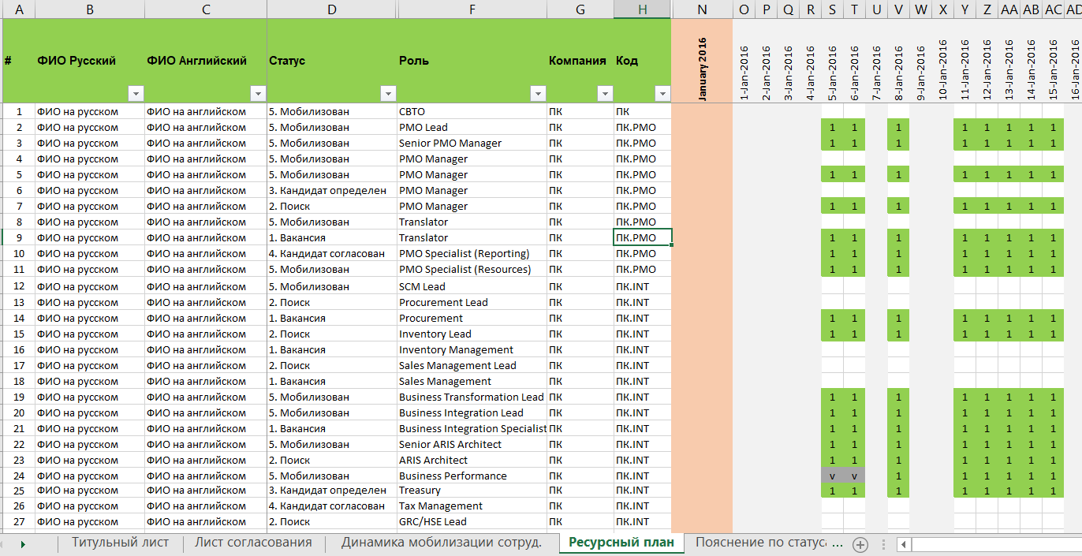
Development of Resource Plan

Slide 36
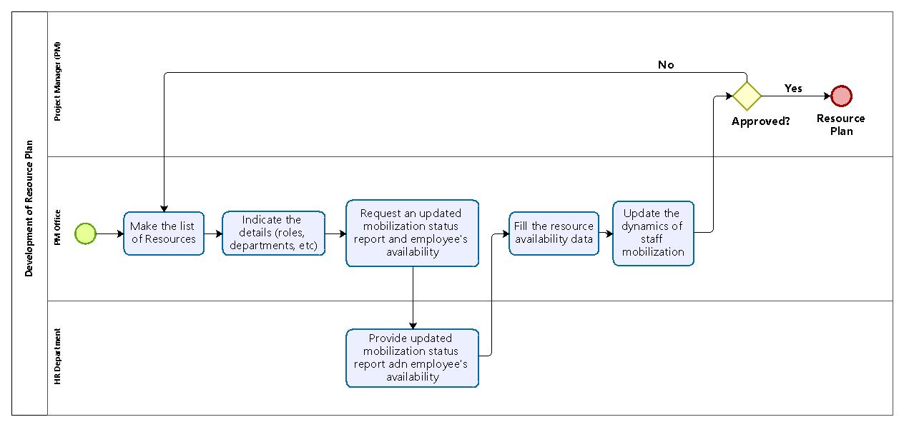
Development of Resource Plan – “as is” model

Slide 37
Development of Resource Plan – Problems & Solutions
Problems
Solutions
Template requires manual input of data
Need for clarification from HR department
Long receival of data
Over-allocation of resources
Reengineering of BP
Partial Delegation to HR Department
Project portfolio resource management

Slide 38
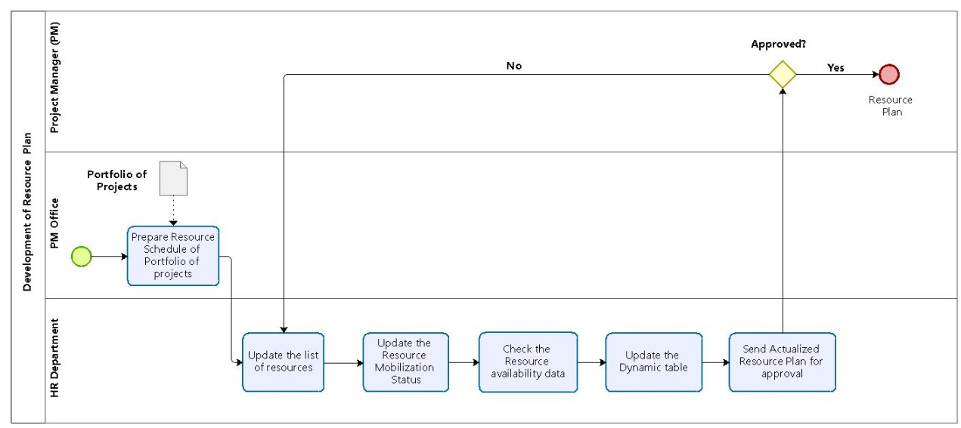
Development of Resource Plan – “to be” model
KPIs: reduced over-allocation, project execution with minimum delays

Slide 39
OPTIMIZATION OF BPs
BP 4. Change Control Process

Slide 40

Change Control Process
Methodology used to manage any change requests that impact the baseline of your project
Change control:
Determination of the order of work with changes
Project plans are rarely 100% fulfilled
Changes connected with the emergence of new opportunities or restrictions

Slide 41
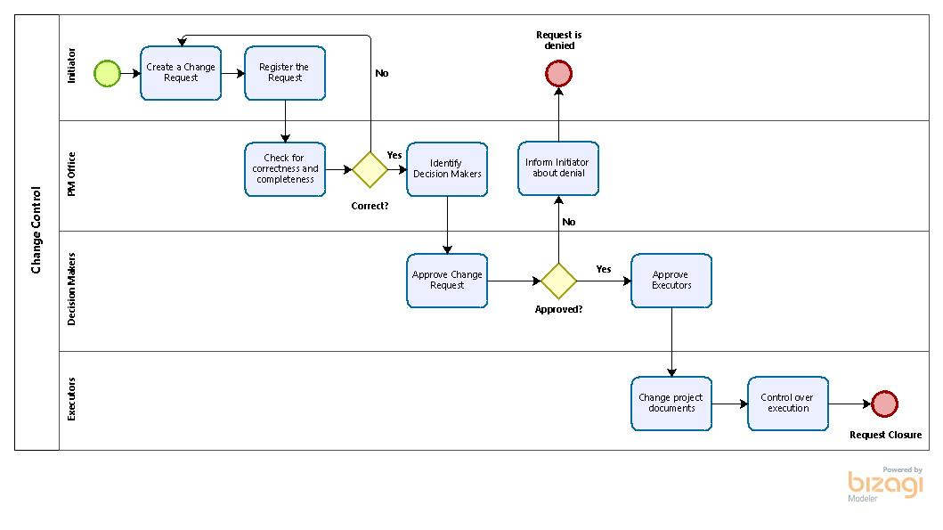
Change Control Process – “as is” model

Slide 42
Change Control Process – Problems & Solutions
Problems
Solutions
Unstructured Change Request
Change Request is not accepted at once
Long cycle time of the process
Non-reflection of changes in project documentations
Irregular control over execution of approved change
BPI method
The creation of the Change Request template
Responsible – PMO
Control over execution of changes

Slide 43
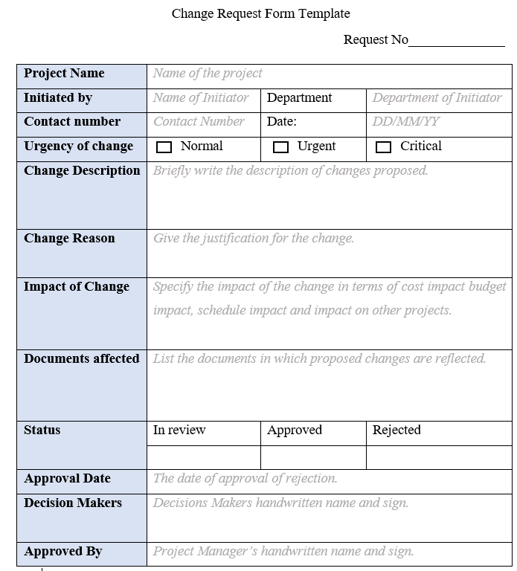
Change Request Template

Slide 44
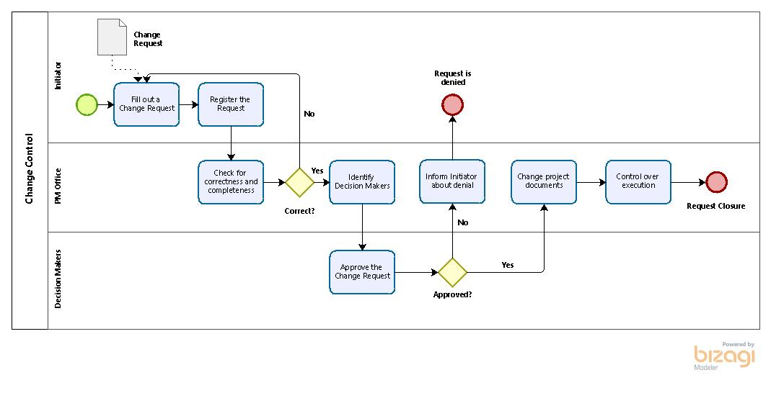
Change Control Process – “to be” model
KPIs: improvement in the average time taken to request approval, number of successful changes implemented.

Slide 45
Recommendations & Conclusion

Slide 46
Recommendations
DOCUMENTATION OF BP
REEVALUATION OF CORPORATE TEMPLATES
STRUCTURAL UNIT RESPONSIBLE FOR THE
BP DOCUMENTATION
EXTENDED USE OF MS PROJECT AND BIZAGI MODELER

Slide 47
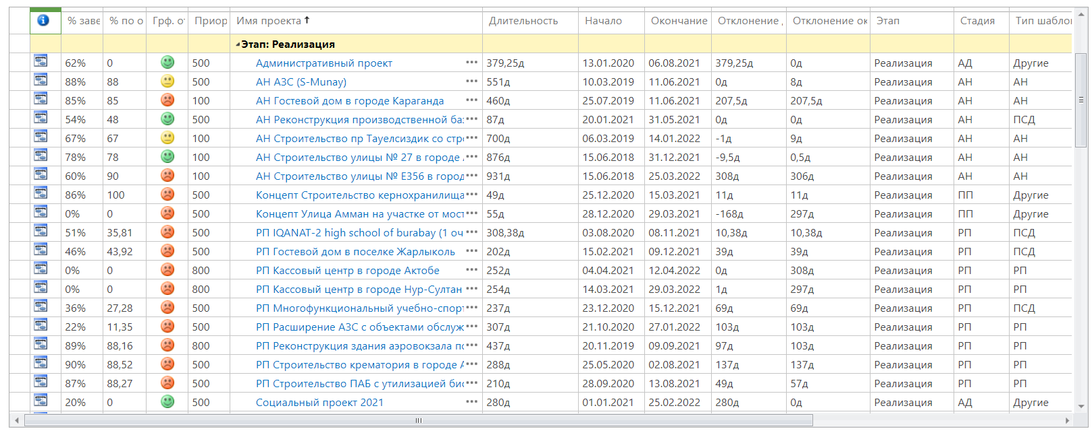
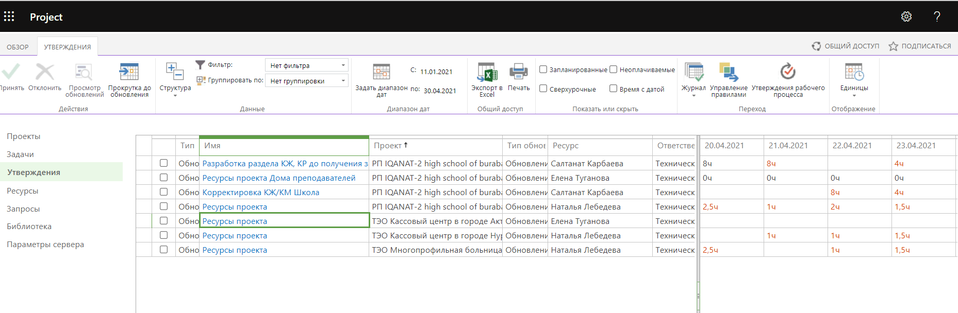
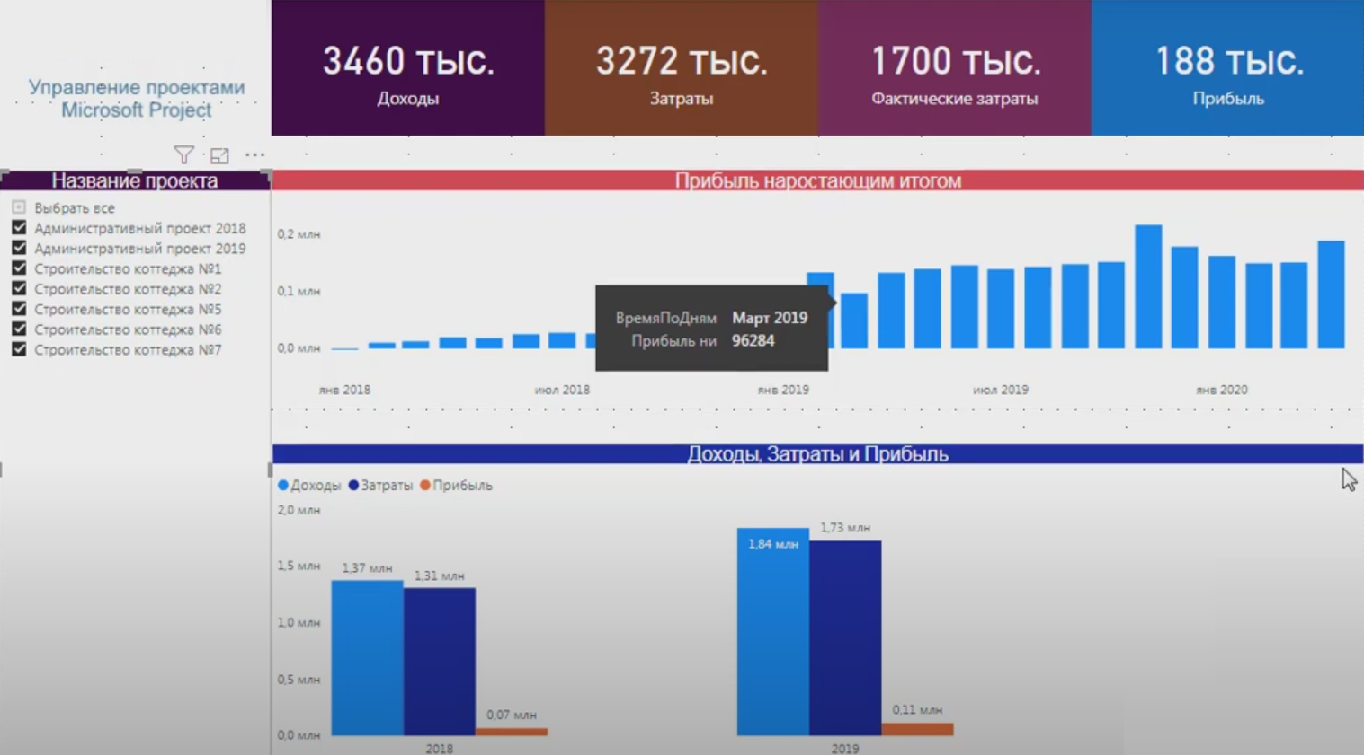
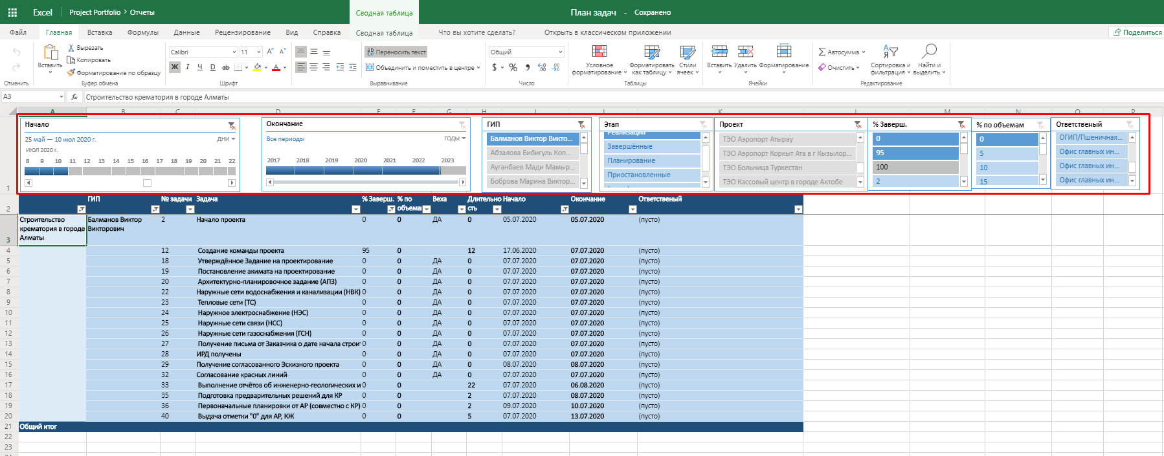
Extended use of MS Project

Slide 48
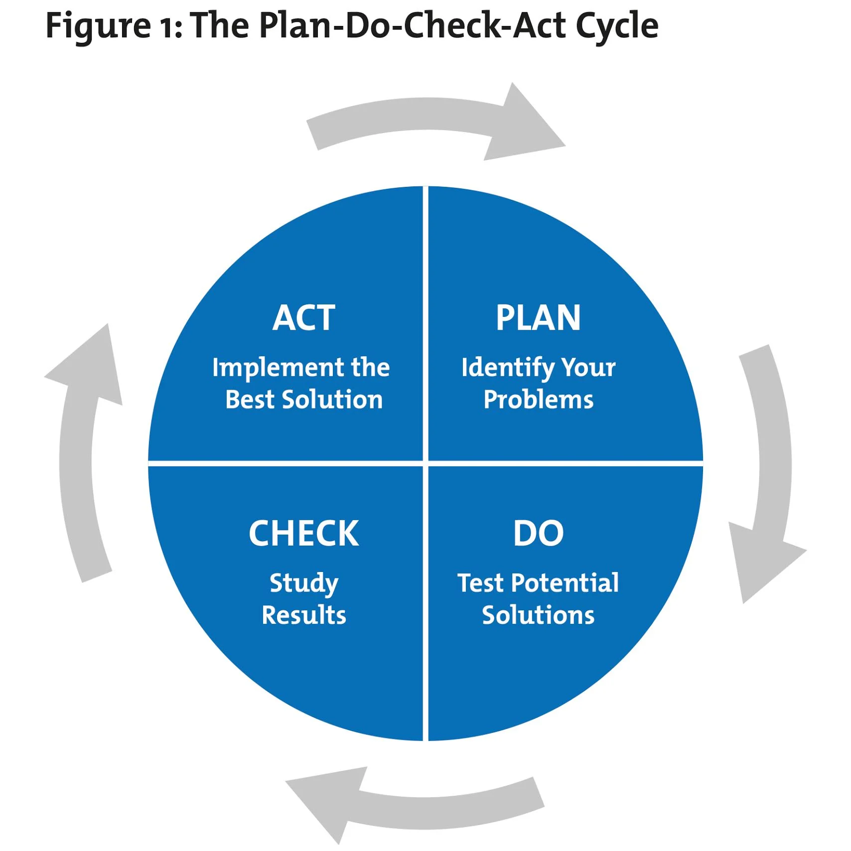
CONTINUOUS IMPROVEMENT

Slide 49
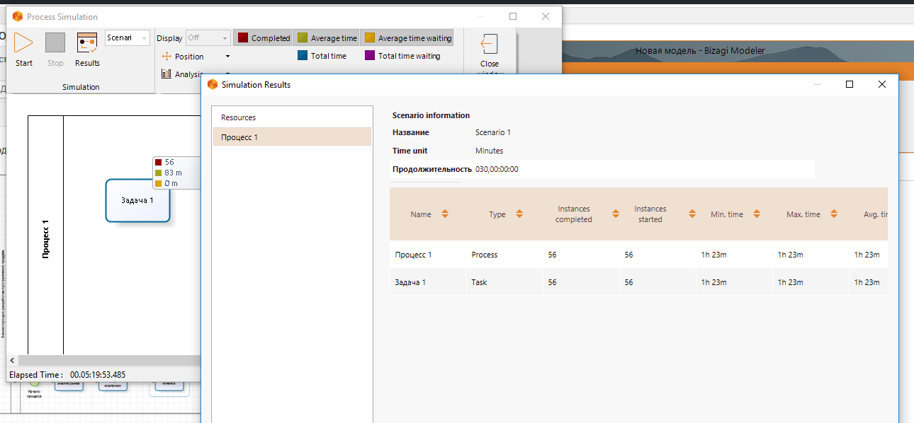
Extended use of Bizagi Modeler

Slide 50
Conclusion
AIM
To model & describe the existing BP
Selected BP
Development of Baseline, Communications Management, Development of Resource Plan, Change control
Recommendations
To pay attention to the documentation & regulation of BP
To recheck the standardized templates
To automate the procedures
Notes:
As a final point, I’d like to emphasize the key contributions of the project to KazTemirTrans company.
The first important thing is the proposed the method to select BP for optimization
The next is the identified bottlenecks of the considered BP and proposed enhanced models of selected BP with the graphical representation in Bizagi Modeler.
The third significant point is the suggested optimization and automation techniques for BP
Summing up the recommendations provided, the team recommends to pay attention to the documentation and regulation of business processes to establish an united vision of the business processes and understanding how to manage them.
Moreover, the company should recheck the standardized templates and provide to employees in a more structured way.
Furthermore, the company can automate the procedures to develop the project baseline and resource management by using the extended version of MS Project and Bizagi tools.
That brings me to the end of our presentation. Thanks for your attention and let’s proceed with Q&A session.

Slide 51
Thank you for your attention!

Slide 52
Reference list
Ahmady G. A., Mehrpour, M., Nikooravesh, A. (2016). Organizational structure. Procedia - Social and Behavioral Sciences, 230, 455–462. https://doi.org/10.1016/j.sbspro.2016.09.057
Asq.org. 2021. PDCA Cycle - What is the Plan-Do-Check-Act Cycle? | ASQ. [online] Available at: <https://asq.org/quality-resources/pdca-cycle> [Accessed 20 April 2021].
Bandara, W., Indulska, M., Chong, S., & Sadiq, S. (2007, October). Major issues in Business Process Management: An expert perspective. BPTrends. (pp. 1–8).
Björn, A 1999, Business Process Improvement Toolbox, 2nd edn., ASQ Quality Press, Milwaukee, Wisconsin.
Elzinga, D. J., Horak, T., Chung-Yee Lee, & Bruner, C. (1995). Business process management: survey and methodology. IEEE Transactions on Engineering Management, 42(2), 119–128. https://doi.org/10.1109/17.387274
Engwall, L., Kipping, M., Usdiken, B. (2016). Defining Management: Business Schools, Consultants, Media (1st ed.). Routledge: Taylor and Francis Group, 1–24. ISBN-13: 978-0415727884
General Director, 2018. Quality Management by ISO 9001: when and how to apply. Professional Magazine of the Head “General Director”, [online] 30 July. Available at: https://www.gd.ru/articles/9881-menedjment-kachestva-iso-9001
Help.bizagi.com. 2021. Bizagi 11.2.4.2x BPM Suite User Guide - Digital Business Platform. [online] Available at: <https://help.bizagi.com/bpm-suite/en/index.html?bpmn_shapes.htm> [Accessed 22 April 2021].
Hobday, M. 2000. The project-based organisation: An ideal form for managing complex products and systems? Research Policy, 29, pp. 871-893.
Iso.org. 2008. ISO 9000 Introduction and Support Package: Guidance on the Concept and Use of the Process Approach for management systems. [online] Available at: <https://www.iso.org/files/live/sites/isoorg/files/archive/pdf/en/04_concept_and_use_of_the_process_approach_for_management_systems.pdf> [Accessed 10 March 2021].
Jacobides., M. G. (2007). The inherent limits of organizational structure and the unfulfilled role of hierarchy: Lessons from a near-war. Organization Science, 18, 3, 455-477
Kffanek.kz. 2021. АО «Қазтеміртранс». [online] Available at: <http://kffanek.kz/ao-k-aztemirtrans> [Accessed 3 April 2021].
Kizikov I.V., and Savchenko Ya.V., 2012. METHOD OF CHOICE OF BUSINESS PROCESSES FOR OPTIMIZATION IN THE INTEGRATED HOLDING COMPANIES. Journal of Modern Problems of Science and Education, №6.
Kohlbacher, M. (2010), “The effects of process orientation: a literature review”, Business Process Management Journal, Vol. 16 No. 1, pp. 135-52.
Konenko, V., 2020. METHODOLOGY OF ORGANIZATION AND DESIGN OF BUSINESS PROCESSES. Efektyvna ekonomika, (11).
Liu, C., Li, Q. and Zhao, X. (2009), “Challenges and opportunities in collaborative business process management: overview of recent advances and introduction to the special issue”, Information Systems Frontiers, Vol. 11 No. 3, pp. 201-9.
Lobanova, A., Dolganova, O. and Vinogradova, E., 2016. The modelling of business processes:. Academic Bachelor Textbook and Workshop. Moscow: Urait, pp.14-28.
McCormack, K., & Johnson, W. (2001). Business process orientation: Gaining the E-business competitive advantage. Delray Beach: St Lucie Press.
Nkomo, A. and Marnewick, C., 2021. Improving the success rate of business process re-engineering projects: A business process re-engineering framework. SA Journal of Information Management, 23(1).
Omg.org. 2021. About the Business Process Model And Notation Specification Version 2.0. [online] Available at: <https://www.omg.org/spec/BPMN/2.0/> [Accessed 22 April 2021].
Paim, R.C.S., Caulliraux, H. and Cardoso, R. (2008), “Process management tasks: a conceptual and practical views”, Business Process Management Journal, Vol. 14 No. 5, pp. 694-723.
Project Management Institute. (2004). A guide to the project management body of knowledge (PMBOK® guide) (3rd ed.). Newtown Square, PA: Project Management Institute.
Quality management systems - Requirements (ISO 9001:2015). European Committee For Standardization. Reference number EN ISO 9001:2015E.
Seethamraju, R. and Marjanovic, O. (2009), “Role of process knowledge in business process improvement methodology: a case study”, Business Process Management Journal, Vol. 15 No. 6, pp. 920-36.
Sinai-group.ru. 2011. Optimization of business processes according to ISO standard. [online] Available at: <http://www.sinai-group.ru/stati/optimizaciya-biznes-processov-po-standartu-iso> [Accessed 15 March 2021].
Syed N.A., 2020. Business Process Redesign. Journal of Business Strategy, 12(6), pp.48-51.
Timane, R., 2012. Business Process Reengineering (BPR) to Business Model Reengineering (BMR). SSRN Electronic Journal.
Torremans, H., Vanhaverbeke, W. (1999). Organizational structure in process‐based organizations. Knowledge and Process Management, 6(1), 41–52. https://doi.org/10.1002/(SICI)1099-1441(199903)6:1<41::AID-KPM47>3.0.CO;2-4
Yoo, K., Suh, E. and Kim, K., 2007. Knowledge flow‐based business process redesign: applying a knowledge map to redesign a business process. Journal of Knowledge Management, 11(3), pp.104-125.
Zaini, Z. and Saad, A., 2019. Business Process Reengineering as the Current Best Methodology for Improving the Business Process. Journal Of ICT In Education, 6, pp.66-85.
Zairi, M. and Sinclair, D. (1995), "Business process re‐engineering and process management: A survey of current practice and future trends in integrated management", Business Process Re-engineering & Management Journal, Vol. 1 No. 1, pp. 8-30.

Slide 53

Q&A

