Slide 1
Launching a personal librarian program at NUL
Eurasian Higher Education Leaders Forum, June 2015
Jennifer Rempel, Patron Services Expert-Manager

Slide 2
Agenda
Introduction
What is a Personal Librarian program?
Action plan for NUL
PL Information Package
Gimlet
Tutorial
Meet and Greet
Current Results
Conclusion

Slide 3
What is a Personal Librarian program?

Slide 4
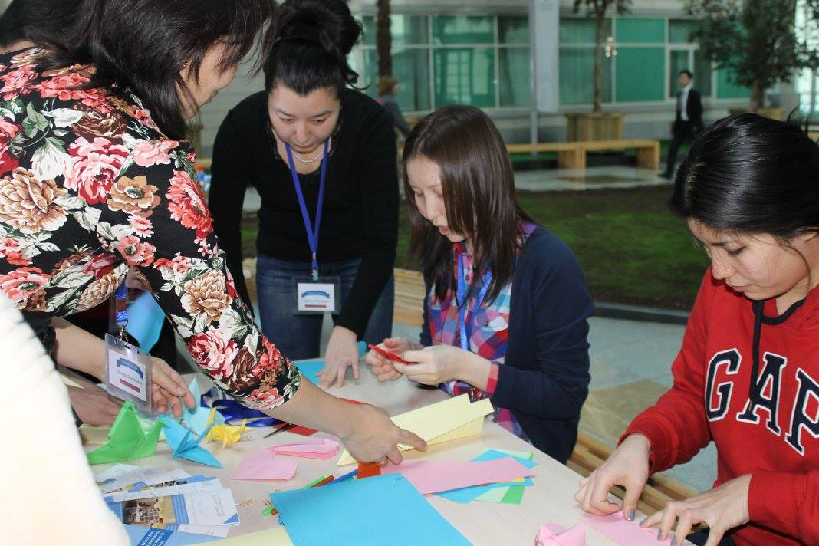
PL programs pair students with a Librarian who will act as their go-to university contact for information needs.

Slide 5
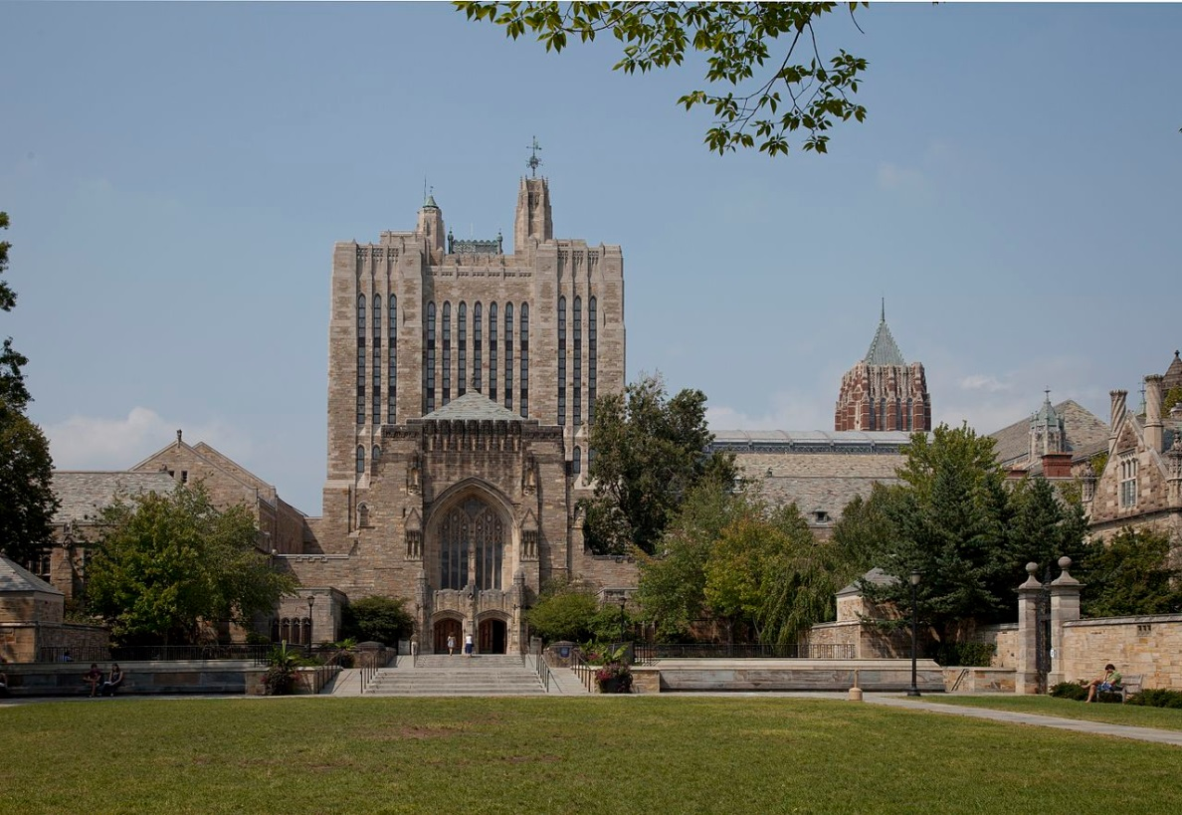
Universities world-wide – including Yale, Duke, the University of Toronto, and Boston University – have pioneered the PL program.
Yale University’s Sterling Memorial University. Source: Carol M. Highsmith, Wikimedia Commons.

Slide 6
PL duties include:
sending students regular email updates on Library services;
providing students with information assistance;
attending a meet and greet;
gathering statistics on student interactions.

Slide 7
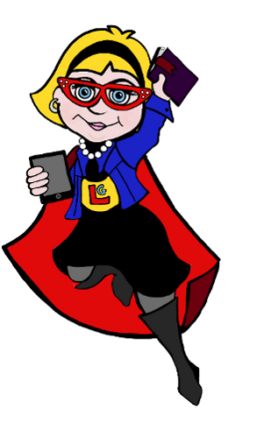
In short…
…PLs act as guides for their students, directing them to the information resource that they need, and making them feel welcome in the Library.

Slide 8
Action Plan for NUL

Slide 9
We created a detailed document outlining all steps required to create a PL program – including a schedule of milestones.

Slide 10
We had to decide:
Who will act as a PL, and how many PLs will we have?
Which students will have a PL, and how many students will have a PL?
What infrastructure do we need?
How will we prepare Library staff for PL duties?

Slide 11
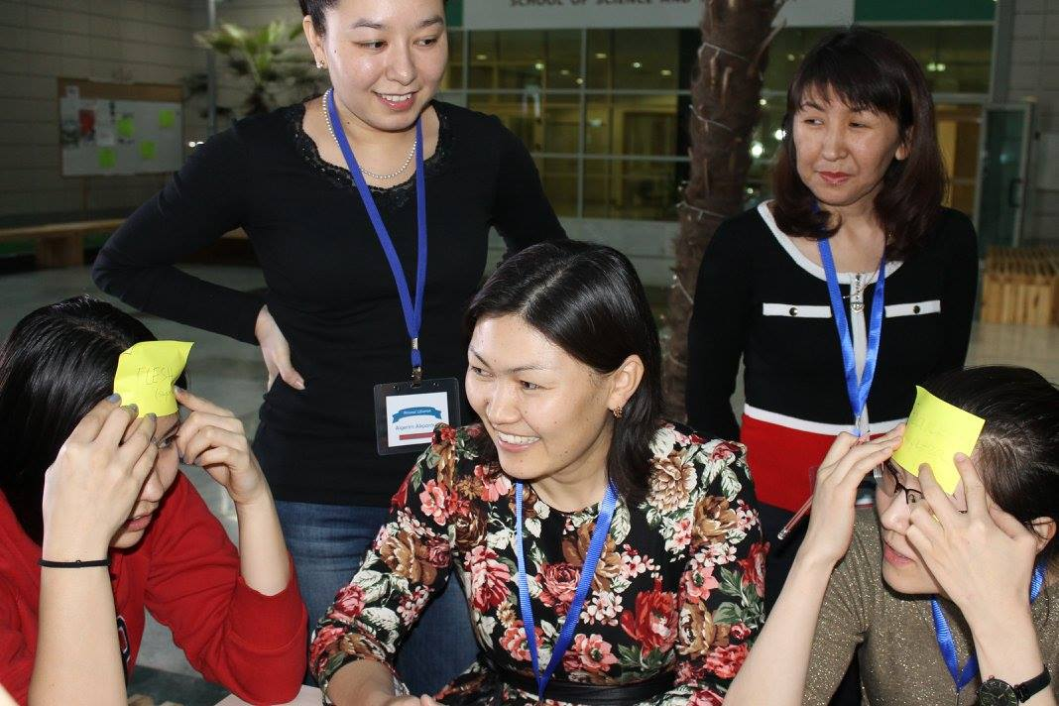
1)
Library staff from all departments should act as PLs.
14 NUL Library staffers volunteered.

Slide 12
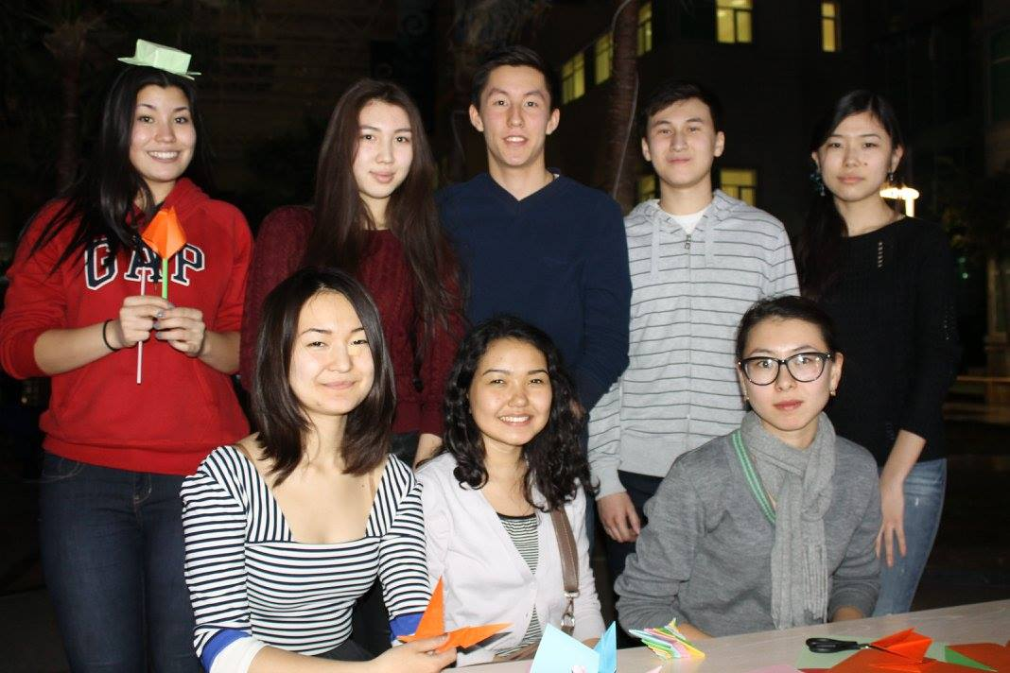
2)
All 547 Foundation-year (CPS Program) students would all be assigned a PL in January 2015.

Slide 13
3)
Infrastructure:
calendar of events;
email templates;
information package;
statistics-collection software.

Slide 14
4)
PLs will all receive training in carrying out their duties.

Slide 15
Information Package

Slide 16
Some NUL staff had little experience with students, so we needed to create an information package to answer PLs questions and to guide them through their interactions with their students.

Slide 17
The PL information package needed to include:
calendar scheduling dates for contacting students;
FAQ for PLs;
page containing basic information about the Library;
information regarding NU policies and procedures;
information regarding NU student services and contacts;
email templates for use of PLs;
list of Subject Librarians and their contact information;
links to NUL resources;
link to NUL social media.

Slide 18
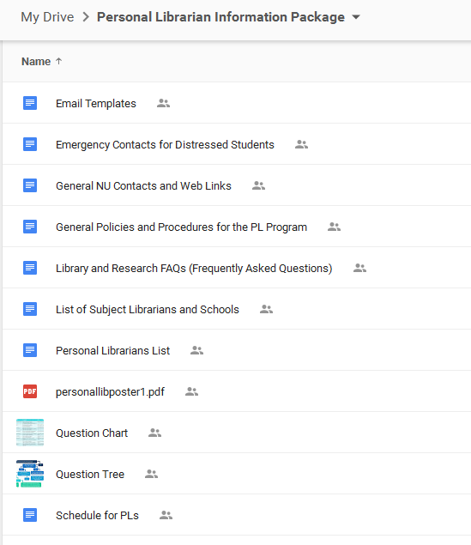
The information package was created using Google docs, and was shared with all PLs.
https://drive.google.com/drive/#folders/0Bw0O9uHtVXreRTlSblQ5T2FWWDQ

Slide 19
Gimlet

Slide 20
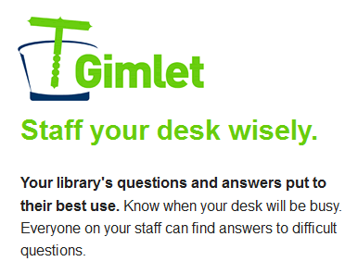
Gimlet Library statistics tracking software was used to keep track of all PL-student interactions.
https://nureference.gimlet.us/sites/1287/questions/new

Slide 21
Tutorial

Slide 22
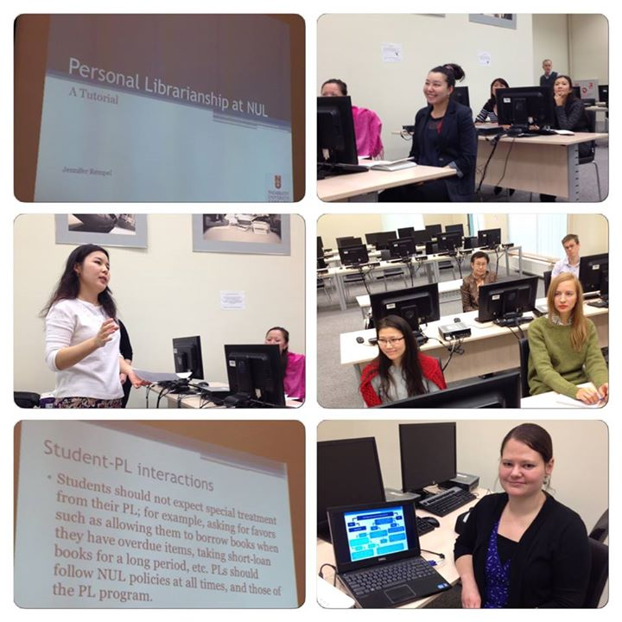
In November 2014, all PLs attended a one-hour tutorial explaining duties, and how to use the PL information package and Gimlet.

Slide 23
Meet and Greet

Slide 24
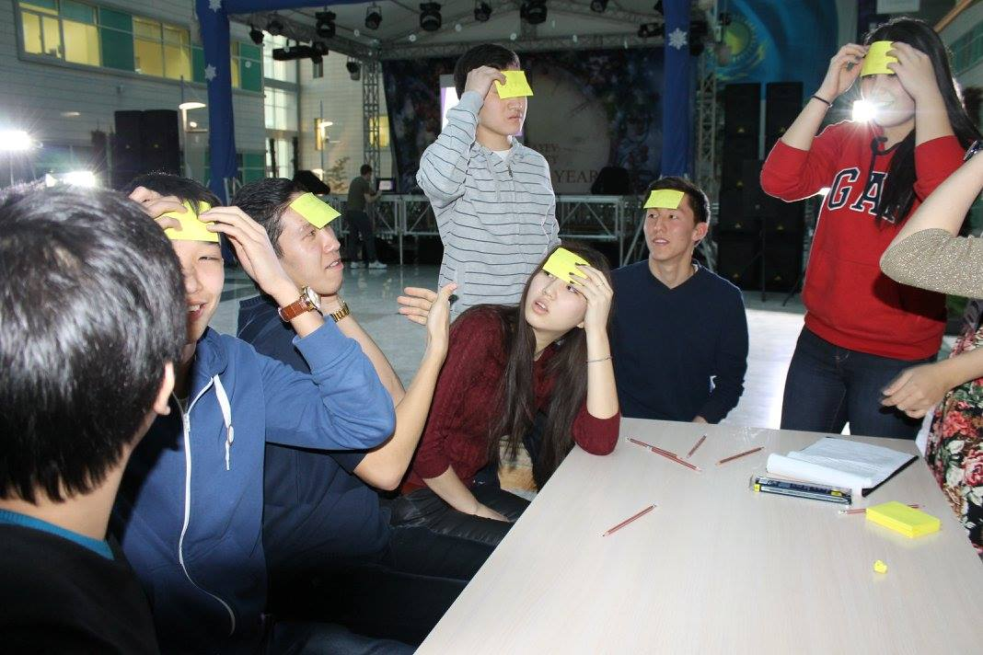
In order to encourage students to meet their PL, we held a Meet and Greet in January, before the start of term.

Slide 25
This required:
event space;
music and sound system;
student performers;
games;
snacks and drinks;
promotion and marketing;
PL participation.

Slide 27
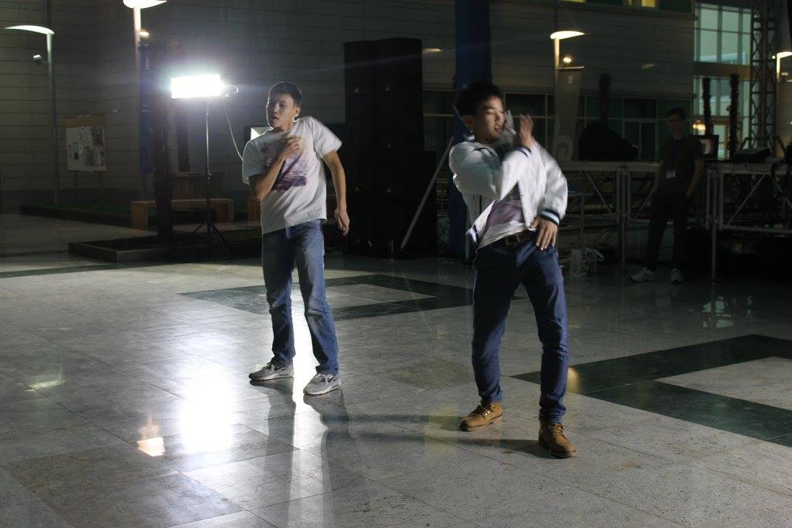

Slide 28
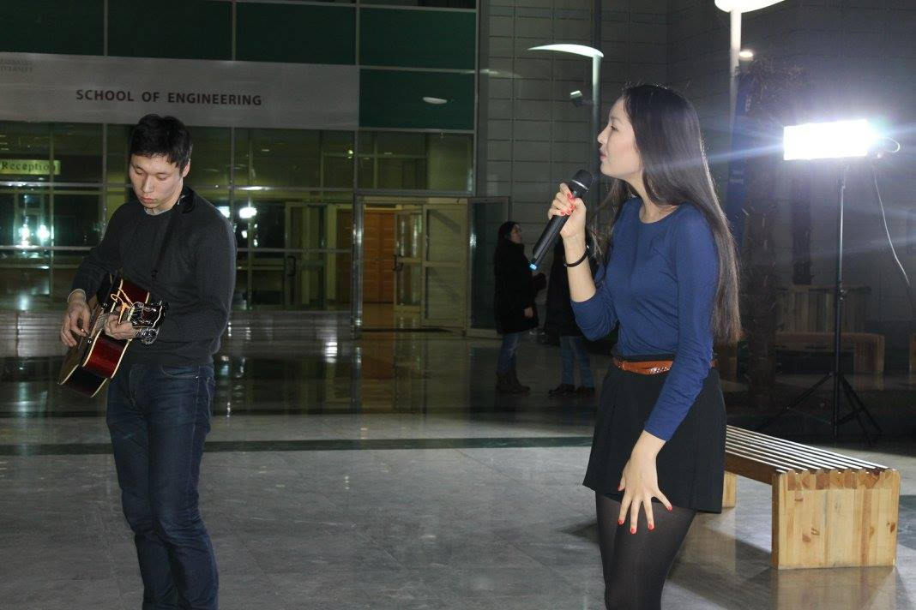

Slide 29
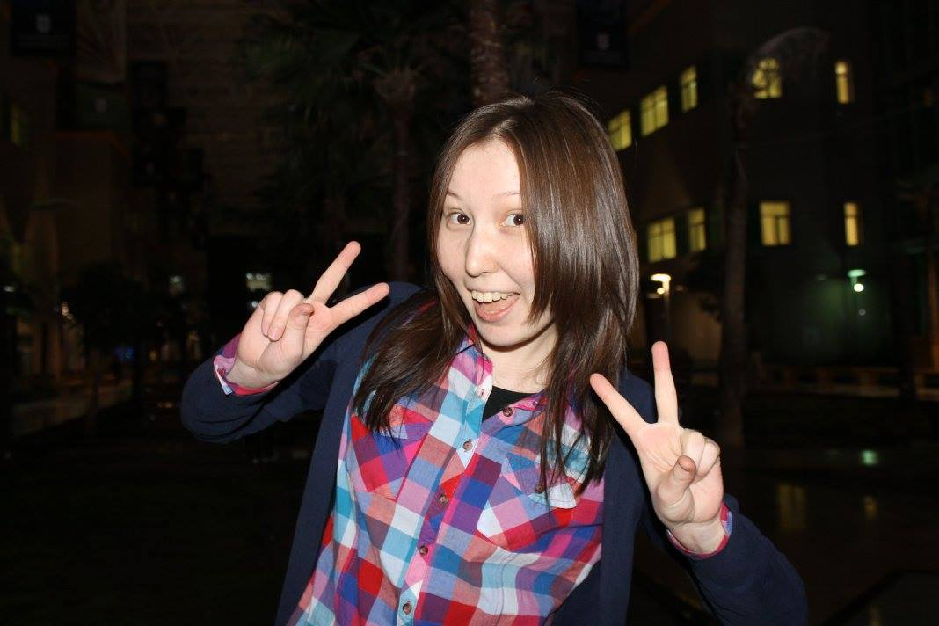

Slide 30
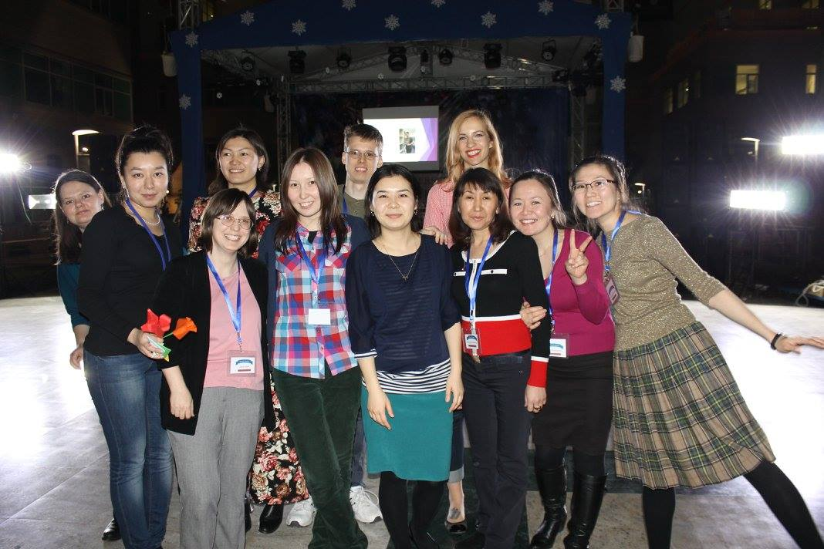

Slide 31
Current Results

Slide 32
The PL program launched in January 2015.
PLs continue to communicate with students via email and in person.
PLs have been keeping track of interaction statistics via Gimlet.
Satisfaction surveys for both students and PLs will be carried out once the term has ended.
Results will be used to plan the PL program for fall 2015.

Slide 33
Thank you for your attention!
Questions?

