Slide 1

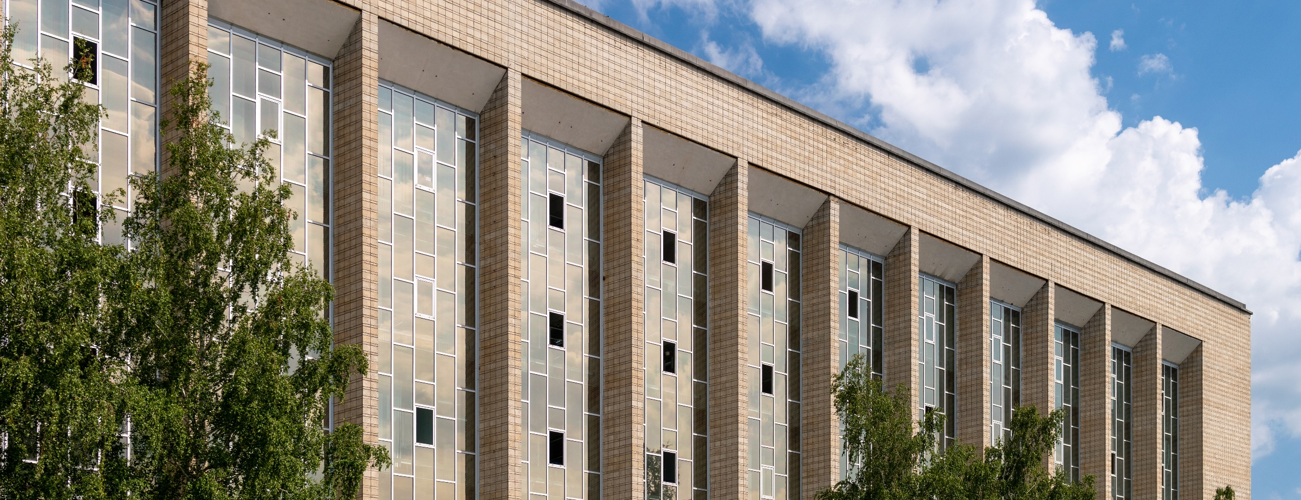
Scientific Research Activity in the State Public Scientific Technological Library of the Siberian Branch of Russian Academy of Sciences (SPSTL SB RAS)
Experience and Current Directions in Development

Slide 2
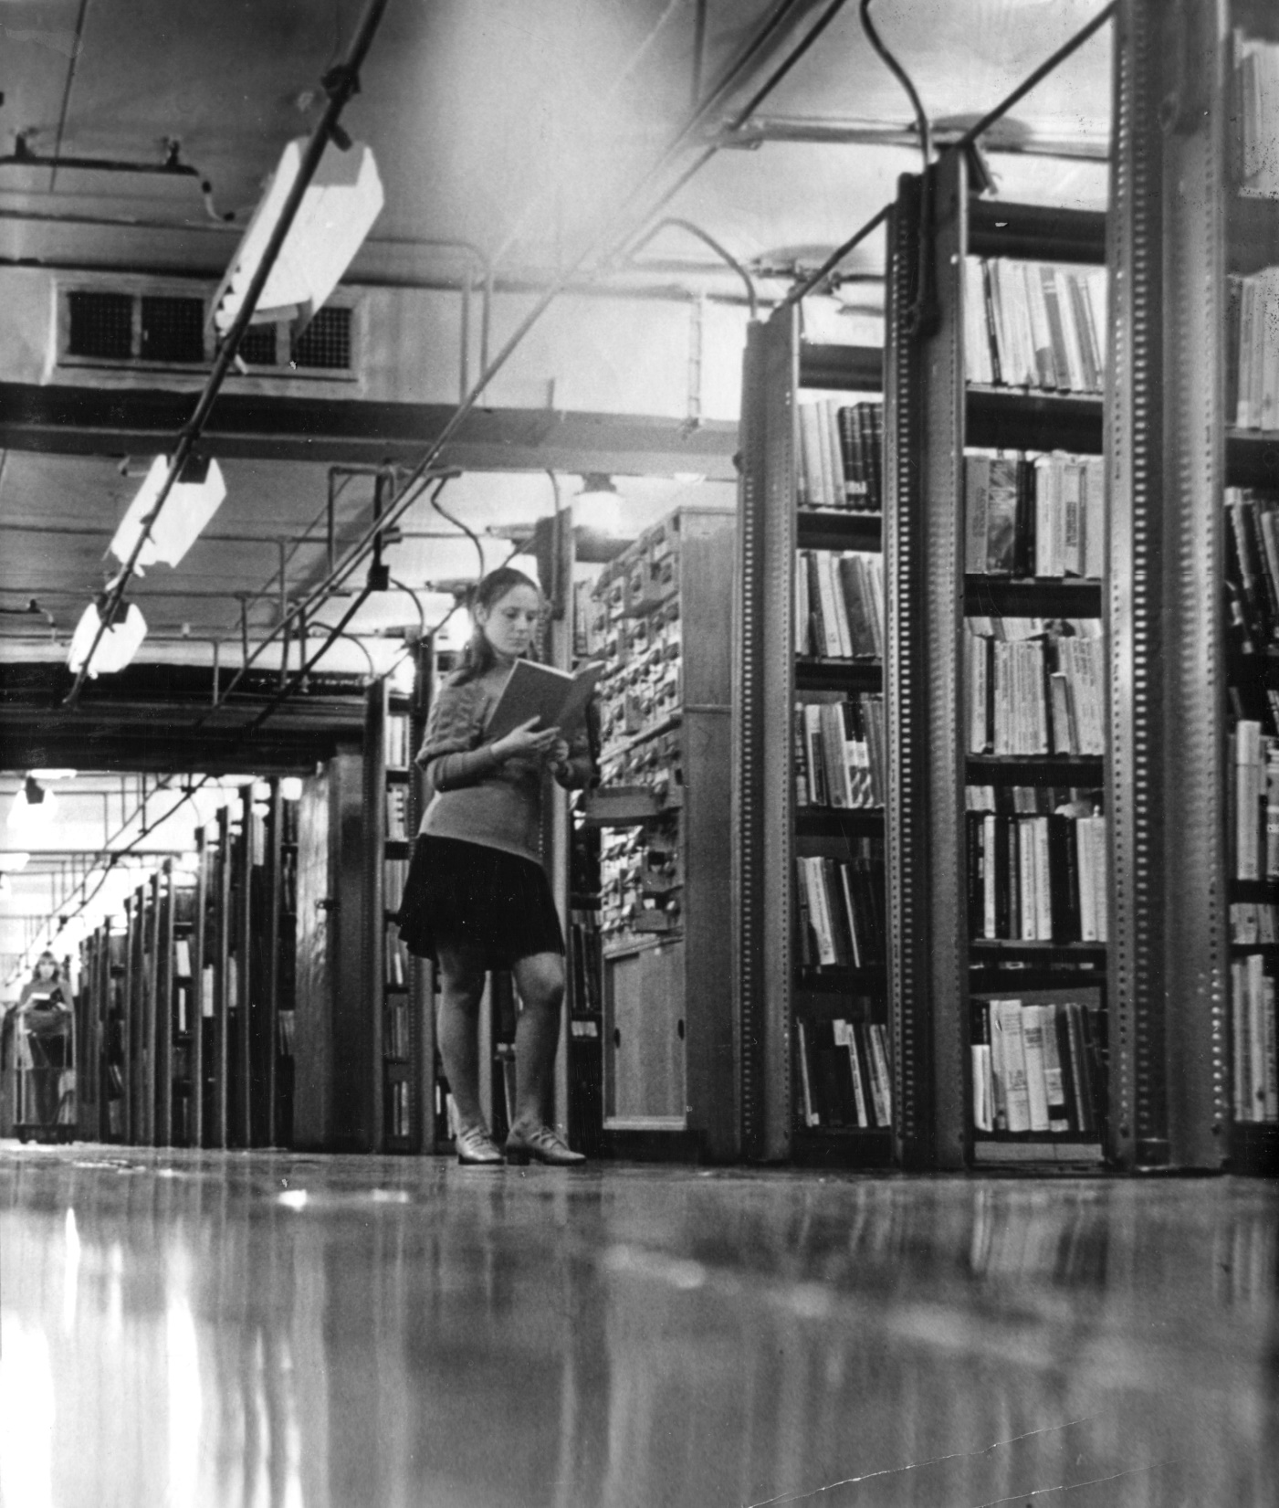


Slide 3
MISSION OF SPSTL SB RAS
to provide access to the most important information resources
to develop and preserve an universal funds of knowledge for future generations
to preserve Book Heritage and Book Culture

Slide 4
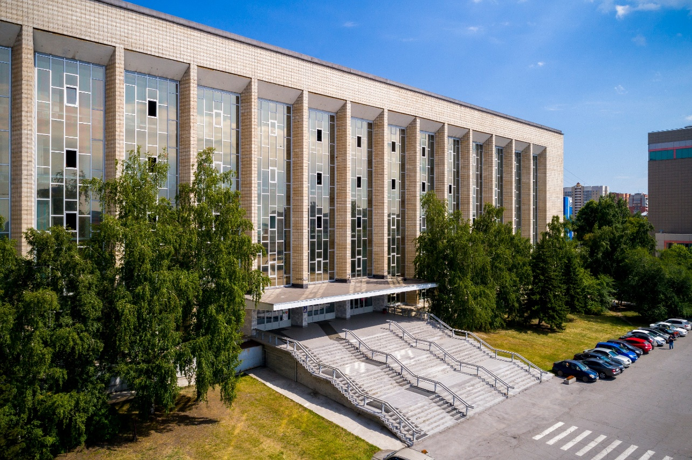
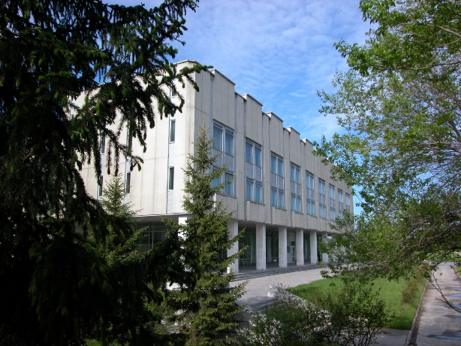
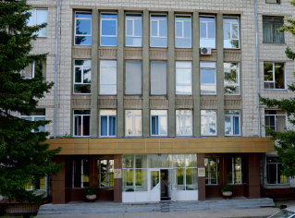
STRATEGIC GOAL
to create and develop an effective regional system of library and information support for highly qualified services for scientists, researchers, universities and society;
to carry out scientific research effectively;
to improve the level of education and culture
The main building of the SPSTL SB RAS
The branch in Krasnoobsk
The Library Branch in Academic city

Slide 5



SPSTL SB RAS CARRIES OUT 3 DIFFERENT DIRECTIONS:
research
library services
education
Research Institute for Library and Information Science, Book Studies and Computer Science (5 research laboratories)
Siberian Regional Centre for Conservation
and Restoration
Methodological Centre for Information and Library System of the Siberian Branch of Russian Academy of Sciences (70 libraries of Research Institutes)
Information and Library Center
Book Museum (more than 50 000 items)
Regional Multifunctional Center for the provision of patent information services in the field of protection of intellectual property
Professional Retraining Centre (Master’s degree and PhD programs)

Slide 6
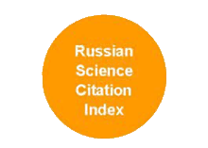
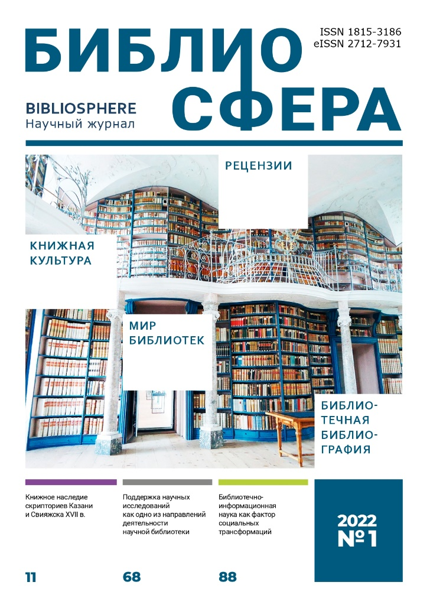
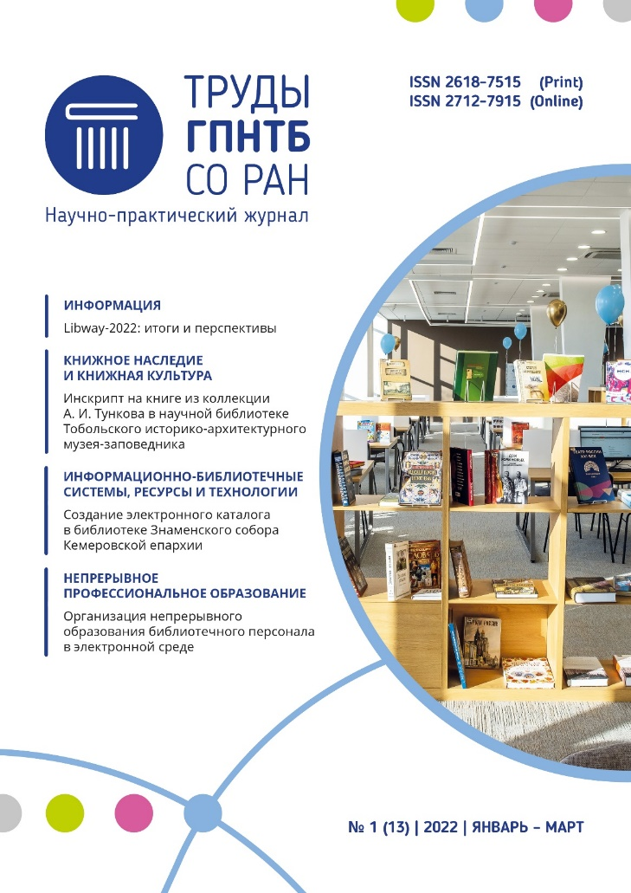
CALL FOR ARTICLES
https://www.bibliosphere.ru/jour
https://proceedings.gpntbsib.ru/jour

Slide 7

RESEARCH
PROJECTS
2021-2026
Notes:
Филиал играет активную роль в культурной жизни Краснообска. Здесь проходят массовые научные и развлекательные мероприятия: Выставки научной литературы, научно-практические семинары, научные и научно-популярные лекции и встречи с учеными, всероссийская акция Библионочь, Тотальный диктант, образовательные программы совместно со станцией юннатов Новосибирского района.
Также библиотека предоставляет свою площадку для проведения научных мероприятий Сибирского федерального научного центра агробиотехнологий.

Slide 8

BOOK STUDIES RESEARCH LABORATORY
TRANSFORMATION OF BOOK CULTURE IN SOCIAL COMMUNICATIONS OF THE 19TH – 21ST CENTURIES
Identification and analysis of the regularities of the transformation of book
culture in social communications
of the XIX-XXI centuries

Slide 9
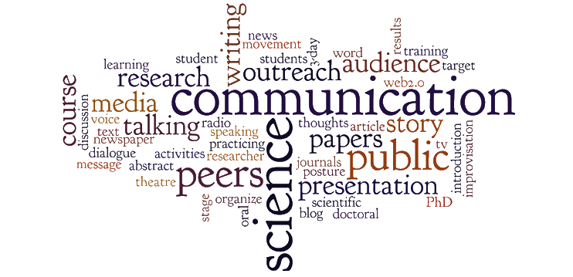
INFORMATION AND SYSTEMATIC ANALYSES LABORATORY
DEPARTMENT OF SCIENTIFIC BIBLIOGRAPHY
CURRENT STATE AND TRENDS IN THE DEVELOPMENT OF COMMUNICATIONS
BETWEEN RUSSIAN SCIENCE AND SOCIETY
Development of a terminological series, metrics and criteria
for the effectiveness of interaction between research institutes
and society, assessment of the attitude of science to communication activities and the public to science, and the dynamics of its change under the influence of various events, development of theoretical and methodological substantiations of the directions of library and bibliographic activity as a channel of interaction between science and society

Slide 10

SCIENTIFIC AND TECHNOLOGICAL DEPARTMENT
DEVELOPMENT OF A MODEL FOR THE FUNCTIONING OF A SCIENTIFIC LIBRARY
IN THE INFORMATION ECOSYSTEM OF OPEN SCIENCE
Building a model for the functioning
of a scientific library, contributing to the creation of an effective information and communication infrastructure to support open science

Slide 11







INTERNATIONAL RELATIONS
SPSL SB RAS began to interact with foreign information
and library institutions in the distant 60-s of XX century, almost immediately after the library had moved to Novosibirsk. Over the past decade, the State Public Scientific Technological Library has signed agreements on cooperation in the field of science, culture, information and library technologies; organizing joint research projects and events, etc.

Slide 12
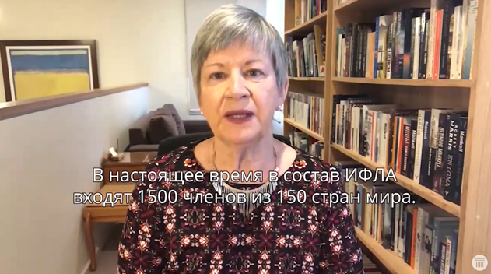
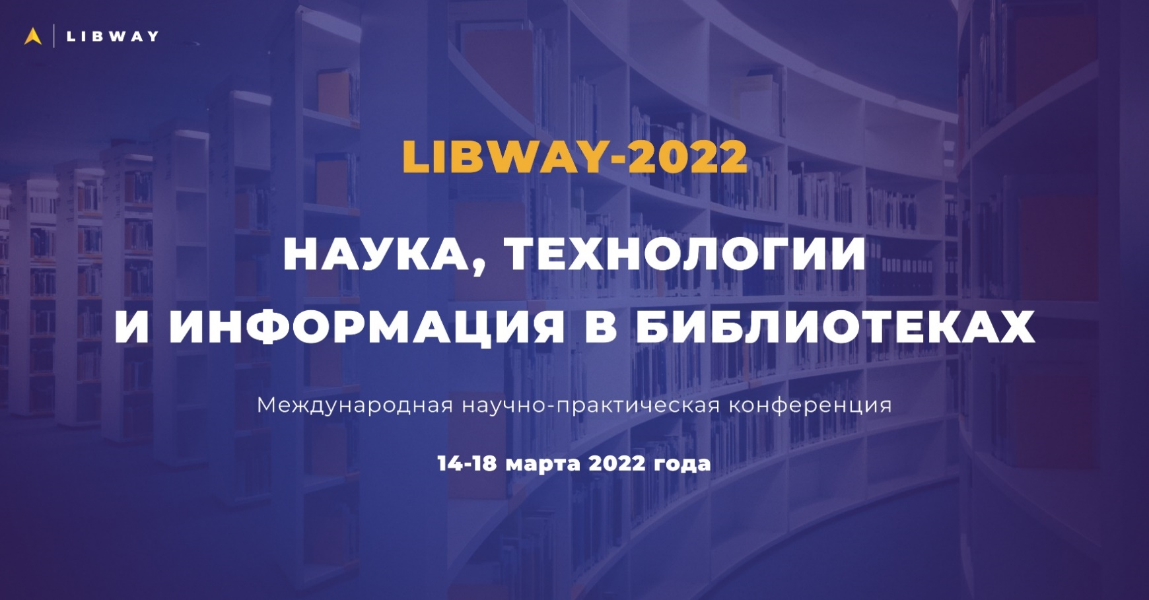
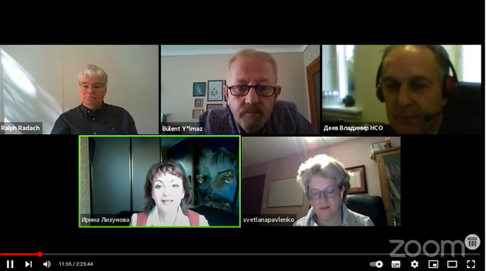
INTERNATIONAL SCIENTIFIC AND PRACTICAL CONFERENCE LIBWAY- 2022
March, 2022
www.libway.ru

Slide 13
CONCLUSION
Over the past 10 years, SPSL SB RAS has become a unique regional library platform for the popularization and promotion of world scientific and technical achievements and familiarization of users with the culture of nations living in the territory
of the Russian Federation and foreign countries.
The library is actively working on the creation of a unique cultural and educational center on its basis, enabling thousands
of people to take part in a wide variety of cultural, educational and scientific events.
Cooperation with foreign scientific and cultural institutions opens up many opportunities for mutual exchange and mutual enrichment in our professional activities, and triggers to towards new achievements and discoveries in scientific research.
At present, the partners are discussing the issues of a scientific approach to study collections of the SPSTL SB RAS
and the partners' libraries

Slide 14
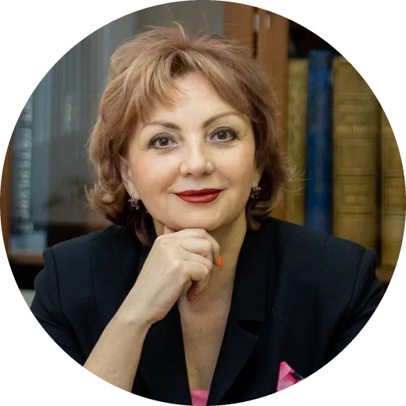

THANK YOU!
Dr. Irina Lizunova
Director SPSTL SB RAS
e-mail: lizunova@spsl.nsc.ru

