Slide 1


Use of Choice Reviews to Build the Geosciences Collection
Joseph Yap | Altynay Kozhayeva
IV International Scientific and Practical Conference
“University Library at a New Stage of Social Communications Development”
Scientific and Technical Library
Dnipro National University of Railway Transport named after Academician V. Lazaryan, Dnipro, Ukraine
3-4 October 2019

Slide 2


Contents
Introduction
Methodology
Results
Conclusion
References

Slide 3
Introduction
Programs of School of Mining and Geosciences has :
Geology, Petroleum Engineering, & Mining Engineering (bachelor)
Petroleum Engineering & Mining engineering (master)
A PhD program
What is the significance of building the print collection?

Slide 4
Methodology
Choice Reviews Online ensures the immediate access to comprehensive archive.
Collection Evaluation

Slide 5



Method 1:adding a keyword

Slide 6
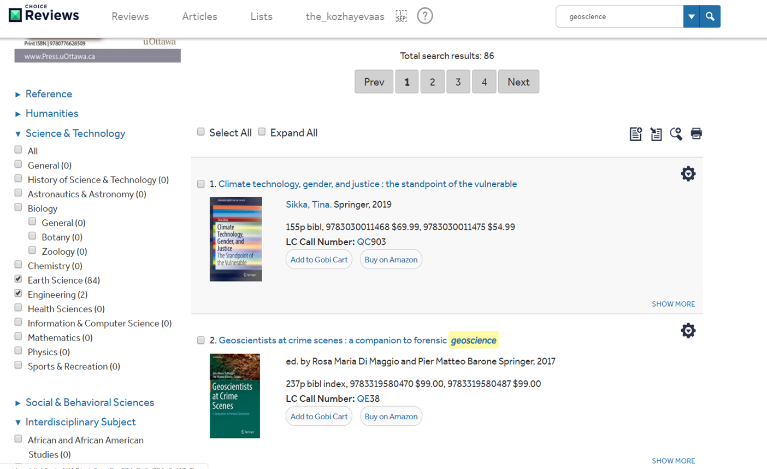

Method 2: results and using filter

Slide 7
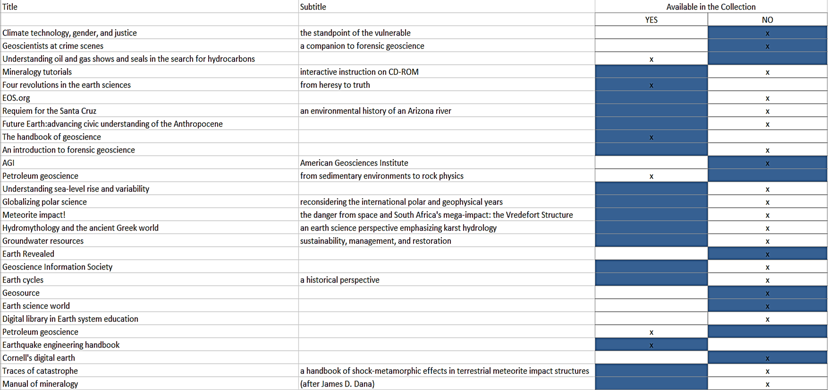
Method 3:extracting a list of results

Slide 8
Results
From the 86 results, we found out that 30 of them are duplicates.
Print books : 7 titles are available in the Choice reviews Online
E-books: 31 titles are available in the Choice Reviews Online

Slide 9
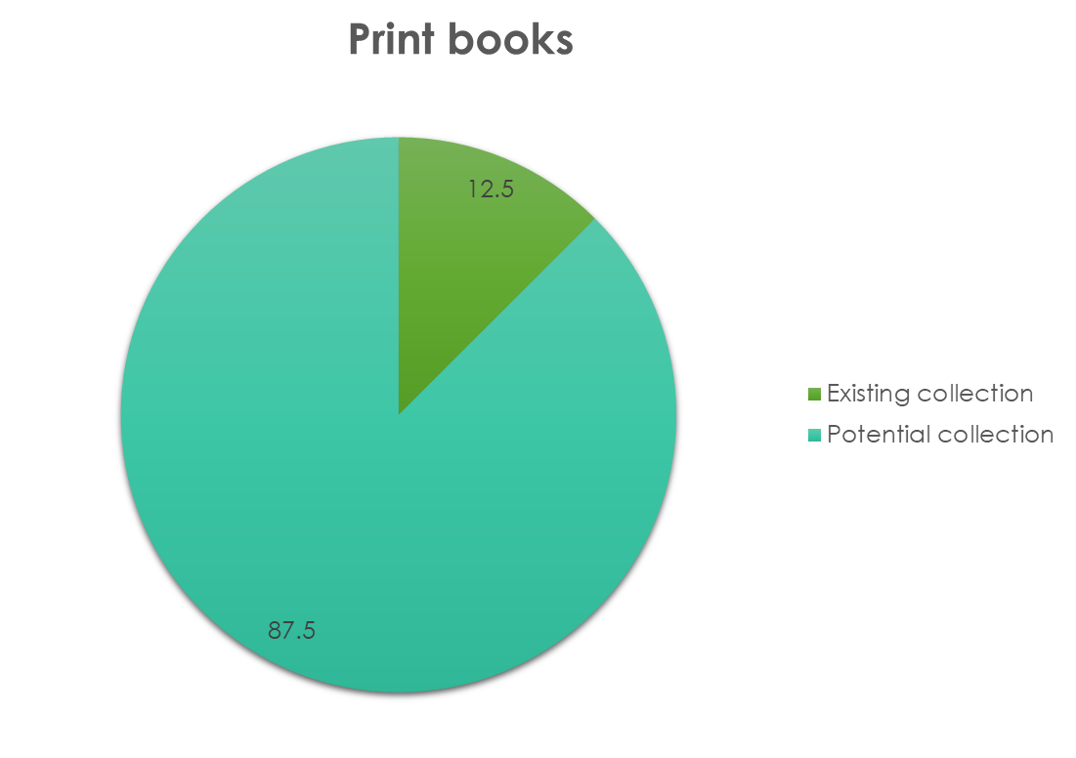
Results
Figure 1. Comparison of print books in the NU collection vs Choice Reviews

Slide 10
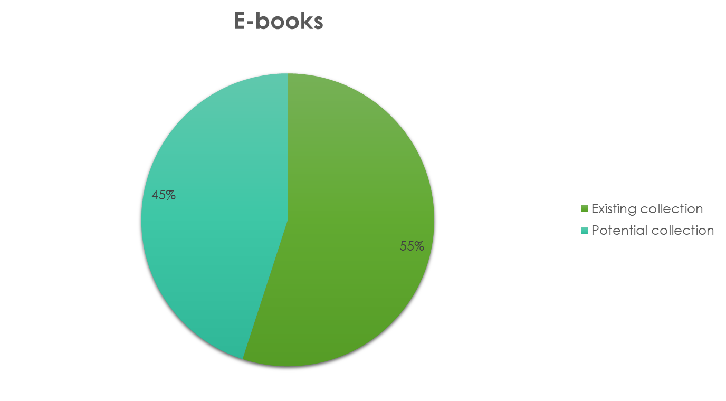
Results

Slide 11
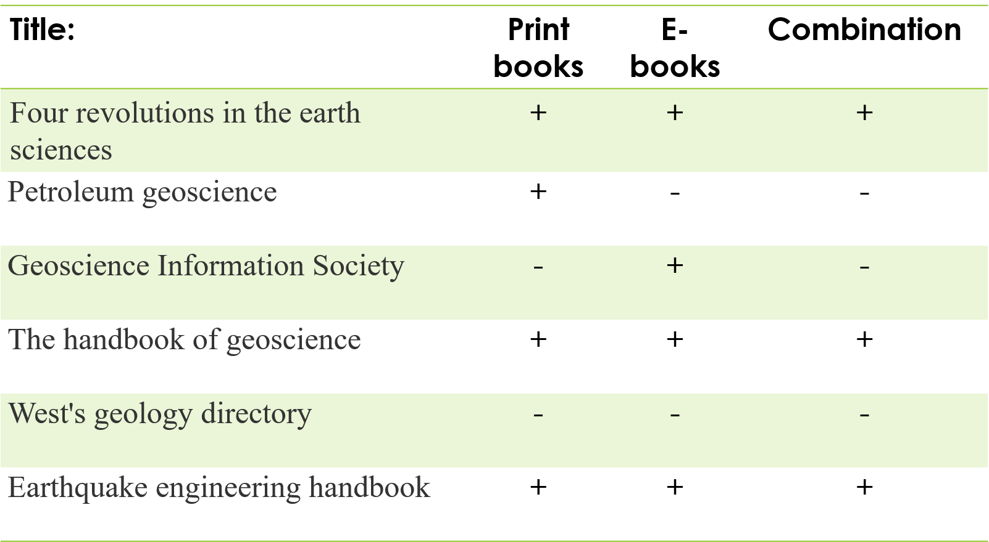
Example of select titles

Slide 12
Conclusion
Choice Reviews, Resources for College Libraries, Books in Print or Best Books for Academic Libraries.
A better collaboration from among the faculty members

Slide 13
References
Benedetto, J., & Gilmour, B. R. (2007). Assessing collections using brief tests and WorldCat Collection Analysis. Collection Building, 26(4), 104 – 107. http://dx.doi.org/10.1108/01604950710831898
Foote, J. B., & Rupp-Serrano, K. (2010). Exploring E-book usage among faculty and graduate students in the geosciences: Results of a small survey and focus group approach. Science & Technology Libraries, 29(3), 216–234. https://doi.org/10.1080/0194262X.2010.497716
Stebelman, S. (1996). Using Choice as a collection assessment tool. Collection Building, 15(2), 4-11. https://doi.org/10.1108/01604959610113842
Suorineni, F. (2018). Welcome message from the Dean. Retrieved from https://smg.nu.edu.kz/en/about-us-en/mission.html

Slide 14

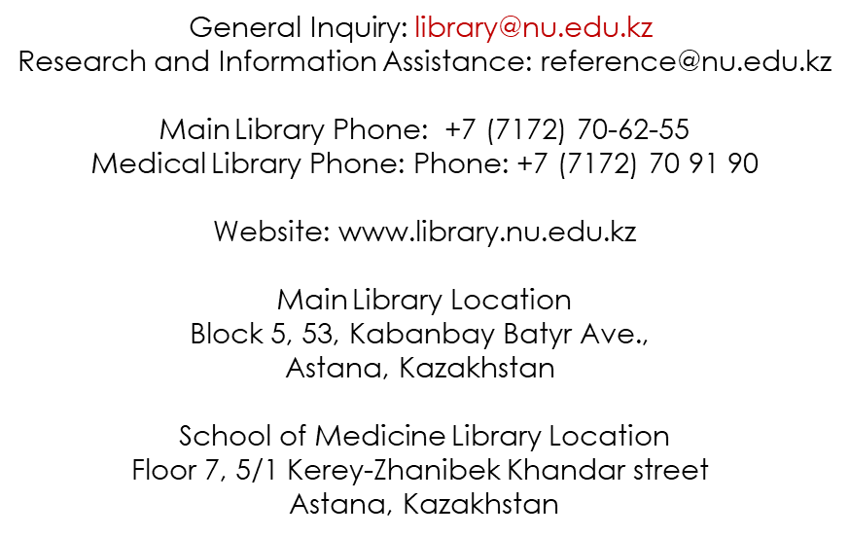
Thank you for your attention!
Questions?

