Slide 1

Civil servants capacity building in the context of state reforms in the Kyrgyz Republic
ASTANA-2018

Slide 2


CONDITIONS OF PUBLIC ADMINISTRATION DEVELOPMENT
  Instead of traditional Soviet administrative system installed a new administrative system with old mispoints
HIGH LEVEL OF CORRUPTION
Decision making not appropriate to declared country targets
Decisions mainly political, instead of economic
Not clear responsibility of main actors
Declared market priorities under absence of real markets in country
Managers appointed by political principles instead of professionalism
Notes:
С момента создания компании существуют проблемы в ее управлении. Т.к.
На месте ушедшей Советской административной системы управления возникла новая административная система со старыми болезнями, а корпоративное управление не построено.
Поэтому, мы получили следующий подход в управлении компанией: (перечисляем, зачитывая по порядку появления)…

Slide 3
CONDITIONS OF PUBLIC ADMINISTRATION DEVELOPMENT
Presidential election 2017 …
NSDS 2018-2040 identified as: «…Current level of professionality, competence and personal values of certain state and municipal servants not appropriate to established requirement…»
«The Year of Regional development in the Kyrgyz Republic»
«Administrative territorial reforms» (sustainable development through development of regions)

Slide 4
REASONS FOR IMPROVING OF CAPACITY BUUILDING
Current level of capacity, including educational background;
The results of performance appraisal;
The results of training needs assessment and definition of main barriers (obstacles) in capacity building;
Influence of implemented upgrading actions (training courses) for quality of decision making;
Identification new needs in capacity strengthening and skills upgrading for professional and personal development.

Slide 5
VISION OF CAPACITY BUILDING OUTPUTS

Slide 6
TARGET & DIRECTIONS FOR CAPACITY BUILDING
Target:
Increasing state body competitiveness through upgrading of civil servants potentials…
Directions:
- Professional development - New skills through professional development program;
- Personal development - Leadership, personal management skills and others…

Slide 7
CURRENT SYSTEM FOR CIVIL SERVANTS CAPACITY BUILDING
State order from government through SPS;
Public tender for local Universities;
International & Donor Organizations;
State body professional courses.

Slide 8
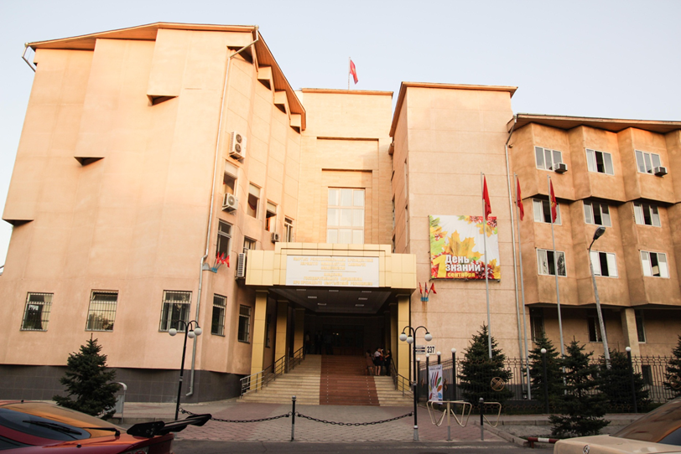
ACADEMY OF PUBLIC ADMINISTRATION UNDER THE PRESIDENT OF THE KYRGYZ REPUBLIC
Is the only educational and research institution in the country in the field of training and re-training of state and municipal servants of Kyrgyz Republic established by the President of the Kyrgyz Republic

Slide 9
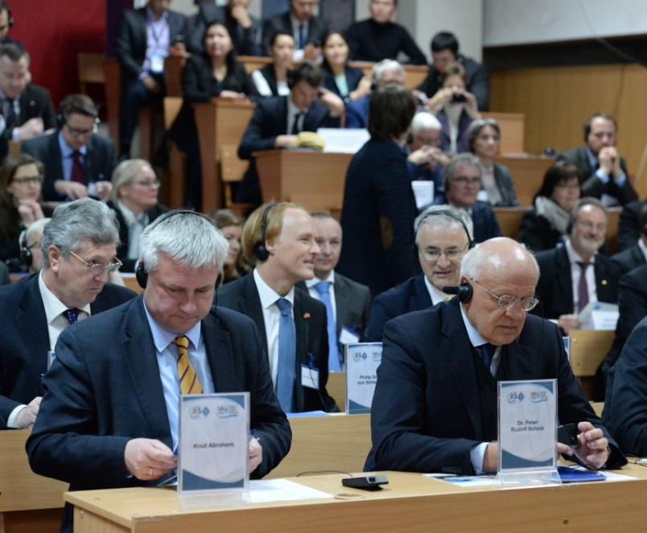
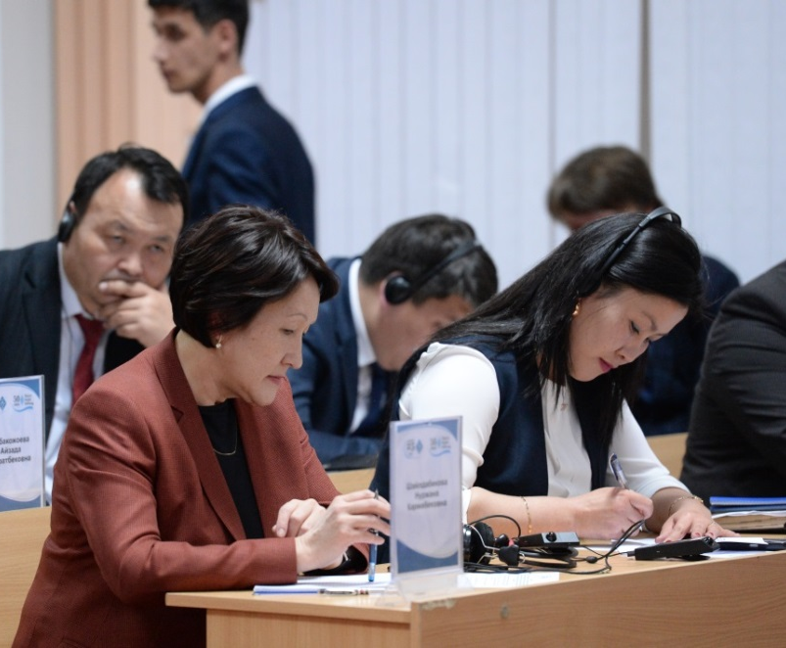
MISSION
The Academy aims at the formation of the new generation of civil servants able to:
develop, implement, monitor and evaluate public policies;
identify, formulate, analyze and solve problems,
make strategic and operational planning,
think critically,
compete in the marketplace,
accept new experience,
maintain an open dialogue.

Slide 10
EDUCATIONAL PROGRAMS IN THE ACADEMY OF PUBLIC ADMINISTRATION UNDER THE PRESIDENT OF THE KYRGYZ REPUBLIC
1
HIGHER SCHOOL OF ADMINISTRATION
2
BACHELOR’S PROGRAM
3
MASTER’S PROGRAM
3
4
THE DISTANCE LEARNING PROGRAM
4
5
DEPARTMENT “STATE AND MUNICIPAL MANAGEMENT,POLITICAL TECHNOLOGIES,MANAGEMENT AND ECONOMY”

Slide 11
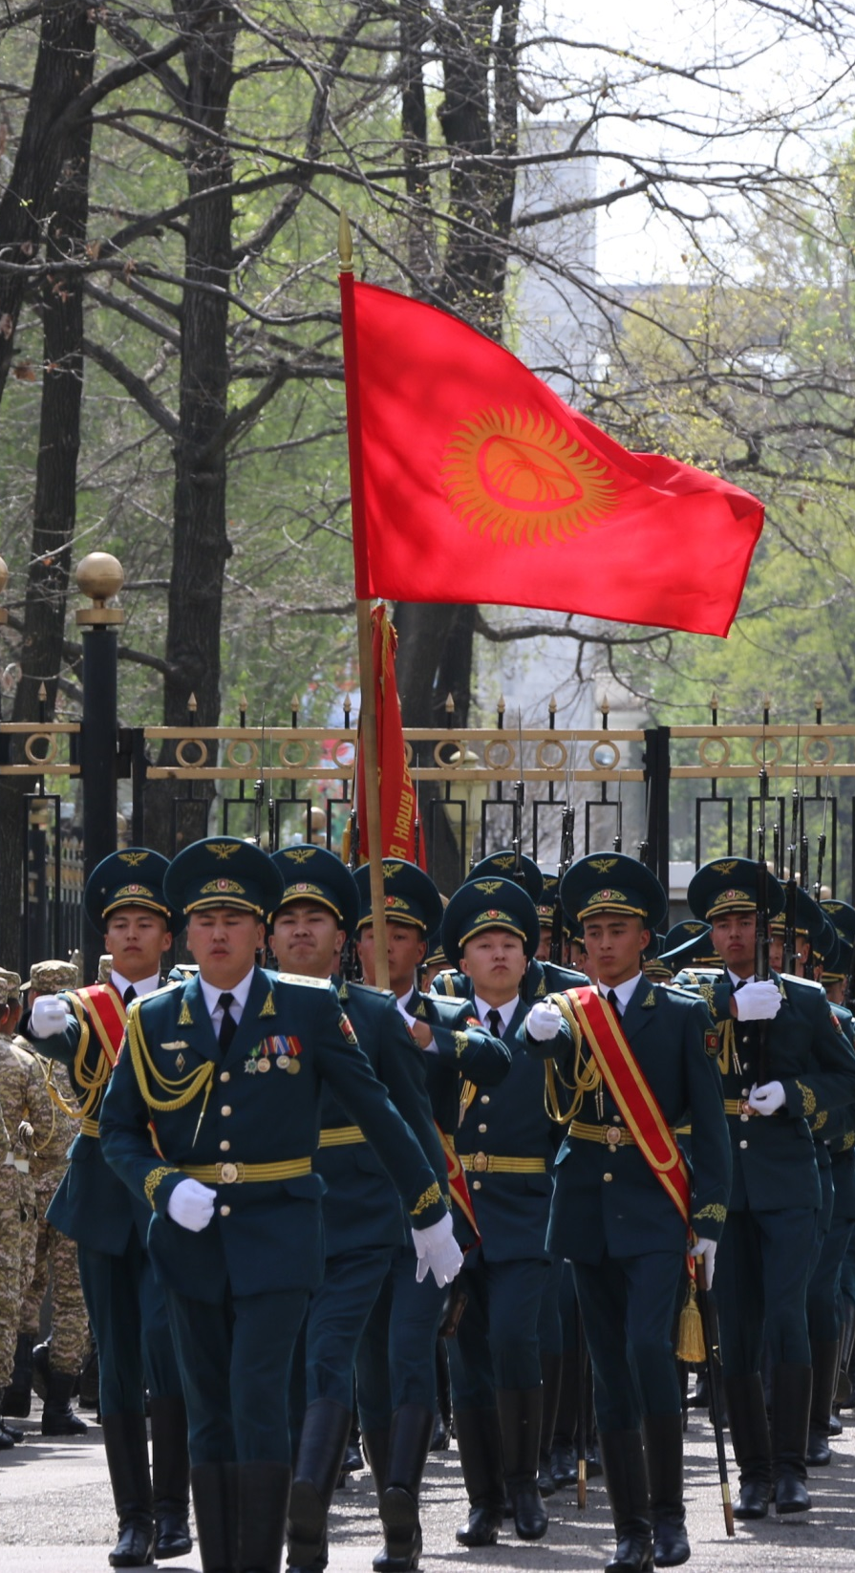

INSTITUTE FOR RESEARCH
OF PUBLIC ADMINISTRATION DEVELOPMENT
- Analytical support of state bodies, implementation of joint research and other projects;
- Conducting researches within the state order, request of state bodies and organizations;
- Development of strategic documents for the development of state bodies and reforms;
- Analysis of the quality and accessibility
of public services

Slide 12
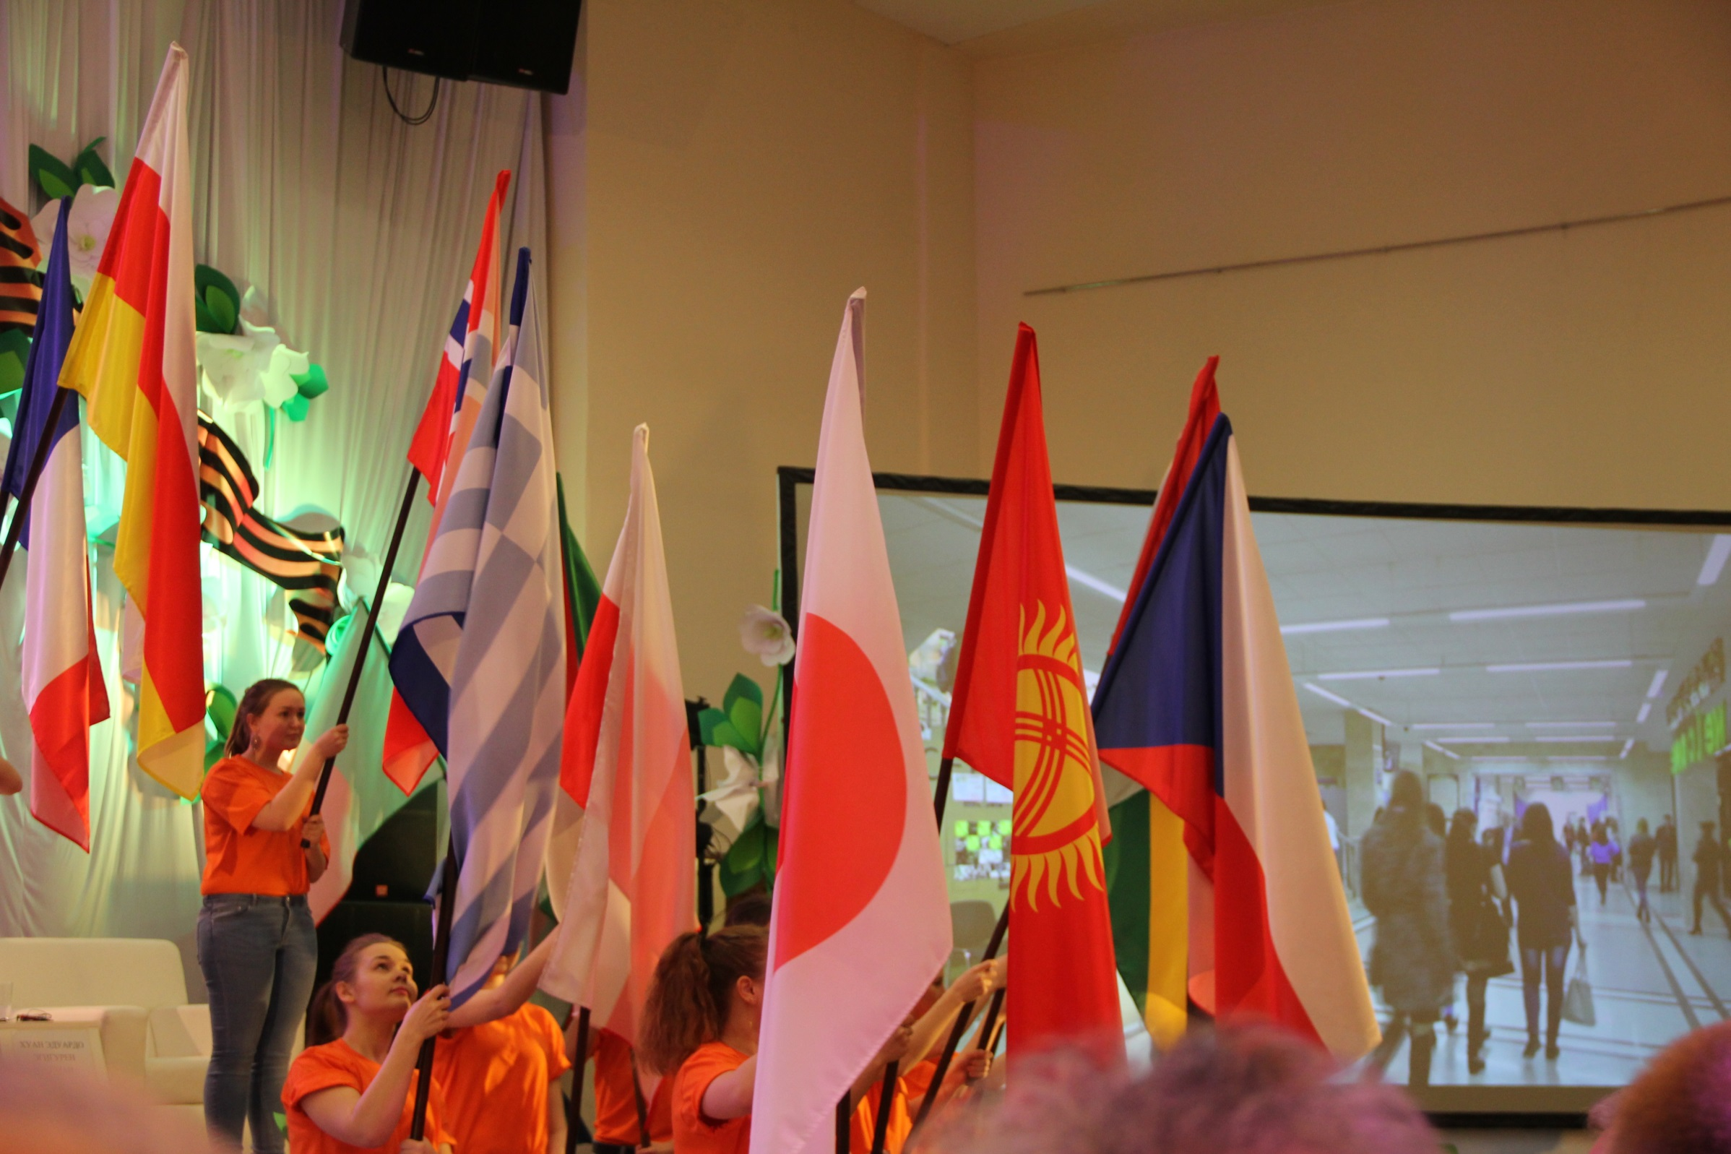
HIGHER COURSES OF ADMINISTRATION AND MANAGEMENT
Implementation of courses for training, retraining for active civil servants, organization of seminars, round tables, etc.;
Realization of the state order for training state and municipal servants;
Issue of certificates by successfully trained civil and municipal servants based on the assessment of acquired knowledge and skills;

Slide 13
DEPARTMENT OF
EDUCATION AND SCIENCE
Development of basic standards, requirements and tools for improving the academic, academic and academic activities of the Academy;
Formation of analytical materials on quality problems and formation of education;
Development of scientifically grounded basic requirements for educational, research activities of the Academy;
Organization and provision of modern information and library services for the Academy

Slide 14
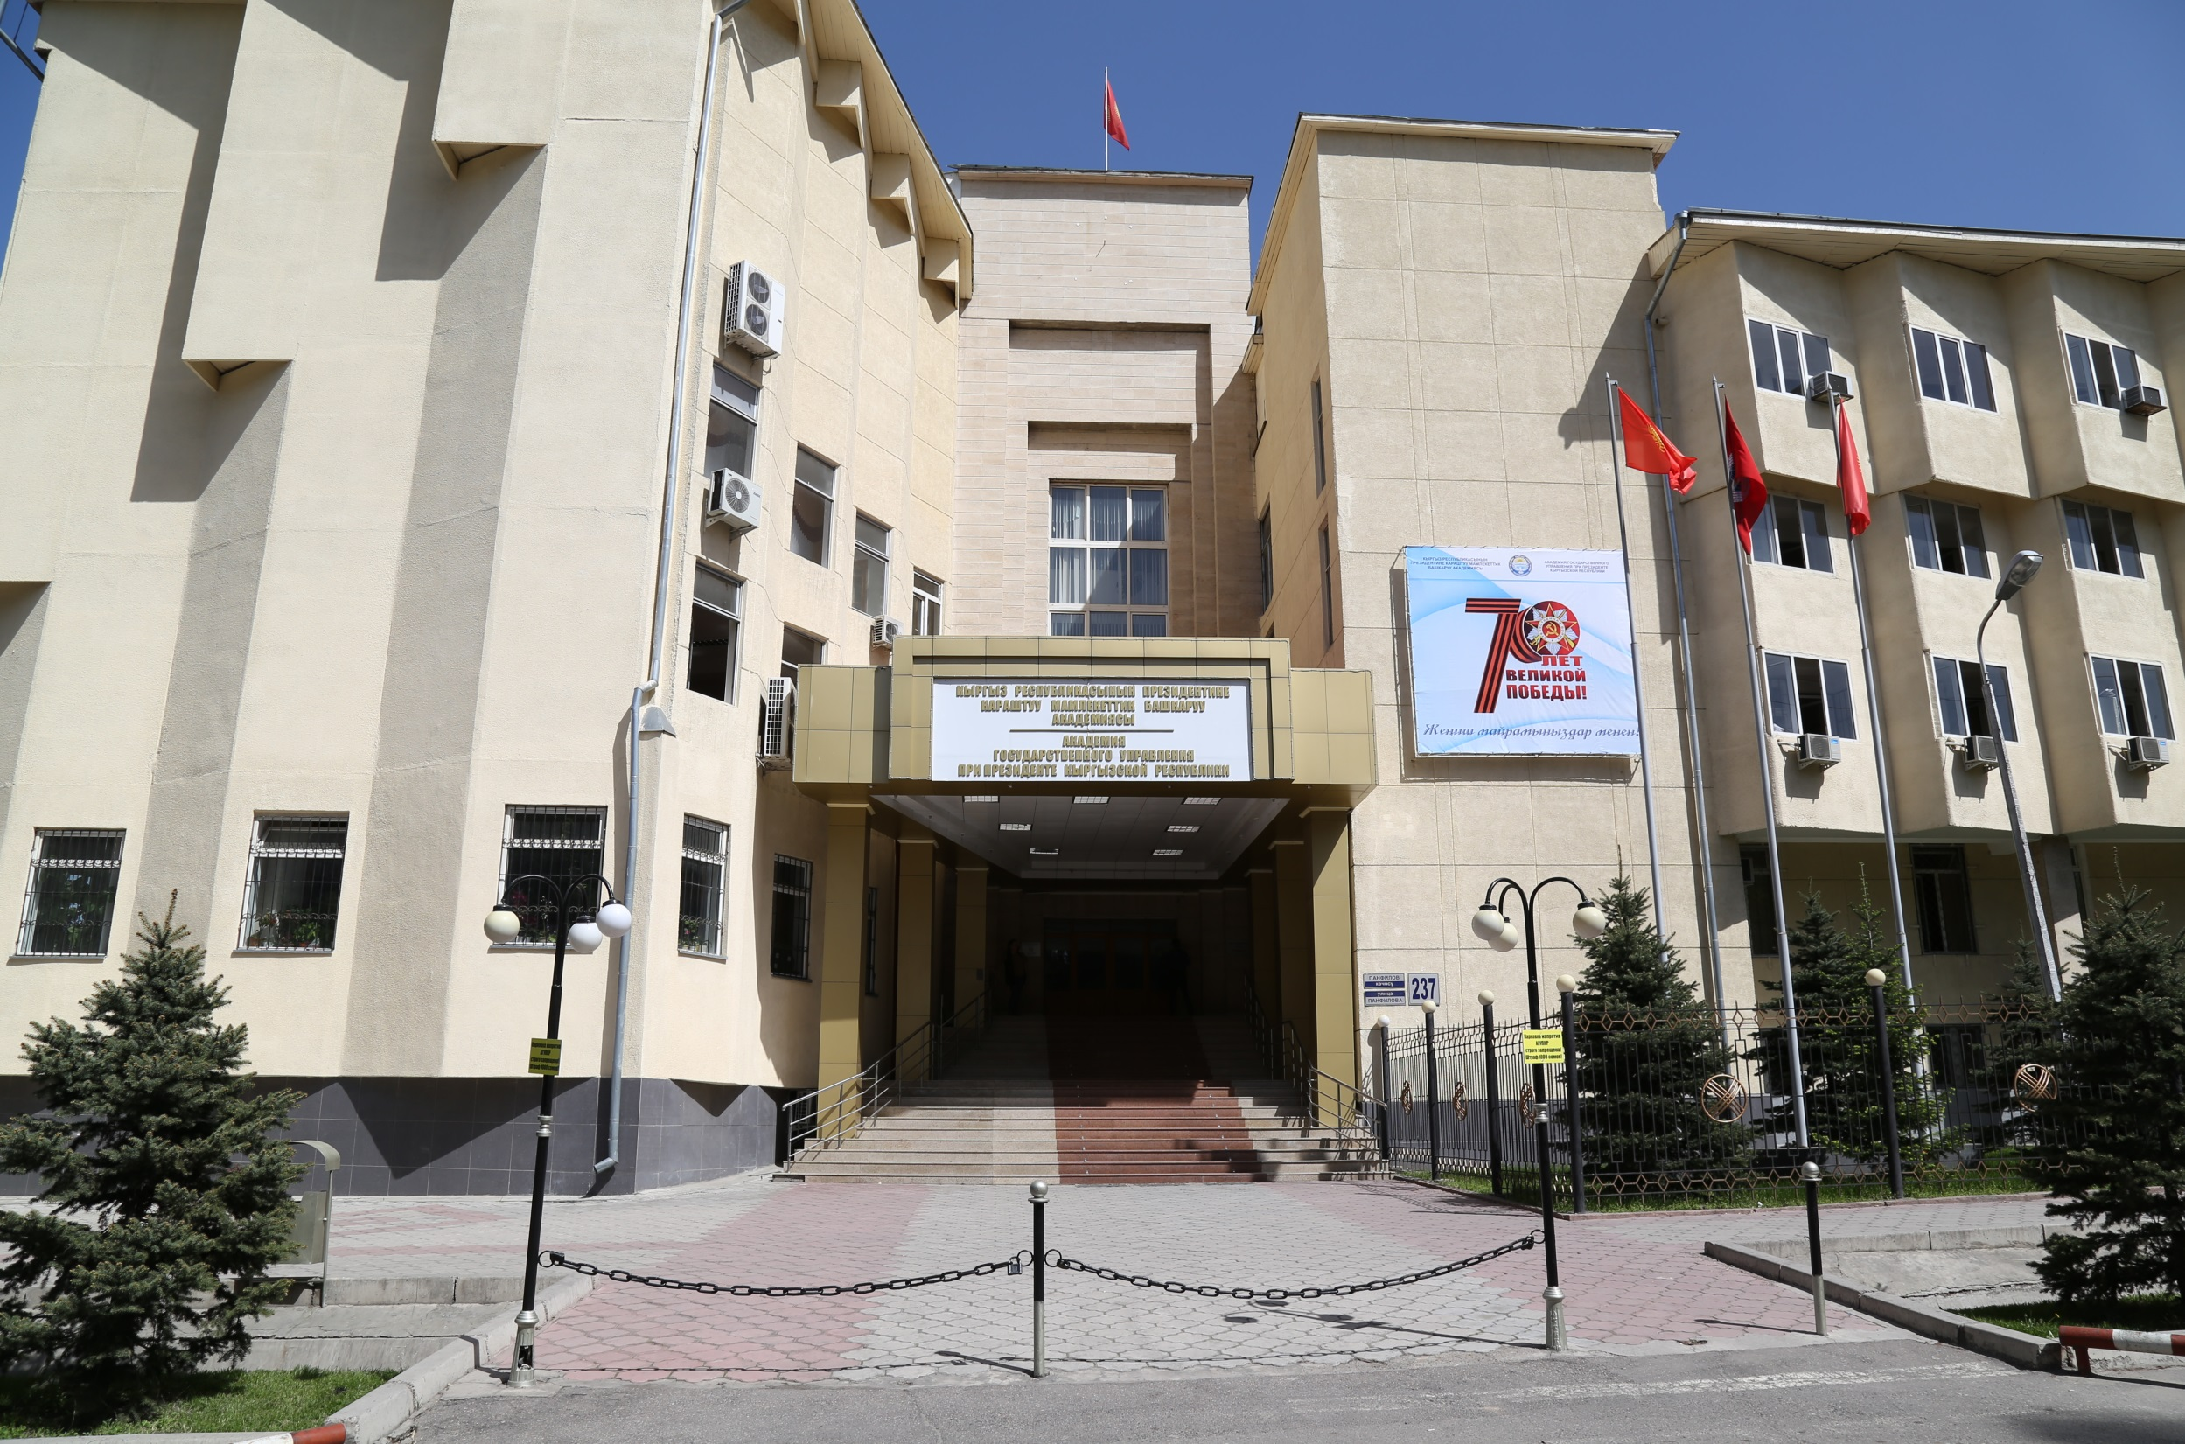
"STRONG PERSONNEL - STRONG COUNTRY!
BECOME USEFUL TO YOUR COUNTRY! "
THANK YOU
FOR YOUR ATTENTION!

Slide 15

КОШ КЕЛИҢИЗДЕР!
WELCOME TO KYRGYZSTAN!

