Slide 1
Analysis of Covid-19 data and predicting future
coronavirus cases by using Machine learning
algorithms
Uldana Zhaksybay,
Astana, 2023

Slide 2
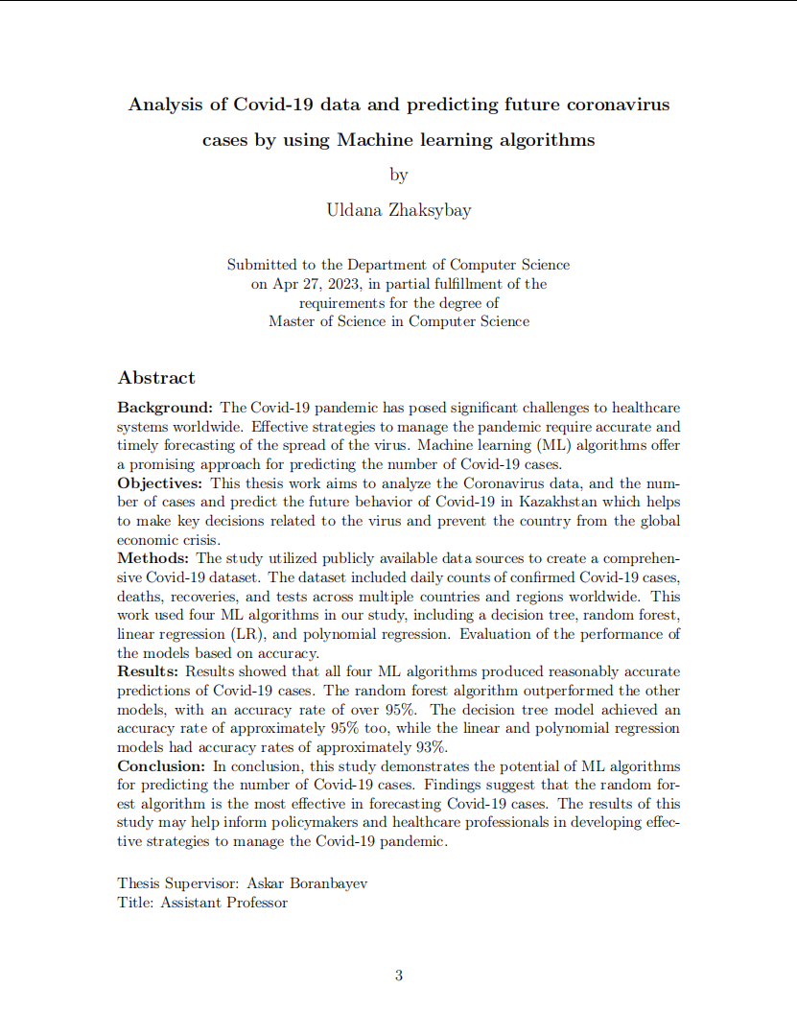
Outline
Introduction
Related works
Methodology
Results
Conclusion
References

Slide 3

Introduction - Background and context
The COVID-19 spread around the world
Detect viruses by the symptoms of patients and if it is not clear by this, RT-PCR test will be used
In Kazakhstan, the first case of Covid-19 disease was announced on 13th March 2020.
At the present time 1,393,974 cases were registered among which recovered patients are 1,379,226 and death cases are 13,692.

Slide 4
Aim of the Thesis work
This thesis work aims to analyze and implement prediction of Covid-19 future cases by looking at confirmed, recovered, and death cases datasets.
The novelty of this thesis work will be the geographical factor.
The main goal of the study is to evaluate the performance of these algorithms and identify the most accurate prediction models for forecasting Covid-19 cases.

Slide 5
Research Questions
What is the best methodology to use for the prediction of Covid-19 cases?
What kind of prediction methodologies will be used to make an analysis of coronavirus cases?
What problems may encounter when predicting the Covid-19 situation?

Slide 6
Methodology
In this thesis work, 2 types of research methodologies were used:
Systematic literature review
To answer research question 1 was made Systematic literature review
Experiment
This part answered research questions of what kind of ML algorithms used for analysis and prediction.

Slide 7
Systematic literature review
The SLR conducted several steps, which are:
Determining the keywords
Comprehensive search
Relevance
Quality assessment
Synthesizing the outcomes
Results

Slide 8


Software Toolset
Jupyter Notebook
Python
In thesis work used this kind of python libraries:
Pandas
Matplotlib
NumPy
Scikit-learn

Slide 9
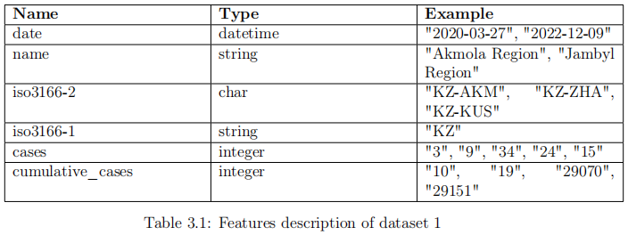
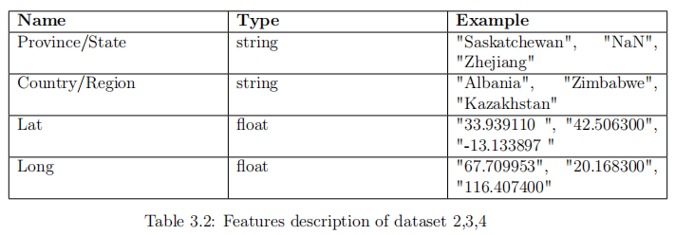
Datasets
To predict the future cases of Covd-19 were used 4 types of datasets:
cases_kazakhstan.csv
time_series_covid19_confirmed_global.csv
time_series_covid19_deaths_global.csv
time_series_covid19_recovered_global.csv

Slide 10

Data Preprocessing
Data cleaning
Data normalization
Missing values

Slide 11
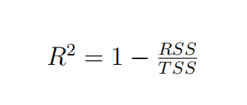
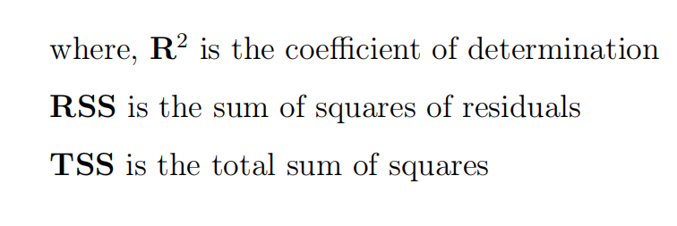
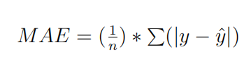
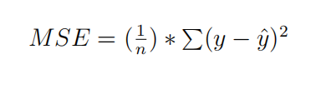
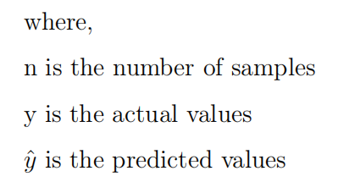
Performance metric
R-squared score (R2), also called as the coefficient of determination, is used for performing the accuracy of regression models.
Mean Absolute Error (MAE) is the average absolute difference between the predicted and actual values. It measures the average magnitude of the errors in a set of predic_x0002_tions, without considering their direction.
Mean Squared Error (MSE) is the average squared difference between the predicted and actual values. It measures the average of the squares of the errors.

Slide 12
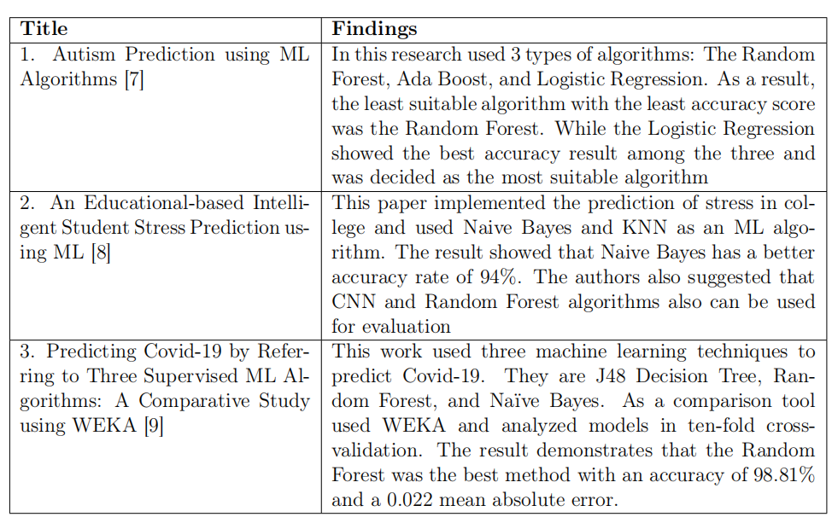
Results
Systematic Literature Review Results
Most of the papers showed the best accuracy with the Random Forest algorithm
The Decision Tree took second place by making also excellent results on evaluation metrics.
Also, some papers used regression models in their research.

Slide 13
Results of Experiment
From the literature review part, I find out which ML algorithms were mostly used for prediction tasks. After that, the four Machine learning models chosen for this experiment are:
Linear Regression
Polynomial Regression
Random Forest
Decision Tree
The above mentioned algorithms were trained and tested with a dataset that was collected and the results were performed.
The dataset of Covid-19 cases by region performed data visualization for a better understanding of the coronavirus situation in Kazakhstan.

Slide 14
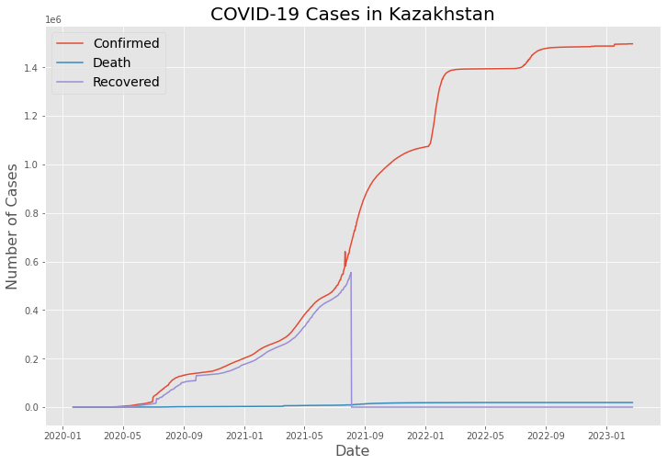
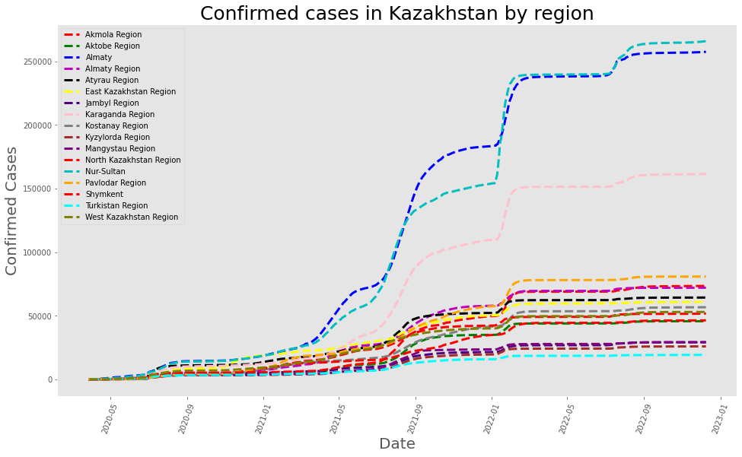
Data Visualization

Slide 15
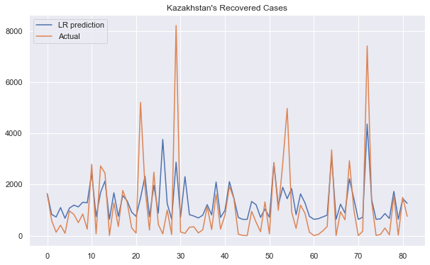
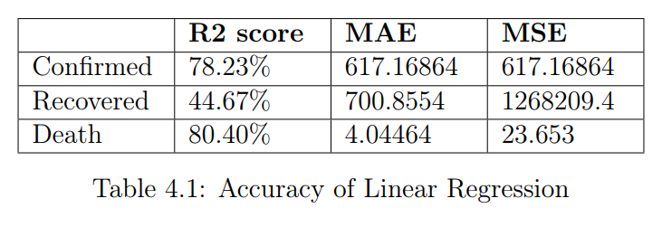
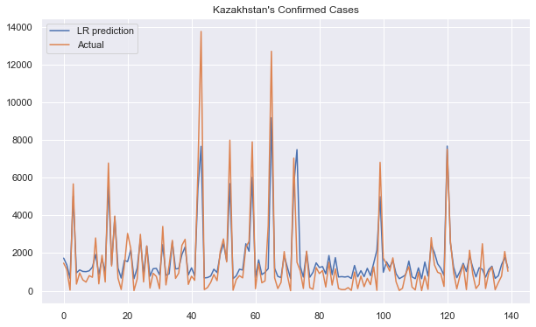
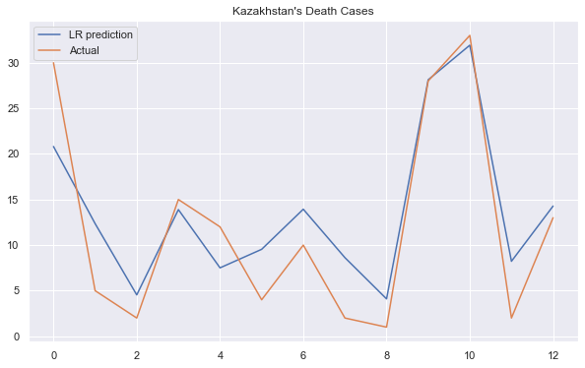
Linear Regression

Slide 16
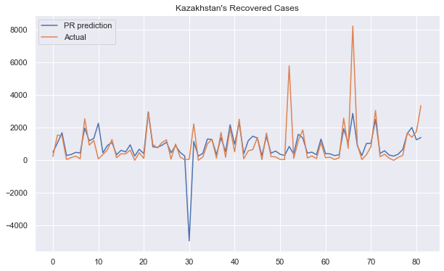
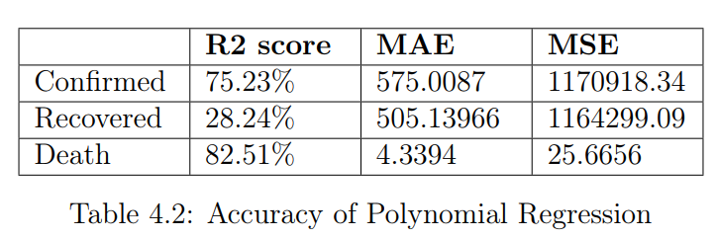
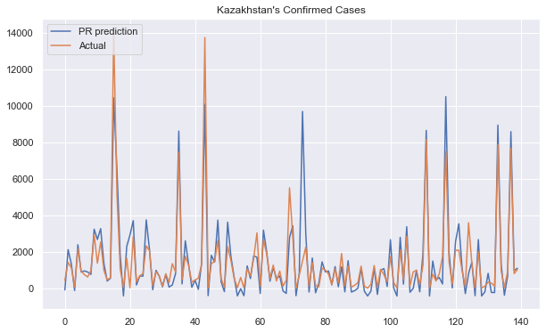
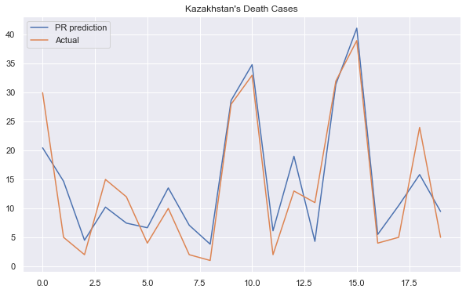
Polynomial Regression

Slide 17
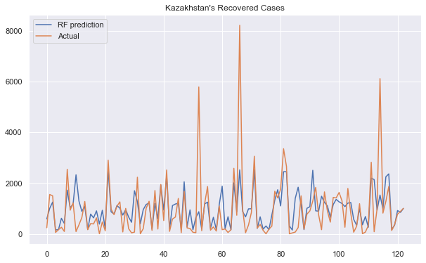
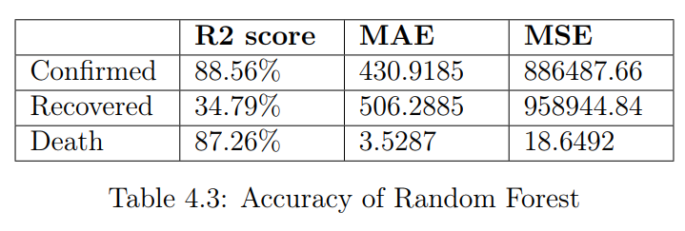
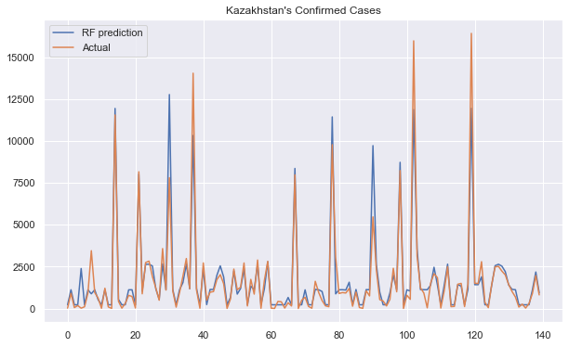
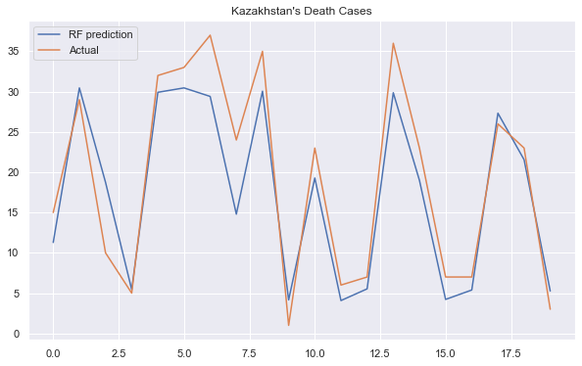
Random Forest

Slide 18
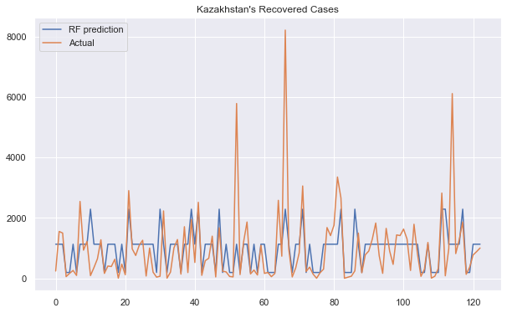
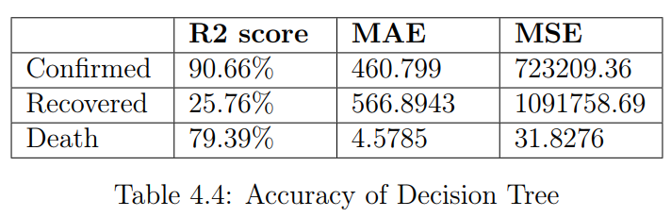
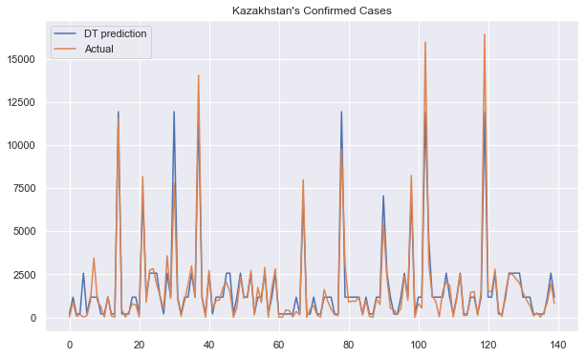
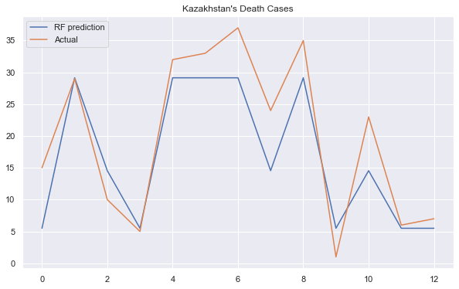
Decision Tree

Slide 19
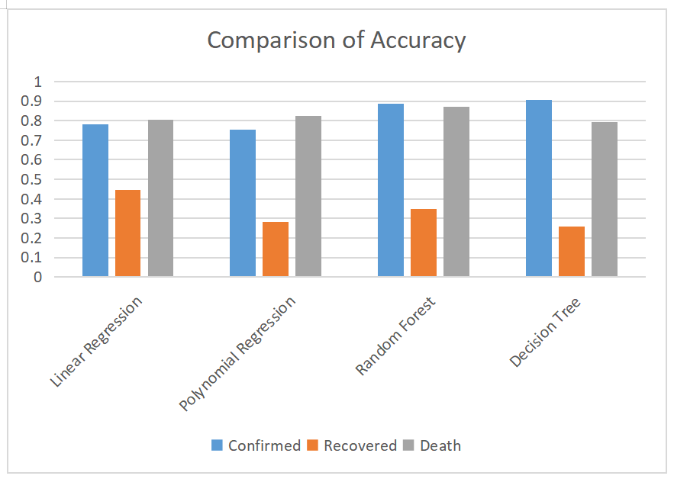
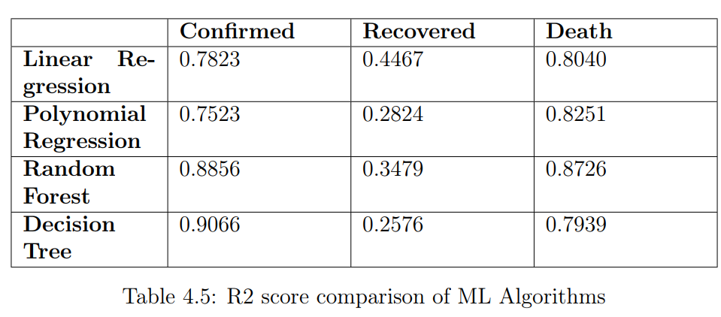
Comparison of Results

Slide 20
Limitations and problems
Data availability: Most of the datasets do not contain Covid-19 information in
Kazakhstan. Because of the little amount of data the prediction model could not be very accurate.
Data quality: The recovered cases dataset does not contain any information
after 8th May 2021, because of that while training and testing the models, they
performed results that are not accurate.
Model complexity: At the first stages it was hard to understand how some of
the Machine Learning algorithms work and what type of evaluation metrics to
use.

Slide 21
Conclusion
The thesis work has been conducted Systematic Literature Review to find the most suitable Machine Learning algorithm for the prediction of Covid-19 cases.
After understanding and analyzing the other papers related to prediction, Linear and Polynomial Regression, Random Forest, and Decision Tree algorithms were chosen for the experiment.
As a result, Random Forest and Decision Tree showed the highest accuracy among other algorithms.
Overall, this thesis demonstrates the potential of machine learning algorithms in
analyzing and predicting COVID-19 cases and provides valuable insights for future
research and public health efforts.

Slide 22
Future work
For future work, there are several areas that could be explored:
Firstly, it may be beneficial to explore the use of more advanced machine learning techniques, such as deep learning and neural networks, which may be better suited to handling complex and nonlinear relationships in the data.
Secondly, it may be worthwhile to investigate the use of ensemble methods, which combine multiple machine learning models to improve prediction accuracy.

Slide 23
Bibliography
[1] A. Panthakkan, S. M. Anzar, S. A. Mansoori and H. A. Ahmad, "Accurate Prediction of COVID-19 (+) Using AI Deep VGG16 Model," 2020 3rd International
Conference on Signal Processing and Information Security (ICSPIS), DUBAI, United Arab Emirates, 2020, pp. 1-4, doi: 10.1109/ICSPIS51252.2020.9340145.
[2] E. Elbasi, S. Mathew, A. E. Topcu and W. Abdelbaki, "A Survey on Machine Learning and Internet of Things for COVID-19," 2021 IEEE World AI
IoT Congress (AIIoT), Seattle, WA, USA, 2021, pp. 0115-0120, doi: 10.1109/AIIoT52608.2021.9454241.
[3] S. Shaikh, J. Gala, A. Jain, S. Advani, S. Jaidhara and M. Roja Edinburgh, "Analysis and Prediction of COVID-19 using Regression Models and Time Series Forecasting," 2021 11th International Conference on Cloud Computing, Data Science & Engineering (Confluence), Noida, India, 2021, pp. 989-995, doi: 10.1109/Confluence51648.2021.9377137.
[4] A. Saini, A. S. Kumar, S. J. N. Kumar and M. U, "Analysis And Implementation of a Novel AI-Based Hybrid Model for Detecting, Predicting and Identification Of COVID-19 Spread," 2021 3rd International Conference on Advances in Computing, Communication Control and Networking (ICAC3N), Greater Noida, India,
2021, pp. 2059-2064, doi: 10.1109/ICAC3N53548.2021.9725778.
[5] A. Chitturi, R. J. Pandya and S. Iyer, "AI-Enabled Covid-19 Prediction Methods and Anti-Covid Strategies," 2022 IEEE International Conference on Distributed Computing and Electrical Circuits and Electronics (ICDCECE), Ballari, India, 2022, pp. 1-5, doi: 10.1109/ICDCECE53908.2022.9792761.
[6] S. Bodapati, H. Bandarupally and M. Trupthi, "COVID-19 Time Series Forecasting of Daily Cases, Deaths Caused and Recovered Cases using Long Short Term Memory Networks," 2020 IEEE 5th International Conference on Computing Com
munication and Automation (ICCCA), Greater Noida, India, 2020, pp. 525-530, doi: 10.1109/ICCCA49541.2020.9250863.
[7] 1.K. S. Tejaswi, K. Meghavarshini and P. Nivedhitha, "Autism Prediction using ML Algorithms," 2022 1st International Conference on Computational
Science and Technology (ICCST), CHENNAI, India, 2022, pp. 1-6, doi: 10.1109/ICCST55948.2022.10040300.
[8] 2.S. Sinha and S. R, "An Educational based Intelligent Student Stress Prediction using ML," 2022 3rd International Conference for Emerging Technology (INCET), Belgaum, India, 2022, pp. 1-7, doi: 10.1109/INCET54531.2022.9824636.
[9] 3.K. Kansal and S. Maitrey, "Predicting Covid-19 by Referring Three Supervised ML Algorithms: A Comparative Study using WEKA," 2022 International Con
ference on Applied Artificial Intelligence and Computing (ICAAIC), Salem, India, 2022, pp. 649-655, doi: 10.1109/ICAAIC53929.2022.9792998.
[10] M. Omkar and K. Nimala, "Machine Learning based Diabetes Prediction using with AWS cloud," 2022 International Conference on Innovative Computing, Intelligent Communication and Smart Electrical Systems (ICSES), Chennai, India, 2022, pp. 1-7, doi: 10.1109/ICSES55317.2022.9914160.
[11] 5.K. Boussaoud, M. Ayache and A. En-Nouaary, "Performance Evaluation of Supervised ML Algorithms for Elephant Flow Detection in SDN," 2022 8th In
ternational Conference on Optimization and Applications (ICOA), Genoa, Italy, 2022, pp. 1-6, doi: 10.1109/ICOA55659.2022.9934652.
[12] 7.A. Saini, A. S. Kumar, S. J. N. Kumar and M. U, "Analysis And Implementation of a Novel AI-Based Hybrid Model for Detecting, Predicting and Identifi
cation Of COVID-19 Spread," 2021 3rd International Conference on Advances in Computing, Communication Control and Networking (ICAC3N), Greater Noida,
India, 2021, pp. 2059-2064, doi: 10.1109/ICAC3N53548.2021.9725778.
[13] 10.Nikhil, A. Saini, S. Panday and N. Gupta, "Polynomial Based Linear Regression Model to Predict COVID-19 Cases," 2021 International Conference on Recent Trends on Electronics, Information, Communication Technology (RTEICT), Bangalore, India, 2021, pp. 66-69, doi:10.1109/RTEICT52294.2021.9574032.
[14] 11.Y. Dubey, P. Wankhede, T. Borkar, A. Borkar and K. Mitra, "Diabetes Prediction and Classification using Machine Learning Algorithms," 2021 IEEE In
ternational Conference on Biomedical Engineering, Computer and Information Technology for Health (BECITHCON), Dhaka, Bangladesh, 2021, pp. 60-63, doi:
10.1109/BECITHCON54710.2021.9893653.
[15] 12.X. Song, "Prediction of People’s Abnormal Behaviors Based on Machine Learning Algorithms," 2022 International Conference on Machine Learning and
Intelligent Systems Engineering (MLISE), Guangzhou, China, 2022, pp. 406-409, doi: 10.1109/MLISE57402.2022.00087.
[16] 13.S. Bhardwaj, H. Bhardwaj, J. Bhardwaj and P. Gupta, "Global Prediction of COVID-19 Cases and Deaths using Machine Learning," 2021 Sixth International Conference on Image Information Processing (ICIIP), Shimla, India, 2021, pp. 422-426, doi: 10.1109/ICIIP53038.2021.9702560.
[17] 14.J. Varshitha, K. Jahnavi and C. Lakshmi, "Prediction Of Used Car Prices Using Artificial Neural Networks And Machine Learning," 2022 International Conference on Computer Communication and Informatics (ICCCI), Coimbatore, India, 2022, pp. 1-4, doi: 10.1109/ICCCI54379.2022.9740817.
[18] 15.N. Mohan, V. Jain and G. Agrawal, "Heart Disease Prediction Using Supervised Machine Learning Algorithms," 2021 5th International Conference on Information Systems and Computer Networks (ISCON), Mathura, India, 2021,pp. 1-3, doi: 10.1109/ISCON52037.2021.9702314.

Slide 24
Thank you for your attention!

