Slide 1
Powder mixed EDM for biomedical alloys
Nurlan Nauryz
2nd Year Master in Mechanical and Aerospace Engineering
Supervisor: Assistant Professor Asma Perveen
Co-Supervisor: Associate Professor Didier Talamona

Slide 2
Outline
Introduction
Literature review
Methodology
Results
Conclusion
References
1
2
3
4
5
6

Slide 3
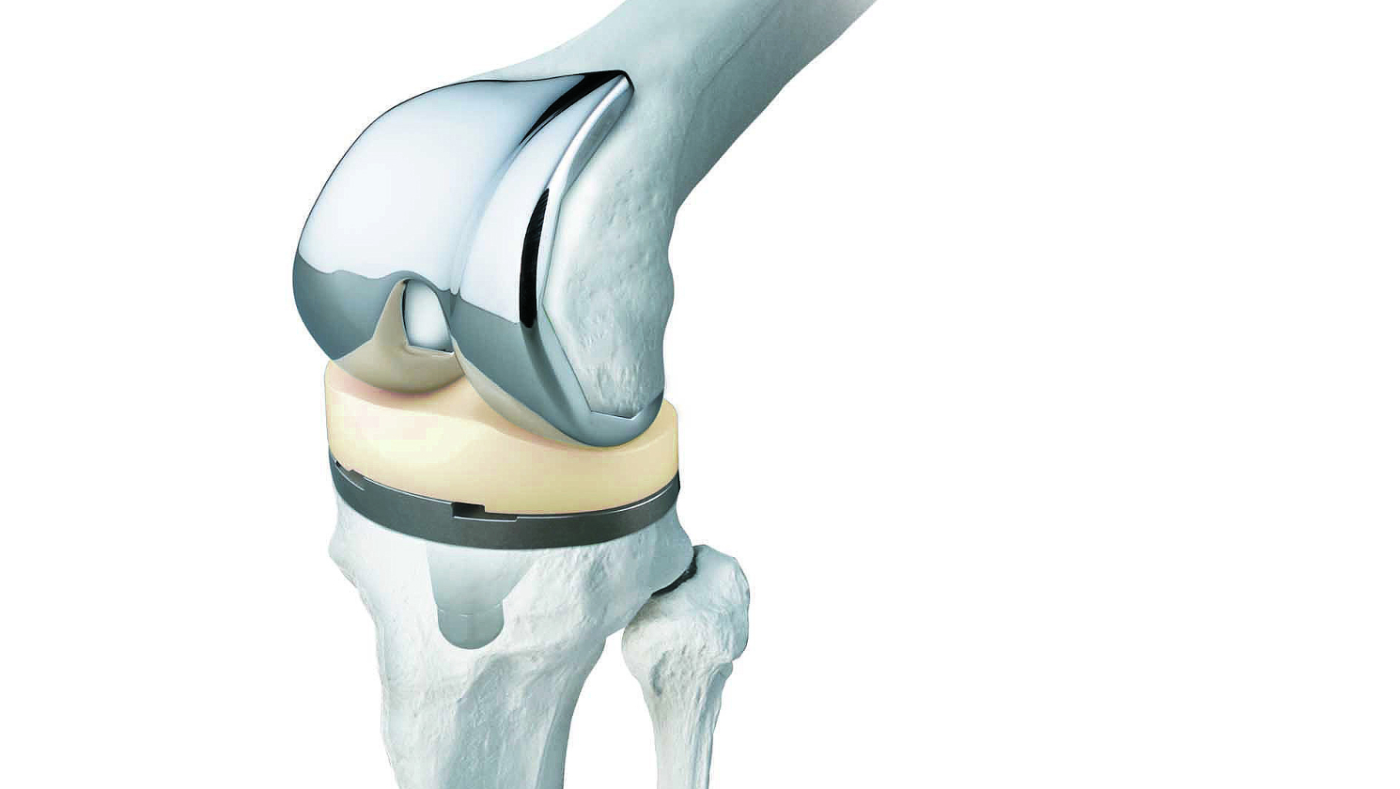
Introduction
Area of application
Biomedical alloys [1,2]
Fractured, lost or diseased parts (bone, teeth, ligaments, and heart) [3]
Bio implants
Problem Statement
Existing coating techniques have some demerits [4,5]:
Nonuniform and thin coating
Unable to generate a nanoporous layer
Cannot shape and coat simultaneously

Slide 4
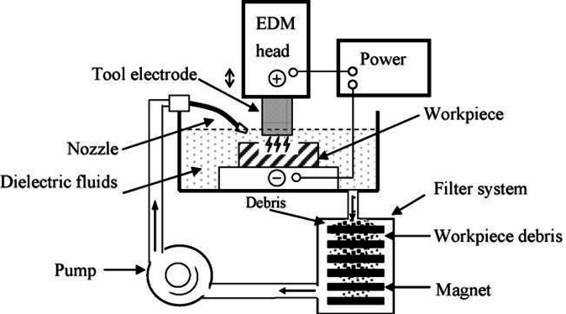
Introduction
Electrical Discharge Machining (EDM)
A desired shape is obtained by using electrical discharge (spark).
Spark machining, spark eroding, die sinking, wire erosion
No contact between the workpiece and the tool.
Advantages:
absence of a cutting force
flexibility of machining
EDM schematics [6]

Slide 5
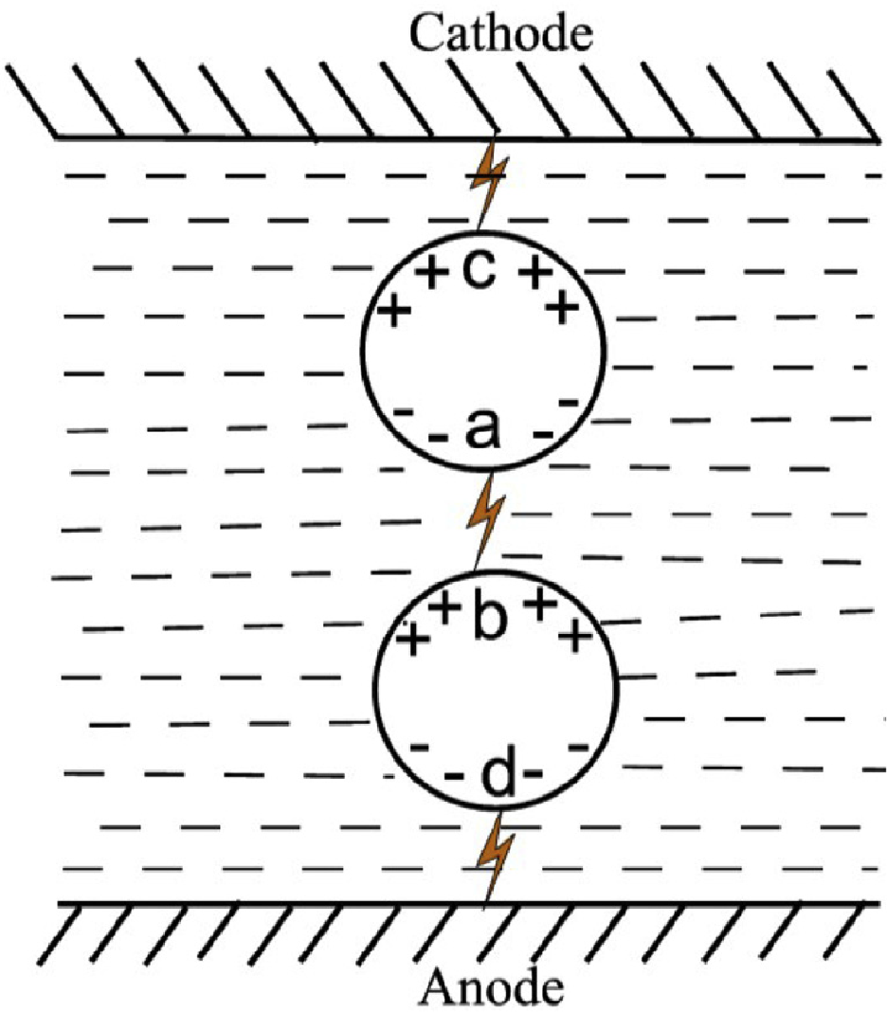
Introduction
Powder mixed EDM
Increases inter electrode gap
Decreases insulating strength of dielectric
Increase in material removal rate
Powder in dielectric [7]

Slide 6
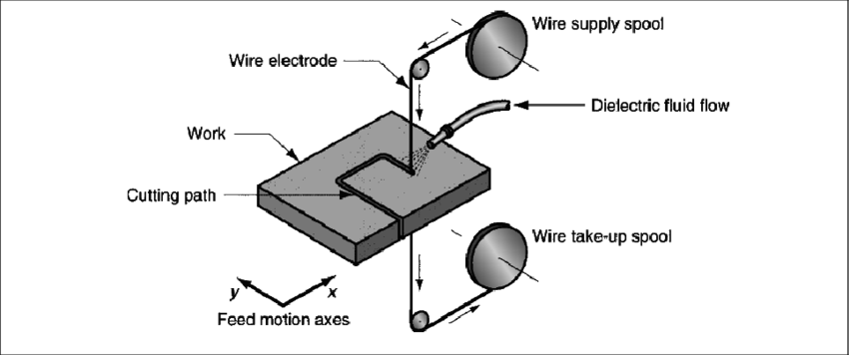
Introduction
Wire EDM
Cut internal corners with very small radii.
Consistent accuracy of the cutting tool

Slide 7

Introduction
Aim
PMEDM machining performance on Ti-6Al-4V
Objectives:
To examine the macro-EDM machining performance with and without the addition of the hydroxyapatite powder into the dielectric fluid for Ti-6Al-4V.
To examine the micro-EDM machining performance with and without the addition of hydroxyapatite powder into the dielectric fluid.
To examine the bacterial attachment and adhesion after PM wire EDM treatment.

Slide 8
Literature review
Authors | Key findings
Tanjilul et al. (2018) [6] | Novel debris removal method, with simultaneous flushing and vacuum for drilling EDM Reduction in machining time and surface roughness improvement
Abu et al. (2018) [8] | Review on machining titanium alloys with several EDM methods Summary on theoretical and experimental EDM investigations targeted at enhancing process efficiency
Kumar et al. (2018) [9] | Various methods, such as introducing cryogenic cooled electrode, addition of magnetic field to the sparking zone and imparting electrode rotation to EDM Optimization of process parameters showed enhancement in material removal rate up to 44% and resulted in the increase of the surface roughness to 51% in comparison with the standard EDM technique
Mohanty et al. (2019) [10] | Used the powder mixed micro-EDM technique to make a firm and solid-lubricating coating on a surface of a Ti6Al4V work piece Improvement in micro-hardness, thickness of recast layer and wear rate

Slide 9
Methodology: Macro EDM
Equipment setup | Description
Machine | Drilling EDM DD703.30A
Tool electrode | Tubular brass electrode
Workpiece | Ti-6Al-4V alloy
Polarity | Tool (+), Workpiece (-)
Dielectric | Deionized water
Experiments on macro EDM conducted on Ti-6Al-4V alloy workpieces
Orthogonal array with 4 parameters in 3 dimensions
Parameters include pulse current, time-on, time-off, and gap voltage
It was repeated 3 times
Same procedure was repeated for 5 g/l hydroxyapatite powder addition
No. exp. | Discharge current | Time-on | Time-off | Gap voltage
1 | 2 | 2 | 2 | 2
2 | 2 | 5 | 5 | 5
3 | 2 | 8 | 8 | 8
4 | 5 | 2 | 5 | 8
5 | 5 | 5 | 8 | 2
6 | 5 | 8 | 2 | 5
7 | 8 | 2 | 8 | 5
8 | 8 | 5 | 2 | 8
9 | 8 | 8 | 5 | 2

Slide 10
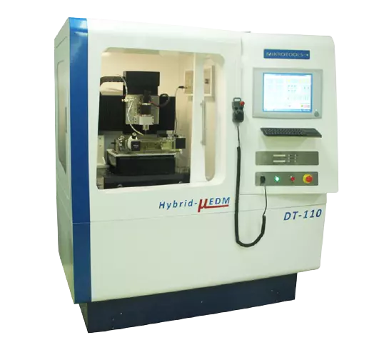
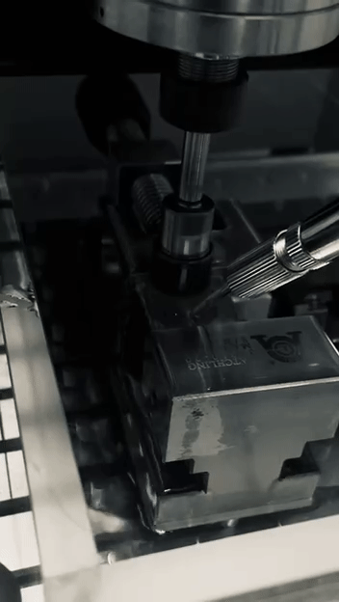
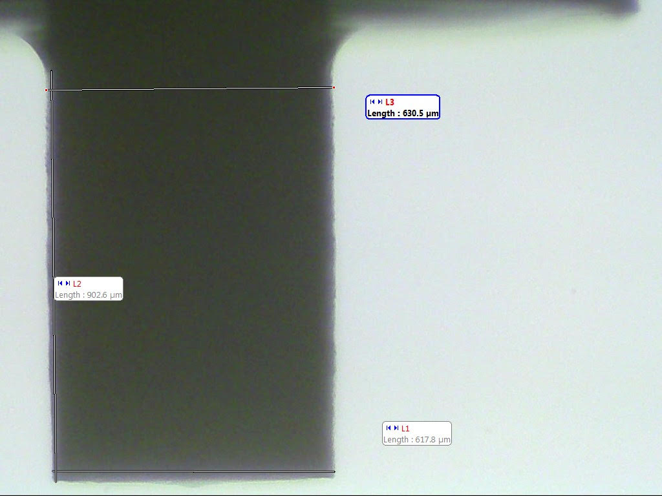
Methodology: Micro EDM
Capacitance | Voltage [V] | Powder concentration [g/l]
100 pF | 90 | 0
100 pF | 90 | 0
100 pF | 90 | 0
100 pF | 100 | 5
100 pF | 100 | 5
100 pF | 100 | 5
100 pF | 110 | 10
100 pF | 110 | 10
100 pF | 110 | 10
1 nF | 90 | 5
1 nF | 90 | 5
1 nF | 90 | 5
1 nF | 100 | 10
1 nF | 100 | 10
1 nF | 100 | 10
1 nF | 110 | 0
1 nF | 110 | 0
1 nF | 110 | 0
10 nF | 90 | 10
10 nF | 90 | 10
10 nF | 90 | 10
10 nF | 100 | 0
10 nF | 100 | 0
10 nF | 100 | 0
10 nF | 110 | 5
10 nF | 110 | 5
10 nF | 110 | 5
Experimental study was conducted on Hybrid DT-110 μEDM Machine
Orthogonal array with 3 parameters in 3 dimensions
Capacitance and voltage settings were divided into 3 levels each (100 pF, 1 nF, and 10 nF for capacitance; 90 V, 100 V, and 110 V for voltage).
Each experimental trial was conducted using a 0.03 mm/min feed, with the aim of machining 0.050 mm in depth
Tungsten carbide electrode diameter tool was decreased from 2 mm to 0.62mm using micro turning tool

Slide 11
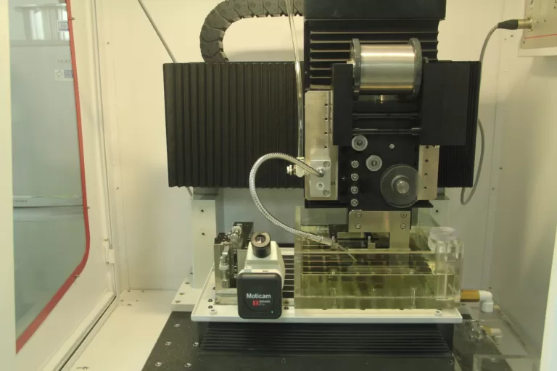
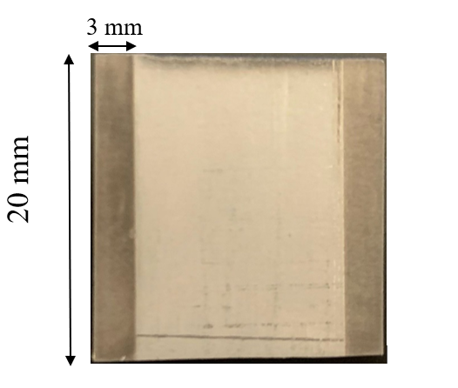
Methodology: Wire EDM
Experimental study was conducted on Hybrid DT-110 μEDM Machine
50-µm diameter tungsten wire to cut 3x20x0.025 mm dimensions on both sides of 9 titanium plates
Three discharge energy values: low (100 pF and 90 V), medium (1 nF and 100 V), and high (10 nF and 110 V)

Slide 12
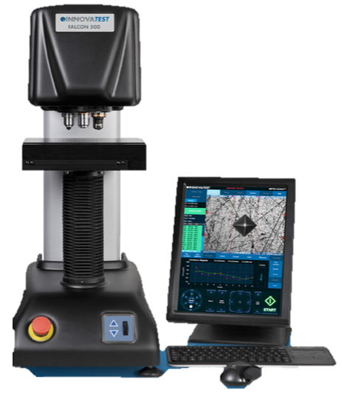
Methodology: Hardness test
Falcon 300 hardness tester used to investigate hardness of Micro EDM machined samples
Vickers 200 g with 10-second dwelling time used for hardness value acquisition
Three measurements conducted for each of the 27 experiments to ensure comprehensive statistical dataset

Slide 13
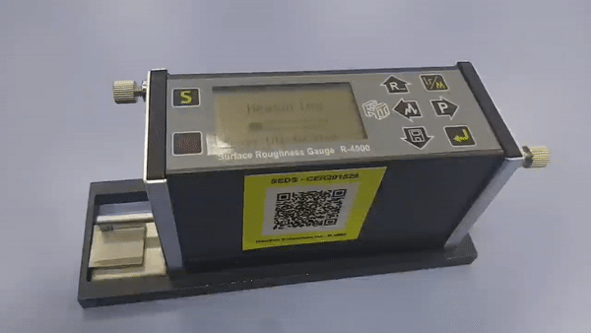
Methodology: Surface roughness
A Portable Surface Roughness Gauge was used for the measurements of micro Wire EDM machined samples
Experiments for each parameter combination was repeated 3 times
The height of the probe position was calibrated using the built-in leveling indicator of the Portable Surface Roughness Gauge

Slide 14
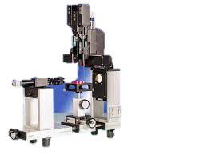
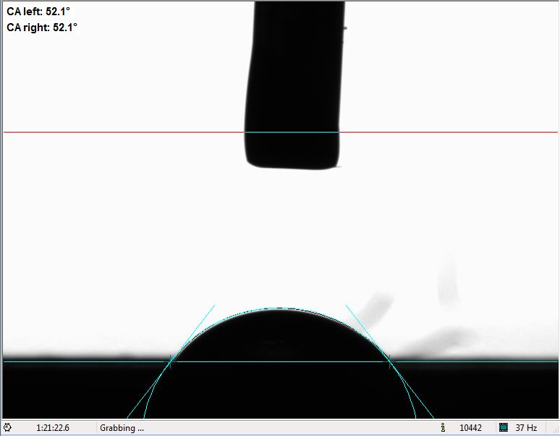
Methodology: Contact angle
Contact angle measurements were conducted using OCA 25 contact angle measurement machine
The sessile drop method was employed for contact angle measurement
Overall, 27 experiments were performed, with three experiments for each combination of input parameters
Deionized water was utilized as the liquid for contact angle measurements

Slide 15
Bacterial attachment
Antibacterial efficacy of Ti-6Al-4V against S. aureus and E. coli
Fresh 24-hour liquid culture of each bacterial species was used to obtain an initial optical density of 0.1.
Each metal piece was suspended in a separate 50 mL Falcon tube and was incubated at 37°C and 220 RPM for 48 hours.
Samples were stained with crystal violet dye and rinsed three times with distilled water
Biofilm coverage was quantified using custom written MatLab code
Metals were sterilized using 30% acetic acid, 70% ethanol, and UV light before each biofilm formation test.

Slide 16
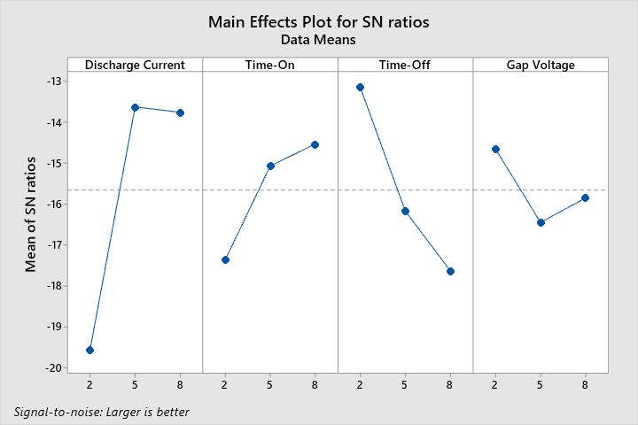
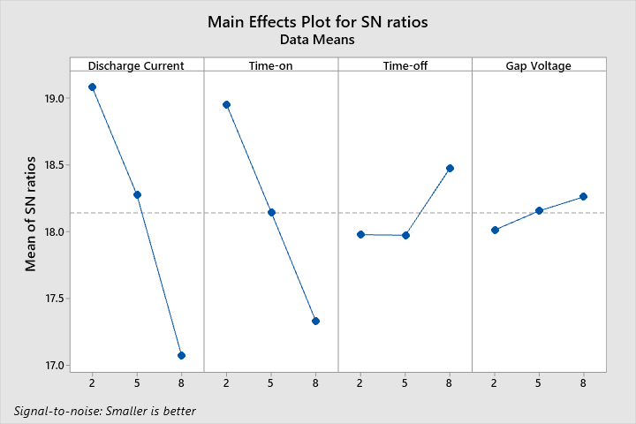
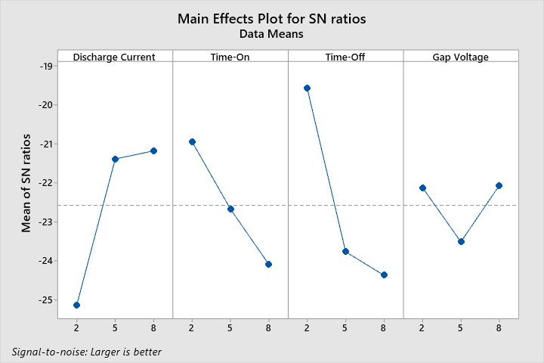
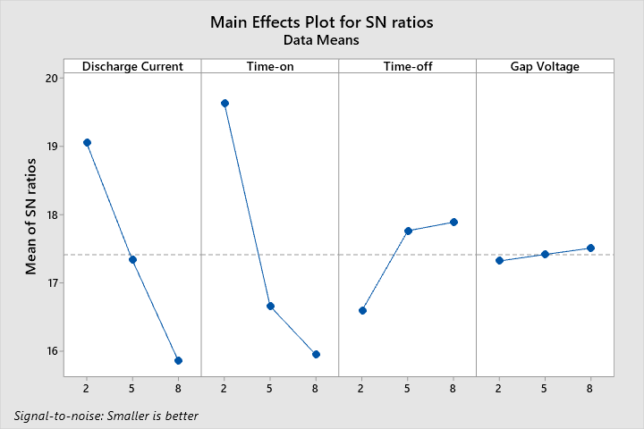
Results: Macro EDM (MRR and Overcut)
Mean of SN ratios for MRR versus Discharge current, Time-on, Time-off, Gap voltage for 0 and 5 g/l concentration
Mean of SN ratios for Overcut versus Discharge current, Time-on, Time-off, Gap voltage for 0 and 5 g/l concentration

Slide 17
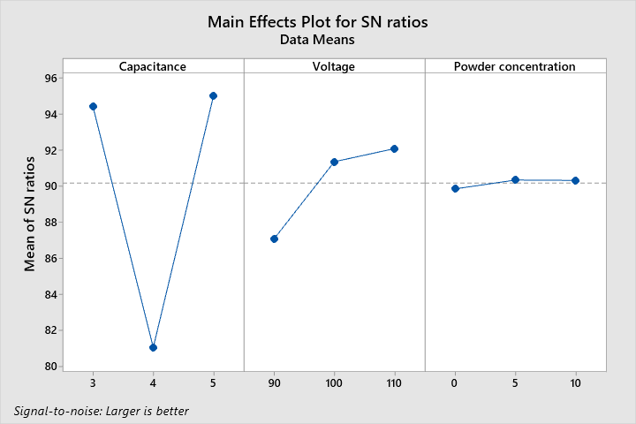
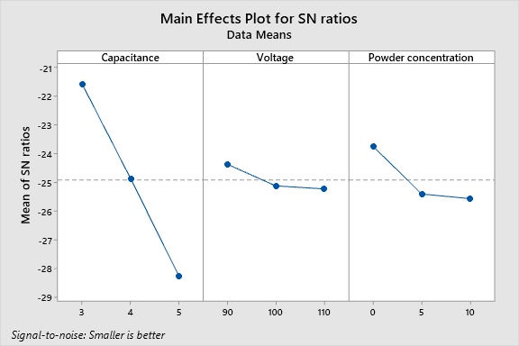
Results: Micro EDM (MRR and Overcut)
Mean of SN ratios for MRR versus Capacitance, Voltage, and Powder Concentration
Mean of SN ratios for Overcut versus Capacitance, Voltage, and Powder Concentration

Slide 18
Results: Micro EDM (Optical microscope)
Optical microscope captures of micro-EDM treated Ti-6Al-4V holes for different discharge energies
Tungsten carbide electrode tool
Constant electrode rotational speed of 1000 rpm
a) 0.405 µJ
b) 0.5 µJ
c) 0.605 µJ
d) 4.05 µJ
e) 5 µJ
f) 6.05 µJ
g) 40.5 µJ
h) 50 µJ
i) 60.5 µJ

Slide 19

Results: SEM images of Micro EDM treated samples
SEM captures for different discharge energies for micro-EDM of Ti-6Al-4V
Tungsten carbide electrode tool
a) 0.405 µJ
b) 0.5 µJ
c) 0.605 µJ
d) 4.05 µJ
e) 5 µJ
f) 6.05 µJ
g) 40.5 µJ
h) 50 µJ
i) 60.5 µJ

Slide 20
Results: EDS analysis (Micro EDM)
Element | Line | Mass% | Atom%
Al | K | 2.87±0.01 | 6.00±0.02
P | K | 0.18±0.00 | 0.33±0.01
Ca | K | 0.02±0.00 | 0.03±0.00
Ti | K | 70.46±0.04 | 82.9±0.05
V | K | 3.15±0.01 | 3.49±0.01
Co | K | 0.17±0.01 | 0.16±0.01
W | M | 23.14±0.04 | 7.09±0.01
Total |  | 100 | 100
 |  | Fitting ratio 0.0450
Ti-6Al-4V alloy used had 90 wt.% Ti, 6 wt.% Al, 4 wt.% V, 0.2 wt.% O, and 0.05 wt.% N.
Material transfer was observed from tungsten carbide electrode and hydroxyapatite powder in dielectric.
Tungsten was identified from electrode and calcium and phosphorus from hydroxyapatite powder.
.
Element | Line | Mass% | Atom%
Al | K | 5.7±0.01 | 9.65±0.02
Ti | K | 89.45±0.04 | 85.19±0.04
V | K | 3.82±0.01 | 3.42±0.01
Na | K | 0.64±0.01 | 1.26±0.01
Cl | K | 0.29±0.00 | 0.38±0.00
K | K | 0.10±0.00 | 0.11±0.00
Total |  | 100 | 100
 |  | Fitting ratio 0.0073

Slide 21
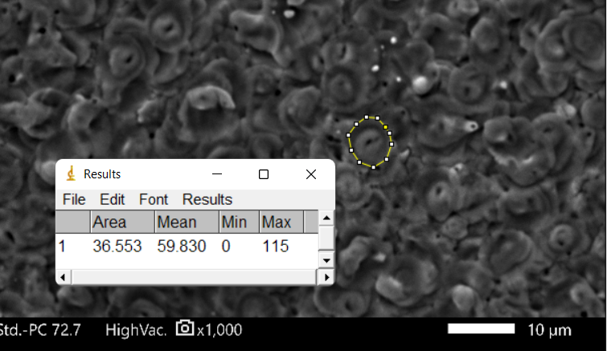
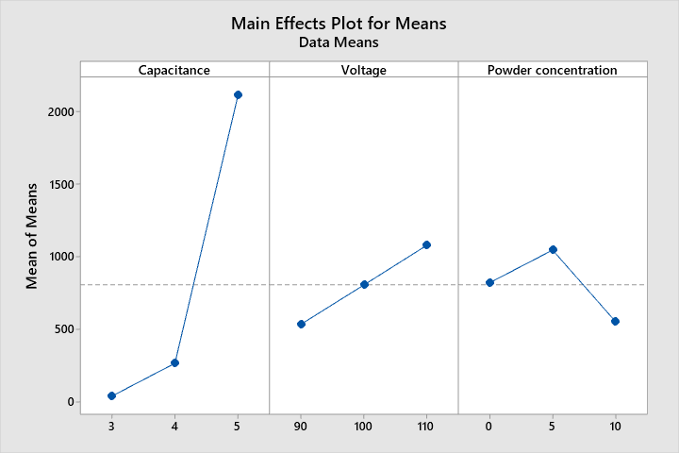
Results: Crater size measurements (Micro EDM)
Results analyzed by measuring crater area for each experimental set using ImageJ software and captured in x1000 magnification
Increase in capacitance and voltage leads to increase in crater size, while effect of powder concentration is moderate
SN ratio approach used for further analysis, with capacitance being the most influential parameter followed by voltage and powder concentration
Capacitance | Voltage [V] | Powder concentration [g/l] | Crater area [µm²]
100 pF | 90 | 0 | 34.116
100 pF | 100 | 5 | 42.5024
100 pF | 110 | 10 | 41.8264
1 nF | 90 | 5 | 217.3106
1 nF | 100 | 10 | 263.9776
1 nF | 110 | 0 | 317.8454
10 nF | 90 | 10 | 1354.6093
10 nF | 100 | 0 | 2111.6435
10 nF | 110 | 5 | 2877.3125
Level | Capacitance | Voltage | Powder concentration
1 | 39.48 | 535.35 | 821.2
2 | 266.38 | 806.04 | 1045.71
3 | 2114.52 | 1078.99 | 553.47
Delta | 2075.04 | 543.65 | 492.24
Rank | 1 | 2 | 3

Slide 22
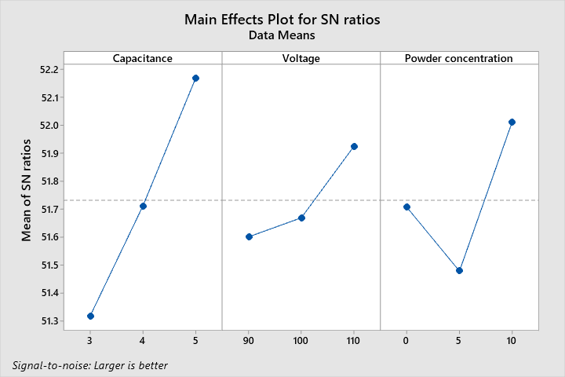
Results: Hardness tests (Micro EDM)
Capacitance | Voltage | Powder concentration | Hardness 1 [HV/0.2] | Hardness 2 [HV/0.2] | Hardness 3 [HV/0.2] | Average hardness [HV/0.2]
100 pF | 90 | 0 | 340.3 | 347.94 | 345.34 | 344.53
3 | 90 | 0 | 340.99 | 332.9 | 346.77 | 340.22
3 | 90 | 0 | 448.96 | 399.21 | 398.25 | 415.47
3 | 100 | 5 | 356.93 | 349.12 | 356.82 | 354.29
3 | 100 | 5 | 355.73 | 350.23 | 353.4 | 353.12
3 | 100 | 5 | 350.4 | 354.49 | 356.53 | 353.81
3 | 110 | 10 | 383.73 | 343.32 | 374.74 | 367.26
3 | 110 | 10 | 423.16 | 454.32 | 499.09 | 458.86
3 | 110 | 10 | 363.92 | 360.31 | 359.42 | 361.22
1 nF | 90 | 5 | 343.6 | 368.93 | 371.15 | 361.23
4 | 90 | 5 | 373.85 | 369.78 | 394.67 | 379.43
4 | 90 | 5 | 362.24 | 362.39 | 375.03 | 366.55
4 | 100 | 10 | 394.47 | 404.8 | 376.05 | 391.77
4 | 100 | 10 | 397.22 | 378.3 | 392.5 | 389.34
4 | 100 | 10 | 403.73 | 400.33 | 415.04 | 406.36
4 | 110 | 0 | 377.84 | 354.83 | 353.46 | 362.04
4 | 110 | 0 | 386.76 | 386.68 | 377.94 | 383.79
4 | 110 | 0 | 367.33 | 507.28 | 444.49 | 439.7
10 nF | 90 | 10 | 396.16 | 422.4 | 409.7 | 409.42
5 | 90 | 10 | 408.99 | 403.32 | 441.61 | 417.97
5 | 90 | 10 | 371.12 | 441.75 | 408.58 | 407.15
5 | 100 | 0 | 388.39 | 394.33 | 452.68 | 411.8
5 | 100 | 0 | 396.08 | 482.6 | 367.95 | 415.54
5 | 100 | 0 | 415.29 | 360.59 | 369.71 | 381.86
5 | 110 | 5 | 379.91 | 416.15 | 362.87 | 386.31
5 | 110 | 5 | 389.65 | 392.88 | 381.33 | 387.95
5 | 110 | 5 | 457.91 | 417.64 | 460.97 | 445.51
The highest average hardness value of 445.5 was obtained at capacitance 5, voltage 110, and powder concentration 5
Addition of powder did not always result in an increase in hardness.
The response table for signal-to-noise ratios shows that the most consistent and reliable results were obtained at level 3, with a delta of 0.85.
Level | Capacitance | Voltage | Powder concentration
1 | 51.32 | 51.60 | 51.71
2 | 51.71 | 51.67 | 51.48
3 | 52.17 | 51.93 | 52.01
Delta | 0.85 | 0.32 | 0.53
Rank | 1 | 3 | 2

Slide 23
Results: surface roughness (Micro Wire EDM)
Energy | Powder | Roughness 1 [µm] | Roughness 2 [µm] | Roughness 3 [µm] | Average roughness [µm]
Low | 0 | 0.295 | 0.279 | 0.243 | 0.272333
Medium | 0 | 0.667 | 0.715 | 0.719 | 0.700333
High | 0 | 1.763 | 1.715 | 1.567 | 1.681667
Low | 5 | 0.274 | 0.249 | 0.343 | 0.288667
Medium | 5 | 0.642 | 0.675 | 0.644 | 0.653667
High | 5 | 1.71 | 1.861 | 1.745 | 1.772
Low | 10 | 0.247 | 0.234 | 0.413 | 0.298
Medium | 10 | 0.754 | 0.869 | 0.627 | 0.75
High | 10 | 1.832 | 1.737 | 1.56 | 1.709667
Surface roughness values varied significantly depending on input parameters.
Surface roughness increased with higher discharge energy.
Hydroxyapatite powder concentration effect was moderate.

Slide 24
Results: Contact angle (Micro Wire EDM)
Energy | Powder (0, 5, 10 g/l) | Contact angle 1 [˚] | Contact angle 2 [˚] | Contact angle 3 [˚] | Average contact angle [˚]
Low | 0 | 52.8 | 49.7 | 61.5 | 54.67
Medium | 0 | 52.1 | 51.4 | 51 | 51.50
High | 0 | 55.8 | 55.8 | 51.1 | 54.23
Low | 5 | 54.4 | 40.3 | 47.8 | 47.50
Medium | 5 | 47 | 51 | 66.1 | 54.70
High | 5 | 59.6 | 58.5 | 56.2 | 58.10
Low | 10 | 43.6 | 47.6 | 45.4 | 45.53
Medium | 10 | 64 | 60.5 | 54.2 | 59.57
High | 10 | 44.7 | 58.3 | 62.8 | 55.27
Ti-6Al-4V samples treated with micro wire EDM were analyzed for contact angle using the sessile drop method
Average contact angle values varied between 45.53° and 59.57° depending on input parameters used
Higher surface roughness generally associated with a higher contact angle value

Slide 25




































Results: Biological attachments Staphylococcus aureus (Micro Wire EDM)
0 g/l
5 g/l
10 g/l
0 g/l
5 g/l
10 g/l
0 g/l
5 g/l
10 g/l
Left
Right
Low
Medium
High

Slide 26

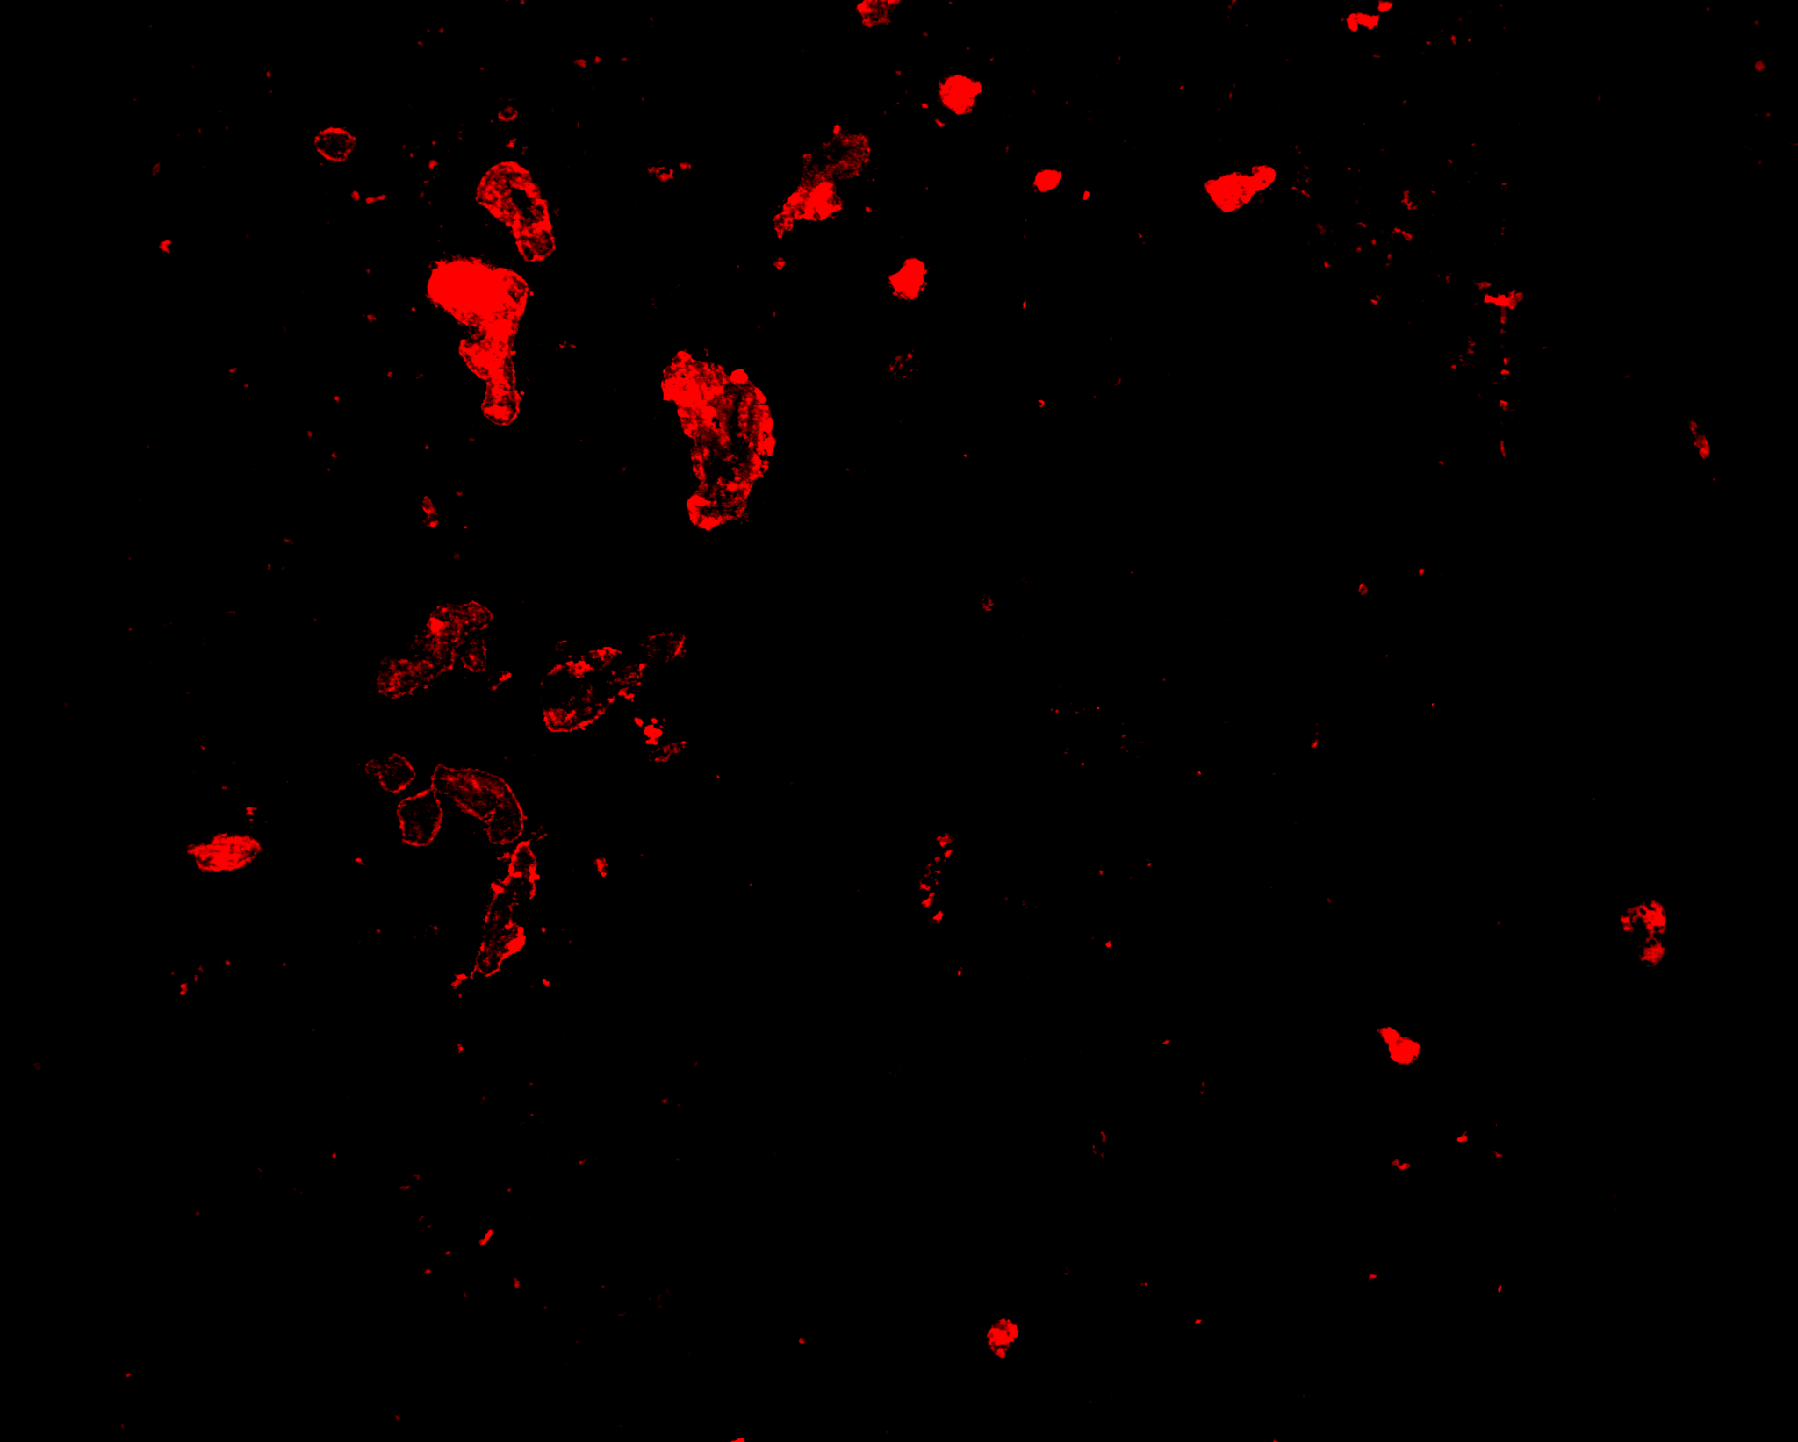



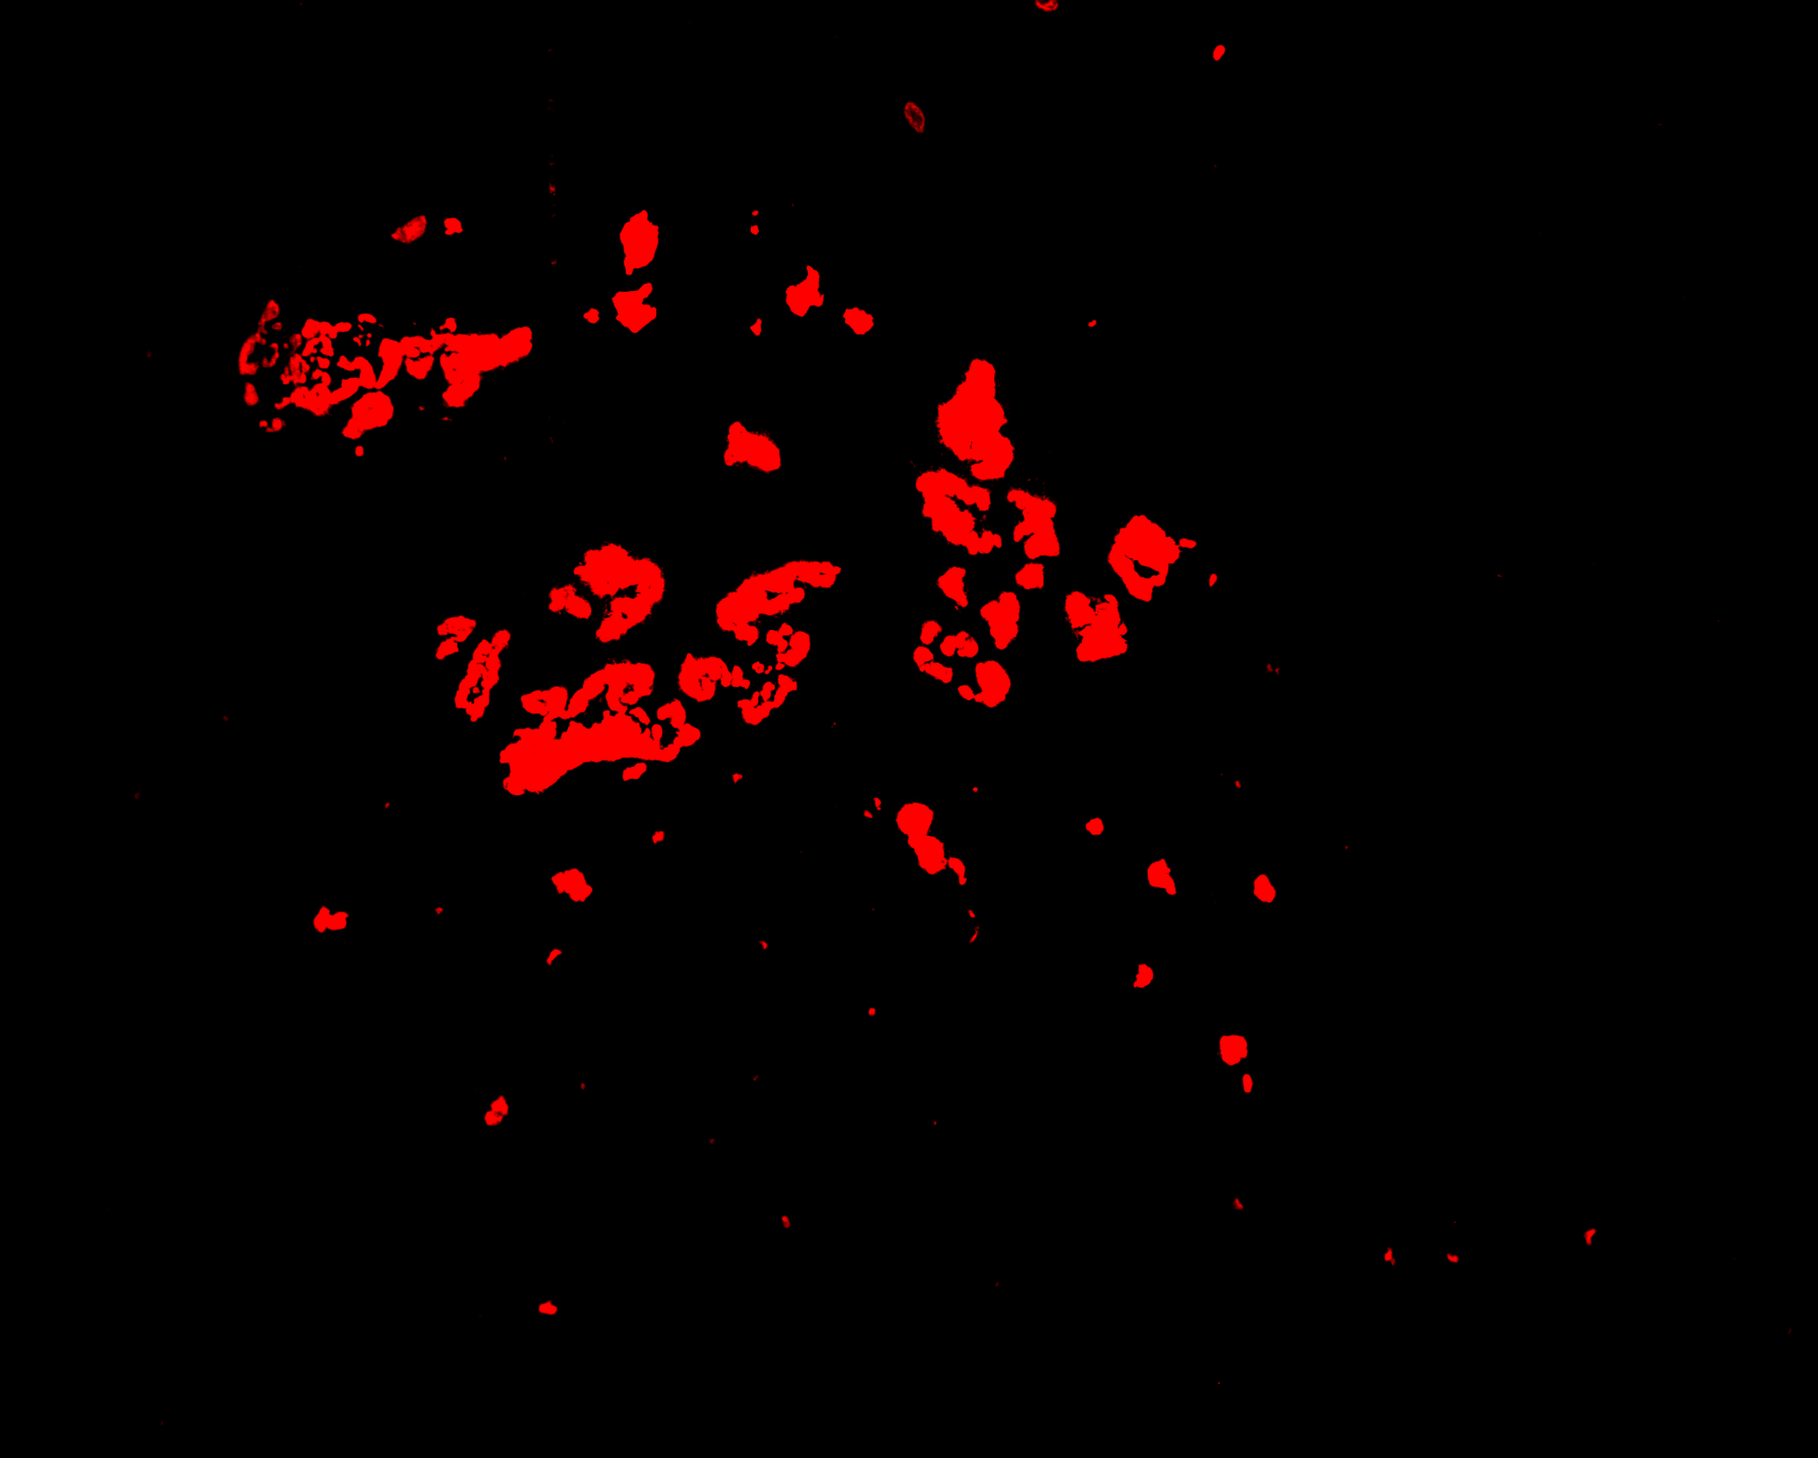

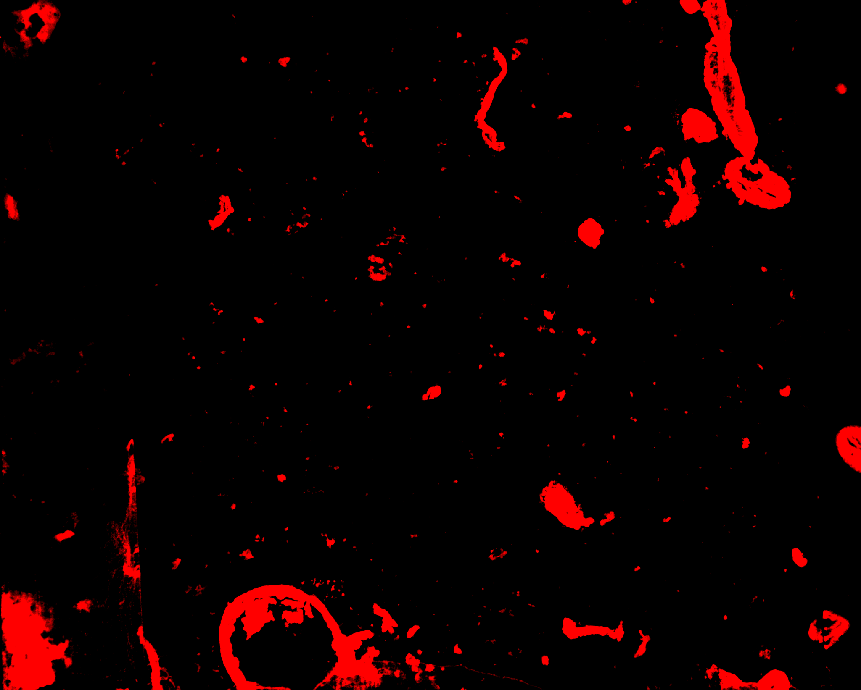
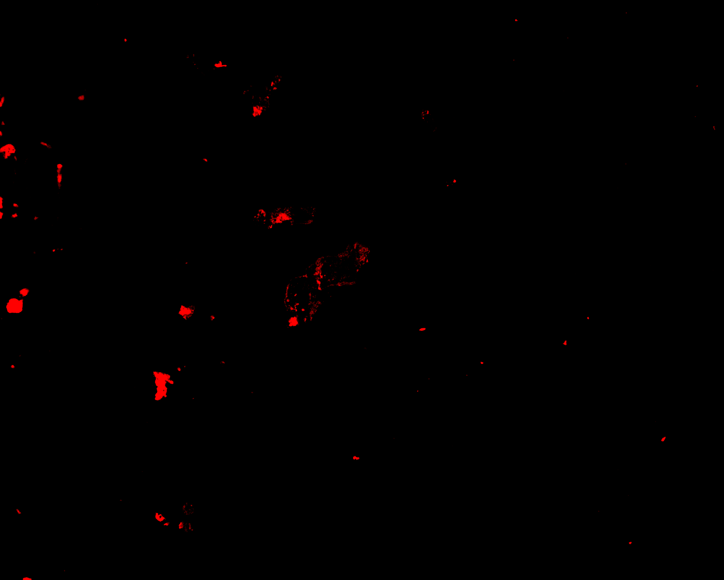

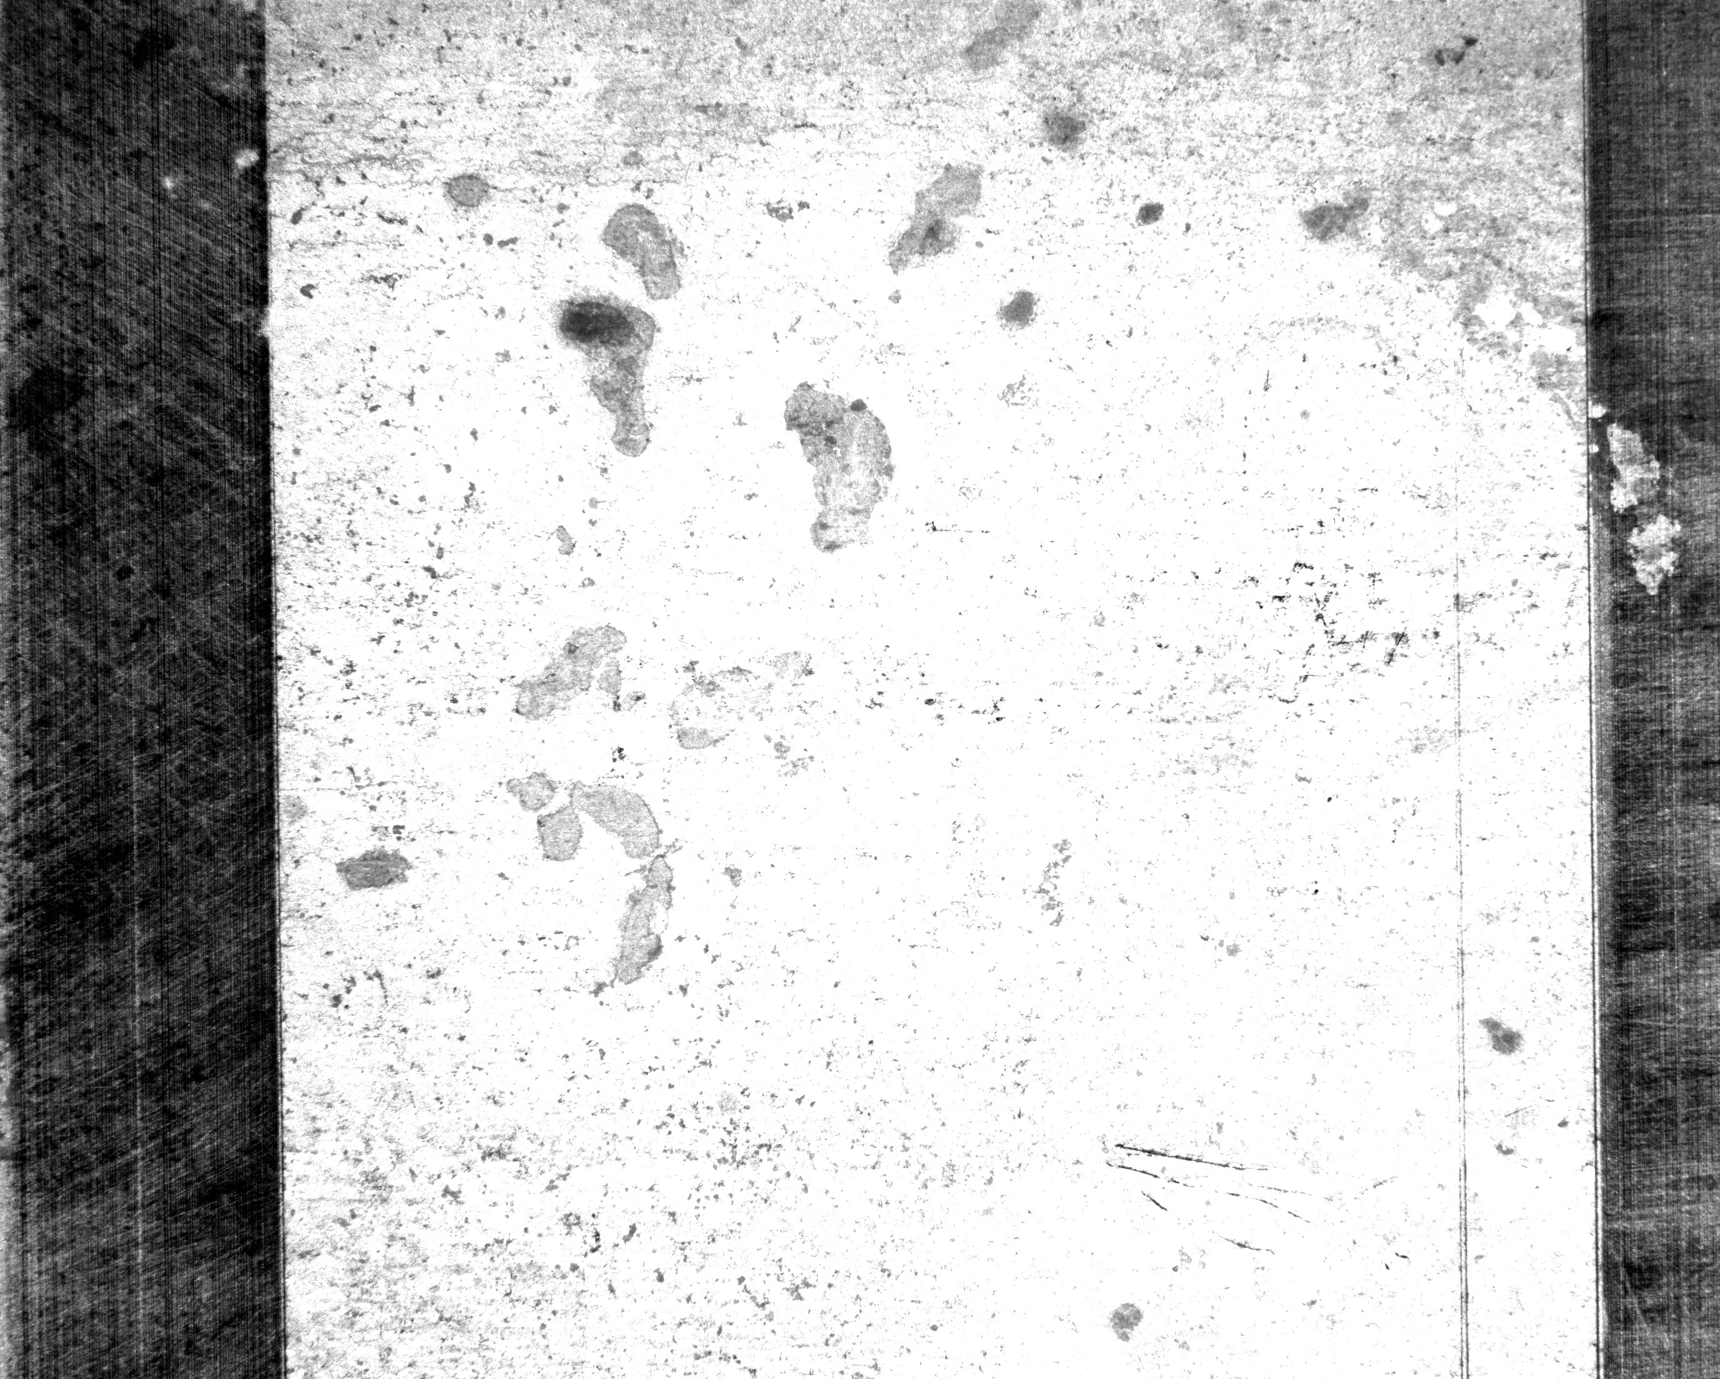

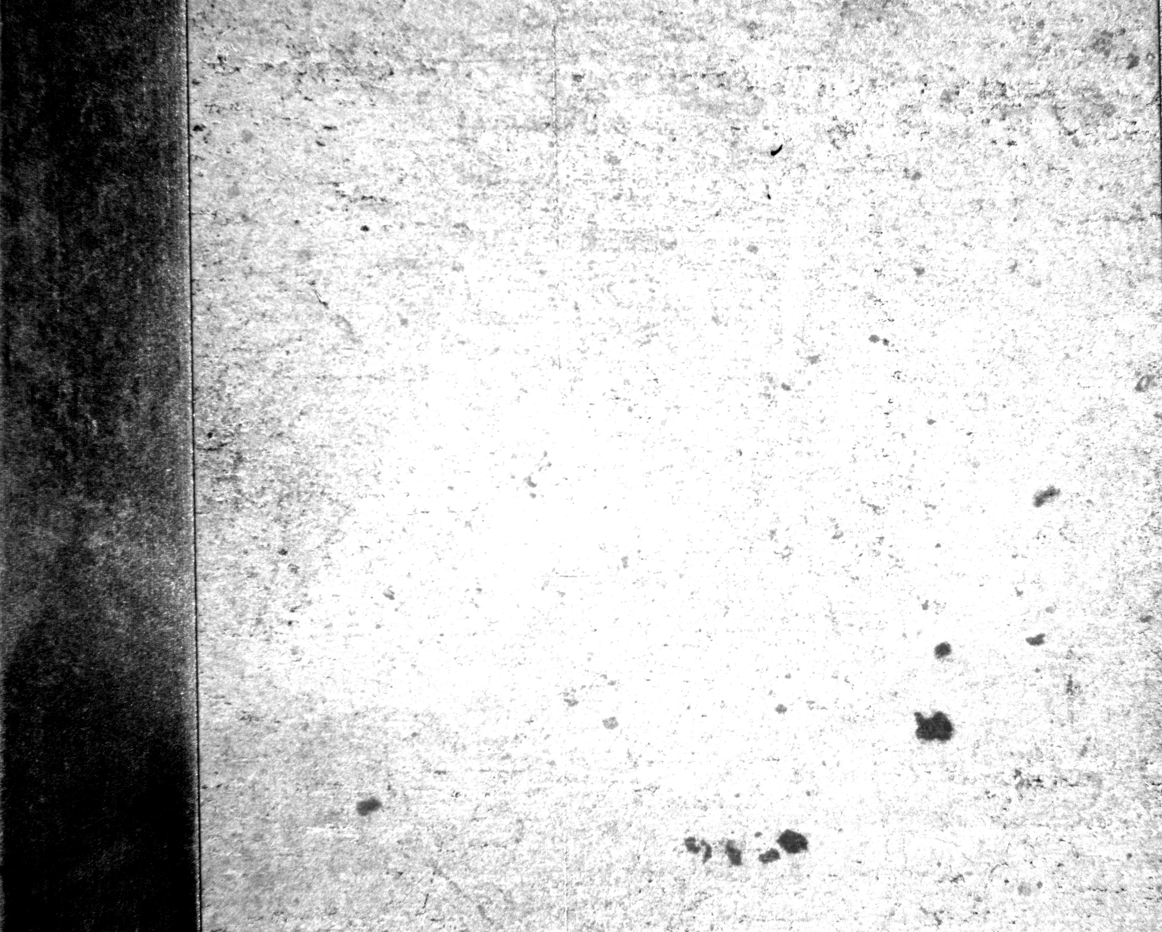
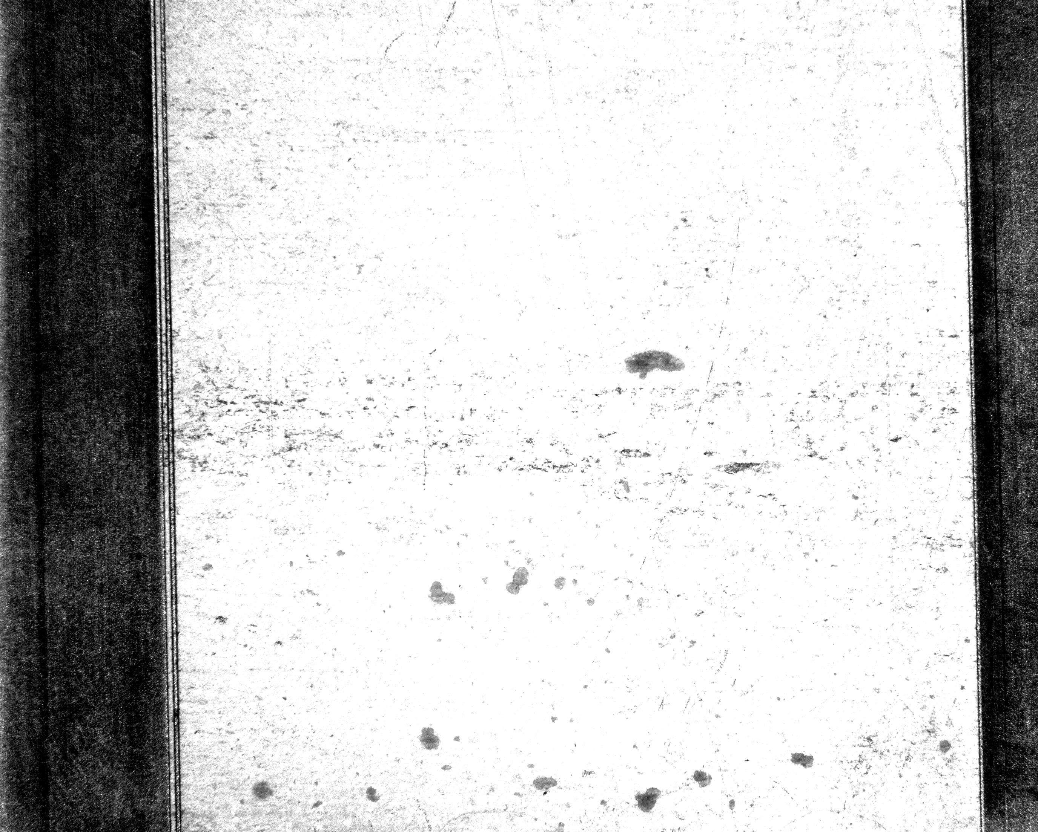
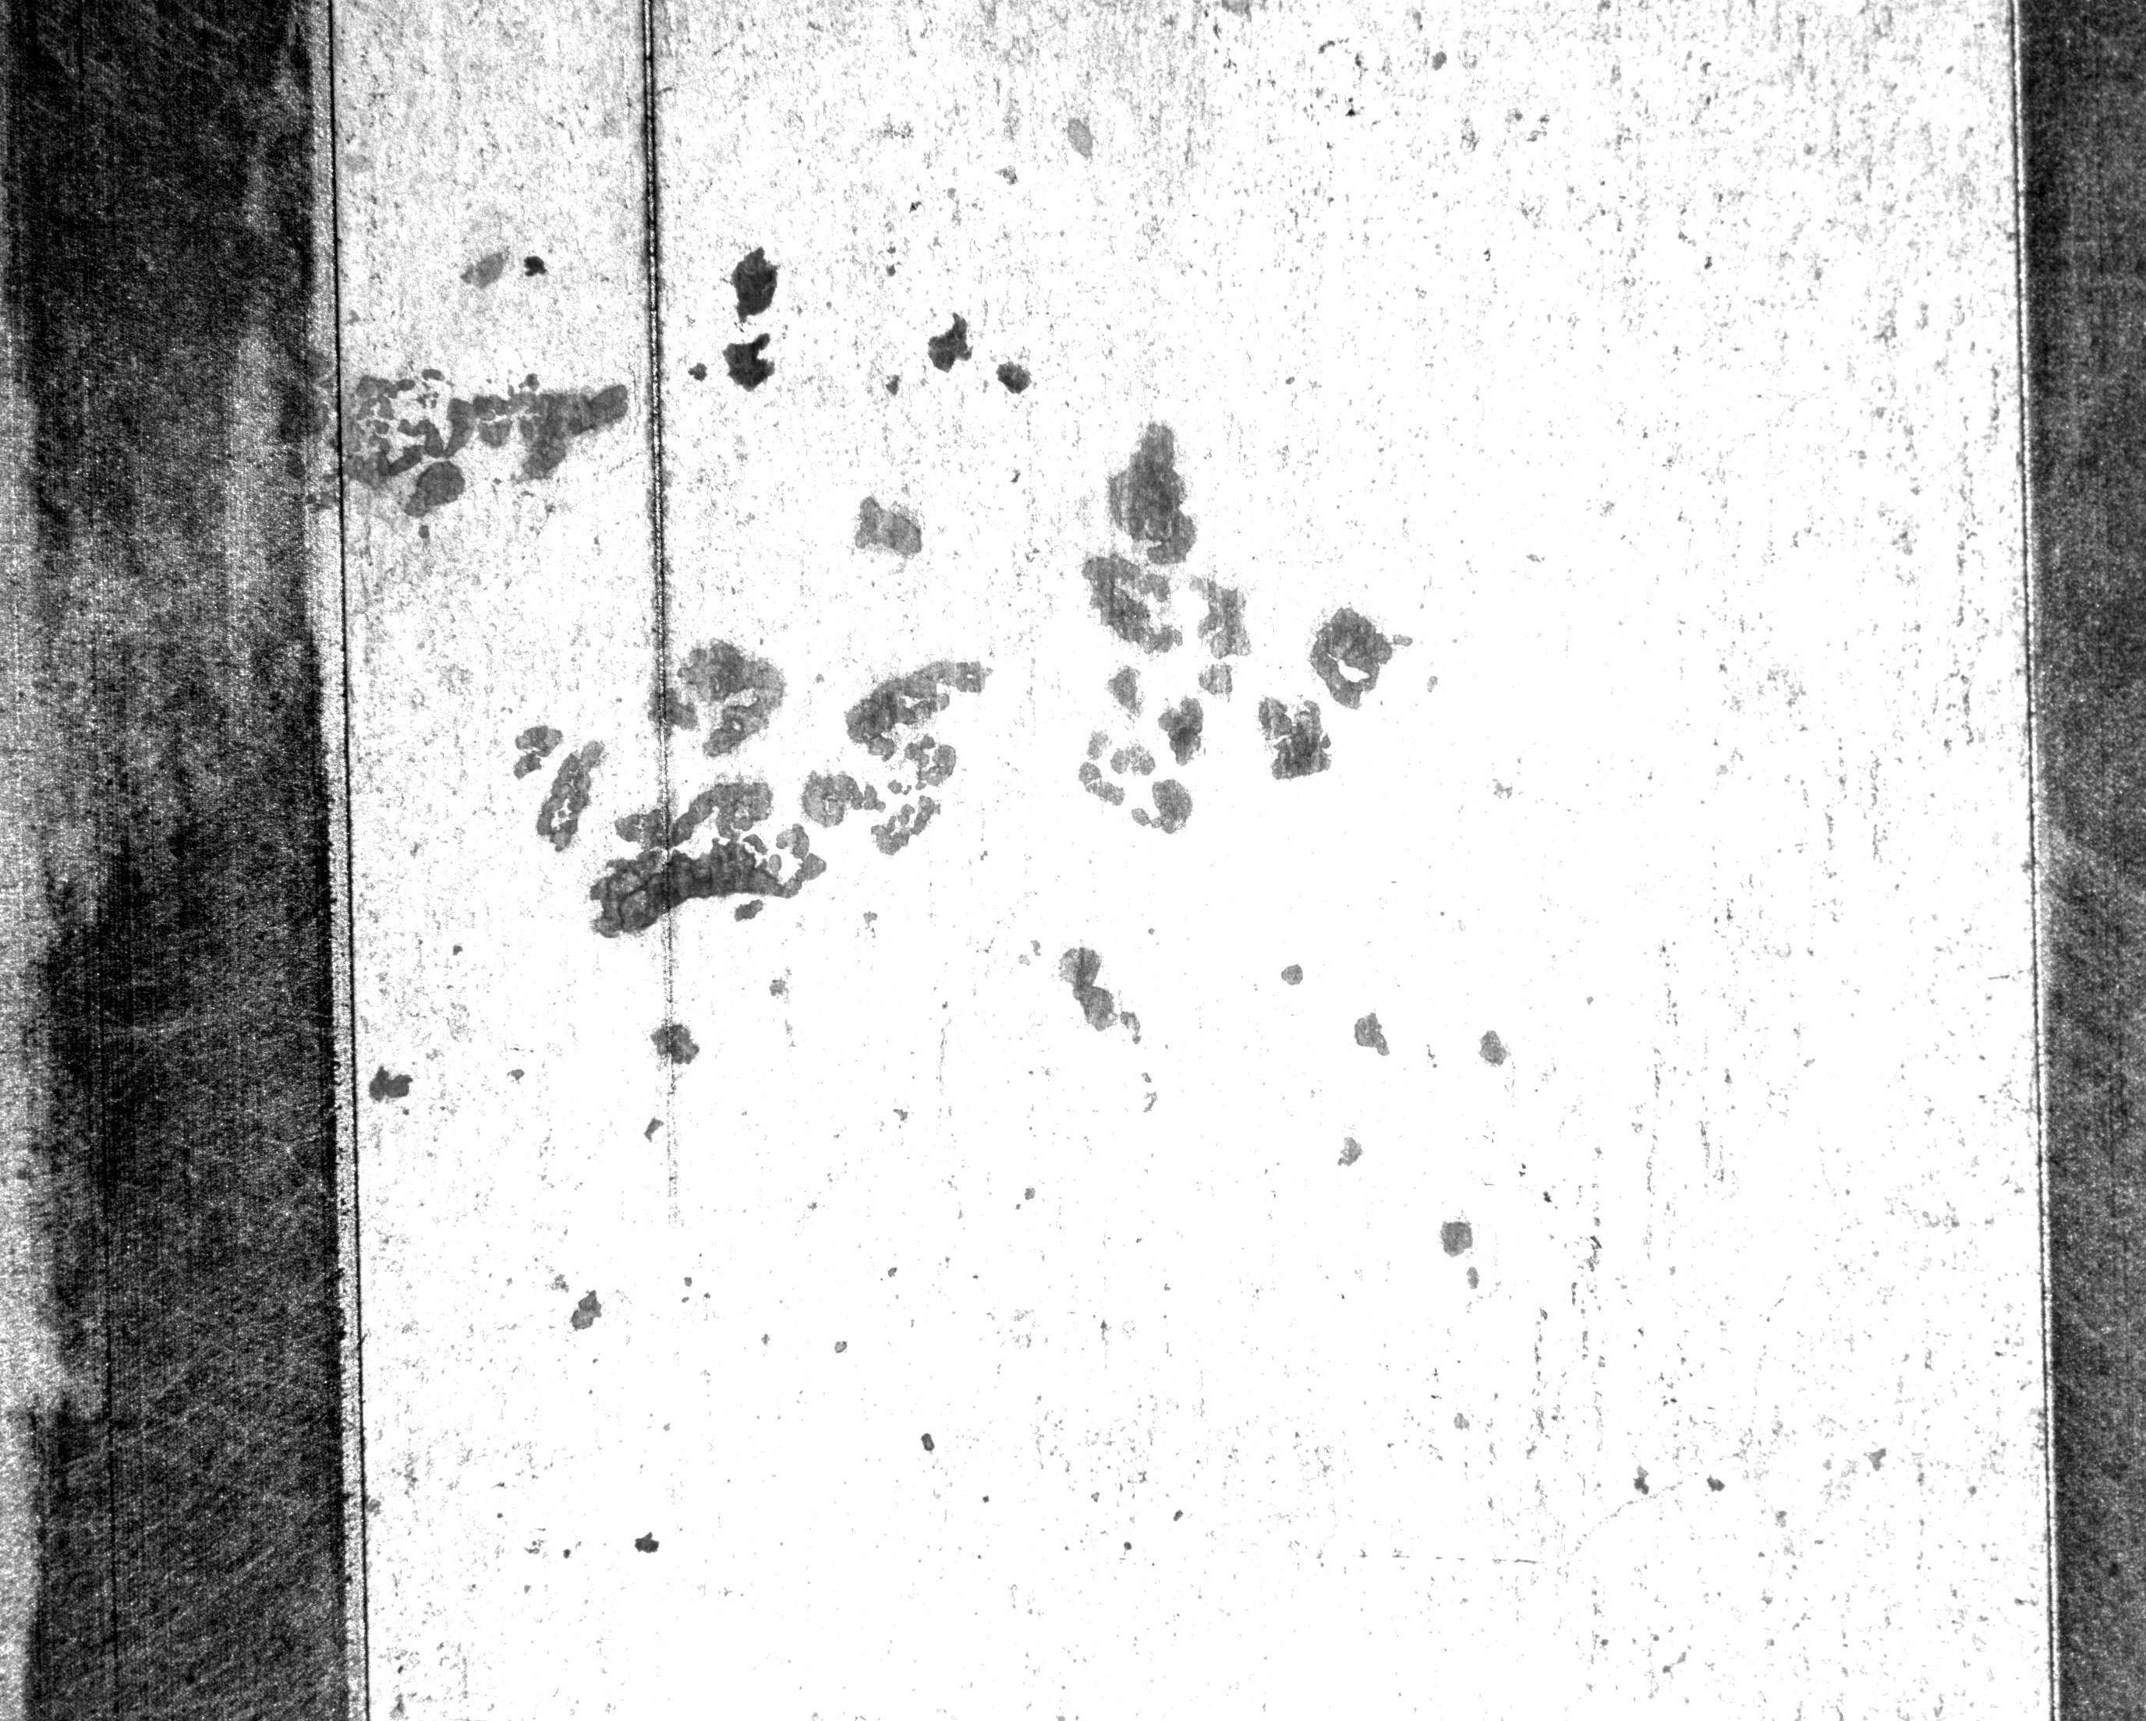

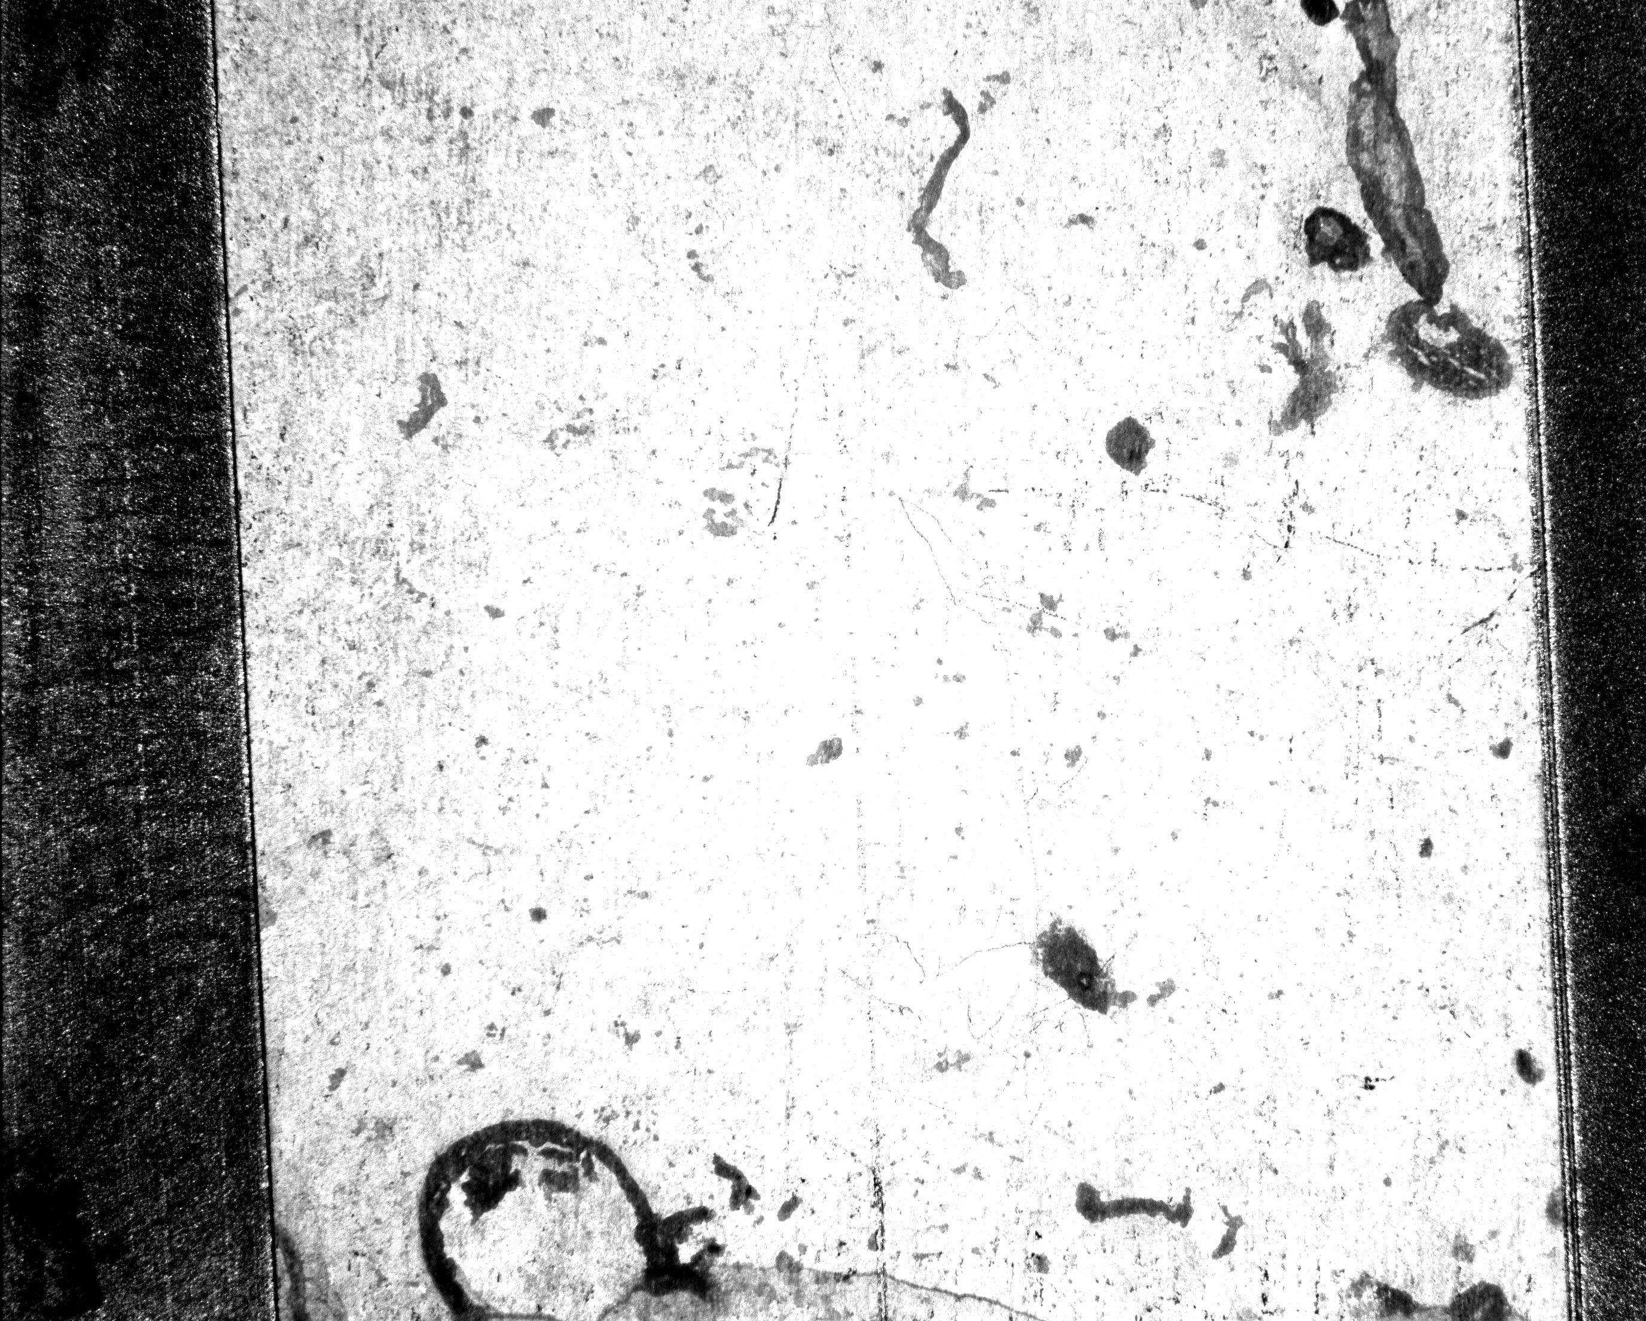


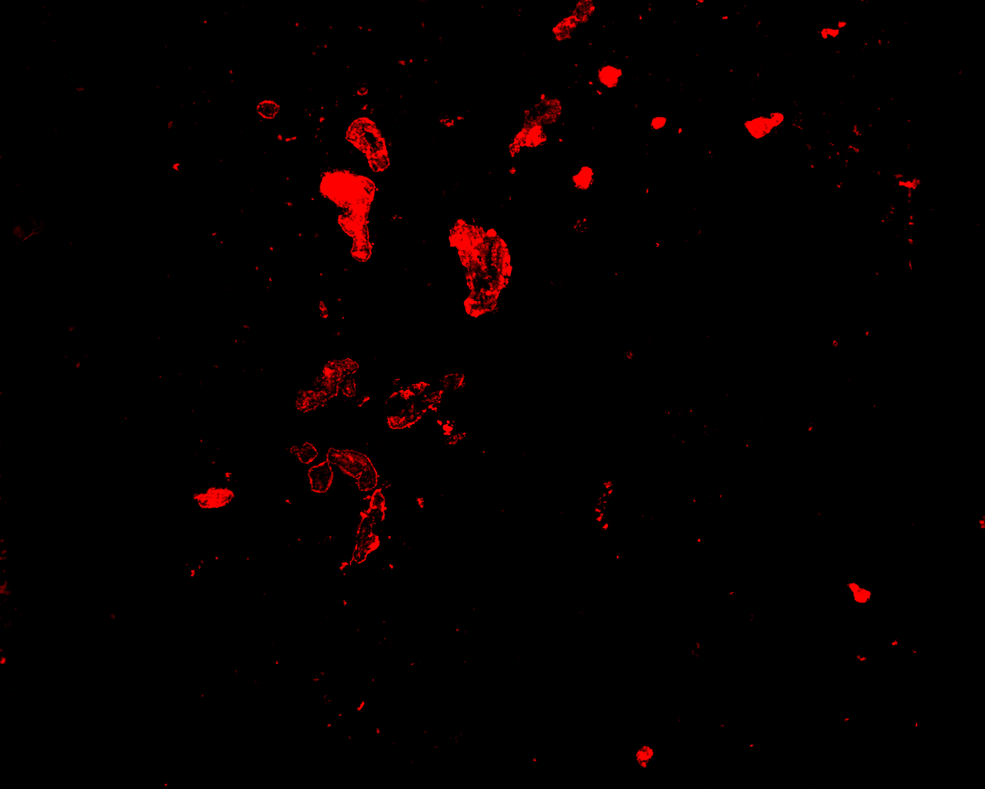



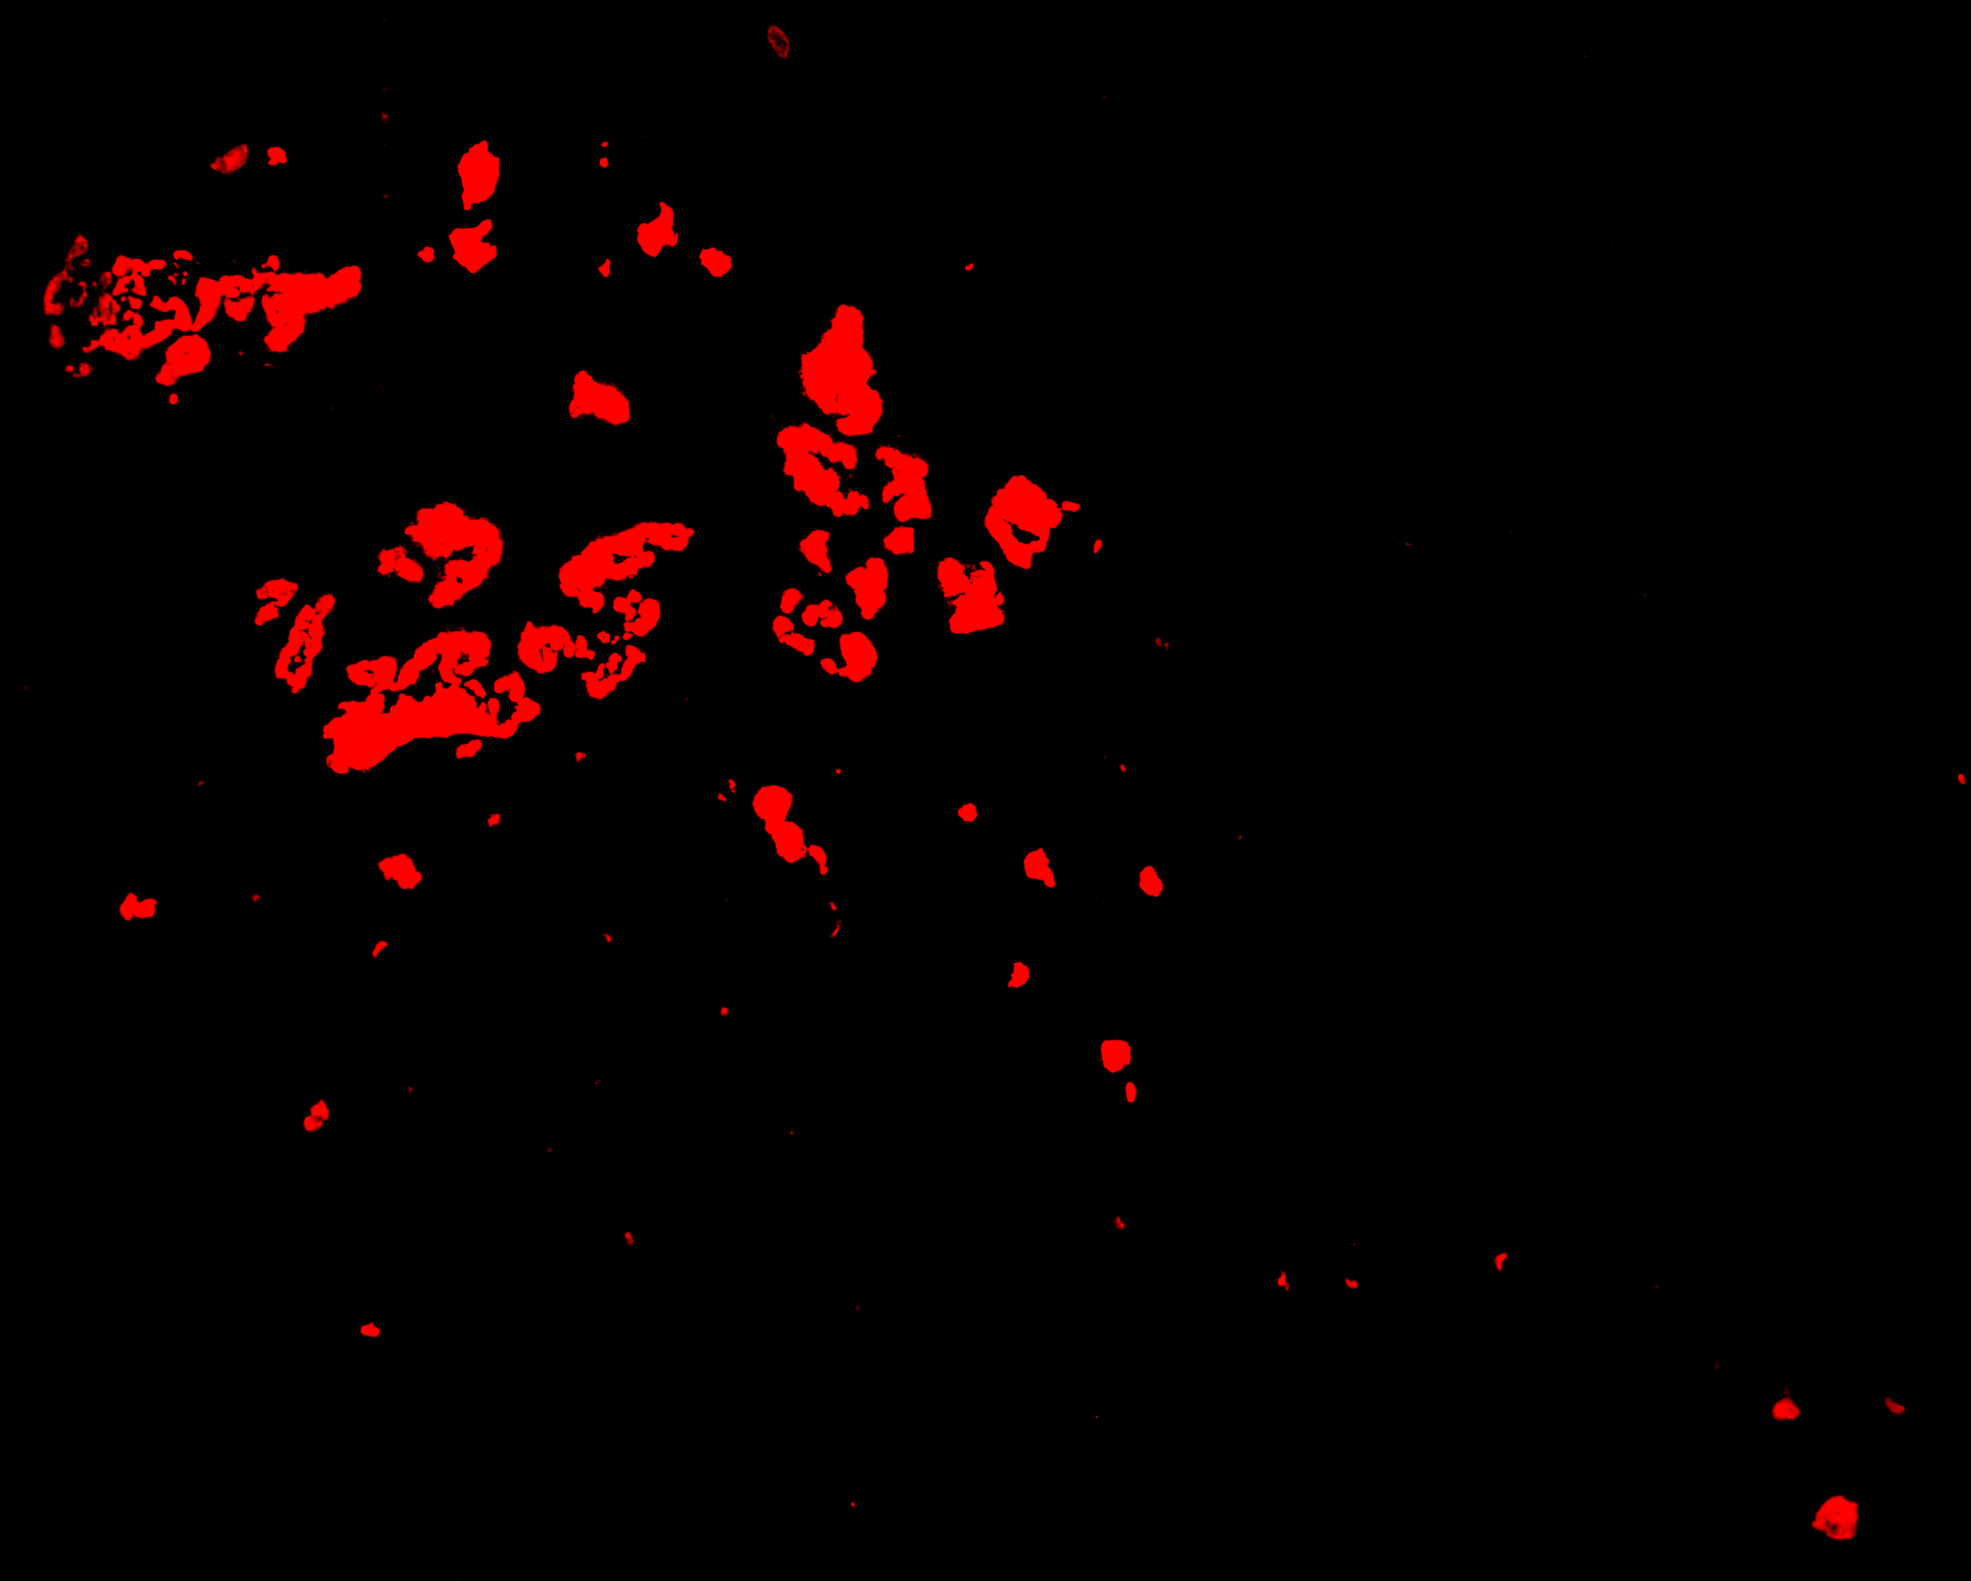

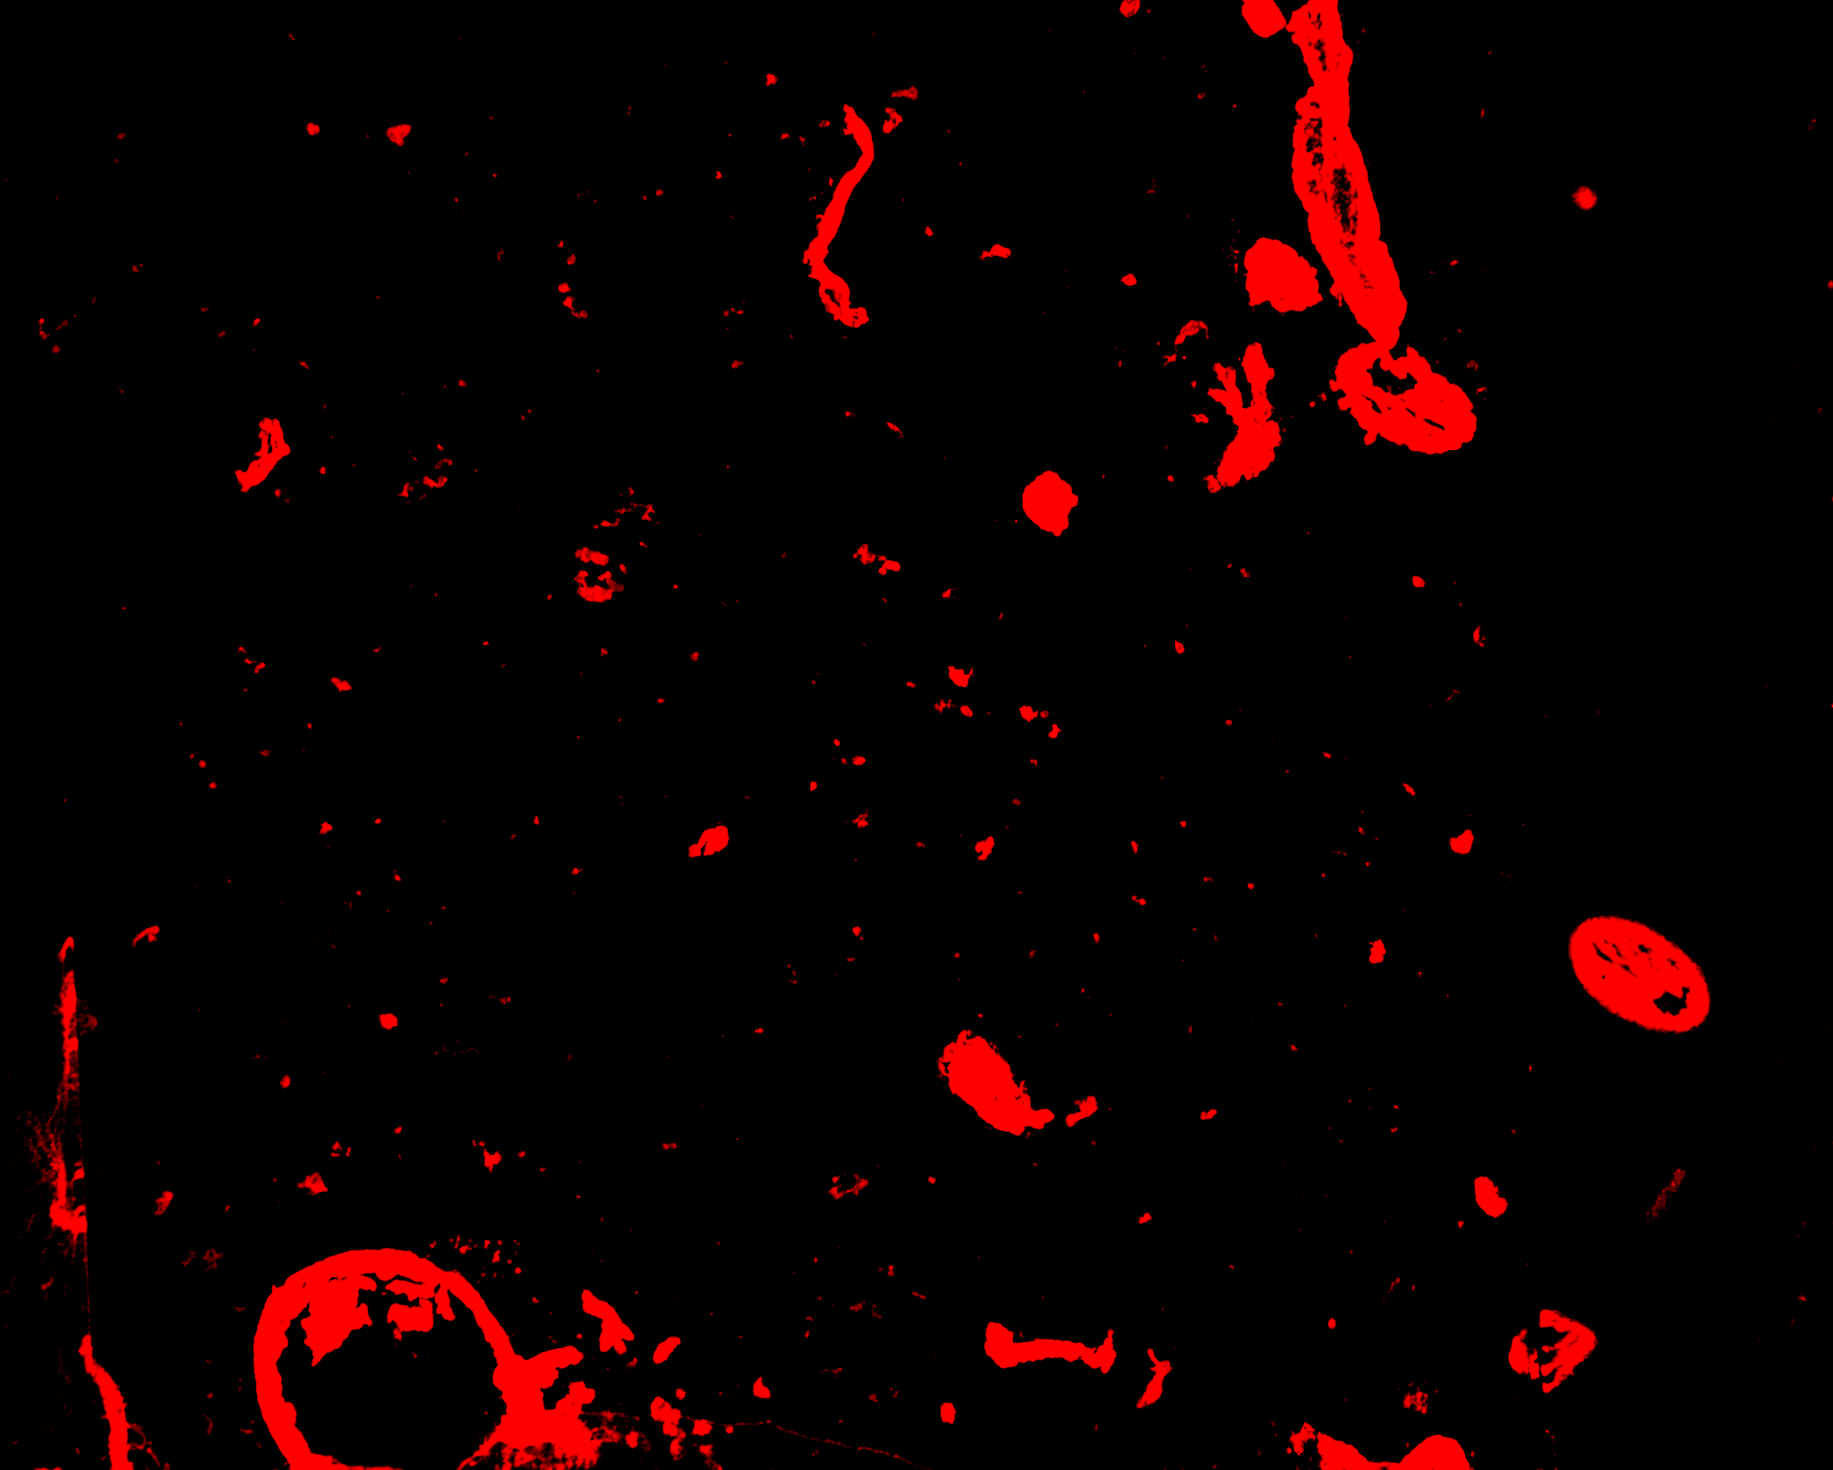


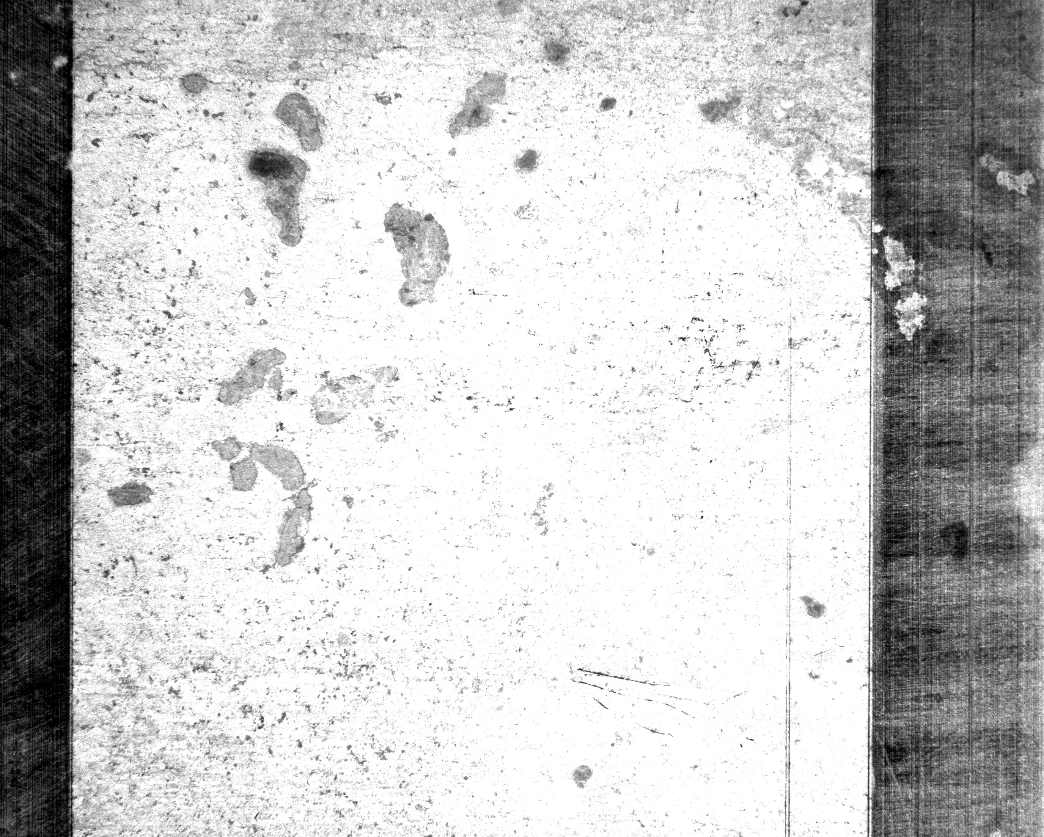


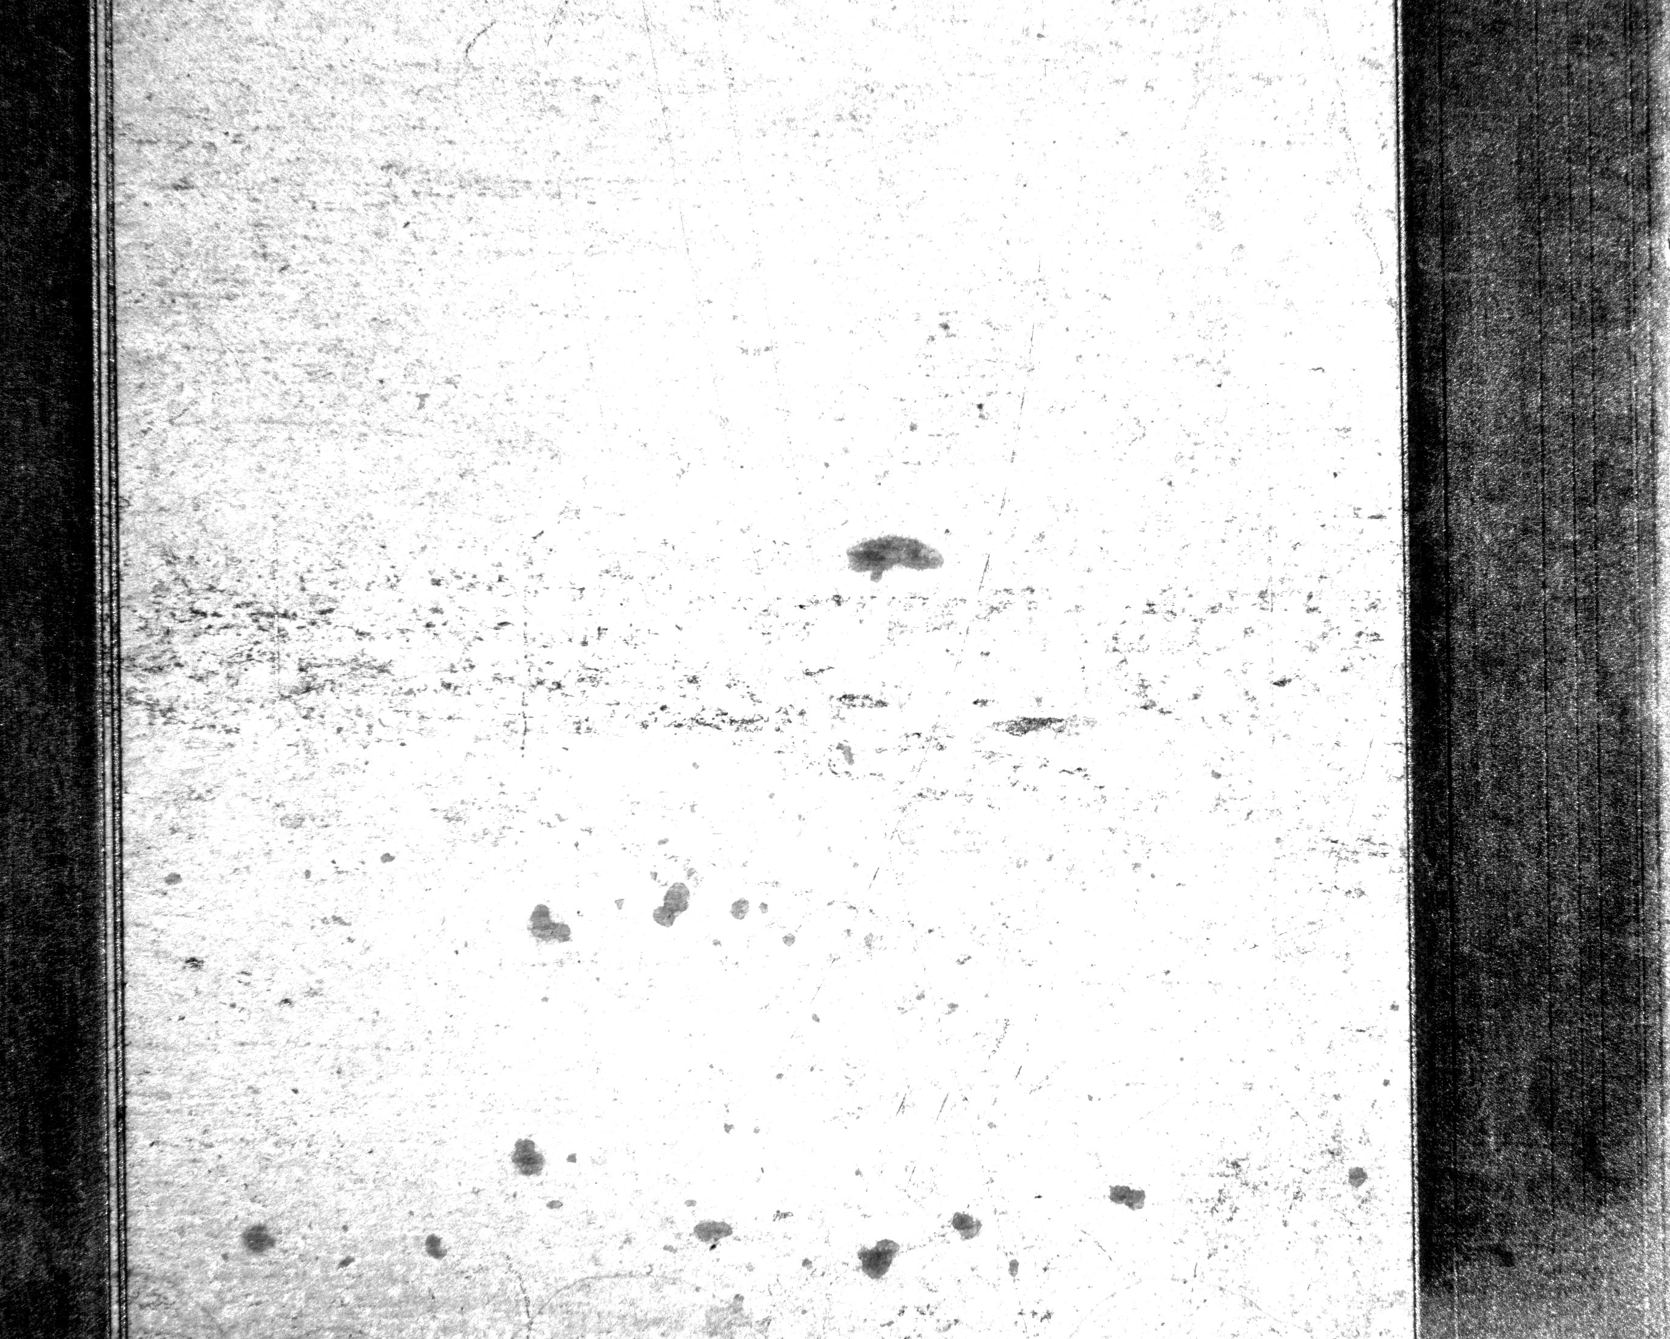
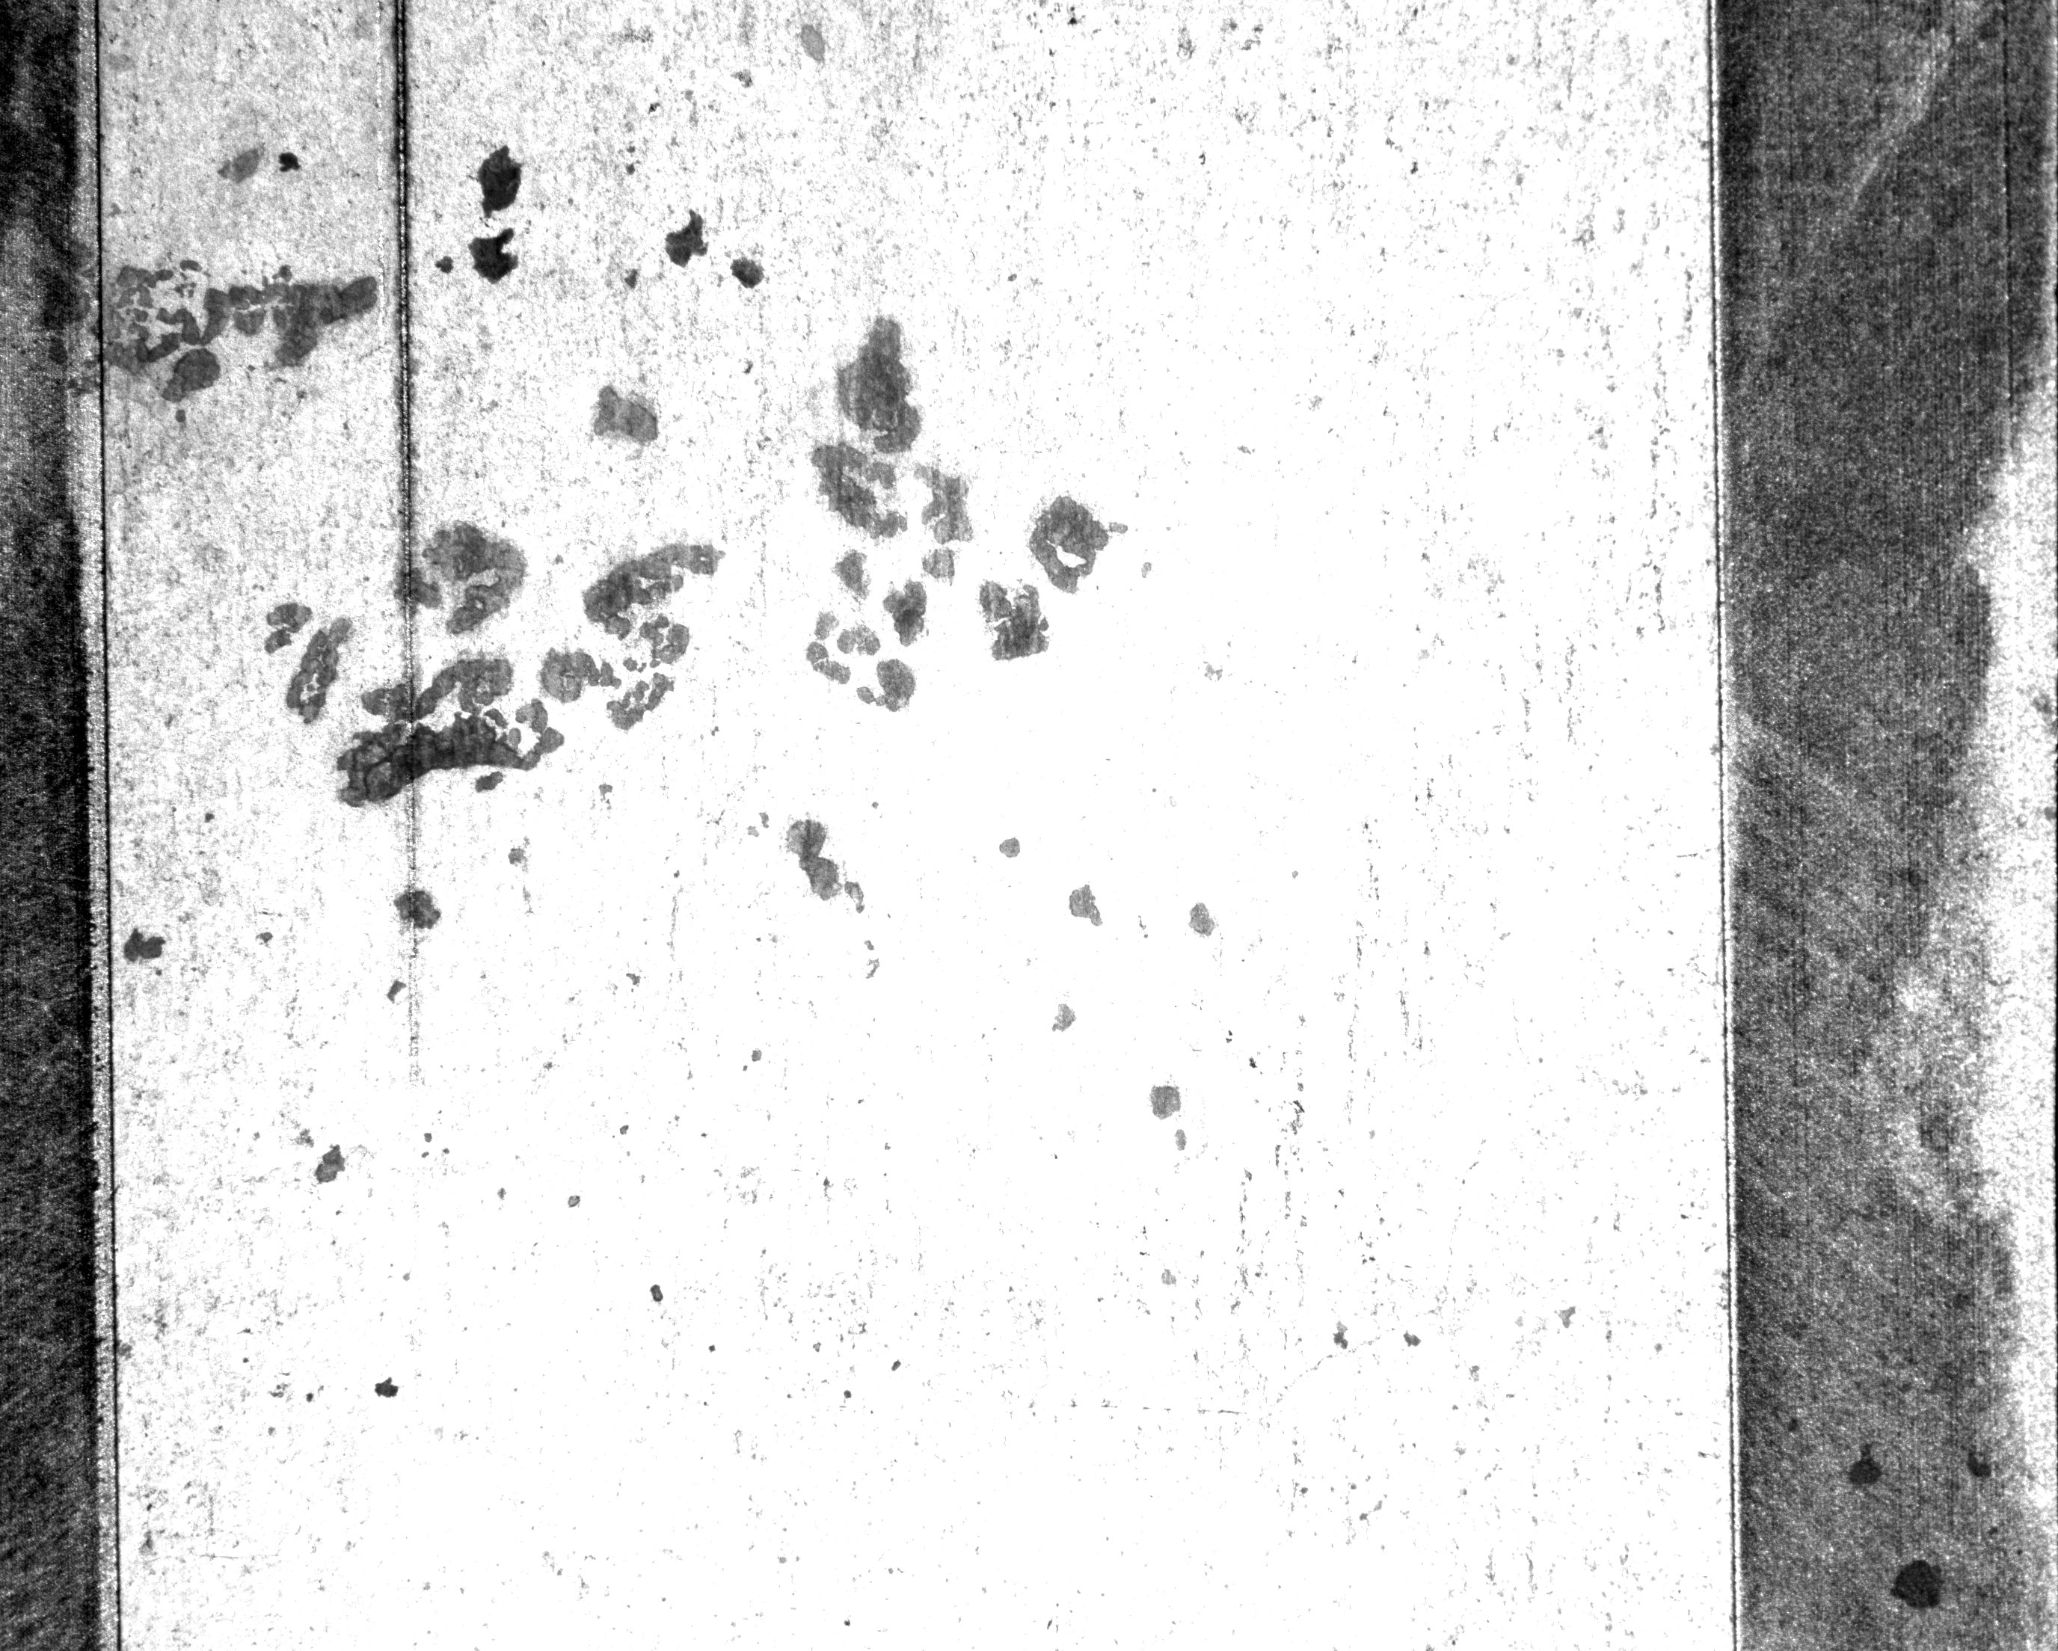

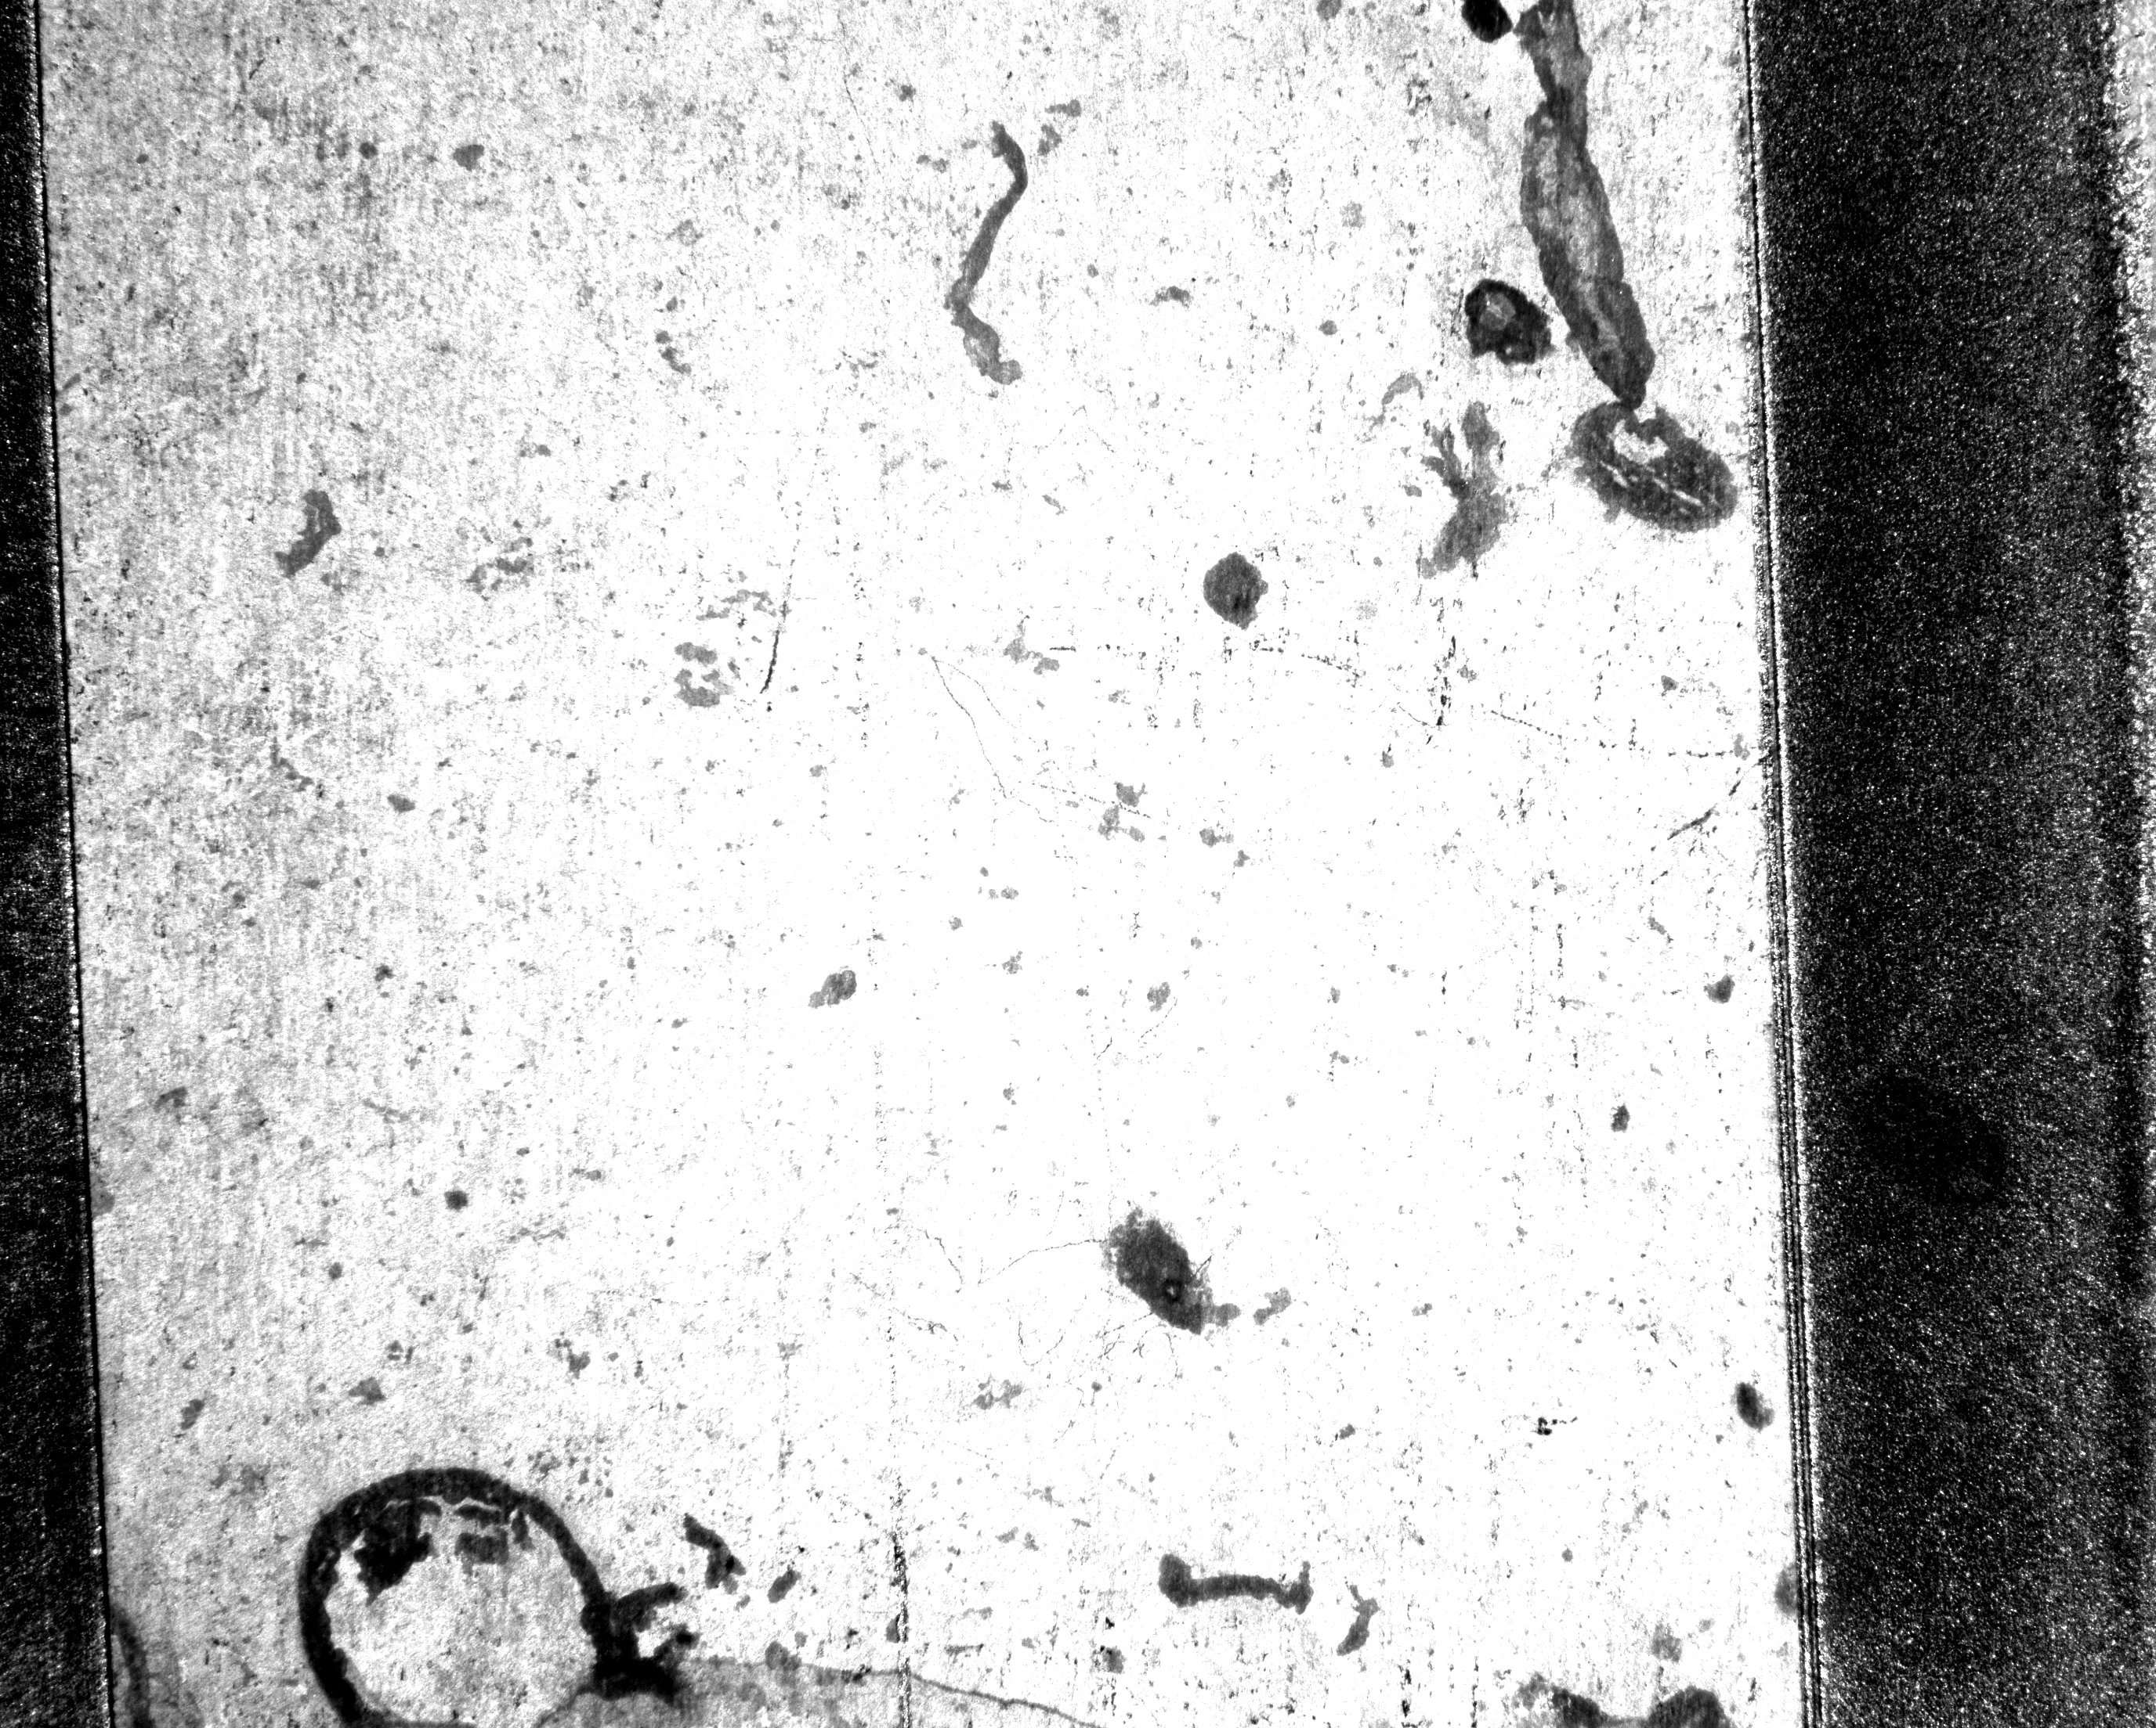

Results: Biological attachments of Escherichia Coli (Micro Wire EDM)
0 g/l
5 g/l
10 g/l
0 g/l
5 g/l
10 g/l
0 g/l
5 g/l
10 g/l
Left
Right
Low
Medium
High

Slide 27
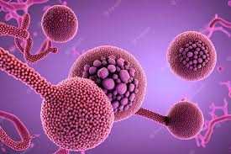
Results: Bacterial attachment (Micro Wire EDM)
Discharge energy and hydroxyapatite settings had a significant effect on bacterial adhesion properties.
Unmachined surface of Ti-6Al-4V alloy had a higher tendency for bacterial adhesion compared to the machined surface.
Powder mixed Wire EDM machining technique can be an effective method to improve the biocompatibility of Ti-6Al-4V alloy against bacterial strains, particularly for high energy settings and higher hydroxyapatite powder concentrations.

Slide 28








Conclusion
Input parameters have a significant effect on bacterial attachment.
The lowest bacterial attachment on micro wire EDM machined parts was achieved with:
medium and high energy input
high hydroxyapatite powder concentration
low surface roughness
Current
Voltage
Powder
Optimization of input parameters resulted in improvement of macro and micro EDM performance on
Ti-6Al-4V
Micro wire EDM machining can reduce bacterial adhesion on metallic surfaces.
Medium and high energy settings are more effective in preventing bacterial adhesion on Ti-6Al-4V for all bacterial strains.
Proper combination of base material, electrode tool, dielectric, and powder additive in micro EDM machining can enhance biocompatibility.

Slide 29
Thank you for your attention!

Slide 30
References
[1] V. D. Bui, J. W. Mwangi, and A. J. J. o. M. P. Schubert, "Powder mixed electrical discharge machining for antibacterial coating on titanium implant surfaces," vol. 44, pp. 261-270, 2019.
[2] M. Navarro, A. Michiardi, O. Castano, and J. J. J. o. t. r. s. i. Planell, "Biomaterials in orthopaedics," vol. 5, no. 27, pp. 1137-1158, 2008.
[3] C. Lhotka, T. Szekeres, I. Steffan, K. Zhuber, and K. J. J. o. O. R. Zweymüller, "Four‐year study of cobalt and chromium blood levels in patients managed with two different metal‐on‐metal total hip replacements," vol. 21, no. 2, pp. 189-195, 2003.
[4] Z. Wang, Y. Fang, P. Wu, W. Zhao, and K. J. J. o. M. P. T. Cheng, "Surface modification process by electrical discharge machining with a Ti powder green compact electrode," vol. 129, no. 1-3, pp. 139-142, 2002.
[5] N. M. Abbas, D. G. Solomon, M. F. J. I. J. o. m. t. Bahari, and Manufacture, "A review on current research trends in electrical discharge machining (EDM)," vol. 47, no. 7-8, pp. 1214-1228, 2007.
[6] M. Tanjilul, A. Ahmed, A. S. Kumar, and M. Rahman, "A study on EDM debris particle size and flushing mechanism for efficient debris removal in EDM-drilling of Inconel 718," Journal of Materials Processing Technology, vol. 255, pp. 263-274, 2018.
[7] A. Y. Joshi and A. Y. Joshi, "A systematic review on powder mixed electrical discharge machining," Heliyon, vol. 5, no. 12, p. e02963, 2019/12/01/ 2019, doi: https://doi.org/10.1016/j.heliyon.2019.e02963.
[8] J. E. Abu Qudeiri, A.-H. I. Mourad, A. Ziout, M. H. Abidi, and A. Elkaseer, "Electric discharge machining of titanium and its alloys," The international journal of advanced manufacturing technology, vol. 96, no. 1, pp. 1319-1339, 2018.
[9] A. Kumar, A. Mandal, A. R. Dixit, and A. K. Das, "Performance evaluation of Al2O3 nano powder mixed dielectric for electric discharge machining of Inconel 825," Materials and Manufacturing Processes, vol. 33, no. 9, pp. 986-995, 2018.
[10] S. Mohanty, V. Kumar, A. K. Das, and A. R. Dixit, "Surface modification of Ti-alloy by micro-electrical discharge process using tungsten disulphide powder suspension," Journal of Manufacturing Processes, vol. 37, pp. 28-41, 2019.

