Slide 1
Wolters Kluwer: Transforming research into knowledge
Ahmed Al Alwani

Slide 2
About Wolters Kluwer®

Slide 3
Transforming the way you carry out learning, research and practice

Slide 4
Wolters Kluwer: Transforming the way you carry out learning, research and practice
Wolters Kluwer is committed to digital innovation that improves clinical workflow and delivers content and solutions to help advance practice change, patient care and quality outcomes.
Innovation
Trusted
Current

Slide 5



From education to research and from research to practice, our market leading brands support the information needs of healthcare practitioners, students, faculty, researchers and librarians…
... to inform clinical decision making and advance patient care
... to keep practitioners current at every stage of their career
... to fuel new discoveries

Slide 6
Ovid® - Innovative Research Tools
Customisable solutions of high quality core and niche content fully integrated with best-in-class technology tools that enhance search precision, speed workflow and maximise research productivity.
Access thousands of content resources through Ovid’s innovative search and discovery platform or have your clinical questions answered quickly and accurately on OvidMD® by simply typing in your clinical question.

Slide 7
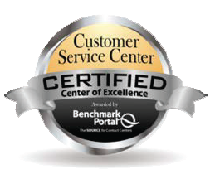
Award-Winning Technical and Customer Services
  Industry leading technical support and customer service accessible 24/7
  Platform and content training tools and services
  Multi-lingual customer service and account management in 14 locations worldwide

Slide 8
Innovative Discovery and Productivity Tools from Ovid®

Slide 9
Ovid®
The leading choice globally among clinicians, researchers, educators and students in the medical, scientific and academic fields.
Delivers a repository of thousands of full text and database resources in a single integrated solution.
Unique tools and features are designed to maximise search precision and efficiency and simplify the speed of analysis and workflow – all in a simple integrated and easy-to-use system
Notes:
Search the Way You Like: Quickly select their preferred search mode, including: Basic Search, Find Citation, Search Tools, Search Fields, Multi-Field Search and Advanced Search.
Add Value to Your Full Text Search: Browse and search thousands of Multimedia assets including videos, audio podcasts and images.
Content Alerting: Automatically receive saved searched via email or RSS with AutoAlerts whenever new articles matching your search criteria become available. Ovid’s eTOCs track and alert users to newly loaded journal issues.
Work Productivity Tools: Quickly identify how you conducted your search with Search History, use Search Limits to bring greater focus to your searches and easily attach Annotations to a citation or search result. Results can be instantly viewed and sorted according to multiple criteria with Search Results Tools and Functionality. Citation Manager Options allow to select a preferred style when viewing, printing, or exporting to your citation manager.
Conduct More of Your Research Work within Ovid: MyWorkspace combines search, discovery, document and research management into a single online destination, dramatically increasing your online work productivity.

Slide 10
Premium Journals from
Lippincott Williams & Wilkins

Slide 11
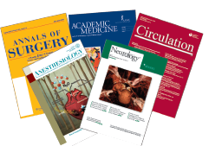
Premium Journals from
Lippincott Williams & Wilkins
Leading international publisher and partner of premier medical, nursing and health professionals and associations
Publish the most current and influential research in more than 20 specialty areas including:
  Anesthesiology
  Cardiology
  Orthopaedics
  Neurology
  Nursing
  Obstetrics and Gynecology
  …and more!

Slide 12
Reasons to choose LWW Journals
Highly ranked influential content
More than 280 medical, nursing and allied health journals in core specialties
Partnerships with more than 60 leading medical societies and 20 nursing and health professions, societies and associations
Content exclusively accessible through Ovid’s search platform

Slide 13
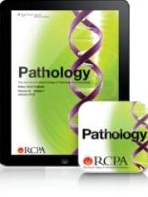

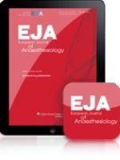
Leading iPad® Apps
Get instant mobile access to browse through your institution’s Ovid journal subscriptions with Ovid Today
More than 100 dynamic journal apps from leading LWW journals including:
  AIDS
  Current Opinion in Anesthesiology
  European Journal of Anaesthesiology
  Pathology - Journal of the RCPA
  Open access content from Medknow
  …and more!
Notes:
About Ovid Today
OvidToday, an easy-to-use app for your library’s Ovid-subscribed journals, is aimed at providing you and your users with the latest and most-relevant
content.
Currently available for iPad®, OvidToday offers instant access to browsethrough your institution’s Ovid journals - including multiple issues andPublish Ahead of Print. Plus, users can read or save PDF articles for later use while they are offsite or offline.
Wehy Ovid Today?
Browse ALL Your Institution’s Ovid® Journal Holdings – search by
A-Z journal name or by category to find journals that best fit any
specialty area
Intuitive Interface and Navigation – made with the busy user in
mind to make reading journal articles a simple experience
Personal Reading List – users can create a list of journals to follow that
is most relevant to their research, practice and education
Stay Up-To-Date – the latest content from the institution’s subscribed
journals is instantly available on the app once on Ovid - including Publish
Ahead of Print
Read Articles Anywhere – Readers can access multiple journal issues and
PDF articles while on-the-go - at work or at home
Dynamic journal apps from Lippincott Williams and Wilkins optimise the best in digital technology to enhance a print–like reading experience with article–sharing features, multi–media links, and more.
Key benefits include:
• Easy to read full–text articles
• Adjustable text sizing with "pinch and zoom"
• Engaging multimedia and supplemental digital content (SDC)
• Downloadable issues
• Speedy issue browsing through Quick View and linked Table of Contents
• Quick scrolling through abstracts
• Convenient notification when a new issue is available
• Links to journal website to view bonus features, including content published–ahead–of–print, article collections, eBooks, and search archived issues.

Slide 14
Essential Journals Collections from LWW
LWW High Impact Collection
An essential base of 53 highly cited, high impact journals
LWW Total Access Collection
Exclusive collection of 280 top journals, ranked by Impact Factor, including Circulation, Annals of Surgery, and Anesthesiology
LWW Current Opinion Journal Series
28 discipline-specific titles presenting reviews of the latest clinical research developments
LWW Clinical Journal Collection
Access the New England Journal of Medicine plus 14 leading LWW Journals, including Circulation and Annals of Surgery
LWW Nursing Journals
LWW Extended Archive
Over 90 journals covering a range of nursing specialties, including AJN: The American Journal of Nursing and Nursing Research
Exclusive backfiles of more than 50000 issues of over 250 journals in core clinical and medical specialties
Presentation
Notes:
The LWW High Impact Collection is a simple, cost-effective way to expand electronic journal holdings. It contains a unique collection of top-ranked journals published by Lippincott Williams & Wilkins provides an essential base of highly cited information perfectly tailored to your most specific research needs, and provides access to a diverse package of high-quality full-text resources and core, must-have clinical titles.
The LWW Total Access collection is a prestigious collection, designed for institutions with more intensive medical information needs. It includes just about every one of Lippincott Williams & Wilkins’ highly respected titles, from the essential core journals to specialised resources in areas such as nursing and bioscience, to help round up your knowledge base. This collection has top journals, ranked by Impact Factor, in 15 different subject categories, including Circulation, Annals of Surgery, and Anesthesiology (all ranked #1 by Impact Factor in their subject categories*).
Many journals are “official” titles of prestigious societies and associations
No journals in the collection are under any embargoes
With the LWW Total Access Collection you get virtually all of LWW’s electronic journal content - at an affordable price.
LWW Clinical Journal Collection includes access to the world’s most influential medical journal- the New England Journal of Medicine- plus 14 leading LWW Journals. Designed with the needs of small and medium-sized general hospitals in mind, this package will instantly provide users with the information they need.
Comprising of 28 titles, the Current Opinion journal series from Lippincott Williams and Wilkins are regarded as the most efficient and authoritative way to keep you informed of all major developments in clinical medicine.
Leading nursing journals published by Lippincott Williams & Wilkins include:
AJN: American Journal of Nursing
Nursing Research
Cancer Nursing: An International Journal for Cancer Care
LWW Extended Archive

Slide 15
Unrivalled Journals Coverage
A wide range of journals from Lippincott Williams & Wilkins provide coverage of 73 specialties, including*:
Internal Medicine (155 titles)
Neurology (37 titles)
Orthopedics (37 titles)
Anesthesiology (31 titles)
Ophthalmology (28 titles)
Pathology (27 titles)
Psychiatry (24 titles)
Sports Medicine (23 titles)
Obstetrics and Gynecology (21 titles)
Surgery (21 titles)
Emergency Medicine & Trauma (13 titles)
Radiology (22 titles)
Critical Care Medicine (17titles)
Nursing (118 titles)
…and more!

Slide 16
Books@Ovid
Why Books and Book Collections on Ovid?
Natural language searching makes it easy to find what you are looking for without complex search terminology
Relevancy ranking in search saves time by delivering the best possible results
Seamless linking to full-text journals and databases and even more resources outside of the Ovid environment
Flexible search and browse options.
More than 5000 titles from the world’s most prestigious scholarly publishers
Notes:
Books@Ovid offer a growing list of more than 4,000 current online book editions from the world’s most prestigious scholarly publishers, including one of the largest selection of core clinical ebooks.

Slide 17
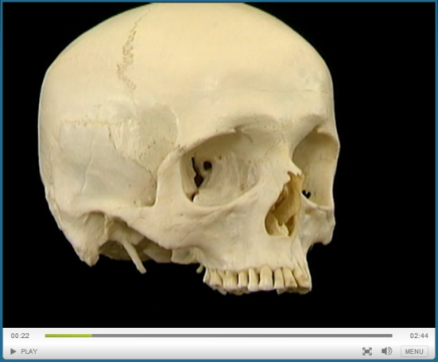
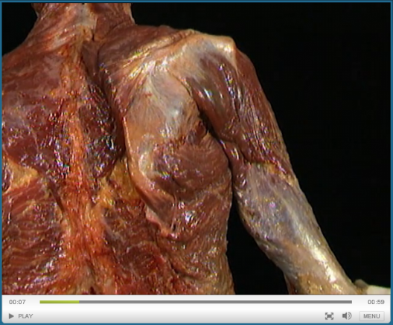
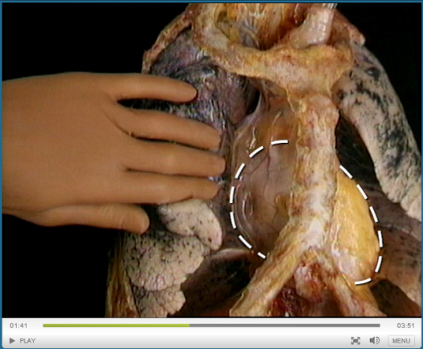
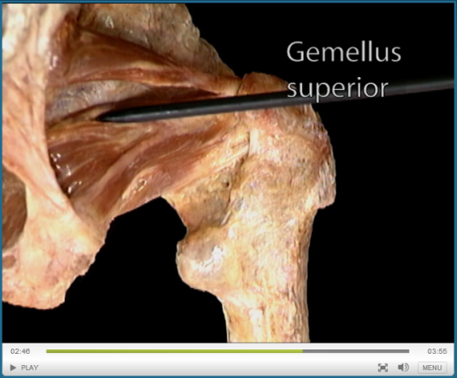
Acland’s Video Atlas of Human Anatomy
Comprehensive 3D video atlas that allows a 360˚ view fresh anatomical specimens in their natural color, accompanied by clear narration and labeled structures
More than 300 narrated videos; coverage includes upper extremity, lower extremity, trunk, head & neck and internal organs; plus, ground-breaking inner ear content
Available in English and Spanish
Notes:
Acland’s Video Atlas of Human Anatomy is the optimal anatomical learning solution. Watch and listen to world-renowned anatomist Dr. Robert Acland —Professor Emeritus of Surgery, University of Louisville School of Medicine— as he shows and explains anatomical movement within each region of the body – covering bones, muscles, tendons, organs and more.
Available online, this atlas is a perfect resource for any institution’s residents, faculty and students within medical, nursing, physician assistant, physical/ occupational therapy, speech/language and dentistry programs. Acland’s Video Atlas of Human Anatomy provides foundational information to supplement the learning and teaching they receive in the classroom and in practice.
Why Acland?
Comprehensive 3D video atlas of fresh anatomic specimens in their natural color
Ideal for preparation and review in human/gross anatomy courses and lab environment
360 view of specimens accompanied by clear narration and labeled structures (The final image shows the inner ear- this content is groundbreaking, and cannot be found anywhere else!)
Interactive Q&A and timed or review quizzes allows students to independently test their knowledge
Quickly navigate to desired sections by region or via A-Z index
Choose between the complete 5-volume collection or specific body region
Available online and optimized for mobile devices
Support the teaching and learning of anatomy more than 300 narrated videos
Coverage includes upper extremity, lower extremity, trunk, head & neck and internal organs; plus, brand new ground-breaking inner ear content
Allow students independent, frequent viewing for review, self-assessment and practical exam preparation - as well as track their performance using interactive Q&A and timed or review quizzes
Demonstrate muscle function in 3D to colleagues, staff, and patients
Browse video clips, share with colleagues and add to a “favorites” area for quick reference
Download PDF transcripts for use in teaching guides and patient handouts

Slide 18
Premium Databases from the world’s leading publishers

Slide 19
Why Databases@Ovid?
More than 100 core and niche databases offered across a wide range of disciplines
Proprietary precision mapping technology easily ‘maps’ a search term to the controlled vocabulary of each database
Multi-file search across databases, journals and books simultaneously
Automatic elimination of duplicate results
Customisable links to all available full-text holdings
Seamless linking to relevant free full-text and internet resources.
Notes:
More than 100 core and niche databases offered across a wide range of disciplines – from MEDLINE to PsycINFO and Embase to AMED, HaPI, and Maternity and Infant Care
Proprietary precision mapping technology easily ‘maps’ a search term to the controlled vocabulary of each database
Multi-file search across databases, journals and books simultaneously
Automatic elimination of duplicate results
Customisable links to all available full-text holdings
Seamless linking to relevant free full-text and internet resources.

Slide 20
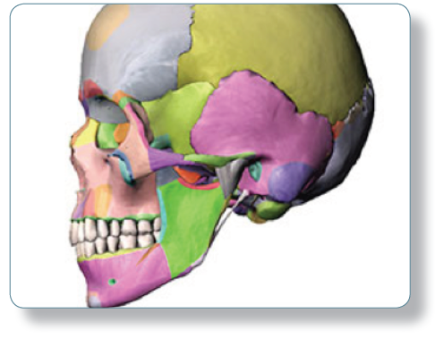
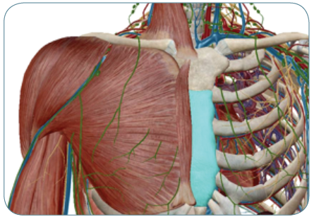
Visible Body®
Suite of online programs that cover anatomy, physiology, muscles, the skeleton and the circulatory system through interactive 3D models, animations, quizzes and more.
Flexible subscription and purchasing options to allow you to customize to meet your specific needs.
Offered for iPad® and/or Android®* to support users who need offline and offsite access to meet their and device preference.
Essential Anatomy & Physiology Resources
  Human Anatomy Atlas
  Physiology Animations
Anatomy For the Classroom
  Anatomy & Physiology
Anatomy at Work
  Anatomy & Function
Premium Specialty Modules
  Heart & Circulatory Premium
  Muscle Premium
  Skeleton Premium
Notes:
Visible Body is a suite of online programs that cover anatomy, physiology, muscles, the skeleton and the circulatory system through interactive 3D models, animations, quizzes and more.
Flexible subscription and purchasing options to allow you to customize to meet your specific needs.
Offered for iPad® and/or Android®* to support users who need offline and offsite access to meet their busy schedules, study habits and device preference.
Peel away structures and layers from head to toe, rotate anatomical models, and dive deep into both systemic and regional anatomy
Complement textbook and classroom-based learning with interactive resources that support learning objectives and measure learner competency
Coverage ranges from complete systemic and regional anatomy to specialty modules, perfect for any curriculum type
Access a variety of content types including animations, illustrations, definitions, audio pronunciations, quizzes and more
Produced by awarding-winning team of medical illustrators and biomedical visualization experts belonging to the Association of Medical Illustrators
Extend access to valuable study tools and custom features, off-campus and no need for an internet connection.

Slide 21
Evidence-Based Practice Resources

Slide 22
Evidence-Based Practice Resources
Access the best available evidence information from an international community and tools for patient engagement all in one place from leading resources such as:
  Evidence-Based Medicine Reviews (EBMR)
  Joanna Briggs Institute (JBI)
  Natural Medicines
  and more…

Slide 23
Evidence-Based Medicine Reviews (EBMR)
  A definitive resource for electronic information in the evidence based medicine (EBM) movement
  Combines 7 of the most trusted evidence resources into a single, fully-searchable database
  Content from the leading producers of evidence including the Cochrane Collaboration published by Wiley, as well as the American College of Physicians Journal Club
  Access to Article, Methodology, Systematic and Technology Reviews.
Notes:
A definitive resource for electronic information in the evidence based medicine (EBM) movement that combines 7 of the most trusted EBM resources into a single, fully-searchable database.
Only with EBMR on Ovid can you get comprehensive integration with MEDLINE!
Topic Reviews
Cochrane Database of Systematic Reviews - produced by Cochrane Collaboration
These reviews allow clinicians to get fast, "bottom line" answers to their most commonly-asked questions, based on a comprehensive and expert analysis of the available medical literature. Includes links to PDFs of the Topic Reviews, the Cochrane Database of Methodology Reviews (CDMR), full-text methodology reviews that summarize the empirical basis for decisions about methods in systematic reviews (includes complete reviews and protocols).
The Database of Abstracts of Reviews of Effectiveness (DARE) - NHS Centre for Reviews and Dissemination (CRD)
Selected systematic reviews on the effectiveness of clinical interventions and policies from databases such as MEDLINE and through manual review of the primary literature. These high-quality reviews are based on evaluation of literature searching, inclusion criteria, study assessment, and synthesis. Selected articles are summarized and evaluated in comprehensive full-text reports.
Health Technology Assessments (HTA) - NHS Centre for Reviews and Dissemination (CRD)
In collaboration with Sweden’s International Network of Agencies of Health Technology Assessment, HTA brings together details on ongoing studies of the medical, social, ethical and economic implications of healthcare interventions. It contains 4,000 records of completed and ongoing assessments from members of INAHTA.
NHS Economic Evaluation Database (NHSEED) - NHS Centre for Reviews and Dissemination (CRD)
Over 6,000 abstracts of quality assessed economic evaluations to assist decision-makers by systematically identifying and describing economic evaluations, appraising their quality and highlighting their relative strengths and weaknesses.
Article Reviews
ACP Journal Club - American College of Physicians
Enhanced abstracts of clinically relevant and sound studies published in top clinical journals. They include commentaries on the applicability of these studies to clinical practice.
Definitive Controlled Trials
The Cochrane Central Register of Controlled Trials - Cochrane Collaboration
Over 350,000 bibliographic references to controlled trials in health care, and imposes quality control standards on included references to ensure that only reports of definite randomized controlled trials or controlled clinical trials are included.
Methodology Reviews
Cochrane Methodology Register (CMR) -
A bibliography of more than 9,000 references to controlled trials in journal articles, book chapters, conference proceedings and reports, and other publications of methodologies used in health studies.

Slide 24
Thank you!

