Slide 1
Jamming LoRaWAN Over The Air Authentication
by Baurzhan Orazbayev
Supervised by: Dimitrios Zormpas
Assistant Professor
Accepted by Ph.D. Adnan Yazici
Department Chair, SEDS
Nazarbayev University, April 2022

Slide 2
Outline.
Introduction
LoRa and LoRaWAN
Problem definition
Previous researches
Research objectives
Methodology and implementation
Conclusion

Slide 3
LoRa (Long Range) is a long-range non-cellular wireless communication technology that uses a spread spectrum (CSS) radio modulation. LoRaWAN is a network architecture that uses LoRa.
LoRa and LoRaWAN are low-power WAN technologies for IoT applications with long-range, low power, and low bandwidth.
Introduction
LoRaWAN main features
ISM frequency bands: | 433, 868, 915 MHz
Mode | Class A, B, C
Spreading Factor | 7-12
Bandwidth | 125, 250, and 500 kHz
Data rates | 0.3 to 50 kbps

Slide 4
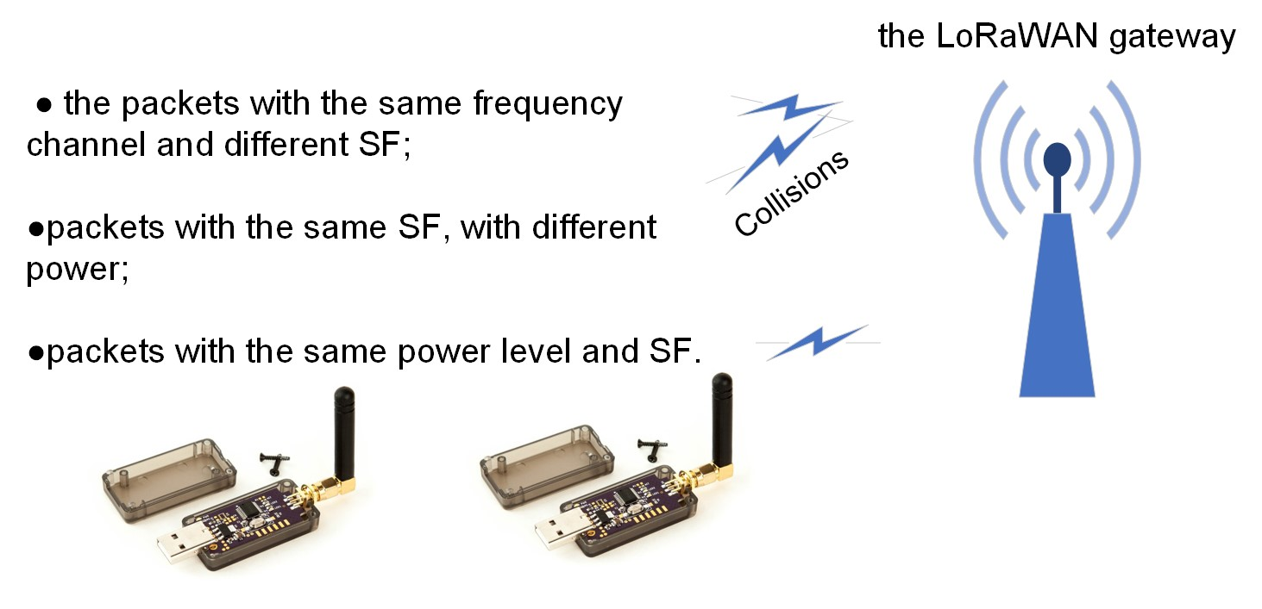
Features of LoRa radio technology:

Slide 5
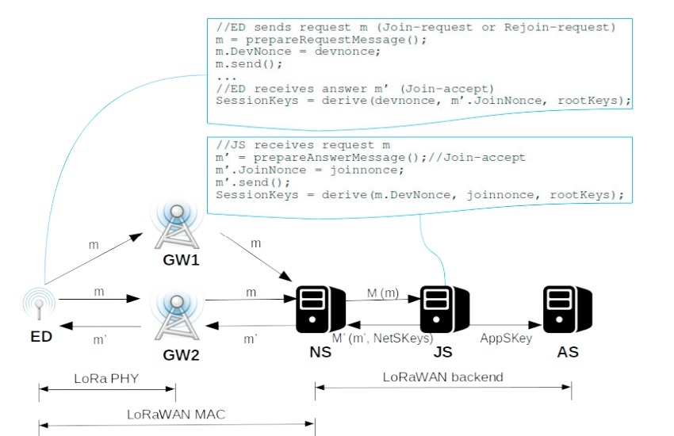
LoRaWAN
Figure 3. LoRaWAN architecture[3]

Slide 6
LoRaWAN authentication protocols
Two possible ways of authentication are available in LoRaWAN:
ABP (Activation By Personalization), where a fixed DevAddr and session keys for a predefined WAN are implemented in the end device.
OTAA (Over The Air Activation), where the LoRa end-node generates a request to join LoRaWAN using root keys, which allows to assign end-device a DevAddr and generating new session keys [5].

Slide 7
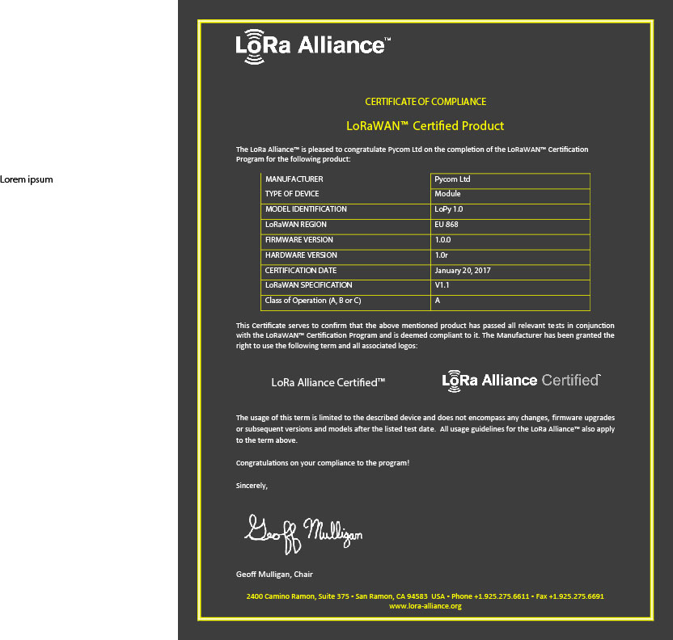
Problem statement.
The impact of jamming on OTAA LoRaWAN was be assessed with the following requirements:
1. The microcontroller (MCU) must be small in size, economical, and energy-efficient.
2. MCU must communicate using LoRaWAN technology.
3. The experimental test-bed should be capable of evaluating OTAA authentication vulnerabilities
using available hardware.

Slide 8
Jamming attacks in LoRa networks
JA is an attack when an attacker generates wireless signals in irregular or sophisticated RF interference signals, making it difficult for wireless devices to decode data packets. Traditional jammer models:
- Band Jamming (BJ) - BJ = B * p, 0 ≤ p ≤ 1.
- Tone Jamming (TJ) - combine several sine waveforms in the used bandwidth. TJ can be single and multi-tone jamming [2]

Slide 9
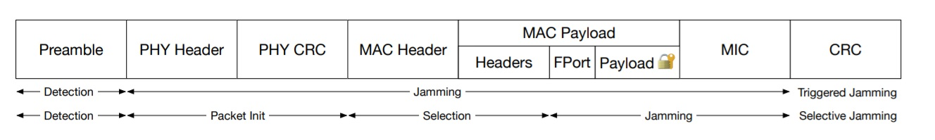
Jamming techniques
Channel-oblivious cases:
Constant jamming
Random jamming
Channel-aware cases:
Triggered jamming
Selective Jamming
Reactive jamming
Replay attack
Figure 4. Timing of Triggered and Selective Jamming [1]

Slide 10
Research objectives
Potential interruption of the OTAA procedure
Investigating jamming vulnerabilities of the OTAA authentication in an experimental test-bed.
Evaluating two kinds of selective jamming attacks – fixed and channel hopping.

Slide 11
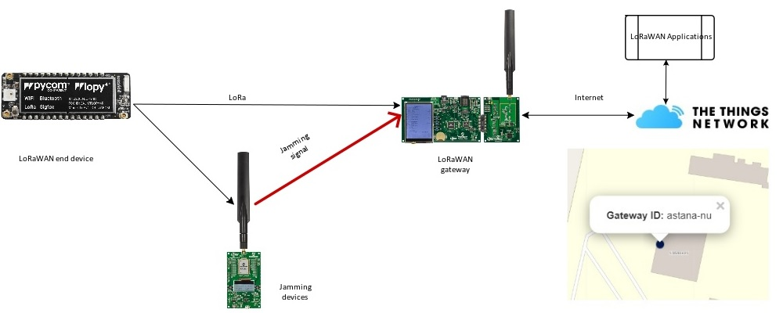
Methodology and implementation: experimental configuration.
Figure 5. Jamming experiment

Slide 12
Fixed channel jamming
OTAA uses in the EU863-870 ISM Band the three default frequency channels to authenticate end-devices: 868.1, 868.3, and 868.5 MHz.
The power of the interfering signal should be at least 6 dBm higher than a legitimate transmitter in case of nearby location[1, 2].
To simplify the experiment, we used the following assumptions:
The same SF, bandwidth and frequency for the jammer and end-device are used
Interruption OTAA authentication were fixed after some(N>15) attempts.

Slide 13
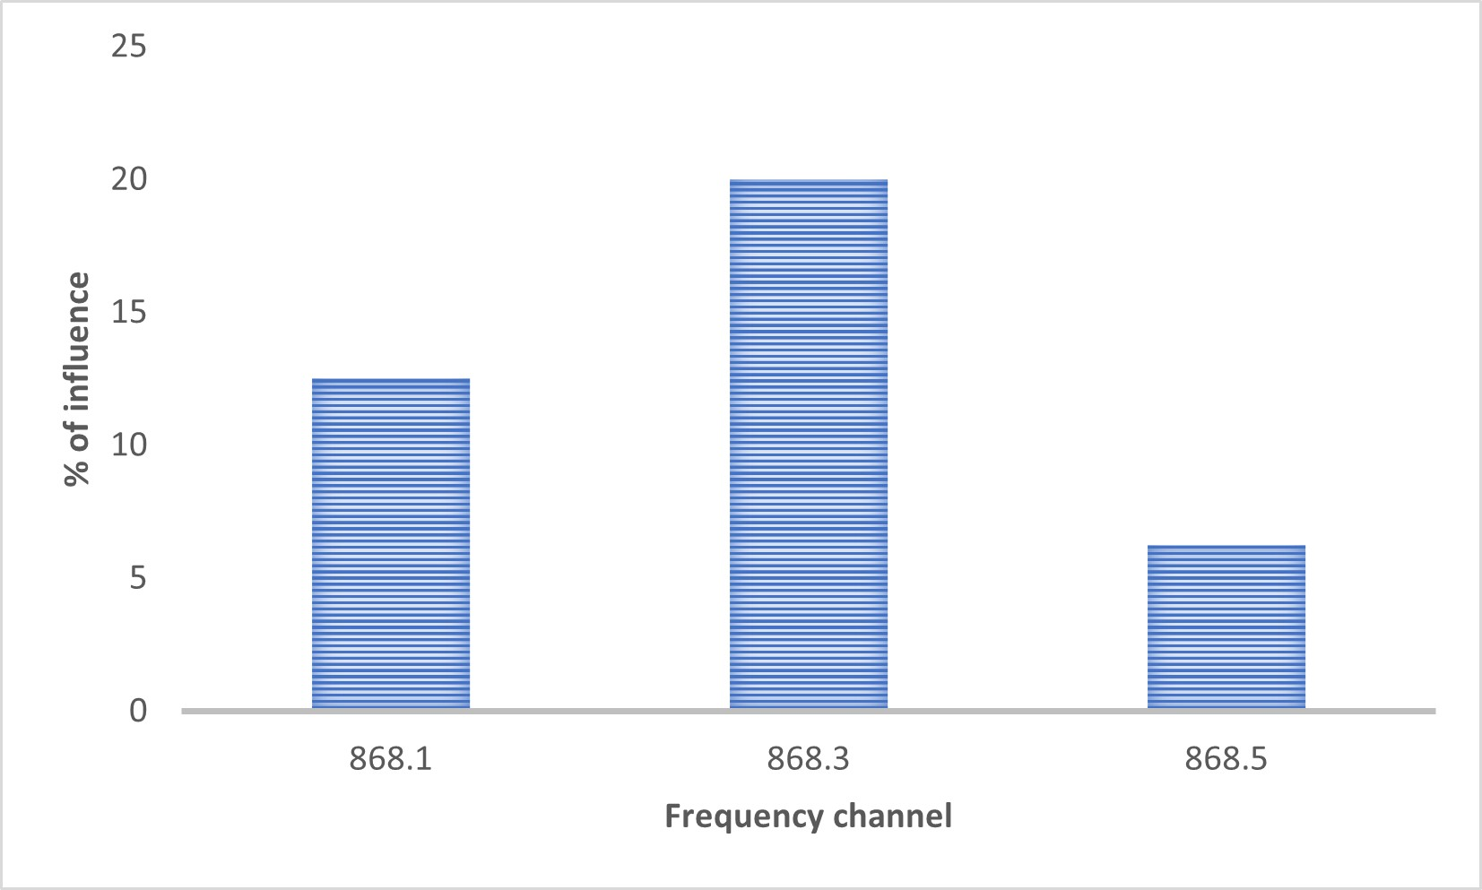
Fixed channel jamming results.
-The efficiency of influence diverse from 6 to 20 percent.
- Successful attempts of interruption OTAA authentication
were not detected
Figure 6. Fixed channel jamming

Slide 14
Channel hopping jamming
The attacker transmits a frame for a given SF on any default channel and then moves to the next frequency channel and performs another transmission.
Jamming in all three default channels in a particular SF 868.1, 868.3, and 868.5 MHz with a bandwidth of 125 kHz.
Different payloads used to influence to the air time of jamming signal.

Slide 15
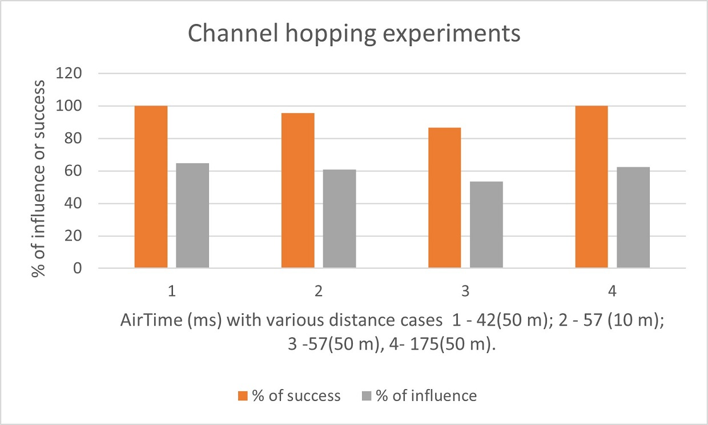
Figure 7. Channel hopping experimental jamming results

Slide 16
Conclusion
Off-the-shelf devices can be used to create collisions
Noise immunity of LoRa
Experimental limitations

Slide 17
REFERENCES
Emekcan Aras, Nicolas Small, Gowri Sankar Ramachandran, Stéphane Delbruel, Wouter Joosen, and Danny Hughes. Selective jamming of lorawan using commodity hardware. In Proceedings of the 14th EAI International Conference on Mobile and Ubiquitous Systems: Computing, Networking and Services, MobiQuitous 2017, page 363–372, New York, NY, USA, 2017. Association for Computing Machinery. DOI:10.1145/3144457.3144478.
Clement Demeslay, Roland Gautier, Anthony Fiche, and Gilles Burel. Band and tone jamming analysis and detection on lora signals. In Workshop on Security and Protection Information SPI2021, Jun 2021. Retrieved from arXiv preprint arXiv:2107.07782.2021.
Tahsin Dönmez and Ethiopia Nigussie. Security of join procedure and its delegation in lorawan v1.1. Procedia Computer Science, 134:204–211, 01 2018. DOI:10.1016/j.procs.2018.07.202.
Xingda Chen, Margaret Lech, and Liuping Wang. A complete key management scheme for lorawan v1. 1. Sensors, 21(9):2962, 2021.
Azhar Iqbal, Muhammad, Sajjad Hussain, Huanlai Xing, and Muhammad Ali Imran. Internet of Things Security, pages i–xix. River Publishers, 2018. Retrieved from doi:10.1002/9781119701460.fmatter.

Slide 18
Thank you for attention!

