Slide 1

Performance Analysis of Edge Computing for 5G and
Internet of Things
School of Engineering and Digital Sciences
Department of Electrical and Computer Engineering
Nazarbayev University
Supervisors: Dr. Behrouz Maham, Dr. Aresh Dadlani
External examiner: Dr. Sain Saginbekov
Aigerim Ospanova
Student ID: 201911399
Nur-Sultan, 2022

Slide 2
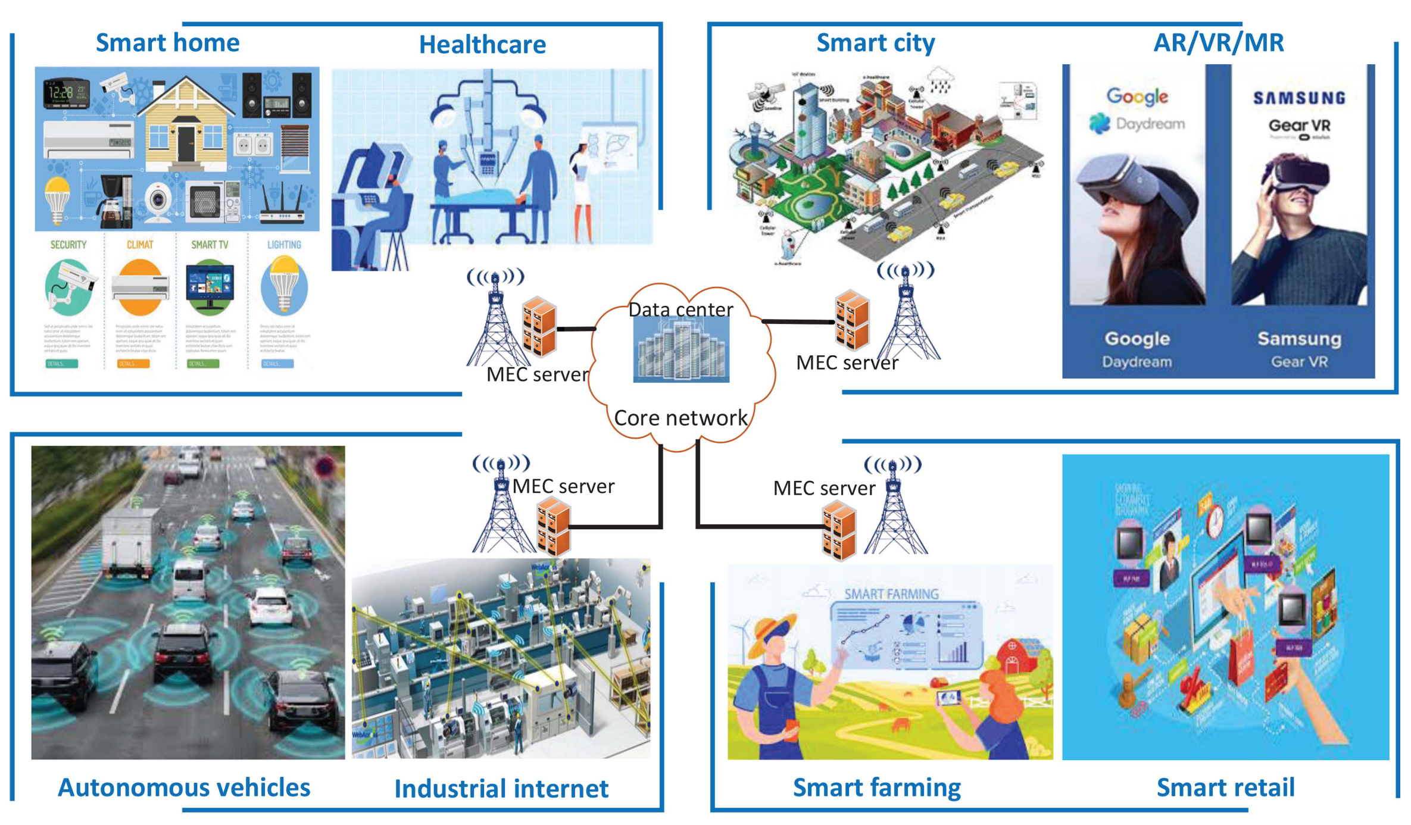
Introduction
Fig. 1. Implementation of edge-assisted IoT [1].

Slide 3
Literature review
Metric
Latency [2], [4]
Reliability [5], [6]
Energy consumption [3], [4]
Capacity [7], [8]
Utility [10], [11]
Security and privacy [9], [10]

Slide 4
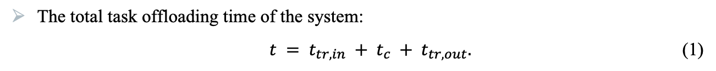
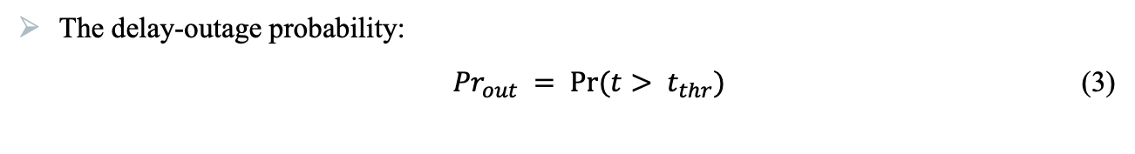
The delay-outage probability
The total task offloading time of the system:
${t = t}_{tr,in} + t_{c} + t_{tr,out}.$ (1)
The result transmission time is omitted:
${ t= t}_{tr, in} + t_{c}.$(2)
The delay-outage probability:
${Pr}_{out} = Pr(t> t_{thr})$ (3)
Communication latency, t_{tr, in}
Computation latency, t_{c}
t_{tr,out}
t
Fig. 2. Edge computing total task offloading [12].

Slide 5
Selection schemes for task offloading
A user device offloads its complex task to one edge node for completion.
Two types of schemes:
Selection-based schemes over Rayleigh fading channels
Selection-based schemes over Nakagami-m fading channels

Slide 6
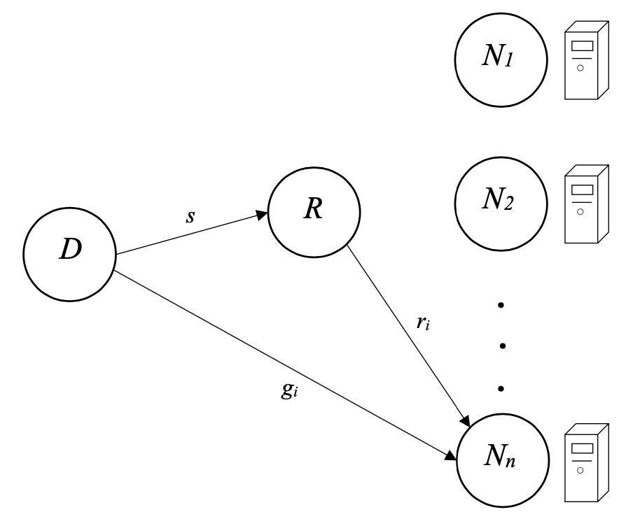
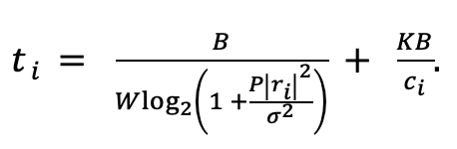
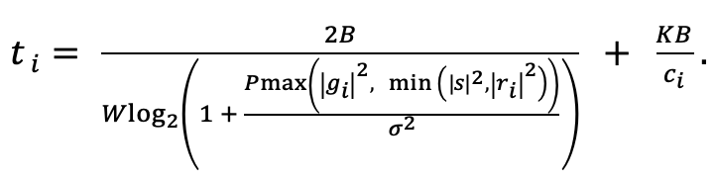
Nakagami-m fading case
Two offloading models:
Edge computing with cache-aided relay:
Edge computing with cache-free relay:
(4)
Fig. 3. Edge computing with relay assistance [6].
(5)

Slide 7
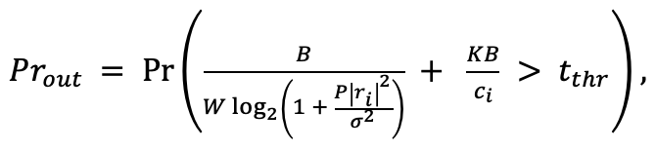
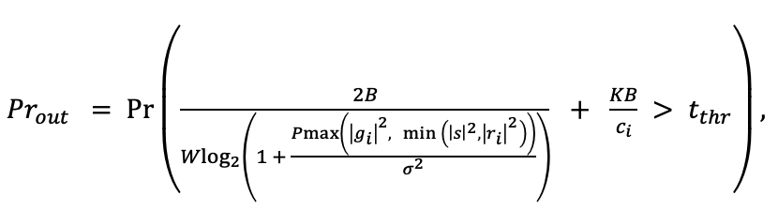
Performance analysis
The delay-outage probability of edge computing model with cache-aided relay:
.
(6)
The delay-outage probability of edge computing model with cache-free relay:
.
(7)

Slide 8
Selection criteria for edge computing
For both models, appropriate node selection criteria are developed [6].
Cache-aided relay
Scheme I: Edge node with the best CPU
Scheme II: Relay – edge node channel with the best power gain
Cache-free relay
Scheme I: Edge node with the best CPU
Scheme II: Relay – edge node channel with the best power gain
Scheme III: User – edge node channel with the best power gain

Slide 9
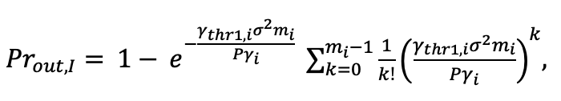
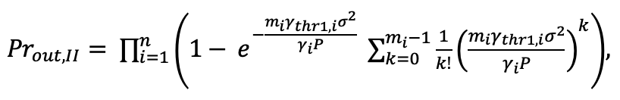
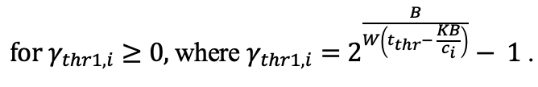
Selection model with cache-aided relay
The delay-outage probability:
Scheme I:
(8)
Scheme II:
(9)

Slide 10
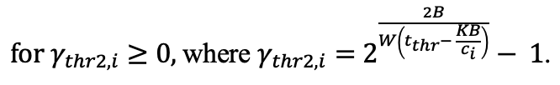
Selection model with cache-free relay
Scheme I:
(10)
Scheme II:
(11)
Scheme III:
(12)

Slide 11
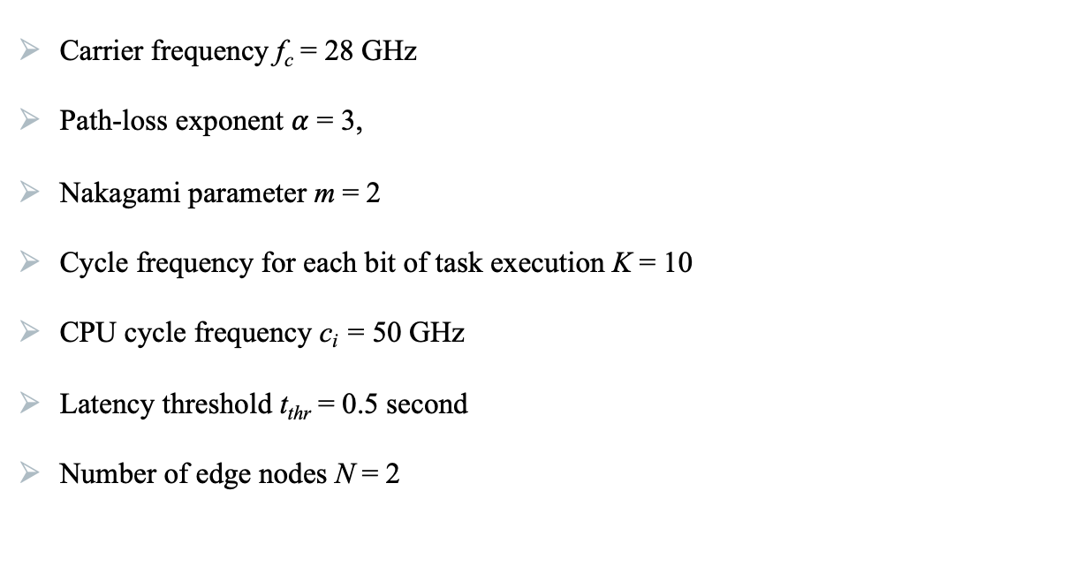
Numerical results
Carrier frequency f_{c} = 28 GHz
Path-loss exponent $α$ = 3,
Nakagami parameter m = 2
Cycle frequency for each bit of task execution K = 10
CPU cycle frequency c_{i} = 50 GHz
Latency threshold t_{thr} = 0.5 second
Number of edge nodes N = 2

Slide 12
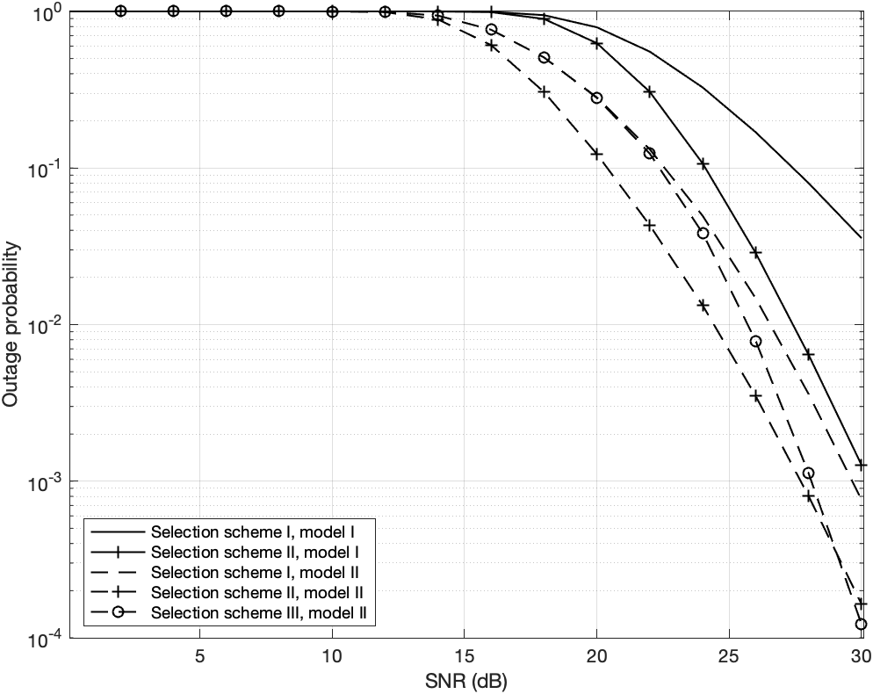
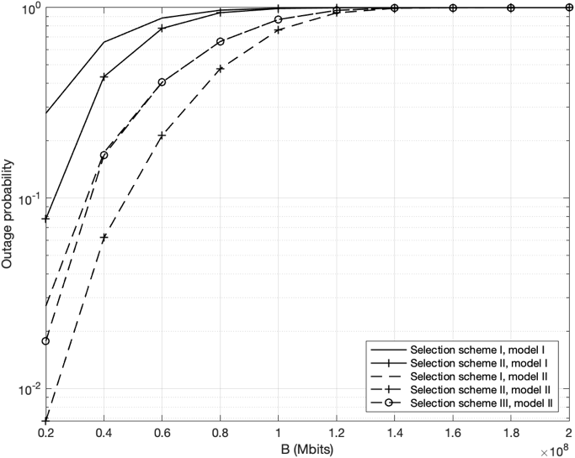
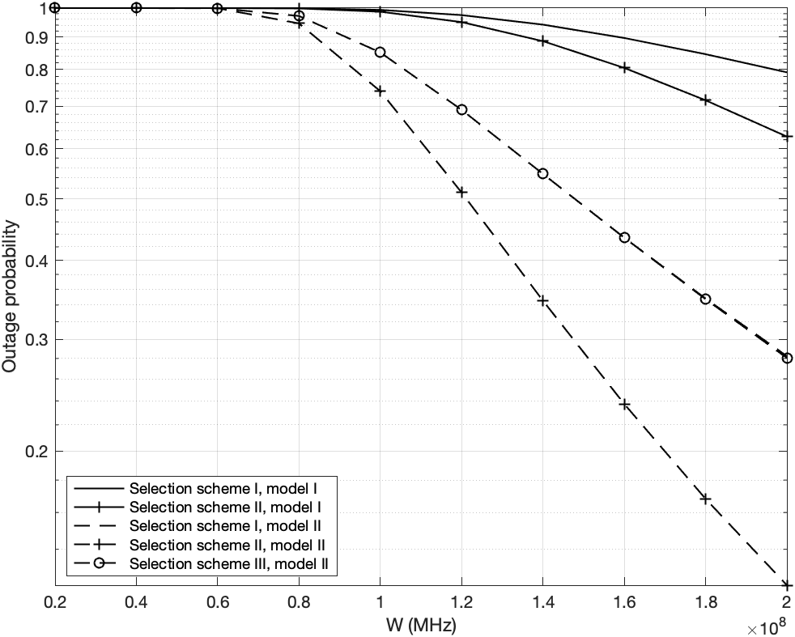
Numerical results
Fig. 4. The outage probability curves versus SNR.
Fig. 5. The outage probability curves versus task size.
Fig. 6. The outage probability curves versus channel bandwidth.

Slide 13
Combining schemes for task offloading
A user device offloads its complex task to all edge nodes simultaneously for completion.
TDMA-based task offloading
FDMA-based task offloading
Capacity achieving-based task offloading

Slide 14
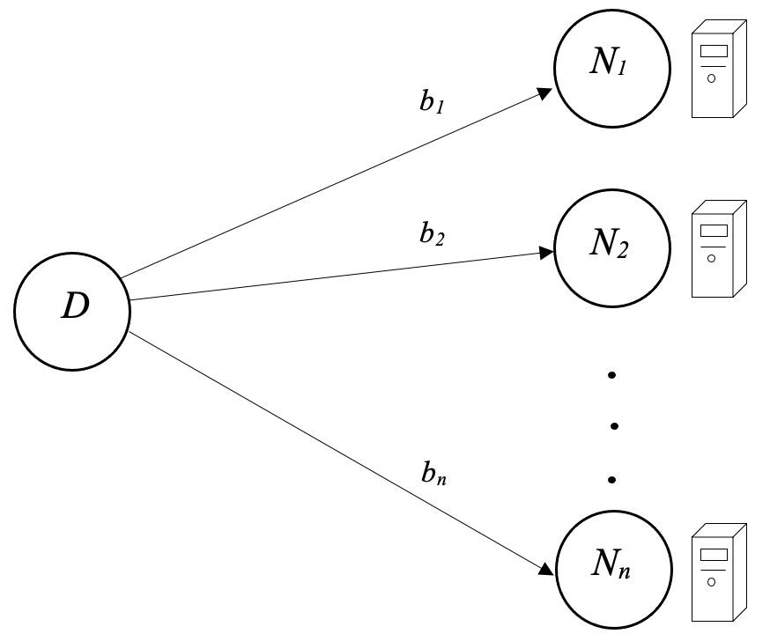
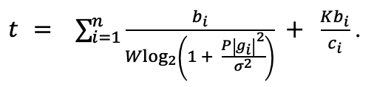
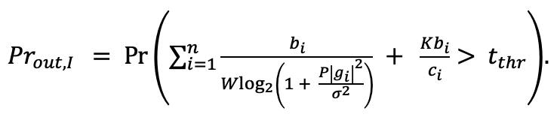
TDMA-based task offloading
The total time of task offloading:
(13)
The delay-outage probability:
(14)
Fig. 7. Edge computing with TDMA.

Slide 15
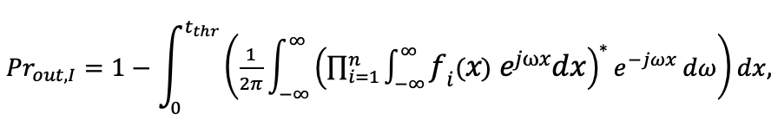
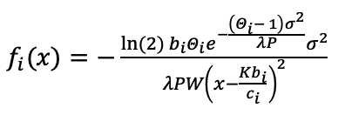


Performance analysis
The delay-outage probability in Rayleigh fading case:
(15)
, where
and
.
There is no closed-form expression; therefore, the reliability can be computed numerically.

Slide 16
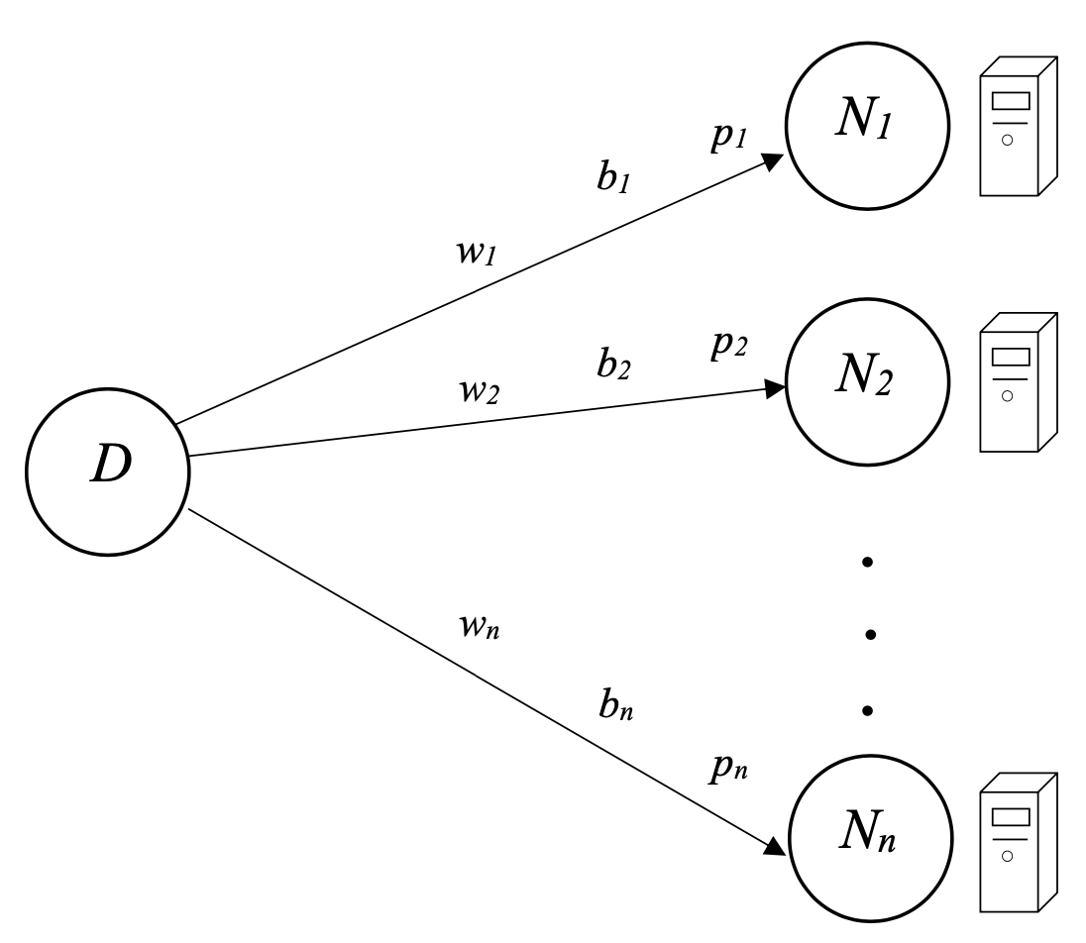
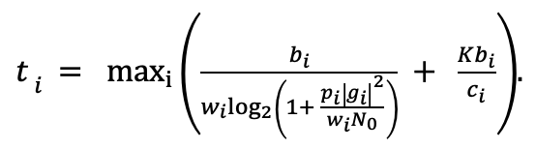
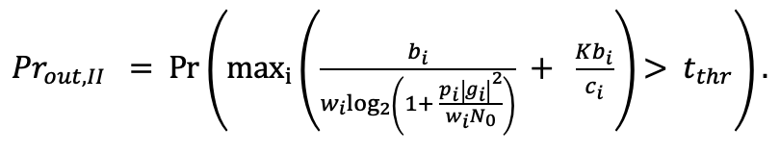
FDMA-based task offloading
The total time of task offloading:
(16)
The delay-outage probability:
(17)
Fig. 8. Edge computing with FDMA.

Slide 17
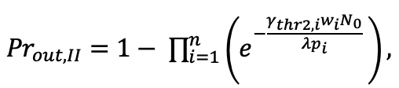
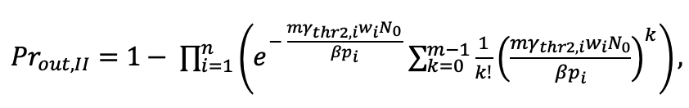
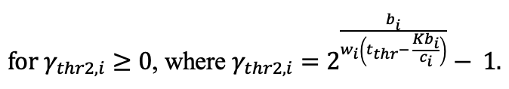
Performance analysis
The delay-outage probability in Rayleigh fading case:
(18)
The delay-outage probability in Nakagami-m fading case:
(19)

Slide 18
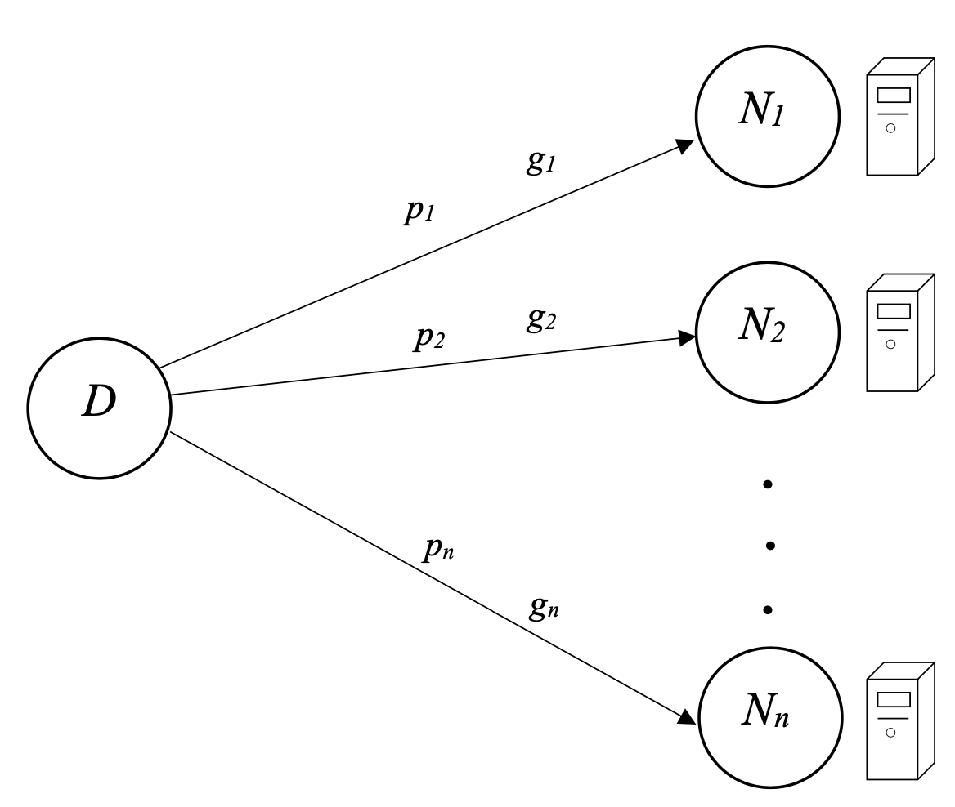
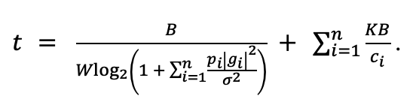
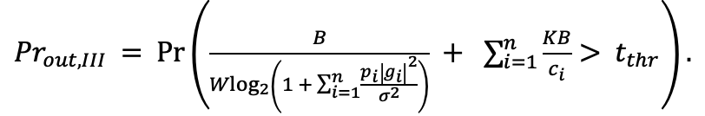
Capacity achieving schemes
The total time of task offloading:
(20)
The delay-outage probability:
(21)
Fig. 9. Edge computing with capacity achieving schemes.

Slide 19
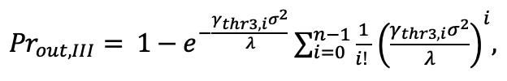
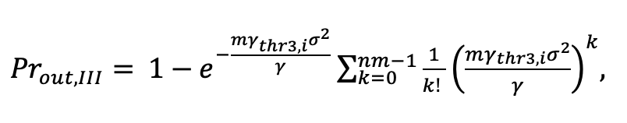
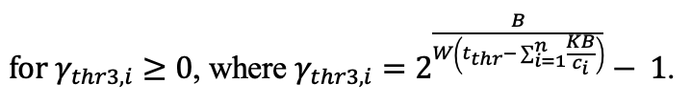
Performance analysis
The delay-outage probability in Rayleigh fading case:
(22)
The delay-outage probability in Nakagami-m fading case:
(23)

Slide 20
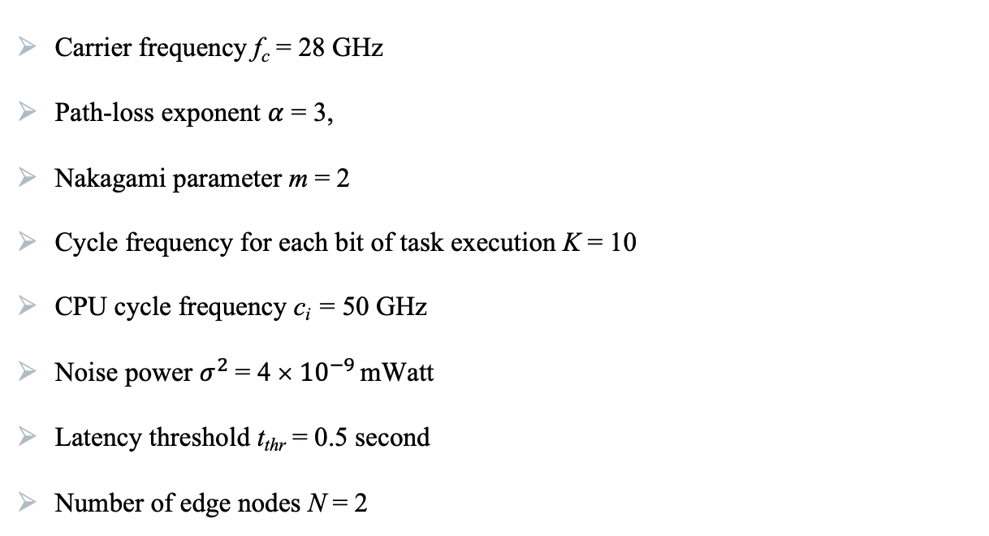
Numerical results
Carrier frequency f_{c} = 28 GHz
Path-loss exponent $α$ = 3,
Nakagami parameter m = 2
Cycle frequency for each bit of task execution K = 10
CPU cycle frequency c_{i} = 50 GHz
Noise power $σ^{2}$= 4 × ${10}^{−9}$ mWatt
Latency threshold t_{thr} = 0.5 second
Number of edge nodes N = 2

Slide 21
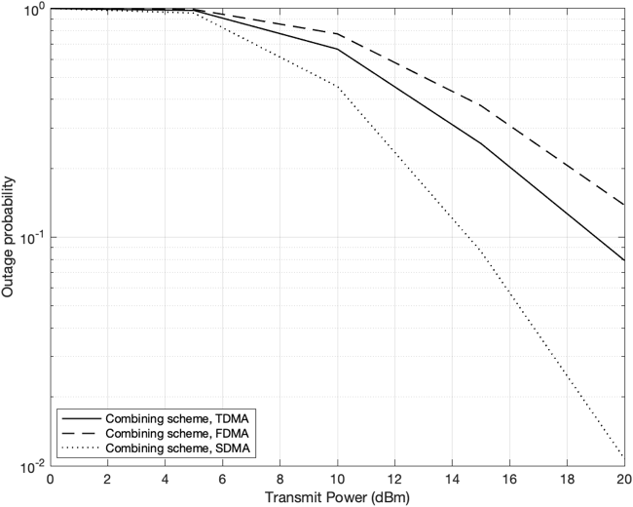
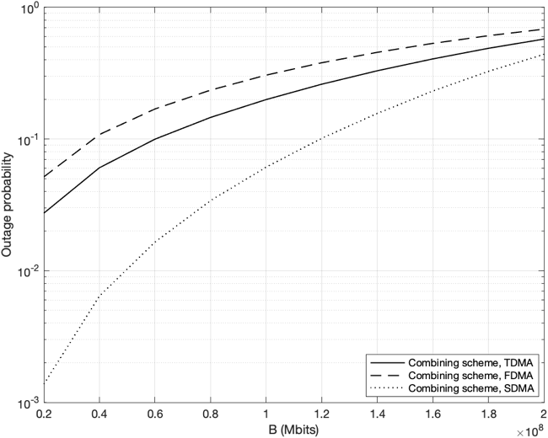
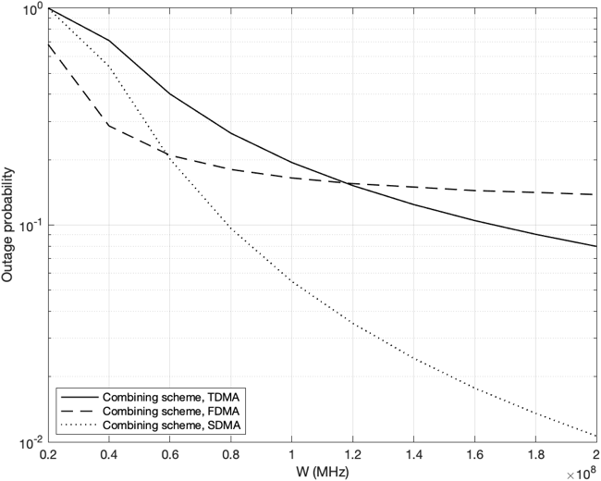
Numerical results
Rayleigh fading channels
Fig. 10. The outage probability curves versus transmit power.
Fig. 11. The outage probability curves versus task size.
Fig. 12. The outage probability curves versus channel bandwidth.

Slide 22


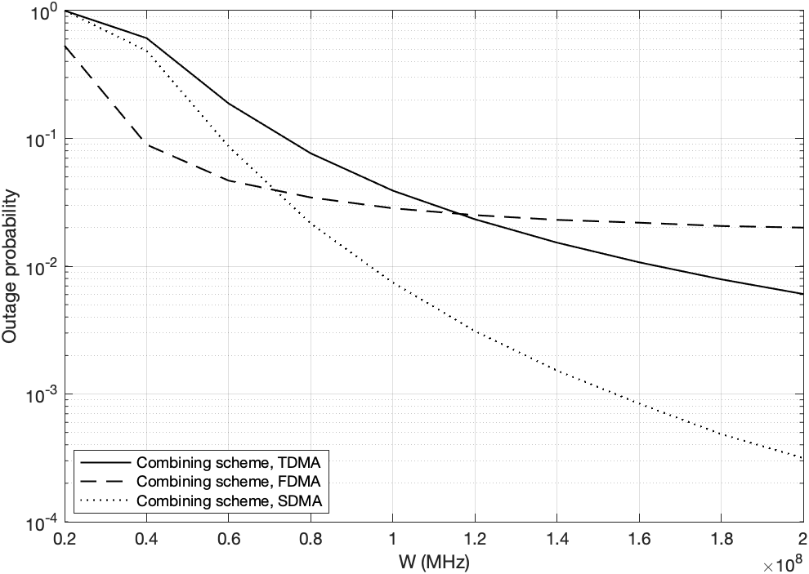
Numerical results
Nakagami-m fading channels
Fig. 13. The outage probability curves versus transmit power.
Fig. 14. The outage probability curves versus task size.
Fig. 15. The outage probability curves versus channel bandwidth.

Slide 23
Conclusions
Selection schemes: Edge computing with cache-free relay, where the best channel gain from the relay to edge node is selected, showed the highest results.
Combining schemes: Edge computing with capacity achieving schemes outperformed TDMA and FDMA schemes in terms of the reliability.

Slide 24
Bibliography
[1] Y. Liu, M. Peng, G. Shou, Y. Chen, and S. Chen, “Toward edge intelligence: Multiaccess edge computing for 5G and Internet of Things,” IEEE Internet of Things J., vol. 7, no. 8, pp. 6722-6747, Aug. 2020, doi: 10.1109/JIOT.2020.3004500.
[2] C. Cicconetti, M. Conti, and A. Passarella, “Architecture and performance evaluation of distributed computation offloading in edge computing,” Simul. Model. Pract. Theory, vol. 101, pp. 1-22, May 2020, doi: ﻿10.1016/j.simpat.2019.102007.
[3] P. W. Khan, K. Abbas, H. Shaiba, A. Muthanna, A. Abuarqoub, and M. Khayyat, “Energy efficient computation offloading mechanism in multi-server mobile edge computing – An integer linear optimization approach,” Electronics, vol. 9, no. 6, pp. 1-20, Jun. 2020, doi: 1﻿0.3390/electronics9061010.
[4] Q. Tang, H. Lyu, G. Han, J. Wang, and K. Wang, “Partial offloading strategy for mobile edge computing considering mixed overhead of time and energy,” Neural Comput. Appl., vol. 32, no. 19, pp. 15383-15397, Aug. 2019, doi: 10.1007/s00521-019-04401-8.
[5] J. Xia et al., “Opportunistic access point selection for mobile edge computing networks,” IEEE Trans. Wirel. Commun., vol. 20, no. 1, pp. 695-709, Jan. 2021, doi: 10.1109/TWC.2020.3028102.
[6] J. Xia et al., “Cache-aided mobile edge computing for B5G wireless communication networks,” EURASIP J. Wirel. Commun. Netw., vol. 2020, no. 1, pp. 1-10, Jan. 2020, doi: 10.1186/s13638-019-1612-0.
[7] Y. Cai and P. Yuan, “Time-varying mobile edge computing for capacity maximization,” IEEE Access, vol. 8, pp. 142832-142842, 2020, doi: 10.1109/ACCESS.2020.3014275.
[8] Y. He, J. Ren, G. Yu, and Y. Cai, “D2D communications meet mobile edge computing for enhanced computation capacity in cellular networks,” IEEE Trans. Wirel. Commun., vol. 18, no. 3, pp. 1750–1763, Mar. 2019, doi: 10.1109/TWC.2019.2896999.
[9] X. Xu, Q. Huang, X. Yin, M. Abbasi, M. R. Khosravi, and L. Qi, “Intelligent offloading for collaborative smart city services in edge computing,” IEEE Internet of Things J., vol. 7, no. 9, pp. 7919-7927, Sept. 2020, doi: 10.1109/JIOT.2020.3000871.

Slide 25
[10] X. Xu, X. Liu, Z. Xu, C. Wang, S. Wan, and X. Yang, “Joint optimization of resource utilization and load balance with privacy preservation for edge services in 5G networks,” Mob. Netw. Appl., vol. 25, no. 2, pp. 713–724, Apr. 2020, doi: 10.1007/s11036-019-01448-8.
[11] S. Li et al., “Joint congestion control and resource allocation for delay-aware tasks in mobile edge computing,” Wirel. Commun. Mob. Comput., vol. 2021, pp. 1-16, Jan. 2021, doi: ﻿10.1155/2021/8897814.
[12] N. C. Luong, P. Wang, D. Niyato, Y. Wen, and Z. Han, “Resource management in cloud networking using economic analysis and pricing models: A survey,” IEEE Commun. Surv. Tutor., vol. 19, no. 2, pp. 954-1001, Secondquart. 2017, doi: 10.1109/COMST.2017.2647981.

