Slide 1




Master’s Thesis Defense
Master’s Thesis Presentation
Haptic Devices and Illusions for Augmented and Virtual Reality Applications
Adilzhan Adilkhanov (Master’s in Robotics, SEDS)
Supervisor: Dr. Zhanat Kappassov
Co-supervisor: Dr. Matteo Rubagotti
28.04.2022
Spring 2022, Astana, Kazakhstan

Slide 2


Master’s Thesis Defense
Outline:
Chapter 1 – Literature Review
  Introduction
  Taxonomy
  Discussions
Chapter 2 – Novel Haptic Device
  Hardware
  Stimuli
  Perceptual Evaluation
  Discussions
Adilzhan Adilkhanov
1/44

Slide 3

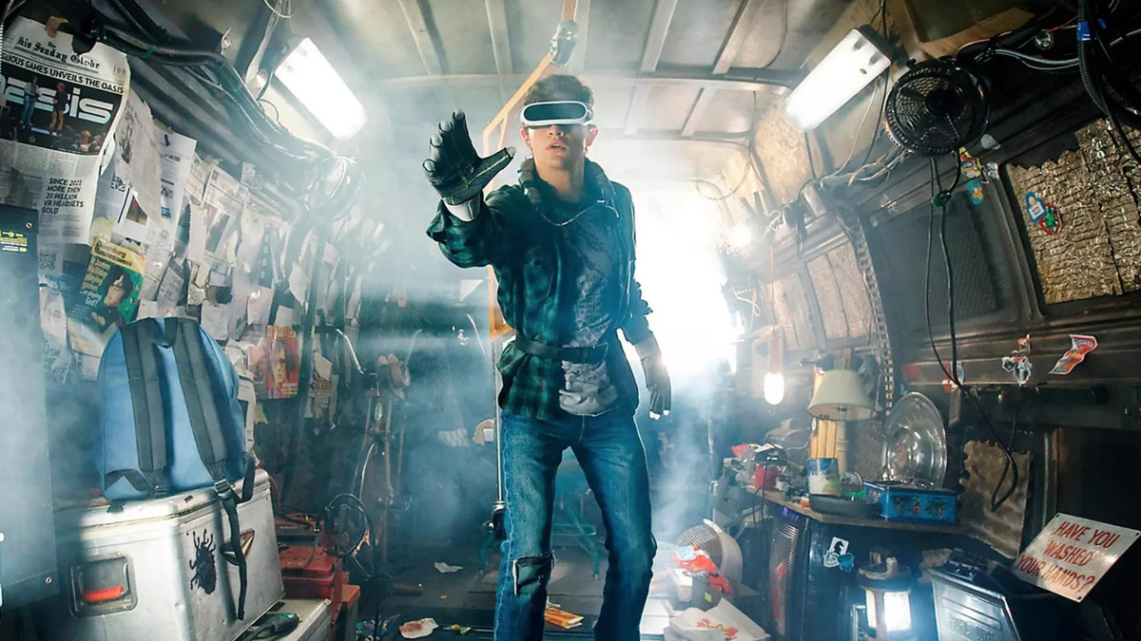
Master’s Thesis Defense
Motivation and Aim:
Scene from “Ready Player One” (2018) movie
Adilzhan Adilkhanov
2/44

Slide 4
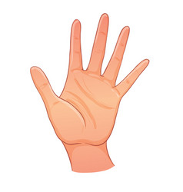
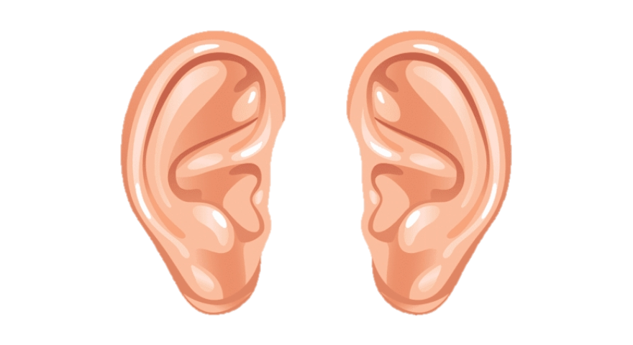

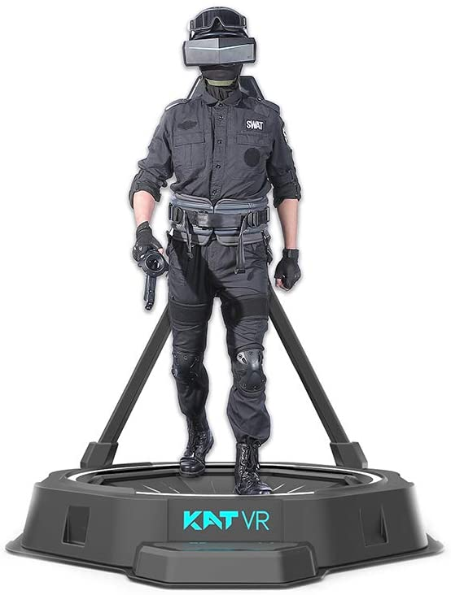
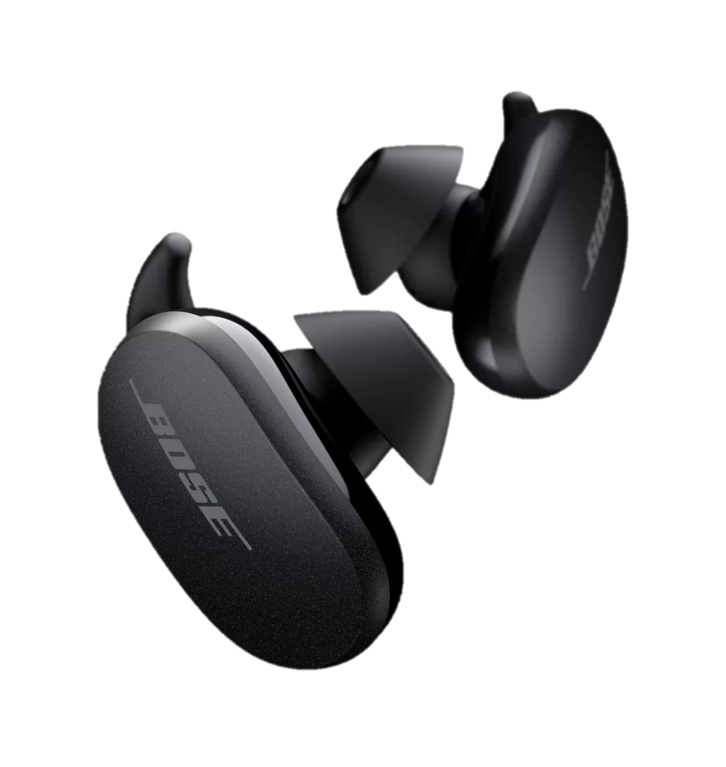
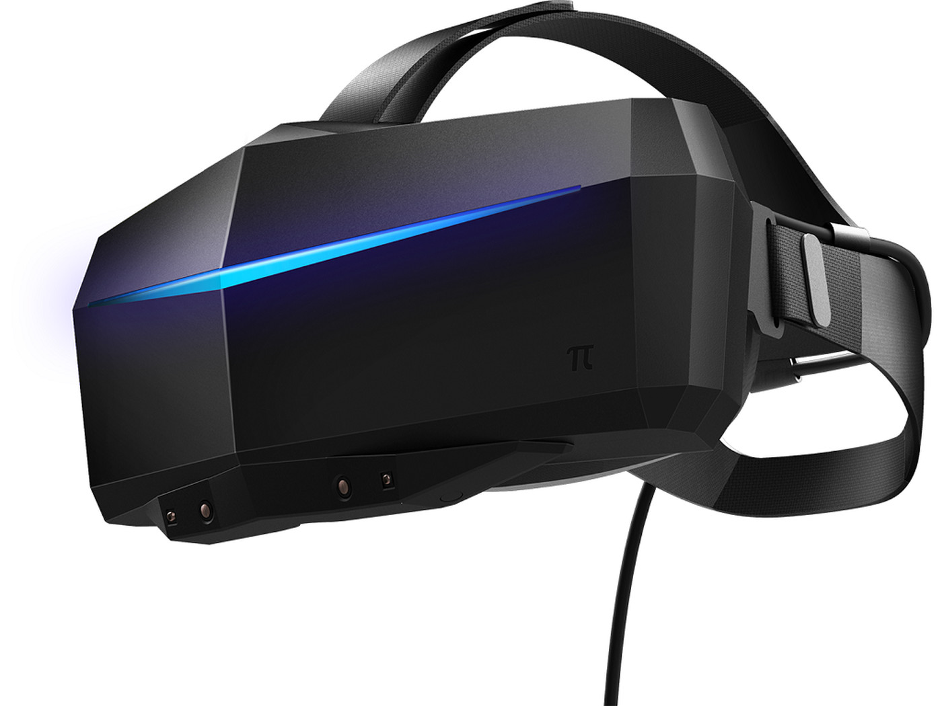

Master’s Thesis Defense
Motivation and Aim:
Adilzhan Adilkhanov
3/44

Slide 5
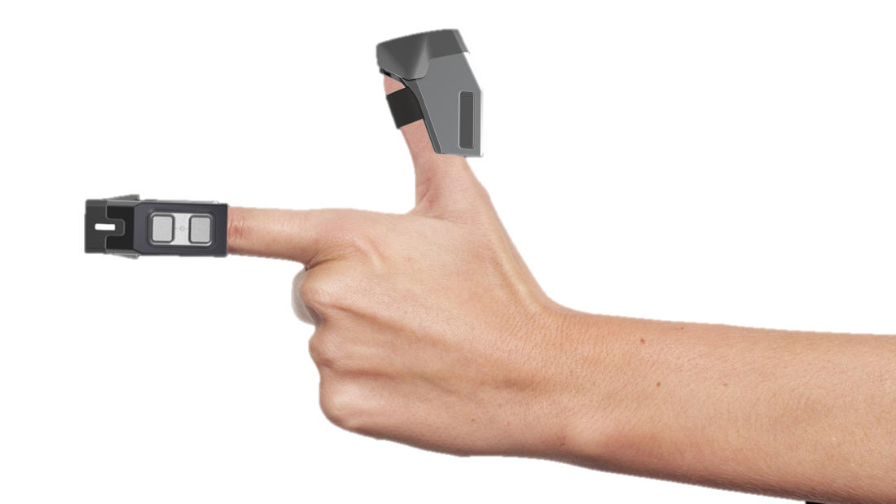
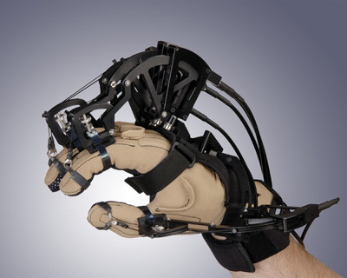
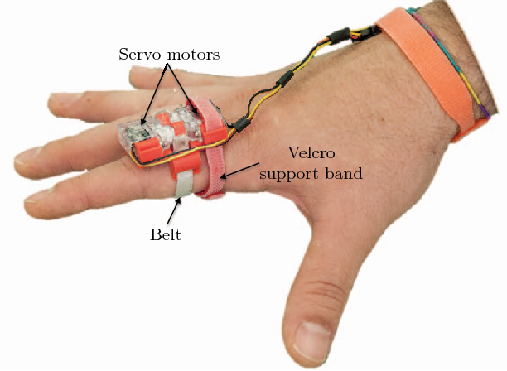
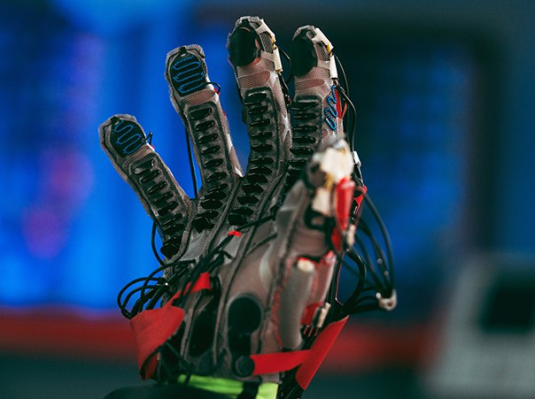
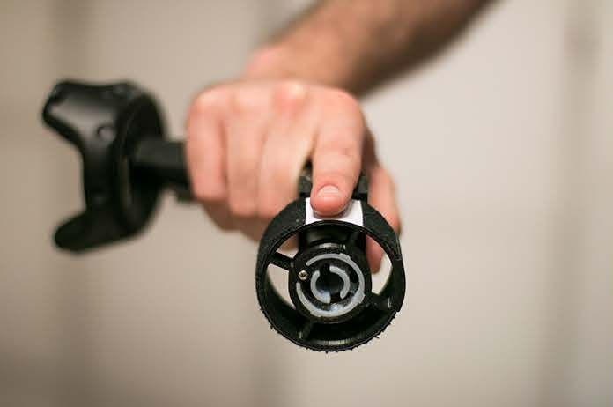
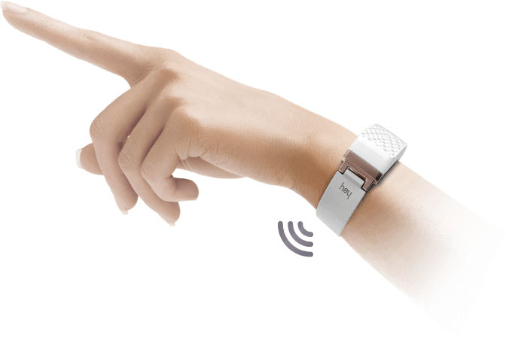
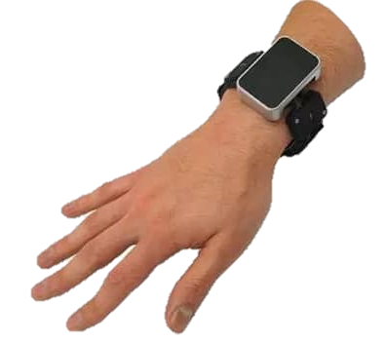
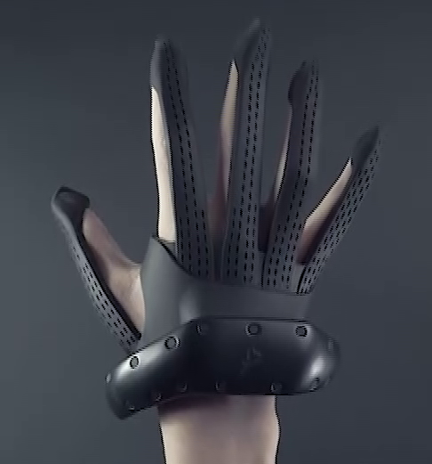
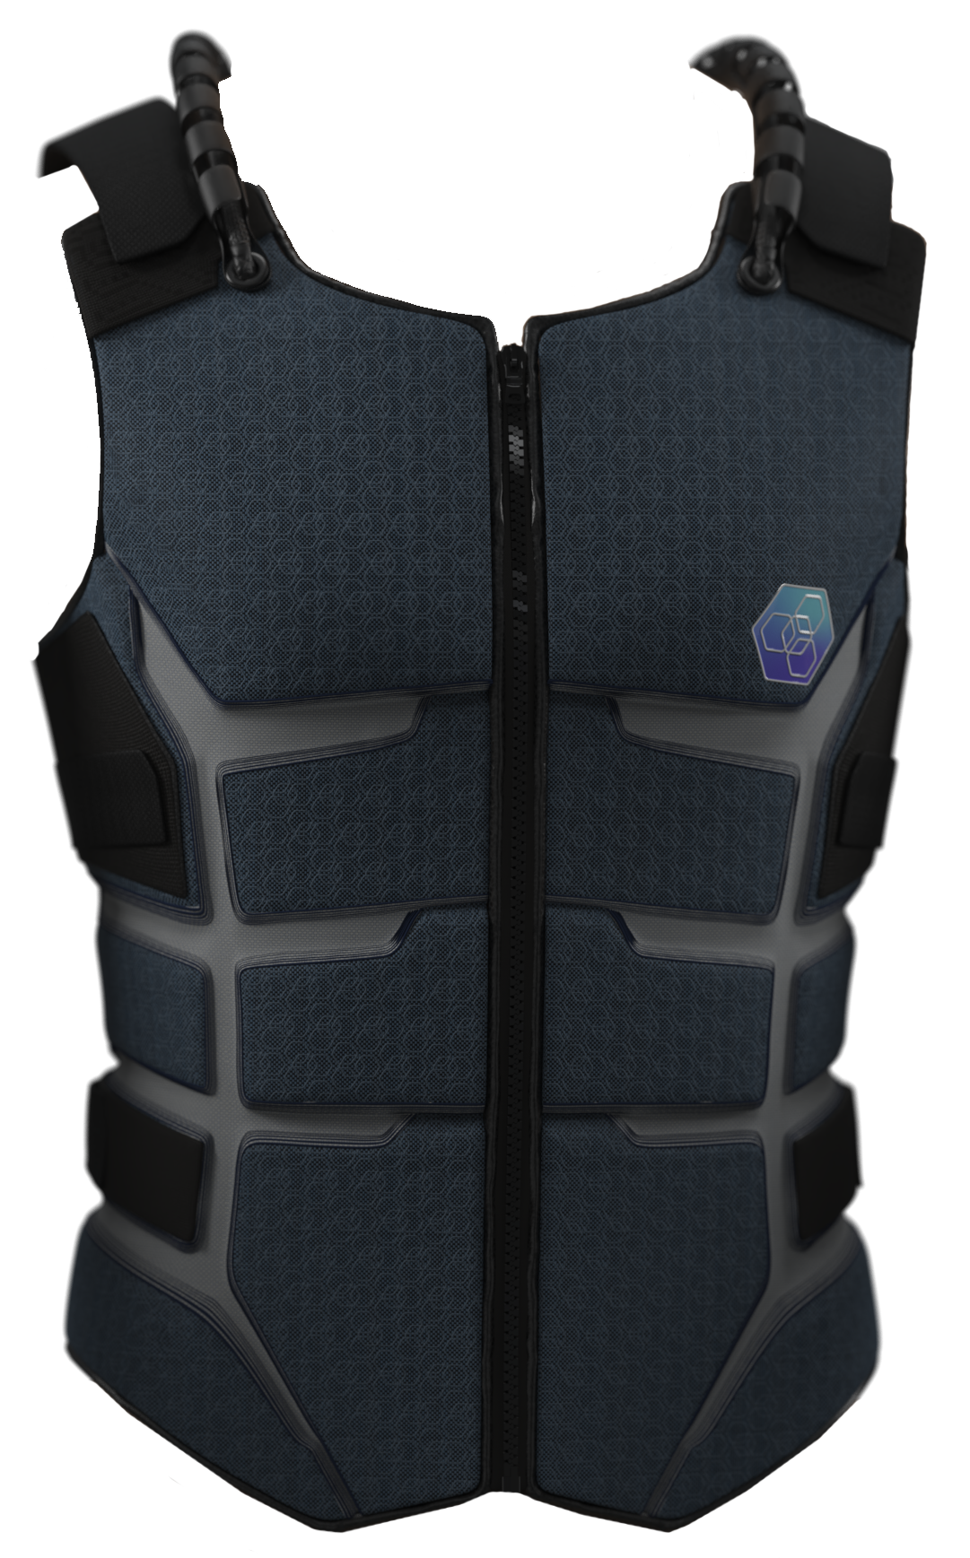
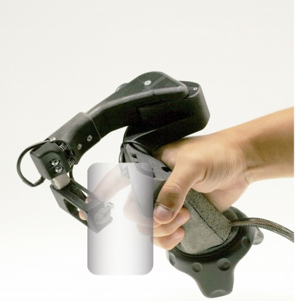
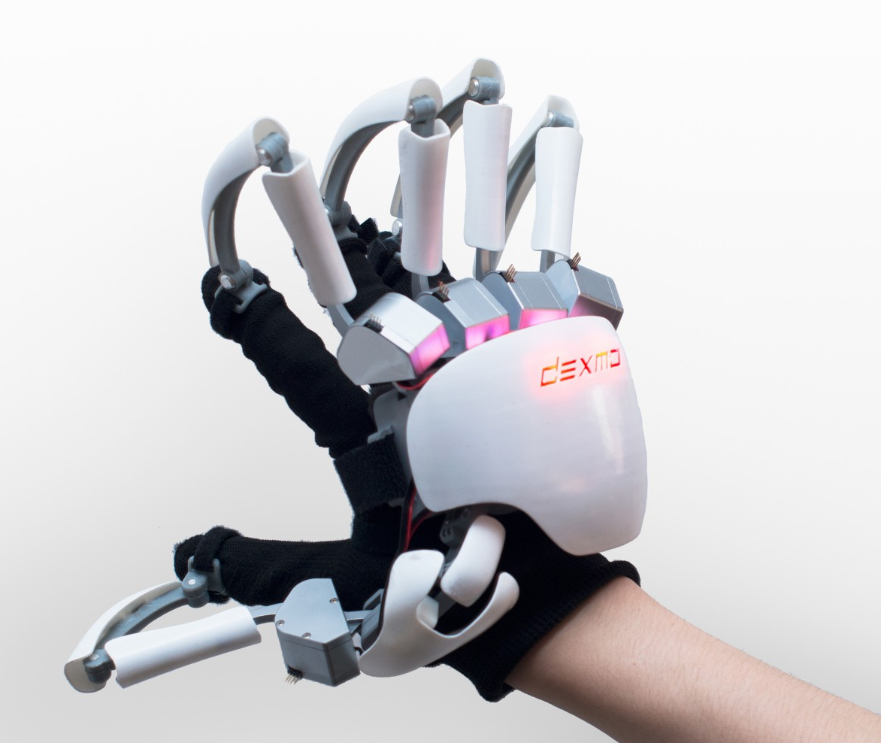
Master’s Thesis Defense
Motivation and Aim:
Adilzhan Adilkhanov
4/44

Slide 6

Master’s Thesis Defense
Motivation and Aim:
How to choose the best with respect to:
Application
Haptic illusions
Hardware combination
Adilzhan Adilkhanov
5/44

Slide 7




Ch.1: Literature Review
Ch.2: Novel Haptic Device
Method:
Haptic devices
Period: 2010-2020
Q1-Q2 Journals & Conferences
Adilzhan Adilkhanov
6/44

Slide 8
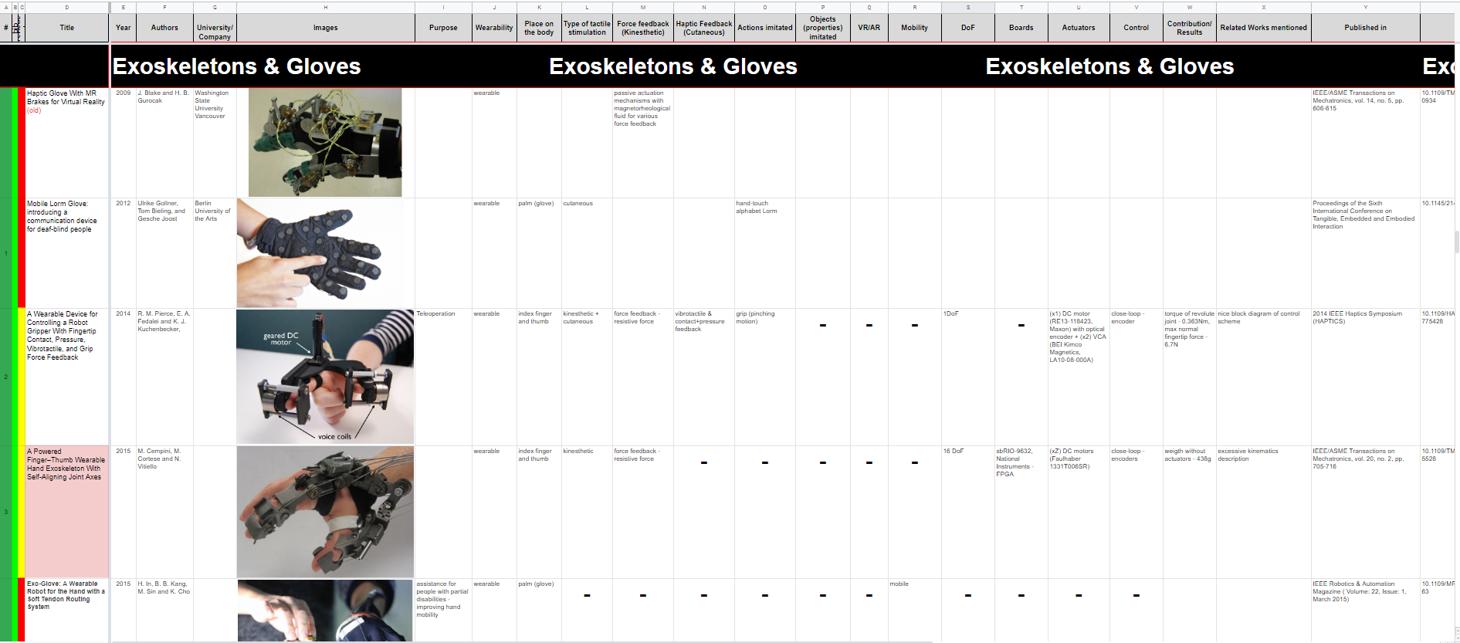
Ch.1: Literature Review
Ch.2: Novel Haptic Device
Method:
Adilzhan Adilkhanov
7/44

Slide 9
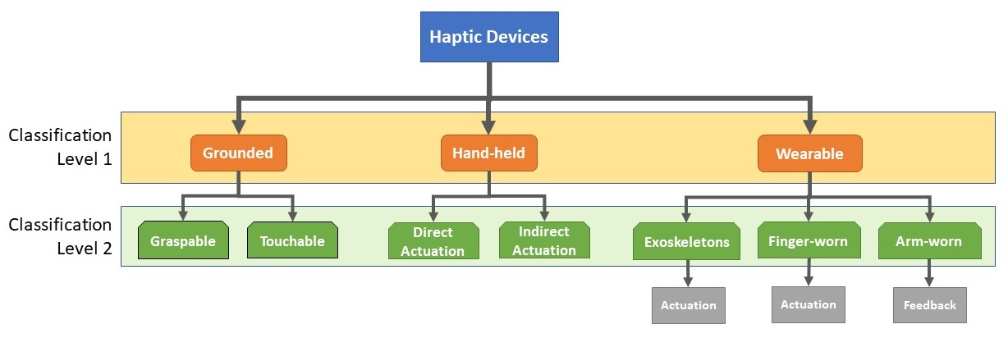
Ch.1: Literature Review
Ch.2: Novel Haptic Device
Taxonomy:
Adilzhan Adilkhanov
8/44

Slide 10
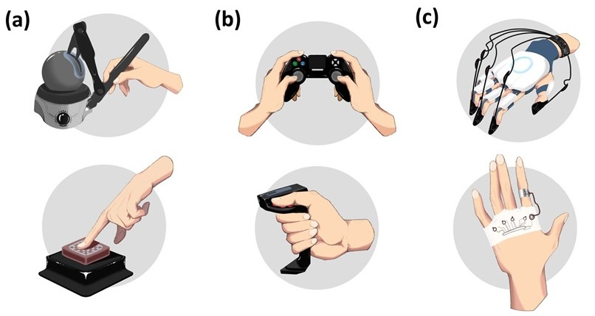
Ch.1: Literature Review
Ch.2: Novel Haptic Device
Taxonomy:
Adilzhan Adilkhanov
9/44

Slide 11
Ch.1: Literature Review
Ch.2: Novel Haptic Device
Grounded:
cannot be worn on a part of the user’s body
kinesthetic and/or tactile feedback
not limited in size
limited in workspace
Adilzhan Adilkhanov
10/44

Slide 12
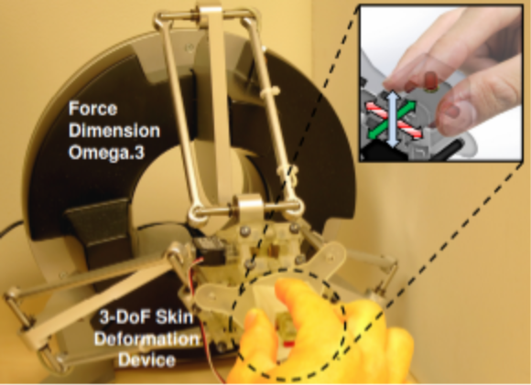
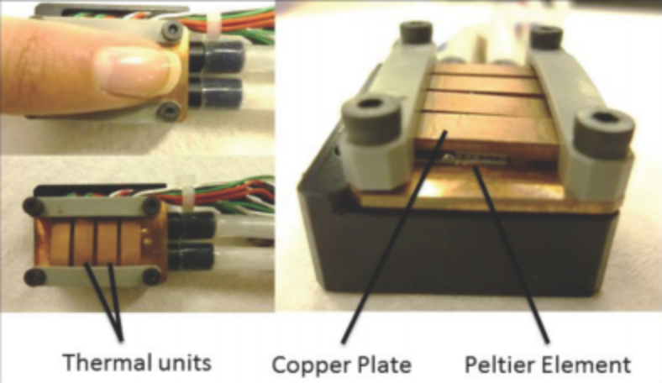
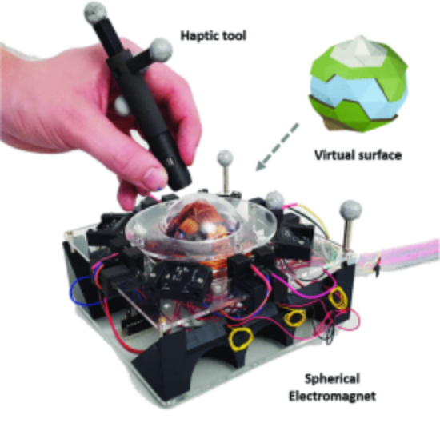
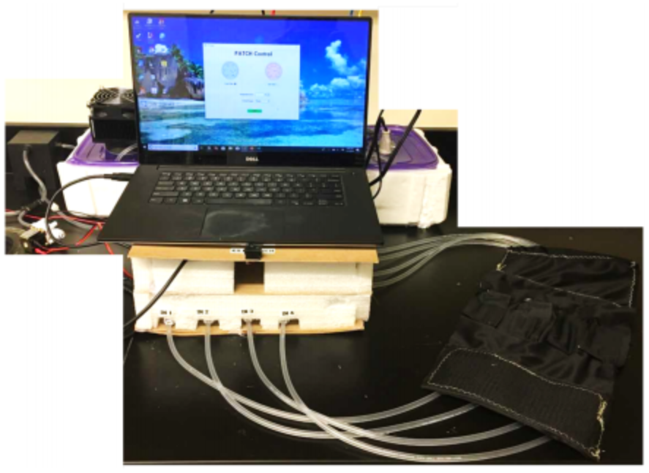
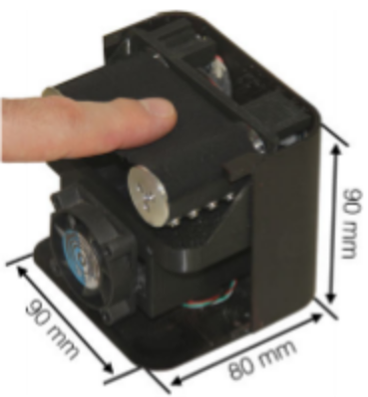
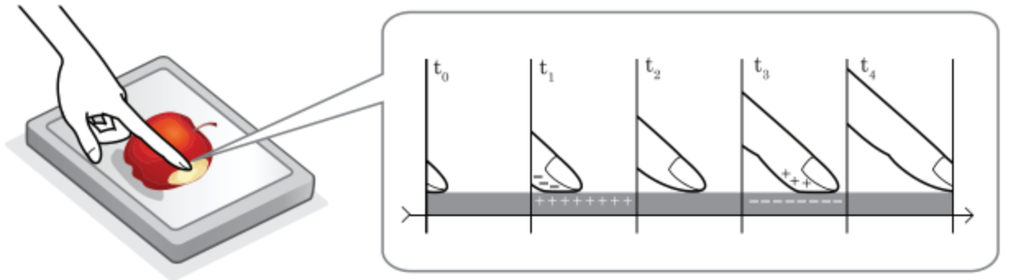
Ch.1: Literature Review
Ch.2: Novel Haptic Device
Grounded:
Graspable
Touchable
Adilzhan Adilkhanov
11/44

Slide 13
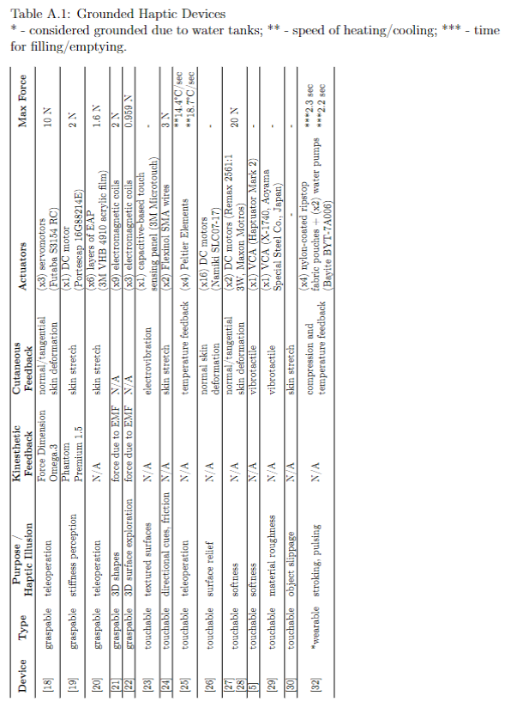
Ch.1: Literature Review
Ch.2: Novel Haptic Device
Grounded:
Adilzhan Adilkhanov
12/44

Slide 14
Ch.1: Literature Review
Ch.2: Novel Haptic Device
Hand-held:
can be picked up and held within hands
without attaching straps
kinesthetic and/or tactile feedback
comparing to grounded:
  lighter
  wider workspace
Adilzhan Adilkhanov
13/44

Slide 15
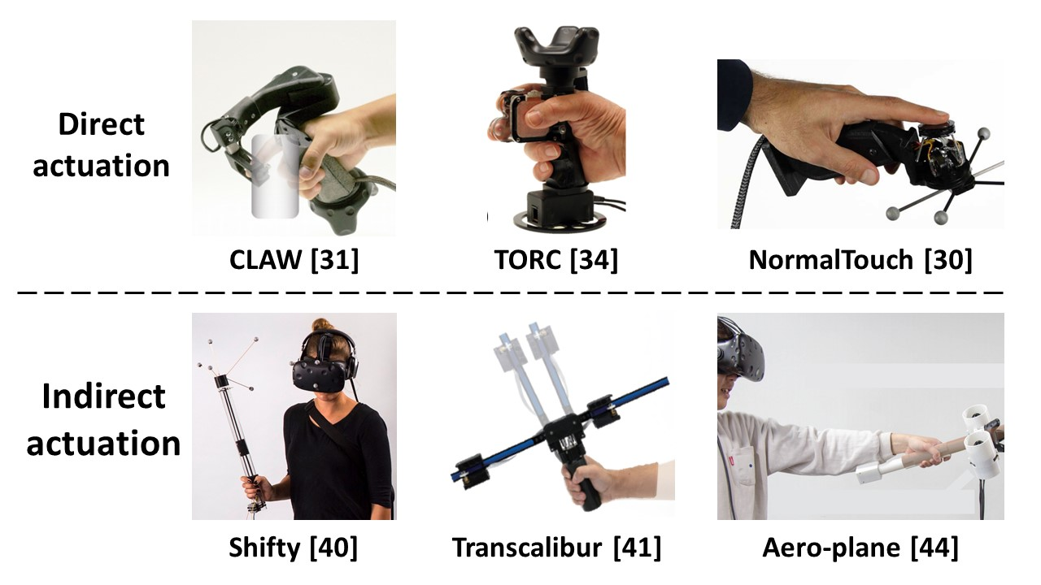
Ch.1: Literature Review
Ch.2: Novel Haptic Device
Hand-held:
Adilzhan Adilkhanov
14/44

Slide 16
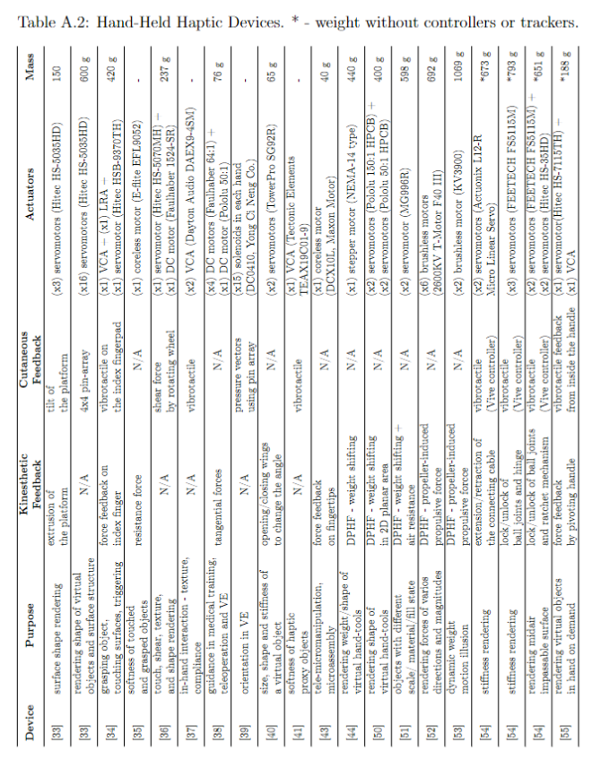
Ch.1: Literature Review
Ch.2: Novel Haptic Device
Hand-held:
Adilzhan Adilkhanov
15/44

Slide 17
Ch.1: Literature Review
Ch.2: Novel Haptic Device
Wearable:
can be worn
kinesthetic and/or tactile feedback
three types:
  Exoskeletons
  Finger-worn
  Arm-worn
Adilzhan Adilkhanov
16/44

Slide 18
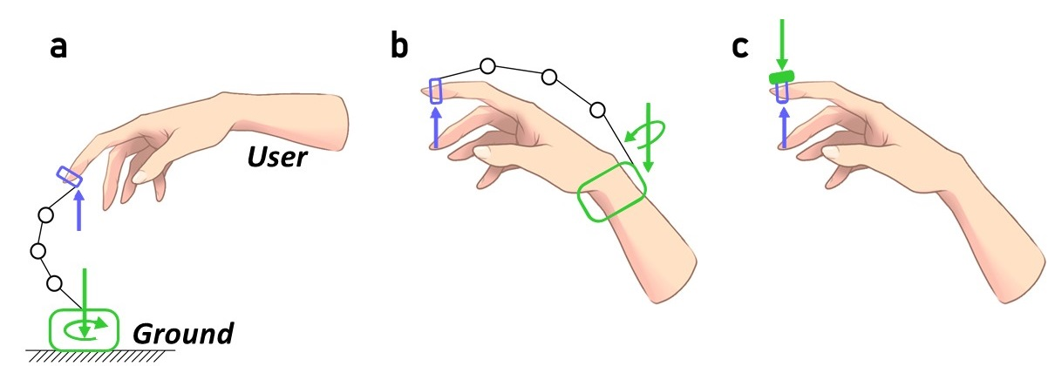
Ch.1: Literature Review
Ch.2: Novel Haptic Device
Wearable:
can be worn
kinesthetic and/or tactile feedback
three types:
  Exoskeletons
  Thimbles
  Bracelets
Adilzhan Adilkhanov
17/44

Slide 19
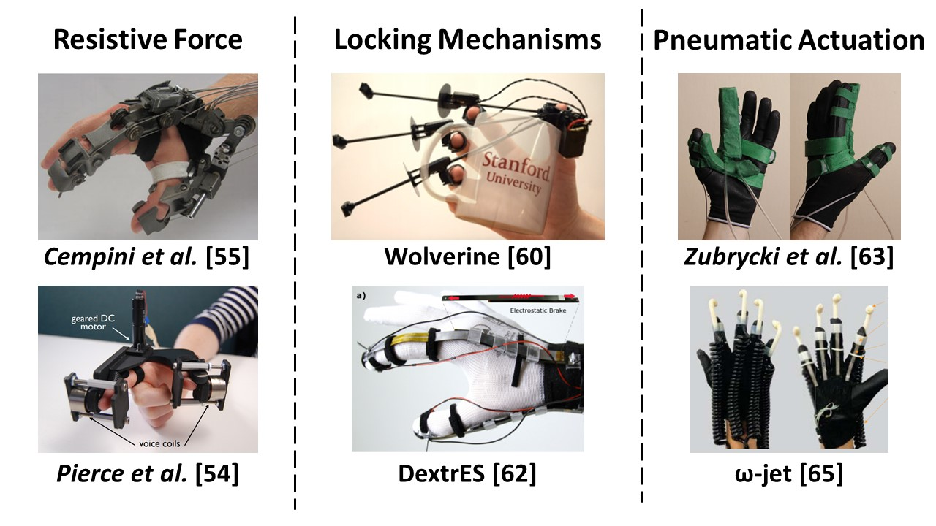
Ch.1: Literature Review
Ch.2: Novel Haptic Device
Wearable - Exoskeletons:
aimed at rendering kinesthetic haptic feedback
grounded to the user’s body
Adilzhan Adilkhanov
18/44

Slide 20
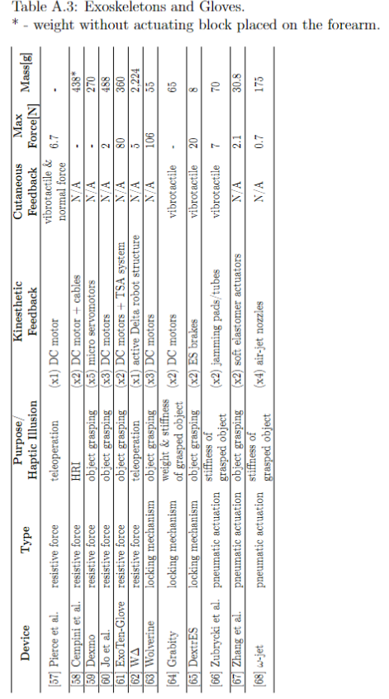
Ch.1: Literature Review
Ch.2: Novel Haptic Device
Wearable - Exoskeletons:
Adilzhan Adilkhanov
19/44

Slide 21
Ch.1: Literature Review
Ch.2: Novel Haptic Device
Wearable - Thimbles:
focus on the tactile stimulation of the fingerpads
two types by actuation method:
  moving plate
  shearing belt
Adilzhan Adilkhanov
20/44

Slide 22
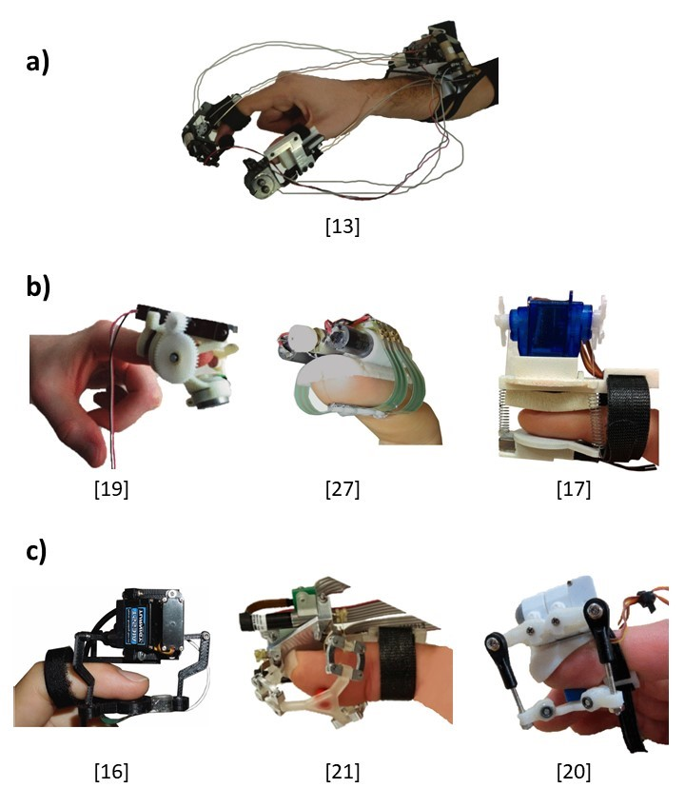
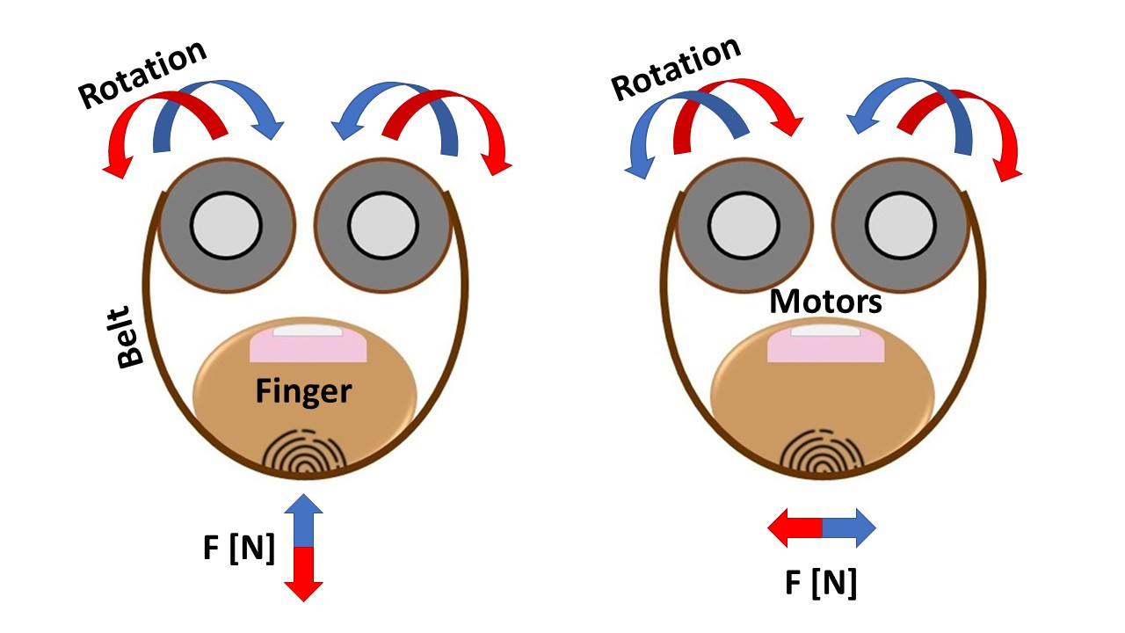
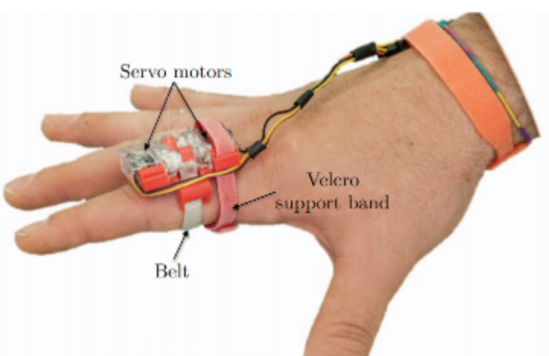
Ch.1: Literature Review
Ch.2: Novel Haptic Device
Wearable - Thimbles:
moving plate type
shearing belt type
Adilzhan Adilkhanov
21/44

Slide 23
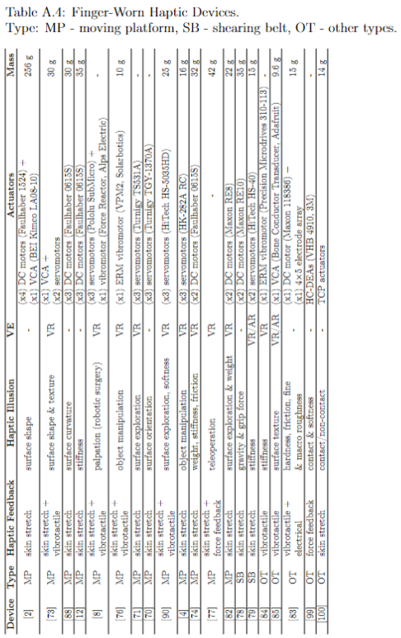
Ch.1: Literature Review
Ch.2: Novel Haptic Device
Wearable - Thimbles:
Adilzhan Adilkhanov
22/44

Slide 24
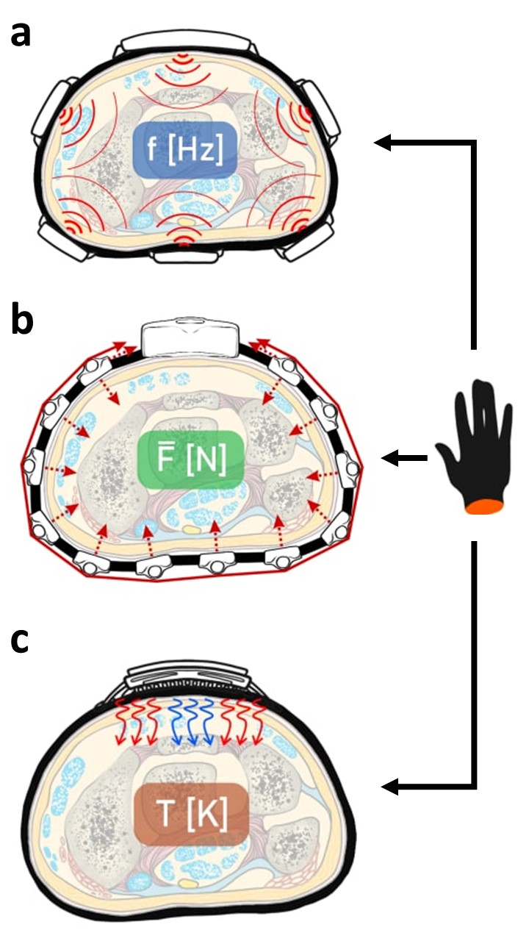
Ch.1: Literature Review
Ch.2: Novel Haptic Device
Wearable - Bracelets:
three types by actuation method:
  vibrotactile
  skin-stretch & compression
  thermal feedback
Adilzhan Adilkhanov
23/44

Slide 25
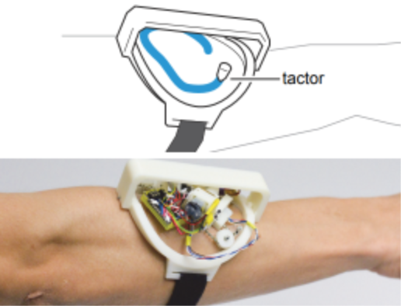
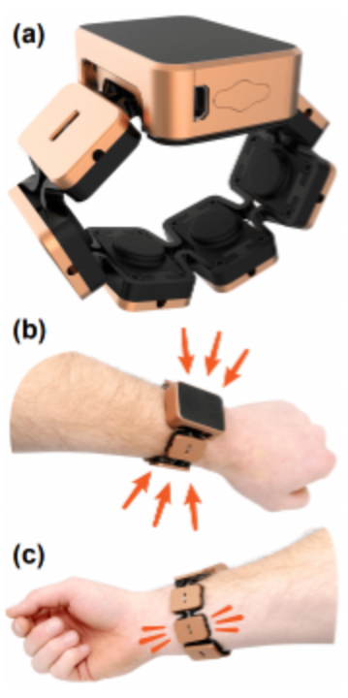
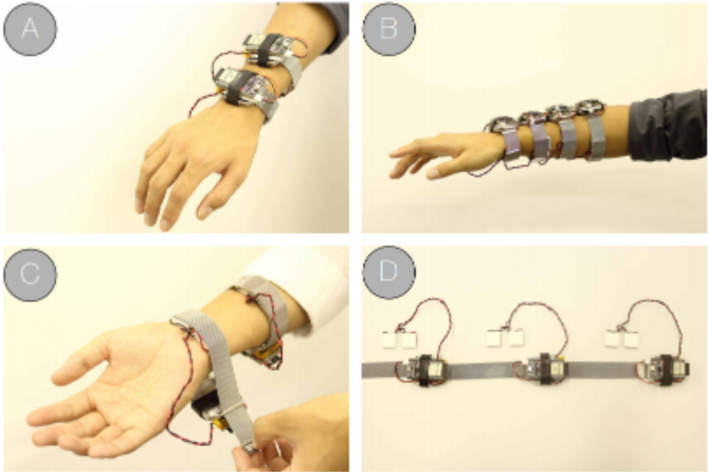
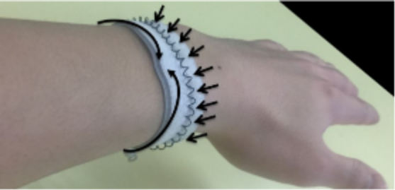
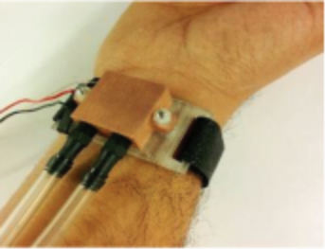
Ch.1: Literature Review
Ch.2: Novel Haptic Device
Wearable - Bracelets:
  vibrotactile
  skin-stretch & compression
  thermal
Adilzhan Adilkhanov
24/44

Slide 26
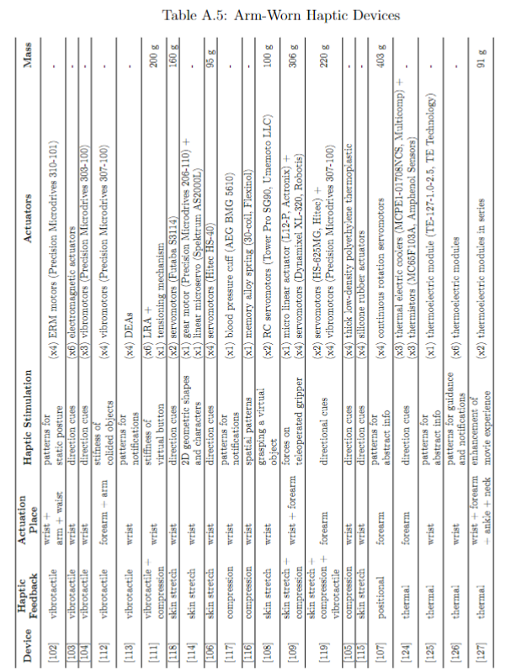
Ch.1: Literature Review
Ch.2: Novel Haptic Device
Wearable - Bracelets:
Adilzhan Adilkhanov
25/44

Slide 27
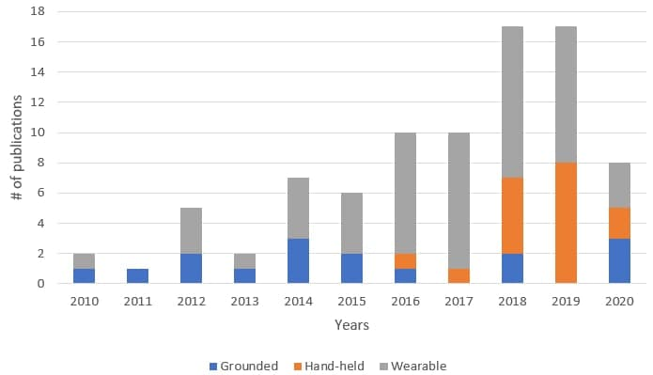
Ch.1: Literature Review
Ch.2: Novel Haptic Device
Discussions:
Adilzhan Adilkhanov
26/44

Slide 28
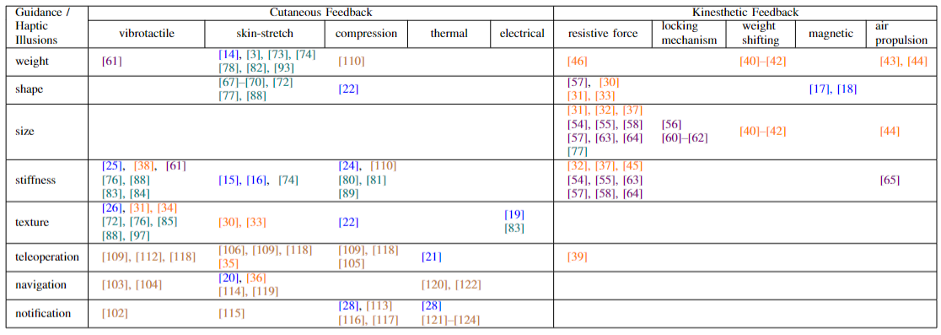
Ch.1: Literature Review
Ch.2: Novel Haptic Device
Discussions:
Adilzhan Adilkhanov
27/44

Slide 29
Ch.1: Literature Review
Ch.2: Novel Haptic Device
Discussions:
Adilzhan Adilkhanov
28/44

Slide 30
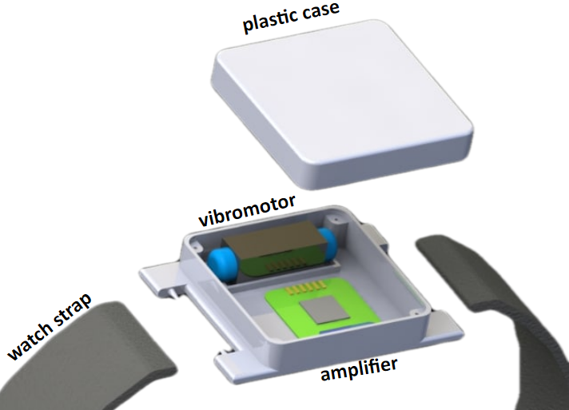
Ch.1: Literature Review
Ch.2: Novel Haptic Device
Hardware:
3D-printed case (x2)
watch strap
Haptuator Mark 2 (x2)
type-D audio amplifier (x2)
controller - Teensy 3.2
TCP socket communication
Adilzhan Adilkhanov
29/44

Slide 31
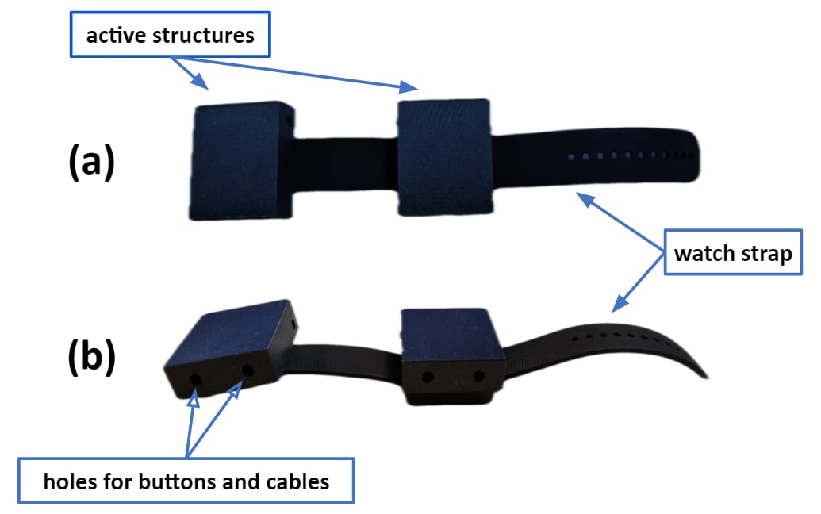
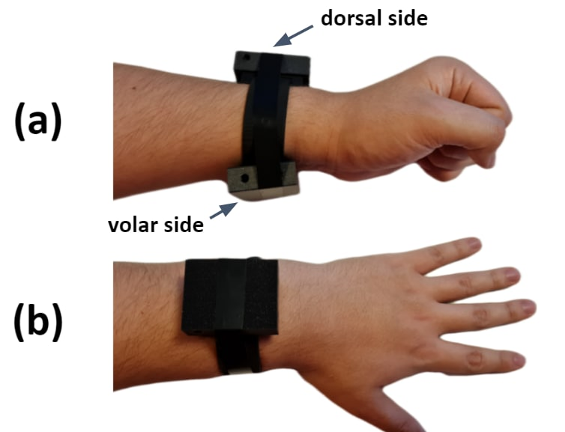
Ch.1: Literature Review
Ch.2: Novel Haptic Device
Hardware:
Adilzhan Adilkhanov
30/44

Slide 32
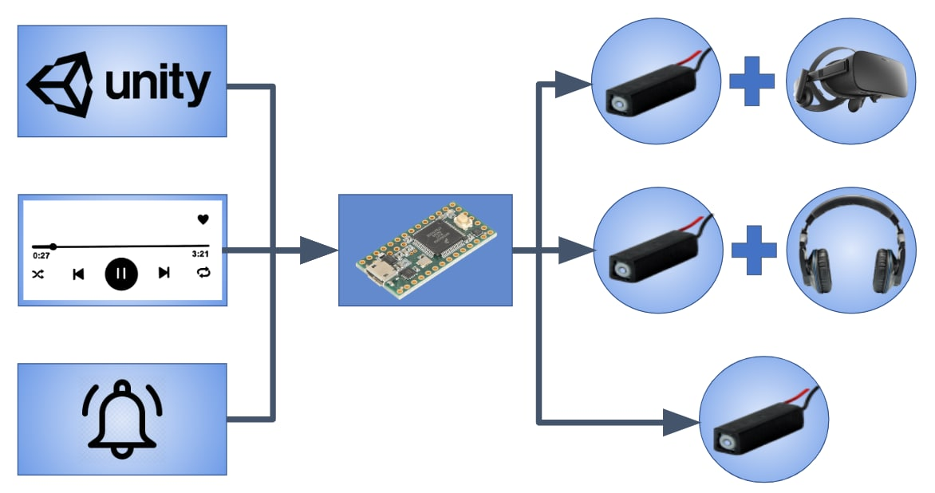
Ch.1: Literature Review
Ch.2: Novel Haptic Device
Stimuli:
3 types of application
1 type of feedback
2 types of haptic illusions
Adilzhan Adilkhanov
31/44

Slide 33
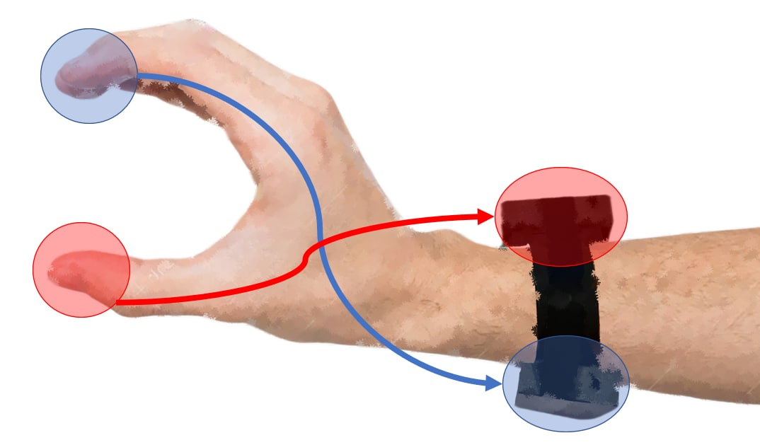
Ch.1: Literature Review
Ch.2: Novel Haptic Device
Stimuli - VE:
Index finger movement – tendon on volar side of the wrist
and
Thumb movement - tendon on dorsal side of the wrist
Adilzhan Adilkhanov
32/44

Slide 34

Ch.1: Literature Review
Ch.2: Novel Haptic Device
Stimuli - VE:
Unity3D game engine
2 haptic illusions:
    stiffness
    weight
Adilzhan Adilkhanov
33/44

Slide 35

Ch.1: Literature Review
Ch.2: Novel Haptic Device
Stimuli - VE:
Adilzhan Adilkhanov
34/44

Slide 36

Ch.1: Literature Review
Ch.2: Novel Haptic Device
Experiment - VE:
Adilzhan Adilkhanov
35/44

Slide 37

Ch.1: Literature Review
Ch.2: Novel Haptic Device
Experiment - VE:
Novel haptic device vs VibeRo: stiffness illusion
Adilzhan Adilkhanov
36/44

Slide 38

Ch.1: Literature Review
Ch.2: Novel Haptic Device
Stimuli - VE:
Haptic illusion of weight
two motors simultaneously playing the same signal
frequency – oppositely proportional to weight
Adilzhan Adilkhanov
37/44

Slide 39

Ch.1: Literature Review
Ch.2: Novel Haptic Device
Experiment - VE:
Adilzhan Adilkhanov
38/44

Slide 40

Ch.1: Literature Review
Ch.2: Novel Haptic Device
Stimuli - Music:
Stimuli - mimic the audio signal
Adilzhan Adilkhanov
39/44

Slide 41

Ch.1: Literature Review
Ch.2: Novel Haptic Device
Experiment - Music:
Adilzhan Adilkhanov
40/44

Slide 42


Ch.1: Literature Review
Ch.2: Novel Haptic Device
Stimuli - Notifications:
Adilzhan Adilkhanov
41/44

Slide 43

Ch.1: Literature Review
Ch.2: Novel Haptic Device
Experiment - Notifications:
Adilzhan Adilkhanov
42/44

Slide 44



Master’s Thesis Defense
Contribution:
VibeRo (RA-L, ICRA 2020)
‘Vibero 2’ (IROS 2021)
Survey paper (under submission)
Novel haptic bracelet
Adilzhan Adilkhanov
43/44

Slide 45
Master’s Thesis Defense
Thank you for attention!
Adilzhan Adilkhanov
44/44

