Slide 1


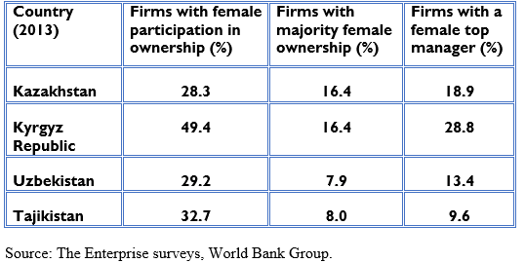

Gender gap in entrepreneurship
Zhannur Dildabayeva, 2nd year student
Charles Sullivan , Assistant Professor
Introduction & Research Question
Research methods
Contribution
Women entrepreneurship is important for economic growth and prosperity of developing countries
Advance the literature about gender gap in entrepreneur-ship in Central Asia countries
The in-depth interview, the survey and the elite interviewing about the condition of women entrepreneurship in Central Asian countries and the barriers for its development
Variables & Hypothesis
DV- a gender gap in entrepreneurship
IV- the low economy of the country leading to high labor migration of men from there.
SV- cultural believes and active business associations of women
How can we account for the varying "gender gaps in entrepreneurship" across post-Soviet Central Asia countries?

