Slide 1

On open access, institutional repositories, reproducibility, and plagiarism:
Librarians and information professionals’ perspectives and roles in open science
Stephen B. Alayon
West Visayas State University, Philippines
stephen.alayon@wvsu.edu.ph
*formerly with Aquaculture Department, Southeast Asian Fisheries Development Center, Philippines

Slide 2
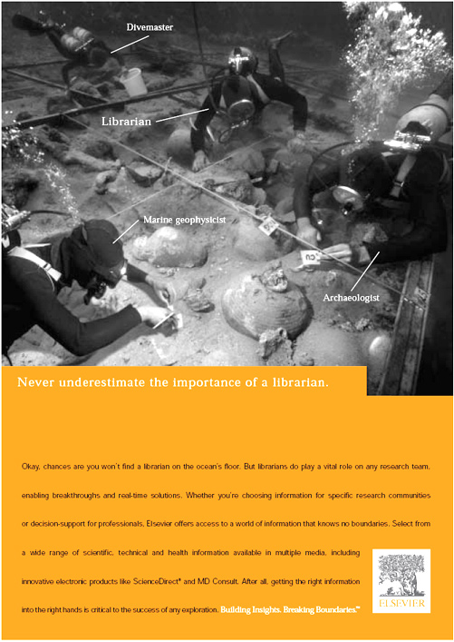

Slide 3
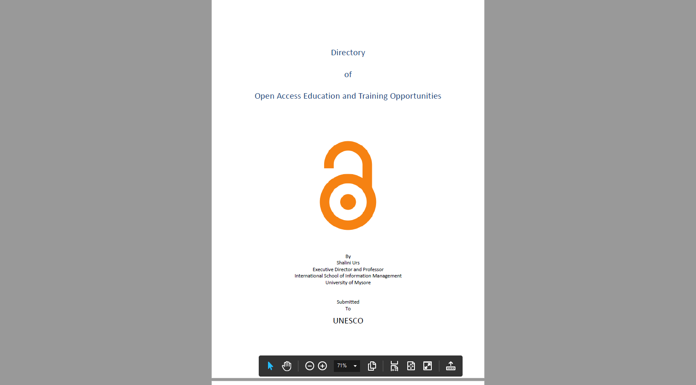
Open Access (OA)
is the provision of free access to peer-reviewed, scholarly and research information to all.
OA literature is digital, online, free of charge, and free of most copyright and licensing restrictions. (Suber, 2016)

Slide 4
Open Access (OA)
OA removes
  price barriers
    (subscriptions, licensing fees, pay-per-view fees)
  permission barriers
    (most copyright and licensing restrictions)
The PLoS shorthand definition — “free availability and unrestricted use” — succinctly captures both elements.
(Suber, 2016)
Notes:
Open-access (OA) literature is digital, online, free of charge, and free of most copyright and licensing restrictions.

Slide 5
Open access is not synonymous with universal access.
Even after OA has been achieved, at least four (4) kinds of access barrier might remain in place:
Filtering and censorship barriers
Language barriers
Handicap access barriers
Connectivity barriers
(Suber, 2016)
Notes:
Filtering and censorship barriers - Many schools, employers, and governments want to limit what you can see.
Language barriers - Most online literature is in English, or just one language, and machine translation is very weak.
Handicap access barriers - Most web sites are not yet as accessible to handicapped users as they should be.
Connectivity barriers - The digital divide keeps billions of people, including million of serious scholars, offline.

Slide 6
Definition of an Open Access Contribution
Establishing open access as a worthwhile procedure ideally requires the active commitment of each and every individual producer of scientific knowledge and holder of cultural heritage.
Open access contributions include
  original scientific research results,
  raw data and metadata,
  source materials,
  digital representations of pictorial and graphical materials and
  scholarly multimedia material.
(Suber, 2016)
(Berlin Declaration)

Slide 7
IFLA Statement on open access – clarifying IFLA’s position and strategy
IFLA acknowledges that there are a number of worthwhile objectives, besides open access, concerning the development of the system of scientific and scholarly communication, such as
implementing a rigorous system for the control of scientific quality;
providing long-term preservation of research information;
safeguarding freedom from censorship;
offering efficient and user-friendly services;
fostering activities that support "information literacy";
expanding bandwidth and other essential infrastructure that underlies robust access to information.

Slide 8
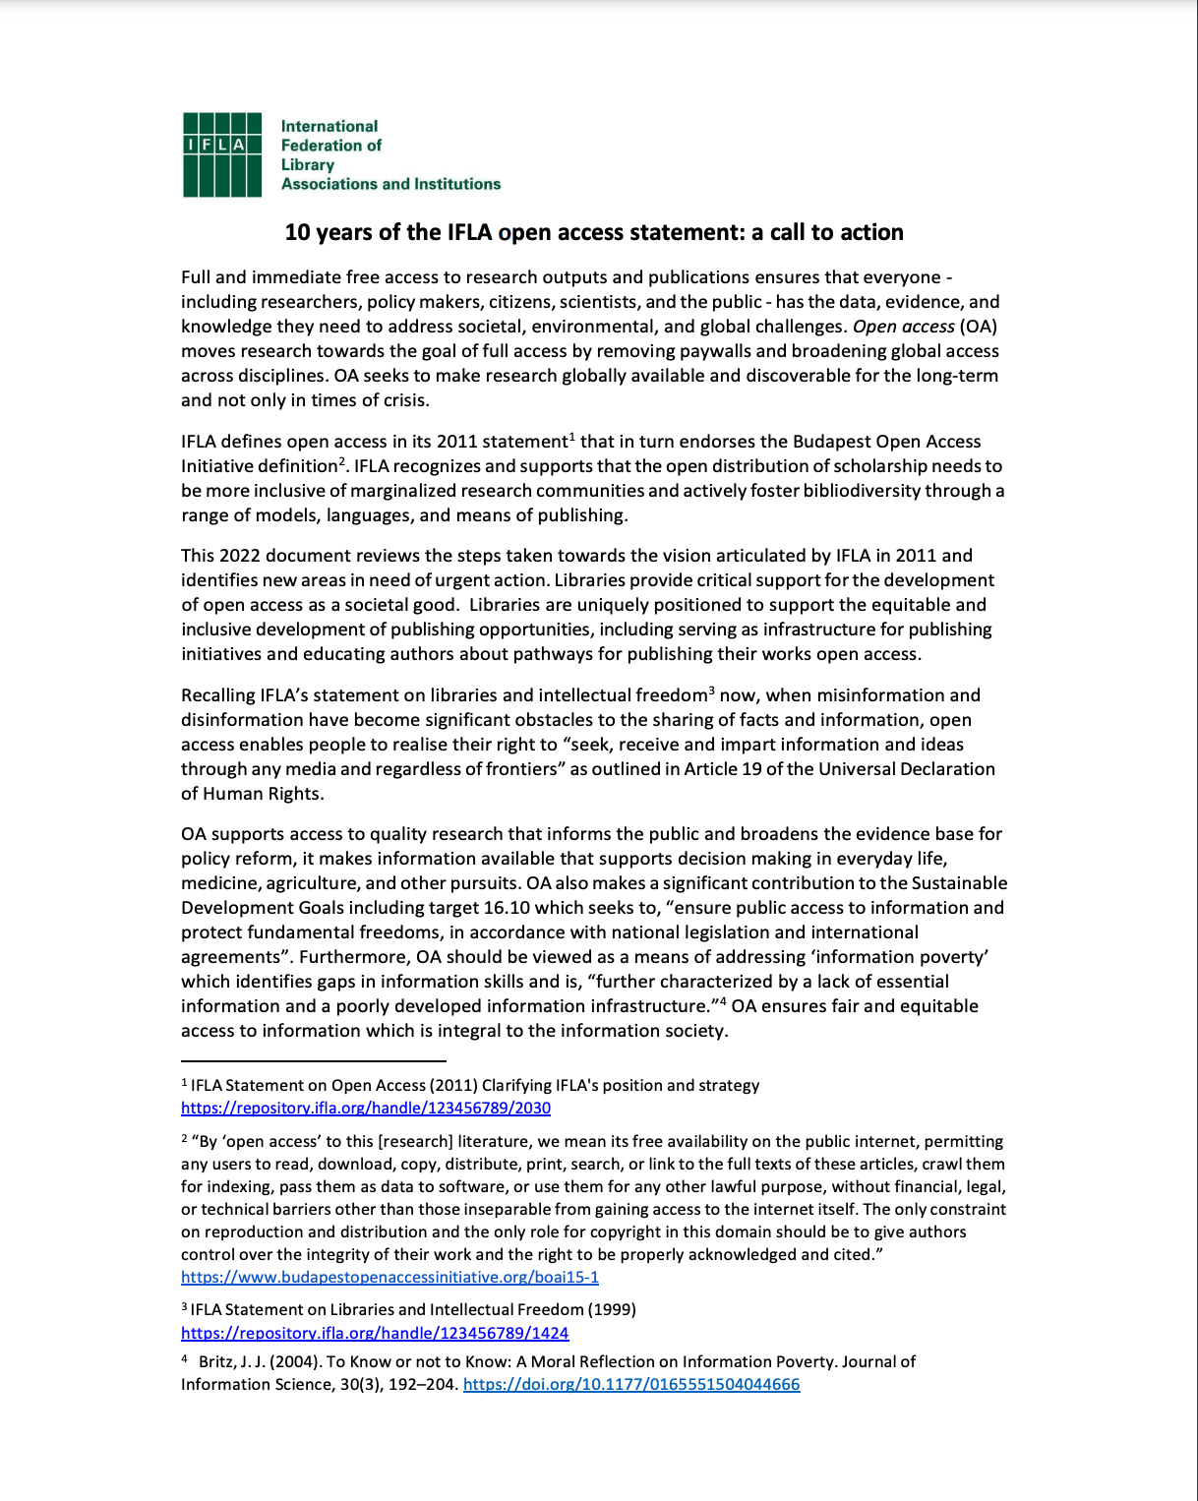
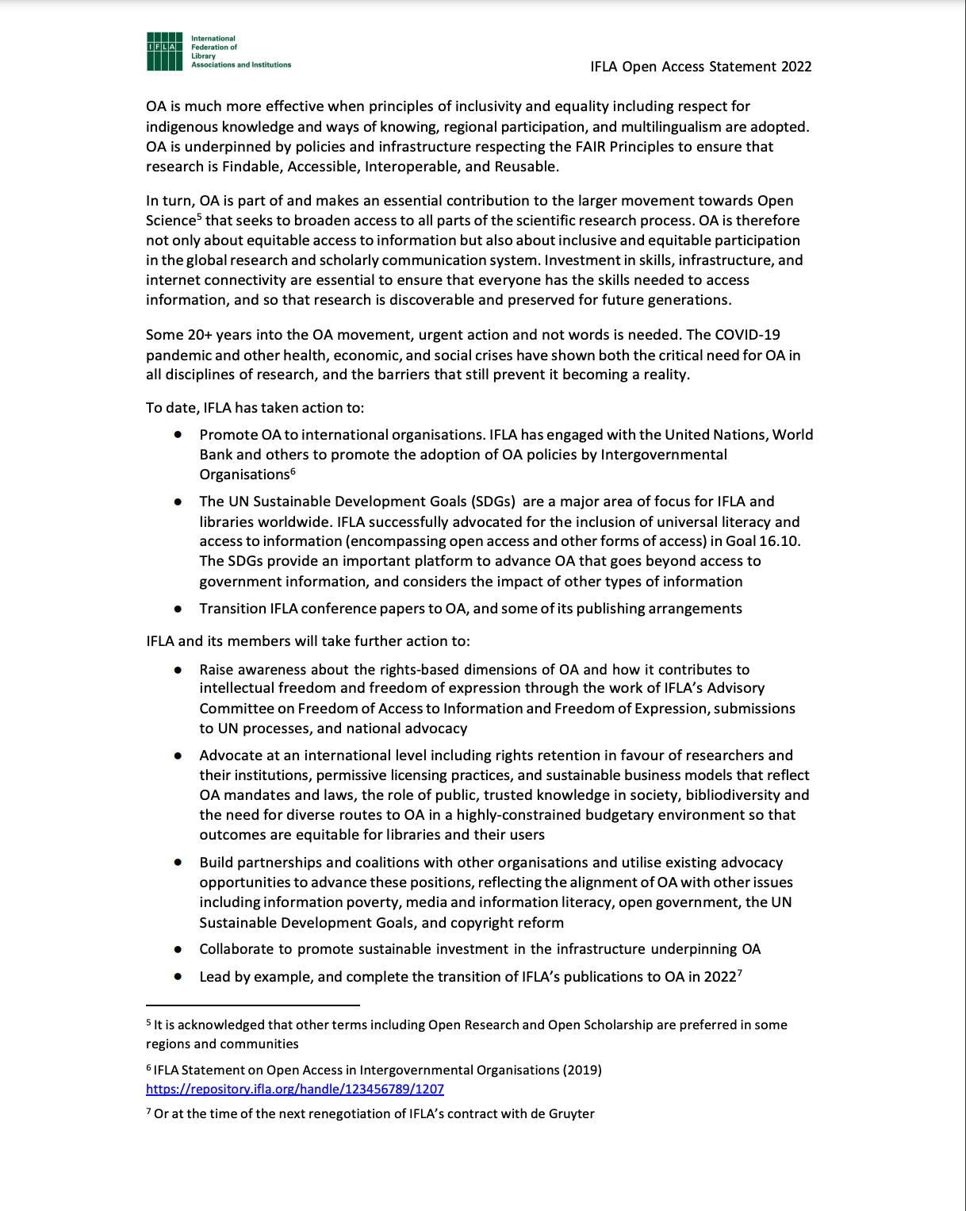

Slide 9
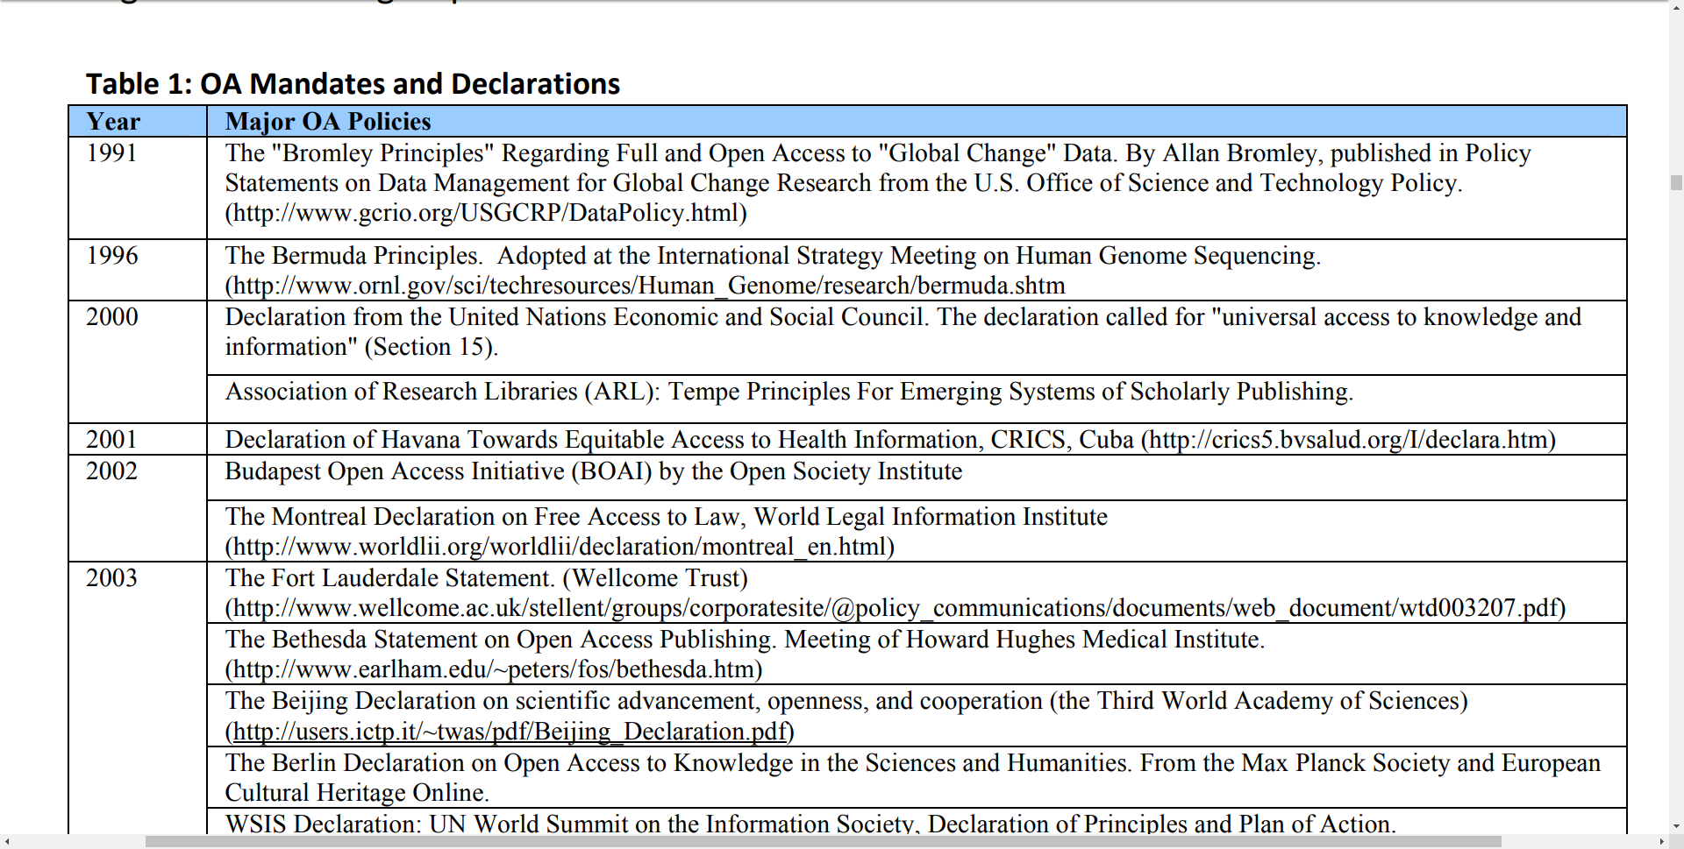
OA Mandates and Declarations
unesco.org/new/fileadmin/MULTIMEDIA/HQ/CI/pdf/UNESCO-OA-ET-Report-WithAppendix-final-Urs.pdf

Slide 10
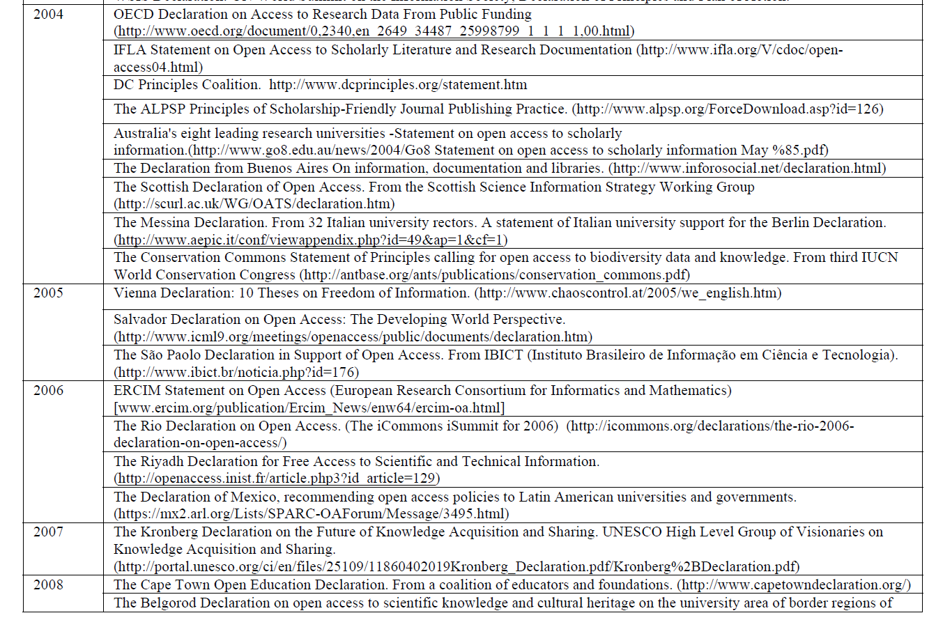
unesco.org/new/fileadmin/MULTIMEDIA/HQ/CI/pdf/UNESCO-OA-ET-Report-WithAppendix-final-Urs.pdf

Slide 11
OA serves the interests of many groups
Authors
Readers
Teachers and students
Libraries
Universities
Journals and publishers
Funding agencies
Governments
Citizens
(Suber, 2016)

Slide 12
OA serves the interests of many groups
Libraries:
OA solves the pricing crisis for scholarly journals.
It also solves what I’ve called the permission crisis.
OA also serves library interests in other, indirect ways.
(Suber, 2016)

Slide 13
OA serves the interests of many groups
Librarians:
Librarians want to help users find the information they need,
  regardless of the budget-enforced limits on the library’s own collection.
Academic librarians want to
  help faculty increase their audience and impact
  help the university raise its research profile.
(Suber, 2016)

Slide 14
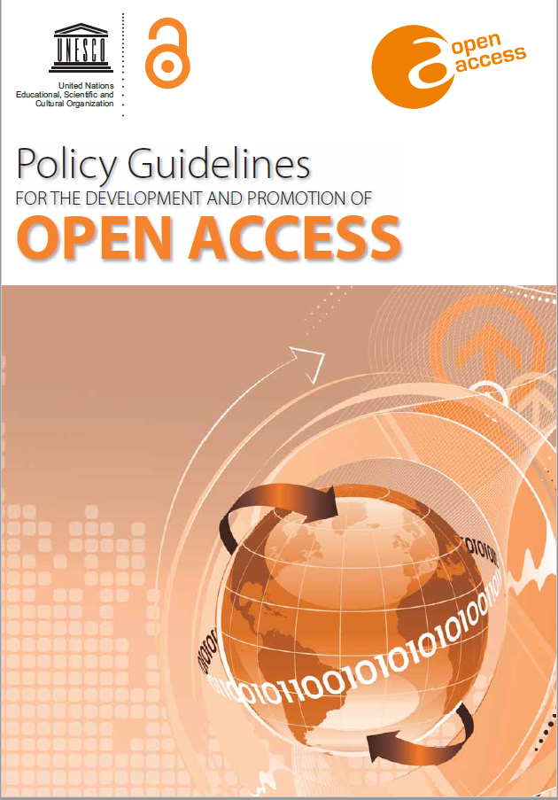
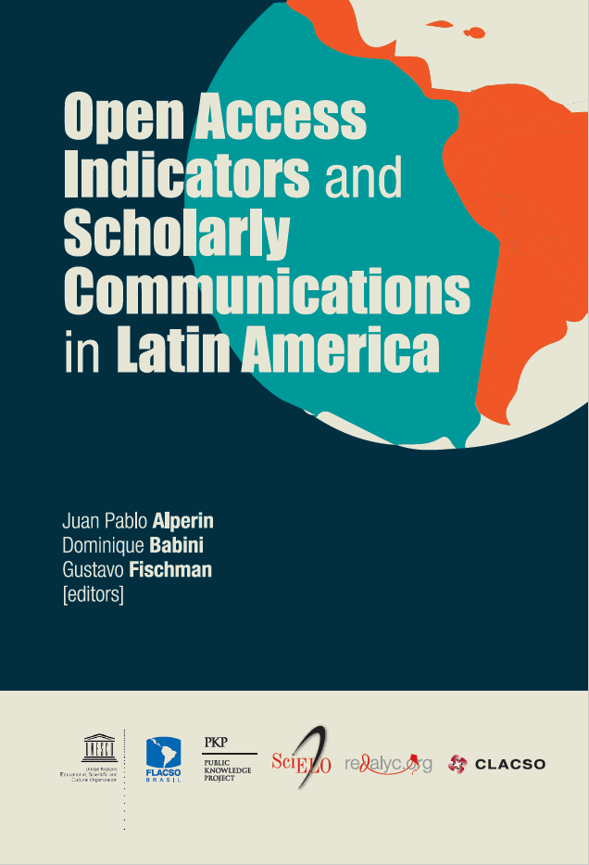

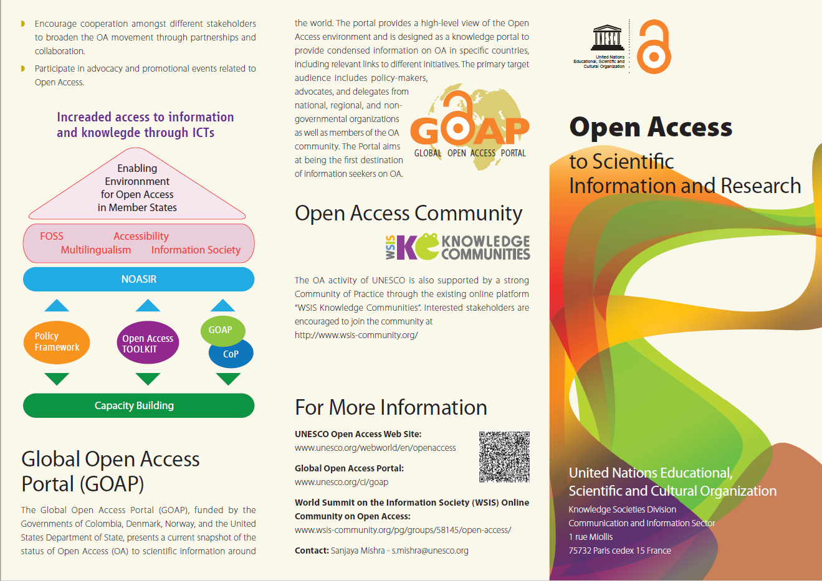

Slide 15
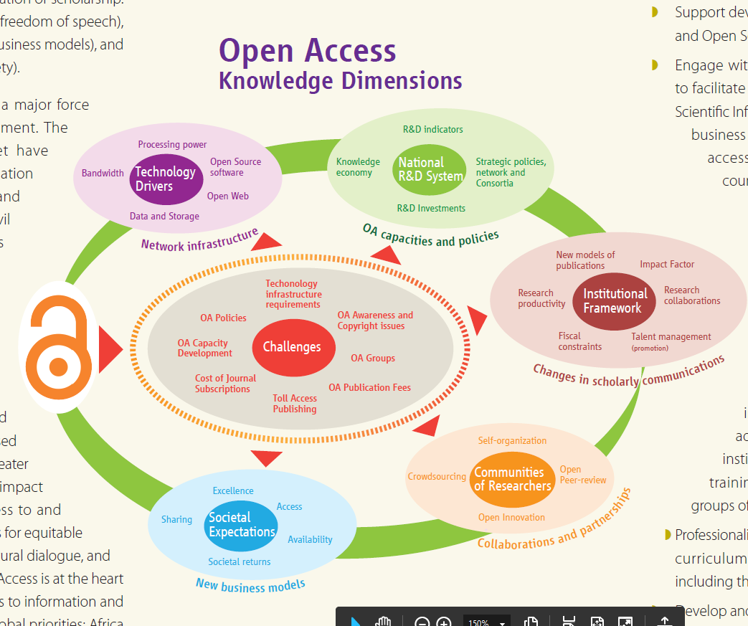
(UNESCO, n.d.)

Slide 16
PREDATORY PUBLISHING

Slide 17

Jeffrey Beall
a librarian at the University of Colorado
coined the term “predatory publishing”
https://indianexpress.com/article/india/jeffrey-beall-american-librarian-predatory-publishers-threaten-scientific-integrity-are-embarrassment-to-india-5266858/
Notes:
Jeffrey Beall, a librarian at the University of Colorado in Denver, US, until March 2018, coined the term “predatory publishing” eight years ago, when he published the first list of such publishers on his blog in 2010. After the list gained attention, Beall started a new blog in 2012, updating his posts almost every day. But following several threats of law suits, Beall removed the blog and list in January 2017.

Slide 18
Predatory Publishing
Watch out for scams by predatory publishers of dubious “journals”
Publishers that are corrupt and which charge author’s fee for publication
Questionable, bogus scholarly open-access journals and publishers with low credibility
See Beall’s List http://scholarlyoa.com/publishers/
Source: Tan, n.d.

Slide 19
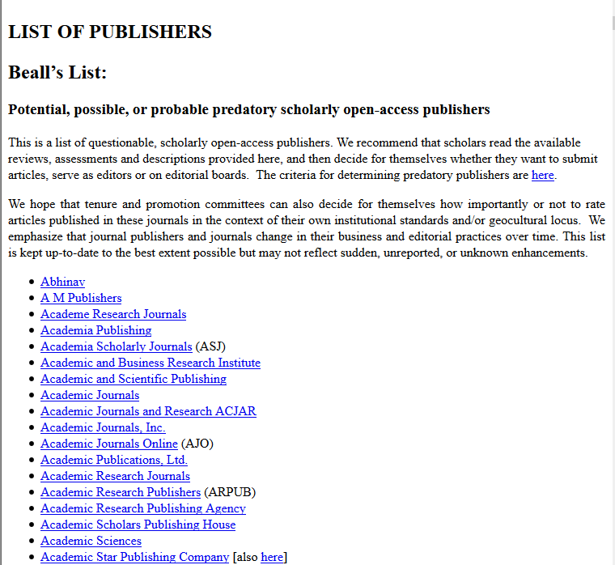

Slide 20
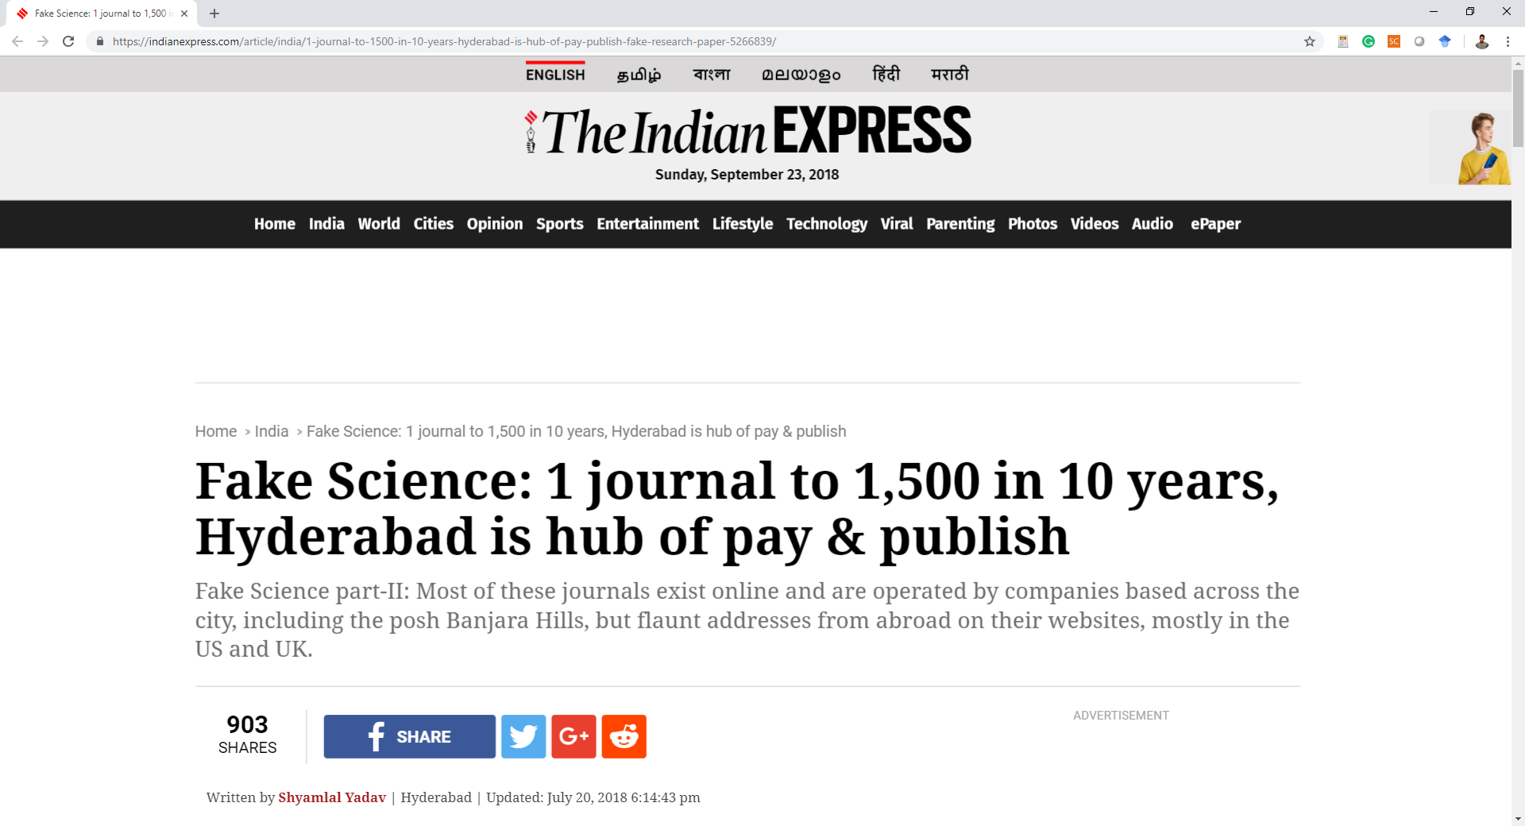

Slide 21
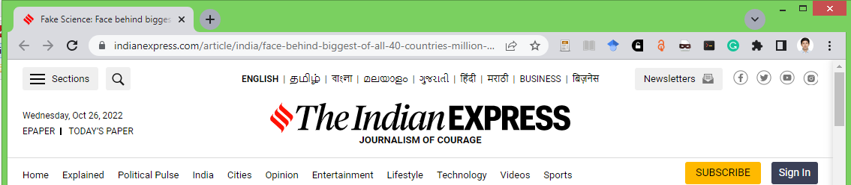
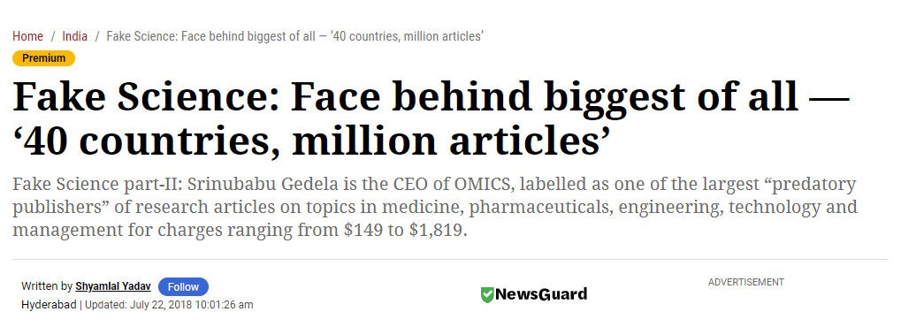
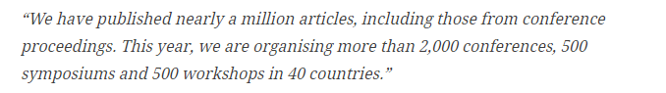

Slide 22
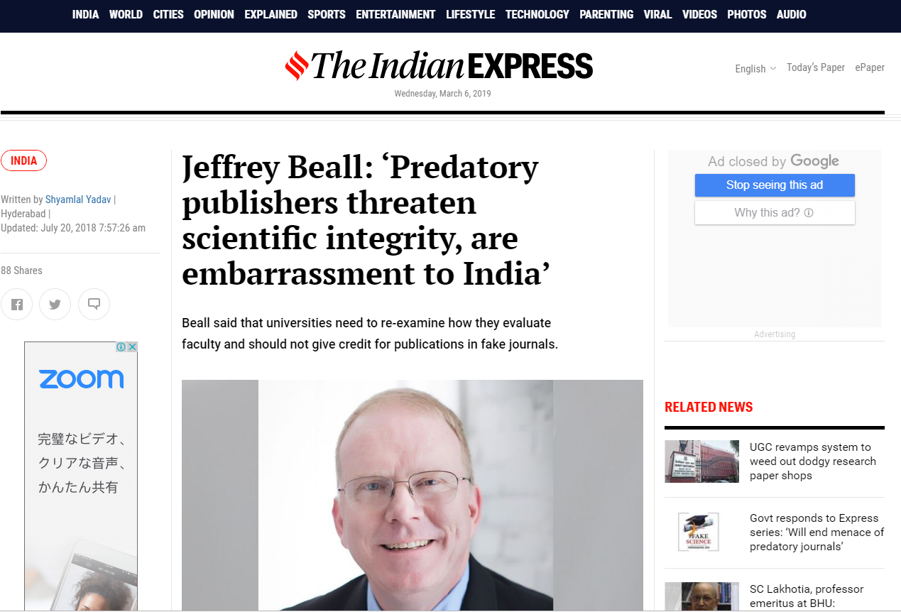
https://indianexpress.com/article/india/jeffrey-beall-american-librarian-predatory-publishers-threaten-scientific-integrity-are-embarrassment-to-india-5266858/
Notes:
Why did you remove the list of predatory publishers and journals from your blog?
My university began to attack me in several ways. They launched a research misconduct investigation against me (after seven months, the result of the investigation was that no misconduct had occurred). They also put an unqualified, mendacious supervisor over me, and he constantly attacked and harassed me. I decided I could no longer safely publish the list with my university threatening me in these ways.

Slide 23
Should all open access journals be banned?
“Banning is not an option because we value freedom of the press.
Universities need to re-examine how they evaluate faculty and should not give credit for publications in fake journals.
The scholarly publishing industry needs to regulate itself better.
Librarians and universities need to help educate university faculty about this problem and should exclude fake journals from their catalogues.” - Beall
https://indianexpress.com/article/india/jeffrey-beall-american-librarian-predatory-publishers-threaten-scientific-integrity-are-embarrassment-to-india-5266858/
Notes:
Why did you remove the list of predatory publishers and journals from your blog?
My university began to attack me in several ways. They launched a research misconduct investigation against me (after seven months, the result of the investigation was that no misconduct had occurred). They also put an unqualified, mendacious supervisor over me, and he constantly attacked and harassed me. I decided I could no longer safely publish the list with my university threatening me in these ways.

Slide 24
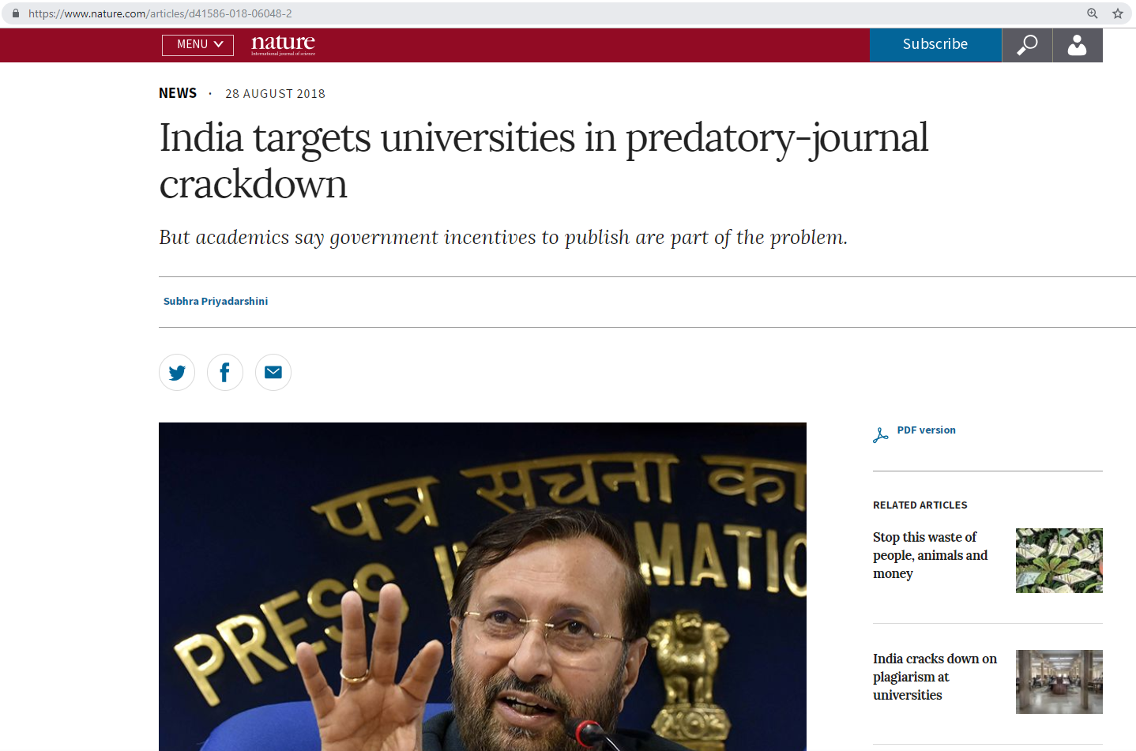
https://www.nature.com/articles/d41586-018-06048-2
Notes:
Most academics regard predatory journals as an irritant — if not a threat — to science. But in India, some universities have recommended the inclusion of﻿ such publications in the country’s ‘white list’ of approved journals. Now the government is cracking down on this practice, which scientists say came about as a result of perverse government incentives

Slide 25
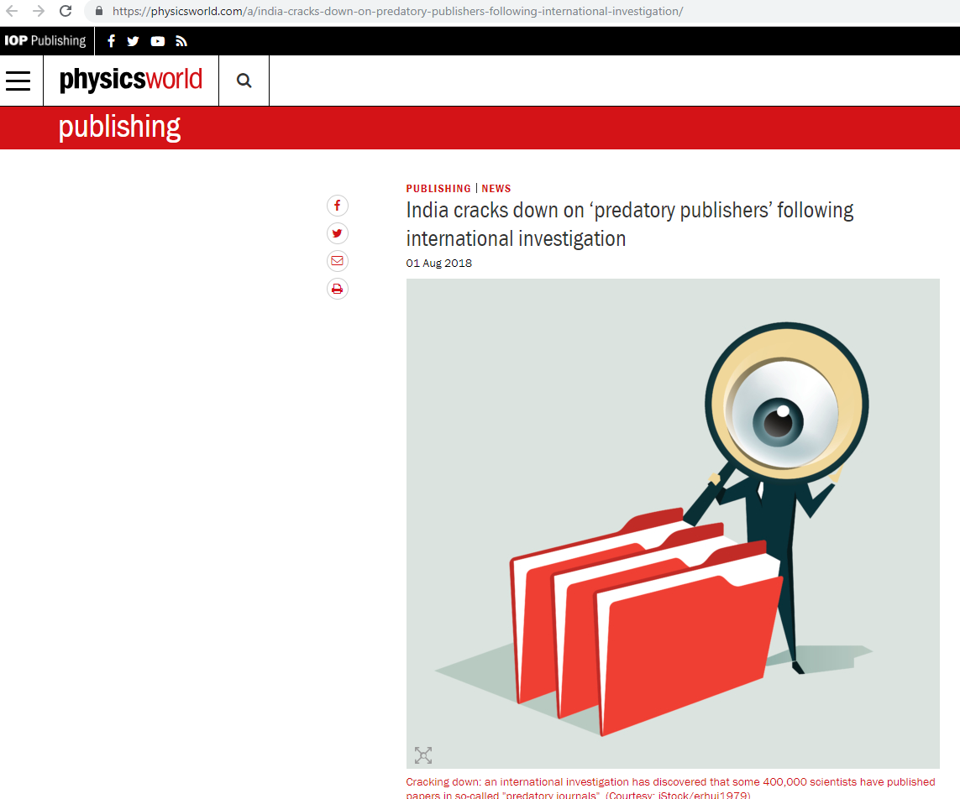
https://physicsworld.com/a/india-cracks-down-on-predatory-publishers-following-international-investigation/

Slide 26
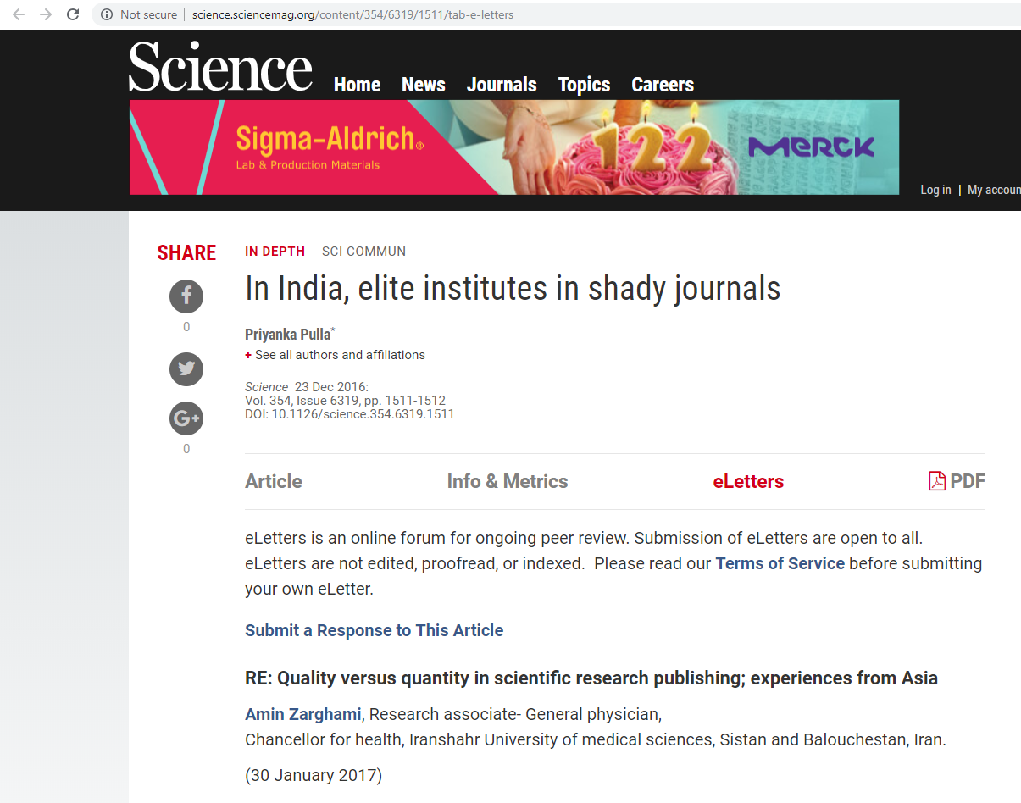
http://science.sciencemag.org/content/354/6319/1511/tab-e-letters

Slide 27
Pakistan
“One reason is the evolution of research in many Asian countries such as Pakistan is still in the elementary stages and many medical students or faculty members perform research projects with a focused objective and a large number of research conducted is descriptive cross sectional studies which has the low probability to be attracted and accepted by high quality valid journals (3).”
3. F. Jawad. J Pak Med Assoc 65, 1 (2015).
Response
RE: Quality versus quantity in scientific research publishing; experiences from Asia
Amin Zarghami, 2017
http://science.sciencemag.org/content/354/6319/1511/tab-e-letters

Slide 28
China
“On the other hand, in China, evaluation system obligations put many doctors under the pressure of publishing articles each year which leads to affect the quality of research and increase the risk of data falsification, expansion of ghostwriter companies and thus production of untrustworthy articles which eventually damages scientific research credibility of this country (4).”
4. B. Ye, A.H. Liu, Lancet 381, 9882 (2013).
Response
RE: Quality versus quantity in scientific research publishing; experiences from Asia
Amin Zarghami, 2017
http://science.sciencemag.org/content/354/6319/1511/tab-e-letters

Slide 29
Iran
“Similarly, in Iran, which is observed that a great number of research projects published for promotional intentions in the least possible time which therefore absorb the authors for rapid publication by any means (5).”
Therefore, the role of predatory journal could be critical in fast and timely publication this regards.
5. A. Zarghami, A. Zarghami J Pak Med Assoc 65, 2 (2015).
Response
RE: Quality versus quantity in scientific research publishing; experiences from Asia
Amin Zarghami, 2017
http://science.sciencemag.org/content/354/6319/1511/tab-e-letters

Slide 30
“It seems that the proliferation of the number of predatory journals is unstoppable.”
Response
RE: Quality versus quantity in scientific research publishing; experiences from Asia
Amin Zarghami, 2017
http://science.sciencemag.org/content/354/6319/1511/tab-e-letters

Slide 31
“The justification of firm regulations in national research councils by giving value to the quality over the quantity of publication can lead to prevent from many unethical behaviors and decrease the valuing of predatory journals.”
Response
RE: Quality versus quantity in scientific research publishing; experiences from Asia
Amin Zarghami, 2017
http://science.sciencemag.org/content/354/6319/1511/tab-e-letters

Slide 32
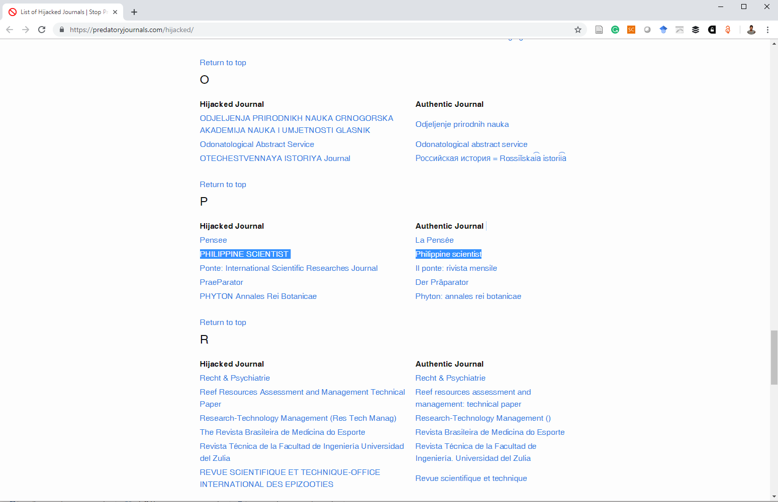
Hijacked Journals
http://psc.tomaspubs.com/
(This site can’t be reached)
https://predatoryjournals.com/hijacked/

Slide 33
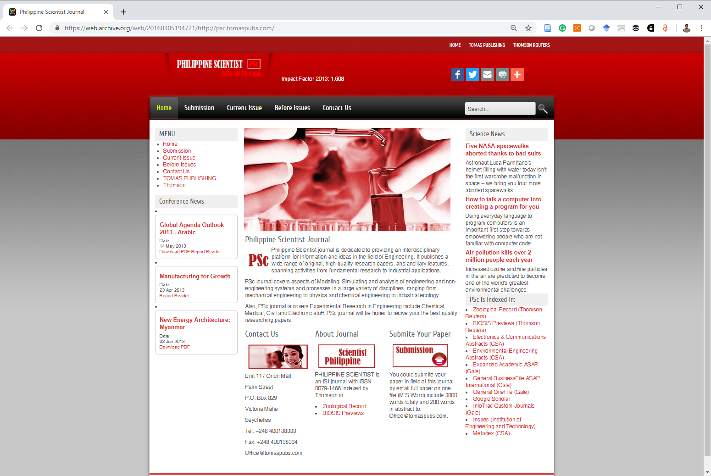
University of San Carlos 0079-1466
https://web.archive.org/web/20160305194721/http://psc.tomaspubs.com/

Slide 34
Reproducibility

Slide 35
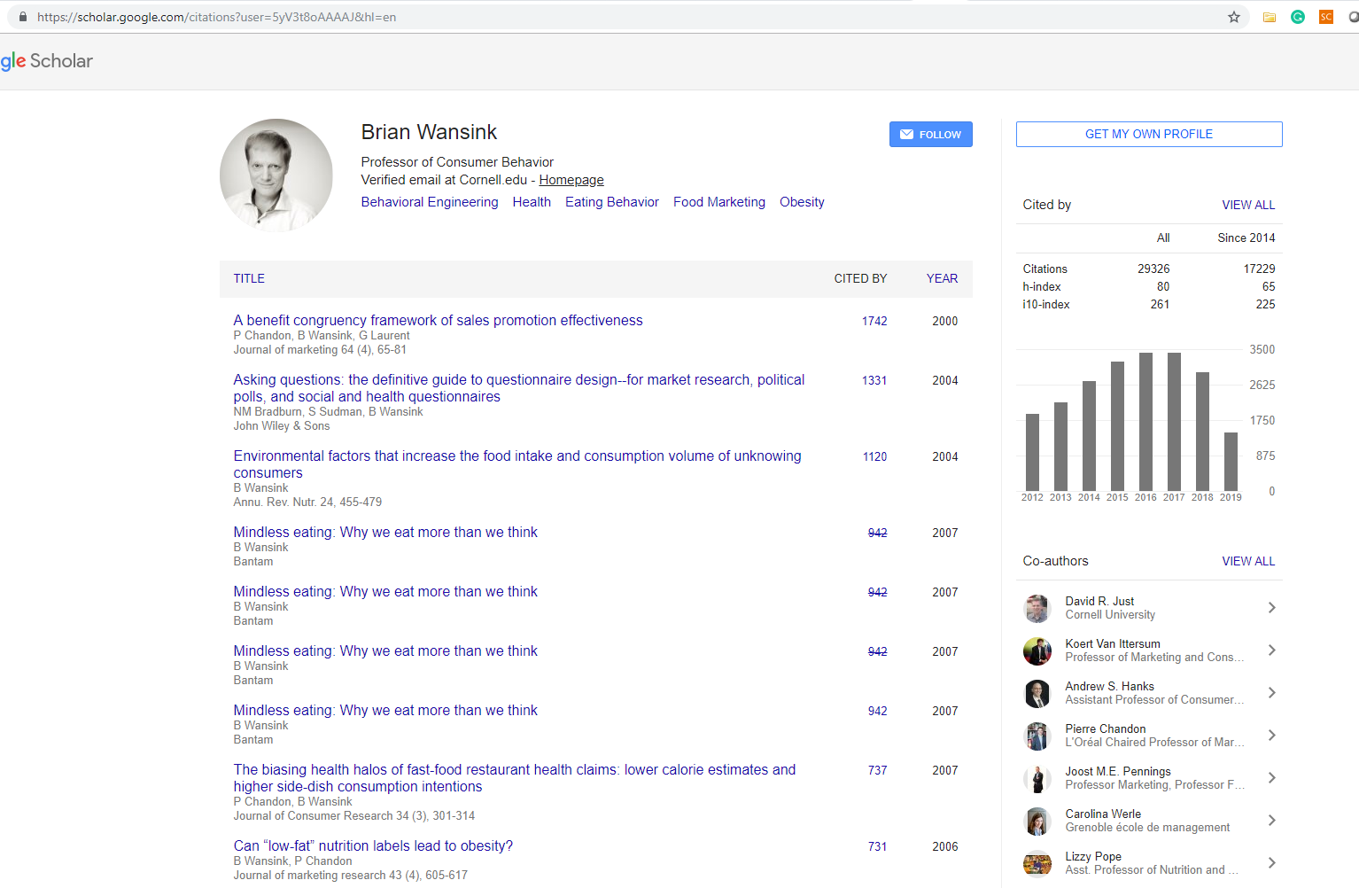

Slide 36
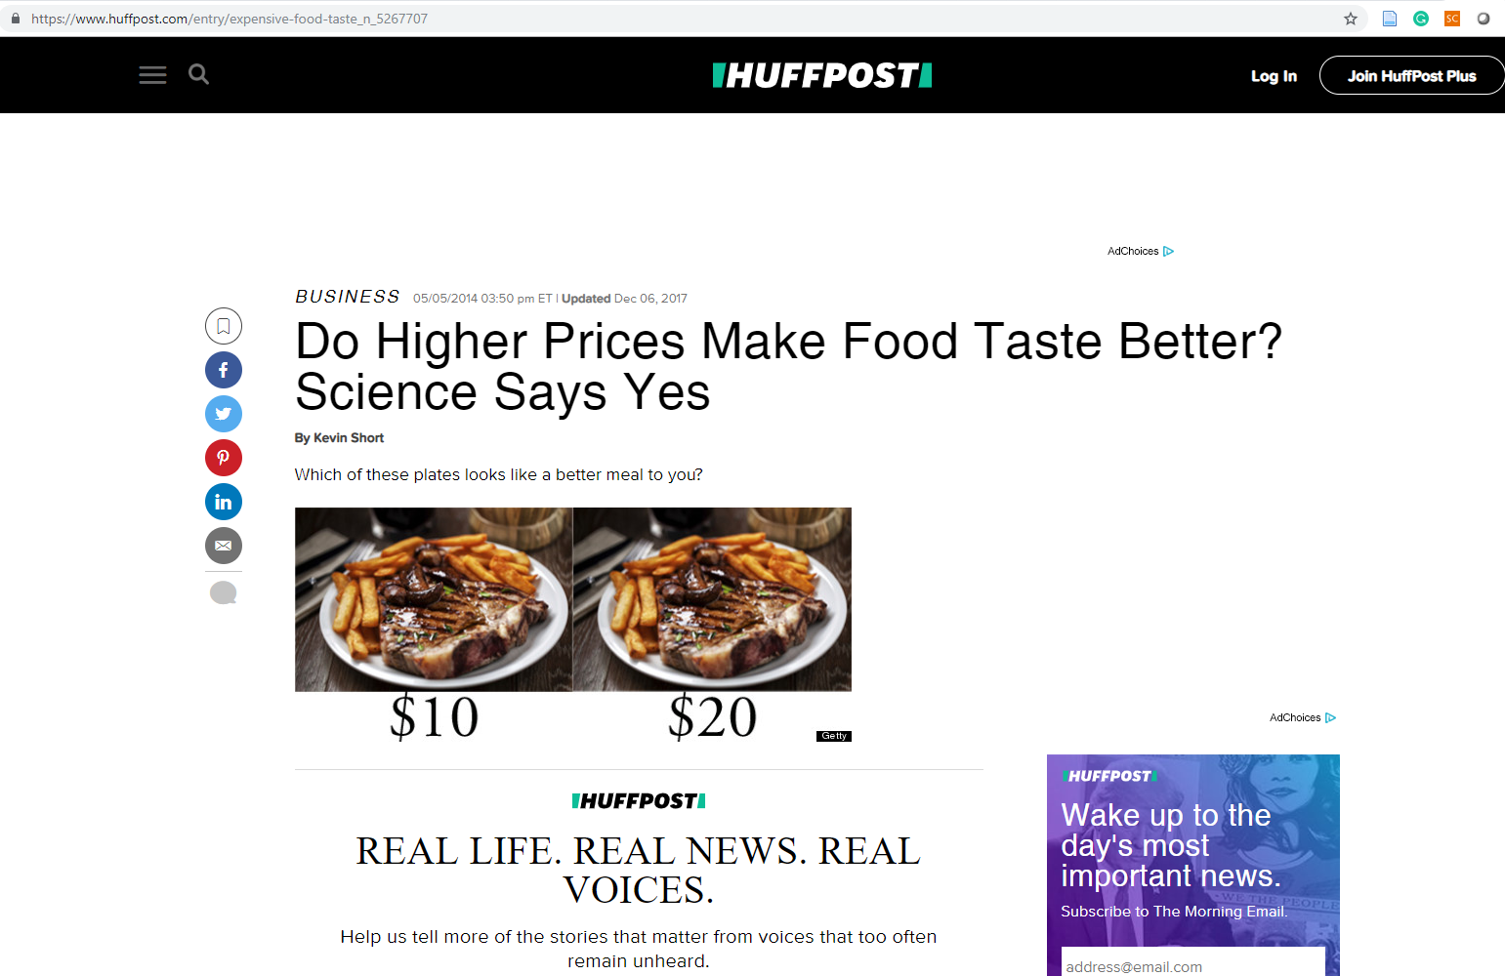

Slide 37
Among his many well-known findings:
People eat more
  when they're served in large bowls,
  and when they're watching an action movie,
  and when they sit close to the buffet at an all-you-can-eat restaurant.
People who eat with someone who is fat will make worse food choices
https://www.npr.org/sections/thesalt/2018/09/26/651849441/cornell-food-researchers-downfall-raises-larger-questions-for-science
Notes:
P-hacking is when researchers play with data to arrive at results that look like they're scientifically significant. For instance, they can cherry pick data points, re-analyze the data in multiple ways or stop an experiment early.
some of his findings — such as the suggestion to use smaller bowls — can be useful to people with healthy relationships with food,

Slide 38
people who grocery shop hungry buy more calories
preordering lunch can help you choose healthier food
serving people out of large bowls encourage them to serve themselves larger portions.
https://www.vox.com/science-and-health/2018/9/19/17879102/brian-wansink-cornell-food-brand-lab-retractions-jama

Slide 39
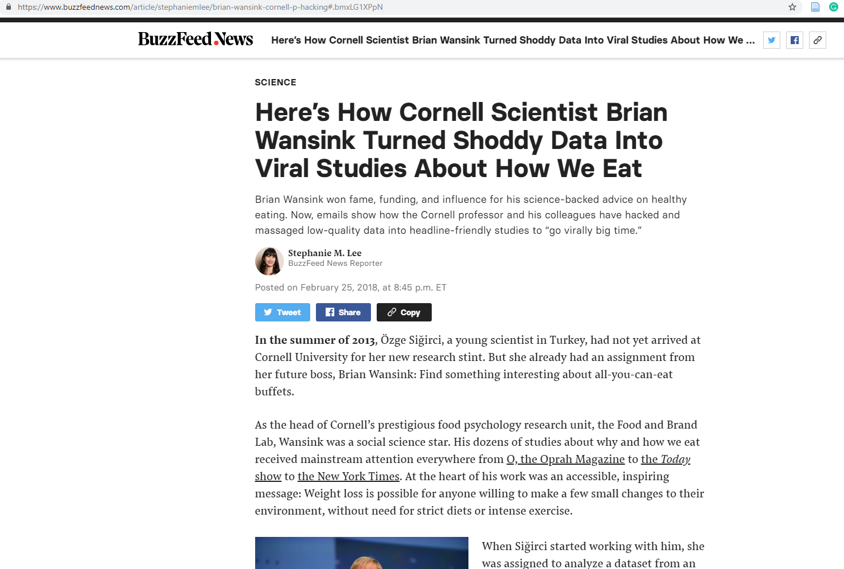
Notes:
how portion sizes affect food intake. Some of his work led to the introduction of mini-size packaging

Slide 40
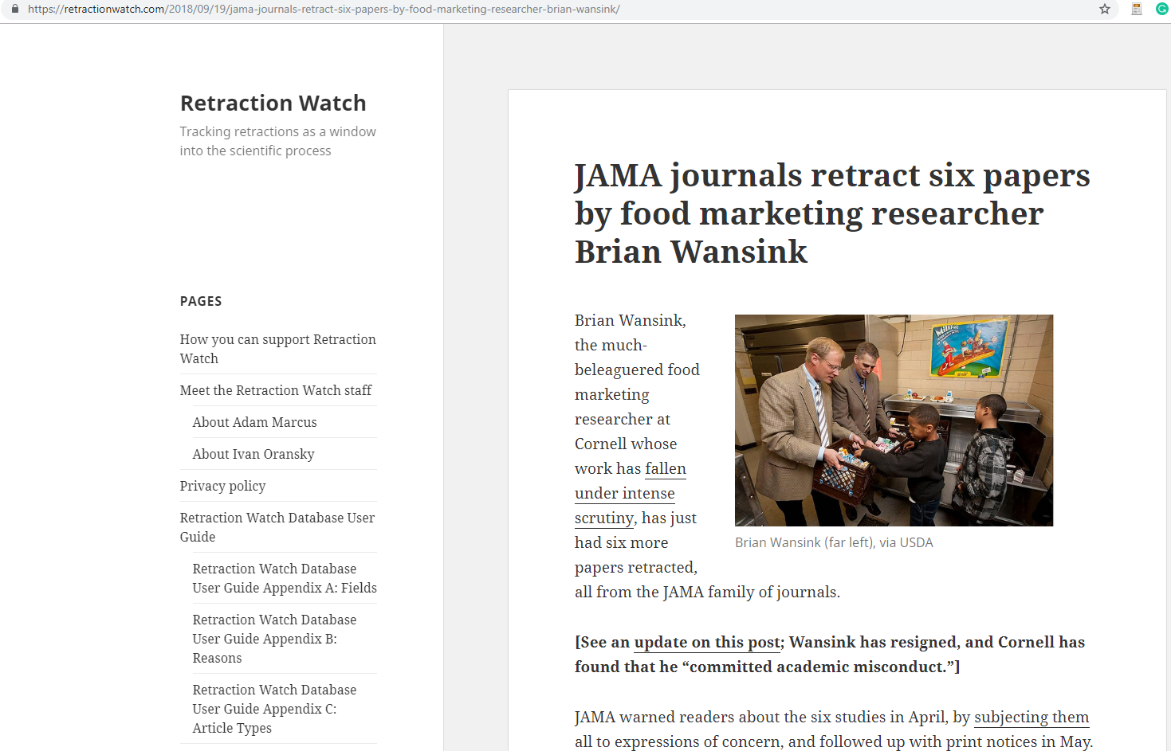

Slide 41
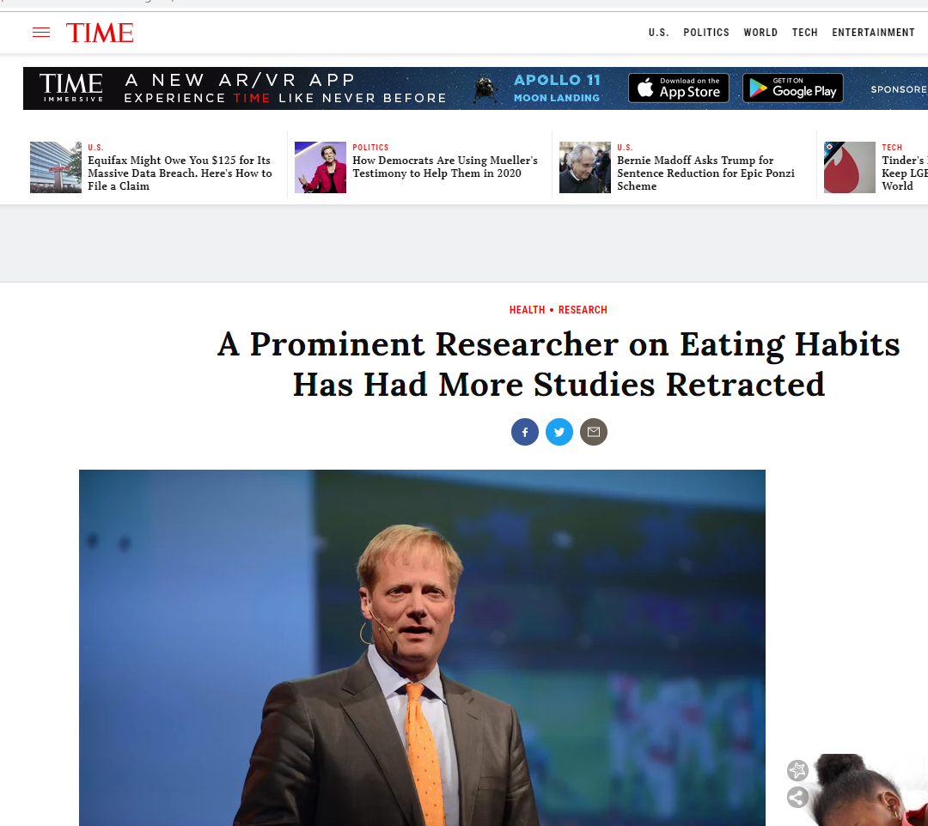

Slide 42
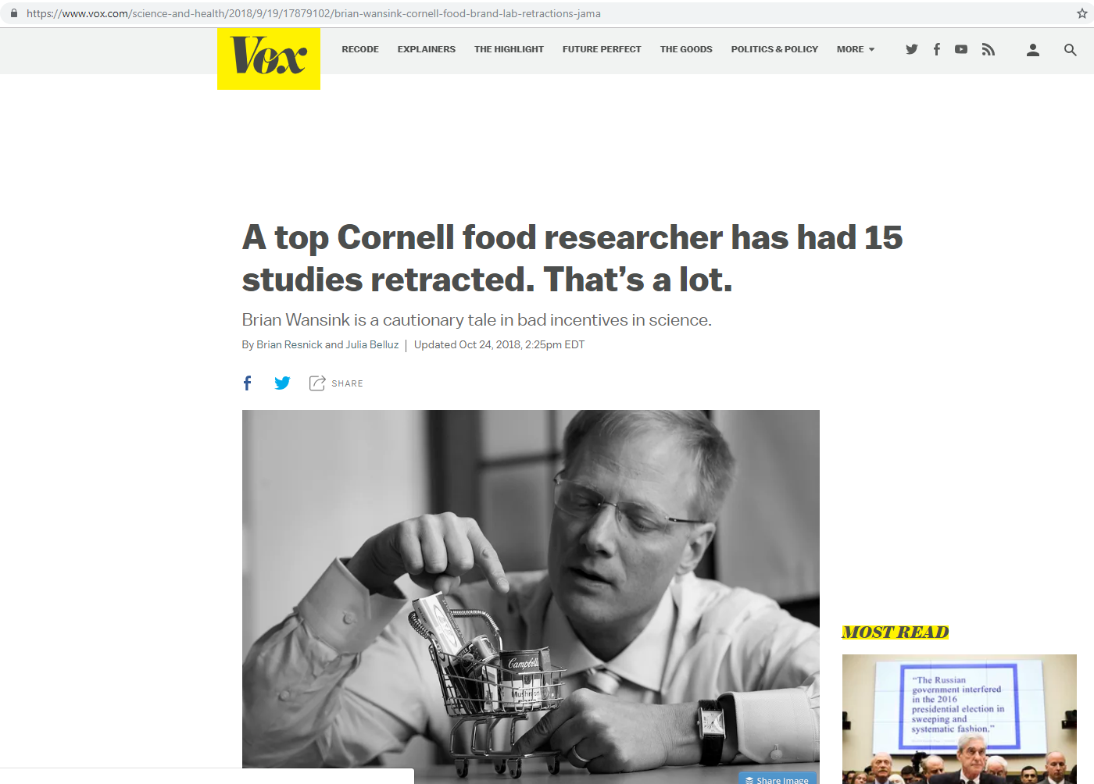
Notes:
The lab had 17 papers retracted (one twice) and had 15 corrections issued.

Slide 43
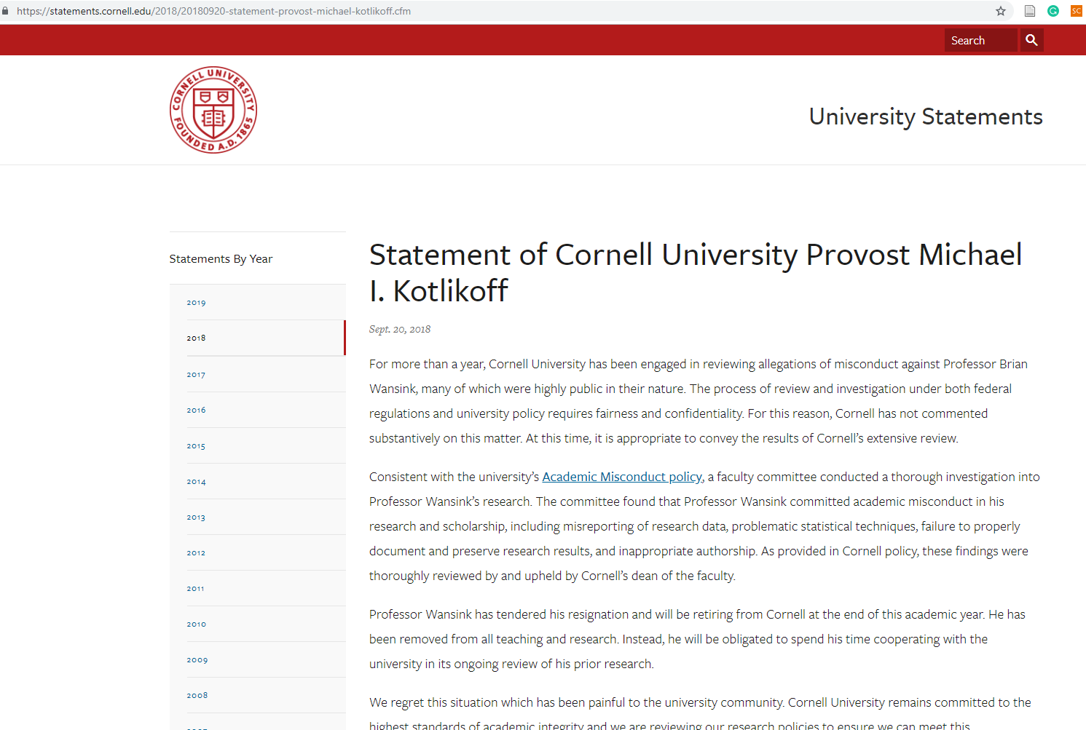

Slide 44
Consistent with the university’s Academic Misconduct policy, a faculty committee conducted a thorough investigation into Professor Wansink’s research. The committee found that Professor Wansink committed academic misconduct in his research and scholarship, including misreporting of research data, problematic statistical techniques, failure to properly document and preserve research results, and inappropriate authorship. As provided in Cornell policy, these findings were thoroughly reviewed by and upheld by Cornell’s dean of the faculty.
Professor Wansink has tendered his resignation and will be retiring from Cornell at the end of this academic year. He has been removed from all teaching and research. Instead, he will be obligated to spend his time cooperating with the university in its ongoing review of his prior research.
https://time.com/5402927/brian-wansink-cornell-resigned/

Slide 45
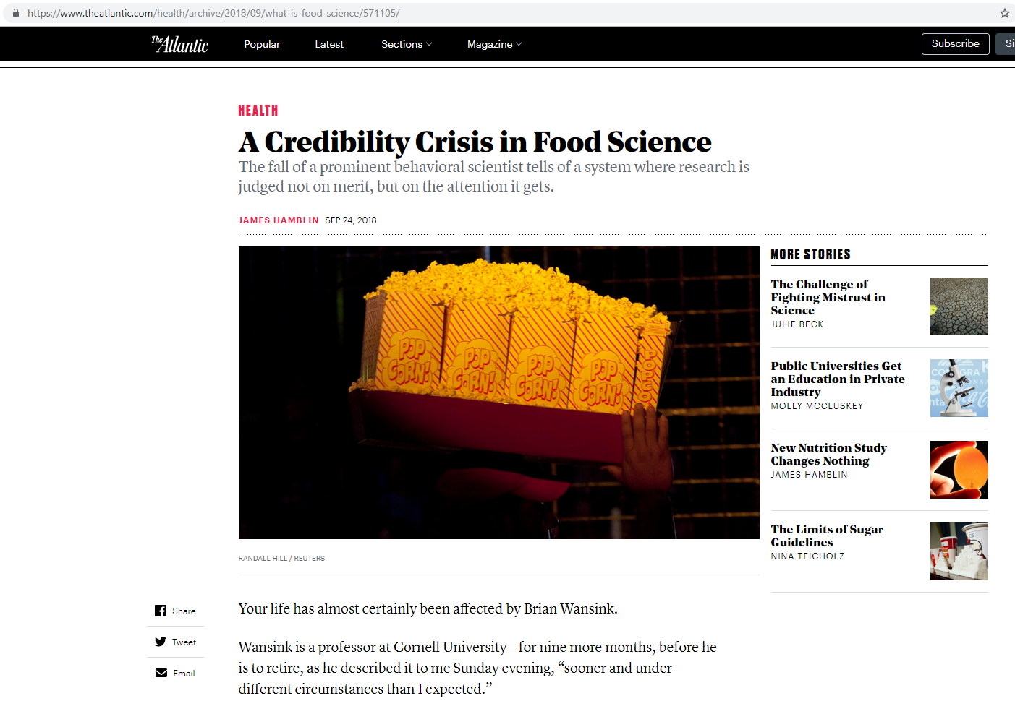

Slide 46
Plagiarism

Slide 47
Plagiarism
is presenting the words or ideas of someone else as your own without proper acknowledgment of the source.
http://www.webpages.uidaho.edu/info_literacy/modules/module6/6_4.htm
Notes:
Plagiarism ranges from
copying word-for-word
paraphrasing a passage without credit
paraphrasing a passage changing only a few words

Slide 48
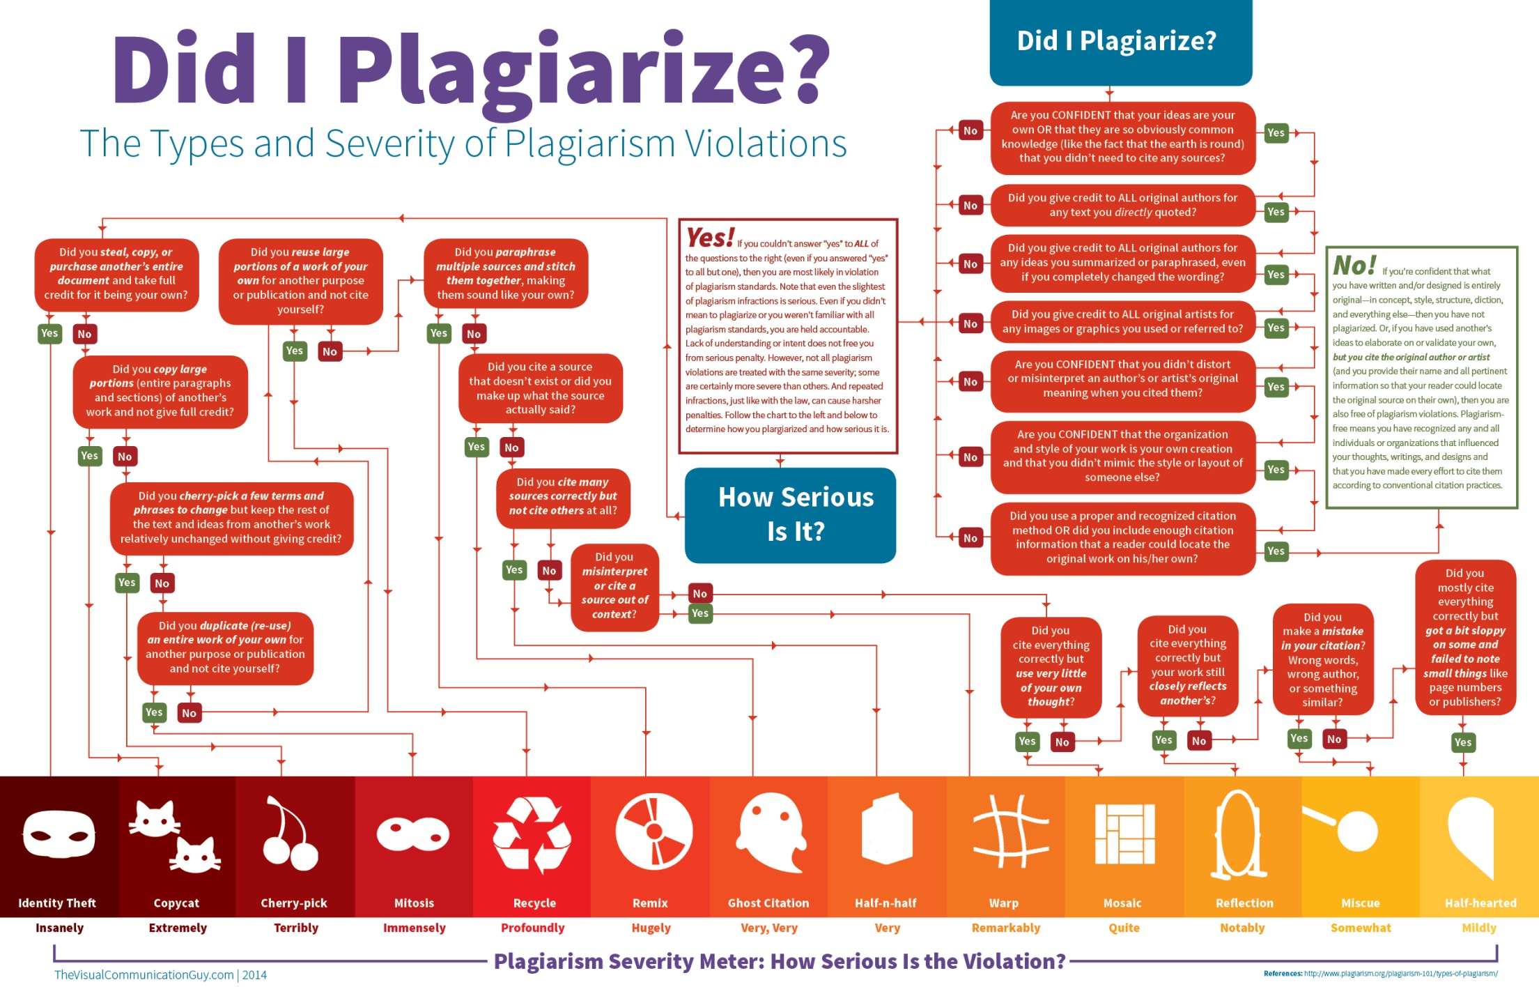
http://thevisualcommunicationguy.com/wp-content/uploads/2014/09/Infographic_Did-I-Plagiarize1.jpg

Slide 49
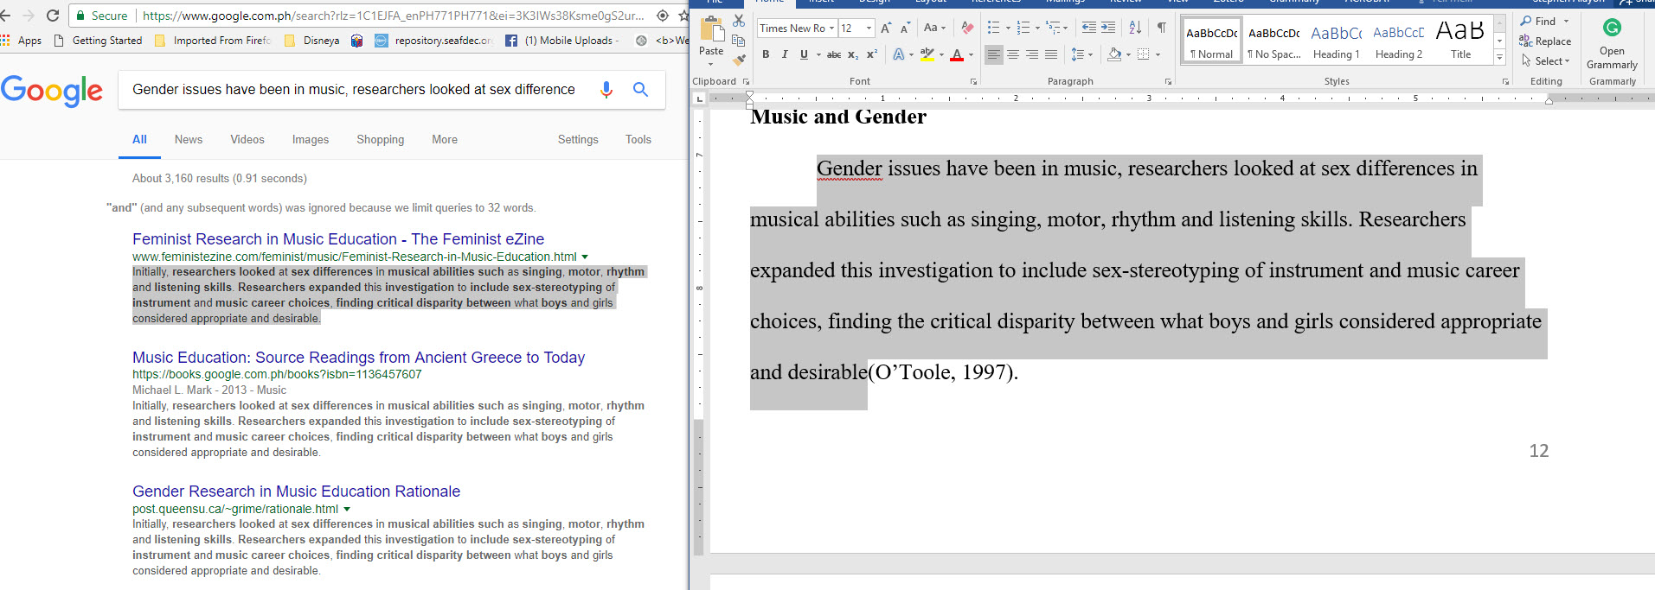

Slide 50
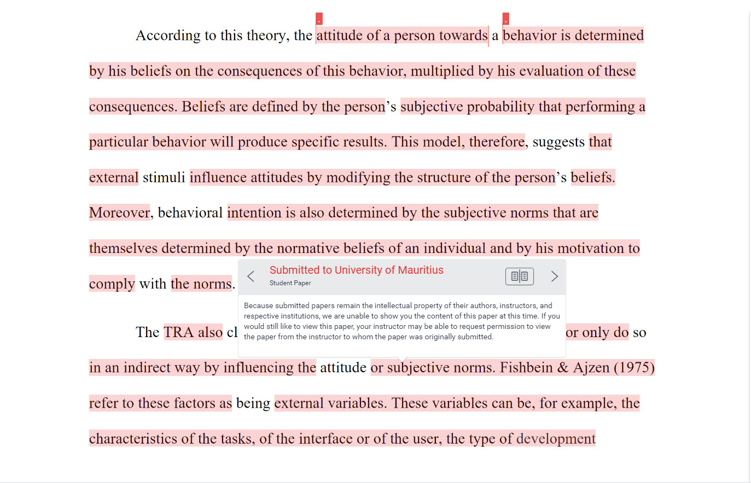

Slide 51
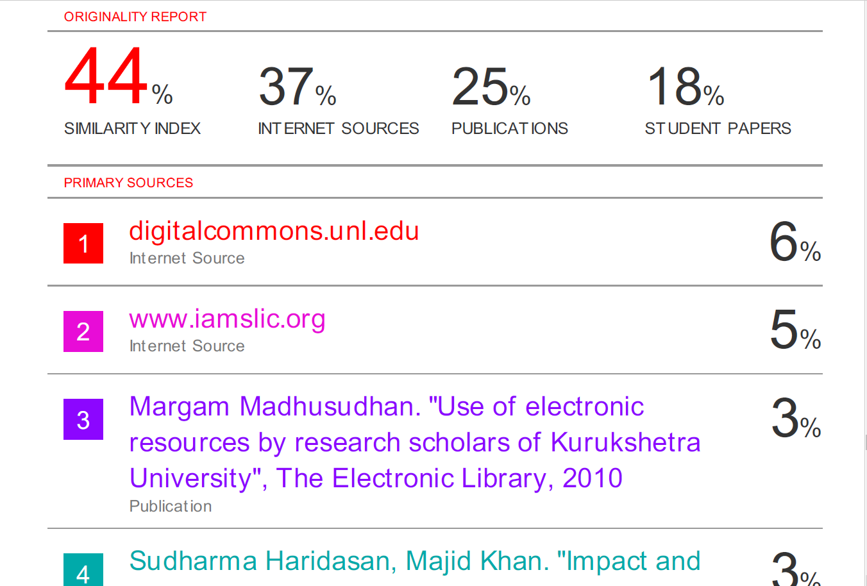

Slide 52
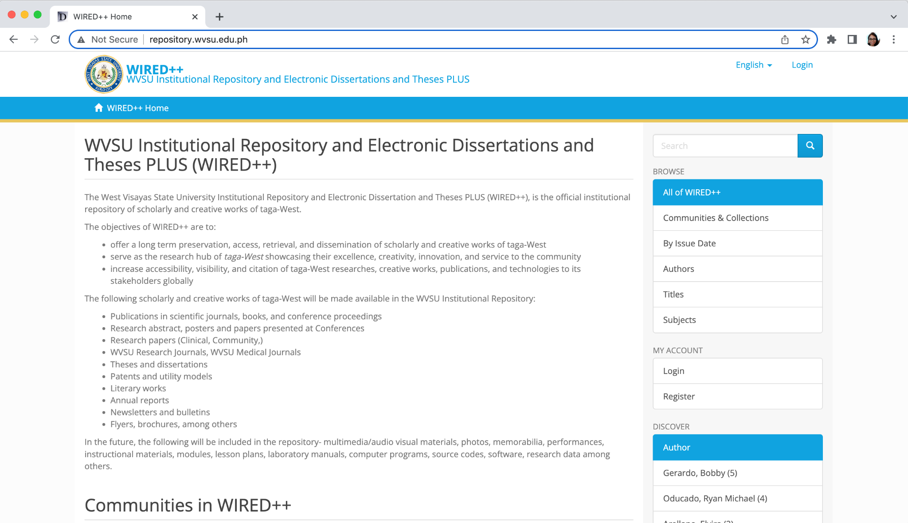
ETD

Slide 53
Dilemma
plagiarism check should be done before deposit.
previous theses and dissertations - unearthing of plagiarized texts

Slide 54
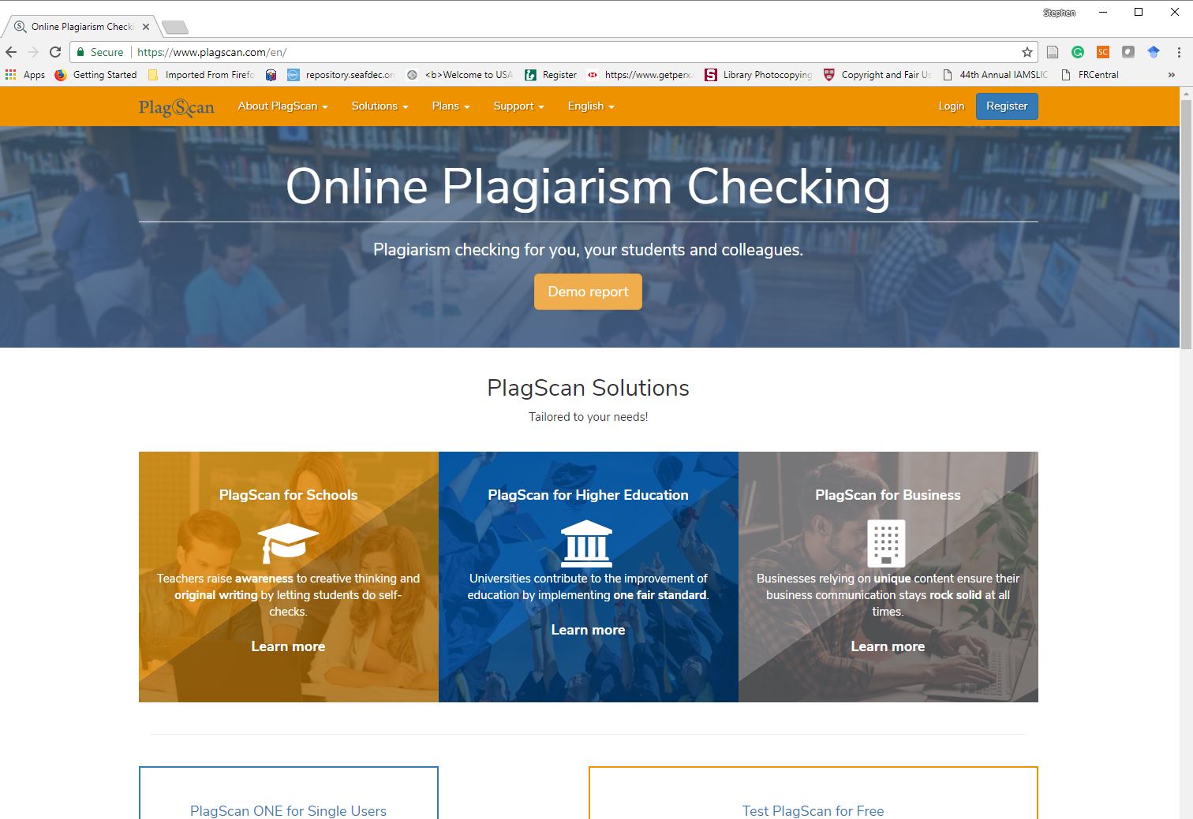
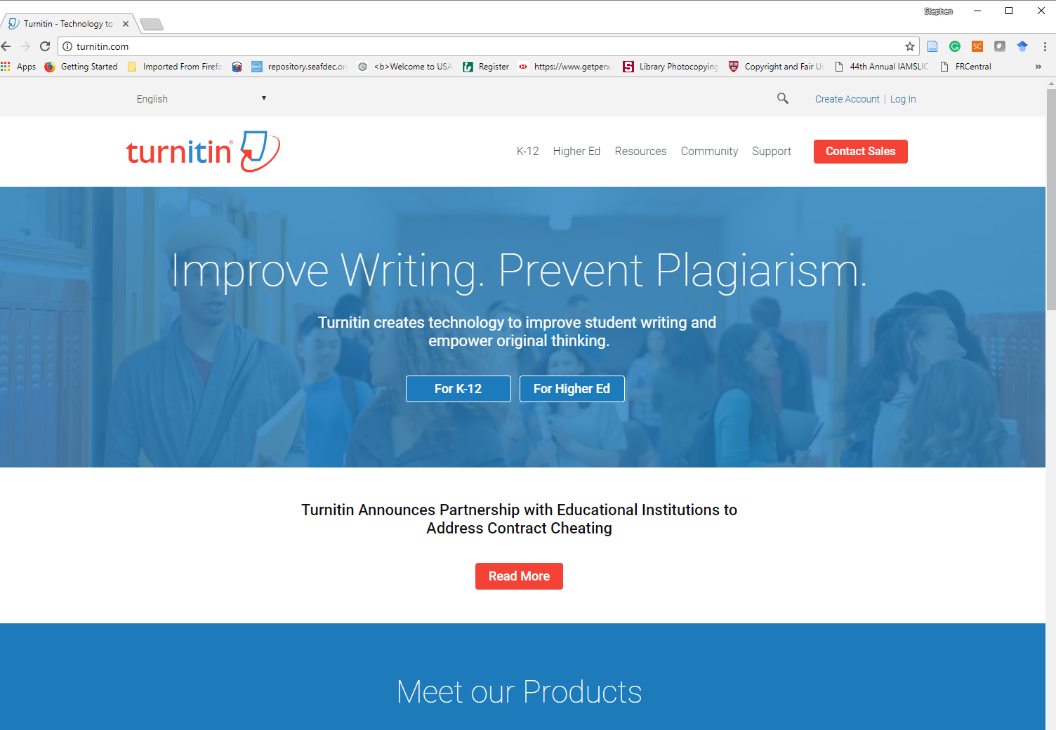
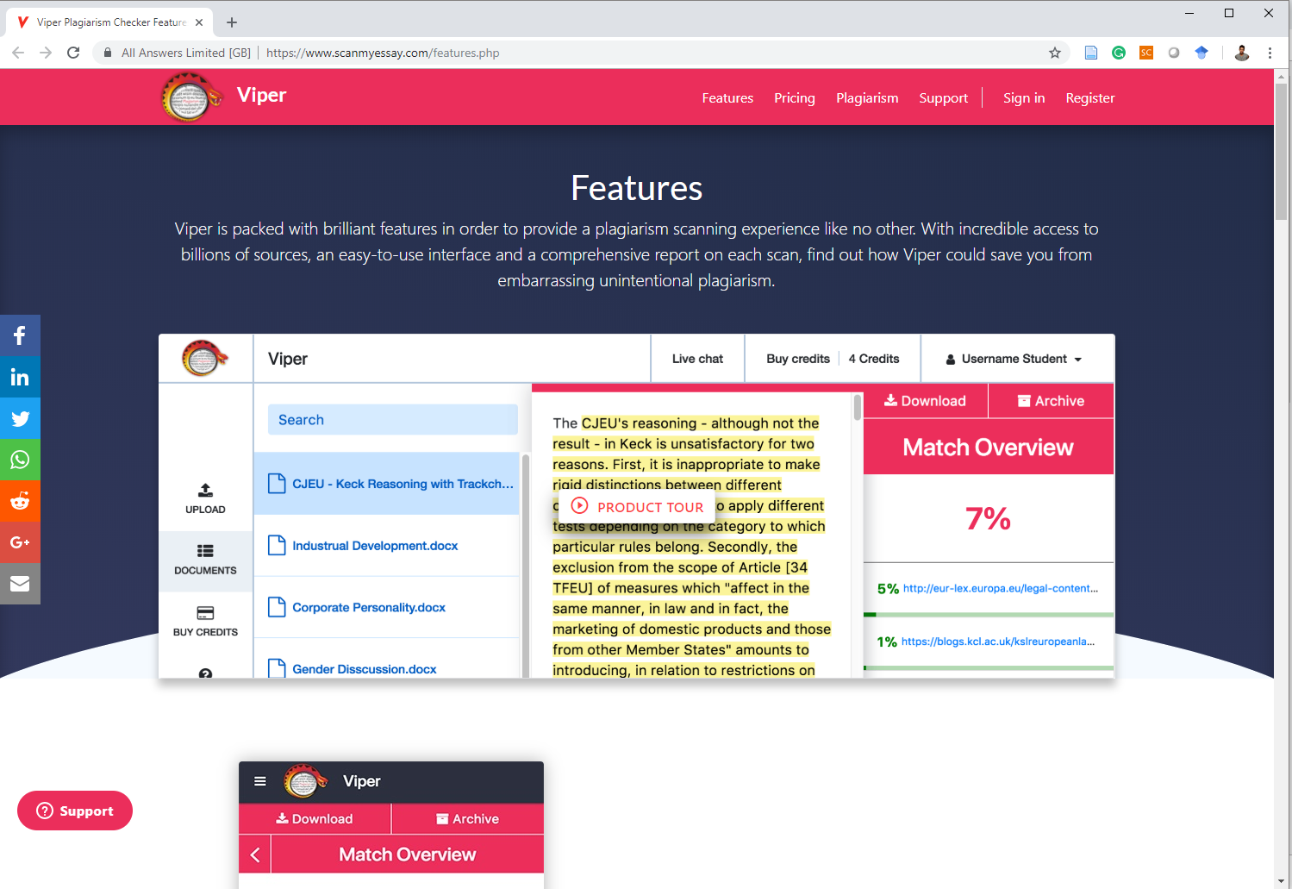
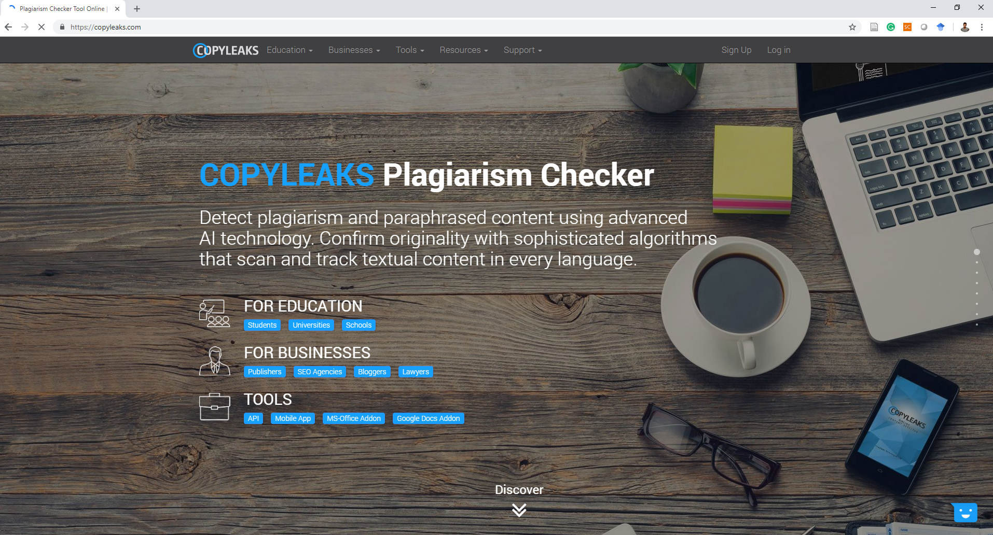
Plagiarism Software and Tools

Slide 55
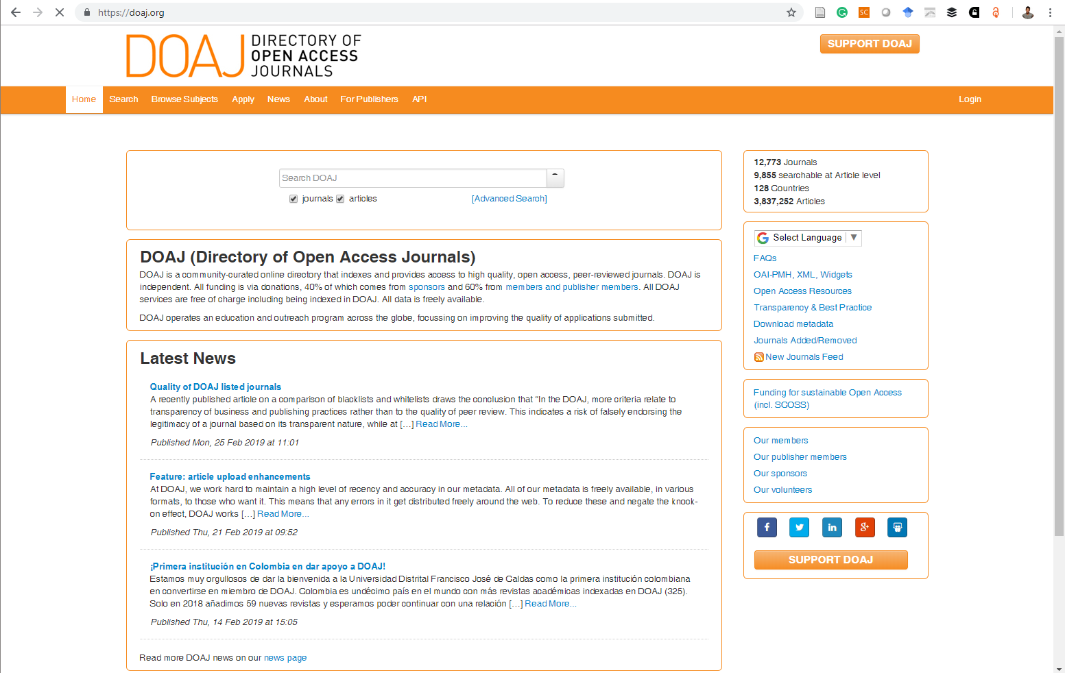
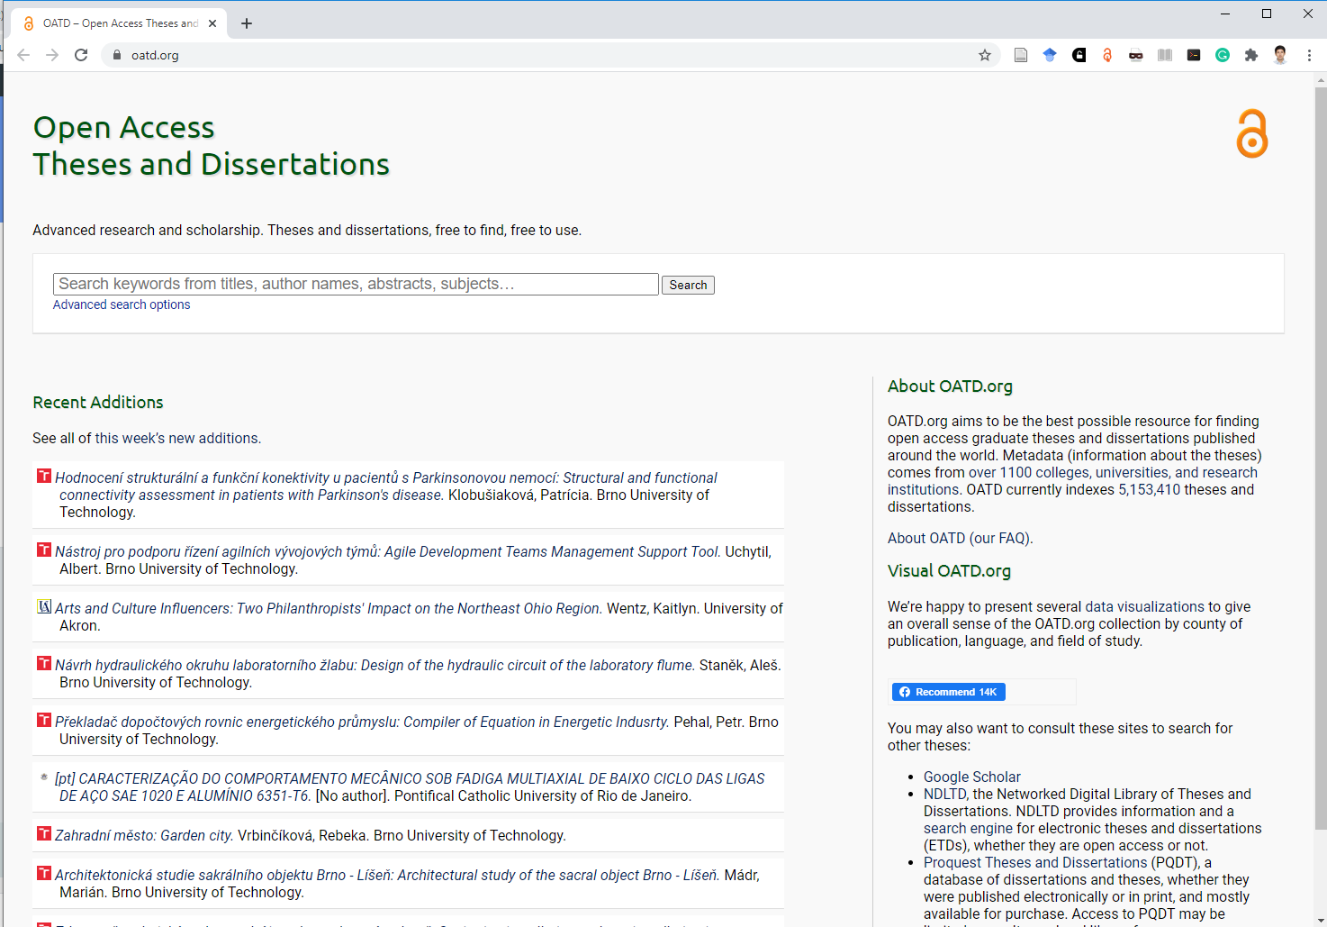
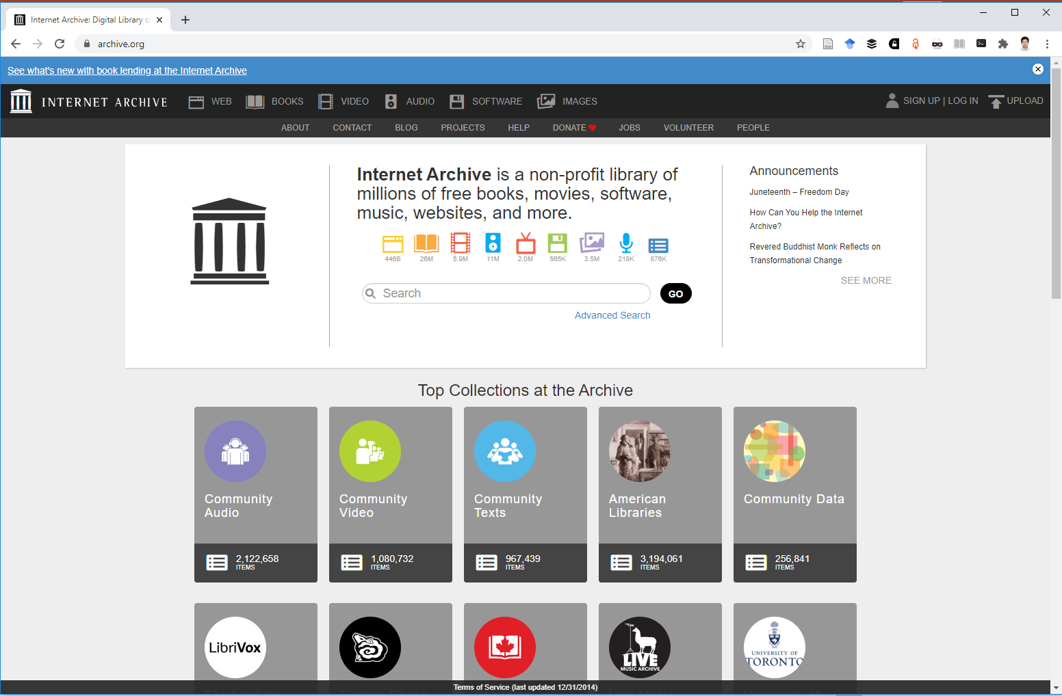
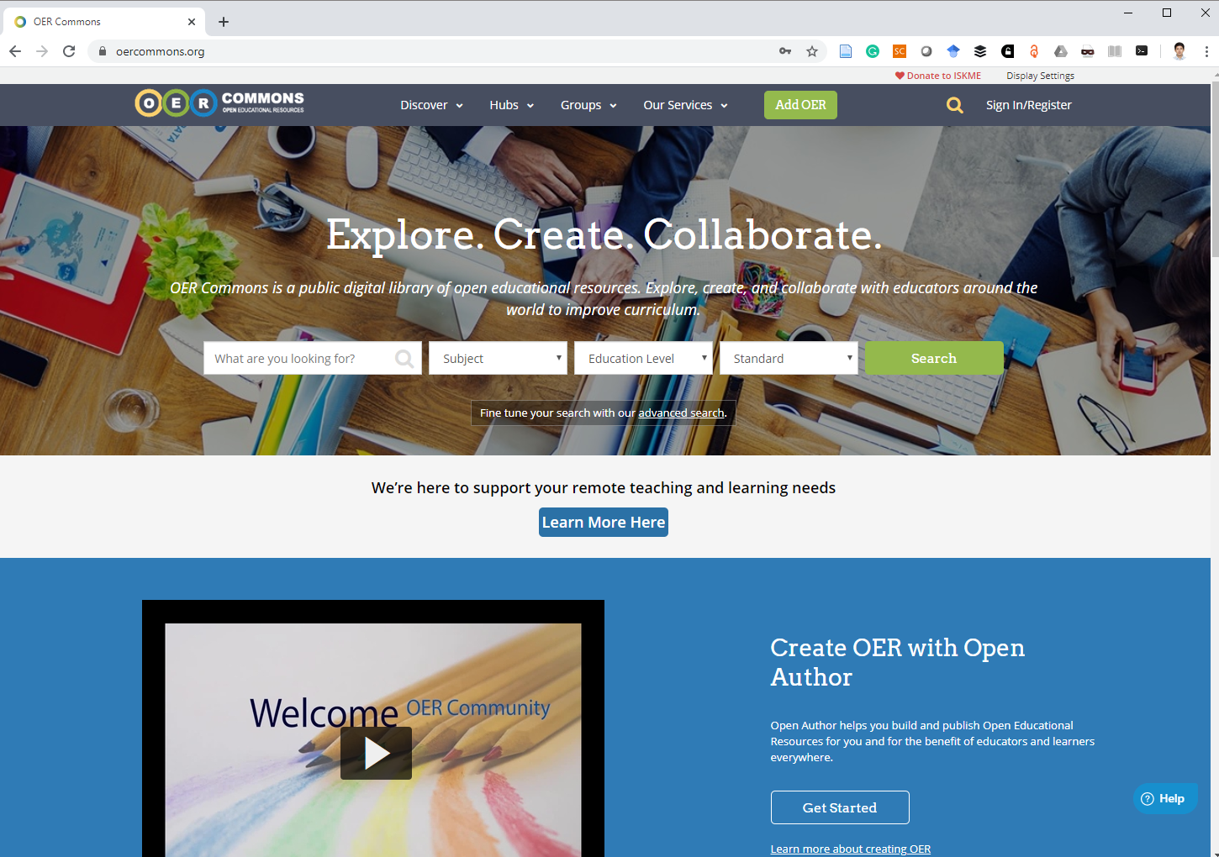
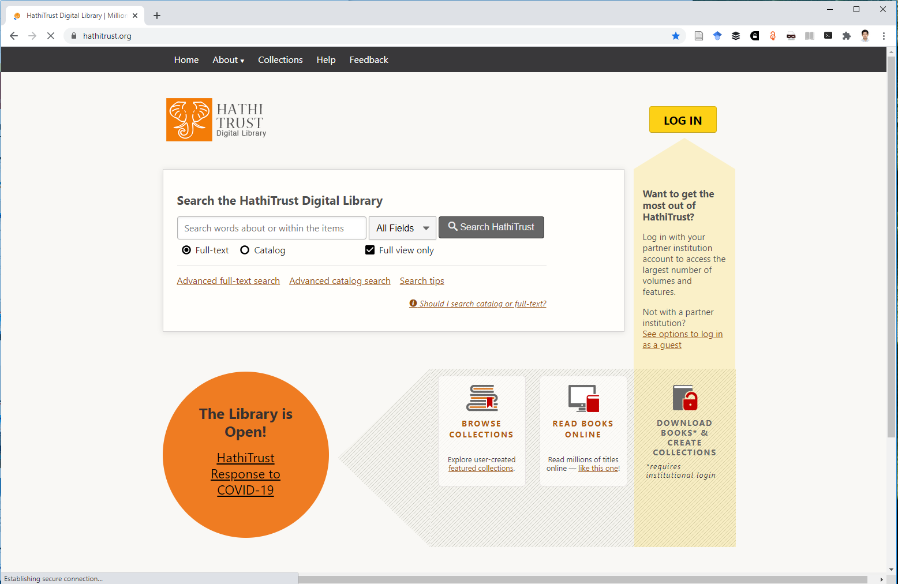
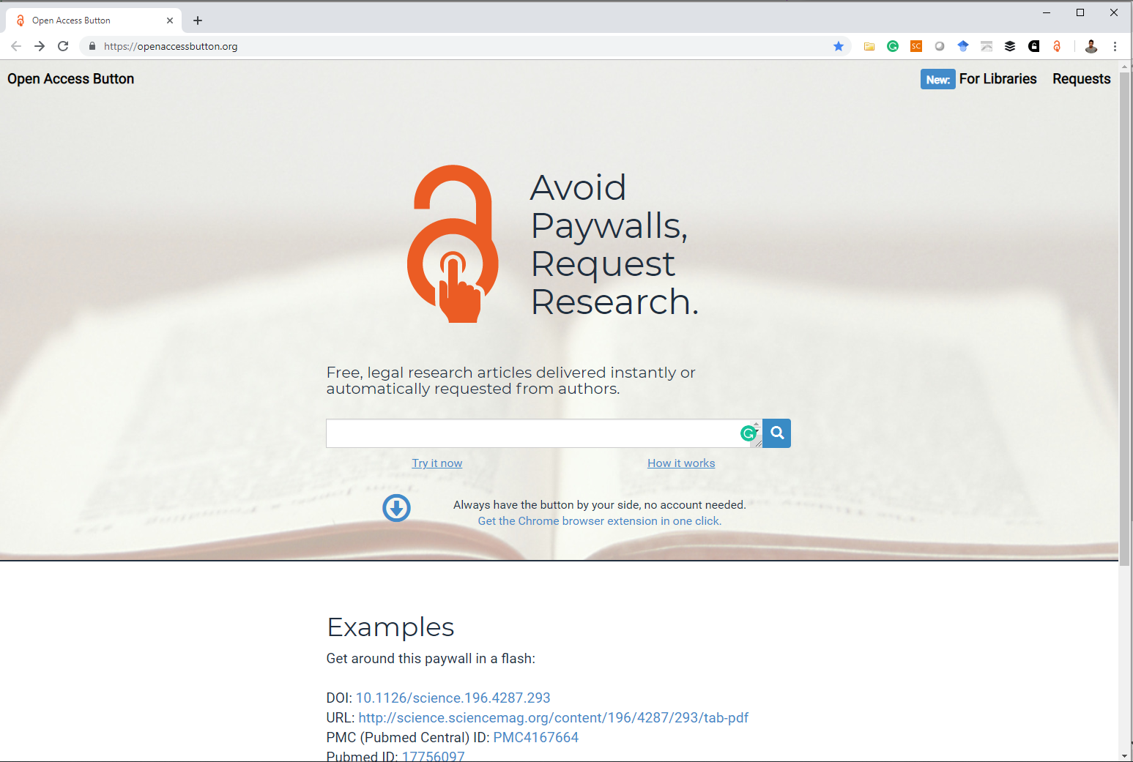
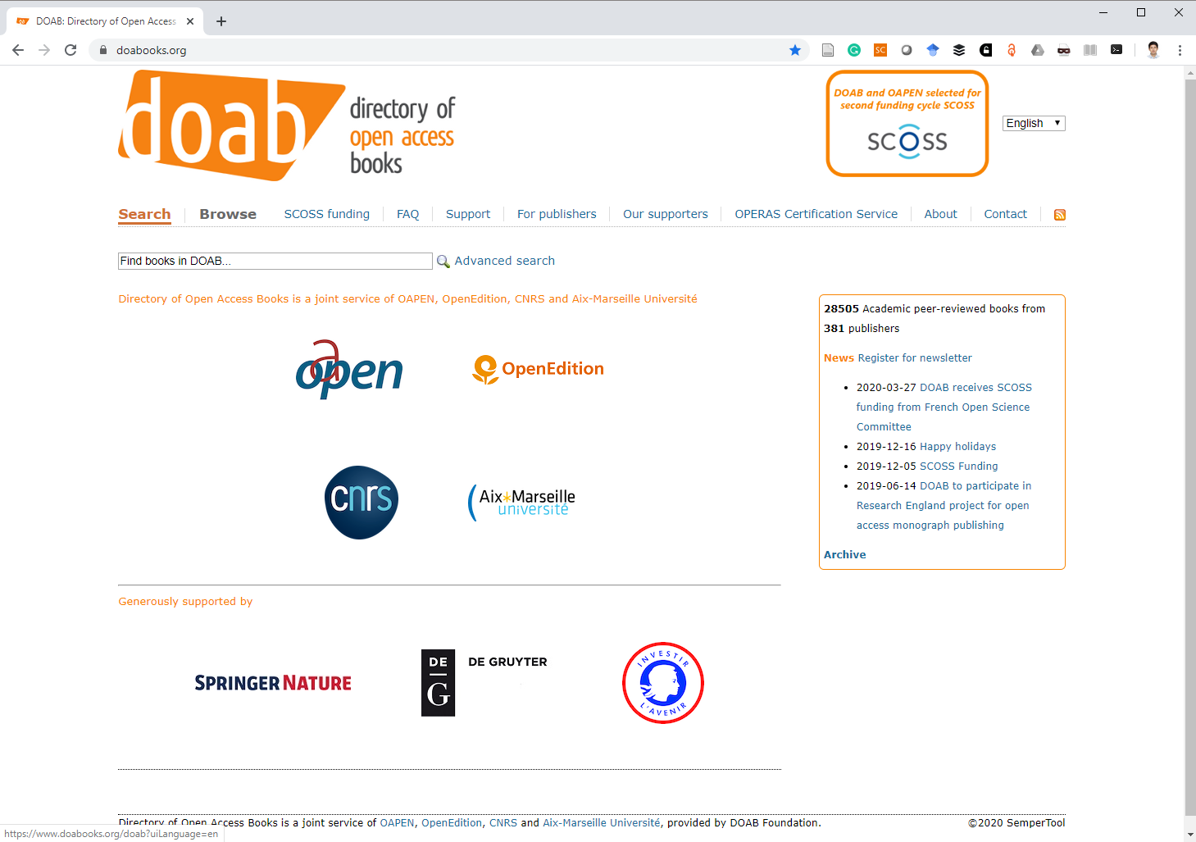
Open Access Tools/Sites

Slide 56
Digital Contents,
Digital Library,
Institutional Repository (IR)

Slide 57
Framework
Sustainable Development
Improved Governance
Information Society
Digital Content/Resources
Libraries Archives Museums

Slide 58
Digital Libraries/
Institutional Repositories (IR)
Digital libraries and institutional repositories (IR) were identified to be important and primary tools in the open access movement
Notes:
This session will :
provide a background to the OA landscape and discuss how organizations/countries have responded to the OA call with the adoption of international and national declarations, recommendations, policies, and mandates.
discuss the initiatives, progress, and milestones related to the OA movement - particularly in Southeast Asia.

Slide 59
Digital Library
IFLA/UNESCO Manifesto for Digital Libraries
Bridging the Digital Divide: making the world’s cultural and scientific heritage accessible to all
an online collection of digital objects of assured quality
are created or collected and managed according to internationally accepted principles for collection development and
made accessible in a coherent and sustainable manner, supported by services necessary to allow users to retrieve and exploit the resources.

Slide 60
Institutional Repository
A set of services offered by a university or group of universities to members of its community for the management and dissemination of scholarly materials in digital format created by the institution and its community members
  e-prints
  technical reports
  theses and dissertations
  data sets
  teaching materials (Reitz/ODLIS, 2014)

Slide 61
Essential elements of IR identified by Prosser(2003) and Crow (2002)
IR should be
institutionally defined
scholarly
cumulative and perpetual
interoperable and open access
Notes:
Institutionally defined
institutional repositories capture the original research and other intellectual property generated by an institution’s constituent population active in many fields.
Defined in this way, institutional repositories represent an historical and tangible embodiment of the intellectual life and output of an institution
Scholarly Content
To control and manage the accession of this content requires appropriate policies and mechanisms, including content management and document version control systems.
The repository policy framework and technical infrastructure must provide institutional managers the flexibility to control who can
contribute,
approve,
access, and
update the digital content
coming from a variety of institutional communities and interest groups (including academic departments, libraries, research centers and labs, and individual authors).
Cumulative and Perpetual
This has two implications:
Whatever the content submission criteria for a repository, items once submitted cannot be withdrawn—except in presumably rare cases involving allegations of libel, plagiarism, copyright infringement, or “bad science.”
institutional repositories aim to preserve and make accessible digital content on a long-term basis.
Interoperability and Open Access
Providing no- or low-barrier access to the intellectual product generated by the institution increases awareness of research contributions
The goals motivating an institution to create and maintain a digital repository—whether pan-institutional, as a component in the changing structure of scholarly communication, or institution-centric—require that users beyond the institution’s community gain access to the content.
IR systems must be able to support interoperability in order to provide access via multiple search engines and other discovery tools.
An institution does not necessarily need to implement searching and indexing functionality to satisfy this demand:
it could simply maintain and expose metadata, allowing other services to harvest and search the content.
This simplicity lowers the barrier to repository operation for many institutions, as it only requires a file system to hold the content and the ability to create and share metadata with external systems.

Slide 62
Uses of Institutional Repository
Main Uses
Address the issue of scholarly communication crisis
Expand access and enhance visibility
Preserve digital content
Others
Serving as one part of marketing plan for an institution
Archiving the institutions’ internal governance documents
Managing and distributing thesis and dissertations

Slide 63
SEAFDEC/AQD Institutional Repository (SAIR)

Slide 64
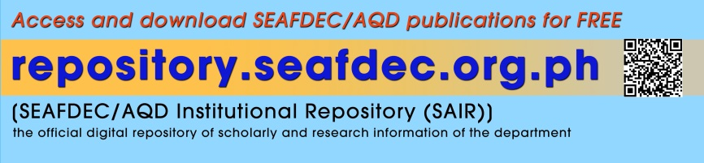
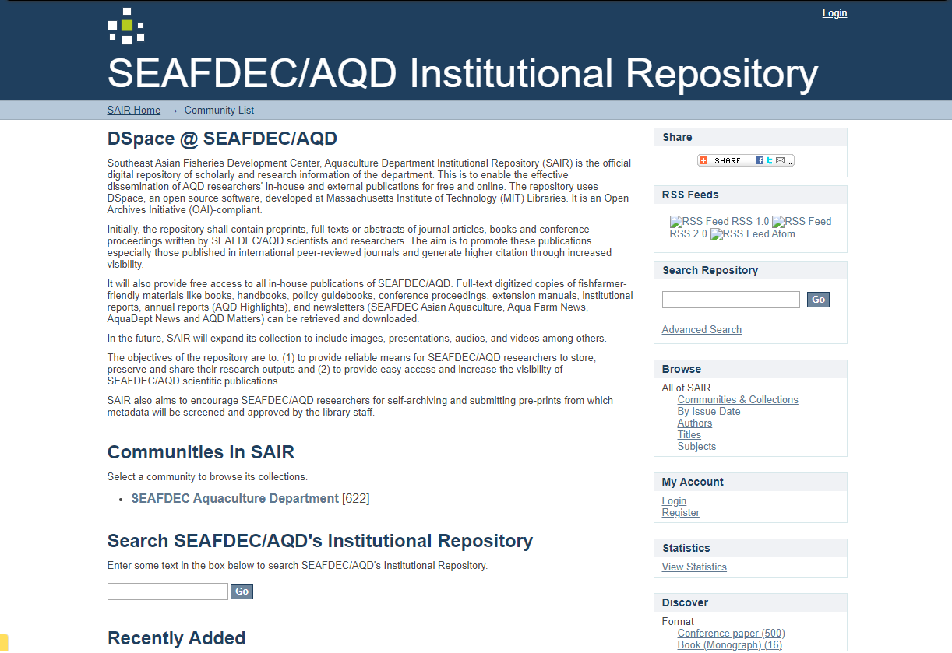

Slide 65
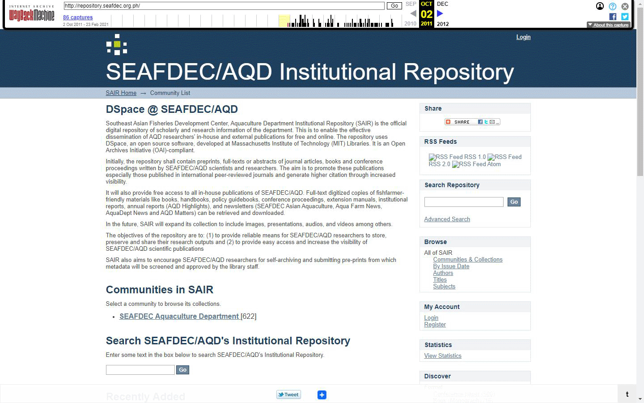
Timeline

Slide 66
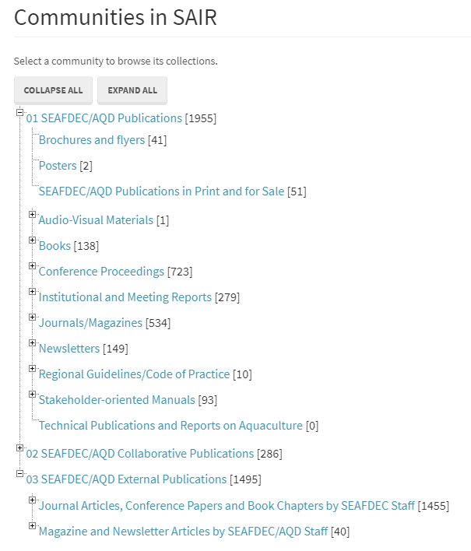
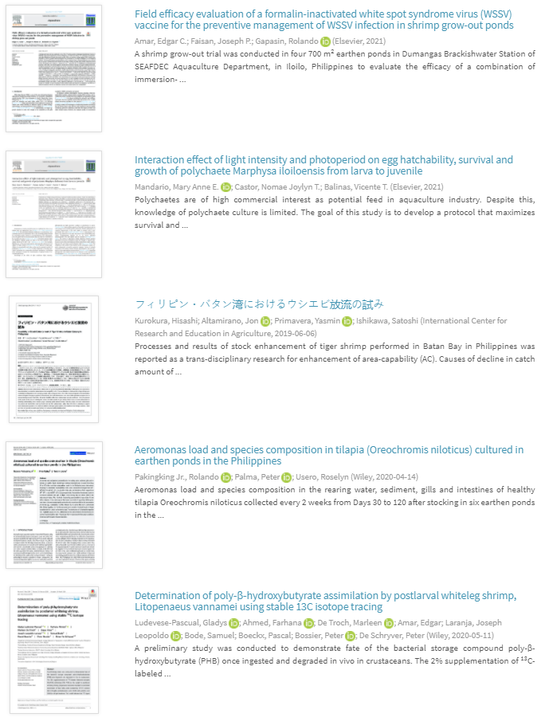
SAIR Structure
Notes:
Structure will be updated to harmonize with other SEAFDEC Department’s repositories

Slide 67

Customization – FB Chat Plugin

Slide 68

Customization – Export Item to CSL
Notes:
Citation Style Language

Slide 69

Customization – Social Media Sharing

Slide 70

Customization – ORCID

Slide 71

Customization – ORCID

Slide 72


Customization – Scopus Citation, Dimensions, Altmetrics, PlumX

Slide 73

Customization – ASFA Vocabulary

Slide 74

Customization – ASFA Vocabulary

Slide 75

Customization – AGROVOC Vocabulary

Slide 76

Customization – AGROVOC Vocabulary

Slide 77
Performance and Impacts

Slide 78




SEAFDEC/AQD Institutional Repository (SAIR)
https://repository.seafdec.org.ph
3,778 total items
1,952 downloadable pdfs
15,421,044 items viewed
11,712,232 pdfs downloaded
42,319,344 searches performed* (March 2011 to August 2021) *legacy stats
DSpace version 6.3
Responsive design
Request Copy Feature
20M searches performed Target for 2020

Slide 79

Searches Performed, Item Views, Downloads (Legacy Stats)
* From March 2011 to August 31, 2021
AVERAGE (Monthly)
31 Items Archived
335,868 Searches performed
92,954 Downloads
122,389 Item Views

Slide 80

SAIR and OPAC visits (as of May 2014)

Slide 81


Slide 82
SAIR Content Analytics
Top 10 downloads of all time*
Title | Downloads
Bacterial isolation, identification and storage | 134,932
Disk diffusion method | 117,410
Minimal inhibitory concentration (MIC) test and … | 87,543
Field guide for the edible crustacea of the Philippines | 58,073
Biology and culture of siganids | 54,117
Biology of milkfish (Chanos chanos Forsskal) | 50,941
The shrimp farming industry in the Philippines | 35,480
Soil sampling and preparation for laboratory analysis | 33,305
The use of chemicals in aquaculture in Thailand | 32,968
Aquaculture in Malaysia | 32,263
* From March 2011 to August 31, 2021
Notes:
Ruangpan, Lila
Tendencia, Eleonor A.

Slide 83

Downloadable Item

Slide 84
SAIR Content Analytics
Top 10 most viewed items* (All time)
Title | Views
Advances in aquaculture research and development… | 135,682
Nursery culture of mud crab Scylla serrata fed diets… | 51,467
Breeding and culture of the polychaete, Marphysa… | 43,680
Updates on the larviculture of mudcrab at SEAFDEC/AQD | 35,755
Status development and use of alternative dietary… | 30,679
Pilot scale production of pellets suitable for mudcrab… | 30,465
Recent developments … technology for the mudcrab | 29,467
Overview on the use of plant protein in aquaculture… | 27,673
The Philippine aquaculture industry | 27,558
The use of chemicals in aquaculture in Malaysia… | 25,392
* From March 2011 to October 14, 2021

Slide 85

Search result

Slide 86
No. of visits by SEAFDEC member-countries to SAIR
SAIR Visibility
Country | 2021* | 2020 | 2019 | 2018 | 2017 | 2016 | 2015 | 2014 | 2013 | 2012 | 2011
Philippines | 240,763 | 204,376 | 38,069 | 42,026 | 49,307 | 22,157 | 17,706 | 13,872 | 10,965 | 11,304 | 5,605
Malaysia | 17,401 | 18,384 | 2,204 | 2,389 | 3,266 | 1,600 | 1,287 | 1,119 | 925 | 770 | 342
Indonesia | 24,539 | 9,181 | 1,389 | 1,779 | 2,102 | 1,236 | 734 | 871 | 480 | 393 | 142
Thailand | 6,823 | 7,306 | 1,164 | 1,337 | 1,218 | 606 | 505 | 554 | 473 | 362 | 151
Viet Nam | 4,051 | 4,515 | 736 | 826 | 849 | 413 | 392 | 351 | 313 | 292 | 94
Japan | 4,001 | 3,620 | 527 | 567 | 664 | 331 | 366 | 334 | 261 | 245 | 107
Singapore | 5,147 | 6,745 | 1,301 | 1,136 | 782 | 383 | 305 | 252 | 194 | 201 | 110
Myanmar | 666 | 2,012 | 365 | 249 | 178 | 57 | 52 | 34 | 27 | 17 | 9
Cambodia | 1,162 | 1,000 | 137 | 96 | 117 | 50 | 38 | 27 | 25 | 37 | 11
Brunei | 425 | 721 | 113 | 118 | 69 | 48 | 33 | 48 | 22 | 17 | 11
Lao PDR | 119 | 109 | 7 | 17 | 14 | 14 | 8 | 9 | 12 | 3 | 6
*Source: Google Analytics (As of August 31, 2021)

Slide 87

No. of users by devices
SAIR Visibility
Devices | 2021 | 2020 | 2019 | 2018 | 2017 | 2016 | 2015 | 2014 | 2013 | 2012 | 2011
Desktop | 664,822 | 260,155 | 30,313 | 55,585 | 42,457 | 23,912 | 18,975 | 18,763 | 14,661 | 13,103 | 6,119
Mobile | 171,347 | 71,811 | 17,337 | 26,834 | 15,699 | 4,566 | 2,620 | 1,728 | 768 | 218 | 83
Tablet | 4,762 | 3,102 | 1,358 | 2,388 | 1,657 | 831 | 734 | 639 | 345 | 180 | 14
*Source: Google Analytics (As of August 31, 2021)

Slide 88

Visitors and Unique Visitors (Google Analytics)
2020-2021

Slide 89
Request a copy button

Slide 90

Default Request a Copy of Document Form
Notes:
Default Request a copy form

Slide 91

SAIR Request a Copy of Document Form
Notes:
Default Request a copy form

Slide 92

Notes:
Default Request a copy form

Slide 93


SAIR Request a Copy of Document Form
Notes:
Default Request a copy form

Slide 94

Request a copy of document

Slide 95

Parsing Email Requests to Google Spreadsheet

Slide 96

Parsing Email Requests to Google Spreadsheet

Slide 97


Request a copy of document

Slide 98

Request a copy of document

Slide 99

Request a copy of document

Slide 100

Request a copy of document

Slide 101


Request a copy of document

Slide 102

Request a copy of document
High School Student - Philippines

Slide 103

Request a copy of document
College Student - Philippines

Slide 104

Request a copy of document

Slide 105


Request a copy of document

Slide 106

Request a copy of document

Slide 107

Request a copy of document

Slide 108

Request a copy of document

Slide 109

Request a copy of document
n=1,359* items
by request only
journal articles
book chapters
proceedings
Notes:
*As of August 31, 2021

Slide 110
Request a copy of document (by year)
Year | Items requested | No. of requestors | No. of Countries
2014 | 70 | 65 | 16
2015 | 523 | 324 | 47
2016 | 520 | 412 | 43
2017 | 1,203 | 905 | 62
2018 | 4,635 | 2,467 | 74
2019 | 1,691 | 1,252 | 63
2020 | 1,895 | 1,327 | 75
2021 | 1,359 | 989 | 57
Notes:
2014 – 65 users from 16 countries requested 70 items
2015 – 324 users from 47 countries requested 523 items

Slide 111
Request a copy of document (by user type)
User Type | Requests
Undergraduate/College | 2,879
Researcher | 1,704
MS Student | 1,397
Faculty/Teacher | 1,068
Businessman/Private | 659
PhD Student | 588
Employee/Officer/Staff | 549
Fish farmer | 517
High School Student | 279
College Graduate | 171
University/School Staff | 47
Technical Assistant | 41
Librarian/Library Staff | 28
Others | 142
Grand Total | 10,156
Organization Type | Requests
Acad/Educ Institutions | 7,029
Private Sector | 1,436
Gov’t Org | 1,203
Reg’l/Int’l/Res/Prof Org | 274
NGO/Peoples/Fisher Org | 271
Media/Publishers | 3
17 Jan 2014 - 31 Aug 2021

Slide 112
Request a copy of document (by country)
Top requesting countries
Other SEAFDEC Member Countries
Countries | Requests
Philippines | 7,103
India | 603
Malaysia | 335
Indonesia | 250
USA | 164
Bangladesh | 130
Thailand | 98
Australia | 93
Singapore | 88
Nigeria | 86
Countries | Requests
Myanmar | 50
Viet Nam | 48
Japan | 37
Cambodia | 36
Brunei | 19
Lao PDR | 0
* From January 17, 2014 to August 31, 2021

Slide 113

Request a copy of document – Time Lapse
https://seafdecaqdlibrary.carto.com/builder/737ecada-535c-4a0b-aa84-157b6ba8401d/embed

Slide 114

Request a copy of document (Org Type)
https://seafdecaqdlibrary.carto.com/builder/b23a981c-e55e-404b-a450-7247d4d931a9/embed

Slide 115

Request a copy of document (Org Type)
https://seafdecaqdlibrary.carto.com/builder/b23a981c-e55e-404b-a450-7247d4d931a9/embed

Slide 116

Request a copy of document (Org Type)
https://seafdecaqdlibrary.carto.com/builder/b23a981c-e55e-404b-a450-7247d4d931a9/embed

Slide 117

Purpose - Word Cloud
https://classic.wordclouds.com

Slide 118


Slide 119


Slide 120


Slide 121


Slide 122
Collaboration

Slide 123







Networking
International
International Association of Aquatic and Marine Science Libraries and Information Centers (IAMSLIC)
UNESCO-IOC-International Oceanographic Data and Information Exchange (IODE)
  Associate Information Unit (AIU)
Special Libraries Association (SLA)
collaborating partner and provides input for the UN-FAO-Aquatic Sciences and Fisheries Abstracts (ASFA)
National
Philippine Librarians Association Inc. (PLAI) - ind. members
Philippine Association of Academic/Research Librarians(PAARL)
Association of Special Libraries in the Philippines (ASLP)

Slide 124










ILL
http://www.iamslic.org/ill/liblist.php
Some Participating institutions/libraries in the IAMSLIC Distributed Libraries
We were the first and only Asian library among the 24 IAMSLIC participating libraries in the Z39.50 Broadcast Search of Catalogs.

Slide 125

aquaticcommons.org

Slide 126

aquaticcommons.org

Slide 127

oceandocs.org

Slide 128

oceandocs.org

Slide 129

aquadocs.org

Slide 130

aquadocs.org

Slide 131

Open ASFA

Slide 132

IAMSLIC | UN-FAO-ASFA | UNESCO-IOC-IODE

Slide 133



Slide 134
IAMSLIC Digital Fisheries Library Box

Slide 135

photo credit: K Talaboc

Slide 136

Turnover of Digital Library Box

Slide 137


Slide 138


Slide 139


Slide 140


Slide 141


Slide 142




Slide 143


Slide 144
SEAFDEC Secretariat and Department repositories

Slide 145



Slide 146


Slide 147


Slide 148


Slide 149


Slide 150


Slide 151
Co-hosting of SEAFDEC Repositories
SEAFDEC/AQD will be hosting Institutional Repositories of
SEAFDEC Secretariat/MFRD
SEAFDEC/TD
SEAFDEC/MFRDMD

Slide 152

Collaborative Publications

Slide 153
Staff Development/ Training

Slide 154



PAPER PRESENTATIONS AT CONFERENCES
INTERNATIONAL
1The development of an institutional repository at the Aquaculture Department of the Southeast Asian Fisheries Development Center, Philippines.
5th Congress of Southeast Asian Librarians (CONSAL) Meeting and General Conference;
28-31 May 2012;
Bali, Indonesia.
Aquatic and Marine Information Sources and Dissemination Programs in Asia
Metadata Creation Practices among Aquatic Science Digital Repositories in Asia and the Pacific
41th IAMSLIC Annual Conference and 16th EURALISC Biennial Meeting
07-11 September 2015 Rome, Italy
Mapping the Distribution, Use and Visibility of Publications and Service: Library Initiatives Beyond Borders”
Special Libraries Association (SLA) Conference 2014
8-10 Jun 2014 Vancouver, Canada
PUBLISH
Alayon, S., Nemiz, E. S., Superio, D., de la Peña, J. G., & Pacino, L. G. (2013). The development of an institutional repository at the Aquaculture Department of the Southeast Asian Fisheries Development Center, Philippines. Program: Electronic Library and Information Systems, 47(4), 384-398. https://doi.org/10.1108/PROG-09-2012-0052
ORGANIZED TRAINING
Organize IT Digitally, Open-Source Tools for your Library (Training on the use of Koha, DSpace and Greenstone Digital Library)
15-17 May 2013 TID Conference Room

Slide 155

“Research Made Easy”
28 to 30 January 2020
Training on research methodology and technical writing for high school science teachers
(funding support from the GOJ)
Citation
Reference Management
SEAFDEC/AQD
  Institutional Repository
  Library Services
IAMSLIC
  IAMSLIC Digital Fisheries Library
Aquatic and Marine Information Sources
  Aquatic Commons
  OceanDocs
  Aquatic Sciences and Fisheries Abstracts (ASFA)
Access to Journals and Databases
  Integrated Philippine E-Lib
How to write a thesis scientific paper
  How to cite and what to include in the review of related literature
  How to select quality journals to cite and where to publish
Plagiarism and Copyright

Slide 156
Future Plans
Notes:
Current Research Information System / Research Information Management System – to integrate with SAIR once latest version is stabilized

Slide 157

DSpace CRIS/RIMS - BEFORE
Notes:
Old CRIS

Slide 158

PROPOSED
Notes:
CRIS integrated with Repository

Slide 159


Slide 160

Notes:
Sample of completed study linked to output publication and section

Slide 161

Notes:
Sample of researcher profile

Slide 162

Notes:
Sample of publication linked to a research study, Org unit linked to TVS because the author is from TVS but also linked to NFDS because the study was submitted under NFDS (with study code FD-01-F2019T)

Slide 163

Open Notebook Science - benchmark
Notes:
"Open Notebook Science" was coined to represent a form of Open Science where the laboratory notebook is made public in as close to real time as possible.(

Slide 164


Slide 165
Future Plans
Develop CRIS – Database of SEAFDEC AQD studies
  Digital archive (and back up)
Require researchers to submit and assist to deposit (with restricted access)
  research proposals
  quarterly/ annual reports
  raw data (Logbook?, Excel, SPSS, .csv)
  photos
  presentations

Slide 166
Future Plans
Continue digitization of SEAFDEC publications
Continue deposit IRs/Database on
  SAIR, ASFA, Aquatic Commons, OceanDocs, and Library Box
Lobby to upload PDF of all SEAFDEC publications that are still for sale
Continue to Develop the Rabanal Collection
  Freshwater (ongoing)
  Brackish Water
Maintain Aquatic News Index (ANI)
Enhance digilib (Digital Library – Local Access)
  Collection of AOs/EOs, Media Appearances
Establish DBS and IMS Mini Library
Training of fisheries librarians/information staff

Slide 167
Future Plans
In collaboration with FishWorld
Accession, describe and organize FishWorld collection
Develop a database of collection (Phase I)
Digitize shell and seaweed collections, describe using Darwin Core metadata (Phase II)
    Key Projects Using Darwin Core
      The Global Biodiversity Information Facility (GBIF)
      The Ocean Biogeographic Information System (OBIS)
      FishNet 2
      Encyclopedia of Life
      Integrated Digitized Biocollections (iDigBio)
Training Module/Immersion Program for Senior High School Students in Aquaculture Research
  Access to literature, Plagiarism, Citation

Slide 168


Slide 169

Ocean Best Practices System

Slide 170
Open Science

Slide 171
Open Science
an inclusive construct that combines various movements and practices aiming
  to make multilingual scientific knowledge openly available, accessible and reusable for everyone,
  to increase scientific collaborations and sharing of information for the benefits of science and society, and
  to open the processes of scientific knowledge creation, evaluation and communication to societal actors beyond the traditional scientific community.
unesco

Slide 172
Open Science
comprises all scientific disciplines and aspects of scholarly practices, including
  basic and applied sciences,
  natural and social sciences and
  the humanities
unesco

Slide 173
Open Science
  builds on the following key pillars
    open scientific knowledge
    open science infrastructures
    science communication
    open engagement of societal actors
    open dialogue with other knowledge systems.
unesco

Slide 174

Open Science
unesco

Slide 175
Key objectives and areas of action
promoting a common understanding of open science and its associated benefits and challenges, as well as the diverse paths to open science;
developing an enabling policy environment for open science;
investing in infrastructure and services which contribute to open science;
investing in training, education, digital literacy and capacity building, to enable researchers and other stakeholders to participate in open science;
fostering a culture of open science and aligning incentives for open science;
promoting innovative approaches to open science at different stages of the scientific process;
promoting international and multi-stakeholder cooperation in the context of open science with a view to reducing digital, technological and knowledge gaps.
unesco
Notes:
By adopting this Recommendation, UNESCO's Member States provided thé urgently
needed international normative framework for open science, and expressed their
common will to strengthen international scientific coopération, in seven areas of action:

Slide 176
Challenges, Perceived Roles and Recommendation

Slide 177


Slide 178


Slide 179


Slide 180

Notes:
Librarians face challenging roles and responsibilities in the organizations with the storage, retrieval, and management of records or information

Slide 181
Role of Libraries
Librarians face challenging roles and responsibilities in the organizations with the storage, retrieval, and management of records or information (esp. digital contents).

Slide 182
Impact of IR to Libraries
In the long-term, organizing and maintaining digital content—as well as supporting faculty as information contributors and end users—should remain the responsibility of the library.
Libraries are best-suited to provide much of the document preparation expertise (document format control, archival standards, etc.) to help authors contribute their research to the institution’s repository.
Crow (2002)

Slide 183
Impact of IR to Libraries
Institutional repository programs promise libraries an extraordinary level of visibility within the university.
As libraries move to support faculty digital publishing activities, the library’s relevance to the faculty—and, consequently, the institution overall—will increase.
Crow (2002)
Notes:
Beyond these tactical implications,

Slide 184
Perceived Roles / Recommendations

Slide 185
Roles
foster equitable access to scientific information
facilitate the sharing of scientific knowledge, data and information
enhance scientific collaboration and science- and knowledge-based decision making
unesco

Slide 186
Roles
collaboration between librarians, information professionals, writers, authors, and publishers
digital curation of science, technology and innovation (STI) works
digital curation of literary (and cultural) works
reproducibility librarian
unesco

Slide 187
Roles
Assist faculty/researchers/authors
  in selecting journals (on what to cite ad where to publish)
  by initiating digital, media and information literacy programs on scholar communication, citation, plagiarism, predatory journals
  by lobbying policies on open access, royalty, incentive to deposit in IRs
  Assuring long term preservation, security, credit, or visibility, as applicable, to deposits

Slide 188
Roles
Negotiate with Publishers and Vendors for Consortial/ Multi-campus Licensing Rates
Lobby with management re: APC
Adhere to Copyright Restrictions
Offer research data services

Slide 189
Recommendations
Re-think and redefine of the roles of librarians and library staff
  Institutional repositories
  Reproducibility
  Ethics in publishing
  Online access to collections/ bibliographic records
  Online indexes
  Virtual references services to facilitate access to data and information
  Discovery services

Slide 190
Recommendations
develop capacities of librarians, information professionals, and staff in addressing the challenges of
  digital gaps
  citizen and participatory science
  inclusivity
  diversity of cultures and knowledge systems
  misinformation and disinformation
  academic freedom
  open access
  open science

Slide 191
Recommendations
Re-align budget to ILS, Digital Library, IR, and Electronic Databases
Be guided with Intellectual Property, Copyright, Creative Commons, Fair Use, Data Privacy, Open Science and other Policies

Slide 192
Recommendations
Utilize (Optimize) use of Open Access tools
Utilize (Optimize) and promote use of Open Access resources (e.g. OERs)
Join Consortia. Participate. Share.
Interlibrary Loan.
Join in Resource Sharing Initiatives.
Learn from other libraries’ experiences

Slide 193

THANK YOU!

Slide 194
References
Berlin Declaration on Open Access to Knowledge in the Sciences and Humanities, (October 22, 2003) http://openaccess.mpg.de/Berlin-Declaration
Bethesda Statement on Open Access Publishing (June 20, 2003) http://www.earlham.edu/~peters/fos/bethesda.htm
Budapest Open Access Initiative (February 14, 2002) http://www.budapestopenaccessinitiative.org/
DOAJ. (n.d.). Directory of Open Access Journals. Retrieved September 21, 2018, from https://doaj.org
Farida, I., Tjakraatmadja, J. H., Firman, A., & Basuki, S. (2015). A conceptual model of Open Access Institutional Repository in Indonesia academic libraries. Library Management. https://doi.org/10.1108/LM-03-2014-0038
Lee, C. A. (2010). Open archival information system (OAIS) reference model. Encyclopedia of Library and Information Sciences, 4020–4030.
Loan, F. A. (2014). Open Access Digital Repositories in Asia: current status and future prospects. International Journal of Information Science and Management (IJISM), 12(2), 35–45.
OpenDOAR - Open Access Countries and Organisations - Asia. (n.d.). Retrieved September 19, 2018, from http://www.opendoar.org/countrylist.php?cContinent=Asia
Pinfield, S. (2015). Making Open Access work: The “state-of-the-art” in providing Open Access to scholarly literature. Online Information Review, 39(5), 604–636. https://doi.org/10.1108/OIR-05-2015-0167
Suber, P. (2016). Knowledge Unbound: Selected Writings on Open Access, 2002–2011. MIT Press.
Suber, P. (n.d.). Very brief introduction to Open Access. Retrieved September 21, 2018, from http://legacy.earlham.edu/~peters/fos/brief.htm
Waters, D., & Garrett, J. (1996). Preserving Digital Information: Report of the task force on archiving of digital information. Commission on Preservation and Access, the Research Libraries Group. Inc. (RLG). Council on Library and Information Resources,

