Slide 1
The Future of Print and eBooks:
Opportunities for librarians from a publisher’s perspective…
Ryan Cooper – UK & European Sales Director
Emily Legge – International Sales Executive, Eastern Europe

Slide 2
Who is Taylor & Francis?
Founded in 1798 and now based in Oxford, UK
Fourth-largest academic publisher in the world
Largest HSS publisher, 7th largest STM publisher
We publish more than 4,500 new titles and 2,100 journals every year with a backlist in excess of 65,000 titles.

Slide 3







Our Imprints
Notes:
Imprints with logos and one sentence about each

Slide 4
Our Future Strategy for Print
Our commitment to high-quality academic research and content through further investment and growth
Innovation in how we present new research i.e. Routledge Handbooks and Companions and Routledge Library Online
Tailored collections with free-to-view, personalised catalogues and the combination of eBook and print book collections.
Notes:
Current trends in the academic publishing market: large publishers moving to becoming “online educational platforms” and focusing more and more on providing online learning content and platforms. Our competitors have started pairing up with digital start-ups and tech giants: Cengage Learning, Macmillan Education, McGraw-Hill, Pearson Education and John Wiley & Sons have all joined forces with Google to enable students to buy and rent books through GooglePlay Textbooks; while McGraw-Hill, Pearson Education, Macmillan Education and Cengage Learning are increasing the sophistication of their integration with BlackBoard.
The Palgrave Pivot and Connect programmes have recognised a growing need for the fast publication of new research in a digestible format – with titles publishing within 12 weeks via a peer-review process and are often longer than a journal article but shorter than a monograph. At T&F, we have also recognised the need to present ground-breaking research across a diverse range of subject areas, from memory studies and Latin American security to risk studies and e-learning in an innovative form i.e. Routledge Handbooks and Companions that combine the latest research in niche subject areas.
The sheer volume of titles offered by T&F has meant that we have needed to create certain tools to improve visibility and collection curation. Bazinga is a unique marketing tool that allows us to create personalised catalogues based on your library’s focus or acquisitions area. These catalogues can include unique titles, logos, contact details and title selection based on even the most niche areas. Concurrently, this can be combined with a free-to-view collection, where we put together an entire collection for your library based on certain subject areas and give you a period of free viewing to ensure your library budget is maximised and you are making the right decisions for you collection.

Slide 5


Taylor & Francis eBook platforms
T&F
Group
Taylor & Francis eBooks
CRC Netbase
Notes:
The vast majority of our eBook content is hosted on two platforms: Taylor and Francis eBooks (www.tandfebooks.com) houses our Humanities and Social Sciences titles, while the CRCnetBASE platform (www.crcnetbase.com) hosts our Scientific, Technical and Medical content.

Slide 6
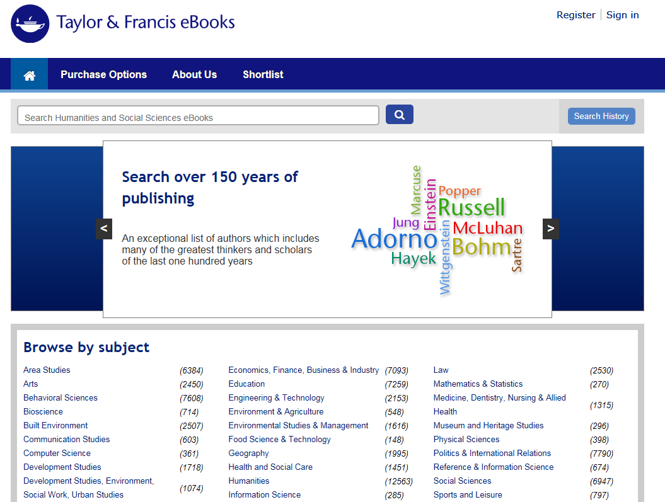
Humanities and Social Sciences eBooks
Humanities &
Social Sciences
50,000+ titles
Notes:
TFE – Taylor & Francis eBooks (HSS)
The site offers access to premier Humanities, Social Sciences, Behavioural Sciences, Built Environment and Law content — from renowned imprints such as Routledge, Psychology Press and Focal Press. There are more than 50,000 titles available for purchase by institutions via the eBook collections — from general subject areas to interdisciplinary selections hand-picked by the editorial teams. These are available to purchase outright, and on a one year subscription basis. We can also assist you to tailor-make your own customised package.

Slide 7





Premium Science, Technology, and Medical eBook Collections
CRC Press
Taylor & Francis Group
www.crcnetbase.com
Notes:
Huge subject breadth consisting of digital versions of our most prestigious imprints - CRC eBook Platform hosts our Science and Technology content – 12,000+ eBooks
100% DRM-FREE material
Personalized bookshelf
Chapter and eBook purchase option
Recommend this title to your library feature
Export citation features
Saved searches, search history and queries
E-mail a colleague a chapter option
FAQs and training
Create your own custom collection
Choose from more than 12,000 eBooks in
40 disciplines covering 350 subject areas
Customize your selection to meet the
needs of your patrons
Annual subscription or outright purchase options available

Slide 8

Create your own custom collection
Choose from more than 12,000 eBooks in
40 disciplines covering 350 subject areas
Customize your selection to meet the
needs of your patrons
Annual subscription or outright purchase options available
Notes:
A platform within CRCnetBase that allows users to create a customised collection to suit their subject needs.

Slide 9
Features and Benefits of our eBook platform
Quick and Easy Access to over 50,000 eBooks 24/7 in library or remotely.
Access content using a variety of authentication methods:
  IP and proxy server
  Athens
  Shibboleth
  Username and password (remote)
Our platform brings knowledge to life with:
A clean, intuitive user interface
Enhanced discoverability
NEW FOR APRIL 2015 all titles are available without DRM
Notes:
(Above applies to both platforms, T&F eBooks and CRCnetBASE)
**As of April 2015, all content available to buy on the HSS platform www.tandfebooks.com has been made DRM Free. This change was made as a direct result of market feedback, so we hope this comes as good news!**
(CRCnetBASE content is also all DRM Free – unlimited multi-user access).

Slide 10

We offer 30-day FREE trials of CRCnetBASE and T&F eBooks.com to all qualifying academic, corporate, and government customers.
You can take advantage of the opportunity to
allow patrons access to the CRCPress award-winning eBook collections for 30 days to assess usage.
We will provide marketing materials to assist
you in communicating your free trial with
your patrons.

Slide 11
T&F’s Combined Journal Library
1790 titles for 2015
Total value over $1.8M
950 Titles listed in Thomson Reuters’ Citation Indexes/Web of Science
5 titles ranked number one
80 titles ranked in the top ten of a subject category
Current access starts from 1997-present
Notes:
We offer a free trial to new journals in volumes 1&2 as an added benefit to those institutions who subscribe to the combined library.

Slide 12
Journals and Open Access
Three ways to go at T&F:
Taylor & Francis Open and Routledge Open Access Journals
Open Select Programme
Cogent OA: Our Open Access Imprint
Articles are published immediately via a rigorous peer-review process and made available online with free access and retention of full copyright.
Two fee models – either the full cost is covered by the author or the institution (pure open access) or articles appear in subscription journals with the option of open access for a fee.
Impact factor - enhanced article-level metrics so you can track who reads, shares and cites your work, and from where.
Notes:
The priorities of Scientific, Technical and Medical (STM) publishing are driving the Open Access (OA) debate, at the expense of HSS, whose titles typically have a longer shelf-life. Whilst Palgrave has embraced new publishing opportunities and models under OA Elsevier and Sage have found themselves at the centre of scandal’s surrounding either payment for OA material or the acceptance of hoax papers.
The article publishing charge for an Open Select article is USD$2,950 (£1,788 / €2,150).
Open Access ensures:
Immediate, universal access to your article on publication
High visibility and discoverability via the Cogent OA website as well as on Taylor & Francis Online
Input from, and dialog with, expert editors and editorial boards
Retention of full copyright of your article
Rapid online publication
Global marketing and publicity
Download and citation statistics for your article
Access to a suite of resources to help optimize usage and citation of your work
Guaranteed legacy preservation of your article
Discounts and waivers for authors in developing regions

Slide 13
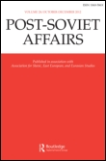
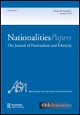

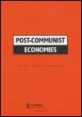
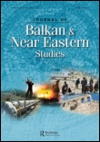


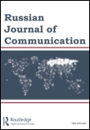

Our Journals for Russia and Central Asia

Slide 14
Thank You!
Рахмет!
Cпасибо!

