Slide 1

Eurasian Academic Libraries Conference EALC
Open Access to
Knowledge and Libraries:
Achievements and Trends
Loretta O’Donnell, Vice Provost Academic Affairs
Asian University Alliance Youth Forum
October, 2022
Notes:
Asian University Alliance Youth Forum - is it necessary?

Slide 2
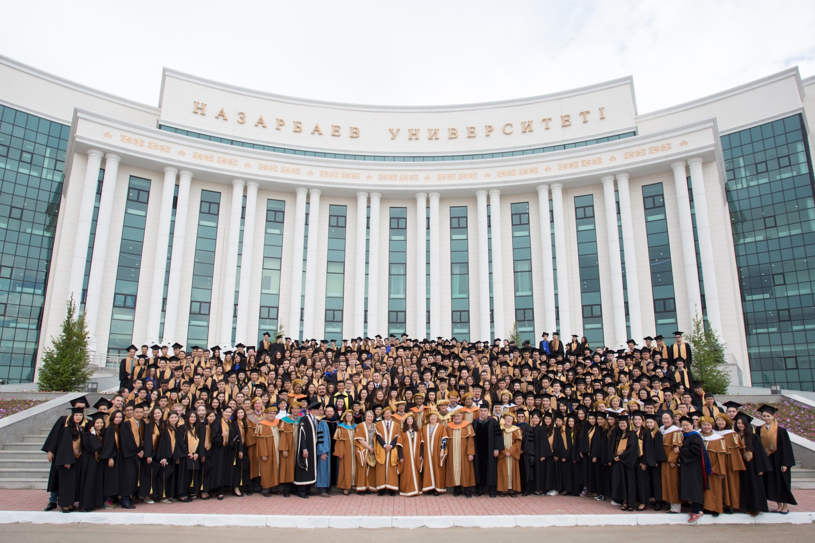
WELCOME TO NU

Slide 3
Greetings!
asalamwalaykum
hello
nǐ hǎo
ayubowan
konnichiwa
namaskaram
annyeonghaseyo
sälemetsiz be!
lí-hó
namaste
မင်္ဂလာပါ
néih hóu
as-salam alaykum
sà-wàt-dee
สวัสดี
assalaam 'alaikum
halo

Slide 4
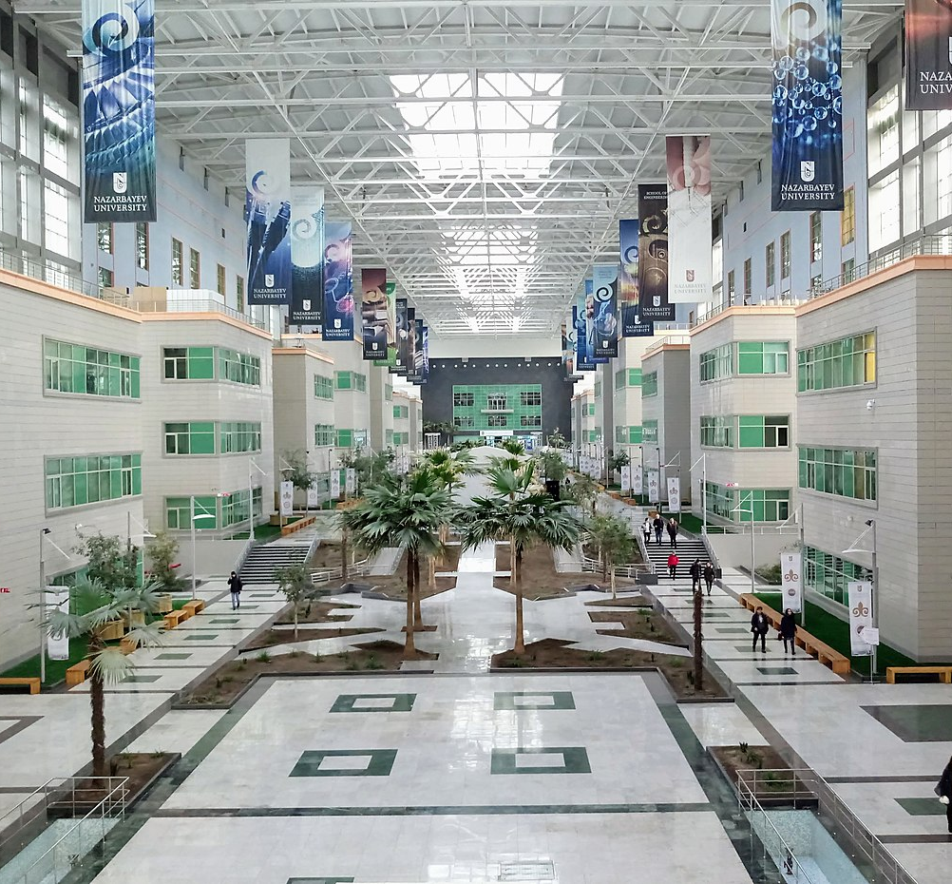


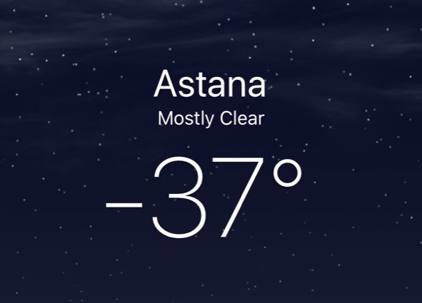

Slide 5
Open Access
What?
Why?
How?

Slide 6

Intellectual curiosity
Leverage
curiosity
Academic freedom
Creating new knowledge
Academic and
Research Integrity

Slide 7

cultural
Leverage intellectual capital
intellectual
financial
human

Slide 8
Reputation
Integrity
Culture
Leverage cultural impact

Slide 9
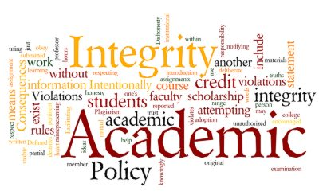
Leverage integrity
(thanks to
Yevgeniya Kim)
Academic Integrity - "a commitment to five fundamental values: honesty, trust, fairness, respect, and responsibility.“
Culture – “the pervasive values, beliefs and attitudes that characterize an institution and guide its practices.”
1. Supporting Academic Integrity: approaches and resources for higher education. 1999, p.4., The HEA JISC Academic Integrity Service, Center for Academic Integrity, American University, Washington DC.
2. Western Cultural Values and its implications on management practices. J. Inun South East Asian Journal of Contemporary Business, Economics and Law, Vol. 1., 2012.

Slide 10

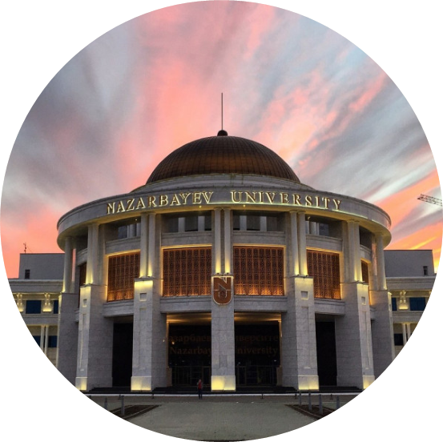
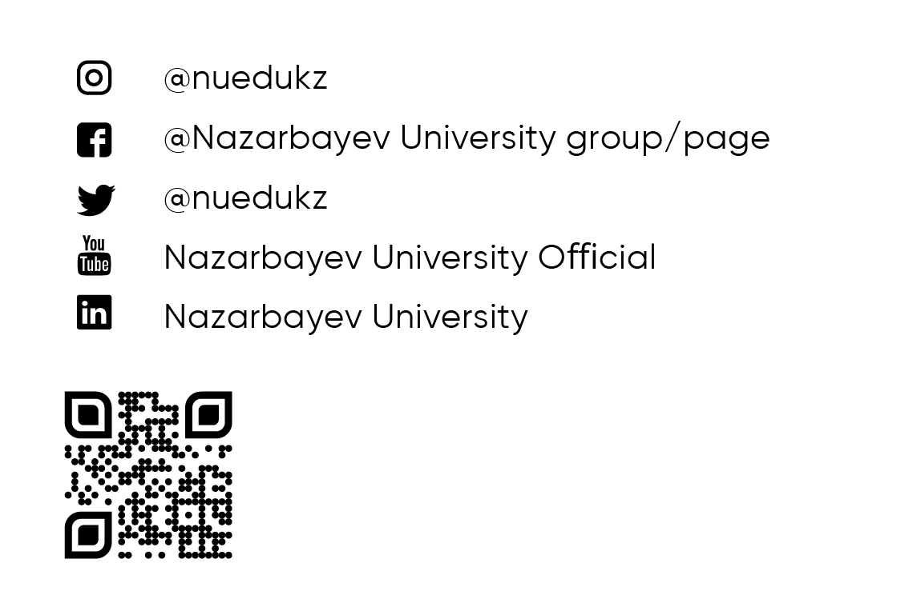

KOP RAKHMET
THANK YOU AND
GOOD LUCK!

