Slide 1
Highly flexible strain sensor based on
Elastomer/MXene
HARUNA ABBA USMAN
2nd Year Master in Mechanical and Aerospace Engineering
MSc. Thesis defense
Supervisor: Ass.Prof. Sherif Araby Gouda
Co-Supervisor: Ass.Prof. Gulnur Kalimuldina

Slide 2
Outline
Introduction
Research Aim and Objectives
Material preparations, characterizations and testing
Experimental Results and Discussion
Conclusion
References

Slide 3

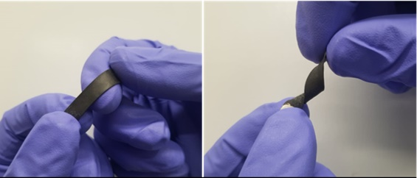
Introduction
Flexible strain sensor
Sensing device made of conductive flexible composite materials
Capable of converting mechanically independent variables (stretching, bending, torsion) into electrical signal.
Having excellent properties such as large stretchability, high gauge factor and wide range of strain sensing.

Slide 4
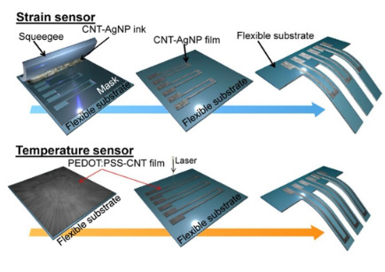
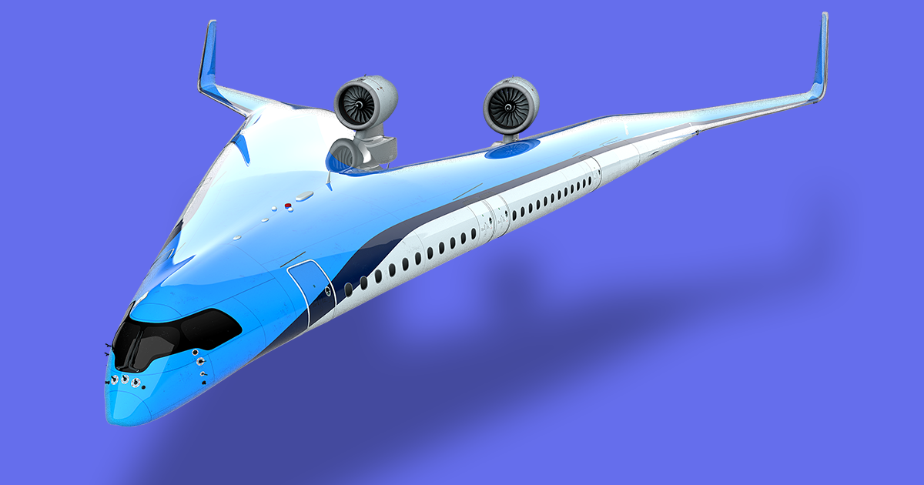
Why Flexible Sensor ?
Traditionally, conventional silicon complementary metal–oxide semiconductor-based sensors have excellent properties, such as high sensitivity, but the rigid and fragile nature dramatically hinder their applications in portable and implantable devices
Flexible in nature
Excellent signal transduction
Fast response to stimuli
Lightweight and smaller in size
Less power consumption
Applied to curved and complex structure profiles
Suitable for biocompatible applications

Slide 5
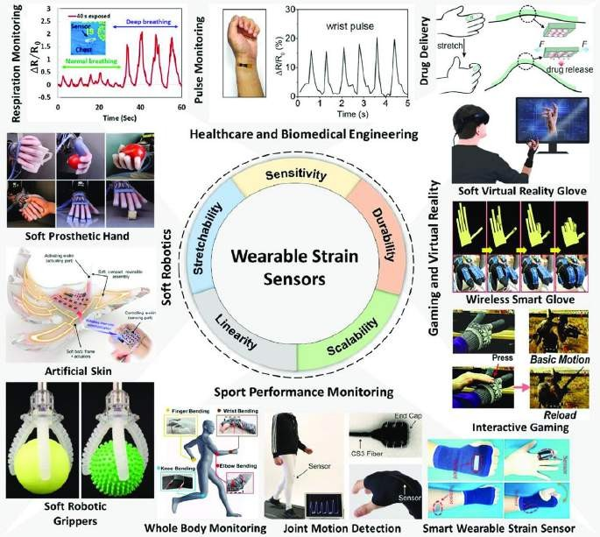
Applications Flexible Sensors
Artificial intelligence (Robots, IoT)
Human-machine interaction
Wearable electronics
Smart textiles
Biomedical devices: human-health monitoring

Slide 6

Aims and Objectives
Aims
Objectives
The aim of this work is to prepare highly flexible strain sensor based elastomer (Ecoflex), MXene (2D material) with MWCNTs (1D material) conductive material to form 3D conductive network with the elastomeric matrix.
High sensitivity
Wider sensing range
Good cycling stability
High resolution and fast response time
To synthesize MXene nanosheet from MAX phase powder using chemical etching approach.
To chemically modify MWCNTs to promote their dispersion with the elastomeric matrix
To prepare elastomer/MXene and elastomer/MXene/MWCNT composites.
To investigate the microstructure and morphology of the developed composites.
To study the strain sensitivity of the developed composites and their durability.

Slide 7
Material preparations, characterizations and testing
In this research,
- MXene is synthesised and employed as conductive filler
- MWCNTs will be modified and used as complementary conductive filler
Matrix is elastomer ; Ecoflex.
Therefore, the following are the main chemicals and materials used:
Titanium Aluminum Carbide (Ti3AlC2) MAX Phase micron powder
Multi-walled carbon nanotube (MWCNTs)
Lithium fluoride (LiF)
Hexadecyltrimethylammonium (CTAB)
Ecoflex 00-50
Deionized water
PVP filter membrane

Slide 8
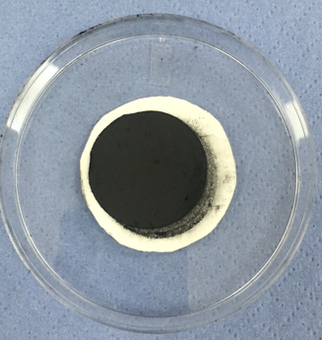
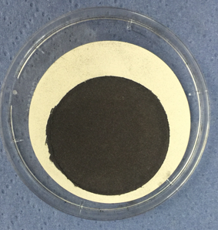
Material preparations, characterizations and testing
Synthesis process
Modification process
1g of Ti3AlC2 MAX Phase powder
Washing with DI H2O by centrifugation at 3000 rpm
Vacuum filtration
LiF-HCl solution
(1 g of LiF, 10 mL of HCl)
Continuous magnetic stirring for 24 at RT
1g of MWCNTs
0.7 g of CTAB in 10 mL of DI H2O
Sonication for 1 h below room temperature
Vacuum filtration
Etching agent
Etching process
Until pH value 4-6
Stabilizing agent

Slide 9
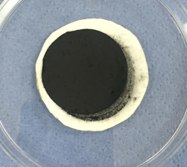
Material preparations, characterizations and testing
Preparation of MXene/m-MWCNT composite
MXene solution and m-MWCNT suspension added together
(1:1) ratio
Sonication for 1 h
Vacuum filtration
Vacuum dry for 2 h at 60 °C
Preparation Ecoflex™ 00-50
Mixing the two of Ecoflex in 1:1 ratio (6 g)
1A is the base part
1B is the curing agent
MXene/m-MWCNTs composite

Slide 10
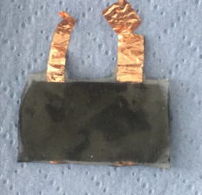
Fabrication of flexible strain sensor sample
Adding MXene/m-MWCNTs to Ecoflex
Homogenization of MXene/m-MWCNT/Ecoflex
(Magnetically stirred for 10 min)
Vacuum degassing to remove bubbles
Pouring down to mold
Cured at RT for 4 h
Fixing copper electrodes
Strain sensor sample

Slide 11
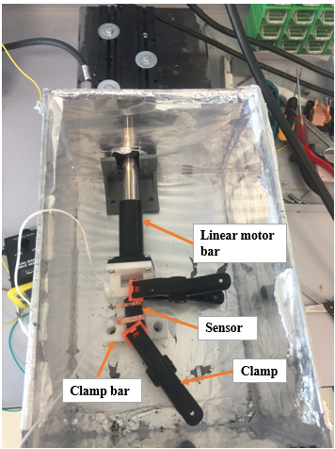
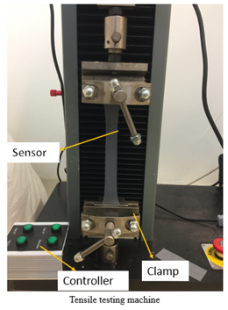
Material characterizations and testing
Scanning Electron Microscopy (SEM) Analysis: To study the microscopic structure and topology of a material’s surface.
X-ray Diffraction Analysis (XRD): Used to determine the crystallographic structure of material as well as chemical composition.
Fourier Transform Infrared Spectroscopy (FTIR): Used for detecting functional groups and characterizing covalent bonding
Electromechanical testing station

Slide 12
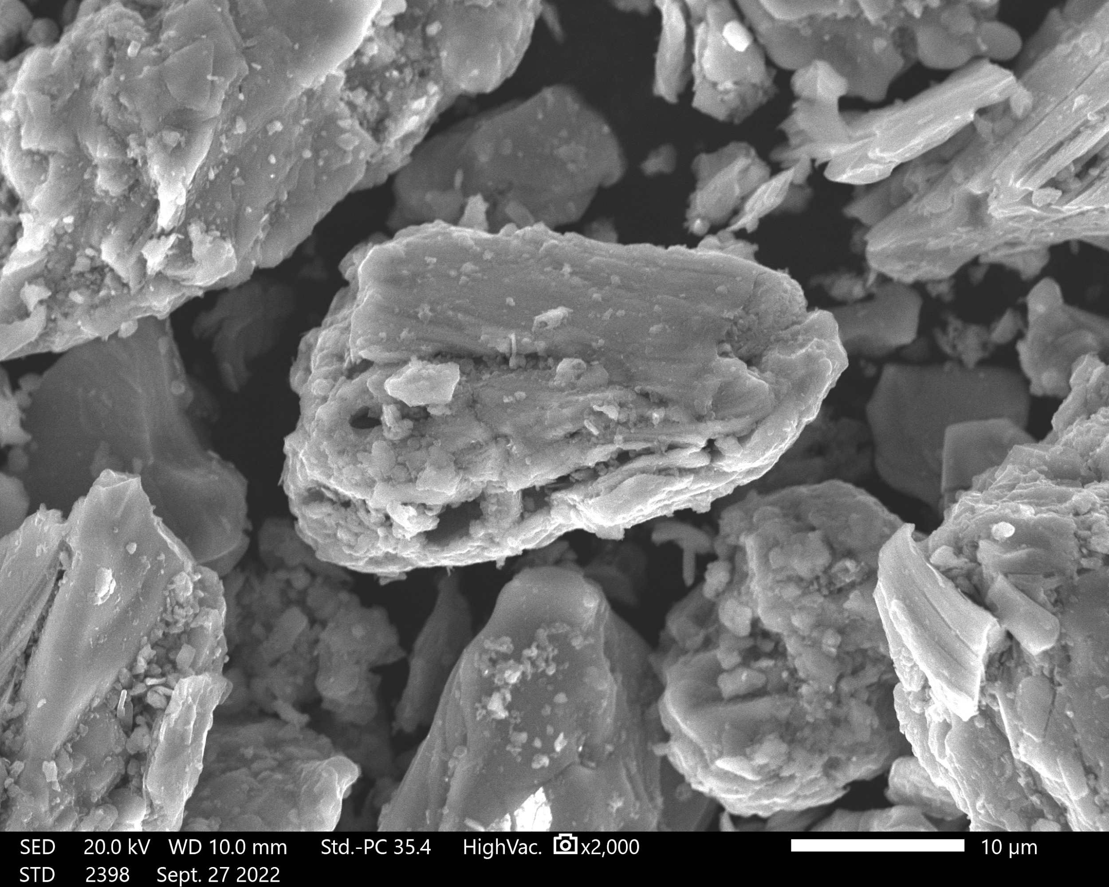
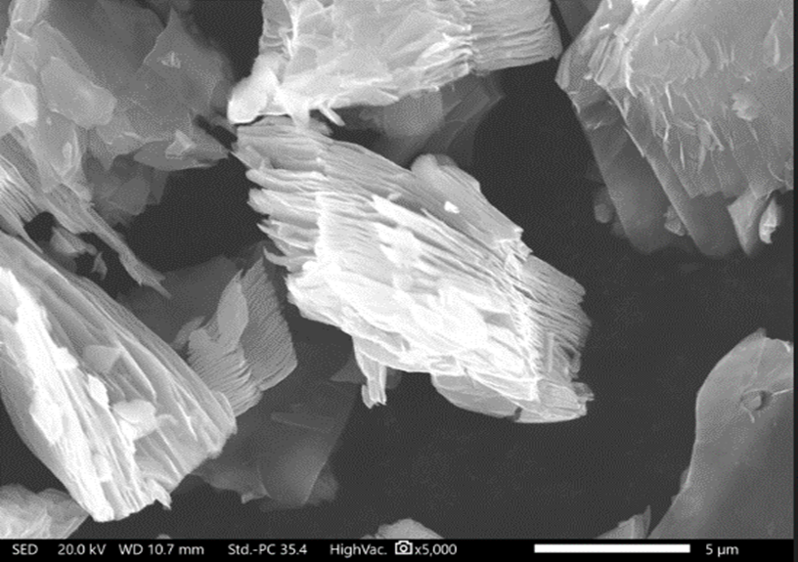
Material characterizations and testing
SEM image of MAX phase before etching
SEM of image of Ti₃C₂-Mxene (after etching)

Slide 13
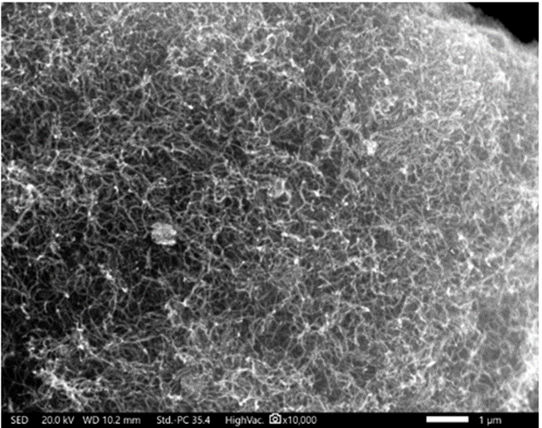
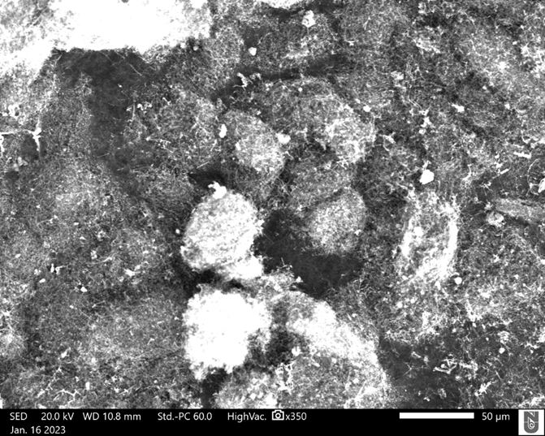
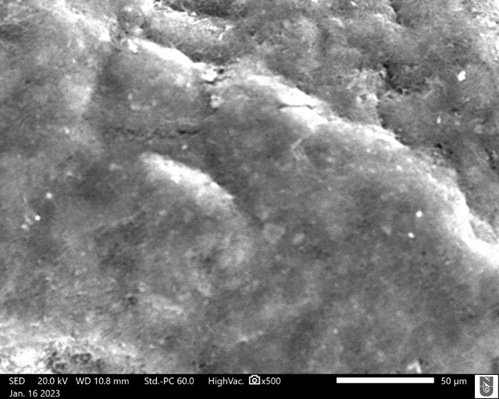
Material characterizations and testing
(a) SEM image of MWCNT
(b) SEM image of modified MWCNTS
(c) SEM image of MXene/m-MWCNT
(a) Shows SEM image of MWCNTs confirming that the structure is in sponge like material.
(b) Displays an SEM image of m-MWCNTs with traces of CTAB, showing full incorporated
(c) SEM image of MXene/m-MWCNTs, revealing complete coverage and bonding of MXene into m-MWCNTs.

Slide 14
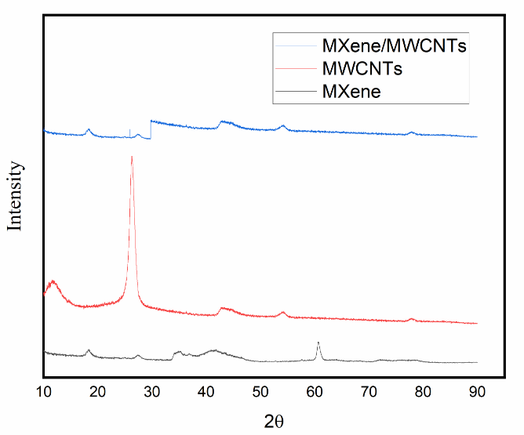
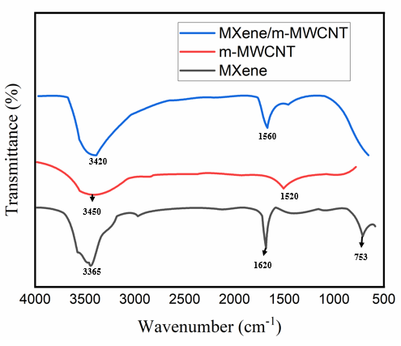
XRD And FTIR Analysis
(a) XRD pattern of MXene, MWCNT and MXene/MWCNT
(b) FTIR Spectra of MXene, MWCNT and MXene/MWCNT
Diffraction peak of MXene attributed to the (002) plane is located at 2θ =18.5° with expansion lamellar spacing, indicates Al layer was removed.
m-MWCNT diffraction peak at a 2θ value of 26° correspond to carbon atom in 002 plane.
Broadening and shift of (002) plane indicated adding of MXene into m-MWCNTs at 29.8° correspond to (002) plane
MXene exhibited two specific bands at (O-H) 3365 cm⁻¹ and (C=O)1620 cm⁻¹
MWCNT displayed bands at (O-H) 3450 cm⁻¹ and (C=O) 1520 cm⁻¹.
MXene/m-MWCNT exhibited bands at (O-H) 3420 cm⁻¹ and (C=O) 1560 cm⁻¹

Slide 15
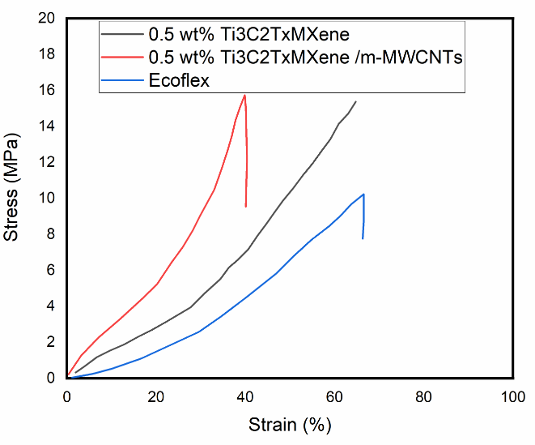
Results and Discussion
Stress-strain performance of the sensor
Tensile strength test
MXene = 15.4 MPa
MXene/m-MWCNT = 16 MPa
Ecoflex = 9.7 MPa

Slide 16
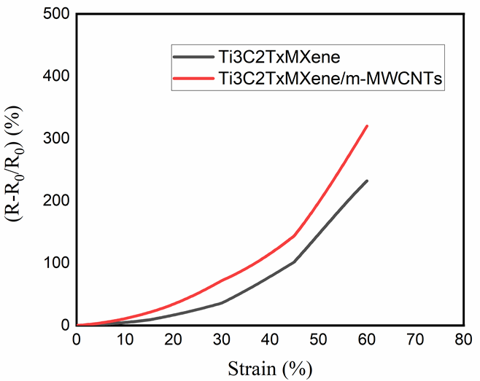

Results and Discussion
Relative resistance-strain curve within 0-60% strain of MXene, and MXene/m-MWCNTs
MXene sample: GF = 3.87
MXene/m-MWCNTs: GF = 7

Slide 17
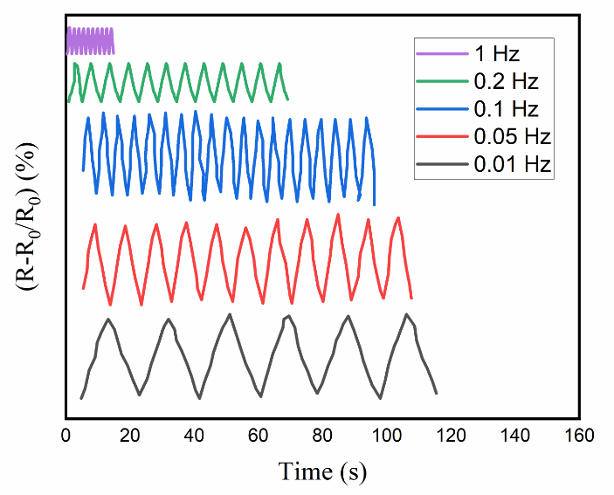
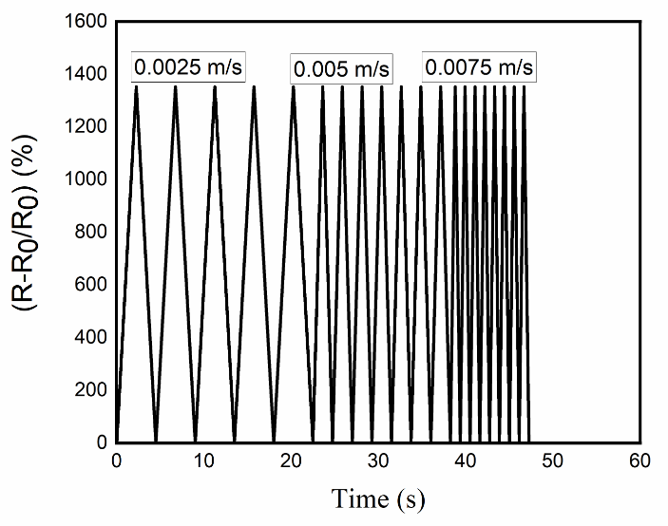
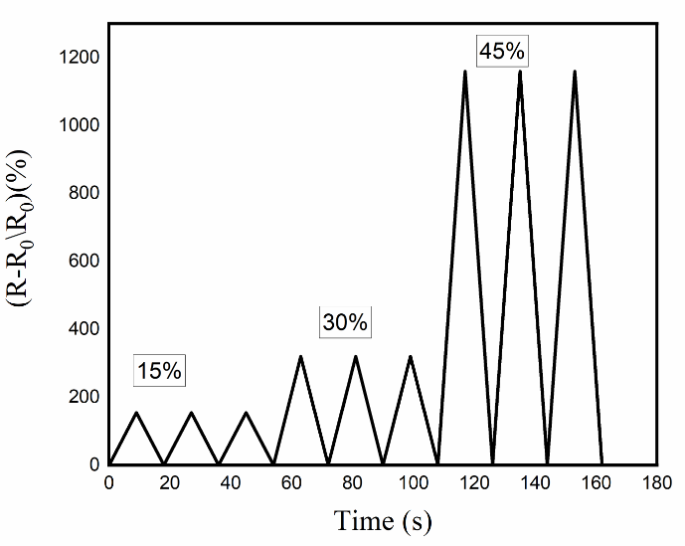
Results and Discussion
(a) 10% strain
(b) 30% strain
(c) Different strains
(a) Relative resistance of our strain sensor at 10% with various frequencies.
(b) Variable-speed stretching/releasing test of our strain sensor at 30% strain, showing good cycling stability.
(c) The performance of our strain sensor was investigated at various strain level (15%, 30%, and 45%). It can be observed that the resistance can be clearly distinguished at different applied strain, showing good reliability.

Slide 18
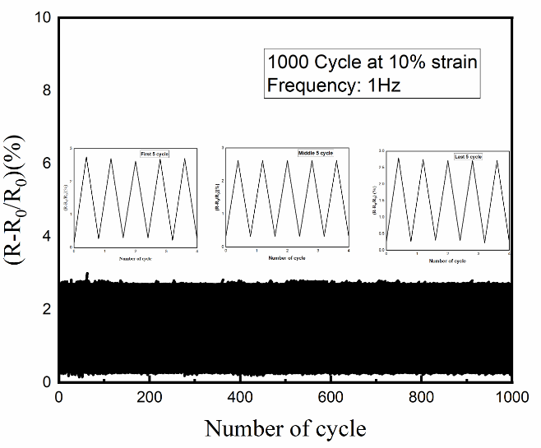
The magnified insets in Figure 16 show the first 5 cycles, 5 cycles in the middle, and the last 5 cycles.
The magnified insets in Figure 16 show the first 5 cycles, 5 cycles in the middle, and the last 5 cycles.
Results and Discussion
Cyclic tensile test for MXene/m-MWCNTs strain sensor at 10 % strain
The magnified inset shows the first 5 cycles, 5 cycles in the middle and the last 5 cycles.
The relative resistance change exhibited good level of stability with nearly same response.

Slide 19
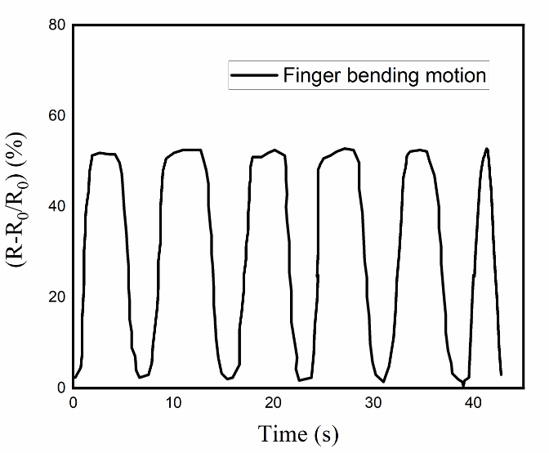
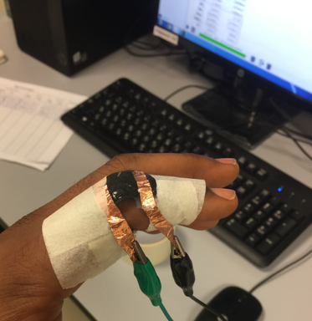
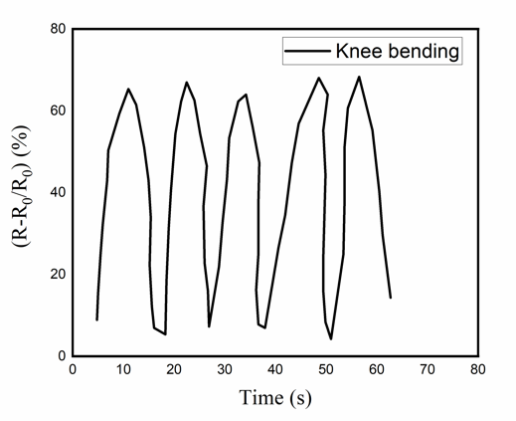
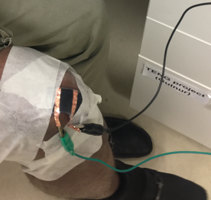
Real-time Application of Human Body Motion

Slide 20
Conclusion
A flexible strain sensor is made up of conductive materials incorporated in soft stretchable materials (elastomers). A strain sensor must meet specific requirement such as sensitivity and durability.
We discussed about the flexible strain sensor by comparing with conventional sensor.
In this work we have performed the synthesis of MXene, Modification of MWCNTs and preparation of the MXene/Ecoflex and MXene/MWCNTs/Ecoflex composites and performed characterizations measurement (XRD, SEM, and FTIR) of the samples.
We fabricated samples of the flexible strain sensor and performed electromechanical and resistivity testing. We calculated gauge factor (GF), for MXene base strain sensor is 3.8 and for MXene/m-MWCNTs is 7. Also, the tensile strength for MXene = 15.4 MPa ,MXene/m-MWCNT = 16 MPa and Ecoflex = 9.7 MPa
We also performed real-time testing of human motion (Finger, and knee) where the sensor displayed good output

Slide 21
References
Gogotsi, Y. and B. Anasori, The Rise of MXenes. ACS Nano, 2019. 13(8): p. 8491-8494.
Aakyiir, M., et al., Elastomer nanocomposites containing MXene for mechanical robustness and electrical and thermal conductivity. Nanotechnology, 2020. 31(31): p. 315715.
Naguib, M., et al., 25th Anniversary Article: MXenes: A New Family of Two-Dimensional Materials. Advanced Materials, 2014. 26(7): p. 992-1005.
Lu, Y., et al., Highly Stretchable, Elastic, and Sensitive MXene-Based Hydrogel for Flexible Strain and Pressure Sensors. Research, 2020. 2020: p. 2038560.
Li, Q., et al., Flexible conductive MXene/cellulose nanocrystal coated nonwoven fabrics for tunable wearable strain/pressure sensors. Journal of Materials Chemistry A, 2020. 8(40): p. 21131-21141.

Slide 22
Thank you
Any questions ?

