Slide 1

Gender Initiatives – Work in Progress
First International Gender Forum
Nazarbayev University
Nur-Sultan, Kazakhstan, June 6, 2019, 15:30-17:00
Dr. Loretta O’Donnell
Vice-Provost, Academic Affairs, Nazarbayev University

Slide 2
Overview
Global context
Athena SWAN
Homeward Bound
NU context
Next steps

Slide 3
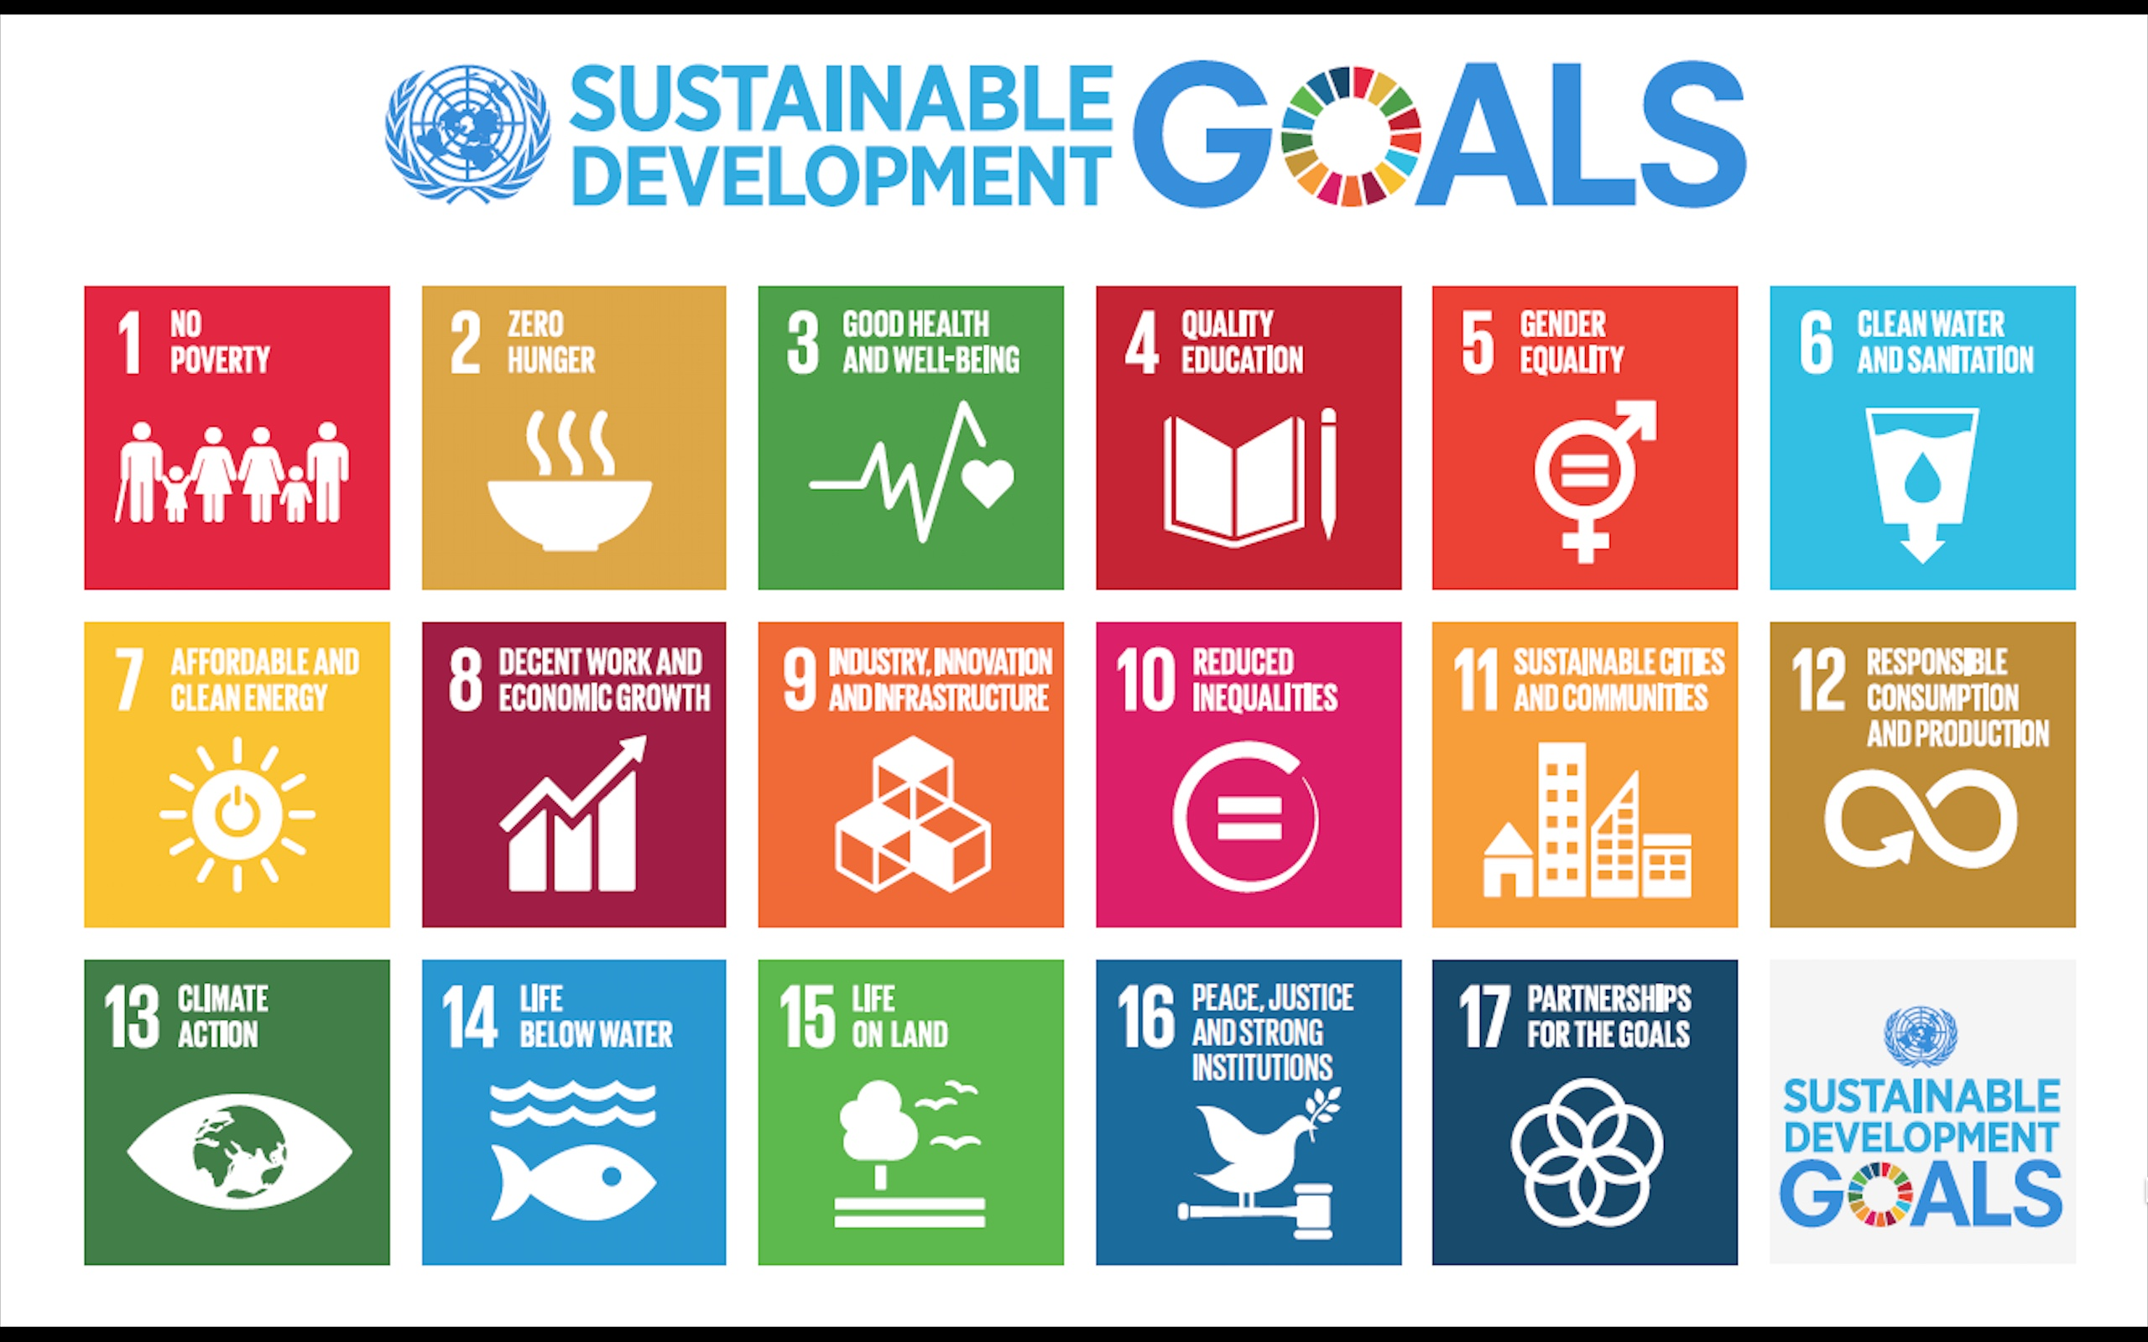
Sustainable Development Goals
Global Context
Notes:
The Sustainable Development Goals (SDGs) are a collection of 17 global goals set by the United Nations General Assembly in 2015 for the year 2030. The SDGs are part of Resolution 70/1 of the United Nations General Assembly, the 2030 Agenda.^{[1][2]}

Slide 4
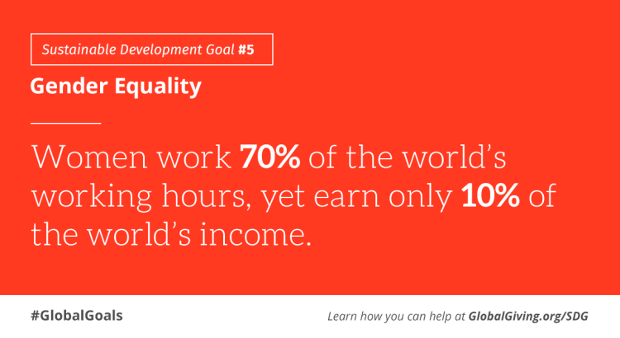

Global Context

Slide 5
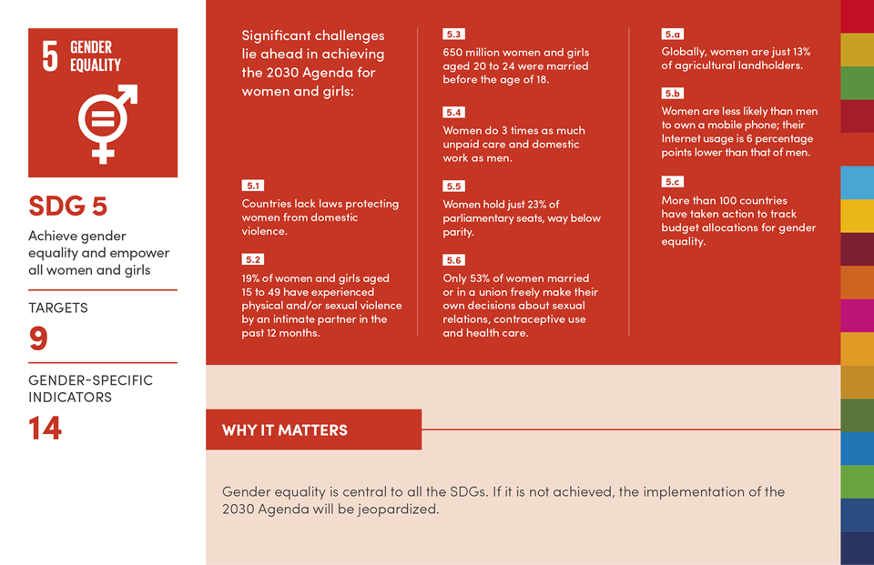
Global Context
Sustainable Development Goals

Slide 6
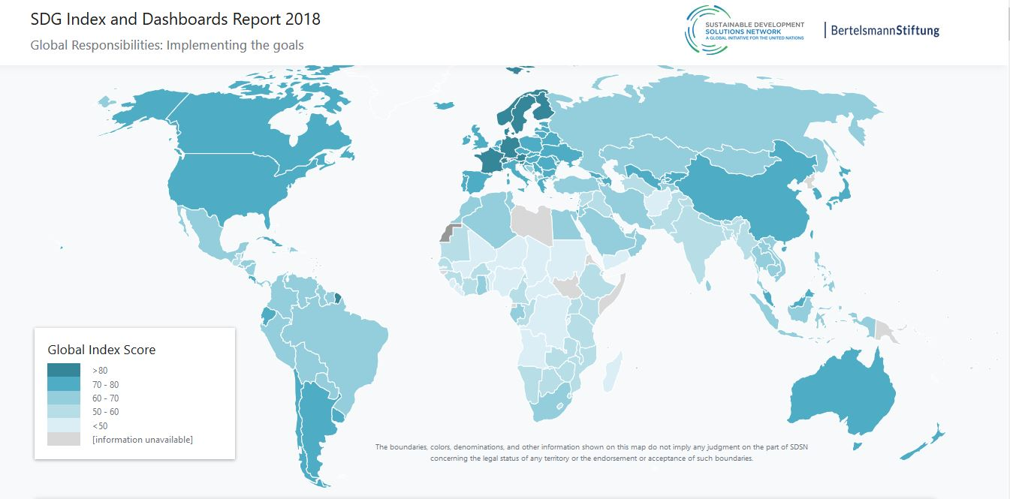
Global Context
Notes:
World map showing countries that are closest to meeting the SDGs (in dark blue) and those with the greatest remaining challenges (in the lightest shade of blue) in 2018.

Slide 7
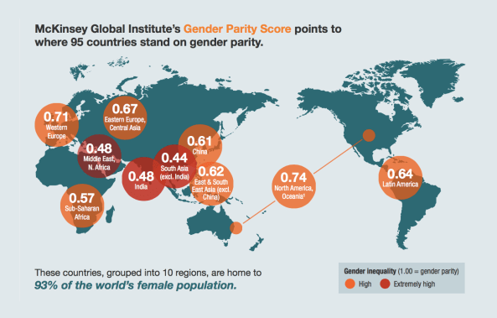
Global Context
https://www.fastcompany.com/3051700/gender-equality-could-unlock-trillions-of-dollars-of-economic-growth
Notes:
MGI has mapped 15 gender-equality indicators for 95 countries and finds that 40 of them have high or extremely high levels of gender inequality on at least half of the indicators. The indicators fall into four categories: equality in work, essential services and enablers of economic opportunity, legal protection and political voice, and physical security and autonomy.
McKinsey says economic output would increase by $12 trillion if all countries raised their level of equality to the best-performing country in their region. If men and women were entirely equal worldwide, a somewhat distant prospect–the opportunity would be as great as $28 trillion by 2025, or a whopping 26% of total global GDP.

Slide 8
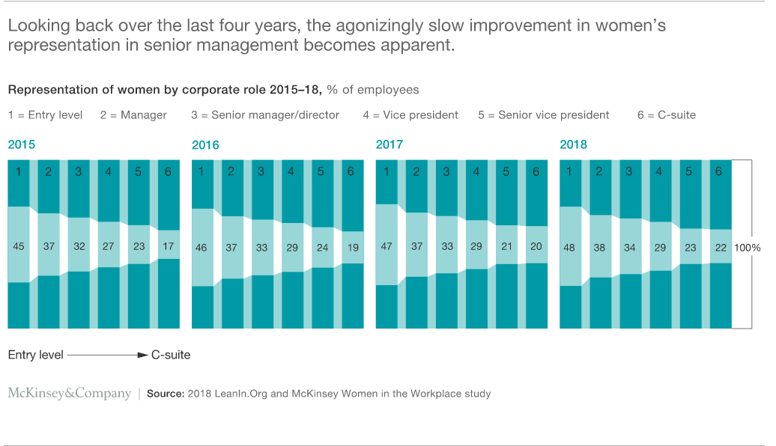
Global Context
https://www.mckinsey.com/featured-insights/gender-equality/women-in-the-workplace-2018
By Alexis Krivkovich, Marie-Claude Nadeau, Kelsey Robinson, Nicole Robinson, Irina Starikova, and Lareina Yee

Slide 9
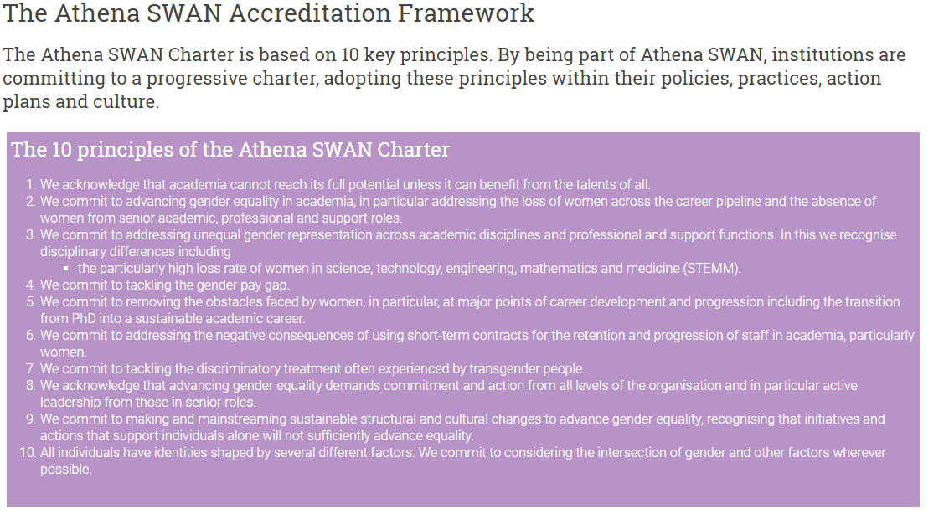
ATHENA SWAN

Slide 10
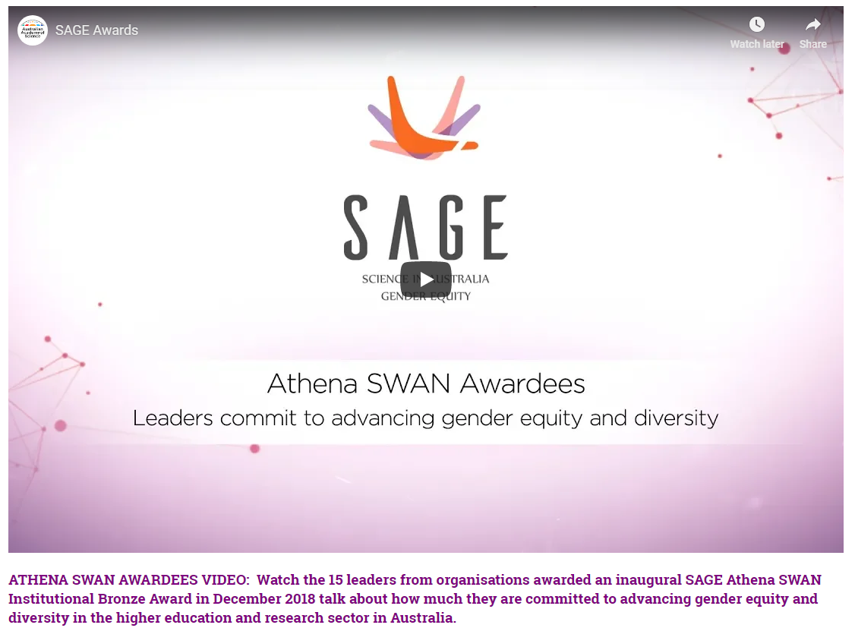
ATHENA SWAN and SAGE
https://www.sciencegenderequity.org.au/sage-pilot/what-is-sage-gender-equity-science/
Notes:
On the 15 September 2015, the SAGE Pilot was officially launched at Parliament House. The event was attended by Ministers, funding and policy stakeholders, and representatives from the 32 institutions who are participating in the Pilot. This video provides highlights of the event, where leaders discuss the importance of the SAGE Pilot in transforming gender equity and diversity in Australian science.

Slide 11

ATHENA SWAN and SAGE

Slide 12
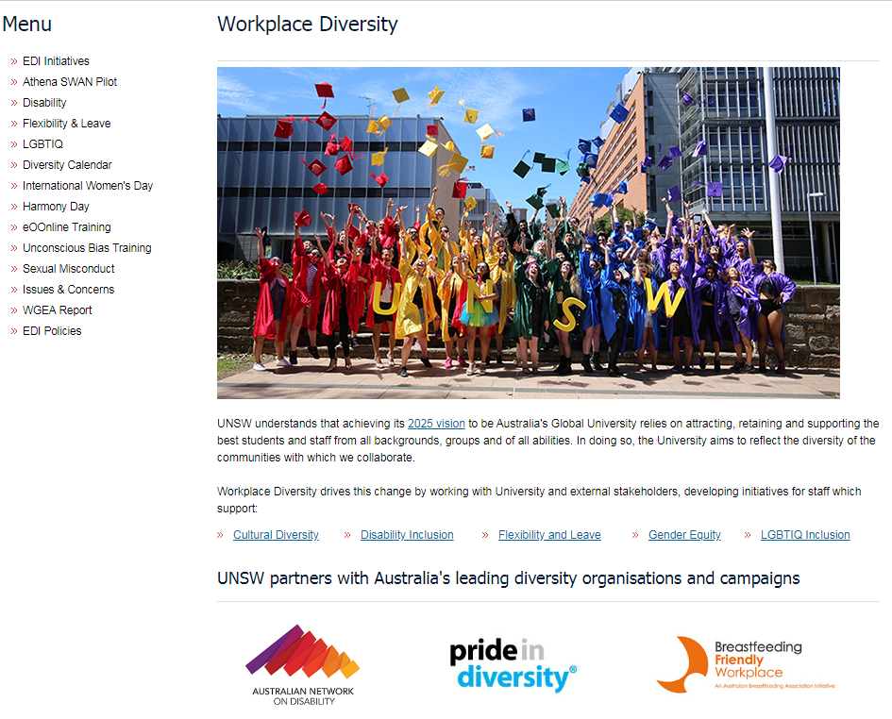
ATHENA SWAN and SAGE

Slide 13
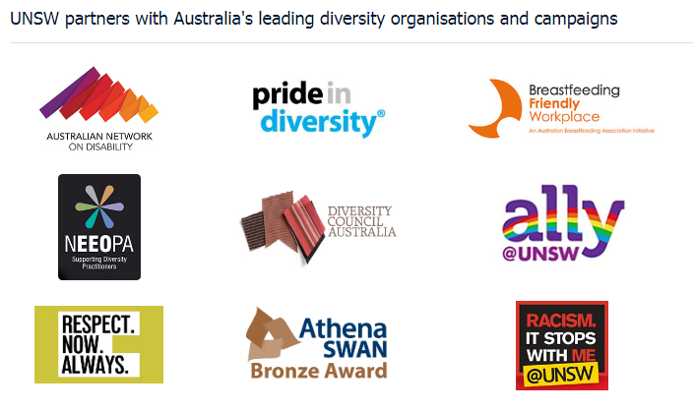
ATHENA SWAN and SAGE

Slide 14
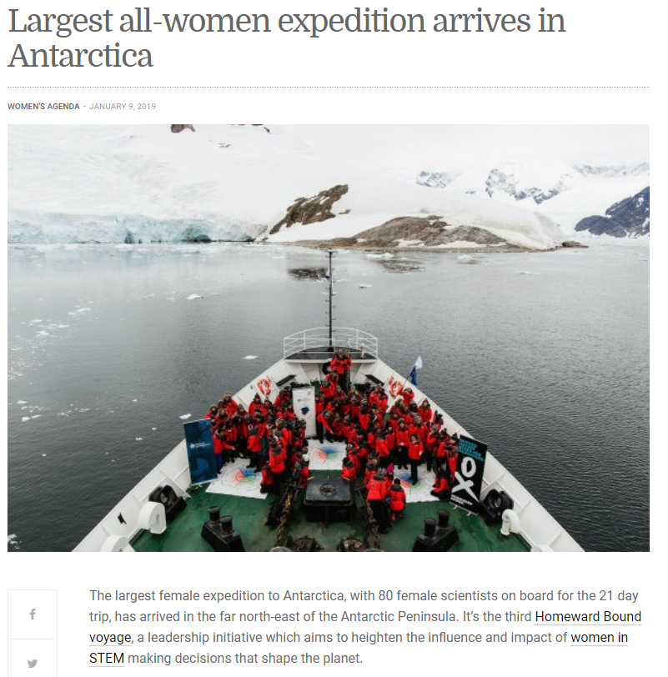
HOMEWARD BOUND
https://homewardboundprojects.com.au/hb1-participants/2019-participants/

Slide 15
NU Context
NU Teaching Strategy
Integration
Integration of research and teaching
Innovation
Innovation in content and process
Inclusion
No discrimination

Slide 16
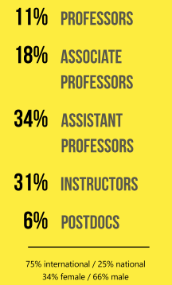
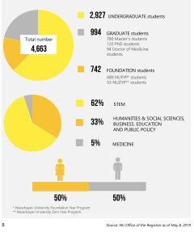
NU Context
NU faculty NU students

Slide 17
NU Gender Statistics (June 2019)
Faculty number: 472
Male: 312
Female: 160
Notes:
Loretta

Slide 18
Next steps
(Lewis, CohenMiller and Satymbekova)
Obstacles and how to overcome them?
Non-discriminatory statement (recommended by TLC)
Courses on gender
UN HeforShe University Champion
Diversity goals for hiring
Awareness among students - partnerships with student clubs
Diversity training
Mentoring program for female faculty and staff

Slide 19
Summary
Global context
Athena SWAN
Homeward Bound
NU context
Next steps

Slide 20
Selected References
Athena Swan and SAGE: https://www.sciencegenderequity.org.au/sage-pilot/what-is-sage-gender-equity-science/
Fast Company, https://www.fastcompany.com/3051700/gender-equality-could-unlock-trillions-of-dollars-of-economic-growth
Homeward Bound 2019: https://homewardboundprojects.com.au/hb1-participants/2019-participants/
Alexis Krivkovich, Marie-Claude Nadeau, Kelsey Robinson, Nicole Robinson, Irina Starikova, and Lareina Yee, Women in the Workplace 2018, October 2018, McKinsey Quarterly
Jenifer L. Lewis, A. S. CohenMiller, with Raikhan Satymbekova, Gender Audit Of Formal Curriculum at Nazarbayev University: Pilot Project For Gender Audits in Kazakhstani Organizations (under review)
United Nations General Assembly, Sustainable Development Goals, 2015.

