Slide 1
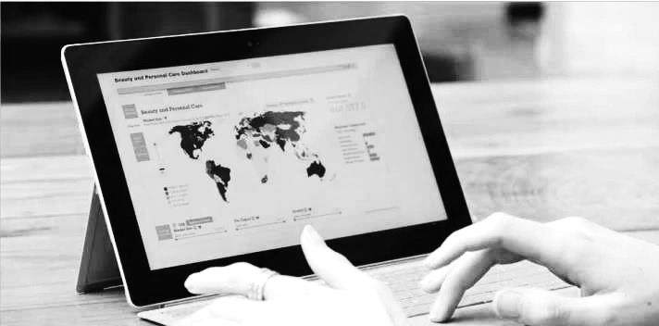
Passport Global Market Information Database, Innovative Modelling, and Scenarios Simulation Tools
Ecaterina Bondarenko
For the Kazakhstan conference Libraries and Its Role in Transforming Societies: Strategies and Trends

Slide 2

ABOUT EUROMONITOR INTERNATIONAL
AND RESEARCH APPROACH
CASE STUDY
PASSPORT OVERVIEW
AND INNOVATIVE MODELLING
HOW OUR RESEARCH HELPS
Notes:
2

Slide 3
ABOUT EUROMONITOR INTERNATIONAL
AND RESEARCH APPROACH
CASE STUDY
PASSPORT OVERVIEW
AND INNOVATIVE MODELLING
HOW OUR RESEARCH HELPS
Notes:
3

Slide 4
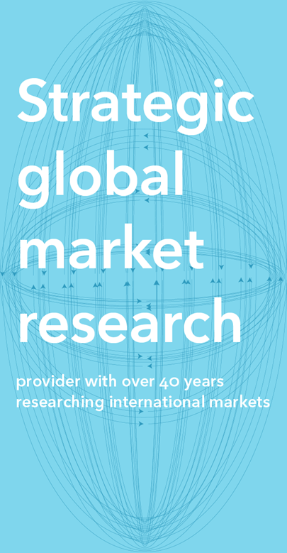
ABOUT EUROMONITOR INTERNATIONAL
About Euromonitor International
Our services
Syndicated market research: Passport
Consulting solutions
Expansive network
1200+ researchers in 100 countries
Global view
Cross-comparable data across every market
Our expertise
Consumers
Economies
Product categories and distribution
Companies and brands
Production and supply chains

Slide 5
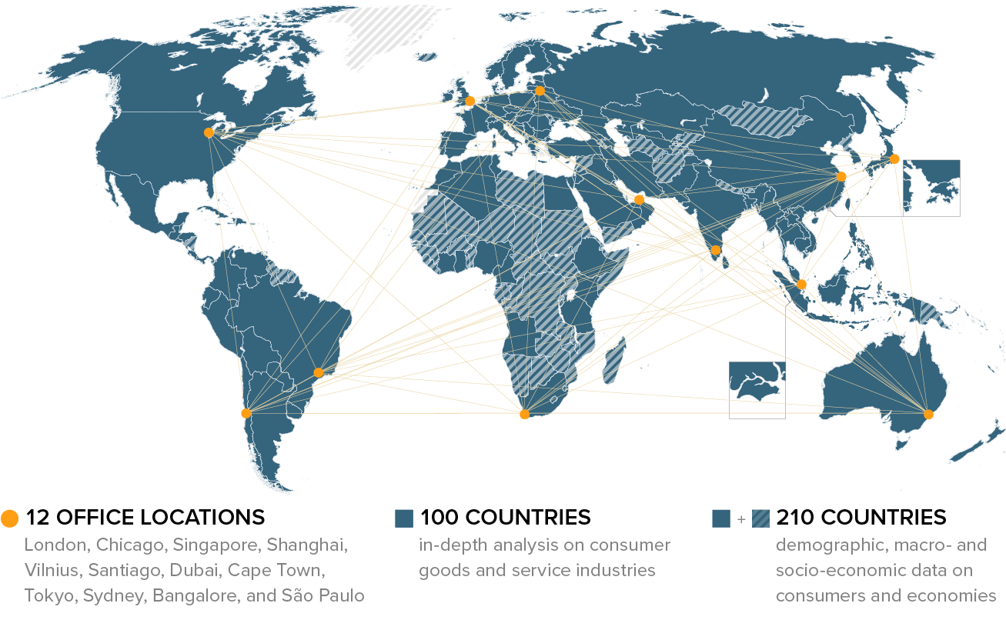
ABOUT EUROMONITOR INTERNATIONAL
Research Coverage

Slide 6
ABOUT EUROMONITOR INTERNATIONAL
AND RESEARCH APPROACH
CASE STUDY
PASSPORT OVERVIEW
AND INNOVATIVE MODELLING
HOW OUR RESEARCH HELPS
Notes:
6

Slide 7

Case study
Let’s Meet John
Market entry assignment:
Political, economic, social,
technological (PEST) analysis:
Understand the wider business
environment, the ease of doing
business, technological challenges
and the political and economic risks
related to investments in new
country markets.
» How easy is it to do business?
» What is the country infrastructure like?
» What are the barriers to successful trade?
Evaluate & Recommend

Slide 8
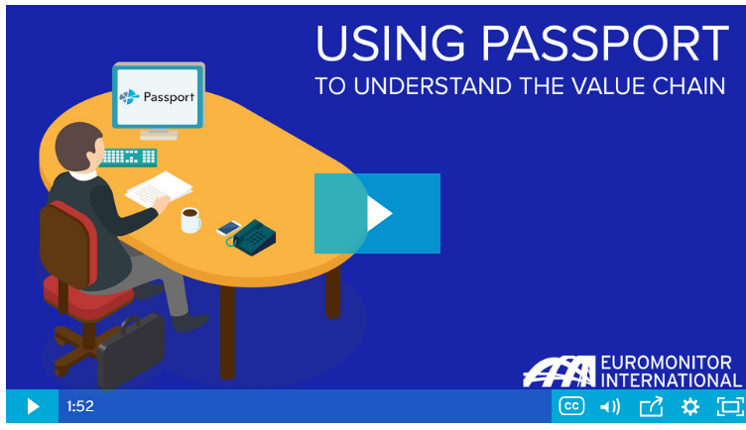
“Meet John after graduation”:
Using Passport to Understand the Value Chain
Passport
Passport by Euromonitor International defines effective market entry strategy for your business. Use Passport to analyse adjacent industries, local market environments and target consumers and gain a complete understanding of the entire value chain.
https://euromonitorint-my.sharepoint.com/:v:/g/personal/peter_kosmal_euromonitor_com/EefNnF1nq95CsGDfUKRBJqgBTc_9yQvqIiMIEK1EgwA_ZA?e=m4ayoI

Slide 9
ABOUT EUROMONITOR INTERNATIONAL
AND RESEARCH APPROACH
CASE STUDY
PASSPORT OVERVIEW
AND INNOVATIVE MODELLING
HOW OUR RESEARCH HELPS
Notes:
9

Slide 10







passport
Research Expertise
CONSUMER PRODUCTS
Alcoholic Drinks
Nutrition
SUPPLY
Apparel
Packaged Food
Ingredients
Automotive
Personal Accessories
Packaging
Beauty and Personal Care
Pet Care
ECONOMIES
Consumer Appliances
Soft Drinks
Business Dynamics
Consumer Electronics
Tissue and Hygiene
Cities
Consumer Health
Tobacco
Economy, Finance and Trade
Eyewear
Industrial
Toys and Games
Fresh Food
Natural Resources
SERVICES
Health and Wellness
Consumer Finance
CONSUMERS
Home and Garden
Digital Consumer
Consumer Foodservice
Home Care
Households
Institutional Channels
Hot Drinks
Income and Expenditure
Luxury Goods
Retailing
Lifestyles
Ethical Labels
Travel
Population

Slide 11
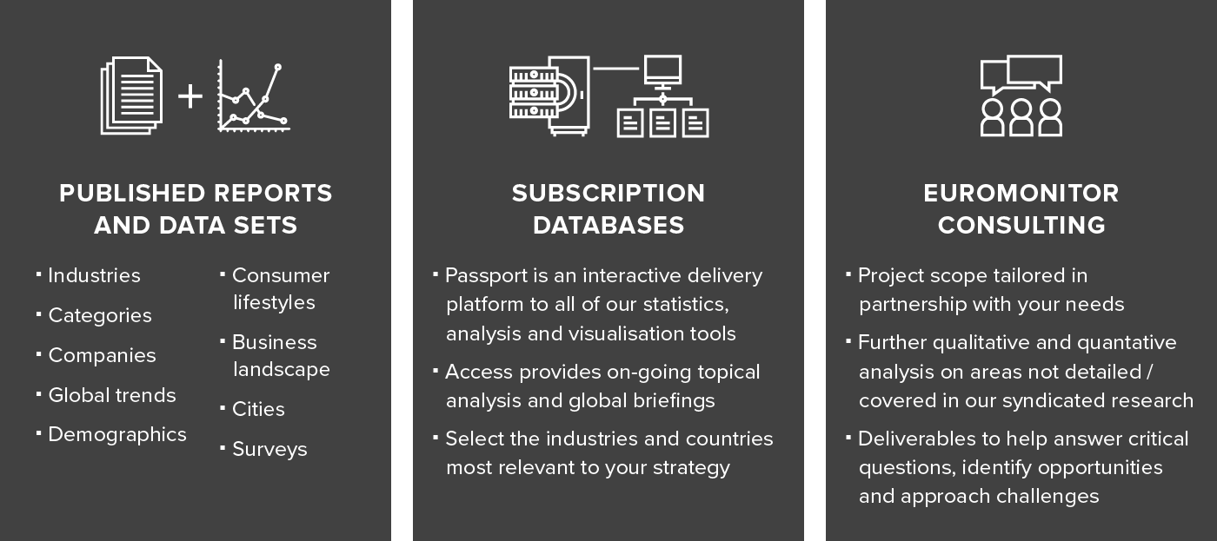
Flexible solutions
ABOUT EUROMONITOR INTERNATIONAL
Euromonitor International research is delivered in multiple formats to suit every budget and deadline. Choose a solution that supports the coverage and depth of detail you require:

Slide 12




HOW EUROMONITOR CONSULTING HELPS THE ACADEMICS SECTOR
Euromonitor Consulting
Solutions for Academics
A wide range of institutions. Similar challenges and business questions…
Competitor Profile
Compare performance, programs, marketing strategies
Potential demand assessment
Understand student needs, identify opportunities for new programs and qualifications.
International overview
Develop strategies for attracting international students.
New market entry
Compare markets to identify opportunities, risks, barriers and develop expansion strategies.
New engagement models
Analyse learning methods and opinions of students, faculty, professionals.
Positioning and brand perception
Understand how your institution is perceived, benchmark versus peers.
Market Check
Adapt your academic programs to industry needs.

Slide 13
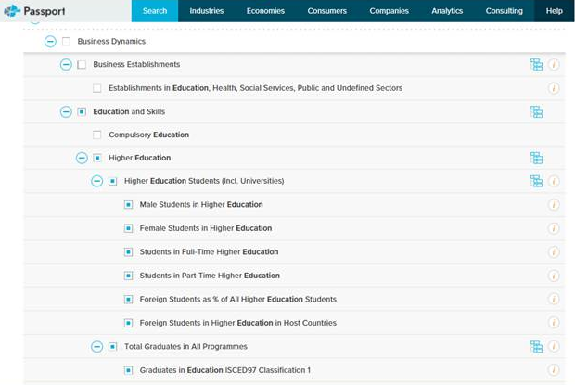
Euromonitor International Passport database

Slide 14
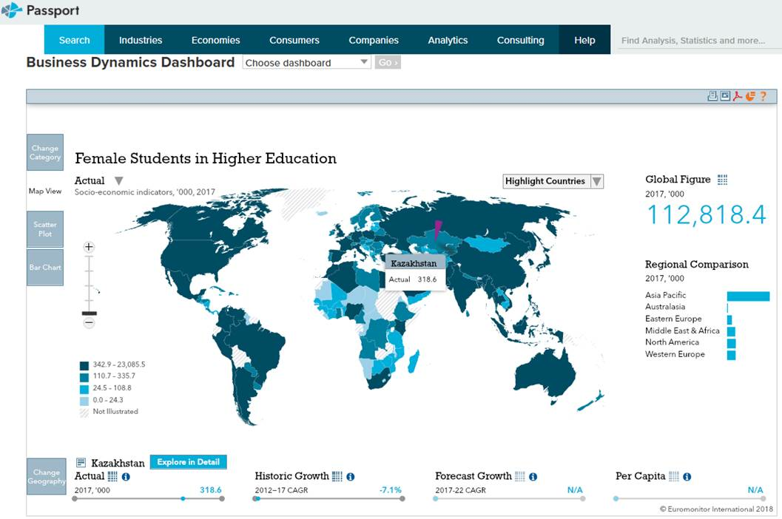
Euromonitor International Passport database
Tracing geographical data to know student potential and estimate focused programs

Slide 15
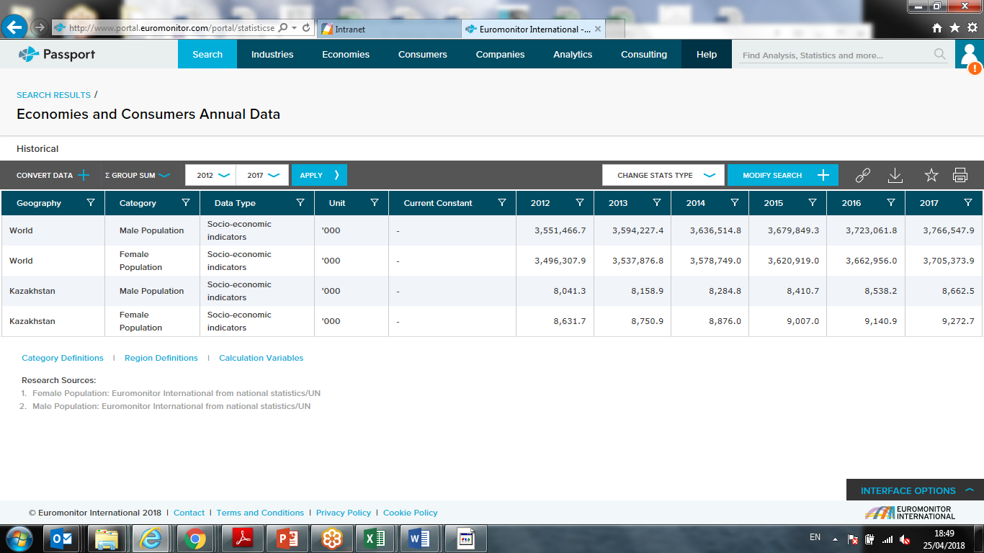
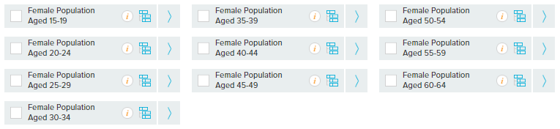
Deep range of demographical data predicting market potential
Euromonitor International Passport database

Slide 16
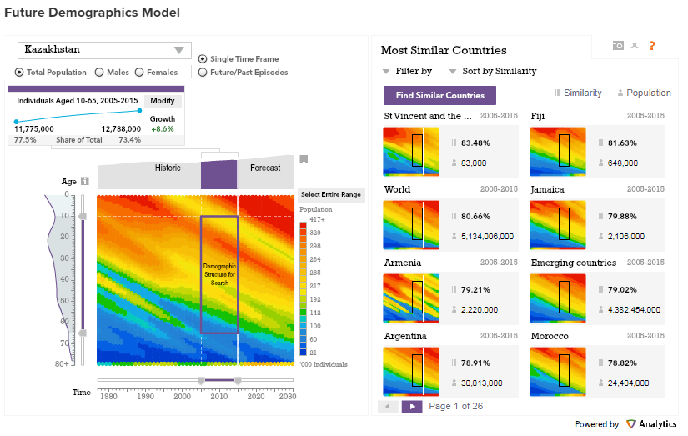
Future Demographic Model allow to examine the demographic structure of countries around the world and search for similarities within total population, male and female.
Passport

Slide 17
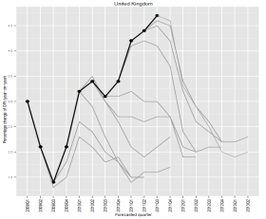
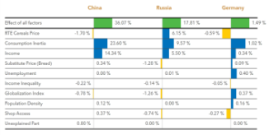
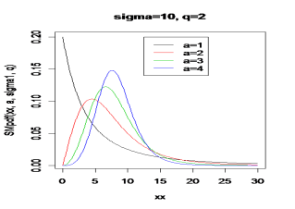
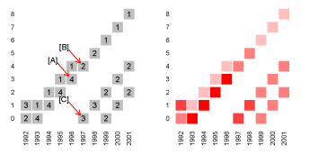
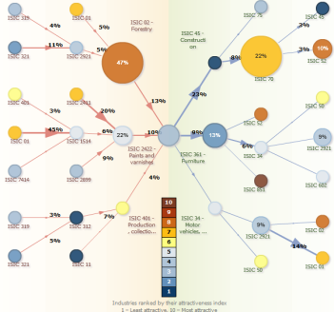
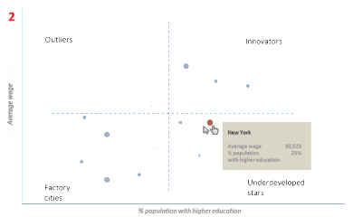
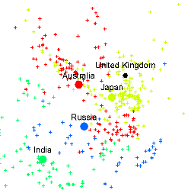
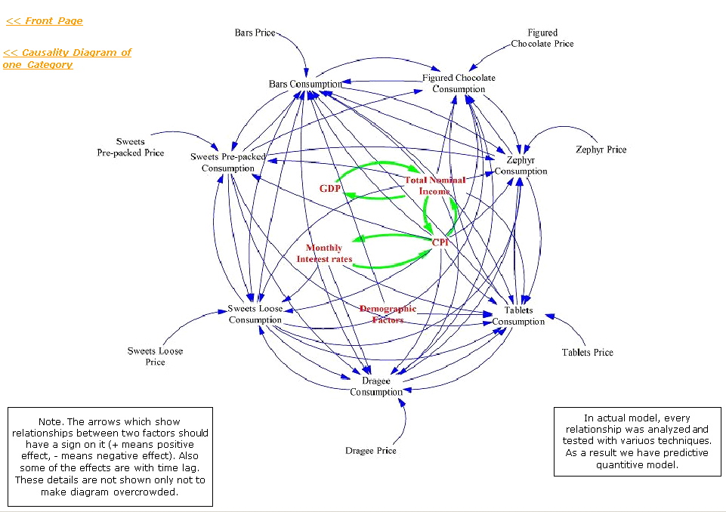

INTRO TO Industry Forecast Model
Euromonitor Analytics (ex CAMI)
Euromonitor Analytics is a modelling-driven business intelligence resource that combines Euromonitor‘s extensive industry knowledge with innovative methods in statistics, economics, data science and data visualisation.
TEAM COMPETENCIES
RESEARCH TOPICS
Economic Modelling
Forecasting
Consumer Demand Drivers
$${\hat{Y}}_{t}={\hat{Y}}_{t−1}+\frac{{g_{}^{\hat{Y}}}_{t}}{4}+{ε_{}^{\hat{Y}}}_{t}$$
Econometrics and
Statistics
applies to
Global Trends
Wealth Distribution
Data Mining and
Visualisation
Scenario Planning and Futurology
Value Chains and Global
Trade
Urban Economics
System Dynamics
Machine Learning
“We want to be more scientific in how we target opportunities”
Notes:
A different perspective to inform and add value to empirical research. It should complement forecast research, not replace it.

Slide 18
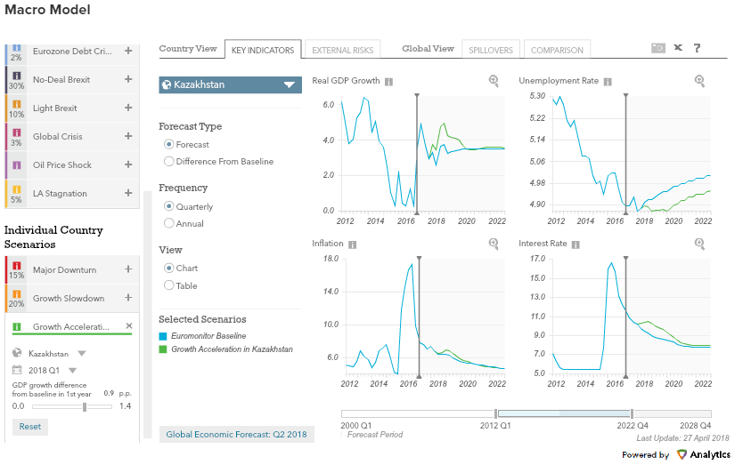
MAKRO MODEL on Economy, Finance and Trade page
Passport
Global Economic Forecasts quarterly overview focuses on world’s key economies and explains the latest macroeconomic changes in them, as well as the most up-to-date baseline. Our Macromodel provides forecasts of GDP, inflation, interest rates and unemployment for the world’s major economies. The model measures spillover effects and provides alternative “what-if” scenarios.

Slide 19
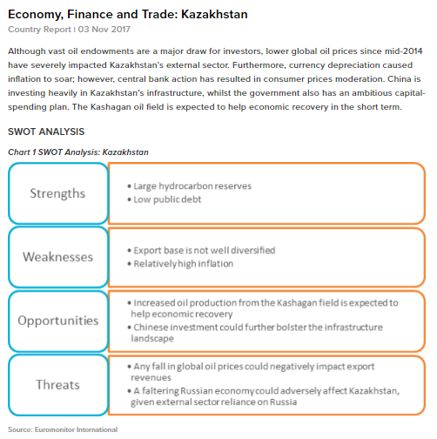
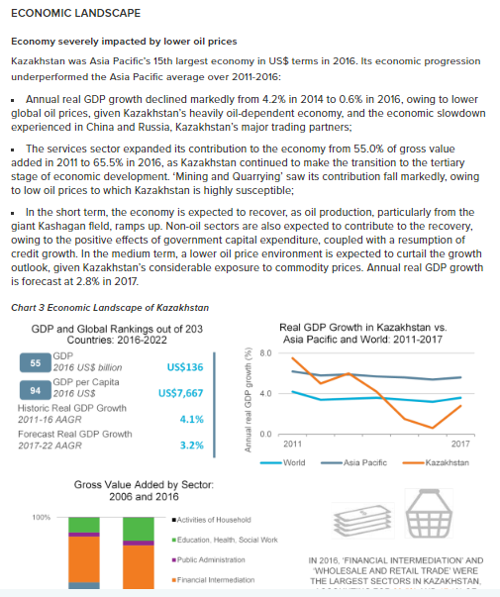
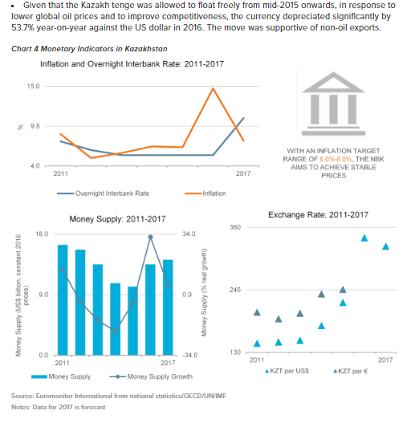
Euromonitor international passport database

Slide 20
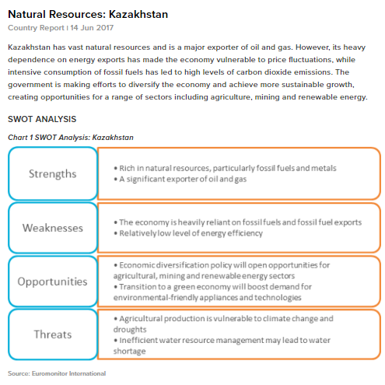


Euromonitor International Passport database

Slide 21
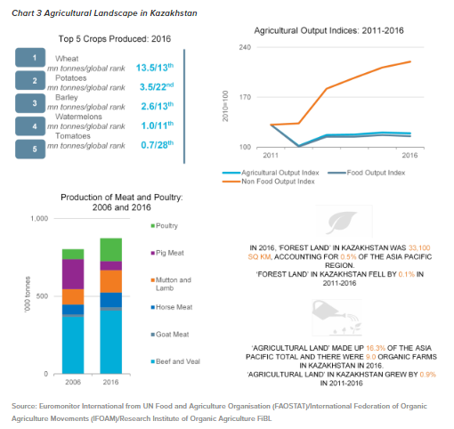
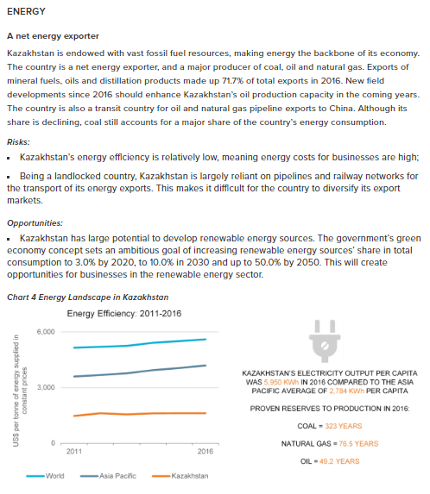
Сельское хозяйство и энергетический сектор
Euromonitor International Passport database
Лидирующие культуры: Пшеница, картофель, ячмень, арбузы, помидоры

Slide 22
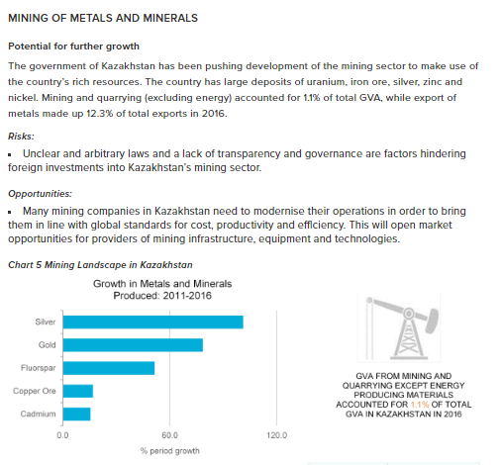
Добыча полезных ископаемых металлов и минералов
Euromonitor International Passport database
объема экспорта в 2016 году.
Риски:
Нечеткие и произвольные законы, отсутствие прозрачности и управления являются факторами, мешающими иностранным инвестициям в горнодобывающий сектор Казахстана.
Возможности:
Многие горнодобывающие компании в Казахстане нуждаются в модернизации своих операций, чтобы привести их в соответствие с глобальными стандартами стоимости, производительности и эффективности. Это откроет рыночные возможности для поставщиков горнодобывающей инфраструктуры, оборудования и технологий.
График 5 Добыча полезных ископаемых в Казахстане

Slide 23
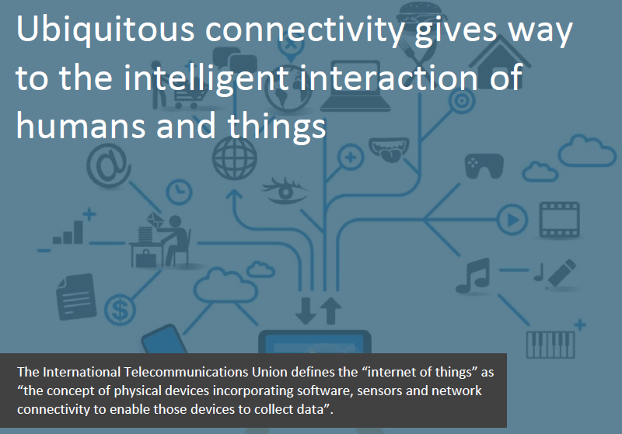
Internet of things
Euromonitor International Passport database

Slide 24
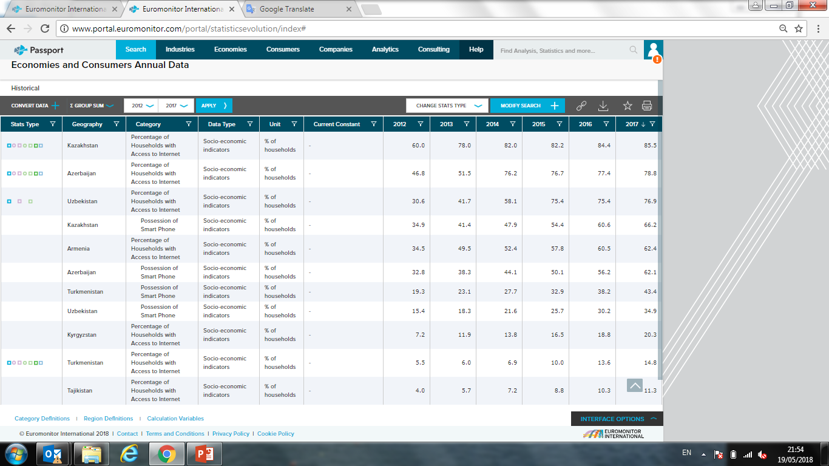
Technology: how do smart phones and internet users develop in different countries?
Euromonitor International Passport database

Slide 25
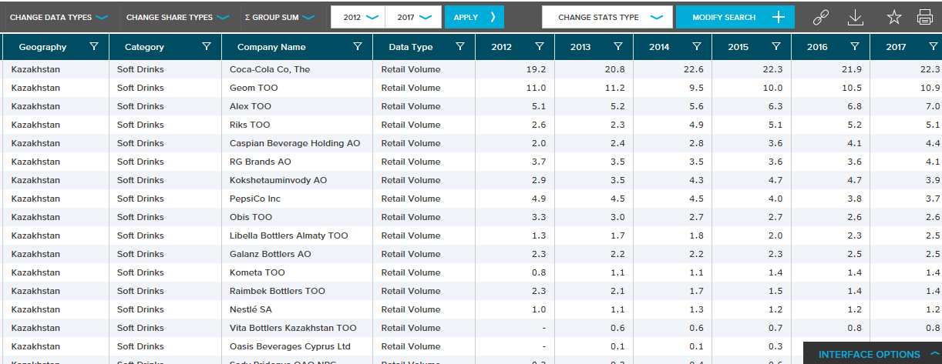
Euromonitor International Passport database
How FMCG industries are developing?
Soft drinks market development, leading company in Kazakhstan?

Slide 26
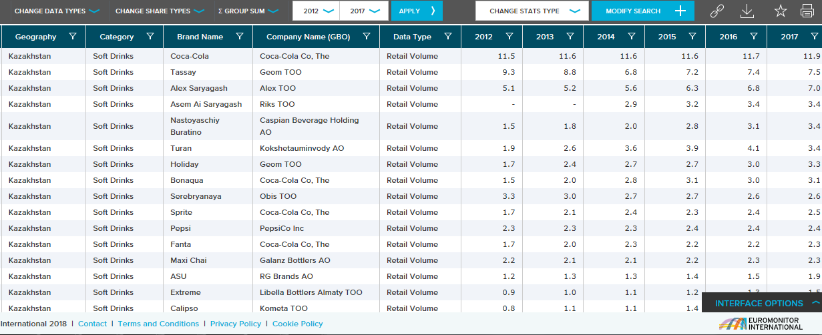
Euromonitor International Passport database
Soft drink market development, leading brand?
Rare actual data, available for academic community.
How many companies do we cower in Kazakhstan?

Slide 27
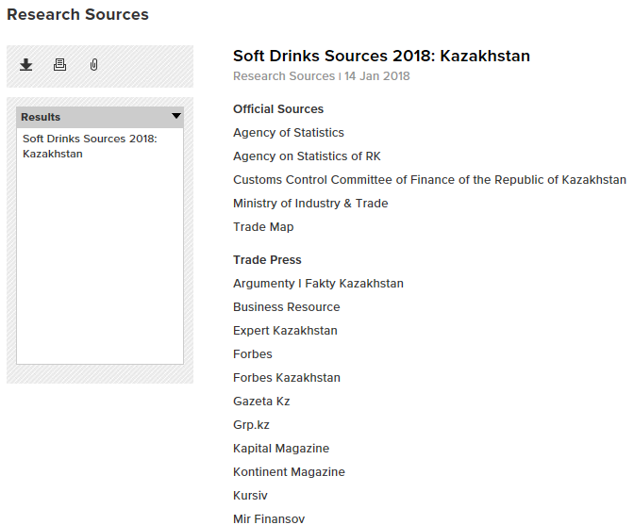
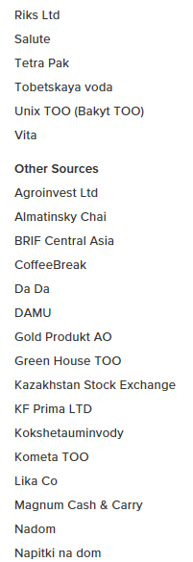
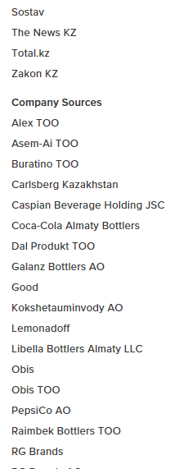
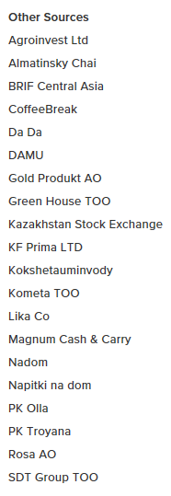
Euromonitor International Passport database

Slide 28
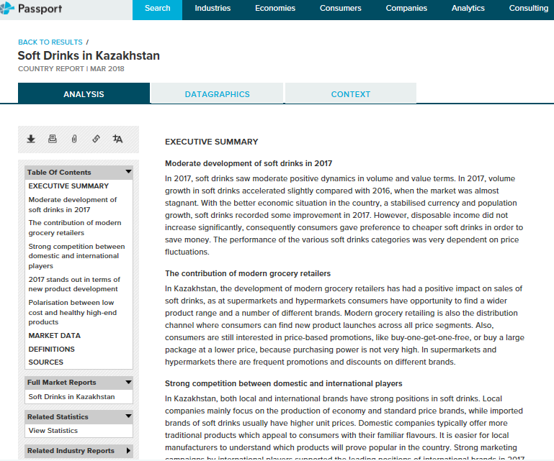
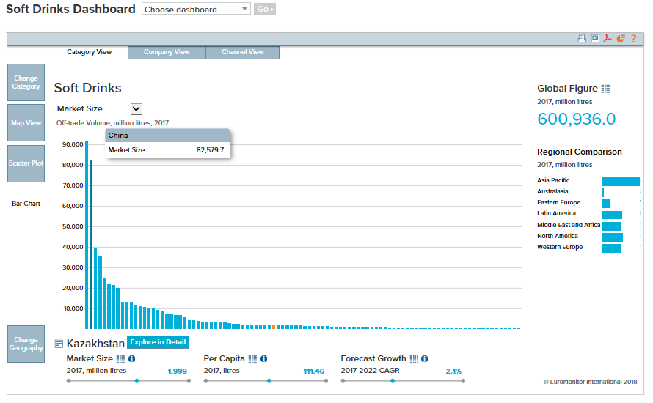
Euromonitor International Passport database

Slide 29
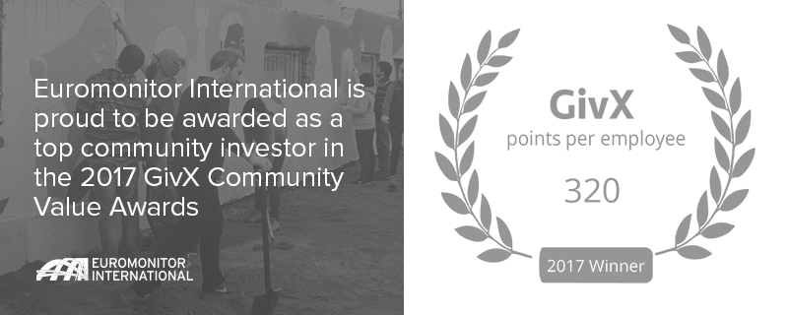
Global Partnerships
Partnership
Euromonitor International as a global information publisher provides market research reports, statistics and online information systems on industries, countries and consumers.
Globally we partner with 75% of Academic Institutions from World University Rankings 2016-2017 list.
Two months trial is available for your university.

Slide 30


















































Organisations we work with
Academic

Slide 31





















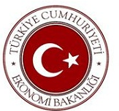


















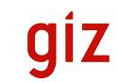


Organisations we work with
Government

Slide 32












































Organisations we work with
Corporate

Slide 33
ABOUT EUROMONITOR INTERNATIONAL
AND RESEARCH APPROACH
CASE STUDY
PASSPORT OVERVIEW
AND INNOVATIVE MODELLING
HOW OUR RESEARCH HELPS
Notes:
33

Slide 34
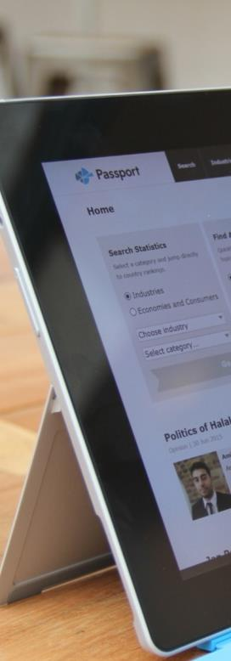
How our research helps
Benefits for the academic community
  Global perspective
  Supports teaching and research
  Encourages to think commercially
  Enhances employability
  Offers unique content
  Saves time
  Updated daily

Slide 35
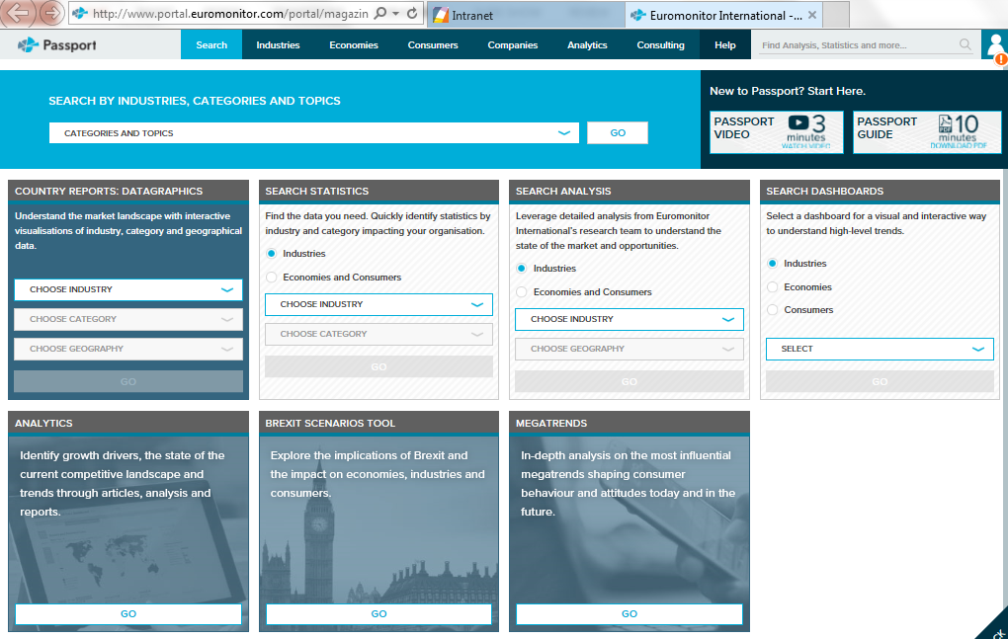
Euromonitor International Passport database
IP addresses www.portal.euromonitor.com/portal
+ remote access

Slide 36





Екатерина Бондаренко,
Ecaterina.Bondarenko@Euromonitor.com
Senior Account Manager
Спасибо за ваше внимание!
http://blog.euromonitor.com/
@Euromonitor
www.facebook.com/euromonitorinternational
Euromonitor International Market Research

