Slide 1
INVESTIGATING THE INTERACTION OF 3D
CONDUCTIVE POLYMER COMPOSITES WITH
BACTERIAL CELLS
Student: Mukhtar Alipuly (ID: 201653626)
Lead Supervisor: Prof. Nurxat Nuraje
Co-Supervisor: Dr. Tri Pham

Slide 2
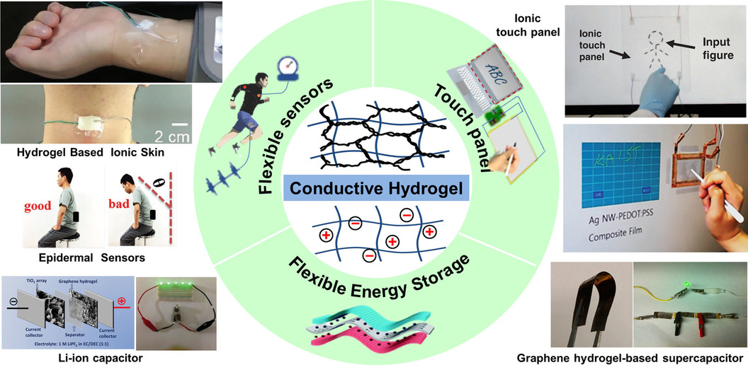
INTRODUCTION
Conductive Polymer-based Hydrogels can act as an advanced electronic sensor platform
required their tunable electrical and mechanical properties
biocompatibility and antibacterial properties are important
can act as a scaffold for the storage or delivery of organic or inorganic molecules
Figure 1. Applications of Conductive Polymer-based Hydrogels
Rong, Q., Lei, W., & Liu, M. (2018). Conductive Hydrogels as Smart Materials for Flexible Electronic Devices. Chemistry (Weinheim an der Bergstrasse, Germany), 24(64), 16930–16943.

Slide 3
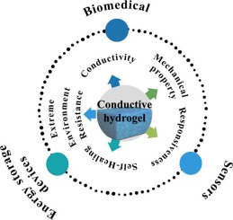
PROBLEM STATEMENT
Disadvantages of Conductive Polymer-based Hydrogels (CPH)
Poor mechanical properties
Low conductivity
Low strength
Poor temperature resistance
Low electrical sensitivity
Figure 2. Main properties and
possible applications of
Conductive Polymer-based Hydrogels
Zhou, C., Wu, T., Xie, X., Song, G., Ma, X., Mu, Q., Huang, Z., Liu, X., Sun, C., & Xu, W. (2022). Advances and challenges in conductive hydrogels: From properties to applications. European Polymer Journal, 177, 111454.

Slide 4
HYPOTHESIS AND GOALS
With the addition of the Conducting Polymer into a hydrogel matrix, electrical sensitivity, and mechanical stability can be increased to build a wearable strain sensor.
Synthesis and optimization of Conductive Polymer-based Hydrogels by the addition of Polyaniline (PAni)
Comparing mechanical properties of hydrogels according to their source of origin
Evaluation of mechanical and electrical properties, as well as its sensitivity to strain
Investigation of the effect of CP addition to antibacterial properties

Slide 5
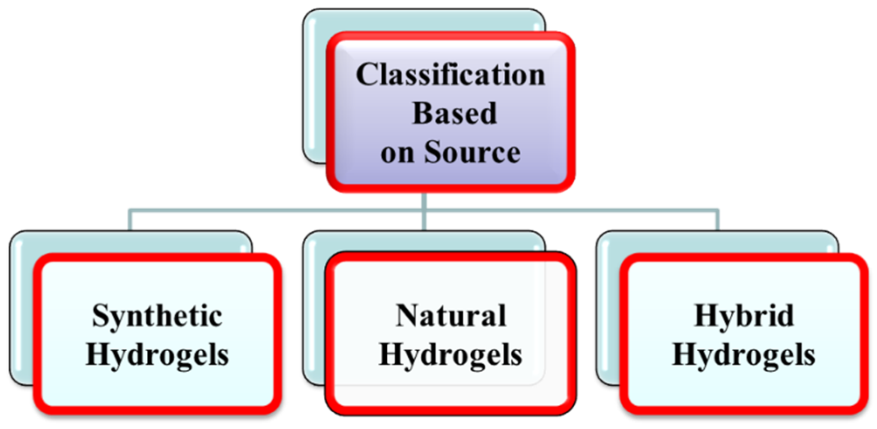

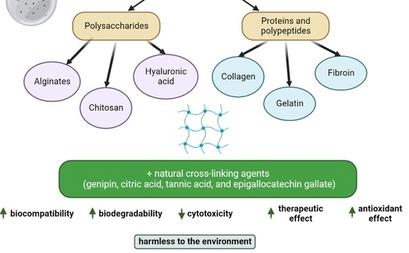


SYNTHESIS OF HYDROGELS
Table 1. Conducting Polymers
Polyacetylene
Polypyrrole
Polyaniline
(Poly Acrylamide)
Figure 3. Classification of Hydrogels
Ali, Fayaz, et al. “Emerging Fabrication Strategies of Hydrogels and Its Applications.” Gels, vol. 8, no. 4, Mar. 2022, p. 205

Slide 6
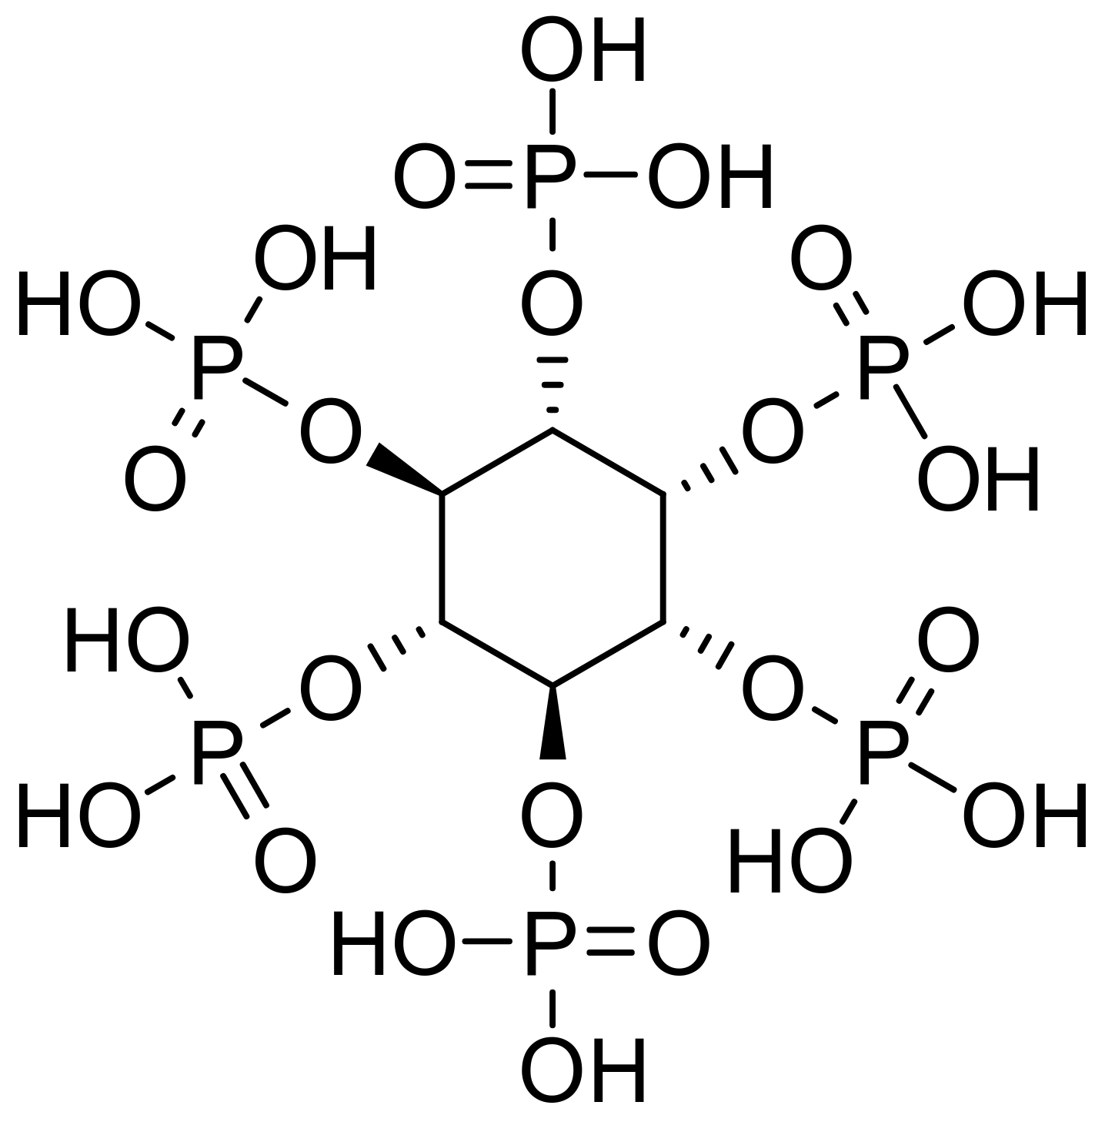
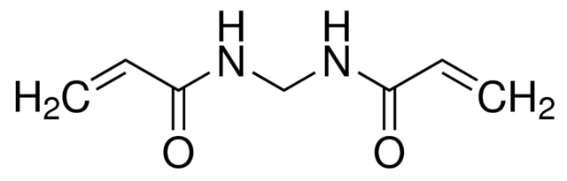
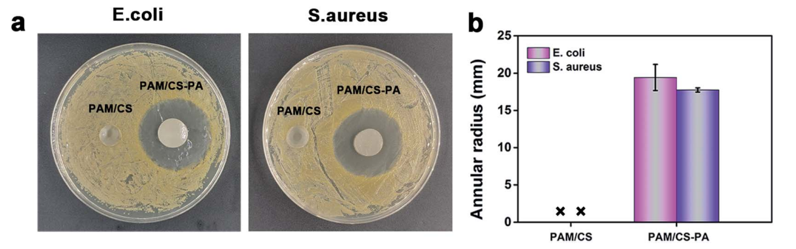
Cross-linking agents
Figure 4. Photos of antibacterial tests of the PAM/CS hydrogels and PAM/CS–PA hydrogels. (Zhang et al., 2021)
Natural
Synthetic
N,N'-Methylenebisacrylamide
(MBAA)
Phytic acid (PA)
Bloot, Ana Paula Marinho, et al. “A Review of Phytic Acid Sources, Obtention, and Applications.” Food Reviews International, Apr. 2021, pp. 1–20

Slide 7
SYNTHESIS OF HYDROGELS
 | System 1 | System 2 (hybrid)
Polysaccharides | Natural (Alginate) | Synthetic (PAAm) + natural (Chitosan)
Cross-linking agent | Ionic (CaCl₂) Natural (PA) | Chemical (MBAA) + natural (PA)
Conducting polymer | PAni | PAni

Slide 8
EXPERIMENTAL PART

Slide 9
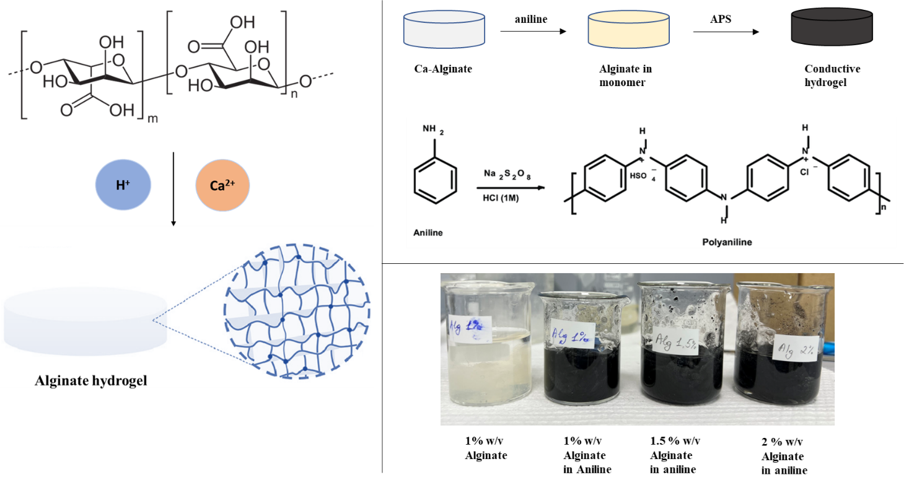
SYSTEM 1
Figure 5. Synthesis of Alginate hydrogel with and without conducting polymer

Slide 10
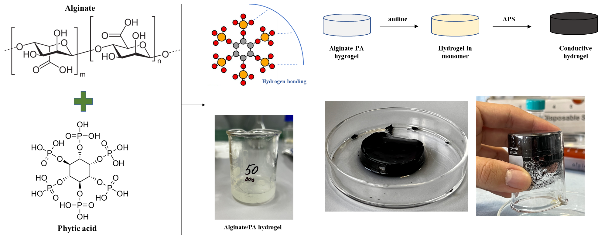
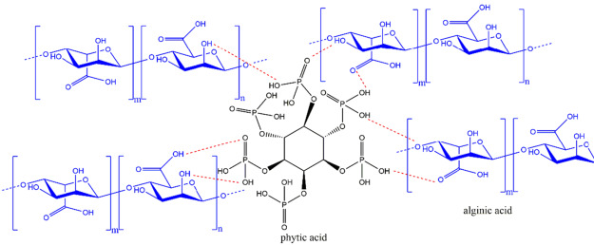
SYSTEM 1
Figure 6. Synthesis of Alg-PA hydrogel with and without conducting polymer
Nita, L. E., Chiriac, A. P., Ghilan, A., Rusu, A. G., Tudorachi, N., & Timpu, D. (2021). Alginate enriched with phytic acid for hydrogels preparation. International journal of biological macromolecules, 181, 561–571

Slide 11
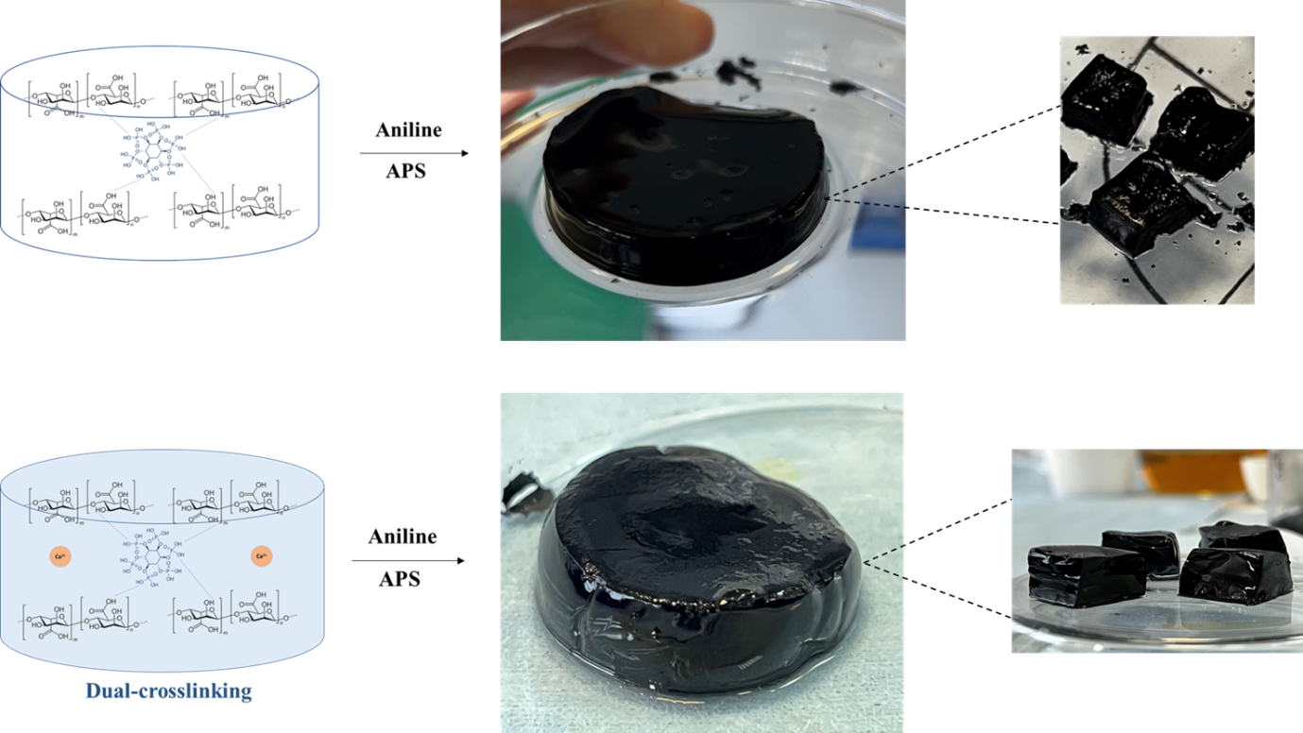
SYSTEM 1
Figure 7. Synthesis of Dual-crosslinked Alg-PA with and without conducting polymer
Single crosslinking

Slide 12
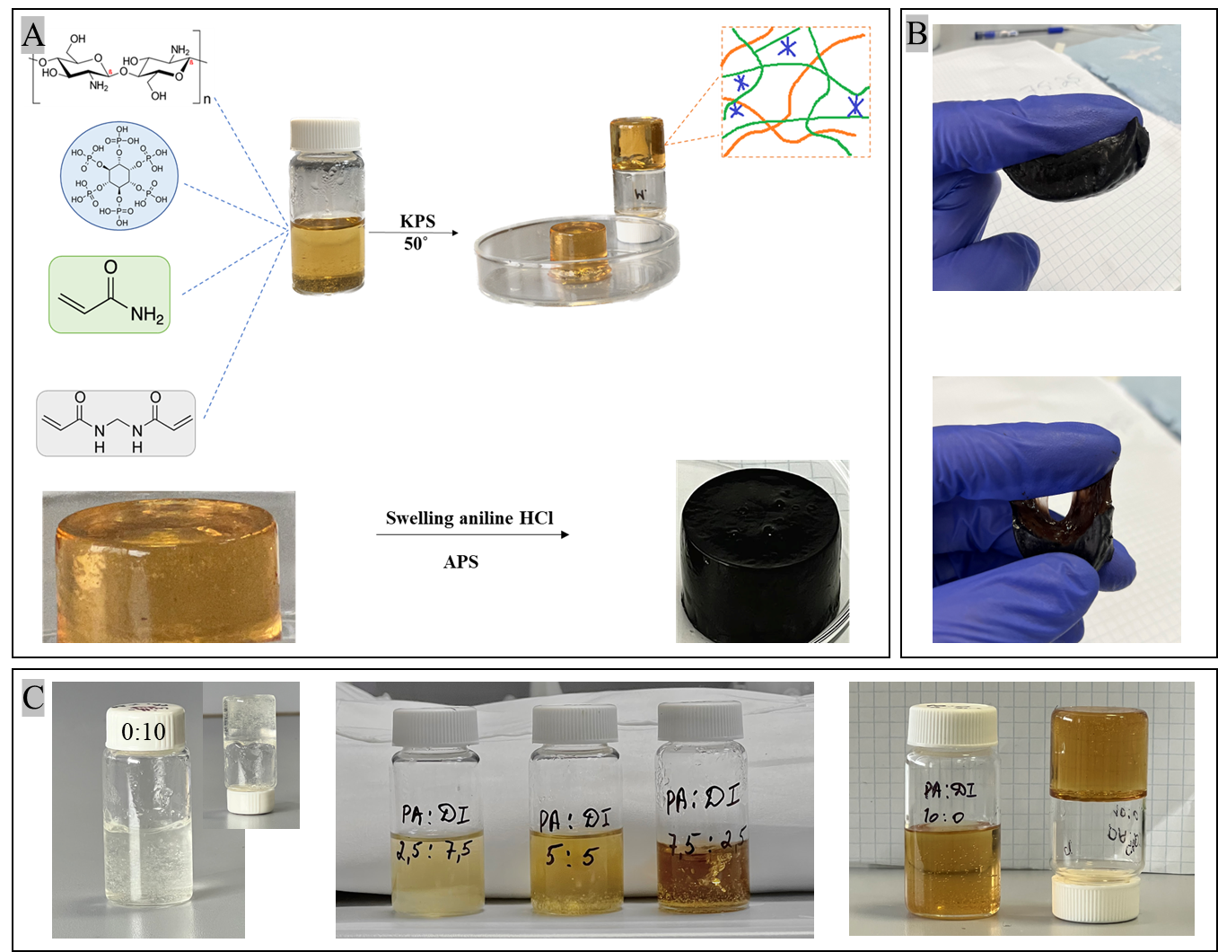
SYSTEM 2
CS
PA
PAAm
MBAA
Figure 8. A) The general scheme of PAAm/PA-PAni hydrogel synthesis and B) its adhesive properties to a dry surface.
C) Different volume ratios between Phytic acid and water (volume of the whole solution is 10 ml).

Slide 13
RESULTS AND DISCUSSION

Slide 14
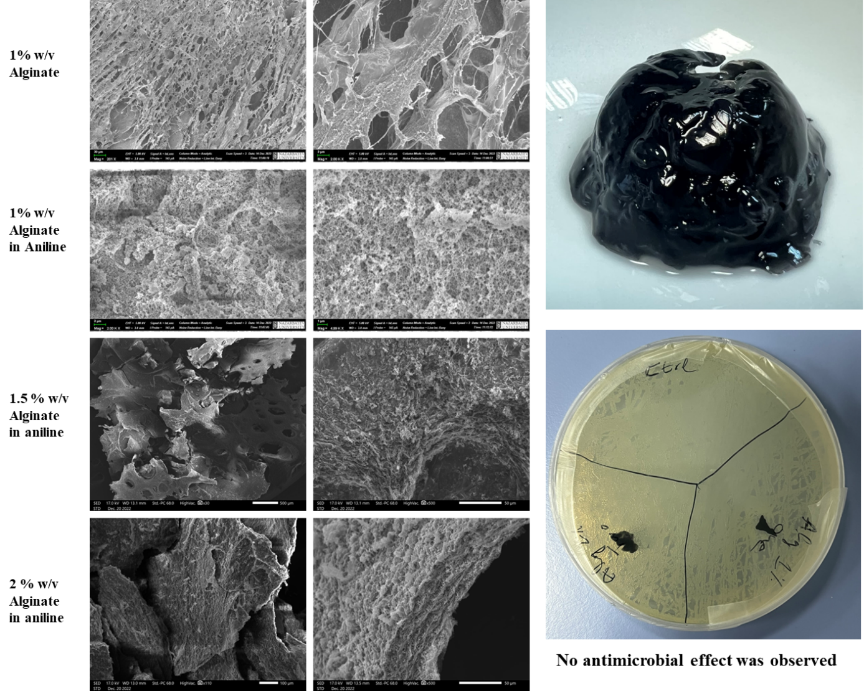
SYSTEM 1
Figure 9. Morphology analysis by SEM images of Alginate hydrogels and its antibacterial test on E.coli.

Slide 15
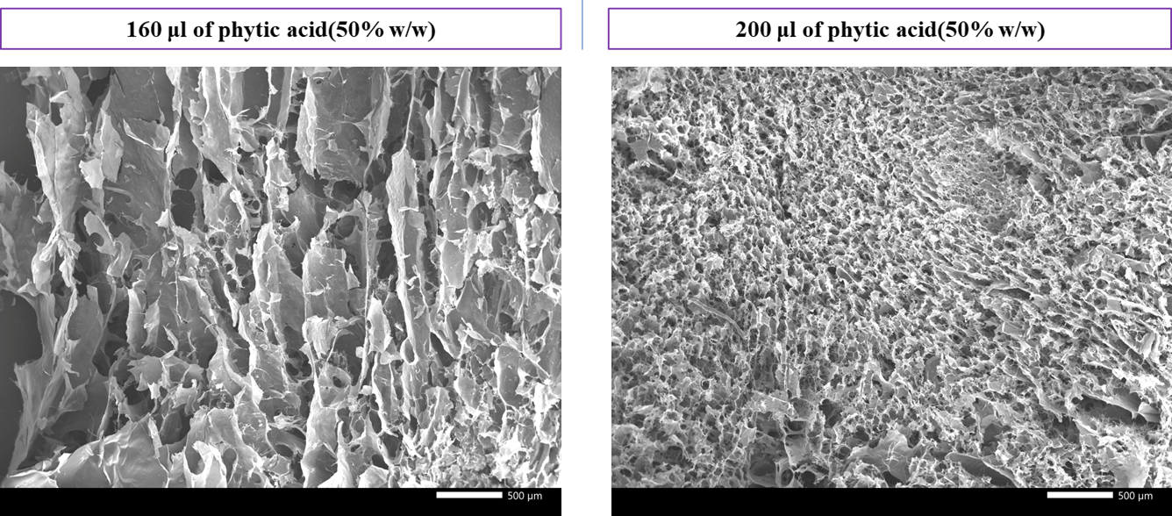
SYSTEM 1
Figure 10. Morphology analysis by SEM images of Alg-PA hydrogels and its antibacterial test.

Slide 16
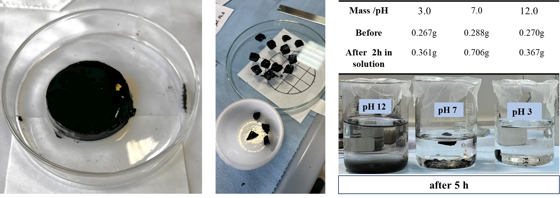
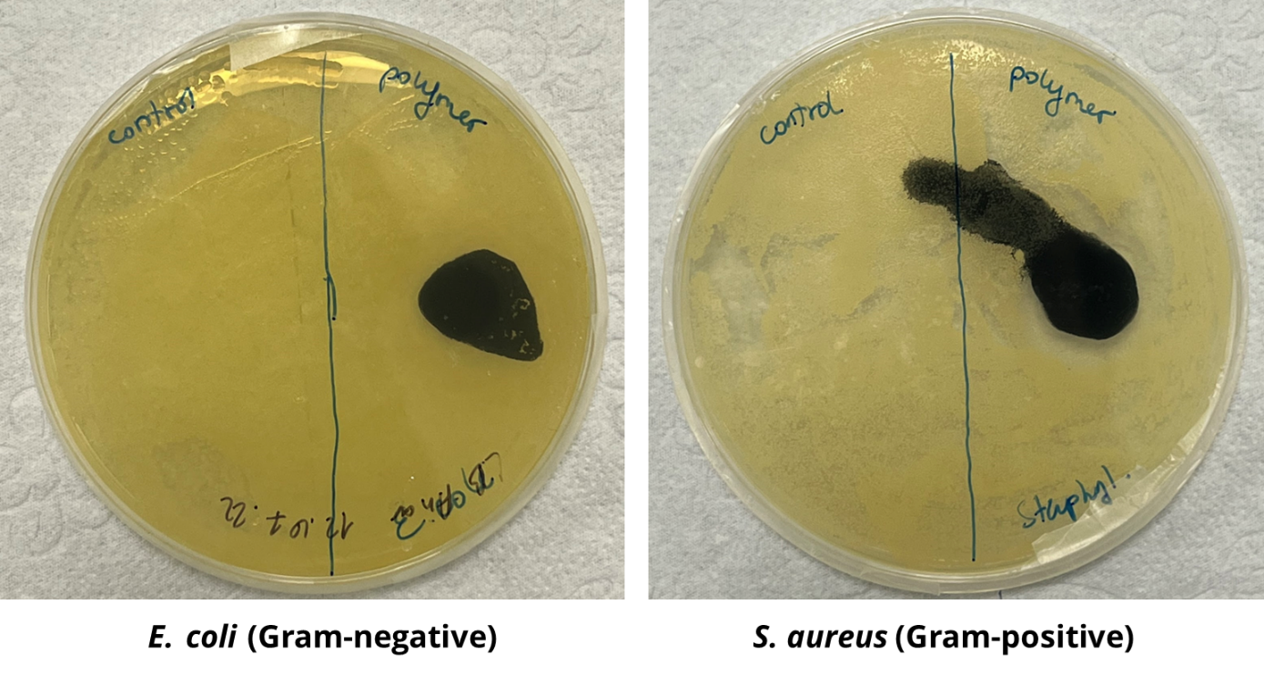
SYSTEM 1
Figure 11. pH and temperature stability* test of Dual-crosslinked Alg-PA hydrogel with conducting polymer (PAni)
*Condition for antibacterial test is 37^{O}C

Slide 17
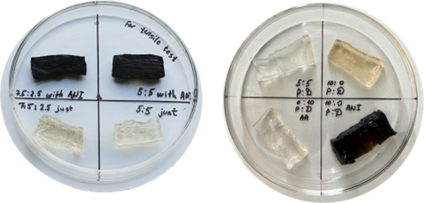
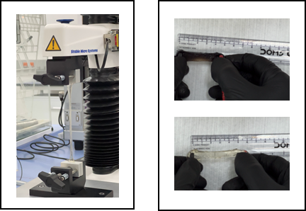
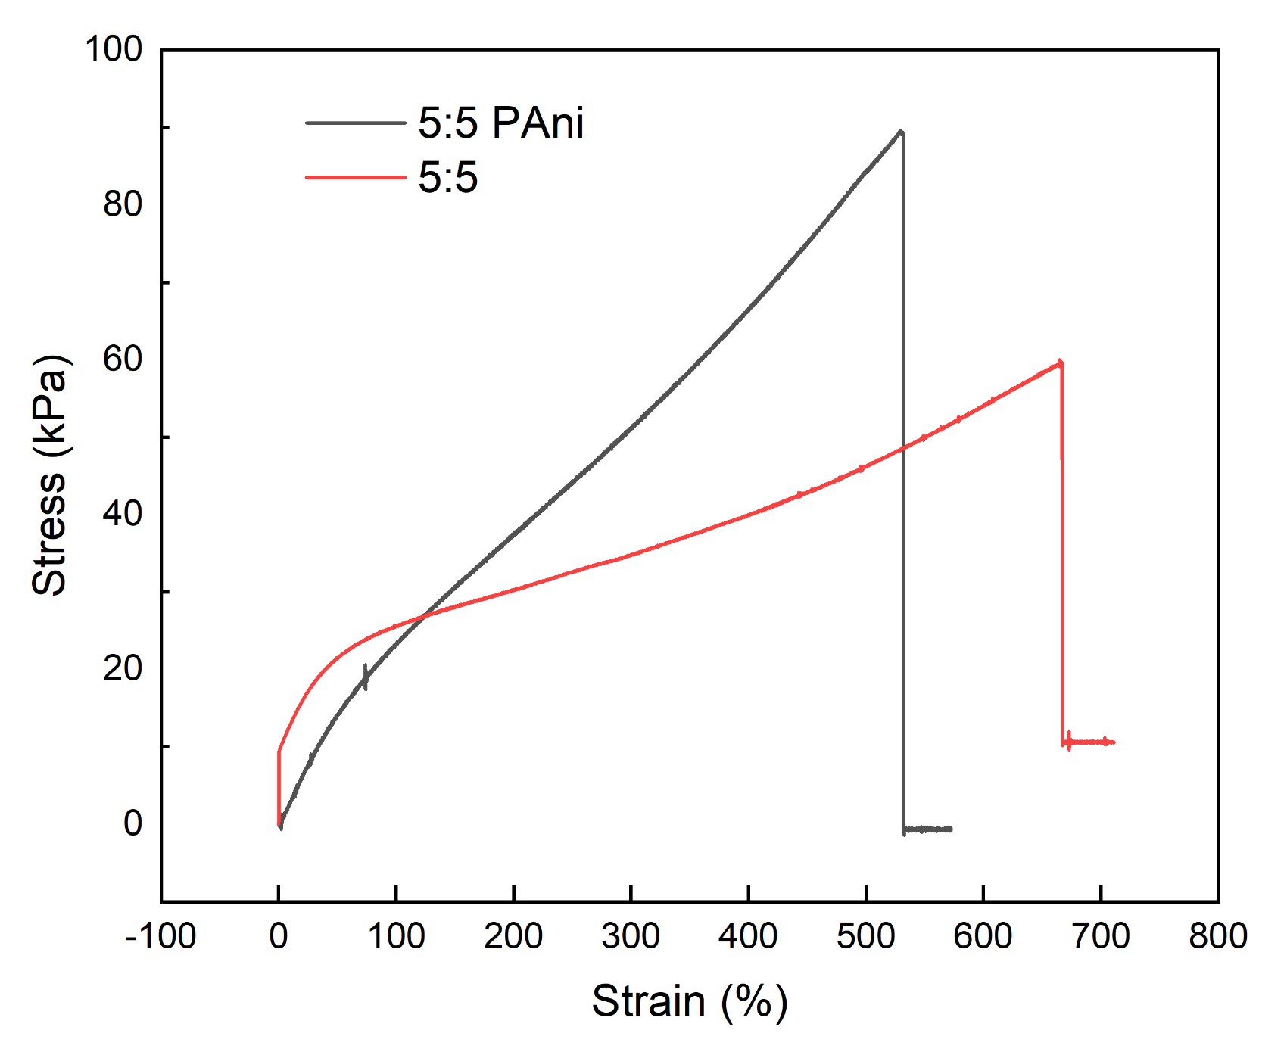
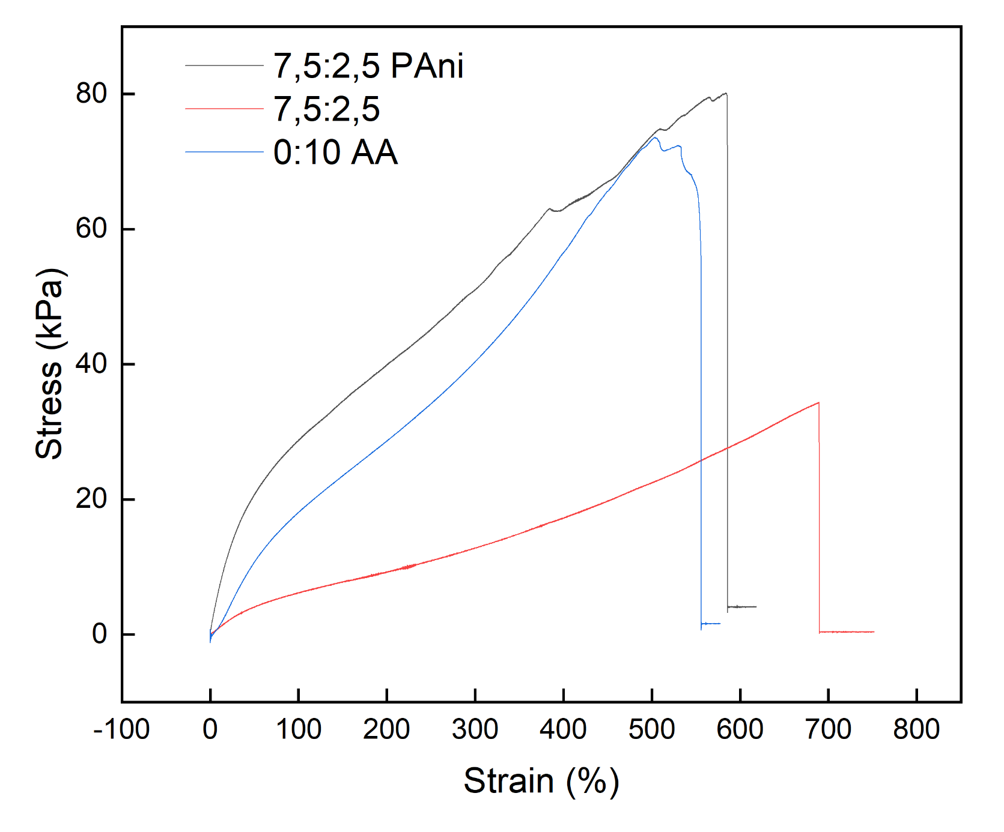
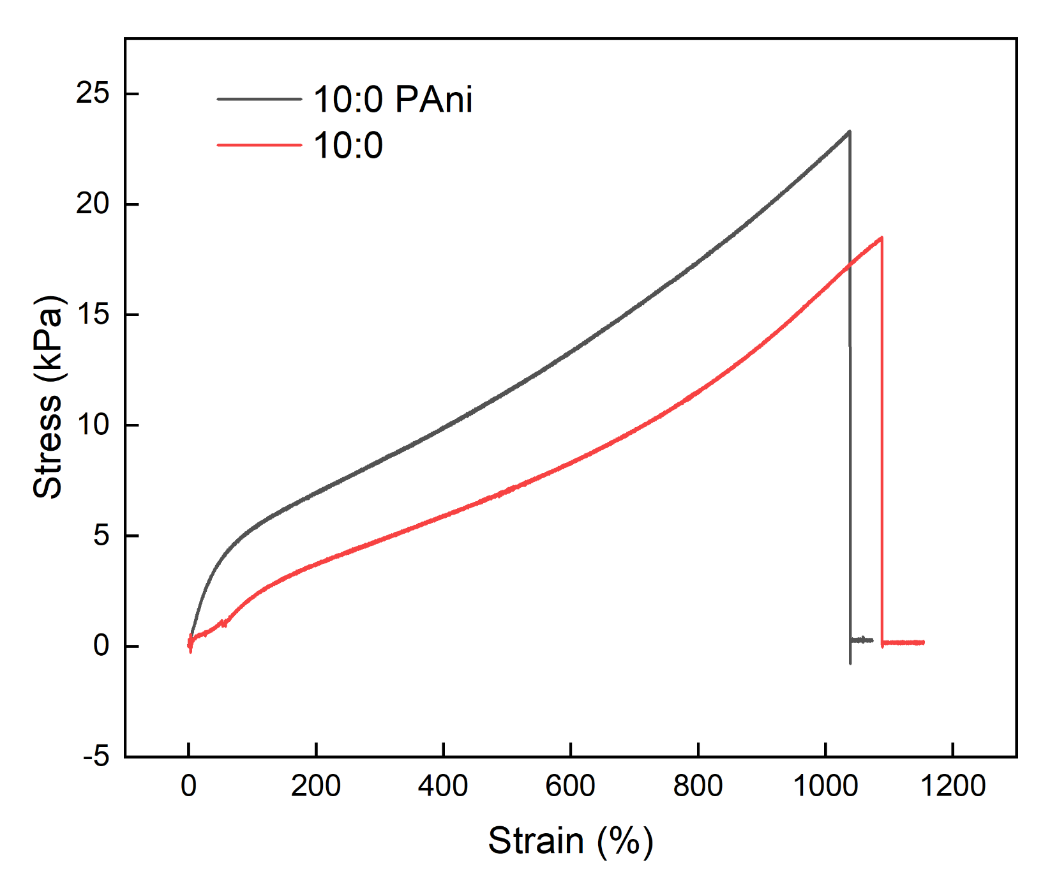
SYSTEM 2
Figure 12. Test of mechanical properties of PAAm/PA-CS hydrogel with conducting polymer (PAni)

Slide 18
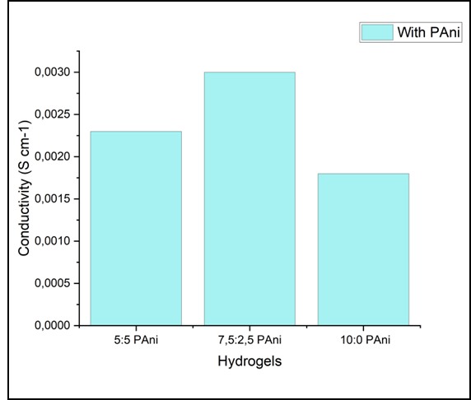
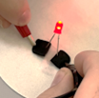
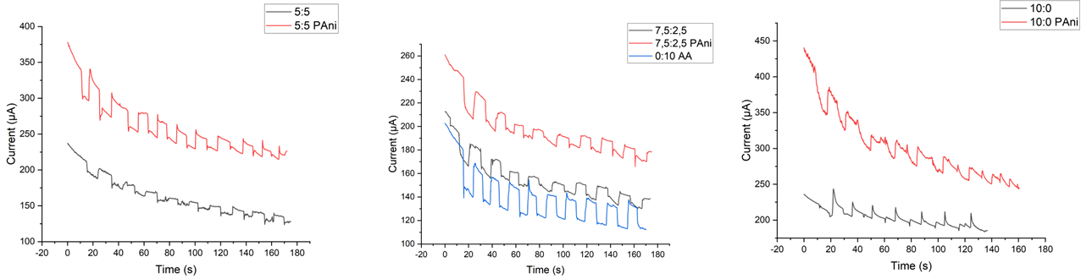
SYSTEM 2
Figure 13. Test of electrical conductivity and sensitivity of PAAm/PA-CS hydrogel with conducting polymer (PAni)

Slide 19
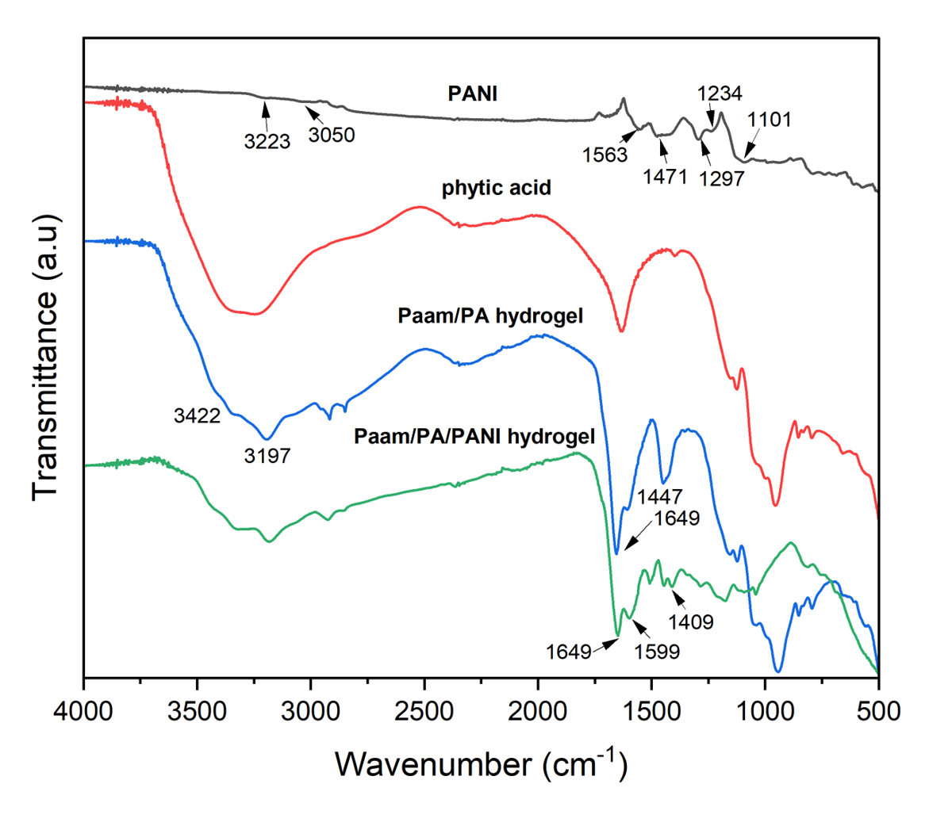
SYSTEM 2
Figure 14. FTIR analysis of PAni, Phytic acid, and hydrogels with and without CP

Slide 20
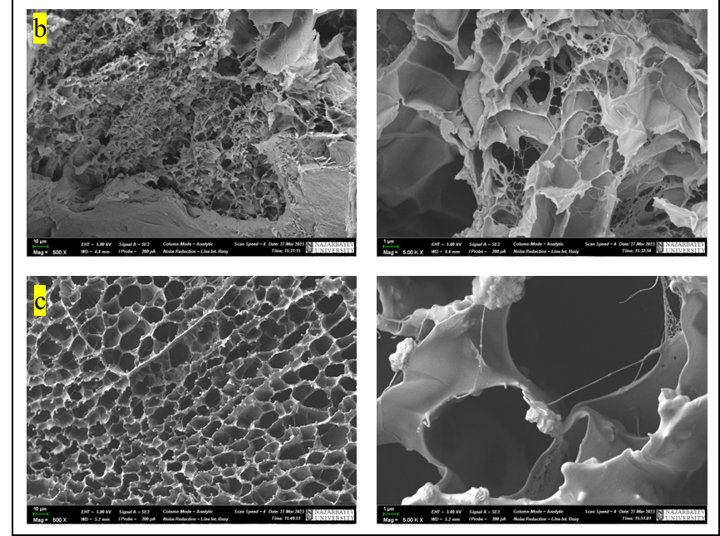
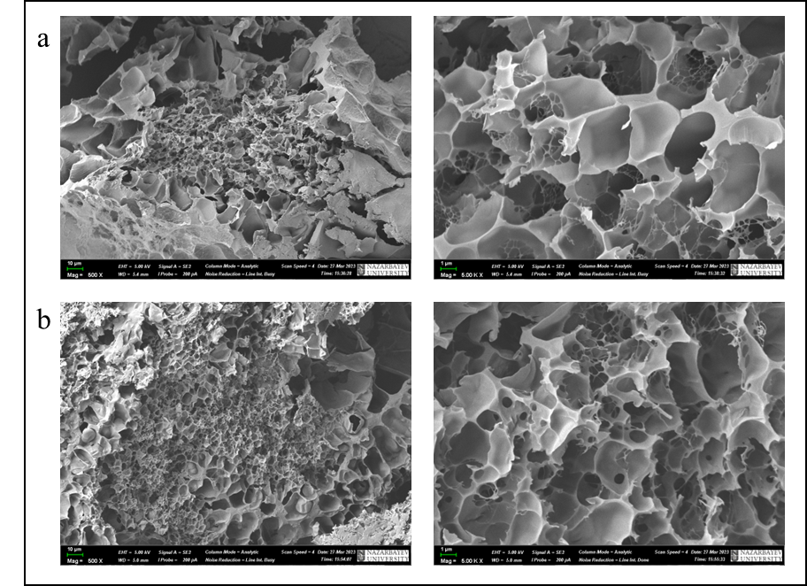
Morphology analysis of PAAm/PA-PAni hydrogels
a
b
Figure 15. SEM images of PAAm/PA hydrogels with a ratio of 5:5 (PA:DI) a) without and b) with PAni at a magnification of 500 and 5000
Figure 16. SEM images of PAAm/PA hydrogels with a ratio of 7,5:2,5 (PA:DI) a) without and b) with PAni at a magnification of 500 and 5000.

Slide 21
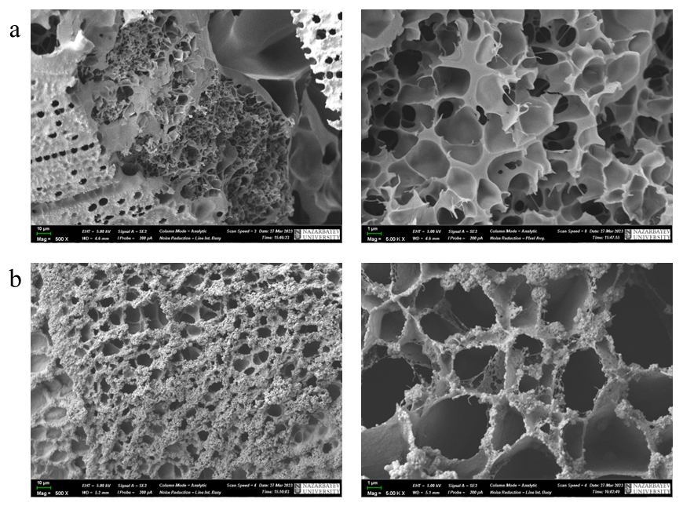
Morphology analysis of PAAm/PA-PAni hydrogels
Figure 17. SEM images of PAAm/PA hydrogels with a ratio of 10:0 (PA:DI) without and b) with PAni at a magnification of 500 and 5000.

Slide 22
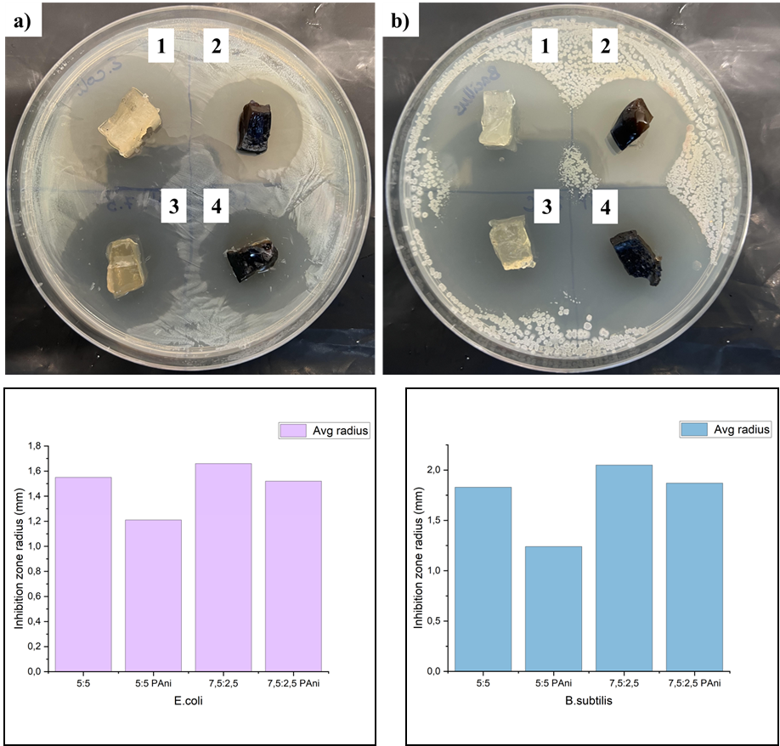
SYSTEM 2
Figure 18. Antibacterial test of PAAm/PA and PAAm/PA-PAni hydrogel on E. coli (a) and B.subtilis (b). 1) 5:5; 2) 5:5 PAni; 3) 7,5:2,5; 4) 7,5:2,5 PAni

Slide 23
CONCLUSION
Novel Conductive Polymer-based Hydrogel systems were obtained
Tunable electrical and mechanical properties were developed
Effect of the addition of CP to electrical sensitivity and stability under strain were investigated
Antibacterial properties were studied

Slide 24
FUTURE WORK
To obtain more statistical data
Study adhesive properties of hydrogels and their applications
Cytotoxicity test
Investigation of hydrogel modification ways
Improvement of electrical conductivity
Insertion of particles for storage and to test stimuli-responsive release

Slide 25
REFERENCES
Rong, Q., Lei, W., & Liu, M. (2018). Conductive Hydrogels as Smart Materials for Flexible Electronic Devices. Chemistry (Weinheim an der Bergstrasse, Germany), 24(64), 16930–16943. https://doi.org/10.1002/chem.201801302
Zhou, C., Wu, T., Xie, X., Song, G., Ma, X., Mu, Q., Huang, Z., Liu, X., Sun, C., & Xu, W. (2022). Advances and challenges in conductive hydrogels: From properties to applications. European Polymer Journal, 177, 111454. https://doi.org/10.1016/j.eurpolymj.2022.111454
Ali, Fayaz, et al. “Emerging Fabrication Strategies of Hydrogels and Its Applications.” Gels, vol. 8, no. 4, Mar. 2022, p. 205, https://doi.org/10.3390/gels8040205.
Bloot, Ana Paula Marinho, et al. “A Review of Phytic Acid Sources, Obtention, and Applications.” Food Reviews International, Apr. 2021, pp. 1–20, https://doi.org/10.1080/87559129.2021.1906697.
Zhang et al. “A Highly Conductive Hydrogel Driven by Phytic Acid towards a Wearable Sensor with Freezing and Dehydration Resistance.” Journal of Materials Chemistry A, vol. 9, no. 39, 2021, pp. 22615–25, https://doi.org/10.1039/d1ta06408h.

Slide 26
ACKNOWLEDGMENTS
My sincere thanks to supervisors Drs. Nurxat Nuraje, Tri Pham, and Salimgerey Adilov, for their countless discussions and advice, and for providing me with good working conditions and support. Also, special thanks to Nazarbayev University for providing a state grant and research-based facilities.
I would also like to thank the whole lab team, especially, Ph.D. student Dana Kanzhigitova and Dr. Munziya Abutalip, and other colleagues, for helping me during the whole way of research and giving insightful ideas on my work.

