Slide 1
The Numerical Simulation and Performance Assessment of Rim-Driven Turbine
Akezhan Zholdybayev
2nd Year Master in Mechanical and Aerospace Engineering
Supervisor: Associate Professor Basman Elhadidi
Co-Supervisor: Associate Professor Luis Rojas-Solórzano

Slide 2
Outline
Introduction
Background
Hypothesis
Literature Review
Aim and objectives
Methods
Results & Analysis
Conclusion and Future work
References

Slide 3
Introduction
The rising global temperature is pushing countries to seek alternative sources of energy
One of the solutions is green energy sources
However, less than 20% of the world energy is produced from these sources
Nevertheless, there a great hydro energy potential which can be implemented in various ways
One of them is the application of rim-driven turbines(RDT)

Slide 4
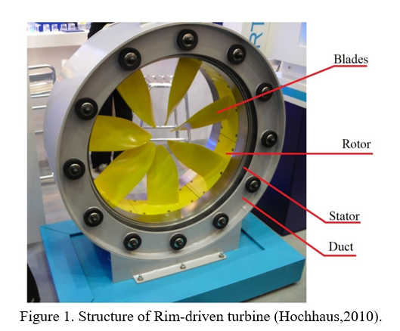
Background
The working principle of RDT turbines is similar to that of regular turbines with central hub
The flow of water through the blades moves the blades converting kinetic energy of the fluid to electric energy
Figure 1. Application areas (Hochhaus, 2010)

Slide 5
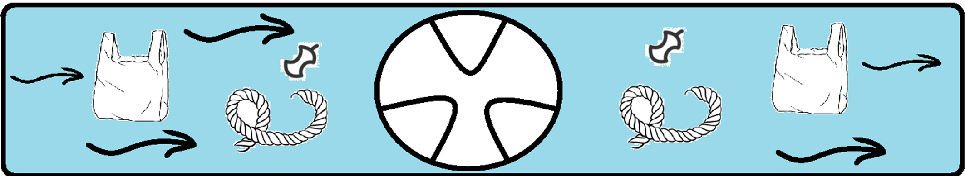
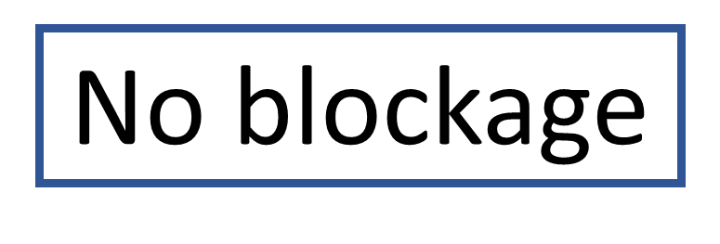
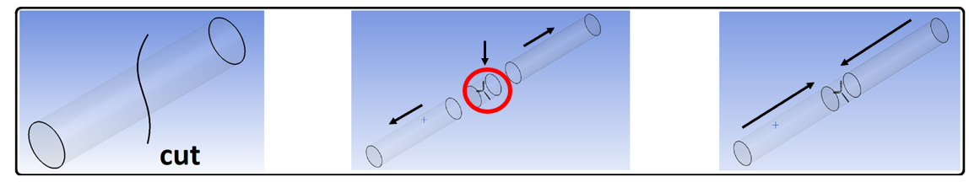

Background. Why RDT turbines?
Figure 2. Advantages of RDT

Slide 6
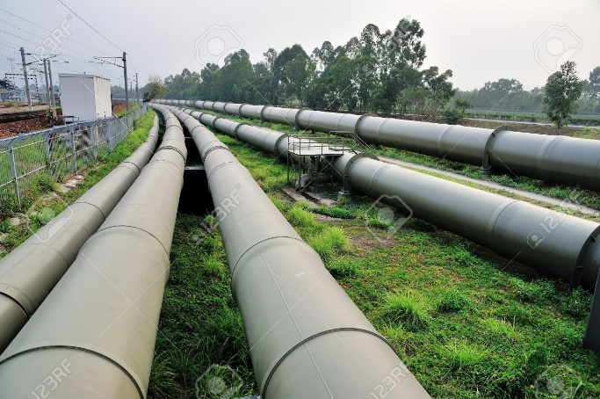
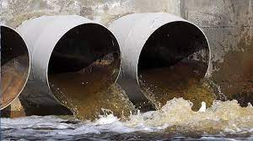
Application Areas
  Water transfer system
  Sewage water flow
Figure 3. Application areas

Slide 7
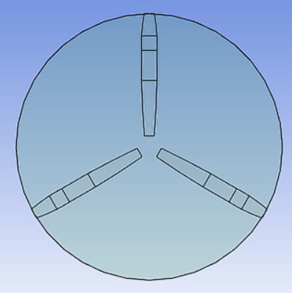
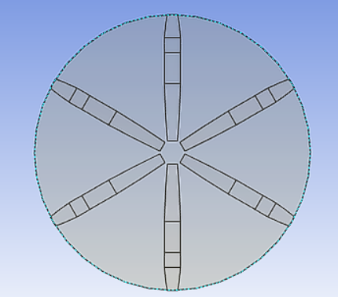
Hypothesis
Doubling number of blades increase Power Output (PO)
PO
Lifetime?
Figure 4. Effects of blades on PO & Lifetime

Slide 8
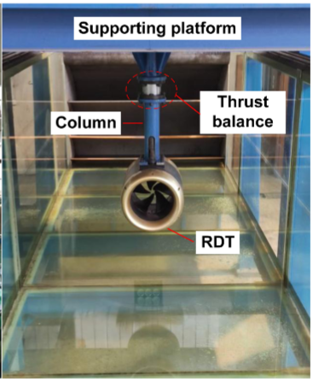
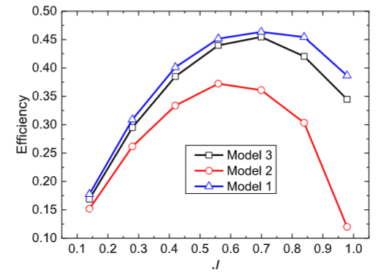
Literature Review. Experimental studies
Focus on design of electromagnetic parts (Gieras et al., 2008; Kim et al., 2013; Djebarri et al., 2012; Djebarri et al., 2015).
Rim turbine design is applied as a thruster (Kim et al., 2020), marine turbine (Djebarri et al., 2012; Xu et al., 2017; Kim et al., 2013), tidal turbine (Djebarri et al., 2014, 2015)
Thus, there is a research gap on RDT turbines
Figure 6. Experimental setup for RDT (Djebarri, 2015)

Slide 9
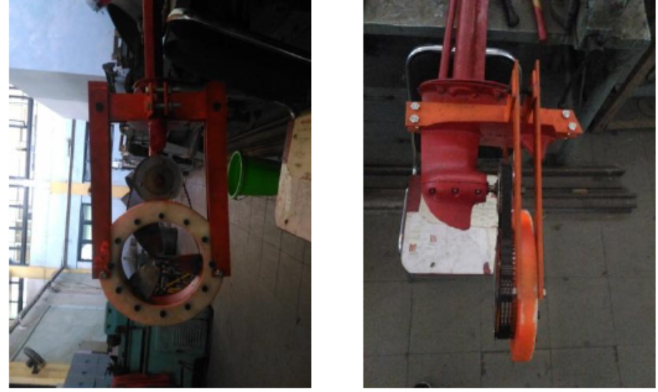
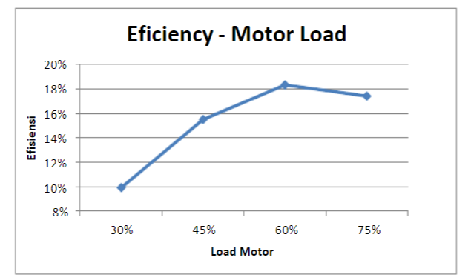
Literature Review. Experimental Studies
Studies investigating the relationship of rpm and performance was done on Kaplan hydroturbines (Santoso et al., 2017).
Results show that peak efficiency is achieved at 260 rpm with 60% load.
2 works focused on effect of polymer coatings. (Mineshima et al., 2019; Fialova et al., 2016).
Results show that hydrophilic coating has better results in preventing blade erosion compared to hydrophobic coating
Figure 7. RDT vs regular turbines(Song, 2022)

Slide 10
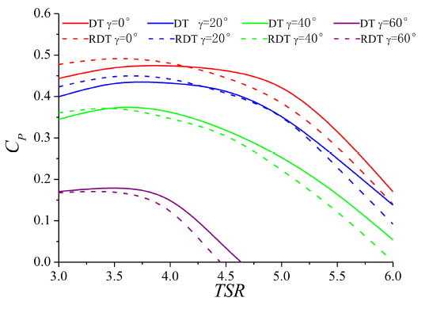
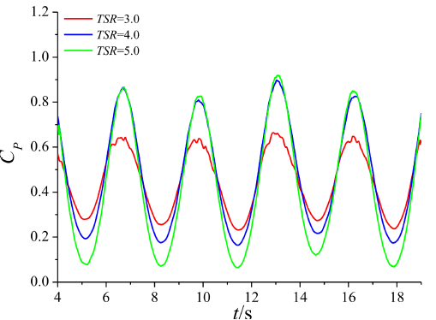
Literature Review. Numerical studies
The experimental studies on turbines:
Ka 4-70 duct propeller
To study the effects of gap fluid (Jiang, 2022) on performance
Conducted CFD with performance analysis(Song et al., 2021, 2022)
Authors indicate, that the RDT have less cavitation inception. Yet, there are lack of studies confirming that
Figure 8. Power curves (Song, 2022)
Figure 9. Performance output vs time-step

Slide 11
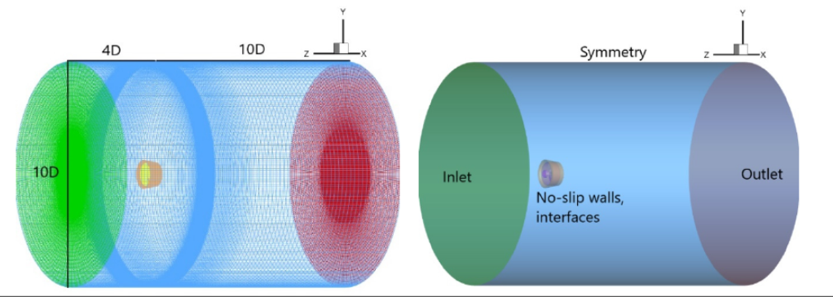
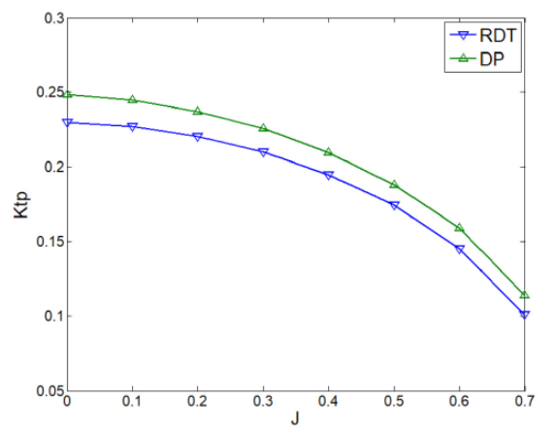
Literature Review. Numerical studies
The numerical studies on RDT design also focuses on thrusters. For instance, the CFD study comparing DT and RDT was conducted using k-omega model with MRF approach (Liu et al., 2021)
They conclude that, the gap flow significantly reduces the RDT thrusters, showing worse performance numbers than DP thrusters
Figure 10. Thrust coefficient vs Advance coefficient

Slide 12
Literature Review: Conclusions and gaps
The shaftless design was applied in thrusters, tidal turbine, marine turbines, Kaplan hydroturbines, indicating the lack of study on RDT turbines.
It was found that the following factors affect the power output:
    Blade design
    Operational velocities (RPM, TSR)
    The fluid flow through the center gap (Turbine case need to be checked)
Literature material imply importance of blade erosion without addressing it in methods
The current literature did not access RDT as a turbine given its installation flexibility

Slide 13
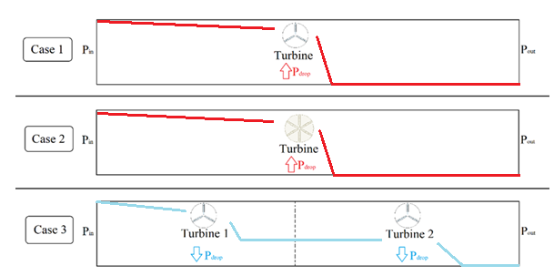
Hypothesis
Series installation reduce pressure load on blades distributing it among turbines increasing lifetime
Figure 5. Application areas

Slide 14
Aim and objectives
The aim of this work is to assess the RDT in generating electricity for a given inlet conditions.
It will be achieved by the following objectives:
  Develop accurate numerical simulation
  Evaluate the results and draw conclusion
  Confirm hypothesis

Slide 15
Methods
Generate a mesh for a turbine blade. Initially OpenProp tool will be used for training purpose then a commercial turbine blade will be used.
Development of numerical simulation:
  Computational Domain with pressure & velocity inlets
  Meshing
  Solution method
  Post-processing

Slide 16
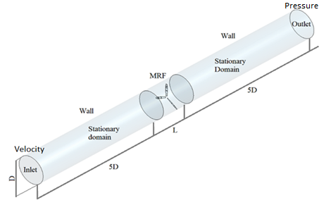
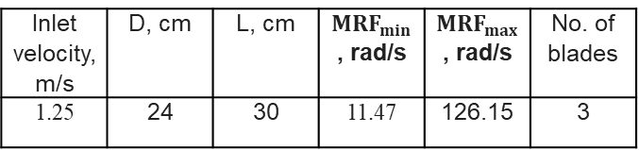
Methods. Computation Domain with velocity inlet
Table 1. Fluid details
Fluid type | Density, kg/m³ | Viscosity, kg/m*s
Water | 998.2 | 0.001
Table 2. Input details
Inlet velocity, m/s | D, cm | L, cm | ${MRF}_{min}$, rad/s | ${MRF}_{max}$, rad/s | No. of blades
1.25 | 24 | 30 | 11.47 | 126.15 | 3
Figure 11. Geometry and Boundary conditions

Slide 17
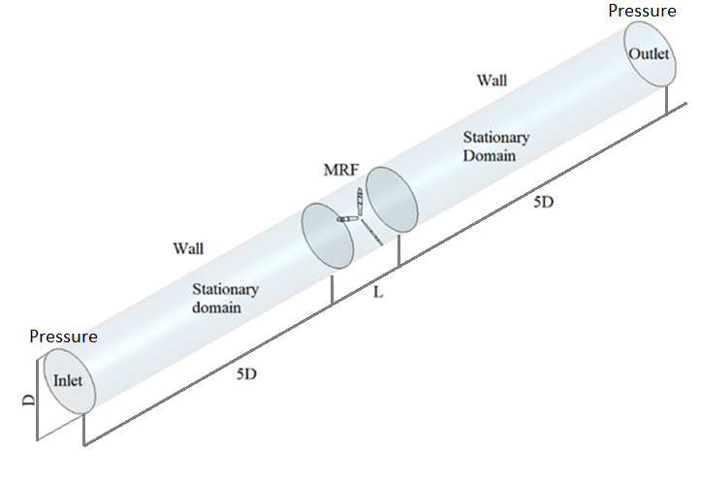
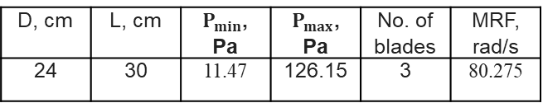
Methods. Computation Domain with pressure inlet
Table 3. Input details
D, cm | L, cm | $P_{min}$, Pa | $P_{max}$, Pa | No. of blades | MRF, rad/s
24 | 30 | 11.47 | 126.15 | 3 | 80.275
Figure 12. Geometry and Boundary conditions

Slide 18
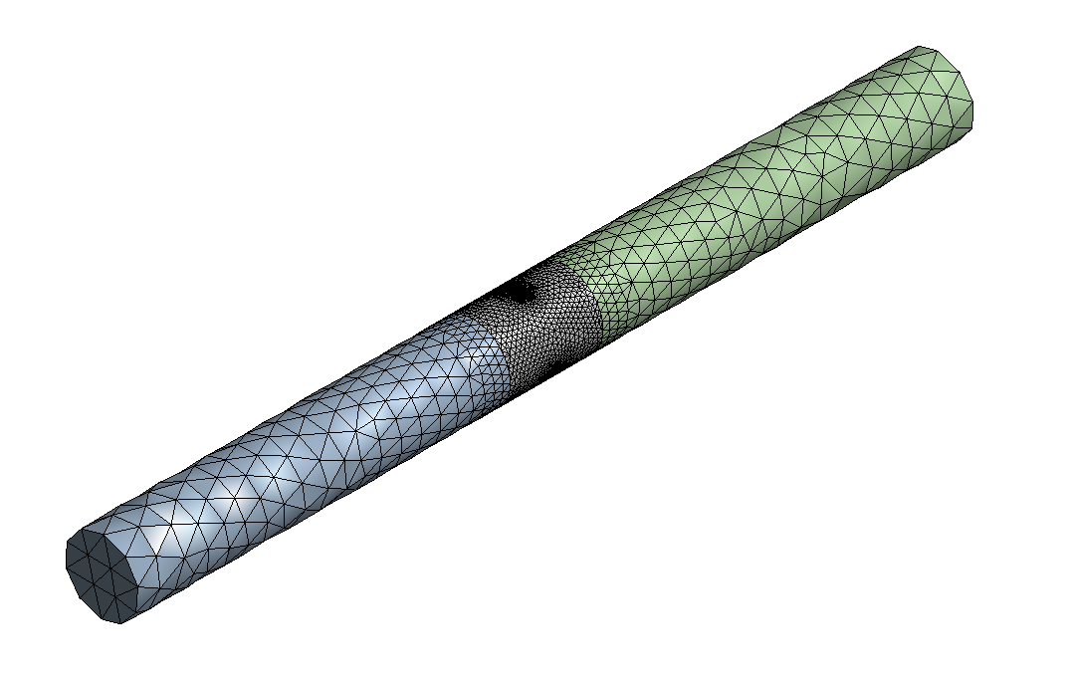
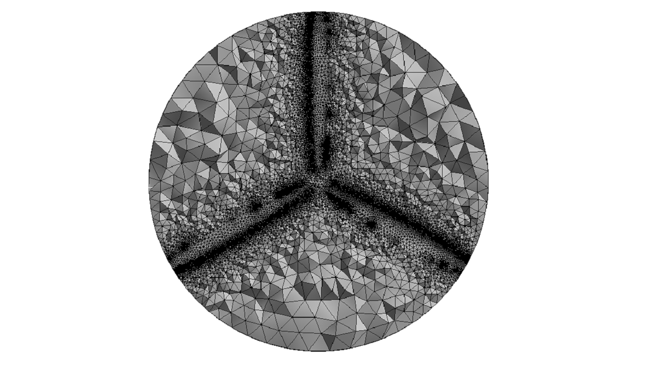
Methods. Meshing of 3 bladed turbine
Figure 13. Mesh of the domain

Slide 19
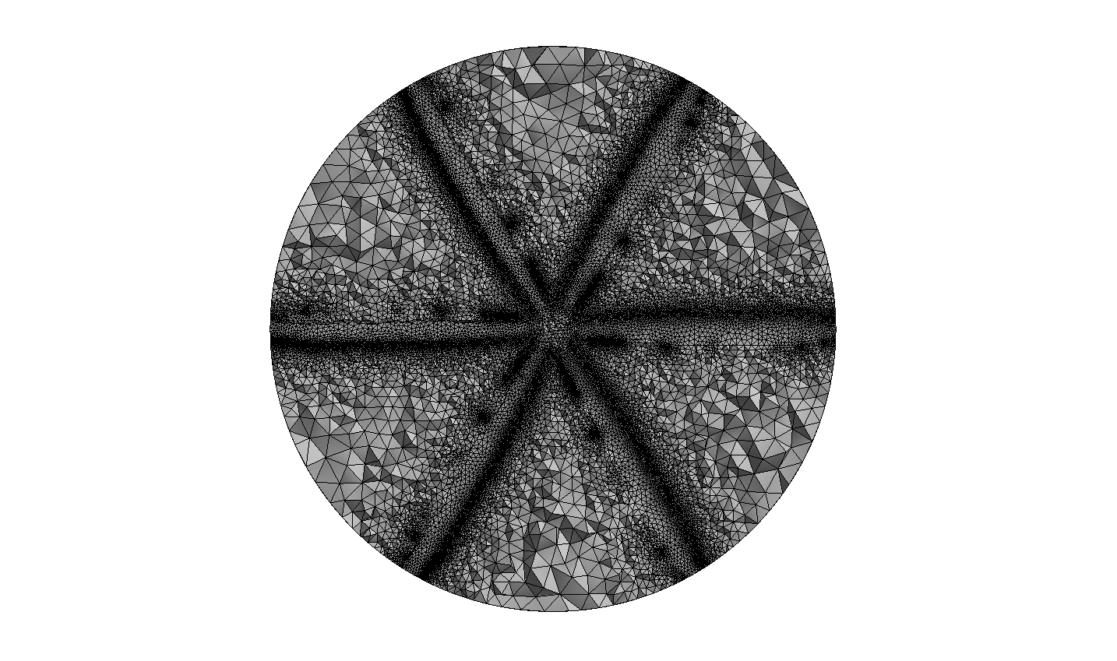
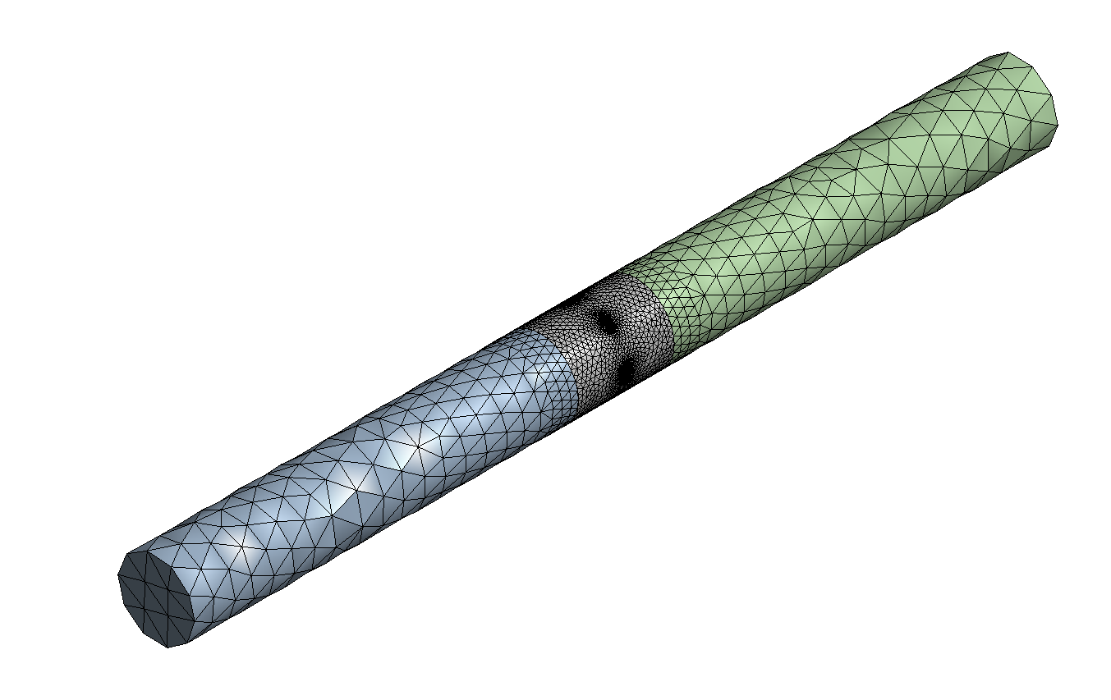
Methods. Meshing of 6 bladed turbine
Figure 13. Mesh of the domain

Slide 20
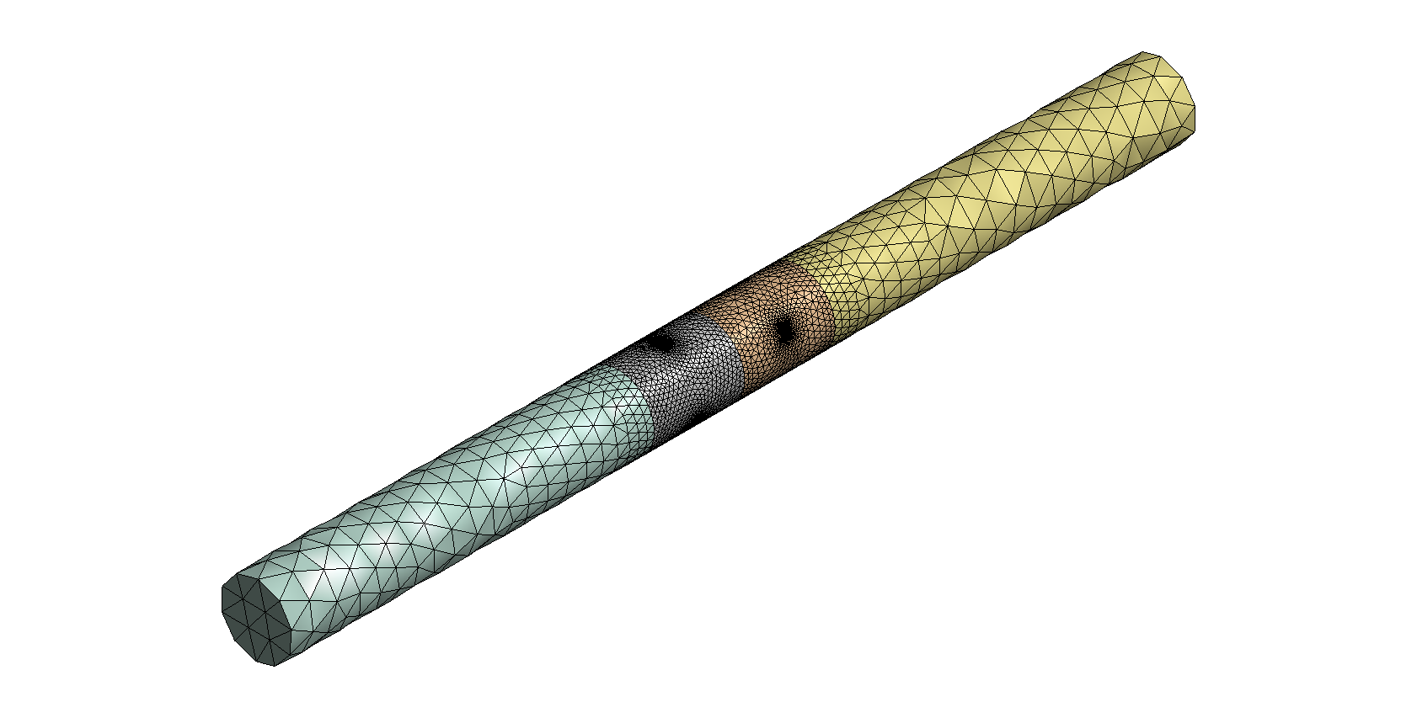
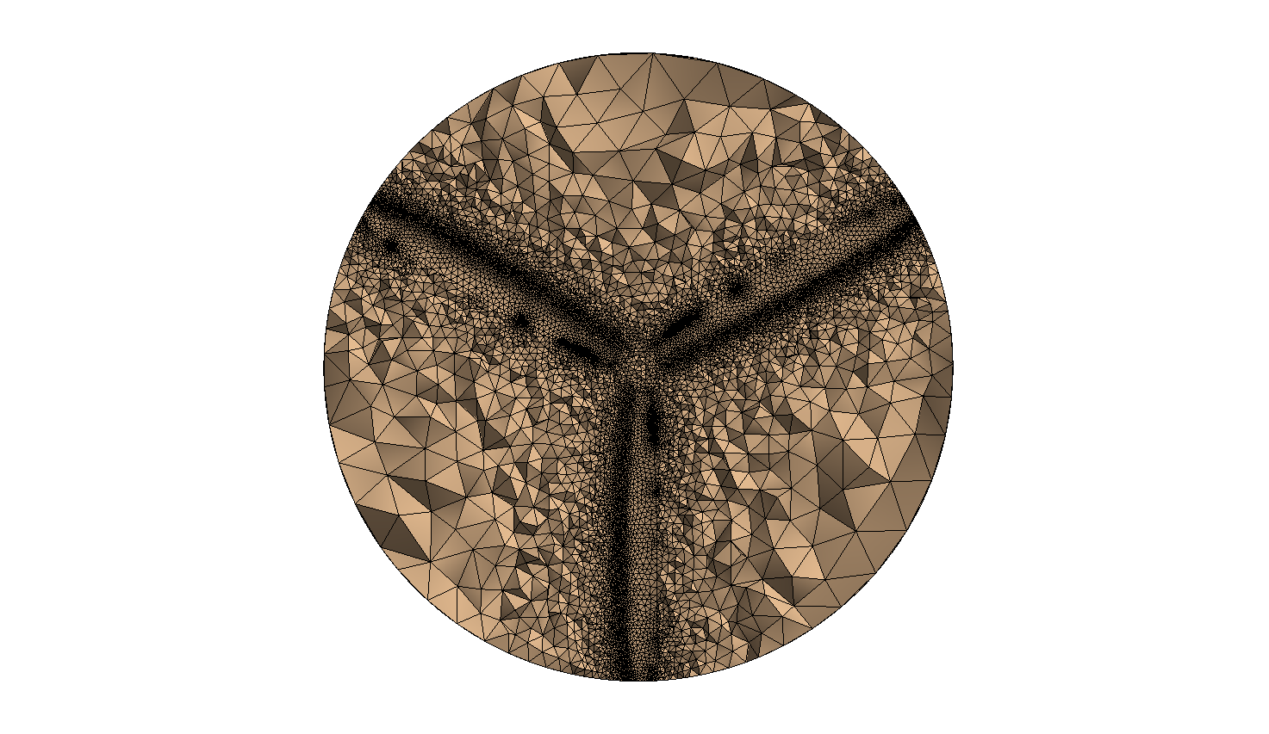
Methods. Meshing of series 3 bladed turbines
Figure 13. Mesh of the domain

Slide 21
Methods. Solution Method
Since the case is a flow in a pipe, the pressure-velocity coupling solution method with least-squared cell based spatial discretization method is used.
Table 4. Solution details
Solution method | Pressure-Velocity Coupling
Scheme | Coupled
Spatial Discretization | Least Square Cell Based
Momentum | Second Order Upwind
Turbulent Kinetic Energy | Second Order Upwind
Specific Dissipation Rate | Second Order Upwind

Slide 22
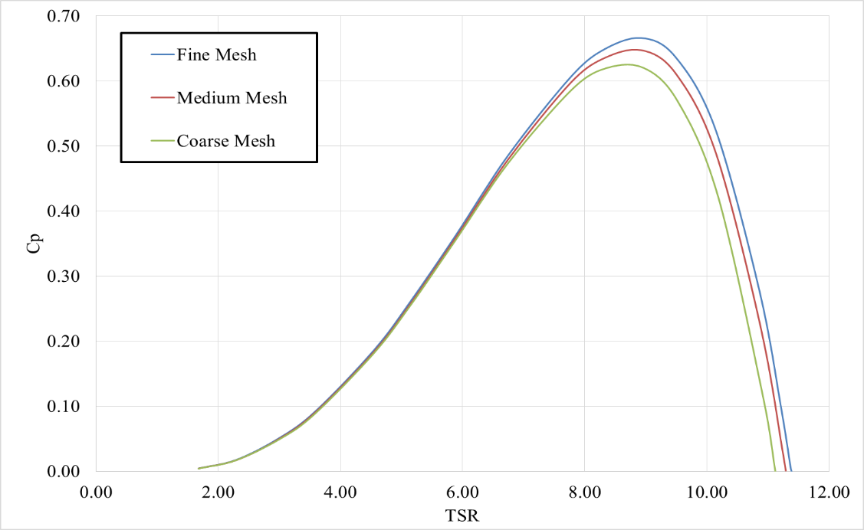
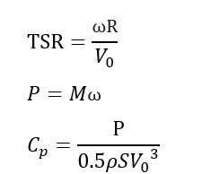
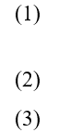
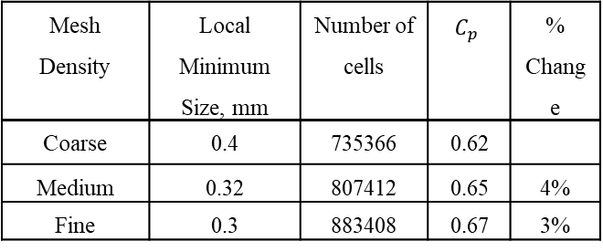
Grid Independence Test
Table 5. Test Results
Mesh Density | Local Minimum Size, mm | Number of cells | $$C_{p}$$ | % Change
Coarse | 0.4 | 735366 | 0.62
Medium | 0.32 | 807412 | 0.65 | 4%
Fine | 0.3 | 883408 | 0.67 | 3%
Figure 14. Grind Independence Power Curve

Slide 23
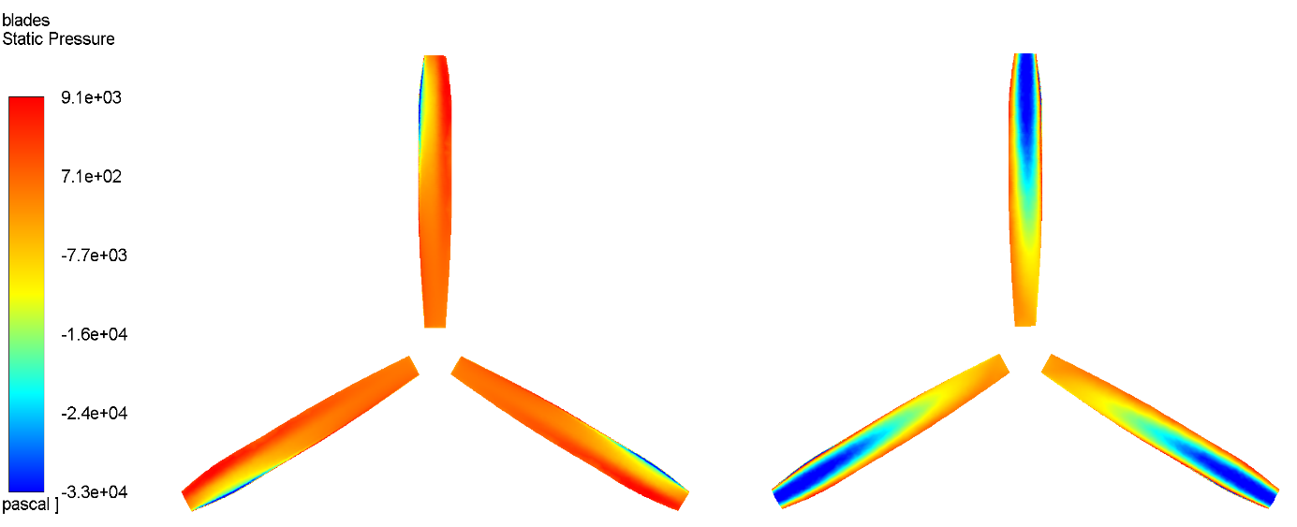
Results & Analysis. 3 bladed single turbine
Figure 15. Pressure Side
Figure 16. Suction Side

Slide 24
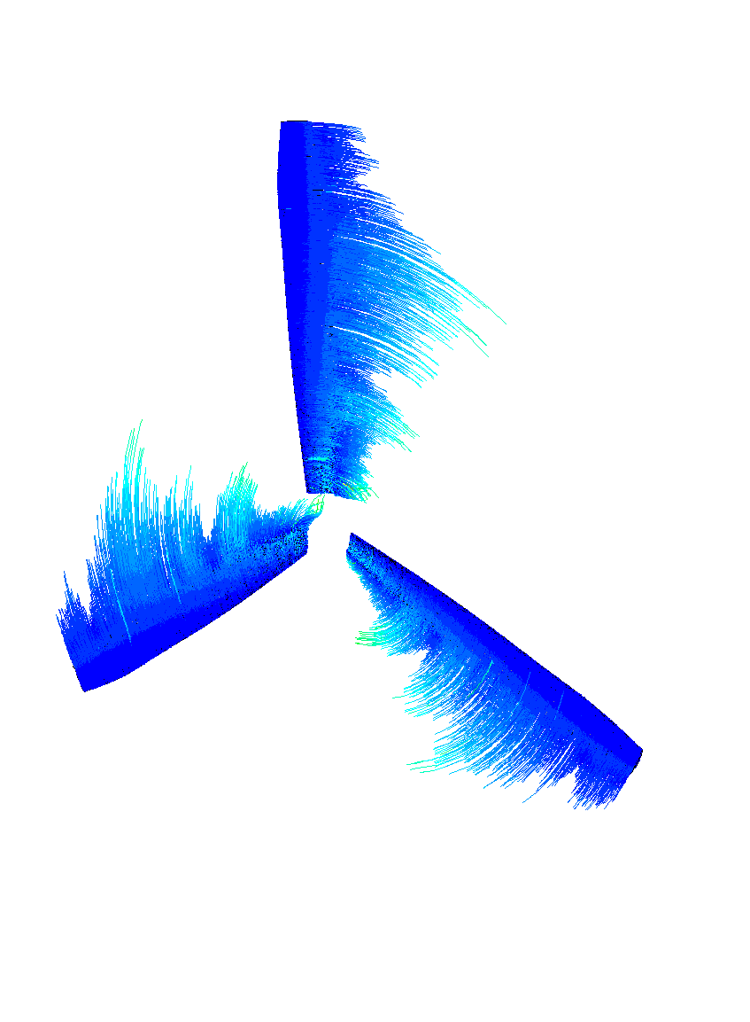
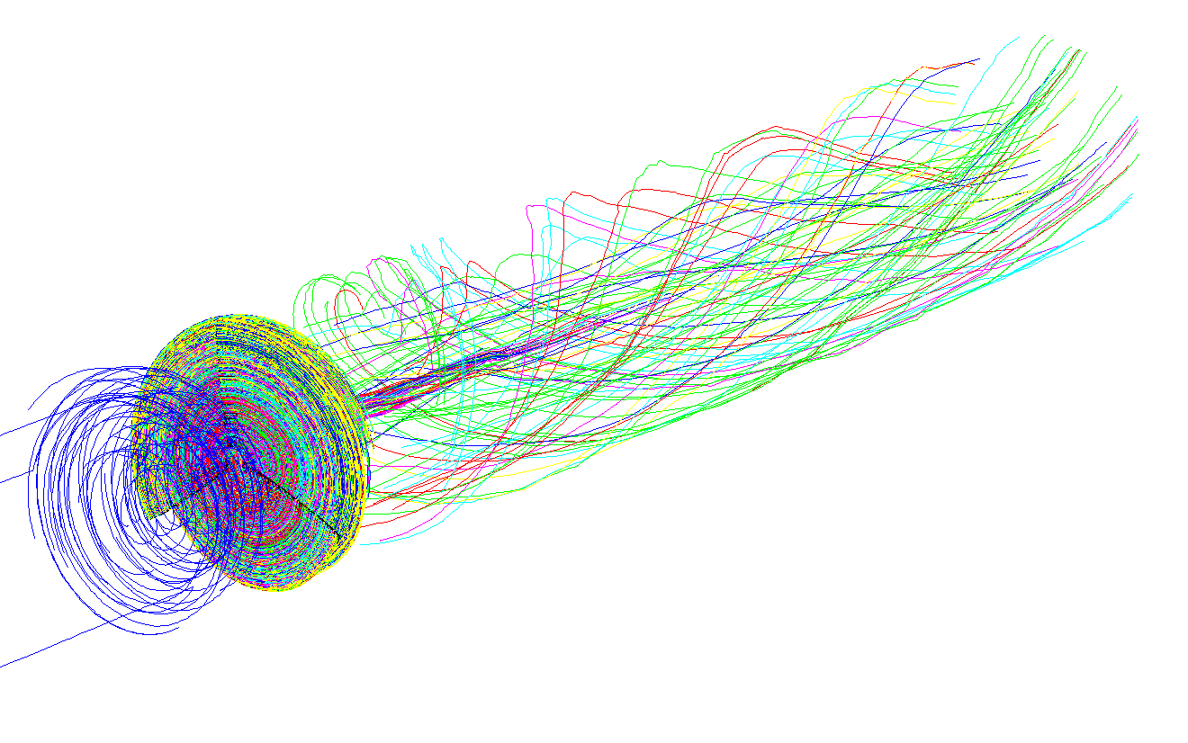

3 bladed single turbine. Fluid flow around blades
Figure 17. Flow around blades

Slide 25
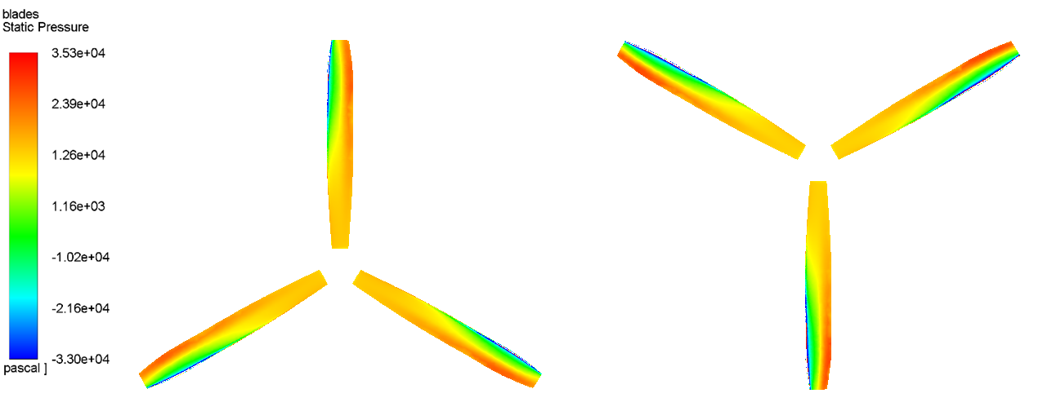
Results & Analysis. 3 bladed series turbines
Figure 18. Front Blade Pressure
Figure 19. Back Blade Pressure

Slide 26
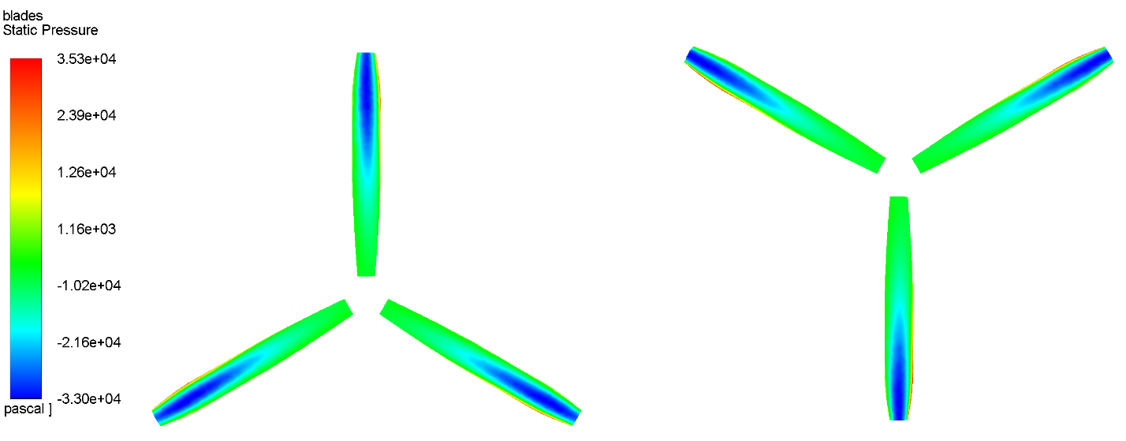
Results & Analysis. 3 bladed series turbines
Figure 20. Front blade suction side
Figure 21. Back blade suction side

Slide 27
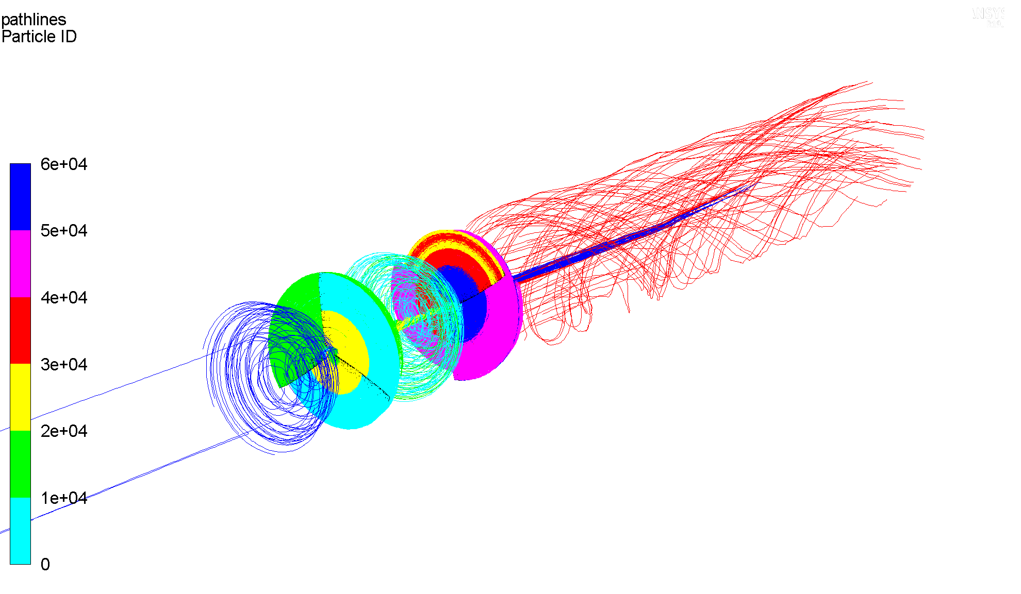

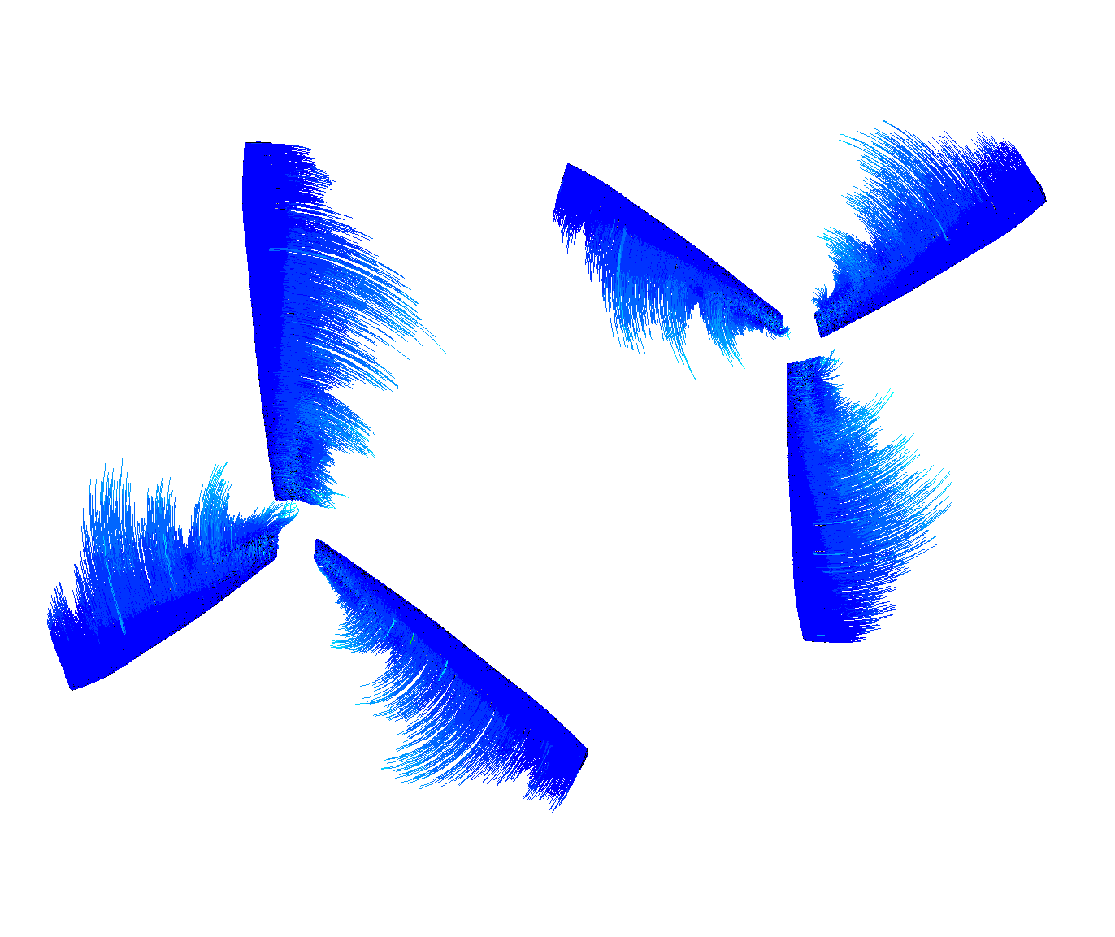
3 bladed series turbine. Fluid flow around blades
Figure 22. Flow around blades

Slide 28
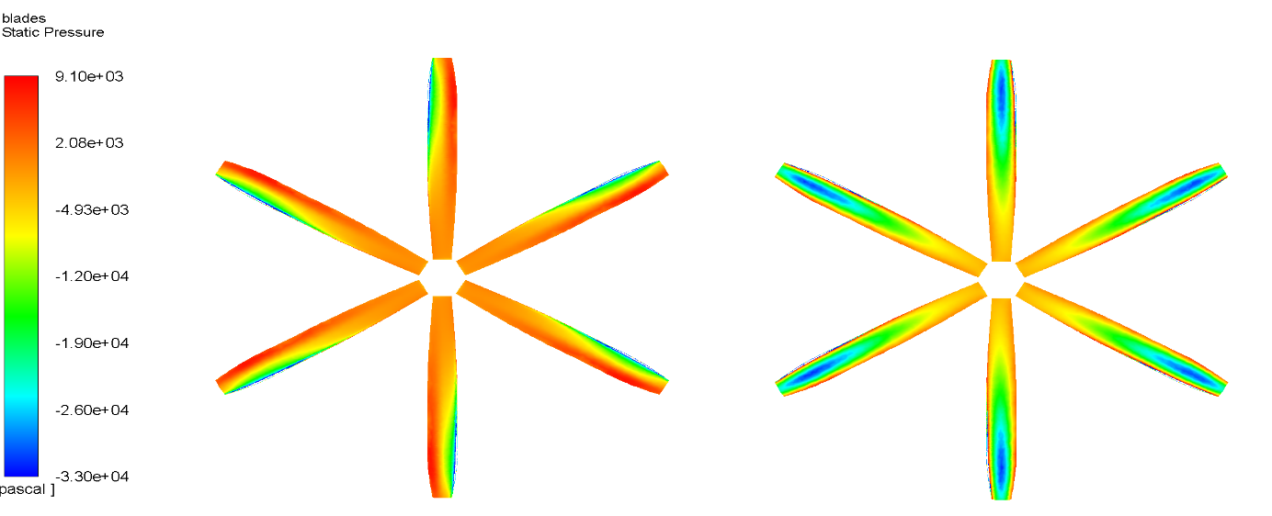
Results & Analysis. 6 bladed single turbine
Figure 23. Pressure Side
Figure 24. Suction Side

Slide 29
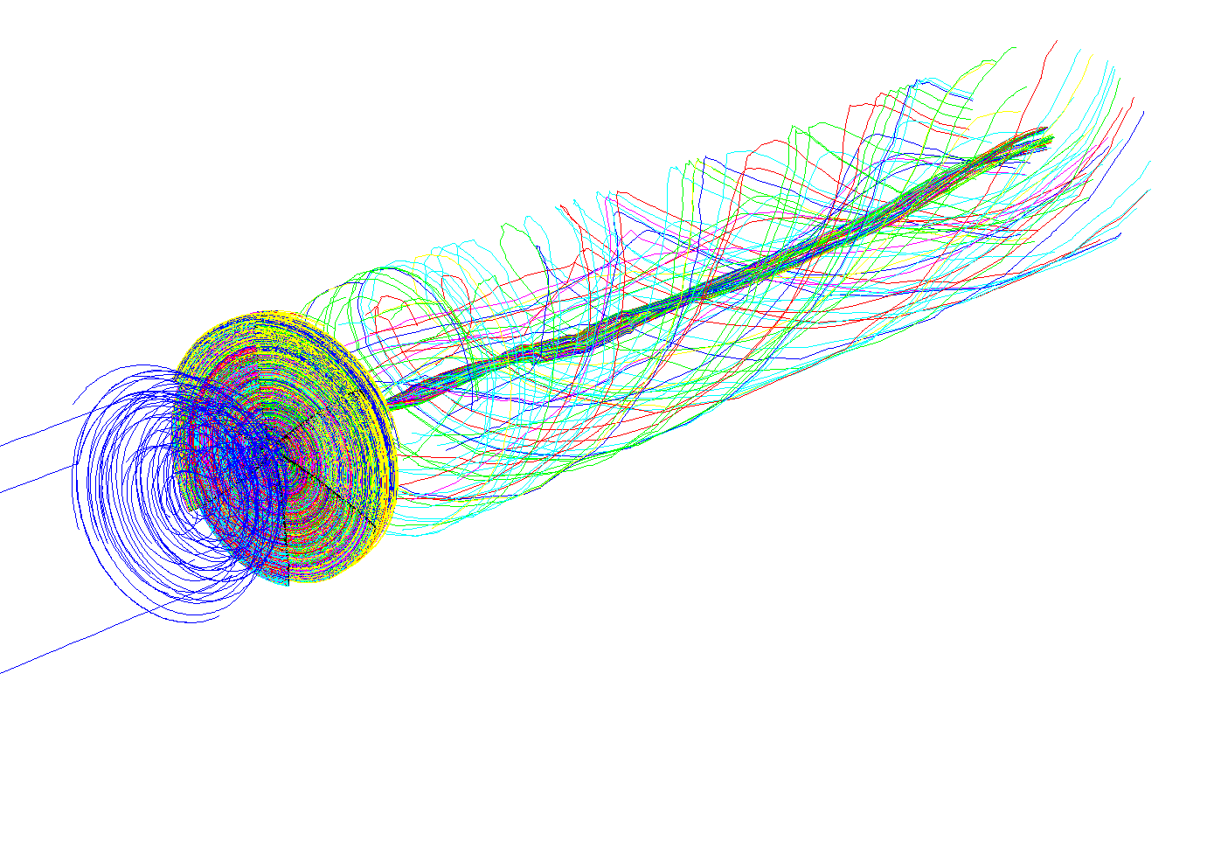
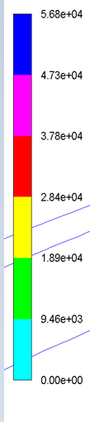
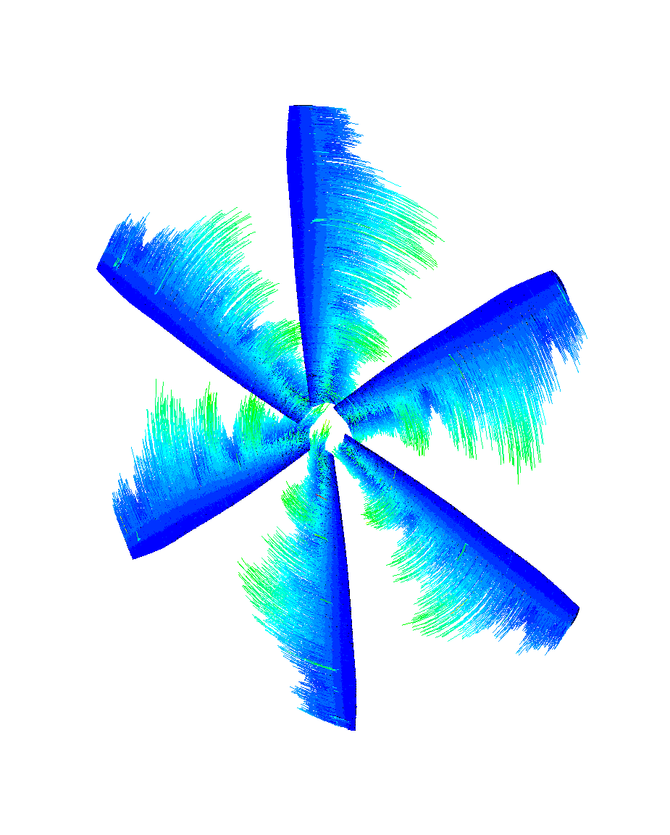
6 bladed single turbine. Fluid flow around blades
Figure 25. Fluid flow around blades

Slide 30
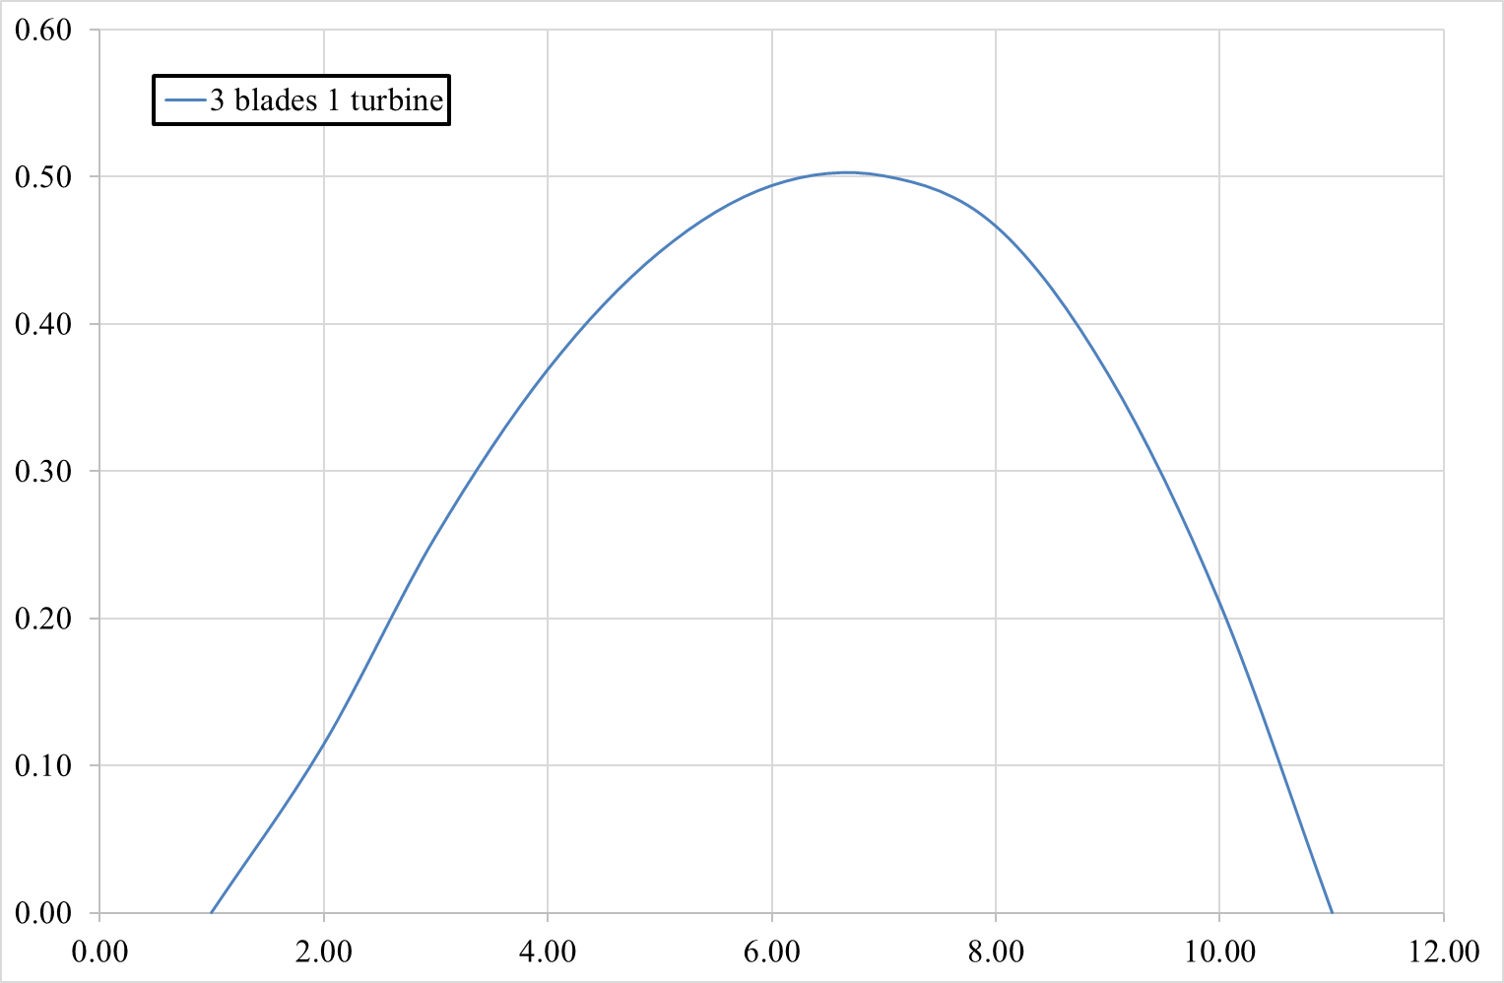
Results & Analysis. Power Coefficient for velocity inlet
Figure 26. Power coefficient

Slide 31
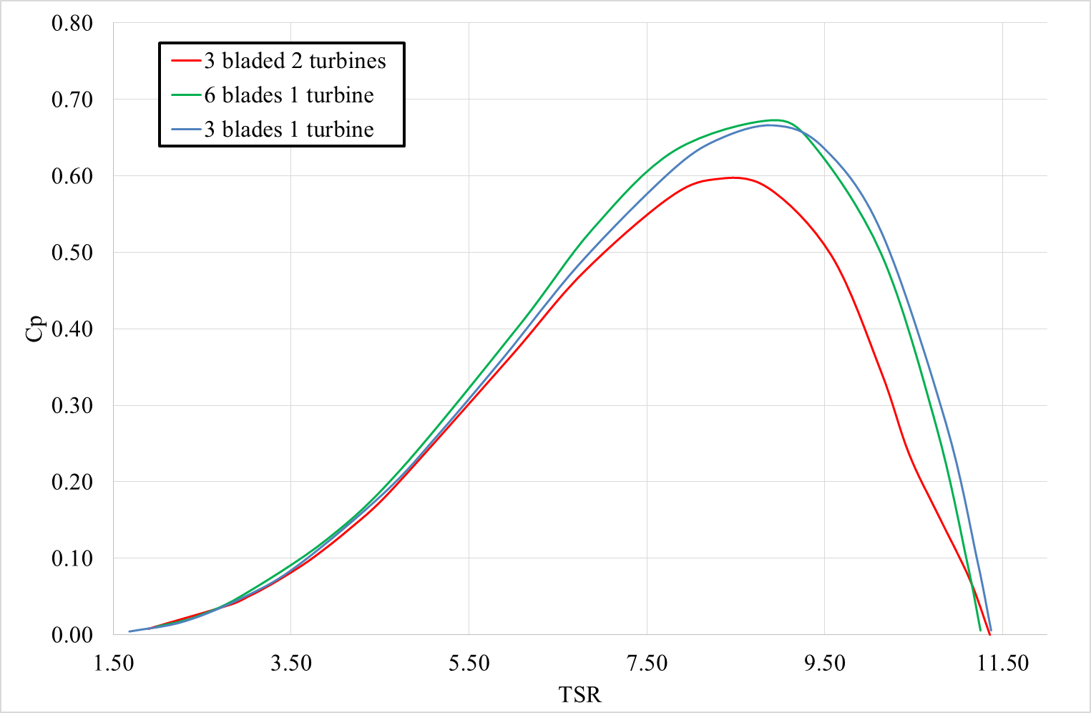
Results & Analysis. Power Coefficient
Figure 26. Power coefficient of each cases

Slide 32
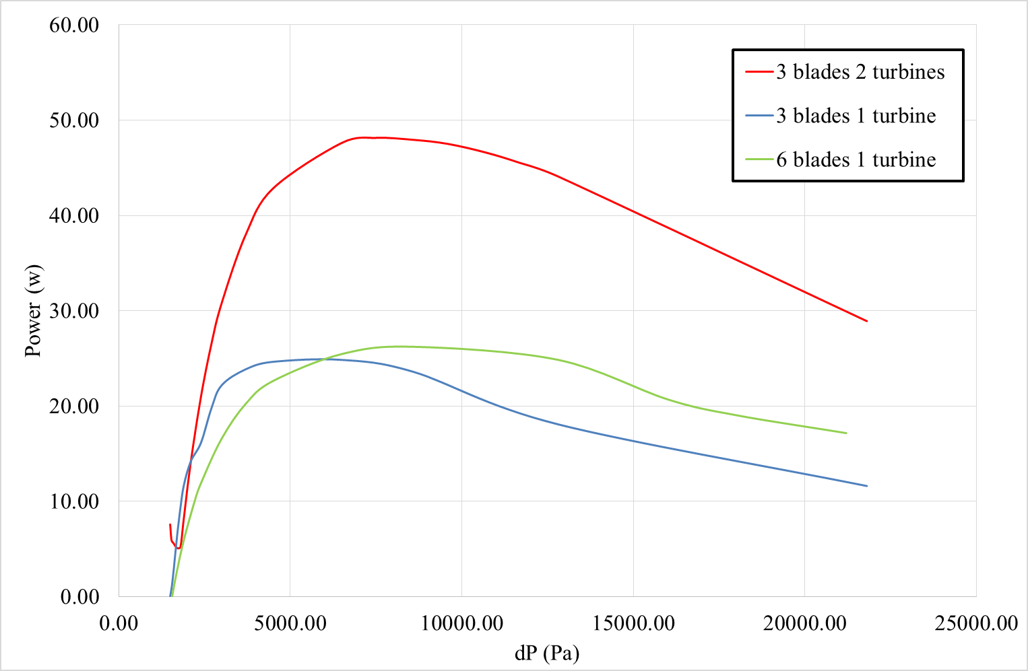
Results & Analysis. Generated Power
Figure 27. Generated Power

Slide 33
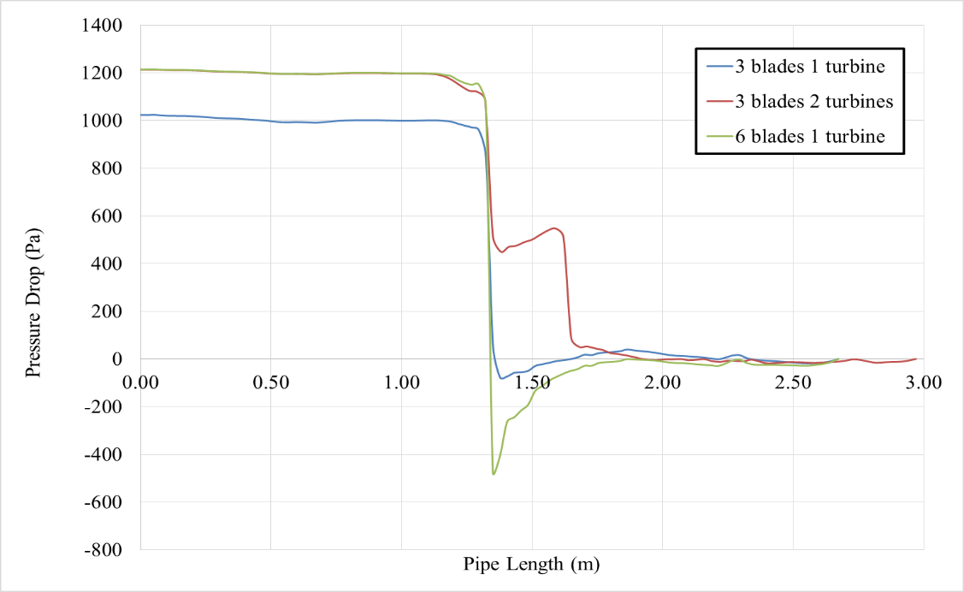
Results & Analysis. Pressure Drop
Figure 28. Pressure Drop

Slide 34
Conclusions
6 bladed single turbine demonstrated the highest efficiency indicating the increase in blades number positively affect turbines’ efficiency
3 bladed 2 turbines demonstrated lowest operating efficiency, yet introduction of 2nd turbine lead to significant increase
Series connection of hydro turbines decrease overall pressure loads on the system approximately by 40% for the front turbine, increasing its lifespan and reducing fatigue, and cavitation
Future Work
Future work involving experimental setup, and CFD with sliding mesh is recommended

Slide 35
References
Kort, L., 1940. Elektrisch angertriebene schiffsschraube, German Patent : DE688114.
Pierro, J. J., 1973. Gearless drive method and means. United States patent, US3708251.
Edwards, I. J., 1988. Electric motor rotor comprising a propeller, British Patent, GB2200802.
Taylor, O. S., Repp, J. R., & Brown, D. W. (1989). U.S. Patent No. 4,831,297. Washington, DC: U.S. Patent and Trademark Office.
Epps, B. (2017). On the rotor lifting line wake model. Journal of Ship Production and Design, 33(01), 31-45.
Djebarri, S., Charpentier, J. F., Scuiller, F., Benbouzid, M., & Guemard, S. (2012, May). Rough design of a double-stator axial flux permanent magnet generator for a rim-driven marine current turbine. In 2012 IEEE International Symposium on Industrial Electronics (pp. 1450-1455). IEEE.
Djebarri, S., Charpentier, J. F., Scuiller, F., & Benbouzid, M. (2015). Design and performance analysis of double stator axial flux PM generator for rim driven marine current turbines. IEEE Journal of Oceanic Engineering, 41(1), 50-66.
Jiang, H., Ouyang, W., Sheng, C., Lan, J., & Bucknall, R. (2022). Numerical investigation on hydrodynamic performance of a novel shaftless rim-driven counter-rotating thruster considering gap fluid. Applied Ocean Research, 118, 102967. .

Slide 36
References
Abbas, A. I., Amano, R. S., Saravani, M. S., Qandil, M. D., & Sakamoto, T. (2019). Optimization of Kaplan hydroturbine at very low head with rim-driven generator. Journal of Energy Resources Technology, 141(11).
Zhu, D., Xiao, R., & Liu, W. (2021). Influence of leading-edge cavitation on impeller blade axial force in the pump mode of reversible pump-turbine. Renewable Energy, 163, 939-949.
Borthwick, A. G. (2016). Marine renewable energy seascape. Engineering, 2(1), 69-78. https://doi.org/10.1016/J.ENG.2016.01.011
Amromin, E. (2014). Design approach for cavitation tolerant hydrofoils and blades. Journal Of Fluids And Structures, 45, 96-106. https://doi.org/10.1016/j.jfluidstructs.2013.11.014
Rim-driven thruster (n.d.). Retrieved from https://wikijp.org/wiki/Rim-driven_thruster
Song, K., & Kang, Y. (2022). A Numerical Performance Analysis of a Rim-Driven Turbine in Real Flow Conditions. Journal of Marine Science and Engineering, 10(9), 1185.
Liu, B., & Vanierschot, M. (2021). Numerical study of the hydrodynamic characteristics comparison between a ducted propeller and a rim-driven thruster. Applied Sciences, 11(11), 4919.
Are rim-driven propulsors the future? (2017, August). Retrieved from https://www.rina.org.uk/Are_rim-driven_propulsors_the_future.html

Slide 37
References
Chen, H., Tang, T., Aït-Ahmed, N., Benbouzid, M. E. H., Machmoum, M., & Zaïm, M. E. H. (2018). Attraction, challenge and current status of marine current energy. IEEE Access, 6, 12665-12685. doi: 10.1109/ACCESS.2018.2795708.
Hochhaus K. H. (2010). Rim-driven thruster. In Wikipedia. https://en.wikipedia.org/wiki/Rim-driven_thruster
Hannah Ritchie, Max Roser and Pablo Rosado (2022) - "Energy". Published online at OurWorldInData.org. Retrieved from: 'https://ourworldindata.org/energy' [Online Resource]
Patella, R. F., Choffat, T., Reboud, J. L., & Archer, A. (2013). Mass loss simulation in cavitation erosion: Fatigue criterion approach. Wear, 300(1-2), 205-215.
Escaler, X., Egusquiza, E., Farhat, M., Avellan, F., & Coussirat, M. (2006). Detection of cavitation in hydraulic turbines. Mechanical systems and signal processing, 20(4), 983-1007.
Schechtl, T., Hötzl, S., Rutschmann, P., & Knapp, W. (2017). Development of a Low Head Tidal Turbine. Part 2: Test Rig and Model Turbine Design. In EWTEC 2017. Proceedings of the 12th European Wave and Tidal Energy Conference (pp. 687-1).
Mineshima, T., Onishi, K., & Miyagawa, K. (2019, March). Flow field and cavitation characteristics of hydrofoils coated with hydrophilic and hydrophobic polymers. In IOP Conference Series: Earth and Environmental Science (Vol. 240, No. 6, p. 062055). IOP Publishing.
Fialová, S., Pochyly, F., KOtek, M., & Jasikova, D. (2016). A Study of the Impact of Surface Hydrophobia on Hydraulic Loses and Velocity Profiles. In 19th International Seminar on Hydropower Plants.

Slide 38
Thank you for your attention!

