Slide 1
Support for Research
Library Resources and Services
Katie Spires and Madina Kairatbekkyzy
Nazarbayev University, April 22, 2016

Slide 2
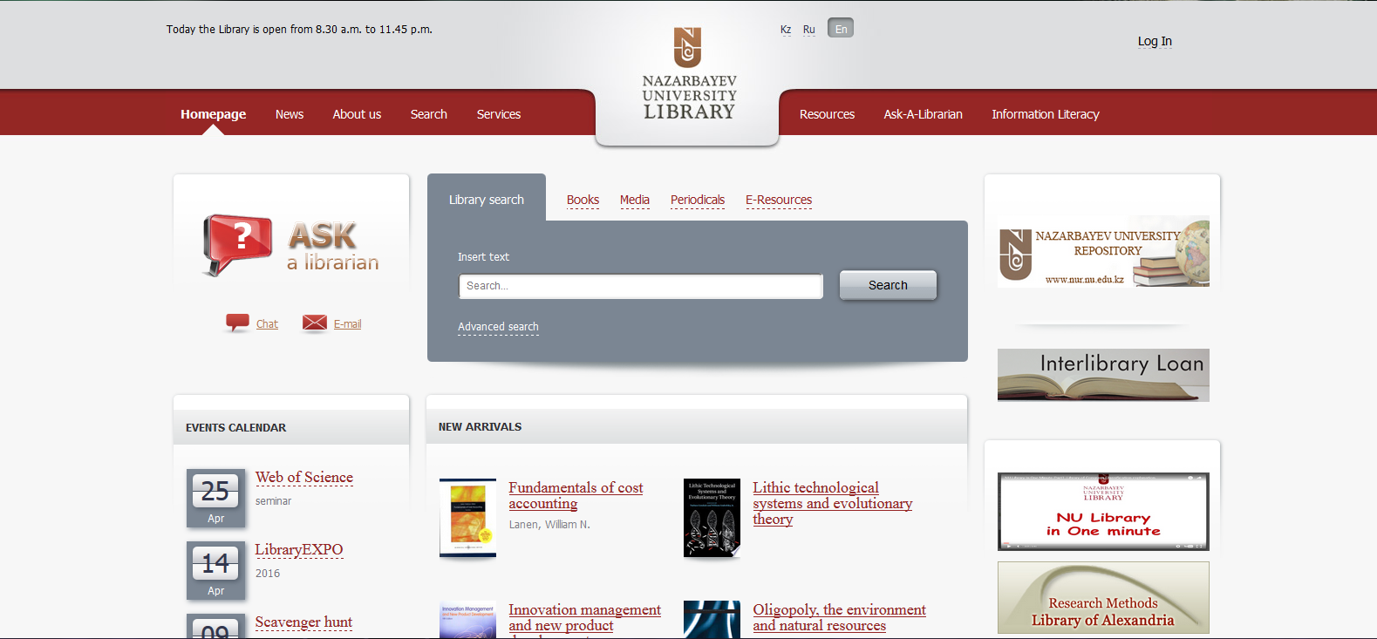
Welcome

Slide 3
The Library and Research
Books
Periodicals
Journals
Electronic resources
  Books
  Journals and articles
  Tools
Librarians!

Slide 4

Forming a Research Question
Thomson Reuters and Scopus
  Seminal Works
Credo Reference
  Wider net

Slide 5
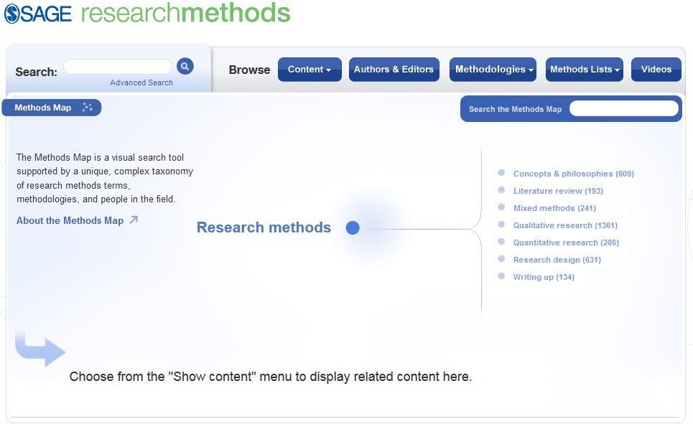
Planning Research
SAGE Research Methods
  Methodologies
  Research process
SciVal Funding
  Grants

Slide 6
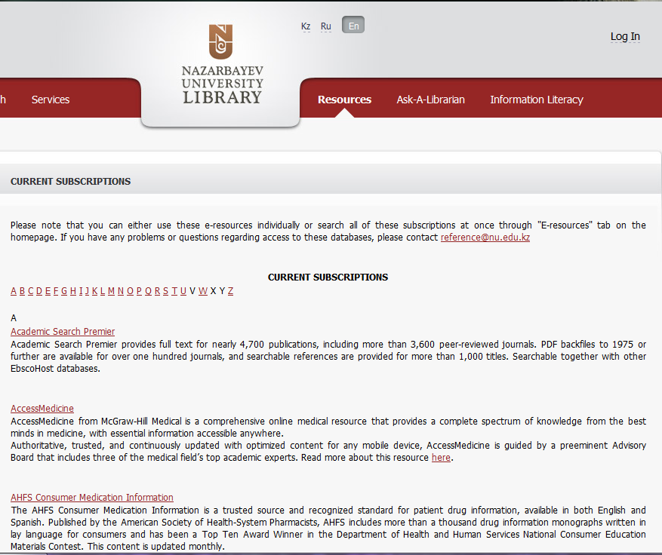
Active Research
Library catalog for print collection
Over 50 databases and thousands of e-books
  Alphabetical list of databases on portal
EBSCO Discovery Service (EDS)
  A-Z list of journals
  Search all e-resources at once
InterLibrary Loan (ILL)

Slide 7


Publishing
Scopus and Web of Science
  Legitimacy
  Impact measurement
Journal information pages
  Scope
  Requirements

Slide 8
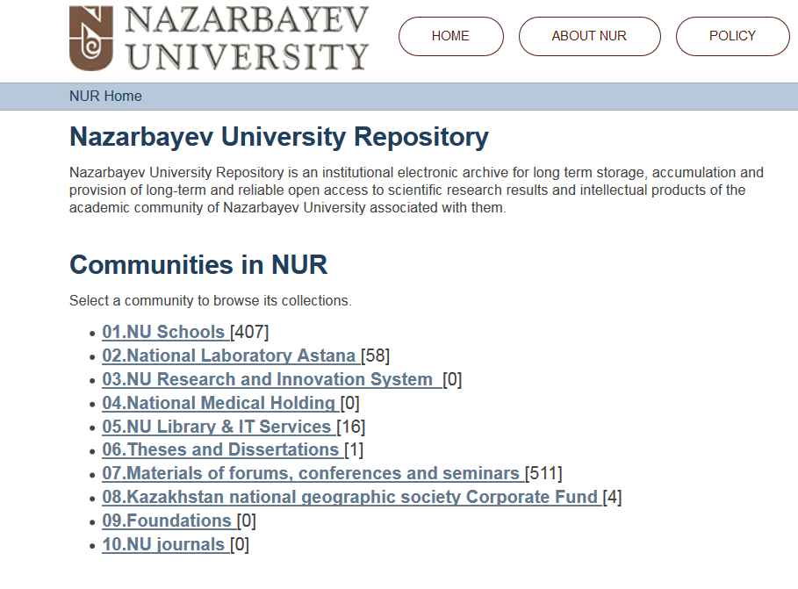
Impact and Reputation
Researcher ID/Orcid
  Accurate Publication Record
  H-index
NU Repository
  Open Access
  Stable URL

Slide 9



Reputation, Communication, and Academic Honesty
Sources must be cited
  Credit where credit is due
  Help reader follow your path
  Academic honesty
Tools help manage lists of sources and archive them

Slide 10

When You Need a Helping Hand
Librarians:
  Develop and curate the collection
  Offer classroom instruction and individual help in using and accessing resources
  Embedded Librarianship
  Are there to help you through the entire research process.

Slide 11

Questions?

Slide 12
Thank you!
Рахмет!
Спасибо!

