Slide 1
Scholarly Publications in International Academia
Beyond the “Publish or Perish” Discourse
Speakers:
Daniel Hernández Torrano, Narabayev University Graduate School of Education
Margaret Khaterine Spires, Nazarbayev University Library

Slide 2
Reasons to publish
Formal requirements (i.e., required for some doctorate programs)
CV enhancement
Experience and career development
Personal satisfaction and motivation

Slide 3

Research and Writing Process
Research
  Print resources
    Books, periodicals
  Electronic resources
    Books, articles, journals, databases, LibGuides
Writing
  Citation management tools
  Style Guides

Slide 4
Personal characteristics that foster productivity
Curious and passionate
Persistence, discipline, and hard work
Healthy perfectionism VS neurotic perfectionism

Slide 5
Collaboration, mentoring, and building relationships
Collaborate with your research mentor/advisor
Surround yourself with talented, productive people
Present at conferences, attend presentations, and networking
Do not collaborate just with anybody

Slide 6
Strategies to increase writing productivity and excellence
Writing is easier when time to write is both scheduled and protected
Writing, writing, writing
Writing in a practical way

Slide 7
Research and publication practices and strategies
Familiarize yourself with available and relevant journals
Know which journals are more appropriate for a particular paper
Read, read, and read to remain current in your area of interest
Focus on one or two areas that allow for a planned, progressive research agenda

Slide 8
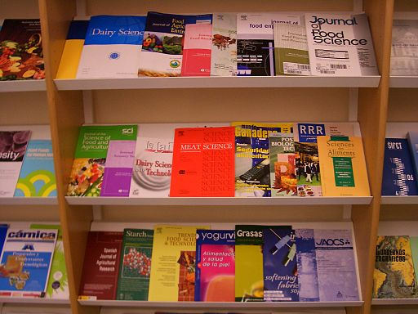
Choosing a Journal
Journal Citation Reports (Thomson Reuters)
  Impact Factor
Scopus
  SJR
  IPP
  SNIP
Journal profiles in databases

Slide 9
Navigating the peer-review process
Taking reviewer feedback seriously while avoiding defensiveness
Becoming a reviewer enhances one’s own quality
Revise and resubmit your work quickly

Slide 10

Peer Review
Reviewers look at
Content
Methodology
Presentation

Slide 11

The Results Are In
Accepted
  Yay!
Accepted Conditionally
  To Edit or Not to Edit
Rejected
  Edit and try elsewhere

Slide 12

One Last Check
Citation style
Layout
Other journal requirements

Slide 13
Just Remember…
Your publication, your decision
Research focus
Choice of journal
Accept required edits

Slide 14
Preparation during your doctoral studies
Take graduate coursework seriously
Collaborative relationship with your advisor and other students
Trial and error

