Slide 1

Status of Open Access, Digitization Initiatives, and Institutional Repositories in the Philippines
Stephen B. Alayon
West Visayas State University, Philippines
stephen.alayon@wvsu.edu.ph
*formerly with Aquaculture Department, Southeast Asian Fisheries Development Center, Philippines

Slide 2
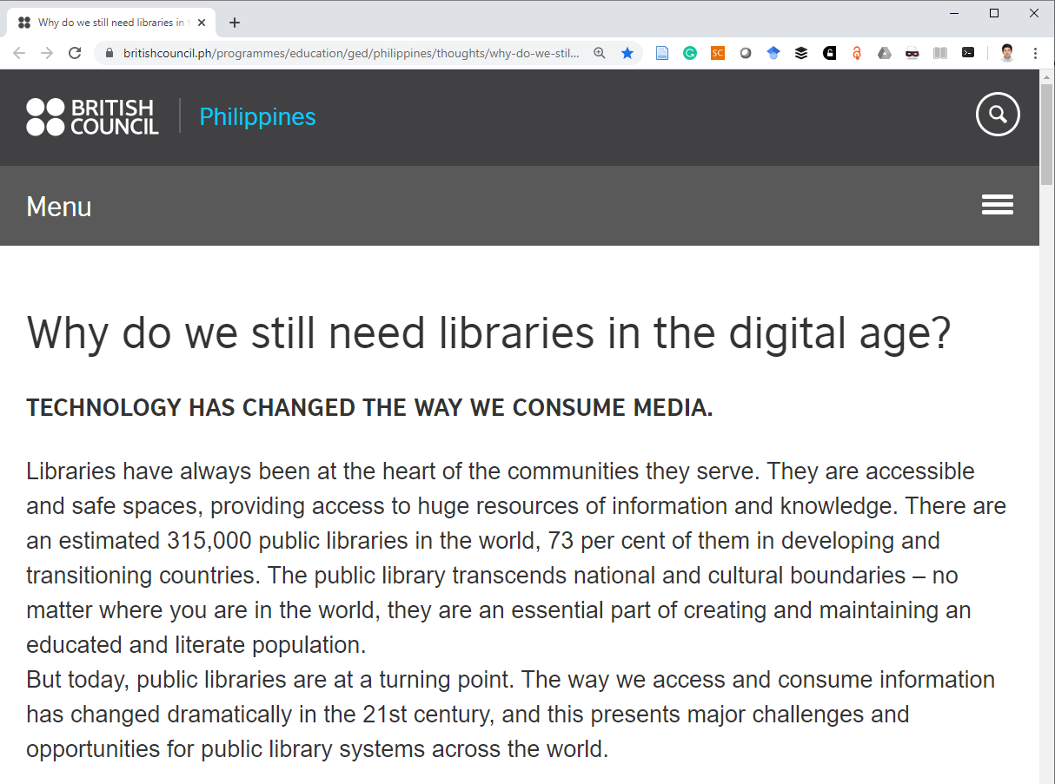

Slide 3
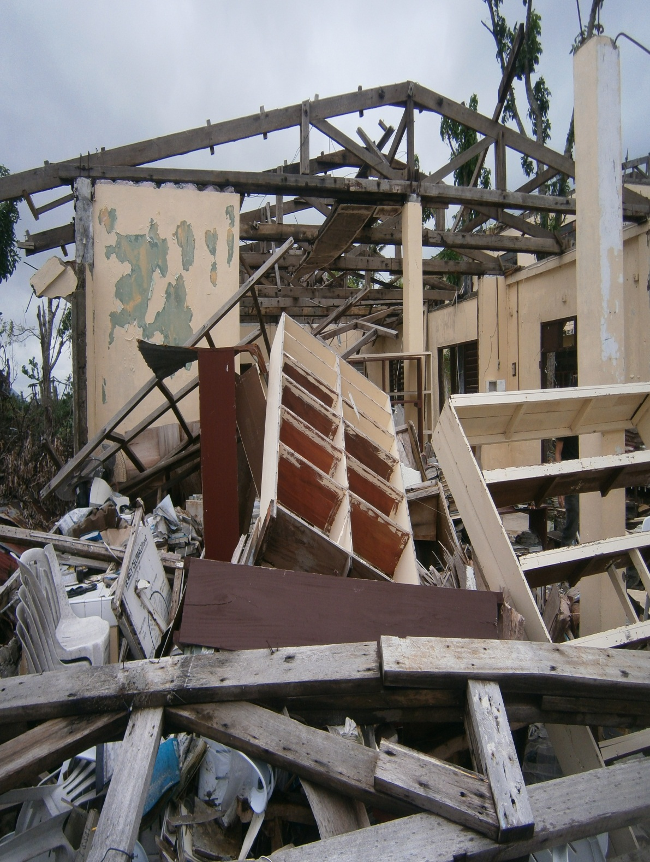
Devastation of Typhoon Haiyan to Libraries
EVSU Tanauan

Slide 4
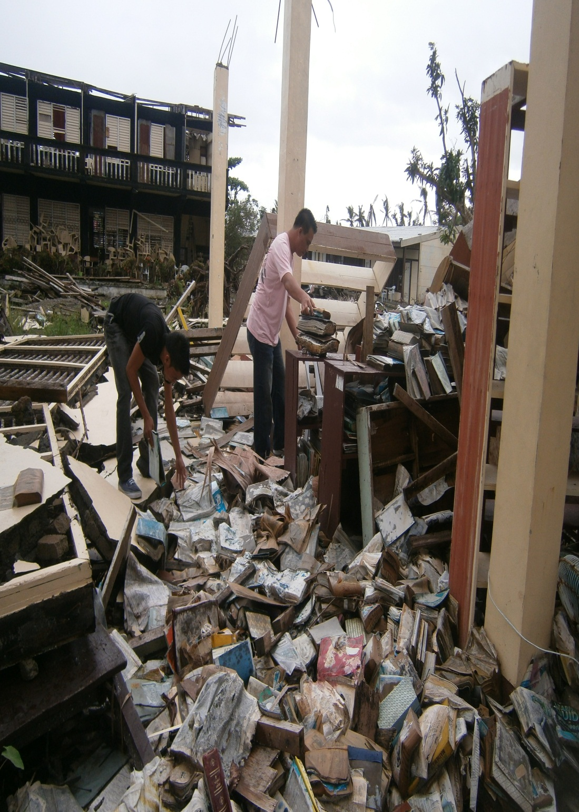

Slide 5
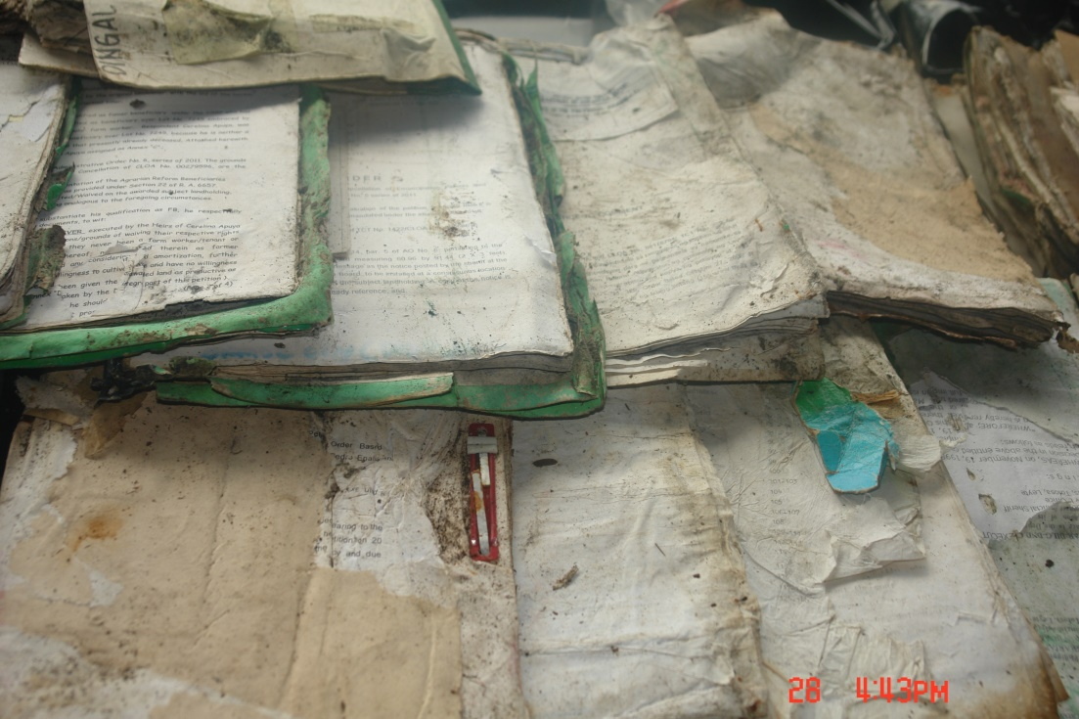
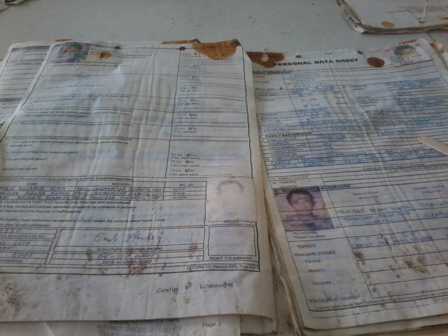
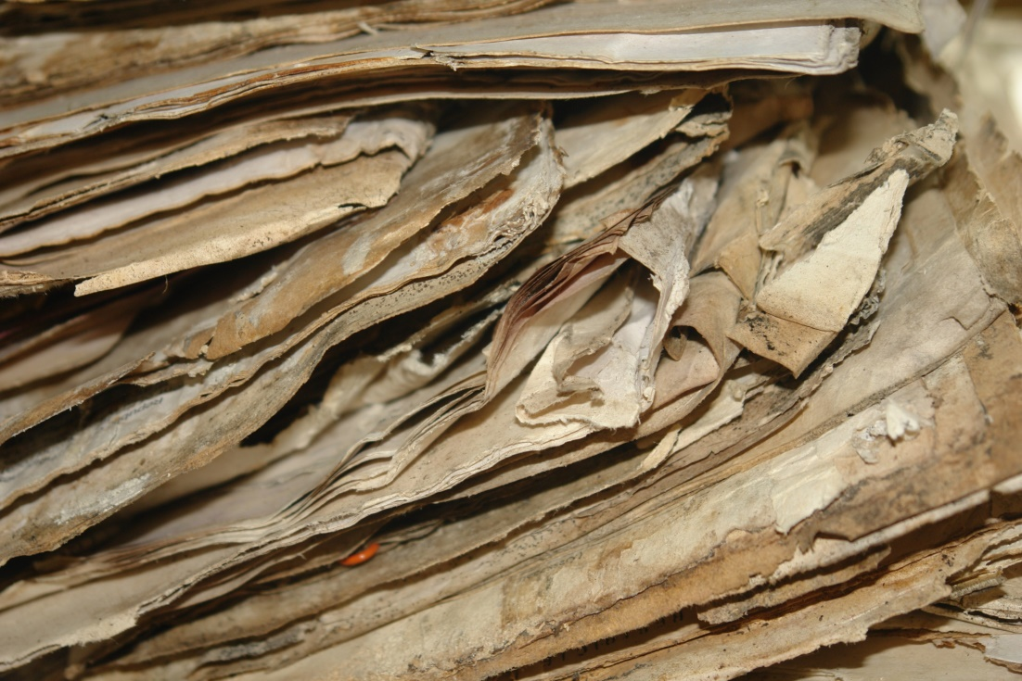
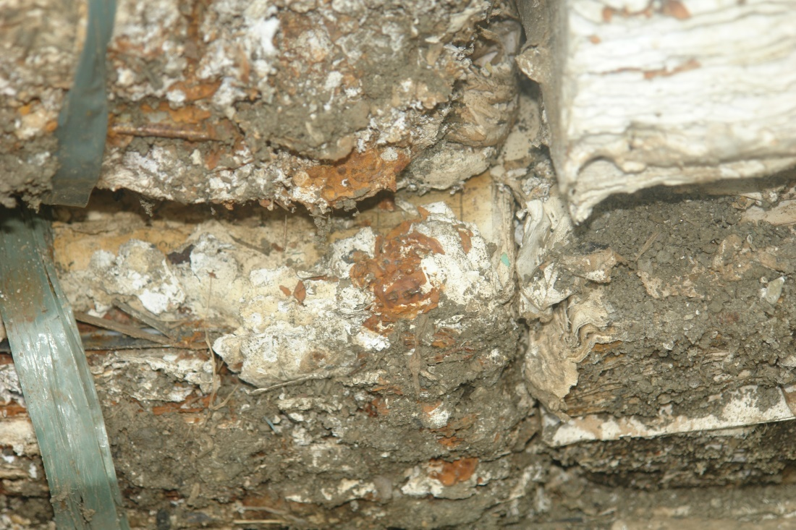
(a)
(c)
(b)
(d)
Examples of documents (a) to be recovered (b) enclosed in a folder (c) with ink blotting and (d) beyond recovery

Slide 6
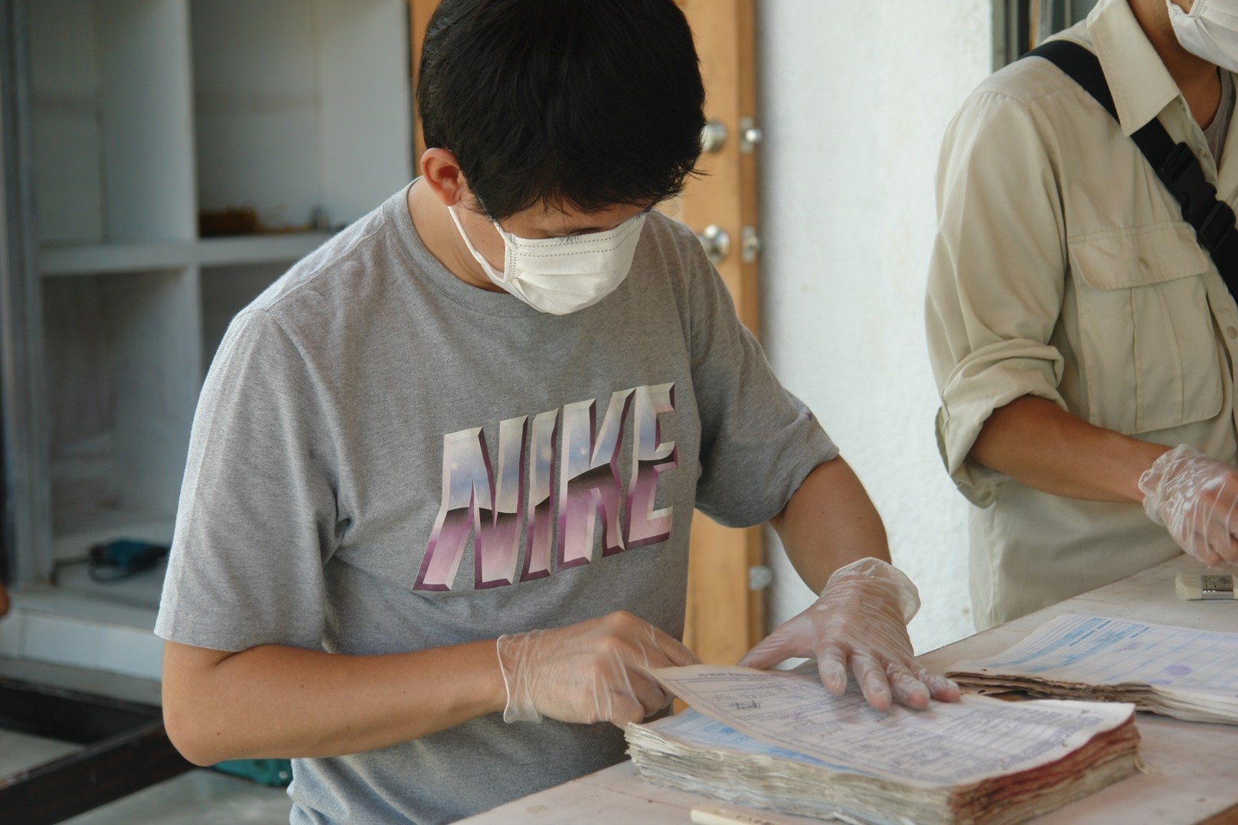

Slide 7
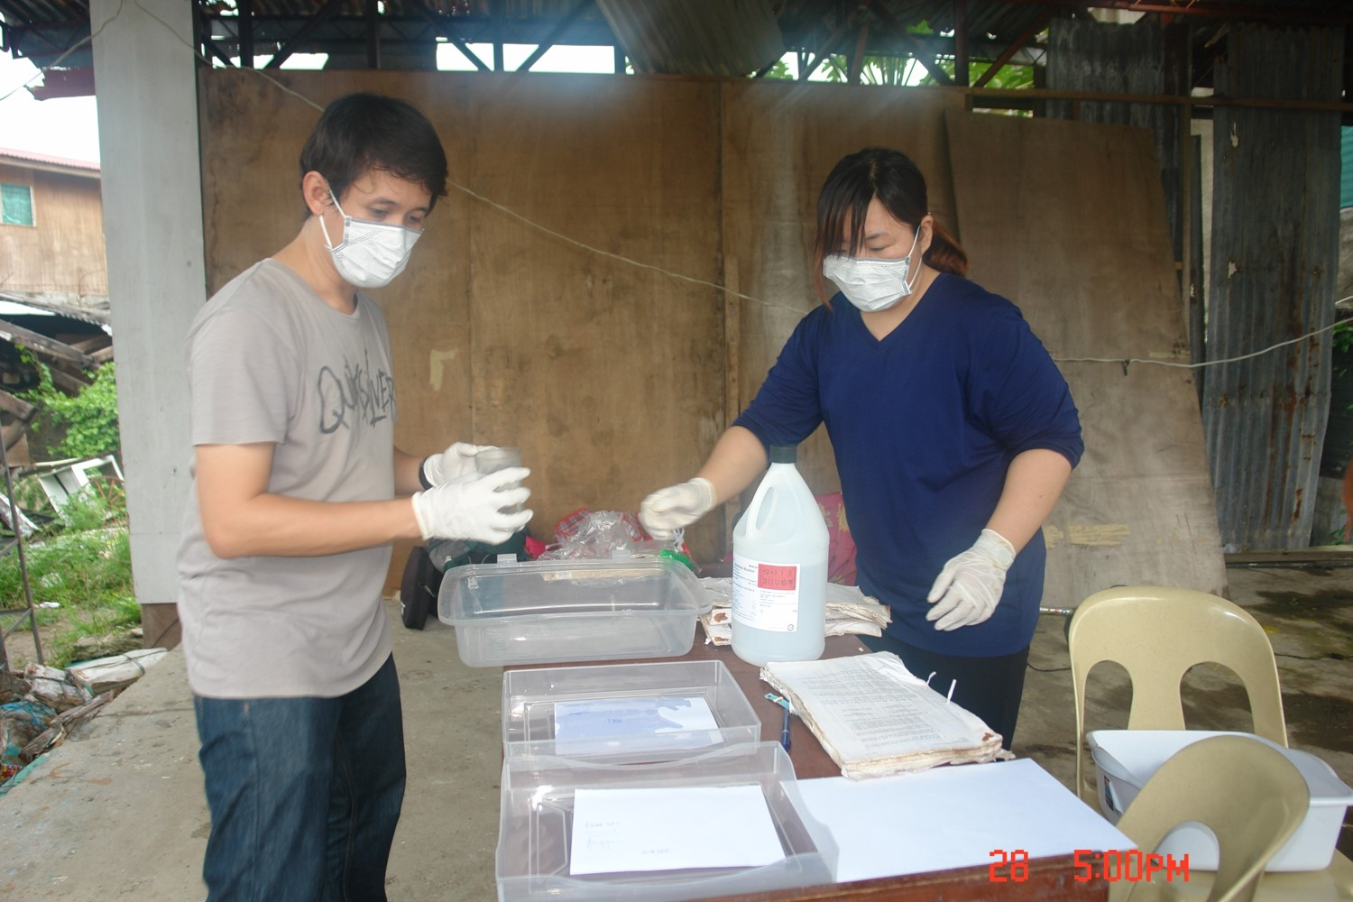

Slide 8
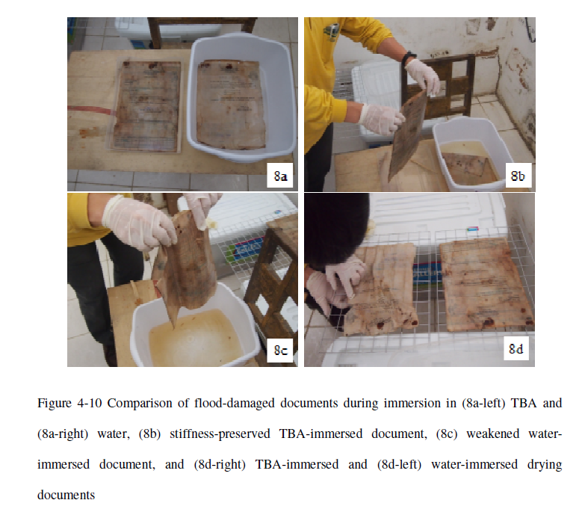
Bunyaphiphat, T, Dissertation

Slide 9
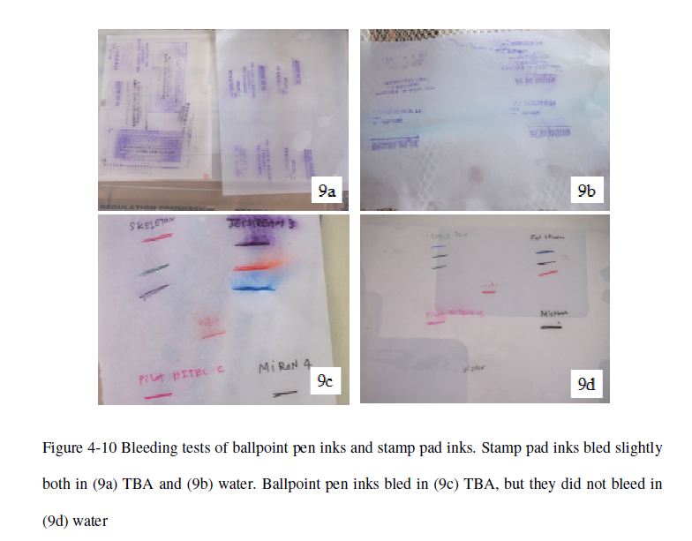
Bunyaphiphat, T, Dissertation

Slide 10
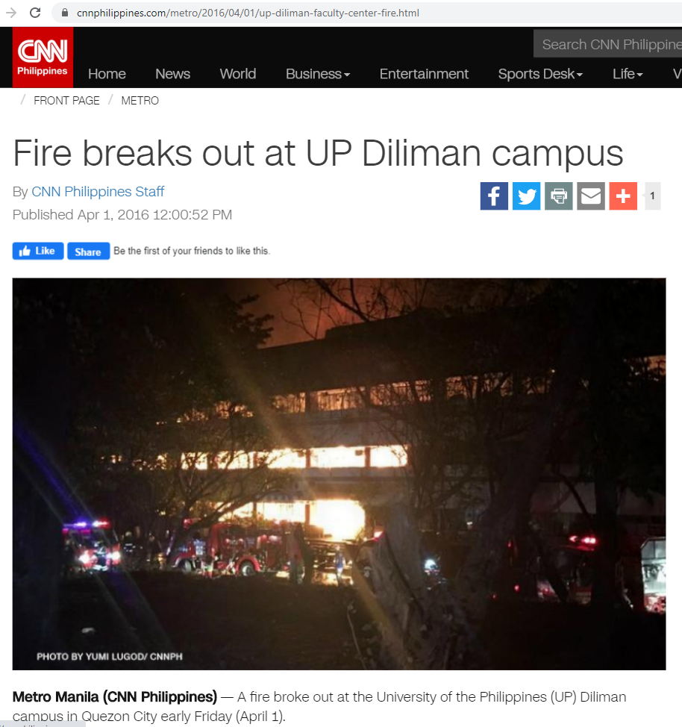

Slide 11
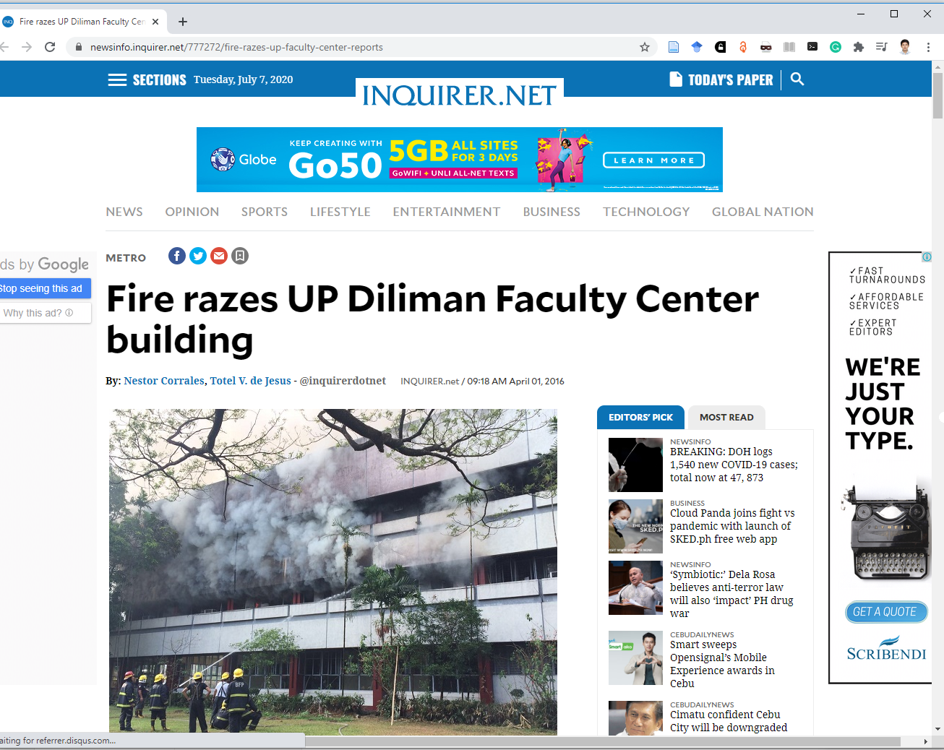
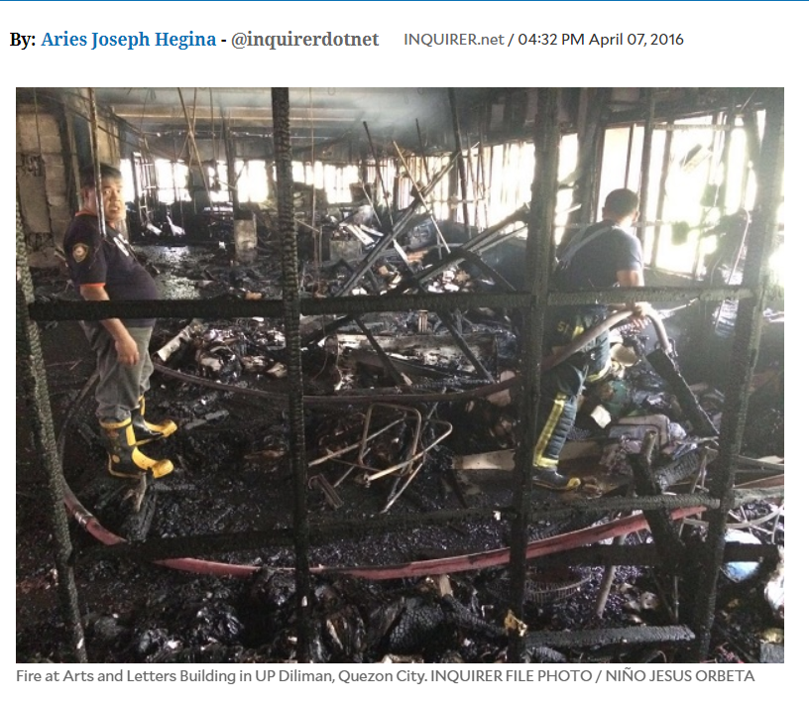

Slide 12
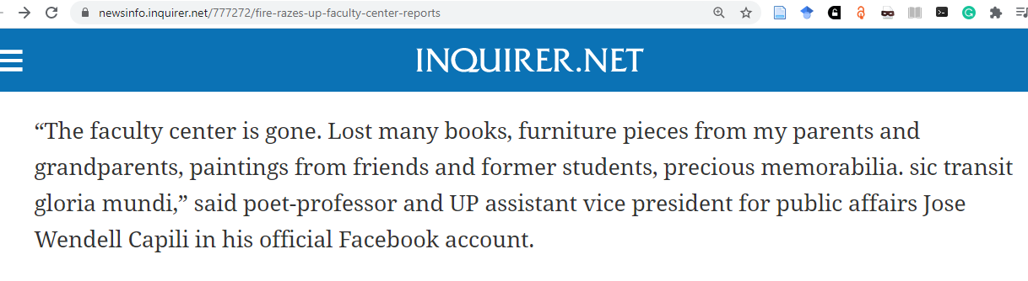
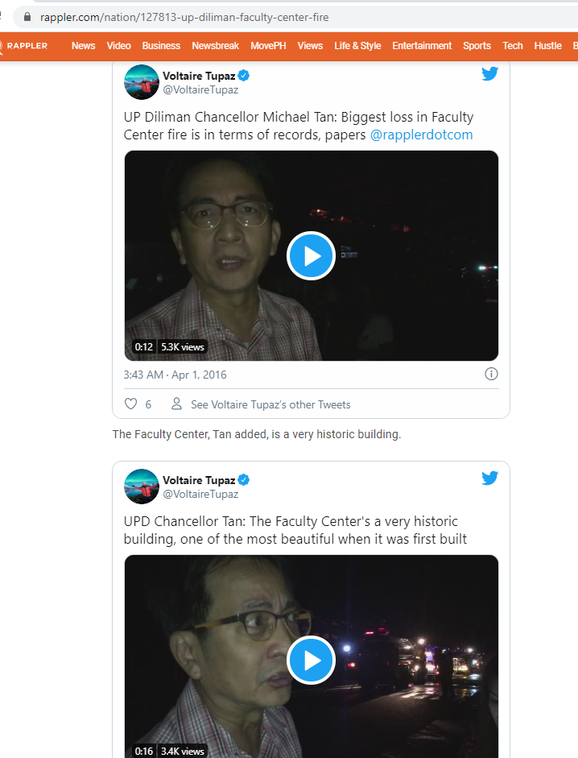
The Rizal Hall or Bulwagang Rizal houses
Department offices of the College of Arts and Letters (CAL)
Faculty rooms of the College of Social Sciences and Philosophy.
UP Creative Writing Center
Notes:
A fire razed the Faculty Center at the University of the Philippines Diliman building campus in Quezon City before dawn Friday. the fire hit the Rizal Hall or the Bulwagang Rizal around 1 a.m.

Slide 13
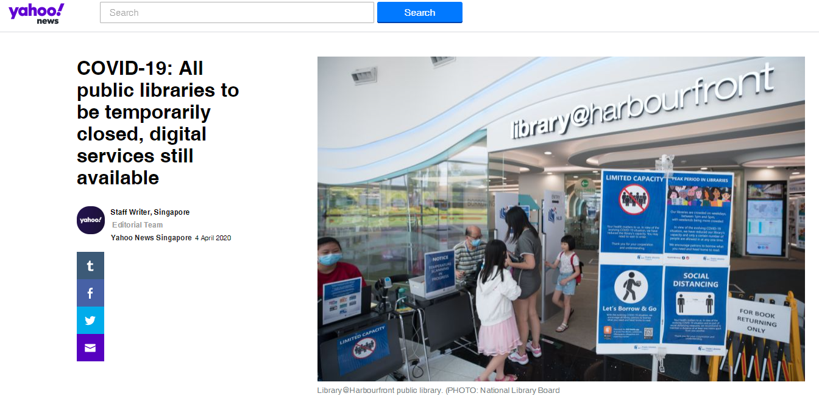
COVID-19 situation and demand for digital services

Slide 14
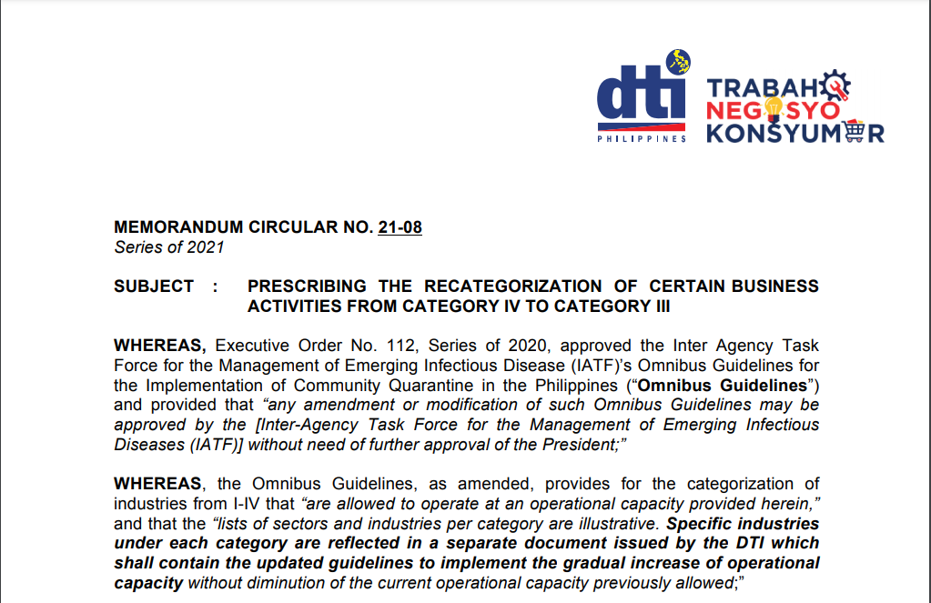
https://www.dti.gov.ph/?smd_process_download=1&download_id=49657

Slide 15
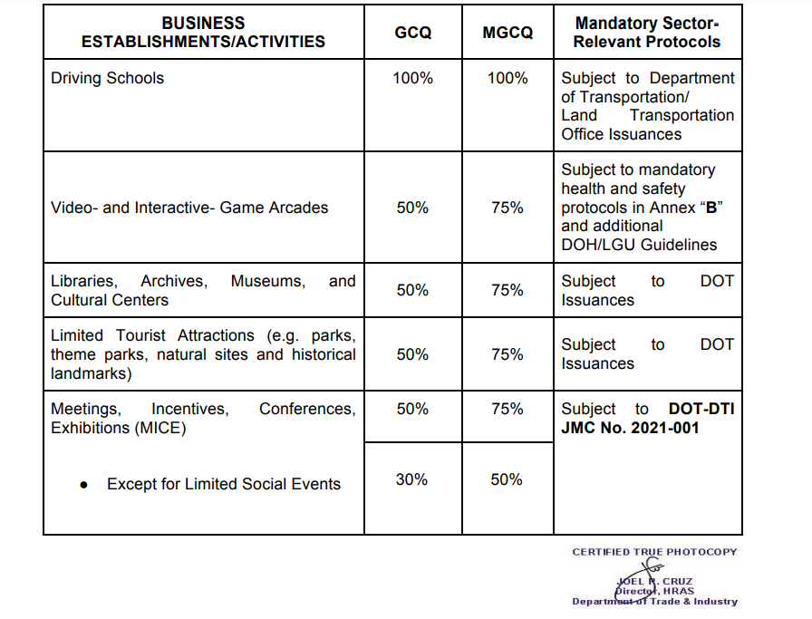
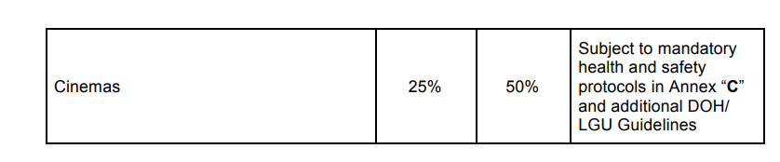

Slide 16
Digitization and Institutional Repository

Slide 17
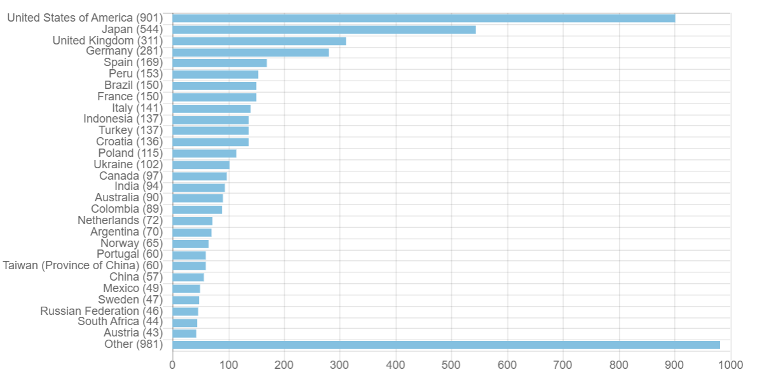
Repositories by Country (OpenDOAR) - 2018
https://v2.sherpa.ac.uk/view/repository_visualisations/1.html

Slide 18
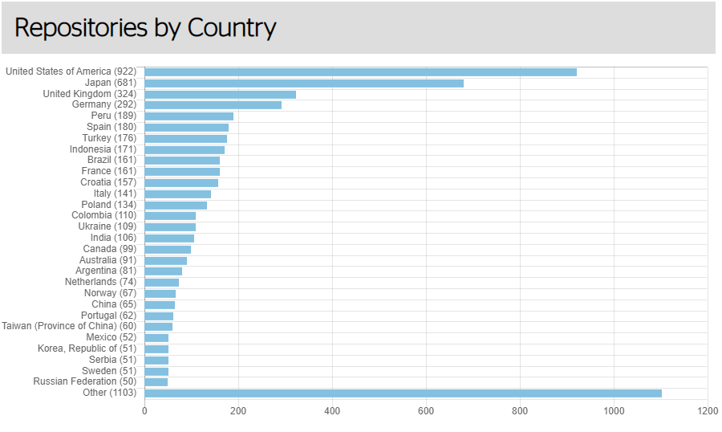
Repositories by Country (OpenDOAR) - as of Oct 2022
https://v2.sherpa.ac.uk/view/repository_visualisations/1.html

Slide 19
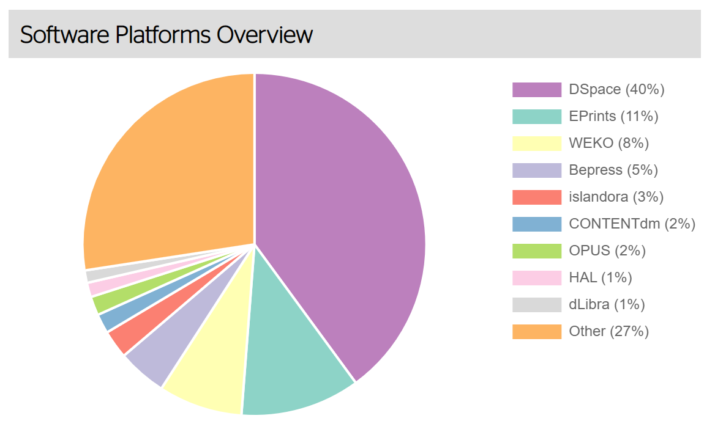
Software Platforms
(OpenDOAR) - World - 2018c

Slide 20
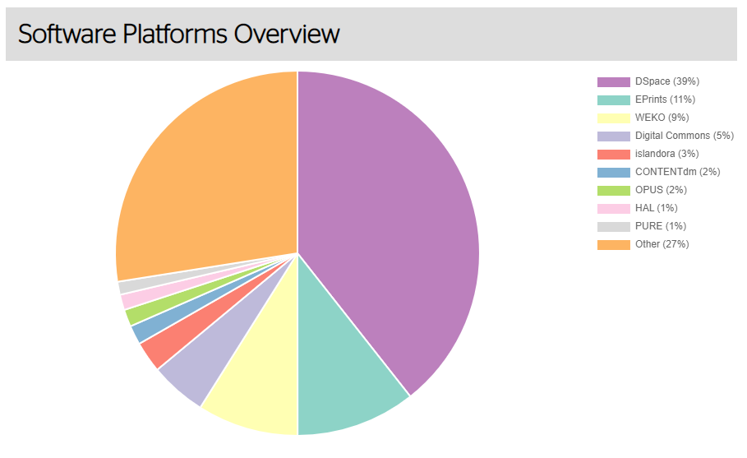
Software Platforms
(OpenDOAR) - World - 2022
https://v2.sherpa.ac.uk/view/repository_visualisations/1.html

Slide 21
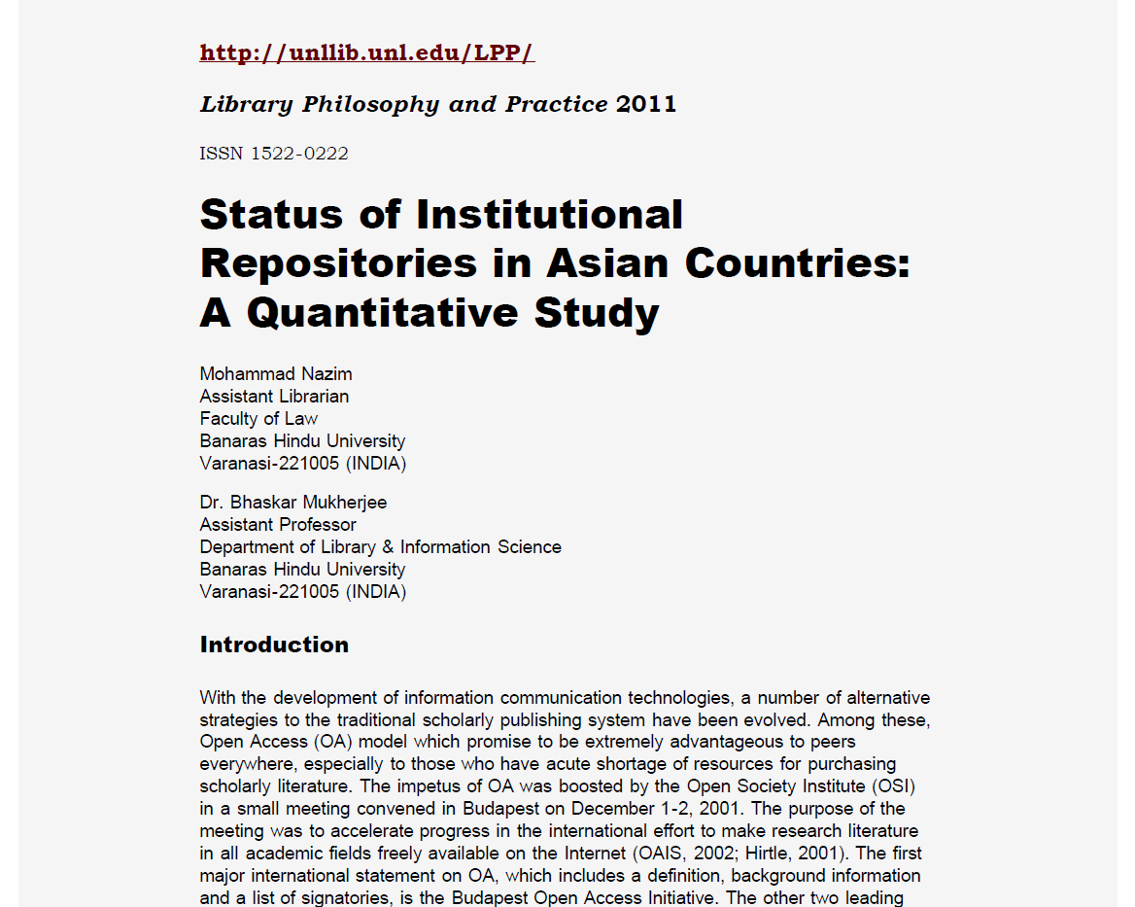

Slide 22
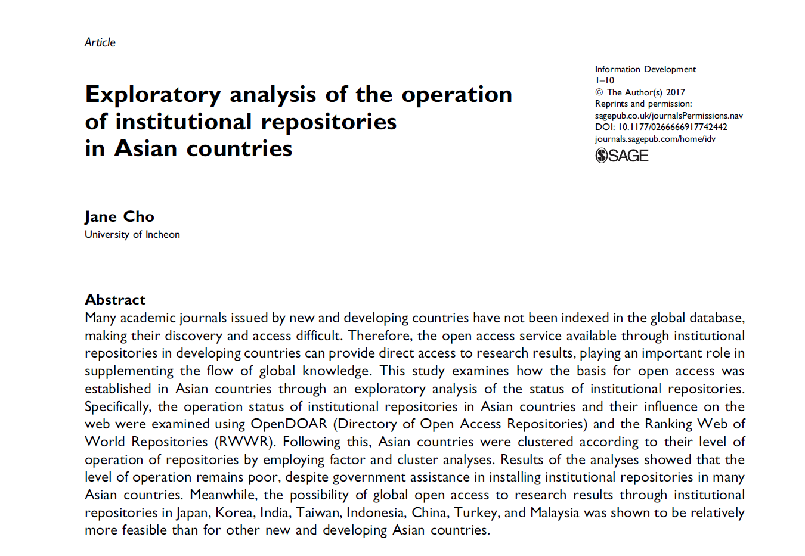

Slide 23
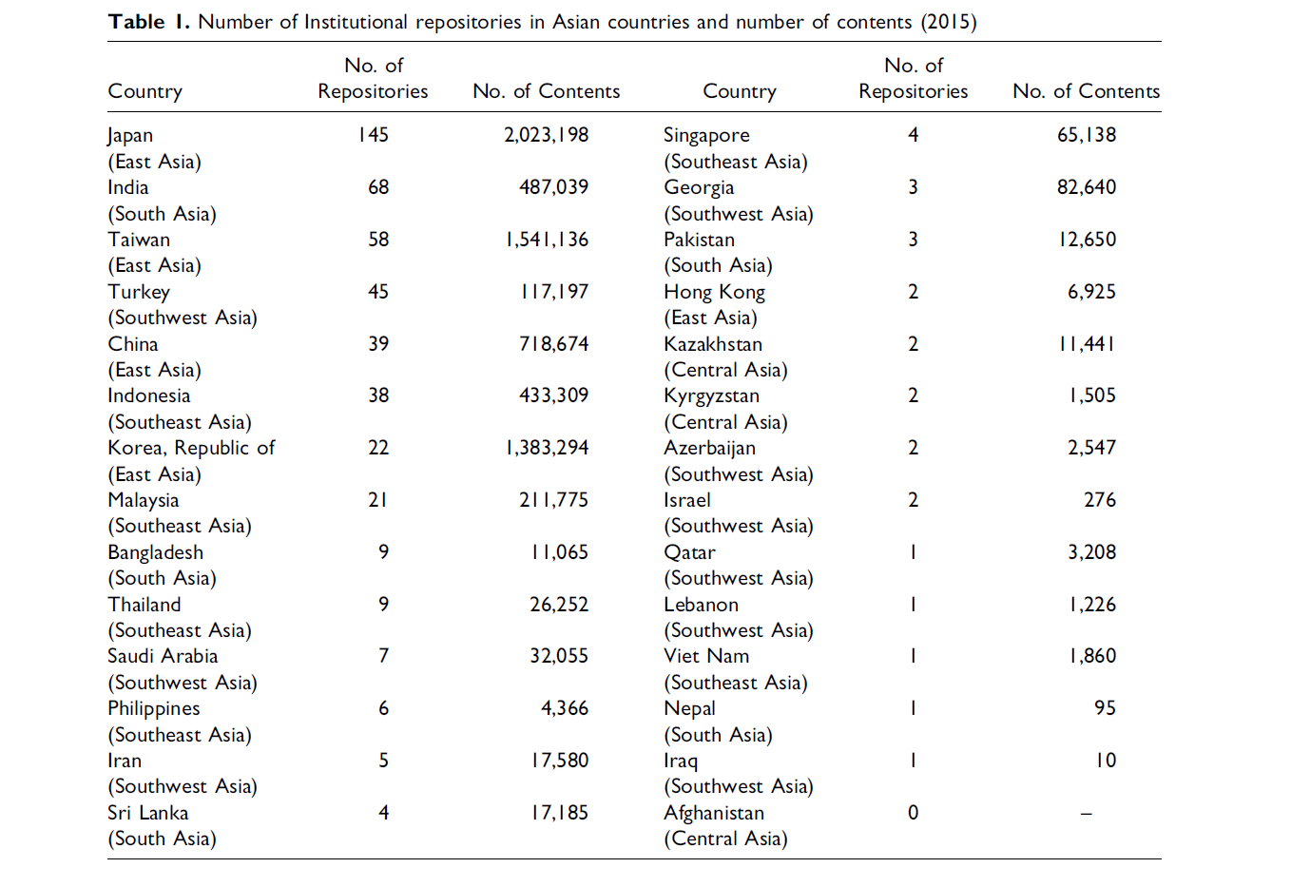
(Cho, 2017)

Slide 24
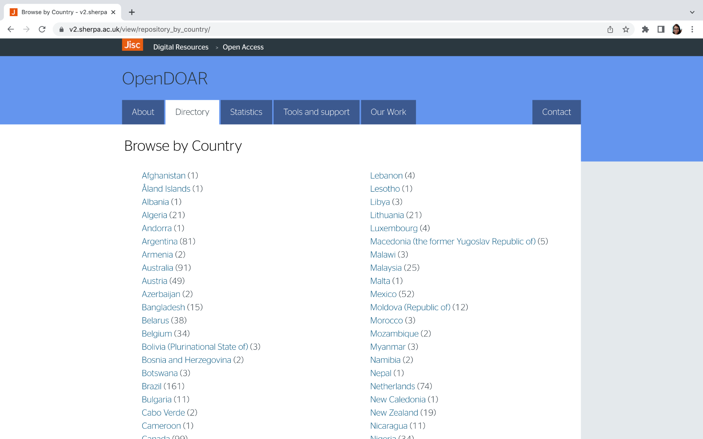

Slide 25
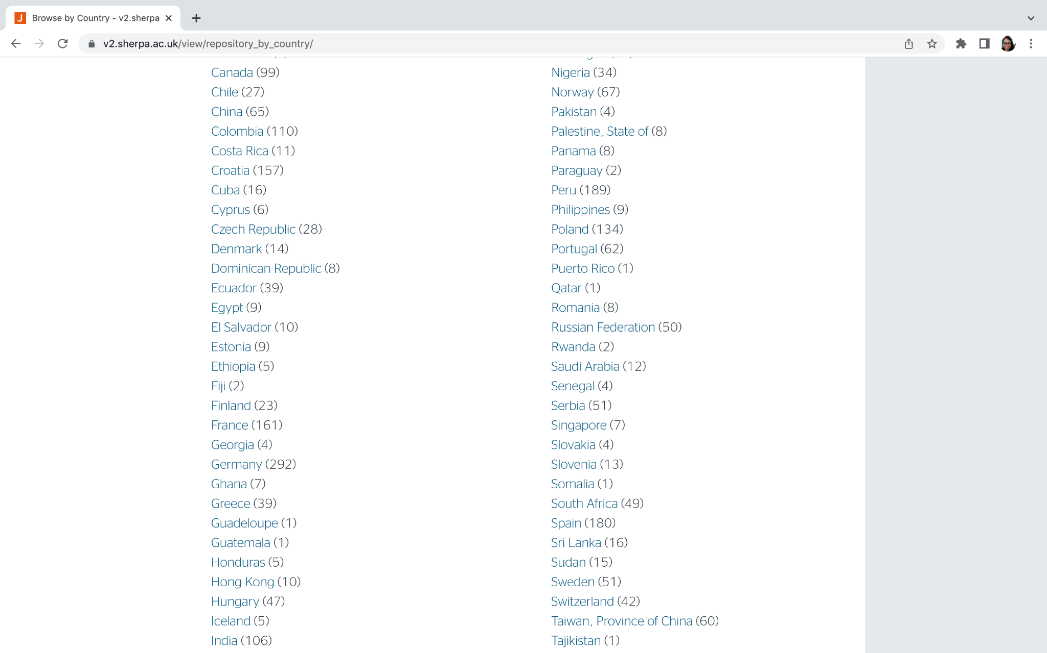

Slide 26
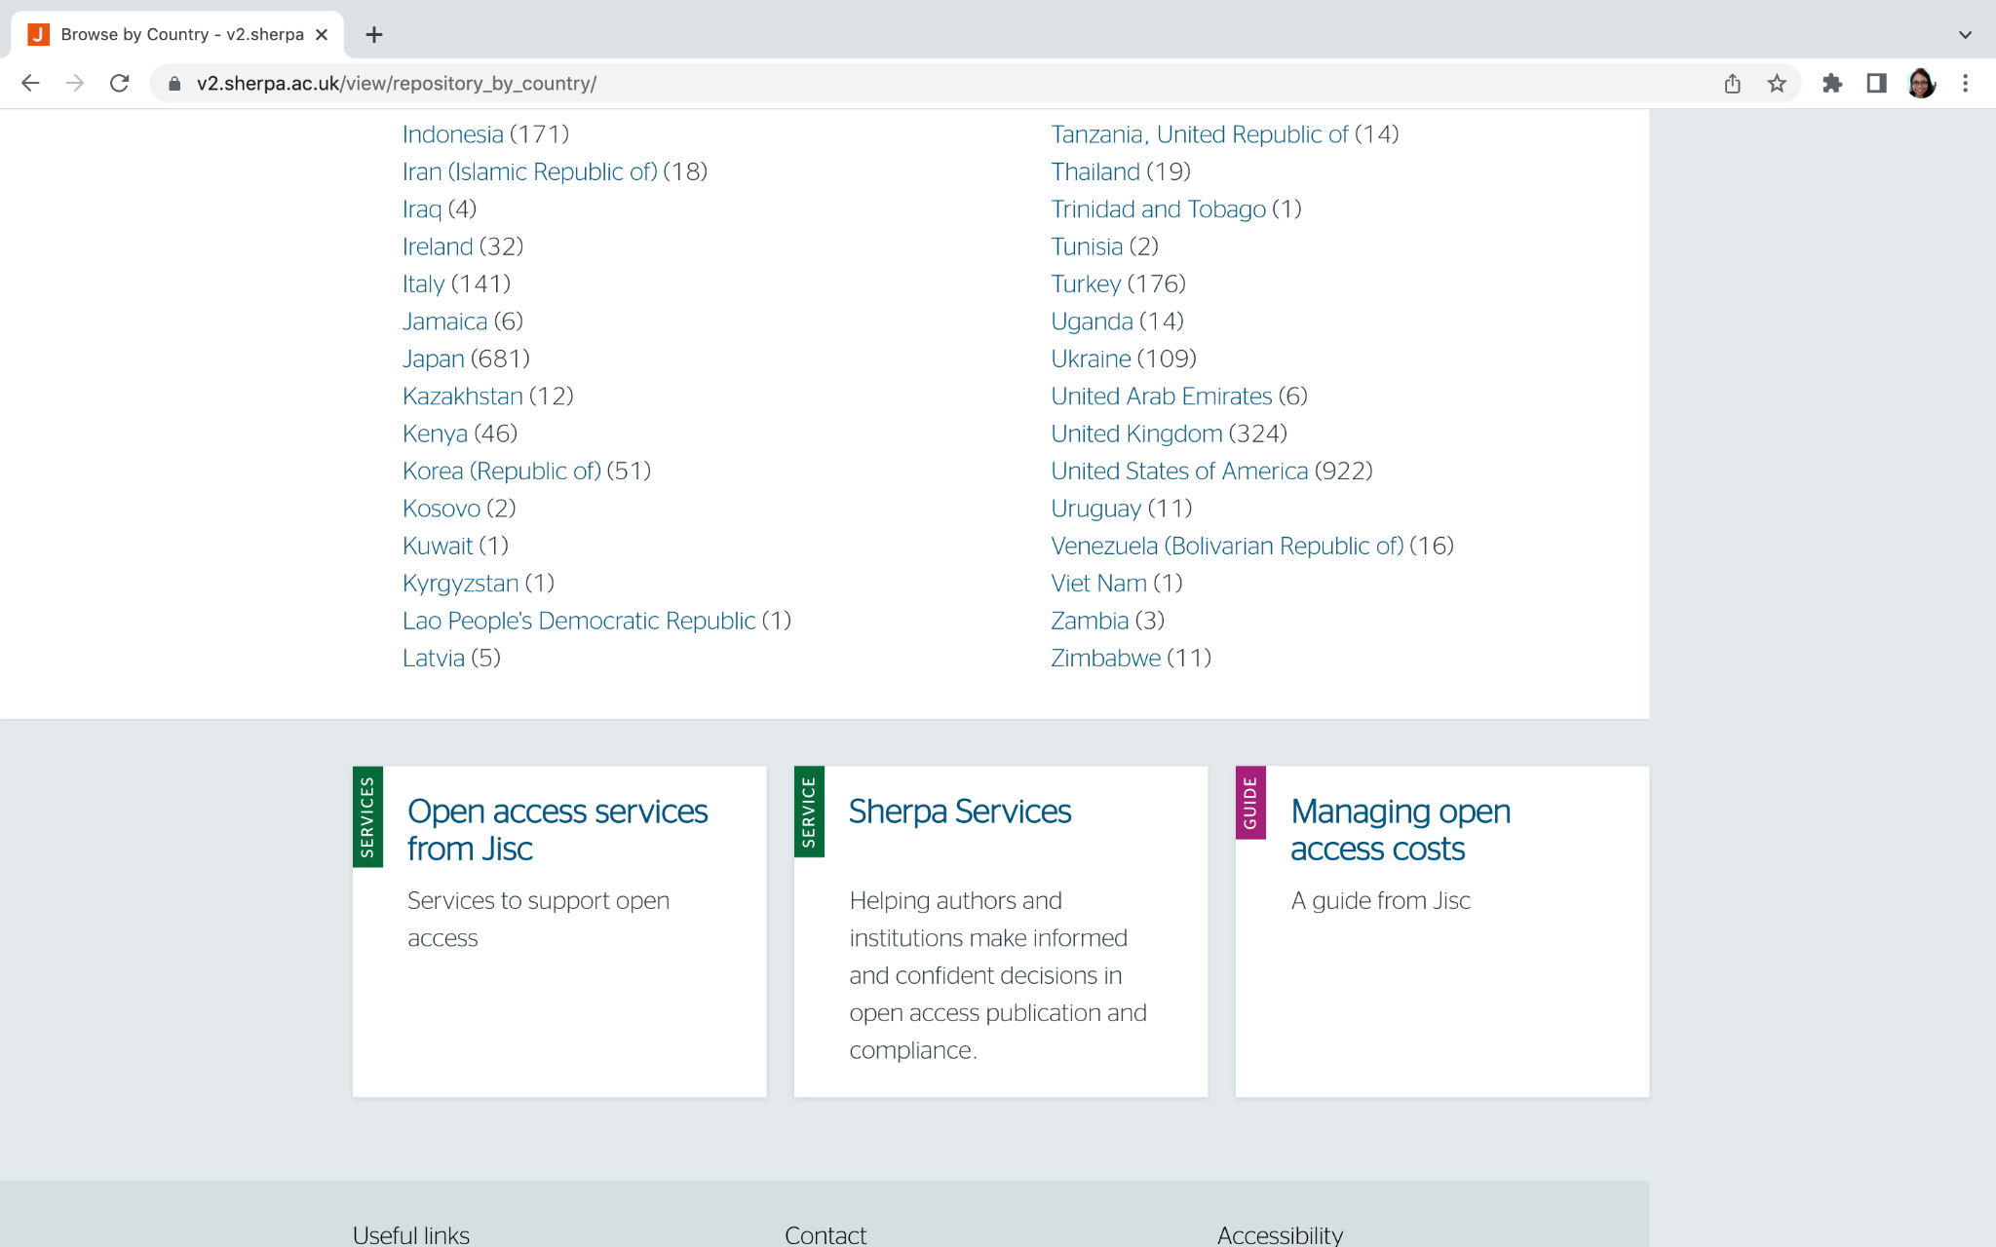

Slide 27
Number of Open Access IR and Software Used in Central Asian Countries (2022)
Country | No. of IR (Institutions) | Software Used
 |  | Eprints | DSpace | Greenstone | Digital Commons | Others / Not Specified
Kazakhstan | 12 (11) |  | 10 | 2 | - | -
Kyrgyzstan | 1 |  | 1 | - | - | -
Tajikistan | 1 |  | 1 | - | - | -
Turkmenistan | - |  | - | - | - | -
Uzbekistan | - |  | - | - | - | -
TOTAL | 14 | - | 12 | 2 | - | -
Source: (Jisc. v2.sherpa.ac.uk/opendoar OpenDOAR, n.d.) – as of October 2022
*Under development

Slide 28
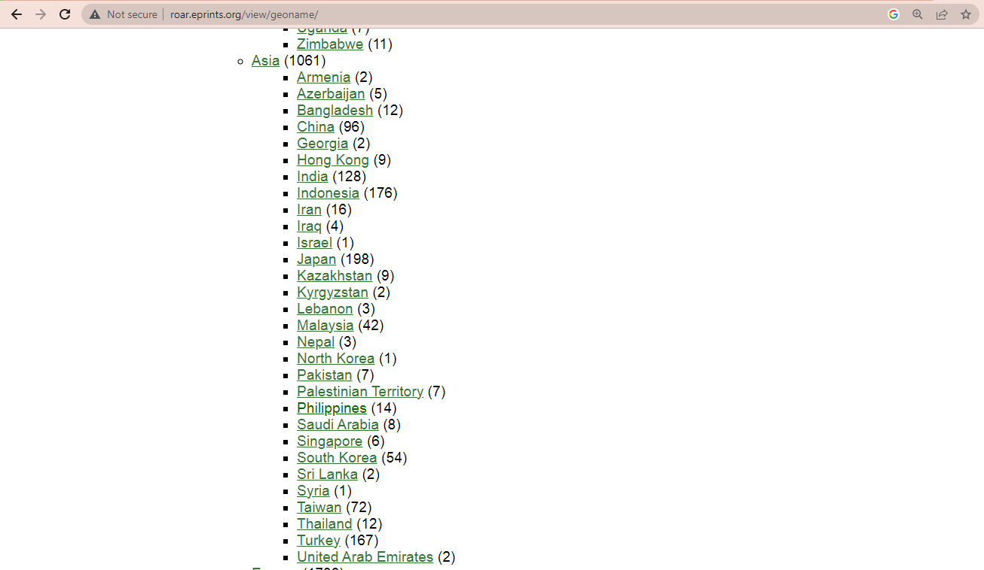
Registry of Open Access Repositories (ROAR)
http://roar.eprints.org/

Slide 29
Number of Open Access IR and Software Used in Southeast Asian countries (2022)
Country | No. of IR (Institutions) | Software Used
 |  | Eprints | DSpace | Greenstone | Digital Commons | Others / Not Specified
Brunei | - | - | - | - | - | -
Cambodia | - | - | - | - | - | -
Indonesia | 171(+) | 137 | 16 | - | 1 | 17^{a-l}
Lao PDR | 1 (1) | - | 1 | - | - | -
Malaysia | 25 (21) | 18 | 5 | 1 | - | 1^{l}
Myanmar | 3 (3) | - | 2 | - | - | -
Philippines | 9 (9) | - | 7 | 1 | 1* | -
Singapore | 7 (5) | - | 4 | - | 1 | 2^{m,n}
Thailand | 19 (19) | - | 17 | - | - | 2^{o,p}
Timor-Leste | - | - | - | - | - | -
Viet Nam | 1 (1) | - | 1 | - | - | -
TOTAL | 193 (+) | 125 | 44 | 2 | 2 | 20
| ªSLIMS Senayan | ^{b}SLIMS (2) | ^{c}Ispektra | ^{d}Django | ^{e}GAE | ^{f}Open Repository | ^{g}Neliti | ^{h}Bepress | ^{i}Omeka | ^{j}WEKO | ^{k}JSP-MySQL-Alfresc | ^{l}Unspecified | ^{m}Dataverse Network | ^{n}Figshare | ºIR+ | ^{p}Wordpress
Source: (Jisc. v2.sherpa.ac.uk/opendoar OpenDOAR, n.d.) – as of October 2022
*Under development

Slide 30
Philippine Government

Slide 31
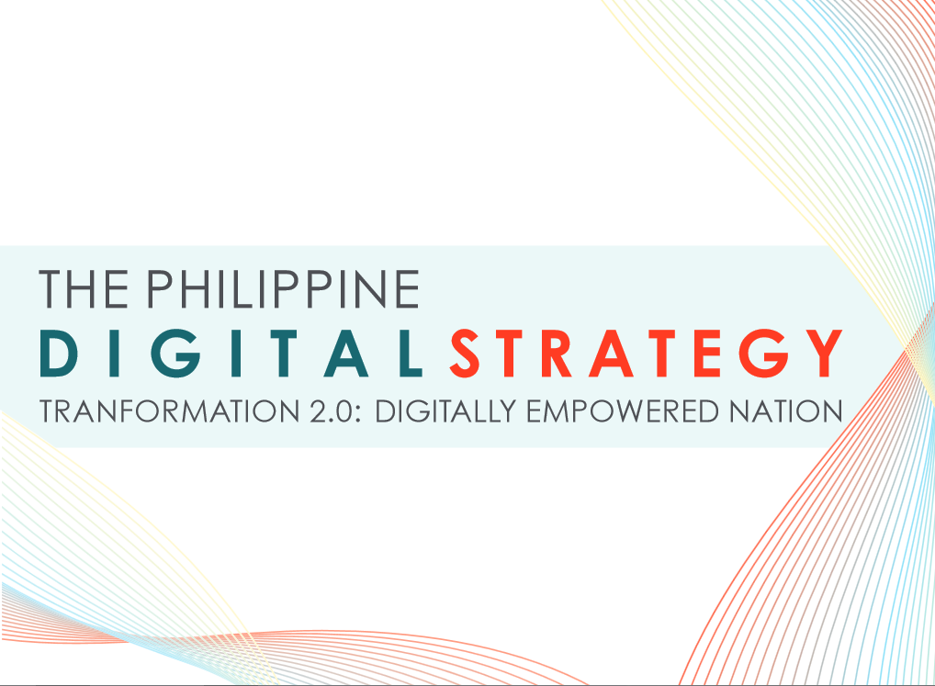
The Philippine Digital Strategy (PDS) for 2011 to 2016 builds on its predecessor, the Philippine Strategic Roadmap for the Information and Communication Technology (ICT) Sector 2006-2010.
http://media.wix.com/ugd/7efb06_9979f93197f84306bfffe41d952c37d3.pdf

Slide 32
Philippine Digital Strategy (PDS)
The vision for the Philippines (as defined under the PDS)
“A digitally empowered, innovative, globally competitive and prosperous society where everyone has reliable, affordable and secure information access in the Philippines.
A government that practices accountability and excellence to provide responsive online citizen-centered services.
A thriving knowledge economy through public-private partnership.”
Notes:
Philippines Development Plan (PDP) 2011-2016

Slide 33
Philippine Strategic Roadmap for the Information and Communication Technology (ICT) Sector 2006-2010
7 Guiding Principles of the
Philippine Strategic ICT Roadmap
The Government is fully committed to the realization of the visionary goal of a people-centered, inclusive and development-oriented Information Society that promotes sustainable growth and improves the quality of life for all Filipinos.
The Government’s primary role in ICT development is to provide an enabling policy, legal and regulatory environment that levels the playing field and allows the private sector to take the leadership positions.
ICT is a tool for human and sustainable development.

Slide 34
Philippine Strategic Roadmap for the Information and Communication Technology (ICT) Sector 2006-2010
4. The development of an Information Society requires a multi-stakeholder approach.
5. A Philippine Information Society requires the availability, accessibility and development of digital content that is relevant and meaningful to Filipino citizens everywhere.
6. A safe and trustworthy online environment for all is a critical component of the Philippine Information Society.
7. The undeniable role of ICT as a major driver of economic progress behooves the creation, focusing and/or strengthening of the government’s institutional arrangements for the facilitation of ICT development, and ICT for development throughout the country.

Slide 35
Philippine Information Society
(Diaz De Rivera, 2007)
contents must be made available online with the provision of easy access for all Filipino citizens
establishment of local digital libraries, online libraries and resource centers should be taken into consideration.
digital content that encompasses
  educational materials,
  national heritage collections,
  government information,
  research databases, and
  collections on literature, history, entertainment, etc. should be developed.
resources in the various Philippine languages - particularly the eight (8) major languages must be encouraged and pursued
Notes:
These contents must be made available online with the provision of easy access for all Filipino citizens.
To aid this endeavour, the establishment of local digital libraries, online libraries and resource centers should be taken into consideration.
Digital content that encompasses educational materials, national heritage collections, government information, research databases, and collections on literature, history, entertainment, etc. should be developed.
Resources in the various Philippines languages - particularly the eight (8) major languages must be encouraged and pursued (Diaz De Rivera, 2007).

Slide 36
Transparency and accountability
President Benigno S. Aquino, III introduced reforms of transparency and accountability through digitization as he assumed office in June 2010
His administration instituted digital reforms measures emphasizing its commitment to improved governance using information and communications technology (ICT) (DBM, 2012).

Slide 37
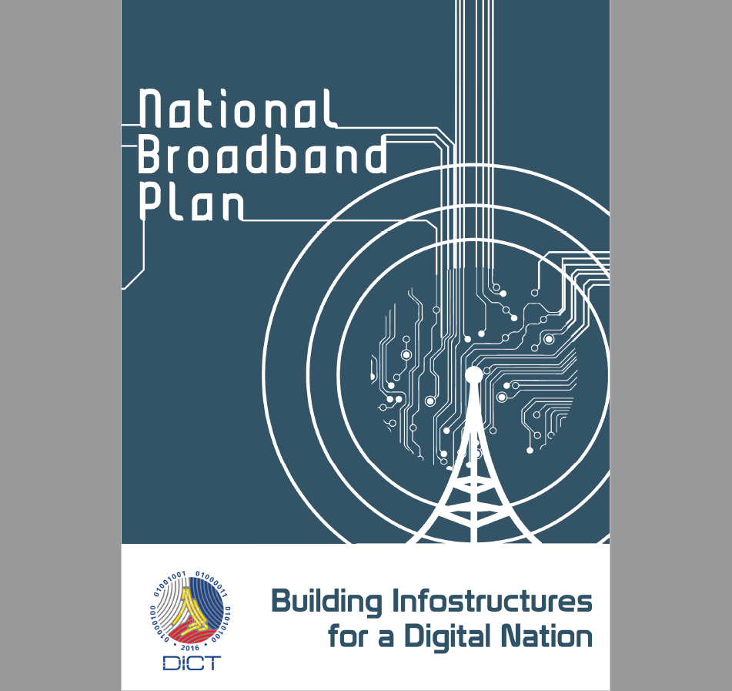

Slide 38
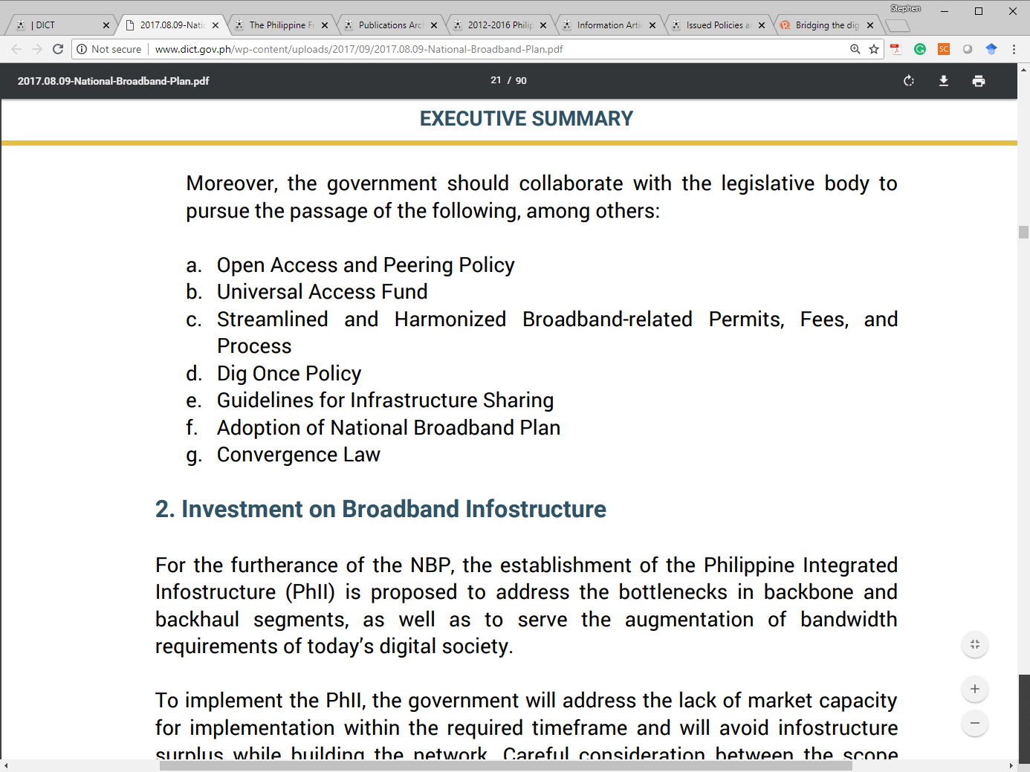

Slide 39
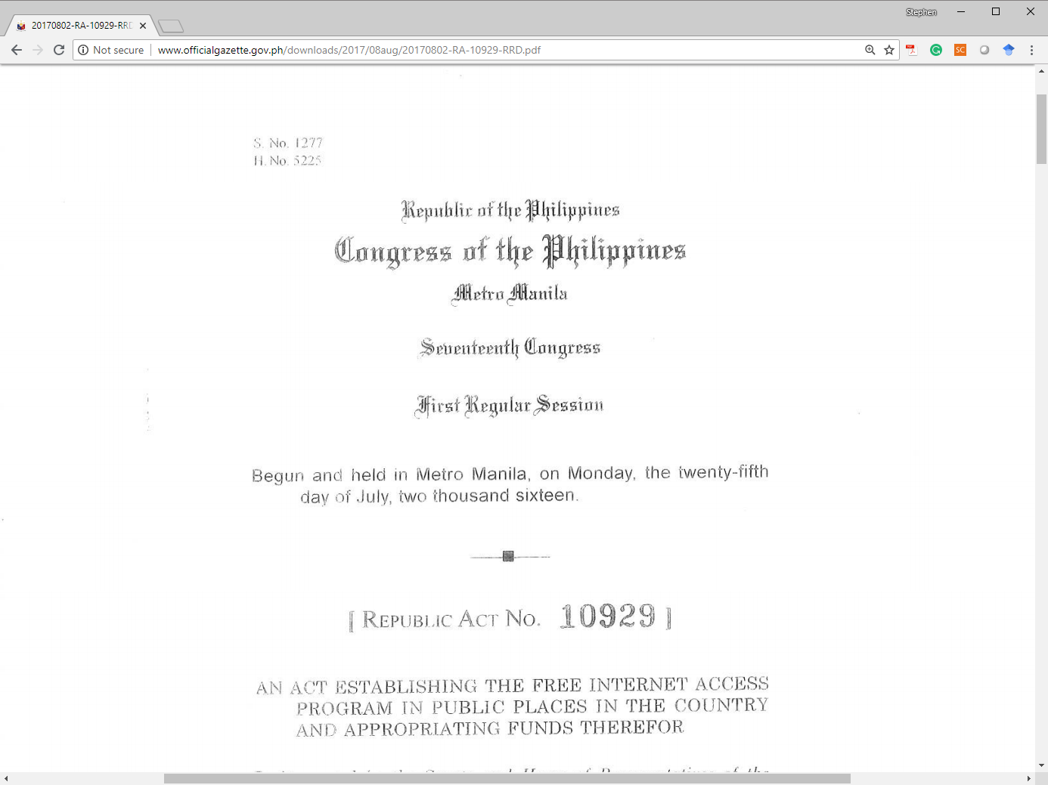

Slide 40
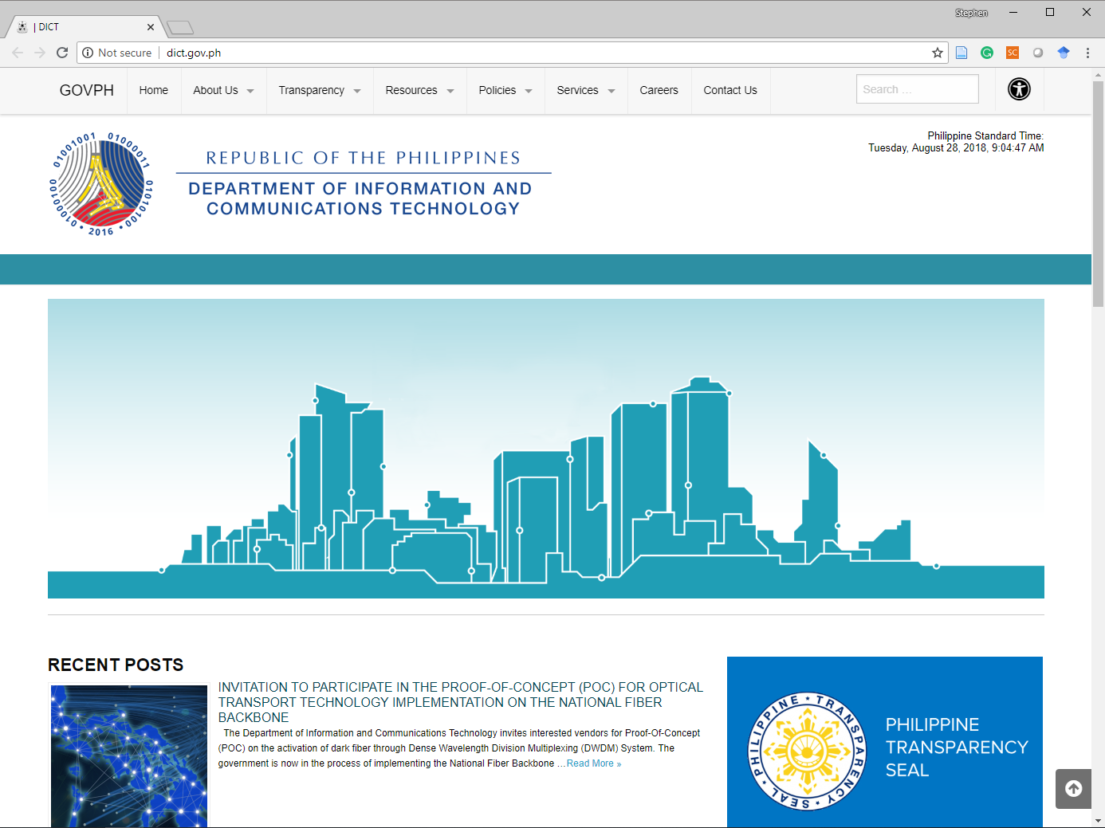

Slide 41
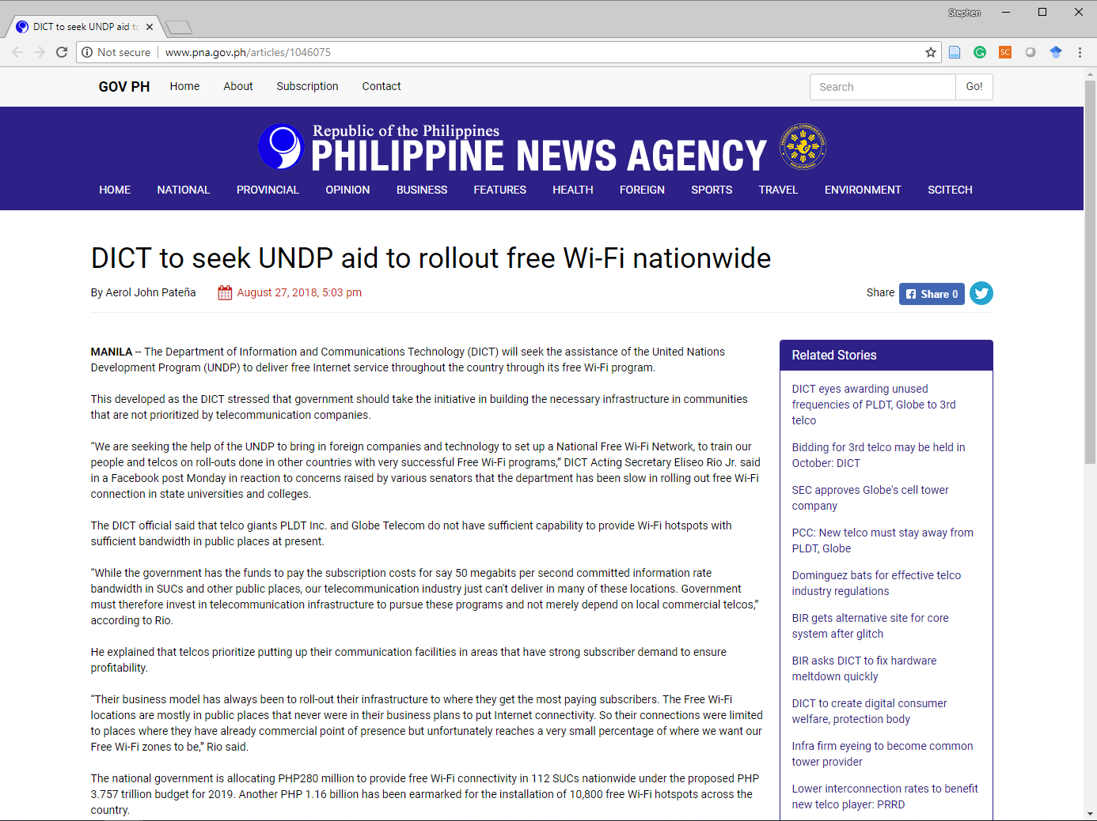

Slide 42
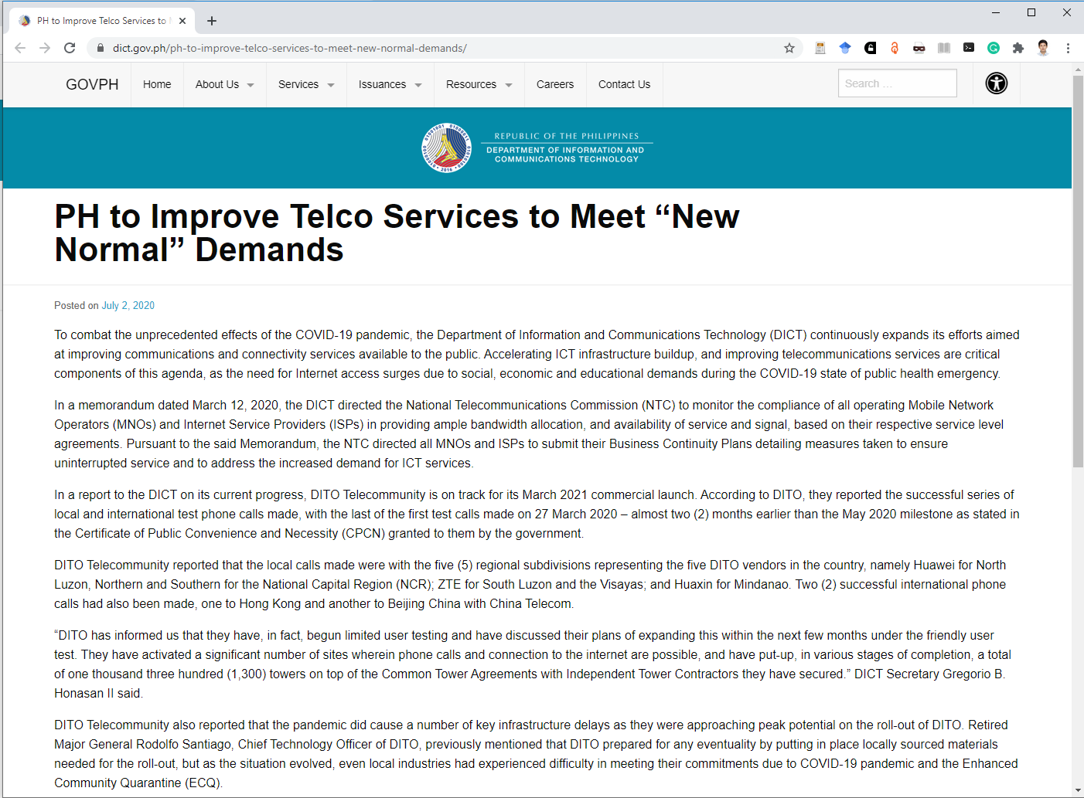
Notes:
PH to Improve Telco Services to Meet “New Normal” Demands
Posted on July 2, 2020
To combat the unprecedented effects of the COVID-19 pandemic, the Department of Information and Communications Technology (DICT) continuously expands its efforts aimed at improving communications and connectivity services available to the public. Accelerating ICT infrastructure buildup, and improving telecommunications services are critical components of this agenda, as the need for Internet access surges due to social, economic and educational demands during the COVID-19 state of public health emergency.
In a memorandum dated March 12, 2020, the DICT directed the National Telecommunications Commission (NTC) to monitor the compliance of all operating Mobile Network Operators (MNOs) and Internet Service Providers (ISPs) in providing ample bandwidth allocation, and availability of service and signal, based on their respective service level agreements. Pursuant to the said Memorandum, the NTC directed all MNOs and ISPs to submit their Business Continuity Plans detailing measures taken to ensure uninterrupted service and to address the increased demand for ICT services.
In a report to the DICT on its current progress, DITO Telecommunity is on track for its March 2021 commercial launch. According to DITO, they reported the successful series of local and international test phone calls made, with the last of the first test calls made on 27 March 2020 – almost two (2) months earlier than the May 2020 milestone as stated in the Certificate of Public Convenience and Necessity (CPCN) granted to them by the government.
DITO Telecommunity reported that the local calls made were with the five (5) regional subdivisions representing the five DITO vendors in the country, namely Huawei for North Luzon, Northern and Southern for the National Capital Region (NCR); ZTE for South Luzon and the Visayas; and Huaxin for Mindanao. Two (2) successful international phone calls had also been made, one to Hong Kong and another to Beijing China with China Telecom.
“DITO has informed us that they have, in fact, begun limited user testing and have discussed their plans of expanding this within the next few months under the friendly user test. They have activated a significant number of sites wherein phone calls and connection to the internet are possible, and have put-up, in various stages of completion, a total of one thousand three hundred (1,300) towers on top of the Common Tower Agreements with Independent Tower Contractors they have secured.” DICT Secretary Gregorio B. Honasan II said.
DITO Telecommunity also reported that the pandemic did cause a number of key infrastructure delays as they were approaching peak potential on the roll-out of DITO. Retired Major General Rodolfo Santiago, Chief Technology Officer of DITO, previously mentioned that DITO prepared for any eventuality by putting in place locally sourced materials needed for the roll-out, but as the situation evolved, even local industries had experienced difficulty in meeting their commitments due to COVID-19 pandemic and the Enhanced Community Quarantine (ECQ).
Most of the scheduled material supplies from China such as fiber cables, DC containers, base stations, towers, and telecom ancillaries failed to arrive as scheduled causing delays in the roll-out. Despite these limitations, more than two hundred fifty (250) tower sites are now operational, integrated and on air, and interim network operation centers are in place to allow limited internet connection and phone calls. The hardest hit during the ECQ was the laying of domestic and submarine cables.
In relation to the delay caused by the COVID-19 crisis, the NTC issued a resolution extending the July 2020 technical audit under the CPCN provisions. Under the current extension, DITO is given within six (6) months to deliver the commitments for the technical audit requirements- that is to provide a speed of 27 megabits per second to cover 37% percent of the population.
DITO Chief Administrative Officer Atty. Adel Tamano stressed that only the technical audit schedule was moved. DITO’s other commitments, such as the commercial launch this March 2021, will proceed as scheduled.
With DITO’s plans of building its network underway, Telco giants PLDT and Globe are each strategizing ways to revamp and upscale their services to meet the growing demand for connectivity in the country.
PLDT returned to the international bond market after 18 years and successfully raised 600 million U.S. dollars from the two-part issuance of the lowest coupon for a 10-year and 30-year offering. The orders reached 10.2 billion dollars or 17 times the amount sold—the largest orderbook size and oversubscription achieved by an issuer driven by institutional investors.
The proceeds from the bond market will primarily serve to refinance PLDT’s existing debt obligations at lower interest rates until 2021, allowing the telco to boost spending for operational and revenue growth.
Globe, for its part, is looking into building cell sites in public schools to ease the transition to blended learning and digital education as face-to-face classes are prohibited pursuant to social distancing measures of the Inter-agency Task Force (IATF).
These private sector efforts, concurrent with the DICT’s strategic issuance of Department Circular (DC) No. 008, s. 2020, that provides for the guidelines on Shared Passive Telecommunications Tower Infrastructure (PTTIs), are expected to improve connectivity services and generate more economic opportunities across the country, in line with the President Duterte’s “Balik Probinsya Bagong Pag-Asa Program.”
“The private telecommunications industry serves a major part in achieving the DICT’s vision of a ‘Digital Philippines’. The quality and coverage of the services they provide highly impact the overall ICT growth of the country,” DICT Secretary Gregorio B. Honasan II said. “The President stressed that the need for reliable Internet connectivity has never been more urgent, so we are accelerating and encouraging digital transformation for both the public and the private sectors to curb the effects of the pandemic on our country’s economy and the continued education of our youth,” he added.

Slide 43
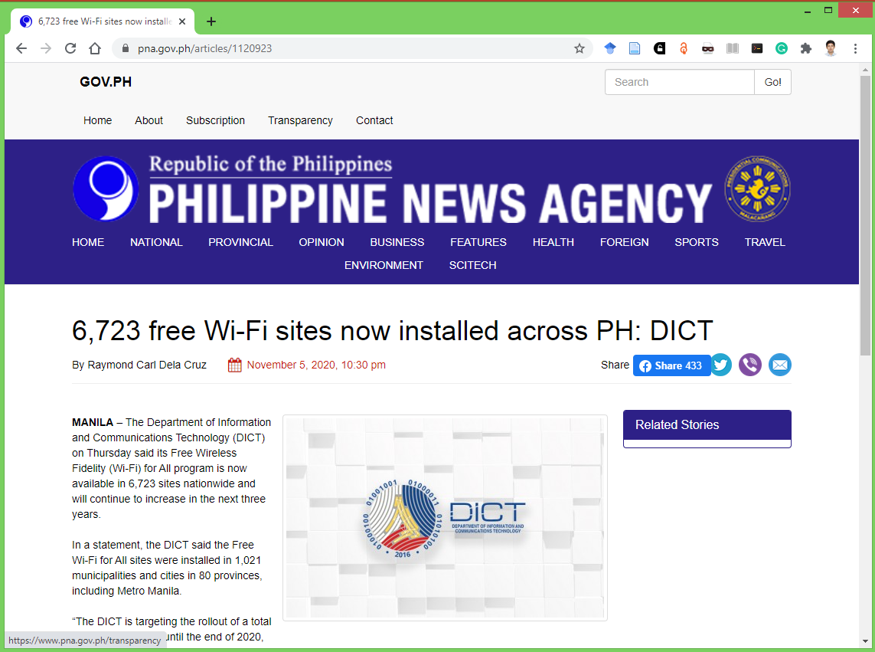

Slide 44
“The DICT is targeting the rollout of a total of 10,069 live sites until the end of 2020, with plans to establish up to 100,000 Wi-Fi access sites by the year 2023 following the deployment of the National Broadband Program,” the DICT said.
Due to the challenges brought by the coronavirus disease 2019 (Covid-19) pandemic, the DICT said the program’s “intensified rollout” presently prioritizes the education sector.

Slide 45
“Presently, the program has established free Wi-Fi sites in
  138 public libraries
  1018 public schools
  967 State Universities/Colleges, and
  Technical Education and Skills Development Authority (TESDA) institutions,” it said.

Slide 46
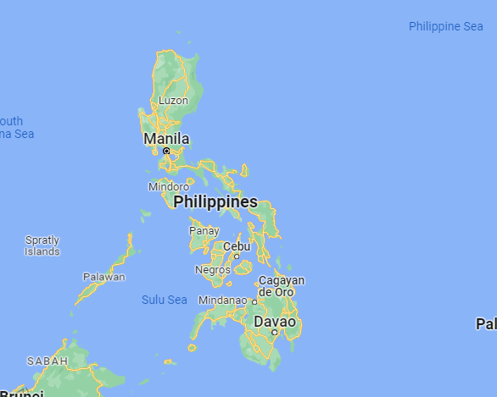

Slide 47
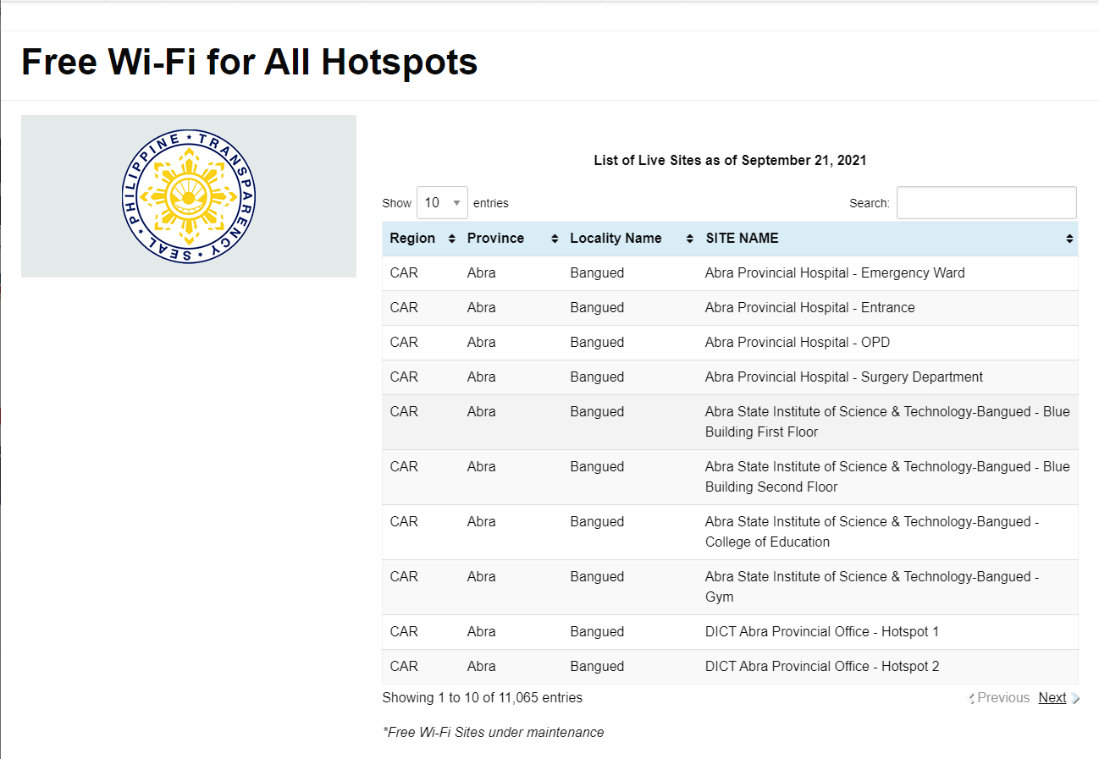
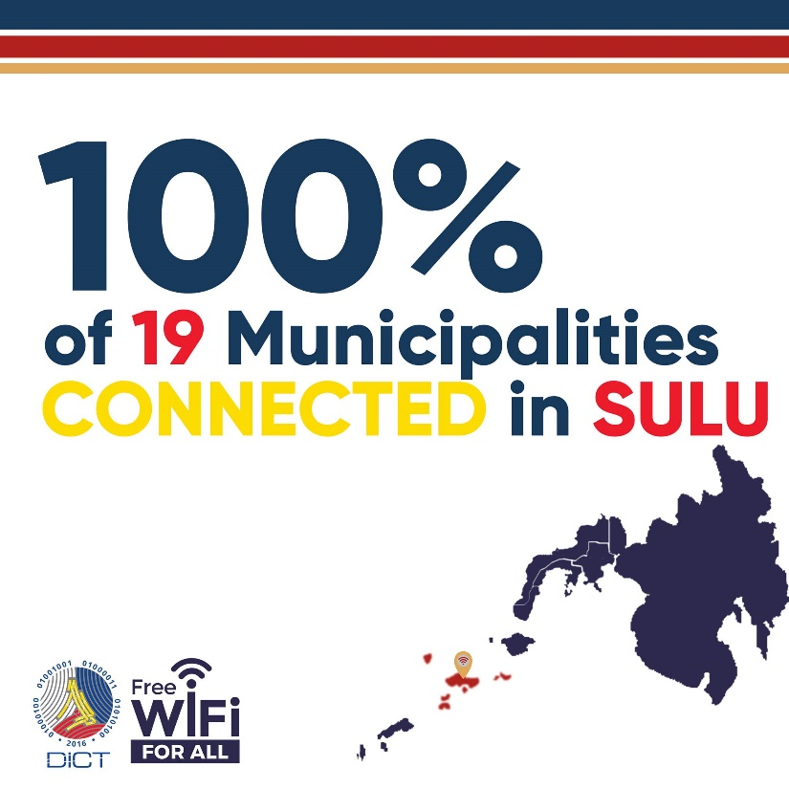
List of Live Sites
https://freepublicwifi.gov.ph/livehotspots
(11,065 entries, as of September 21, 2021)

Slide 48
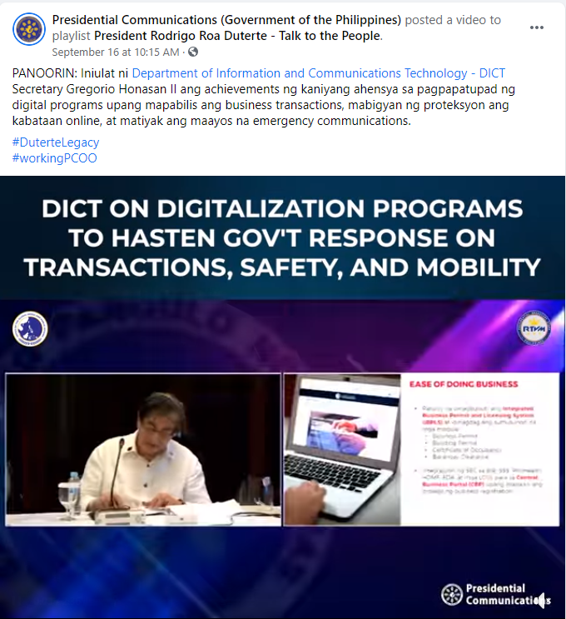

Slide 49
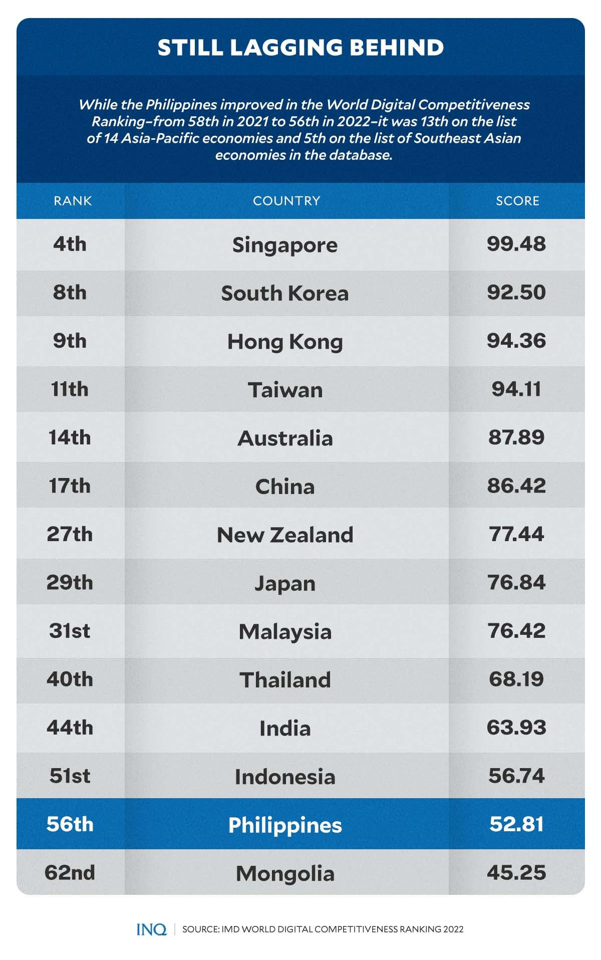
World Digital Competitiveness

Slide 50
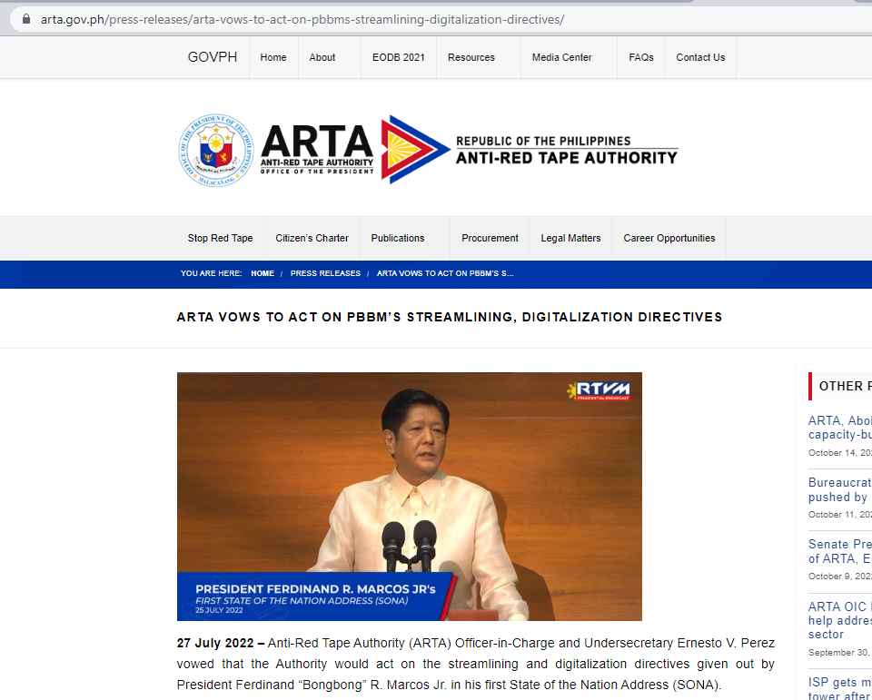

Slide 51
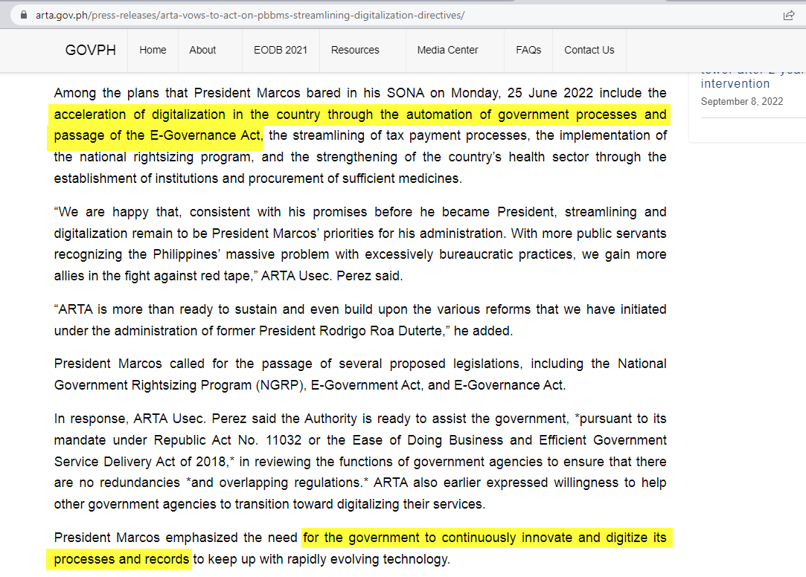

Slide 52
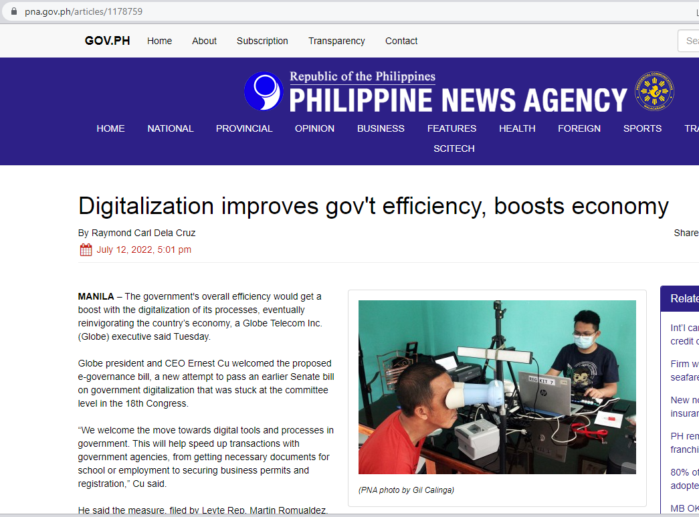

Slide 53
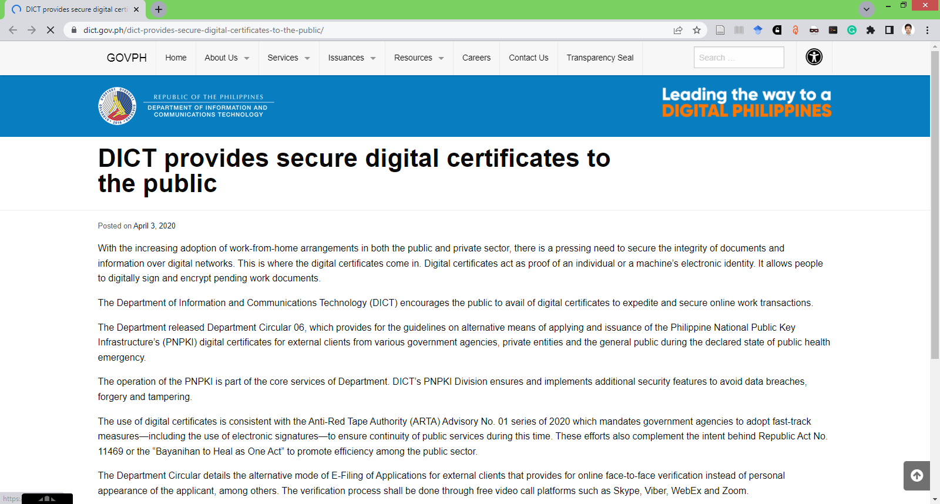

Slide 54
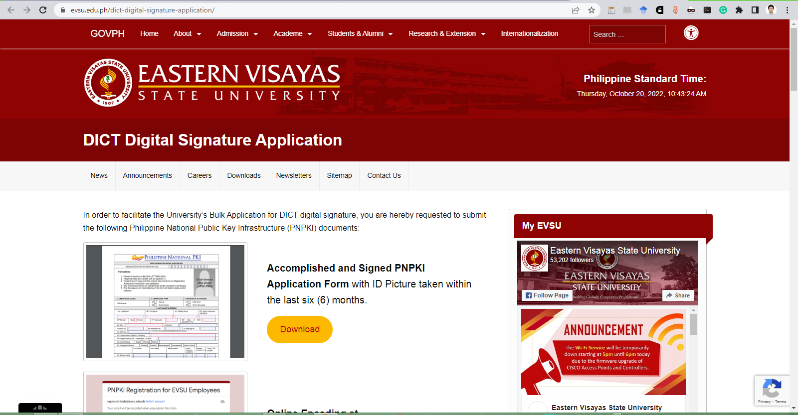

Slide 55
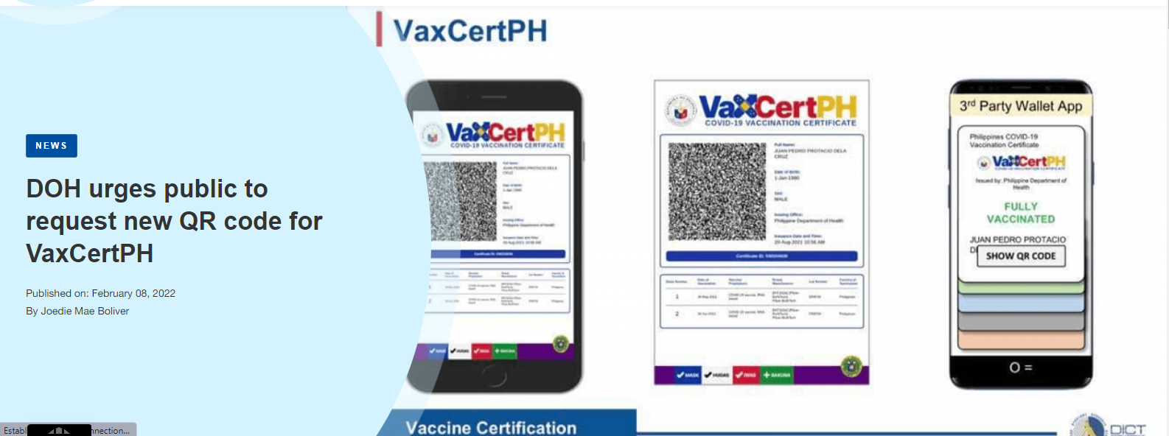

Slide 56

Electronic Records Management System (ERMS)

Slide 57


Slide 58
Outline
Digitization, Digital Library, Digital Scholarship, and Open Access Initiatives in the Philippines
  Introduction
    Sustainable Development
    Role of Libraries, Archives, and Museums
  Digitization
  Digital Scholarship
  Open Access
  Digital Libraries/ Institutional Repositories
  Indexing Databases
  Electronic Thesis and Dissertation
  Discovery Services
  Library Boxes
  Lessons Learned and Recommendations

Slide 59
Digitization and Digital Library Initiatives of Selected Libraries and Institutions in the Philippines
Stephen B. Alayon
Aquaculture Department, Southeast Asian Fisheries Development Center, Iloilo, Philippines
E-mail: sbalayon@seafdec.org.ph
Martin Julius V. Perez, Chito N. Angeles
School of Library and Information Studies, University of the Philippines - Diliman, Quezon City, Philippines
E-mail: martinjuliusperez@gmail.com , cnangeles@gmail.com

Slide 60
Digitization
GOVERNMENT

Slide 61
Most notable of EGF funded projects
Notable projects but overall utilization rate is low
LGU Community e-Center (LGU CEC) Project Component by the Commission on Information and Communications Technology (CICT);
E-Budget Implementation and Business Continuity Project by the Department of Budget and Management(DBM);
Integrated Drug Test Operations and Management Information System (iDTOMIS) Project by the Department of Health (DOH); and
Philippine e-Library Project by the National Library of the Philippines (NLP)
Source: The Philippine digital strategy transformation 2.0: digitally empowered (2011)

Slide 62






Philippine eLib
The Philippine eLib is a collaborative project of
  National Library of the Philippines (NLP)
  University of the Philippines (UP)
  Department of Science and Technology (DOST)
  Department of Agriculture (DA)
  Commission on Higher Education (CHED)

Slide 63
Philippine eLib
  Funded through the e-Government Fund of the Philippine Government, the project hopes to provide for the information needs of all sectors of society in a convenient, affordable, and efficient way of delivery.

Slide 64
www.elib.gov.ph
It envisions making available in digital format the holdings of
  National Library (over 1.2 million volumes, including materials considered part of the national heritage)
  UP Library System (over one million also)
  SciNet libraries of the DOST
  the library networks of the Department of Agriculture
A total of 24 million images will be accessible in the world wide web (www.elib.gov.ph).
(Versoza, 2005)

Slide 65

Philippine eLib
Available resources include:
  Union catalog of the five partners;
  Digitized Filipiniana materials including theses and dissertations;
  Special collection/researches of the five partners; and,
  Online resources/subscription to electronic databases.

Slide 66
National Library of the Philippines (NLP)
NLP undertook digitization activity of its rare books, rare maps, rare photographs, Philippine presidential papers and speeches, theses and dissertations and other materials that pertain to the cultural and historical heritage of the country (NLP, 2007).
It aimed to increase access to Filipiniana materials and contribute to the preservation of heritage materials by decreasing physical handling of the fragile original physical resources.

Slide 67
NLP experience
In Phase 1, around 25 million pages were targeted for digitization.
It was achieved in less than 1 year in 2004 by outsourcing digitization.
Quiros (2009) shared their experiences and lessons learned from the project.
  Some of the problems encountered include
    unreadable pages,
    too large output file, and
    damages sustained from the originals.
  Re-work was done until 2007 when it was stopped.
    The decision was made due to the fact that it would take longer to perform quality control than to re-scan the materials in-house.

Slide 68
Department of Science and Technology (DOST)
The same experience happened to DOST
A digitizing company was commissioned to do the scanning
saved the master copies in TIFF format (at 762 dpi).
The librarian had to check the scanned files and identify pages
  not properly scanned
  needs editing / re-scanning
    such as
    deskewing,
    editing of dark areas,
    re-scanning missing pages, etc..
Notes:
The same experience happened to DOST

Slide 69
Institutional Repository
Digital Library/ Archives
Digital Humanities/ Scholarship
UNIVERSITY

Slide 70
Open Access IR and Software Used in the Philippines (2022)
Institution | Software
AHS Memory Project | DSpace
AIIAS Online Repository | DSpace
Asian Development Bank Open Access Repository | DSpace
BAHANDIAN: Institutional Repository of Central Philippine University | DSpace
Benguet State University Digital Library | Greenstone
DSpace at IRRI | DSpace
SEAFDEC/AQD Institutional Repository | DSpace
UP Baguio Open Digital Repository | DSpace
WMSU | Other
Source: (Jisc. v2.sherpa.ac.uk/opendoar OpenDOAR, n.d.) – as of October 2022

Slide 71

AHS Memory Project
http://emc.hs.admu.edu.ph:8080/

Slide 72

ADB Open Access Repository
https://openaccess.adb.org/

Slide 73

Adventist International Institute of Advanced Studies dspace.aiias.edu

Slide 74

repository.cpu.edu.ph

Slide 75


Slide 76


Slide 77


Slide 78
IR / digital library and software used in selected libraries, archive and museum in the Philippines
University/ Institution | Software | IR Name | URL | Birth Year | No. of Items
BSU | Greenstone | BSU Digital Library | digilib.bsu.edu.ph | 2010 | 1,424
SLU | DSpace | SLU DSpace | dspace.slu.edu.ph* | 2006 | 341
IRRI | DSpace | DSpace at IRRI | dspace.irri.org:8080/dspace* | 2010 | 1,347
UP - Diliman | EPrints | UP University Archives and Records Depository | uard.mainlib.upd.edu.ph | - | 277
SEAFDEC/AQD | DSpace | SEAFDEC/AQD Institutional Repository (SAIR) | repository.seafdec.org.ph* | 2011 | 1,218
SEAFDEC/AQD | Greenstone | SEAFDEC/AQD Digital Library | In-house access | 2009 | -
ADMU | EPrints | Rizal Library Digital Repository | rldigital.lib.admu.edu.ph | - | -
APS | Greenstone | APSL Digital Library | In-house access | - | -
ADMHS | DSpace | Educational Media Center Digital.Space | emc.hs.admu.edu.ph:8080 | 2011 | -
DA-BAR | DSpace | PhilAgriNet Database | 203.131.67.235:8080/xmlui | 2012 | 72
DOST | DSpace | DSpace at DOST | dspace.stii.dost.gov.ph (unknown status) | - | -
DOST | Greenstone | PREGINET Digital Library | library.asti.dost.gov.ph/gsdl/digilib | 2012 | -
*registered in OpenDOAR (http://www.opendoar.org) and in ROAR (http://roar.eprints.org)
BSU - Benguet State University; ADMHS - Ateneo de Manila High School; DA-BAR-PhilAgriNet - Department of Agriculture - Bureau of Agricultural Research - Philippine Agricultural Network; PREGINET - Philippine Research, Education and Government Information Network

Slide 79
Table 3. IR / digital library software used in selected libraries, archive and museum in the Philippines (2022)
University/ Institution | Software | IR Name | URL | Birth Year | No. of Items
SLU | DSpace | SLU DSpace | dspace.slu.edu.ph* | 2006
 |  | Saint Louis University Digital Repository | tceprints.slu.edu.ph | 2013
ADMHS | DSpace | Educational Media Center Digital.Space | emc.hs.admu.edu.ph:8080 | 2011
AIIAS | DSpace | AIIAS Online Repository | dspace.aiias.edu | 2020
DLSU | Digital Commons | Animo Repository | animorepository.dlsu.edu.ph
ADB | Dspace (others) | Asian Development Bank Open Access Repository | adb.org/publications | 2015
CPU-HLL | DSpace | Bahandian Institutional Repository of CPU | repository.cpu.edu.ph | 2021
SEAFDEC/AQD | DSpace | SEAFDEC/AQD Institutional Repository (SAIR) | repository.seafdec.org.ph* | 2011
 | ** | duplicate |  | 2011
CapSU | ** | CapSU Tapaz Aklatan Repository
Don Bosco | ** | Don Bosco Research Repository
WMSU | ** | Western Mindanao State University Repository
 | ** | duplicate
 | ** | triplicate
*registered in OpenDOAR (http://www.opendoar.org) and in ROAR (http://roar.eprints.org) October 2022 **Error

Slide 80
Table 1. Type of materials digitized in selected libraries, archives and museums in the Philippines
 | Books /Mono-graphs | Manus-cript | Company Records | Audio Visual | Thesis/ Dissertation | Published work | Correspondences | Unpublished works | Photos | Others
APSL |  |  |  |  | x
HPAM |  |  | x | x |  |  | x |  |  | x
LMLM | x | x |  |  |  | x |  |  | x | x
LPU-JPLDC | x |  |  |  |  |  |  |  | x
MO | x |  |  |  |  | x | x | x | x
Official Gazette |  |  | x |  |  |  |  |  |  | x
SEAFDEC/AQD | x | x | x |  |  | x | x |  | x
UERMMCI |  |  | x |  |  |  |  |  | x | x
UPCE |  | x |  | x |  |  |  |  | x
UP-UARD |  |  |  |  | x |  |  |  | x
Notes:
This paper utilized the case studies, site visit, reports, papers and publications on different digitization projects and digital / institutional repositories initiatives of selected special libraries, archives museums in the Philippines. Among these are the Ateneo Professional Schools Library (APSL), House of Representatives Archives and Museum (HPAM), Jorge B. Vargas Museum and Filipiniana Research Center, Lopez Memorial Library and Museum (LMLM), Lyceum of the Philippines University-Jose P. Laurel Digital Collection (LPU-JPLDC), Manila Observatory (MO) Library and Archives, Official Gazette Digitization Project, Southeast Asian Fisheries Development Center/Aquaculture Department (SEAFDEC/AQD) Library, University of the East-Ramon Magsaysay Memorial Medical Center Inc. (UERMMMCI), University of the Philippines Center of Ethnomusicology (UPCE) Library, and University of the Philippines-University Archives and Records Depository (UP-UARD) . Others special libraries and museums with digitization project and IR development has been reviewed and included. Literature review and visit to websites and portals of selected institutions were also conducted. The case studies, reports, papers and publications have been reviewed and summarized in this paper.
Table 1 shows the types of material digitized by selected libraries, archives and museums in the Philippines. MO’s official publications, reports, letters and telegrams, drafts and raw data were digitized (Samaniego, 2012). The UPCE digitizes collections such as musical scores, field notes, and audio recordings (Amio, 2012). SEAFDEC/AQD digitizes mostly its in-house publications like books, handbooks, policy guidebooks, conference proceedings, extension manuals, institutional reports, annual reports, and newsletters (Alayon, 2012). The LMLM digitizes rare books, manuscripts, photographs, map and other Filipiniana holdings / collections (Mateo, 2012). The APSL (dela Torre, 2012) and UP-UARD digitize theses and dissertations. The Official Gazette digitization project uploads presidential speeches, reports, statements, press release, documents concerning its Institutional Memory (Espinoza, 2012).

Slide 81



AUNILO
members of ASEAN University Network Inter-Library Online (AUNILO)
  University of the Philippines (UP) Diliman Library
  Ateneo de Manila University (ADMU) Rizal Library
  De la Salle University (DLSU) Library
The Information Networking in AUNILO emphasizes on the establishment and development of on-line information exchange system within the member universities.
The members are strongly encouraged to develop and establish Institutional Repositories.

Slide 82

University Archives and Records Depository (UARD) – (beta)
http://uard.mainlib.upd.edu.ph/
Notes:
The official archival agency of UP, the University Archieves and Records Depository (UARD) was established in 1974 and is located at the 3rd Floor of the UP Main Library. It contains University records of permanent value and permanent papers of University administrators, faculty, and alumni. Foremost of these are the official records of the Board of Regents, Executive Committee, University Council, administrative officials of the University, individual records such as the UP Gazette, UP Newsletter, Philippine Collegian, reports of comittees created by the University President and Board of Regents, memorabilia, plaques, trophies, pins, posters, photographs and theses and dissertations of the colleges
On display at the Archives are conributions of the UP to the celebration of the Centennial of the Republic of the Philippines in 1989.
The Archives maintains computerized indexes to the Philippine Collegian, UP Gazette, and the Minutes of the Meetings of the Board of Regents for easy retrieval by officials, students and researchers.
The UARD is open Monday-Friday from 8am-12nn / 1pm-5pm, and Saturday 8am-12nn.

Slide 83

digitalarchives.upd.edu.ph

Slide 84

repository.mainlib.upd.edu.ph

Slide 85


Slide 86


Slide 87


Slide 88

Notes:
DAGITAB: Palihan sa Digital na Humanidades | Digital Humanities Workshop
Some dept of euplanguagesDEL faculty and other faculty members in the field of Humanities and Social Sciences from the different CUs of the University of the Philippines took part in an intensive 5-day introductory course from July 15-19, 2019 at Microtel UP Technohub that provided an overview of Digital Humanities (DH) research and background for data management, construction, and analysis that will allow humanities scholars to explore a computational approach in their research. In this summer course, participants acquired basic skills necessary for DH research.
This workshop was organized and conducted by lecturers from the University of Antwerp and University of the Philippines Diliman and was funded by VLIRUOS.

Slide 89


Slide 90


Slide 91


Slide 92


Slide 93


Slide 94


Slide 95


Slide 96


Slide 97




www.upcenom.com
http://www.phonogrammarchiv.at/wwwnew/jose_maceda_coll_e.htm
Notes:
From November, 2009, the project was able to digitize around 1530 open reels of Filipino music and 800 open reels of international sources, as well as 191 cassette tapes, which equates to around 2500 running hours of music .As of August 2012, the catalogue has already accumulated 2649 titles, with the steadfast expansion as the project is still going on.
the new digital catalogue consist of such parameters as: data identification number (title accession number), old catalogue number , original format, digital format, location of the original data, electronic location, researcher, year, ethnic group, country of origin, meta data description, etc. This provided an efficient system to search online or at UPCE library by providing key words.
Secondly, the Jose Maceda collection also consists of a vast amount of related ethnomusicological materials such as musical transcriptions, transcribed texts, photos, field notes, etc.
The UPCE Collections Portal. The Collections Portal enable you, subject to the restrictions set forth herein, to browse the Collection catalog and view sample ASEANA Profiles Copyright © Goethe-Institut Alle Rechte vorbehalten www.goethe.de/indonesien D-41 Digital Content (catalogs, diagrams, scores, audio, video, documents, and images) on your devices, including but not limited to mobile devices, e-readers, and personal computers. Restrictions. You may not copy, rip, download, upload, reproduce, exhibit, present, transmit, distribute, broadcast, sell, rent, lease, transfer, or assign rights to the Digital Content or any portion of it except as expressly permitted by the Center. In addition, you may not remove any watermarks, labels, or other proprietary notices on or in the Digital Content. The copyright in all the Digital Content remains the property of their respective owners.

Slide 98
3 versions
  Archival version
      96KHZ/ 24bit wave format audio file format
  Research version
      MPEG-2 Audio Layer III (MP3) format
  Web version
      .ogg format
Challenge
  Incorporating musical transcriptions, transcribed texts, photos, field notes, etc. into the digital audio library.
(Jia, 2012)

Slide 99

UPLB UKDR

Slide 100


Slide 101


Slide 102
Inter-Institutional Consortium Project
Inter-Institutional Consortium Project
(South Manila Consortium)
In the Philippines, our early efforts at digitization began in the late ’90s
Selected Filipiniana rare books were digitized
stored in a CD-ROM.
funded by United Board for Higher Education
later continued by De la Salle University on its own initiative.
Versoza, 2005

Slide 103
De La Salle University Archives
De La Salle University Archives has digitized
  its theses collection as early as in 1998.
    doctoral dissertation in CDs,
    master’s theses in CDs,
    born-digital theses received from the Registrar’s office.
Yearbook collection from the 1920s to 1961 were digitized, and from 1998 onwards, Green and White came in both print and CD versions.
Versoza, 2005

Slide 104

animorepository.dlsu.edu.ph

Slide 105


Slide 106

Rizal Library Digital Repository
http://rldigital.lib.admu.edu.ph/

Slide 107

archium.ateneo.edu

Slide 108


Slide 109


Slide 110

epics.ateneo.edu/epics

Slide 111


Slide 112

Ateneo Electronic Repository of Abstracts (Ateneo de Naga)
http://adnulib.adnu.edu.ph/era.htm

Slide 113


Slide 114

University of Santo Tomas Digital Collections

Slide 115


Slide 116


Slide 117

http://digitallibrary.ust.edu.ph/

Slide 118


Slide 119

repository.wvsu.edu.ph

Slide 120


Slide 121
Institutional Repository
Digital Library/Archives
PRIVATE COMPANIES/INSTITUTIONS/NGOs

Slide 122


Filipinas Heritage Library
Ulahingan is a major epic of the Manobo indigenous group in Mindanao, Philippines, with 4,000-6,000 lines per episode and 79 episodes on average
The epic was orally recorded on an estimated 1,200 audio reels and cassette tapes and compiled by the late Silliman University professor Dr. Elena Maquiso.
Photo Credit: Filipinas Heritage Library
Notes:
Ulahingan Chronicles Digitization: Preserving a Philippine Oral Tradition, Philippines Ulahingan is a major epic of the Manobo indigenous group in Mindanao, Philippines, with 4,000-6,000 lines per episode and 79 episodes on average. This tradition is orally passed from one generation to the next. The epic has been orally recorded in over 1,200 items of reels and cassette tapes. The Filipinas Heritage Library (FHL) recognizes the need to digitally preserve these traditions as part of its mission to preserve and promote accessibility to learning resources on Philippine culture and heritage for the present and future generations.

Slide 123



Slide 124

Filipinas Heritage Library
The Ulahingan project will convert these into playable digital sound files, as the old media storage formats are expected to last only two to three more years before they deteriorate.
Notes:
Dr. Alicia Magos, foremost scholar on the epic oral chants of Central Panay island called the "Hinilawod";
In Iloilo, there was an immediate search for the Landa-Jocano audio tapes of the Hinilawod epic chants taken in 1956 in open reel tapes. There was excitement when the tapes were found in the library collection at the Central Philippine University (CPU). Urgent communications were made by CPU with the U.P. College of Music Center for ethno-musicology to determine if those tapes were newly-found or already included in the Center's collection;
A Conference on Panay Sugidanon (Storytelling) will be held in December at the University of the Philippines Visayas, Miag-ao campus, and U.P. Prof. Nick Deocampo, who headed the discussions in the UNESCO seminars, is invited as a Plenary Speaker;

Slide 125

Retrato – A photo archive of FHL
Notes:
In our Filipiniana library is a treasure trove of images of Philippine life, history and culture from the 15th century to the early seventies. The 4" x 5" black and white photos include reproductions of engravings, lithographs, drawings, and other modes of visual representation, as well as original photos gathered and annotated by the Ayala Museum research department over several years.
We have over 35,000 photos at the moment and are expanding the collection.

Slide 126

covid-19archive.org

Slide 127


Slide 128
Lopez Museum and Library
Mission
  to further engage audiences and safeguard our collective patrimony
    embarked digitization project
    strengthen public programming
    established a conservation center.
Roberto M. Lopez Conservation Center
  committed to the restoration and preservation of Lopez museum and library collections
    specializing accordingly in paintings on canvas and wood, artworks and artifacts on paper, and books.
http://lopez-museum.com/

Slide 129



Lopez Museum and Library
To facilitate conservation and enable online access
    digitization project started in 2007 to complement microfilming of the library holdings.
Photo Credit: Lopez Museum Library

Slide 130


ABS-CBN Film Archives
the country’s pioneer in locally restoring and remastering films
started restoring films in late 2011 in partnership with Central Digital Lab
it has already restored a total of 63 films that were produced from 1976 to 2011
https://en.wikipedia.org/wiki/ABS-CBN_Film_Archives#/media/File:Himala-Restoration.jpg
Notes:
to watch and enjoy classic Filipino films in full high definition format.

Slide 131

Martial Law Museum Digital Library

Slide 132


Slide 133

Project Gutenberg Philippines
http://www.gutenberg.ph/books.php
Notes:
launched in 2006

Slide 134


Slide 135


Slide 136

Welga Digital Archive(US based)

Slide 137
Institutional Repository
Digital Library/Archives
INTERNATIONAL ORGANIZATIONS

Slide 138

WHO-WPRO
http://iris.wpro.who.int/

Slide 139


Slide 140

http://www.unesco.org/new/en/communication-and-information/memory-of-the-world/register/access-by-region-and-country/ph/

Slide 141
Institutional Repository
Digital Library/Archives
GOVERNMENT AGENCIES

Slide 142

Digital Library of the Presidential Museum and Library
Notes:
The Presidential Museum and Library, in celebration of International Museum Day, launches a digital archive to make a broad range of preserved historical and digitized materials available online. This project is hosted by the Internet Archive (archive.org), a nonprofit organization founded to build internet libraries around the world such as Project Gutenberg and Open Library, to preserve and provide access to a wide array of materials such as texts, audio files, and videos.
The Presidential Museum and Library, under the supervision of the Presidential Communication Development and Strategic Planning Office (PCDSPO), is responsible for preserving, managing, and promoting the history and heritage of the Philippine presidency and the Malacañan Palace. It is in keeping with these goals that we launch this project to provide a permanent access to government documents and publications for everyone. Our policy has been to prove that these resources can be shared with the public at minimal cost to the government. The use of an an open-source platform enables researchers, historians, scholars and the general public to use a variety of resources, all for free.
We will be compiling books, documents, publications, documentary films, maps, charts, scanned and colorized historical photographs, articles, infographic maps, and other material.
These can be accessed through this URL: http://archive.org/details/presidentialmuseumandlibrary. You can can also access them through the Presidential Museum and Library and the Official Gazette of the Philippines.

Slide 143

Digital Library of the Presidential Museum and Library
https://archive.org/details/presidentialmuseumandlibrary

Slide 144

elibrary.judiciary.gov.ph

Slide 145
Supreme Court E-Library
Supreme Court E-Library
  part of the Judicial Reform Support Project (JRSP) of the Supreme Court
  conceived in 2004
  it has the complete compilation of the sources of laws, statutes and jurisprudences
  it aims to be the primary research tool in the speedy delivery of justice, to serve the entire Judiciary, and to support legal education.
elibrary.judiciary.gov.ph
Santos-Ong

Slide 146

REPUBLIC OF THE PHILIPPINES – Official Gazette
http://www.gov.ph/

Slide 147

REPUBLIC OF THE PHILIPPINES – Official Gazette
http://www.gov.ph/

Slide 148

commons.deped.gov.ph

Slide 149

https://www.youtube.com/watch?v=M_kS5aN1ScM

Slide 150

phlconnect.ched.gov.ph

Slide 151


Slide 152

Notes:
DICT launches wfh.gov.ph to provide telecommuting resources for government employees
Posted on July 6, 2020
Remote work tools, tips and other learning materials and resources to enrich digital literacy and build ICT knowledge for people working from home can now be accessed by government employees at the Department of Information and Communications Technology’s (DICT) Work from Home website (wfh.gov.ph).
The website aims to be a resource to help government agencies continue with their work online for the duration of the public health emergency. It features content that complements the continuing objective of the recently concluded National ICT Month 2020 to maximize ICT for the new normal through various digitalization initiatives, strategies and best practices.
President Rodrigo Duterte is steadfast in his directives to promote ICT-enabled work arrangements since the enactment of R.A. No. 11165 or the Telecommuting Act of 2018. After the President’s June 30, 2020 announcement of the new quarantine classifications for the next two weeks, with the National Capital Region and select provinces remaining under General Community Quarantine (GCQ), and Cebu City under Enhanced Community Quarantine (ECQ), it is apparent that telecommuting remains a strategic alternative for both the public and private sector to consider and implement.
“The launch of wfh.gov.ph serves to support the President’s agenda of unhampered and efficient service to the people,” DICT Secretary Gregorio B. Honasan II said. “We encourage our government employees to visit the website and find the right resources to help guide them transition into a remote working lifestyle,” he added.
Among other content, the website features instructions on how government employees can avail of various telecommuting software for video conferencing, document processing, e-mail, and digital certificates.
It aims to help government employees manage the new virtual working environment in accordance with the Civil Service Commission (CSC) Memorandum Circular No. 10, s. 2020 that provides guidelines for implementing alternative work arrangements for government employees affected by the community quarantine.
The website is set to be updated regularly and was created at no additional cost to the government. Its creation complements the public health management measures of the Inter-Agency Task Force for the Management of Emerging Infectious Diseases (IATF-MEID) in its objectives to address the COVID-19 pandemic.
To access the website, visit https://wfh.gov.ph/.

Slide 153

wfh.gov.ph

Slide 154

“A Community eCenter in Every Municipality”

Slide 155
The Community eCenter Program envisions “A Community eCenter in Every Municipality”

Slide 156

Health Research and Development Information Network (HERDIN)

Slide 157

The Philippine National Codex Organization (NCO)
http://nco.uplb.edu.ph/xmlui/

Slide 158
Indexing Databases

Slide 159



Ateneo de Manila University
Ateneo de Manila University - Rizal Library
  Photoduplication Services Section
    one of the pioneers and leading preservation and digitization center in the Philippines (Versoza, 2005).
    microfilming and digitizing Philippine newspapers and magazines

Slide 160

Ateneo de Manila University
Ateneo de Manila University - Rizal Library
  digitization of four major dailies:
    Philippine Daily Inquirer
    The Philippine Star
    The Manila Times
    Malaya
  Philippine Library Material Project Foundation - financing and marketing the Project.
  The Current Newspaper Project in Digital Format is distributed in DVDs with a software for searching and an index
Versoza, 2005

Slide 161

Computerized Index to Philippine Periodical Articles (CIPPA)
http://rizal.lib.admu.edu.ph/cippa/cippa.asp

Slide 162
University of the Philippines
University of the Philippines (UP) Diliman Main Library
started in 2000
project on Cumulative Index to Philippine Periodicals in CD-ROM
Versoza, 2005

Slide 163

https://ipp.mainlib.upd.edu.ph/

Slide 164


Index to Philippine Newspapers
https://ipn.mainlib.upd.edu.ph

Slide 165


Slide 166

ani.seafdec.org.ph
6,987 items archived
315,913 item views
1,226,005 searches performed
5,114 visits from 3,720 unique visitors

Slide 167

Aquatic News Index (ANI)

Slide 168
Indexing Databases of selected libraries, archives, and museums in the Philippines
University/ Institution | Software | Indexing Data Base Name | URL | Birth Year | No. of Items
UP - Diliman |  | Index to Philippine Periodicals (IPP) | ipp.mainlib.upd.edu.ph
UP - Diliman |  | Index to Philippine Newspapers (IPN) | ipn.mainlib.upd.edu.ph
ADMU |  | Computerized Index to Philippine Periodical Articles (CIPPA)* | rizal.lib.admu.edu.ph/cippa/cippa.asp
DLSU |  | Andrew Gonzalez Philippine Citation Index (AGPCI) | 42.93.69.211
SEAFDEC/AQD | DSpace | Aquatic News Index (ANI) | ani.seafdec.org.ph | 2017 | 9,108
(*for subscription)

Slide 169
Annotated Bibliography

Slide 170

An Annotated Bibliography on President Manuel A. Roxas
http://repository.mainlib.upd.edu.ph/pmarf/
Notes:
Manuel A. Roxas (1892-1948) was the last President of the Commonwealth, first President of the Republic, first bar top-notcher in 1913 and an alumnus of the University of the Philippines.
In celebration of his 54th death anniversary on 22 April 2002, the University of the Philippines (UP) and the President Manuel A Roxas Foundation (PMARF) signed a Memorandum of Understanding to institute the Manuel A. Roxas Studies Program, which aims to increase awareness of Roxas' legacy in politics and economics. The program was spearheaded by the UP National College of Public Administration and Governance under Dean Ma. Concepcion P. Alfiler and the College of Social Sciences and Philosophy under Dean Cynthia B. Bautista.
On the same day, the University Librarian/Archivist, UP Diliman Salvacion M. Arlante put up a Photo-memorabilia Exhibit on Roxas in the Filipiniana Book Section. Two months later, she started microfilming the President Manuel A. Roxas Papers owned by the foundation with a copy to be deposited in the University Archives and Records Depository. In July 2002, she proposed the project to build "An Annotated Bibliography on President Manuel A. Roxas" in book as well as in digital format, which will provide the research base for the Manuel A. Roxas Program.
This bibliographic project has two parts. Part I is an annotated bibliography consisting of works by Roxas - his books, speeches, addresses, messages and statements - both published and unpublished. Part II consists of works on or about Roxas compiled from various sources in 9 local and 13 foreign libraries and institutions. A subject index with annotations comprises the bibliography in print; scanned images of selected materials have been added to the bibliography in electronic format as a distinctive feature. In this database available online, the works by Roxas ran up to 542 entries; while the works on or about Roxas ran up to 143 entries.

Slide 171
Discovery Services

Slide 172


Slide 173


Slide 174
Library Boxes/Kiosk

Slide 175


The First Philippine Science Digital Library
Notes:
pods

Slide 176

STARBOOKS
Special Citation
  2015 American Library Association (ALA) Presidential Citation for Innovative International Library Project
http://americanlibrariesmagazine.org/2015/10/06/ala-honors-international-innovators/

Slide 178
Western Visayas

Slide 179


Digitization of F. Landa Jocano Collections
F. Landa Jocano
  National Scientist and eminent anthropologist
  documented and translated the Central Visayan folk epic Hinilawod.
Central Philippine University Library Collection
Filipinas Heritage Library

Slide 180




Photo Credit: Central Philippine University HLL Library and Archives

Slide 181



Photo Credit: Central Philippine University HLL Library and Archives

Slide 182


Photo Credit: Central Philippine University HLL Library and Archives

Slide 183


Photo Credit: Central Philippine University HLL Library and Archives

Slide 184
Magdalena Jalandoni
“When she died on September 14, 1978 at the age of 87, she left a total of 66 volumes (with one unfinished volume) of 24 novels, long poems, dramas, historical epic, translations, meditations, short stories, her autobiography, a bibliography of her works and other literary pieces.
  20 novels, however, were burned inside the Archbishop’s Palace, which is a stone’s throw away from her house in Commission Civil Street, Jaro, Iloilo during World War II.
Her extant works have been copyrighted and kept at the National Library, the University of the Philippines and the Syracuse and Yale Universities in the United States.
Copies of her works were also donated to several universities in Iloilo City.”
Source:
Torio, Tita S. and Rosario H. Asung (2011). “Unsung, Unwritten, Unrecognized: The Women of Panay.” Unpublished A Research Report, University of the Philippine Visayas, Iloilo City.

Slide 185


Photo Credit: University of San Agustin Archives and Museum

Slide 186

Photo Credit: University of San Agustin Archives and Museum

Slide 187

Photo Credit: University of San Agustin Archives and Museum

Slide 188

Photo Credit: University of San Agustin Archives and Museum
Notes:
Magdalena Jalandoni was born on May 27, 1891 to a wealthy family. As an ilustrada, she strated formal education in the school of Clemente and Donata Gonzales. In 1902, she studied at the Colegio de San Jose as a day boarder and in 1904 as an eternal (stay-in or intern). She stopped schooling at Iloilo High School in 1907 because her mother objected to co-education and a cholera epidemic has swept the city. It was a frowned upon by society for females. Thus, her parents did not encourage her to pursue it. Her mother in particular told her that it was not proper for a girl to devote her time to writing and instead should learn all the work done by women inside the house. Nonetheless, she dimmed her lamp (quinqet/kingke) so that her parents would not notice what she was doing. According to her niece Ofelia Jalandoni, she once expressed a desire to deliver a diskurso (talk) on certain issues but her father told her, “kon gusto mo, magpantalon ka kag mag kamisa dentro para makasaka sa entablado” (if that is what you want, you have to wear pants and kamisa dentro).
She wrote her first corrido, “Padre Juan and Beata Maria” at the age of ten. Her passion for writings grew each day. She wrote more corridos that were later on printed by La Editorial Publishing House and sold to the public. At sixteen, she wrote her first novel, “Ang Mga Tunok Sang Isa Ka Bulak” (The Thorns of a Flower). She went on to become the most prolific woman writer in Hiligaynon. Consequently, she obtained recognition from different institutions. Some of these awards are: Papal Award by Pope John XXIII on December 10, 1962, First Republic Cultural Heritage Award for Literature in Malacanang Palace on June 12, 1969, Hiyas Award by Iloilo Cultural Foundation Board of Trustees on May 27, 1975, General Emilio Jacinto Pingkian Award for vernacular writing g at the Himlayang Pilipino at Tandang Sora, Quezon City on December 15, 1976 and Gawad Likhaan from the UP Creative Writing Center in Diliman, Quezon City in April 1991. When she died on September 14, 1978 at the age of 87, she left a total of 66 volumes (with one unfinished volume) of 24 novels, long poems, dramas, historical epic, translations, meditations, short stories, her autobiography, a bibliography of her works and other literary pieces. Twenty novels, however, were burned inside the Archbishop’s Palace, which is a stone’s throw away from her house in Commission Civil Street, Jaro, Iloilo during World War II. Her extant works have been copyrighted and kept at the National Library, the University of the Philippines and the Syracuse and Yale Universities in the United States. Copies of her works were also donated to several universities in Iloilo City. Her memorabilia consisting of her works, paintings of local artists, figurines and other personal effects is stored in her house, a heritage site which is under the care of Ms. Ofelia Jalandoni. As her living kin and sole heir, Ofelia was instrumental in donating funds for preserving, enhancing and disseminating West Visayas history and culture as well as providing a scholarship to U.P. Visayas in order to perpetuate the ideals of Magdalena Jalandoni through the study of her life and works.
Source:
Torio, Tita S. and Rosario H. Asung (2011). “Unsung, Unwritten, Unrecognized: The Women of
Panay.” Unpublished A Research Report, University of the Philippine Visayas, Iloilo City.
Photo taken from : https://lh4.googleusercontent.com/pPE1clGMmI8/AAAAAAAAAAI/AAAAAAAAAFU/_Yp4YVVeqrU/photo.jpg

Slide 189


Photo Credit: University of San Agustin Archives and Museum

Slide 190
SEAFDEC Secretariat and Department repositories

Slide 191



Slide 192


Slide 193


Slide 194


Slide 195


Slide 196


Slide 197
Co-hosting of SEAFDEC Repositories
SEAFDEC/AQD will be hosting Institutional Repositories of
SEAFDEC Secretariat/MFRD
SEAFDEC/TD
SEAFDEC/MFRDMD

Slide 198

Collaborative Publications

Slide 199
Staff Development/ Training

Slide 200



PAPER PRESENTATIONS AT CONFERENCES
INTERNATIONAL
1The development of an institutional repository at the Aquaculture Department of the Southeast Asian Fisheries Development Center, Philippines.
5th Congress of Southeast Asian Librarians (CONSAL) Meeting and General Conference;
28-31 May 2012;
Bali, Indonesia.
Aquatic and Marine Information Sources and Dissemination Programs in Asia
Metadata Creation Practices among Aquatic Science Digital Repositories in Asia and the Pacific
41th IAMSLIC Annual Conference and 16th EURALISC Biennial Meeting
07-11 September 2015 Rome, Italy
Mapping the Distribution, Use and Visibility of Publications and Service: Library Initiatives Beyond Borders”
Special Libraries Association (SLA) Conference 2014
8-10 Jun 2014 Vancouver, Canada
PUBLISH
Alayon, S., Nemiz, E. S., Superio, D., de la Peña, J. G., & Pacino, L. G. (2013). The development of an institutional repository at the Aquaculture Department of the Southeast Asian Fisheries Development Center, Philippines. Program: Electronic Library and Information Systems, 47(4), 384-398. https://doi.org/10.1108/PROG-09-2012-0052
ORGANIZED TRAINING
Organize IT Digitally, Open-Source Tools for your Library (Training on the use of Koha, DSpace and Greenstone Digital Library)
15-17 May 2013 TID Conference Room

Slide 201

“Research Made Easy”
28 to 30 January 2020
Training on research methodology and technical writing for high school science teachers
(funding support from the GOJ)
Citation
Reference Management
SEAFDEC/AQD
  Institutional Repository
  Library Services
IAMSLIC
  IAMSLIC Digital Fisheries Library
Aquatic and Marine Information Sources
  Aquatic Commons
  OceanDocs
  Aquatic Sciences and Fisheries Abstracts (ASFA)
Access to Journals and Databases
  Integrated Philippine E-Lib
How to write a thesis scientific paper
  How to cite and what to include in the review of related literature
  How to select quality journals to cite and where to publish
Plagiarism and Copyright

Slide 202
Future Plans
Notes:
Current Research Information System / Research Information Management System – to integrate with SAIR once latest version is stabilized

Slide 203

DSpace CRIS/RIMS - BEFORE
Notes:
Old CRIS

Slide 204

PROPOSED
Notes:
CRIS integrated with Repository

Slide 205


Slide 206

Notes:
Sample of completed study linked to output publication and section

Slide 207

Notes:
Sample of researcher profile

Slide 208

Notes:
Sample of publication linked to a research study, Org unit linked to TVS because the author is from TVS but also linked to NFDS because the study was submitted under NFDS (with study code FD-01-F2019T)

Slide 209

Open Notebook Science - benchmark
Notes:
"Open Notebook Science" was coined to represent a form of Open Science where the laboratory notebook is made public in as close to real time as possible.(

Slide 210


Slide 211
Future Plans
Develop CRIS – Database of SEAFDEC AQD studies
  Digital archive (and back up)
Require researchers to submit and assist to deposit (with restricted access)
  research proposals
  quarterly/ annual reports
  raw data (Logbook?, Excel, SPSS, .csv)
  photos
  presentations

Slide 212
Future Plans
Continue digitization of SEAFDEC publications
Continue deposit IRs/Database on
  SAIR, ASFA, Aquatic Commons, OceanDocs, and Library Box
Lobby to upload PDF of all SEAFDEC publications that are still for sale
Continue to Develop the Rabanal Collection
  Freshwater (ongoing)
  Brackish Water
Maintain Aquatic News Index (ANI)
Enhance digilib (Digital Library – Local Access)
  Collection of AOs/EOs, Media Appearances
Establish DBS and IMS Mini Library
Training of fisheries librarians/information staff

Slide 213
Future Plans
In collaboration with FishWorld
Accession, describe and organize FishWorld collection
Develop a database of collection (Phase I)
Digitize shell and seaweed collections, describe using Darwin Core metadata (Phase II)
    Key Projects Using Darwin Core
      The Global Biodiversity Information Facility (GBIF)
      The Ocean Biogeographic Information System (OBIS)
      FishNet 2
      Encyclopedia of Life
      Integrated Digitized Biocollections (iDigBio)
Training Module/Immersion Program for Senior High School Students in Aquaculture Research
  Access to literature, Plagiarism, Citation

Slide 214


Slide 215

Ocean Best Practices System

Slide 216
Open Science

Slide 217
Open Science
an inclusive construct that combines various movements and practices aiming
  to make multilingual scientific knowledge openly available, accessible and reusable for everyone,
  to increase scientific collaborations and sharing of information for the benefits of science and society, and
  to open the processes of scientific knowledge creation, evaluation and communication to societal actors beyond the traditional scientific community.
unesco

Slide 218
Open Science
comprises all scientific disciplines and aspects of scholarly practices, including
  basic and applied sciences,
  natural and social sciences and
  the humanities
unesco

Slide 219
Open Science
  builds on the following key pillars
    open scientific knowledge
    open science infrastructures
    science communication
    open engagement of societal actors
    open dialogue with other knowledge systems.
unesco

Slide 220

Open Science
unesco

Slide 221
Key objectives and areas of action
promoting a common understanding of open science and its associated benefits and challenges, as well as the diverse paths to open science;
developing an enabling policy environment for open science;
investing in infrastructure and services which contribute to open science;
investing in training, education, digital literacy and capacity building, to enable researchers and other stakeholders to participate in open science;
fostering a culture of open science and aligning incentives for open science;
promoting innovative approaches to open science at different stages of the scientific process;
promoting international and multi-stakeholder cooperation in the context of open science with a view to reducing digital, technological and knowledge gaps.
unesco
Notes:
By adopting this Recommendation, UNESCO's Member States provided thé urgently
needed international normative framework for open science, and expressed their
common will to strengthen international scientific coopération, in seven areas of action:

Slide 222
Challenges, Perceived Roles and Recommendation

Slide 224


Slide 225


Slide 226

Notes:
Librarians face challenging roles and responsibilities in the organizations with the storage, retrieval, and management of records or information

Slide 227
Role of Libraries
Librarians face challenging roles and responsibilities in the organizations with the storage, retrieval, and management of records or information (esp. digital contents).

Slide 228
Impact of IR to Libraries
In the long-term, organizing and maintaining digital content—as well as supporting faculty as information contributors and end users—should remain the responsibility of the library.
Libraries are best-suited to provide much of the document preparation expertise (document format control, archival standards, etc.) to help authors contribute their research to the institution’s repository.
Crow (2002)

Slide 229
Impact of IR to Libraries
Institutional repository programs promise libraries an extraordinary level of visibility within the university.
As libraries move to support faculty digital publishing activities, the library’s relevance to the faculty—and, consequently, the institution overall—will increase.
Crow (2002)
Notes:
Beyond these tactical implications,

Slide 230
Perceived Roles / Recommendations

Slide 231
Roles
foster equitable access to scientific information
facilitate the sharing of scientific knowledge, data and information
enhance scientific collaboration and science- and knowledge-based decision making
unesco

Slide 232
Roles
collaboration between librarians, information professionals, writers, authors, and publishers
digital curation of science, technology and innovation (STI) works
digital curation of literary (and cultural) works
reproducibility librarian
unesco

Slide 233
Roles
Assist faculty/researchers/authors
  in selecting journals (on what to cite ad where to publish)
  by initiating digital, media and information literacy programs on scholar communication, citation, plagiarism, predatory journals
  by lobbying policies on open access, royalty, incentive to deposit in IRs
  Assuring long term preservation, security, credit, or visibility, as applicable, to deposits

Slide 234
Roles
Negotiate with Publishers and Vendors for Consortial/ Multi-campus Licensing Rates
Lobby with management re: APC
Adhere to Copyright Restrictions
Offer research data services

Slide 235
Recommendations
Re-think and redefine of the roles of librarians and library staff
  Institutional repositories
  Reproducibility
  Ethics in publishing
  Online access to collections/ bibliographic records
  Online indexes
  Virtual references services to facilitate access to data and information
  Discovery services

Slide 236
Recommendations
develop capacities of librarians, information professionals, and staff in addressing the challenges of
  digital gaps
  citizen and participatory science
  inclusivity
  diversity of cultures and knowledge systems
  misinformation and disinformation
  academic freedom
  open access
  open science

Slide 237
Recommendations
Re-align budget to ILS, Digital Library, IR, and Electronic Databases
Be guided with Intellectual Property, Copyright, Creative Commons, Fair Use, Data Privacy, Open Science and other Policies

Slide 238
Recommendations
Utilize (Optimize) use of Open Access tools
Utilize (Optimize) and promote use of Open Access resources (e.g. OERs)
Join Consortia. Participate. Share.
Interlibrary Loan.
Join in Resource Sharing Initiatives.
Learn from other libraries’ experiences

Slide 239

THANK YOU!

Slide 240
References
Berlin Declaration on Open Access to Knowledge in the Sciences and Humanities, (October 22, 2003) http://openaccess.mpg.de/Berlin-Declaration
Bethesda Statement on Open Access Publishing (June 20, 2003) http://www.earlham.edu/~peters/fos/bethesda.htm
Budapest Open Access Initiative (February 14, 2002) http://www.budapestopenaccessinitiative.org/
DOAJ. (n.d.). Directory of Open Access Journals. Retrieved September 21, 2018, from https://doaj.org
Farida, I., Tjakraatmadja, J. H., Firman, A., & Basuki, S. (2015). A conceptual model of Open Access Institutional Repository in Indonesia academic libraries. Library Management. https://doi.org/10.1108/LM-03-2014-0038
Lee, C. A. (2010). Open archival information system (OAIS) reference model. Encyclopedia of Library and Information Sciences, 4020–4030.
Loan, F. A. (2014). Open Access Digital Repositories in Asia: current status and future prospects. International Journal of Information Science and Management (IJISM), 12(2), 35–45.
OpenDOAR - Open Access Countries and Organisations - Asia. (n.d.). Retrieved September 19, 2018, from http://www.opendoar.org/countrylist.php?cContinent=Asia
Pinfield, S. (2015). Making Open Access work: The “state-of-the-art” in providing Open Access to scholarly literature. Online Information Review, 39(5), 604–636. https://doi.org/10.1108/OIR-05-2015-0167
Suber, P. (2016). Knowledge Unbound: Selected Writings on Open Access, 2002–2011. MIT Press.
Suber, P. (n.d.). Very brief introduction to Open Access. Retrieved September 21, 2018, from http://legacy.earlham.edu/~peters/fos/brief.htm
Waters, D., & Garrett, J. (1996). Preserving Digital Information: Report of the task force on archiving of digital information. Commission on Preservation and Access, the Research Libraries Group. Inc. (RLG). Council on Library and Information Resources,

Slide 241
THANK YOU!

