Slide 1
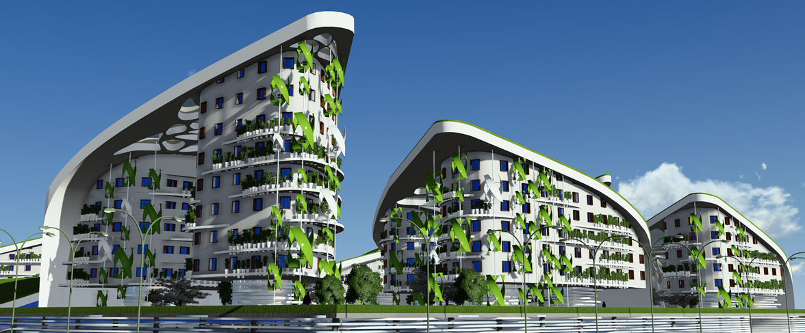



RESIDENTIAL COMPLEX WIND OF CHANGE
KAZAKHSTAN
Satbayev Kazakh National Technical University
Vyssotskaya Alexandra/Kalinina Arina

Slide 2
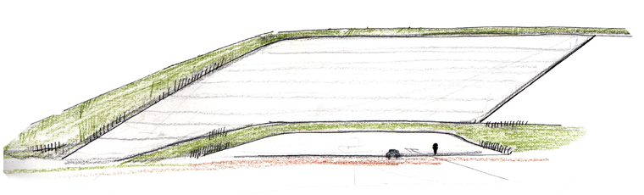
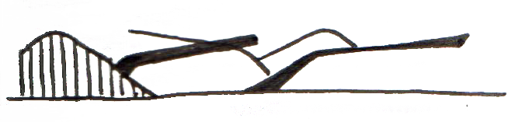
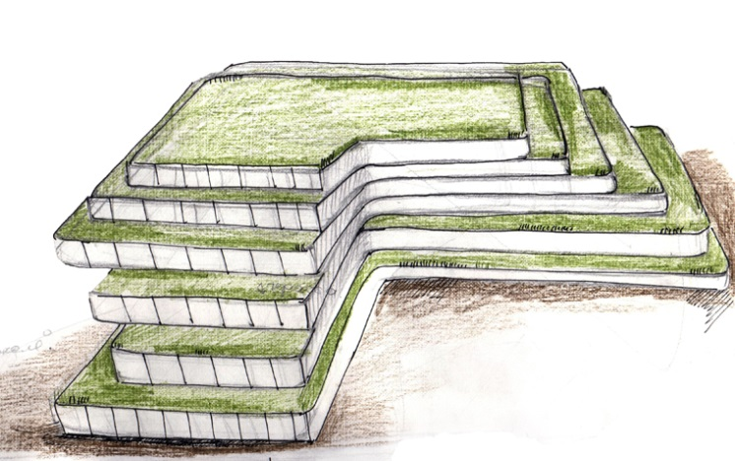
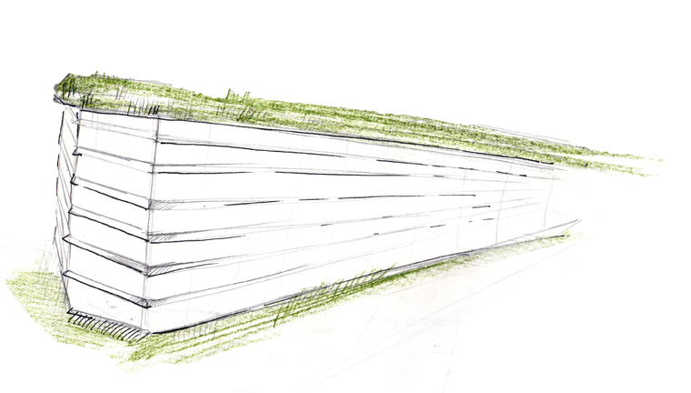
BIRTH OF IDEA

Slide 3


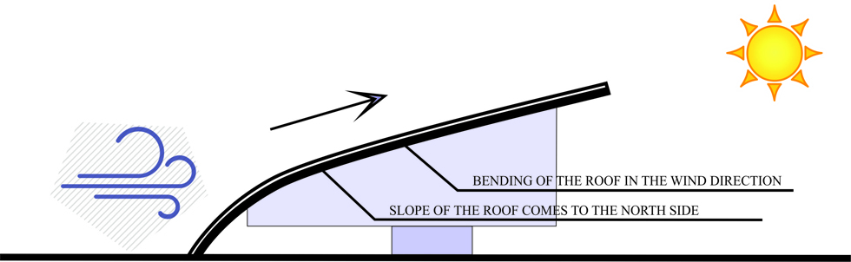
CONCEPT

Slide 4
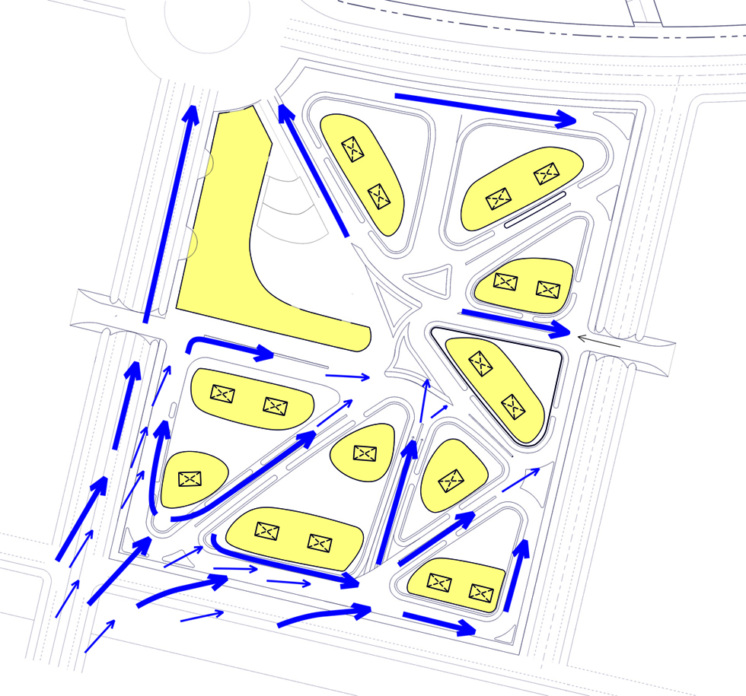
WIND DIAGRAM

Slide 5
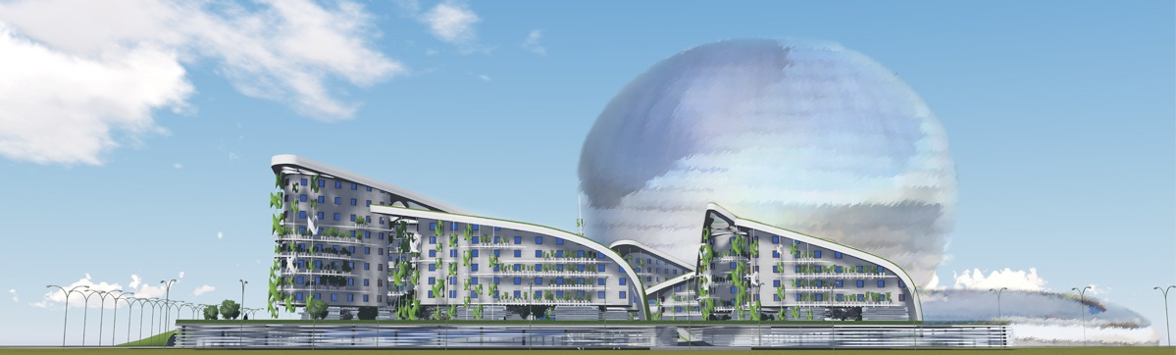
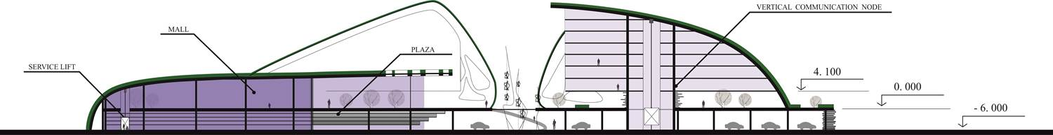
FACADE
SECTION

Slide 6
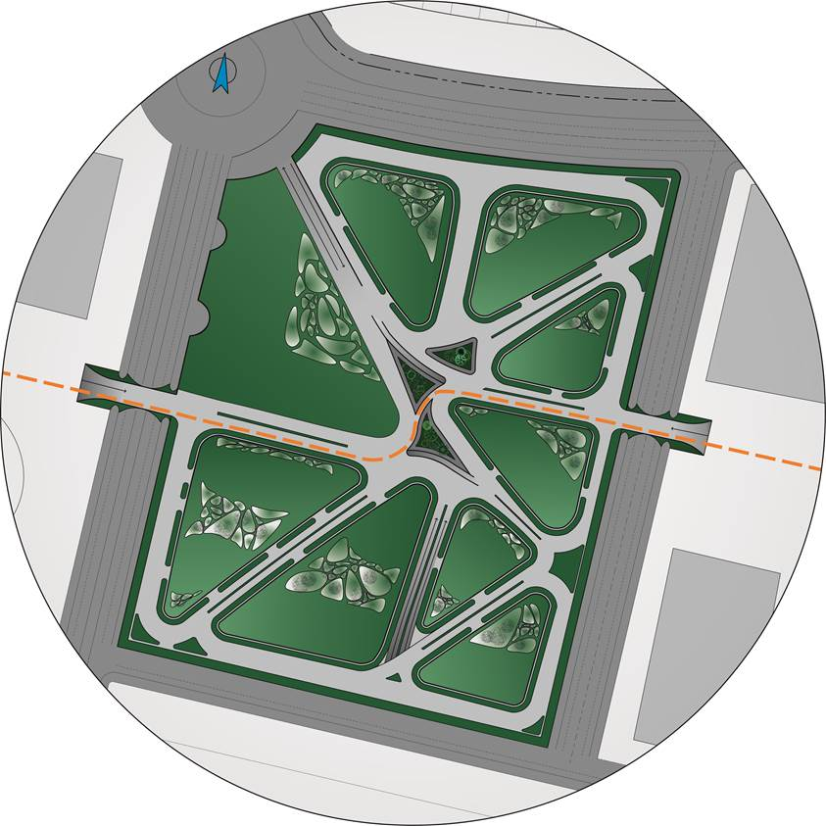
APRTMENT HOUSES
PLAZA
MASTER PLAN

Slide 7
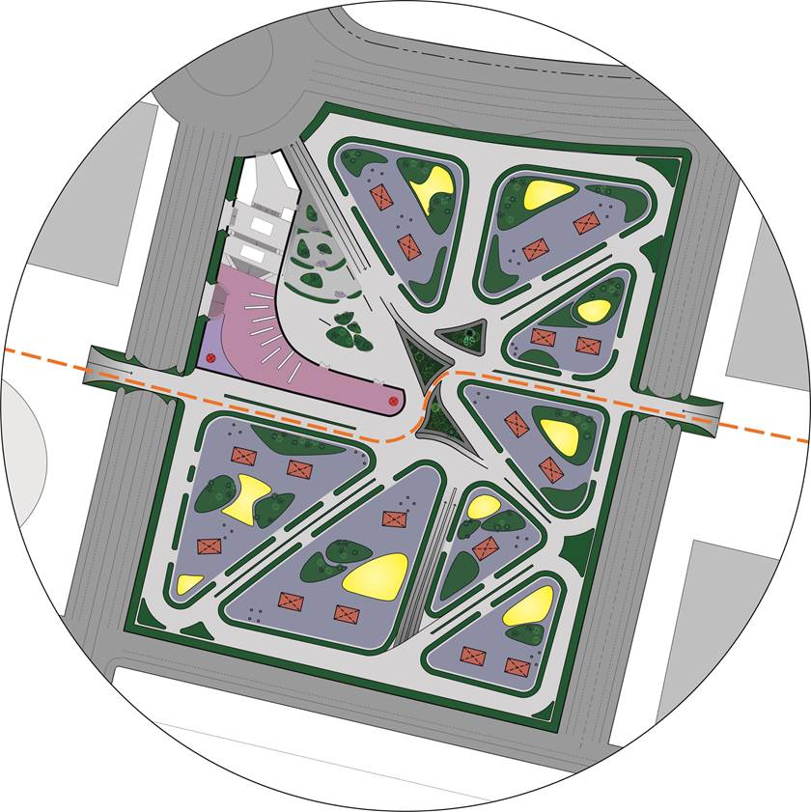
MALL
PLAZA
INTERNAL YARDS
STAIRWELLS
PLAYGROUNDS
ZONING

Slide 8
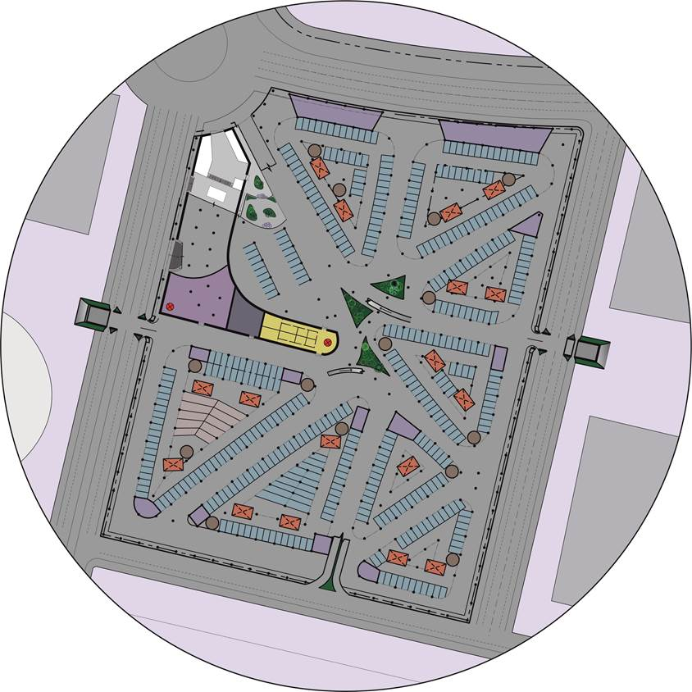
PARKING SPACES
TECHNICAL ROOMS
GARBAGE RESERVOIRS
PARKING PLAN

Slide 9
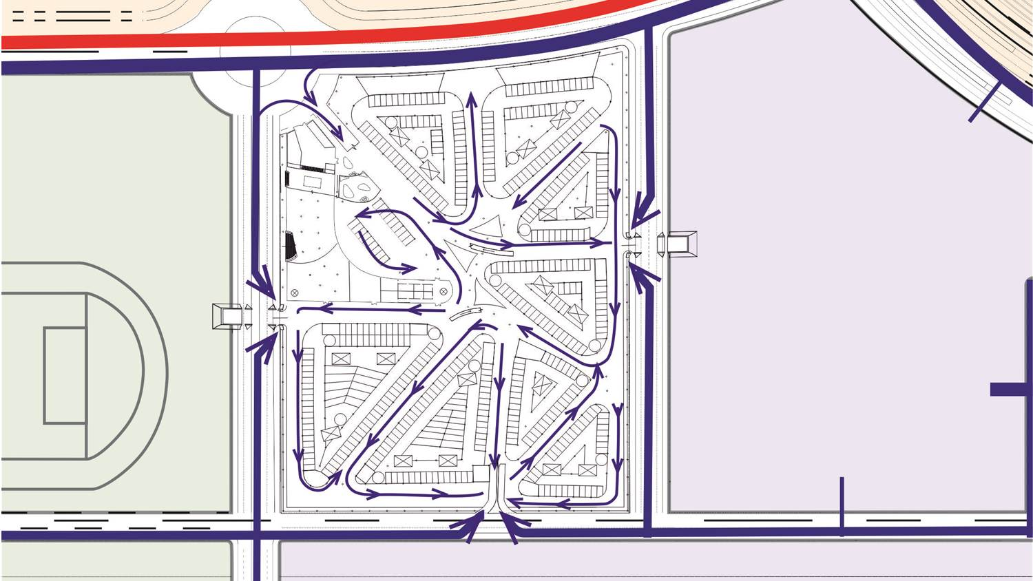
BICYCLE PATH (EXPO)
TRANSPORT CONECTIONS

Slide 10
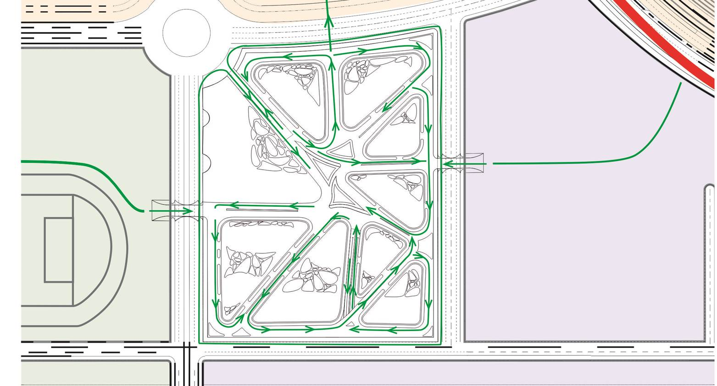
PEDESTRIAN PATHS

Slide 11
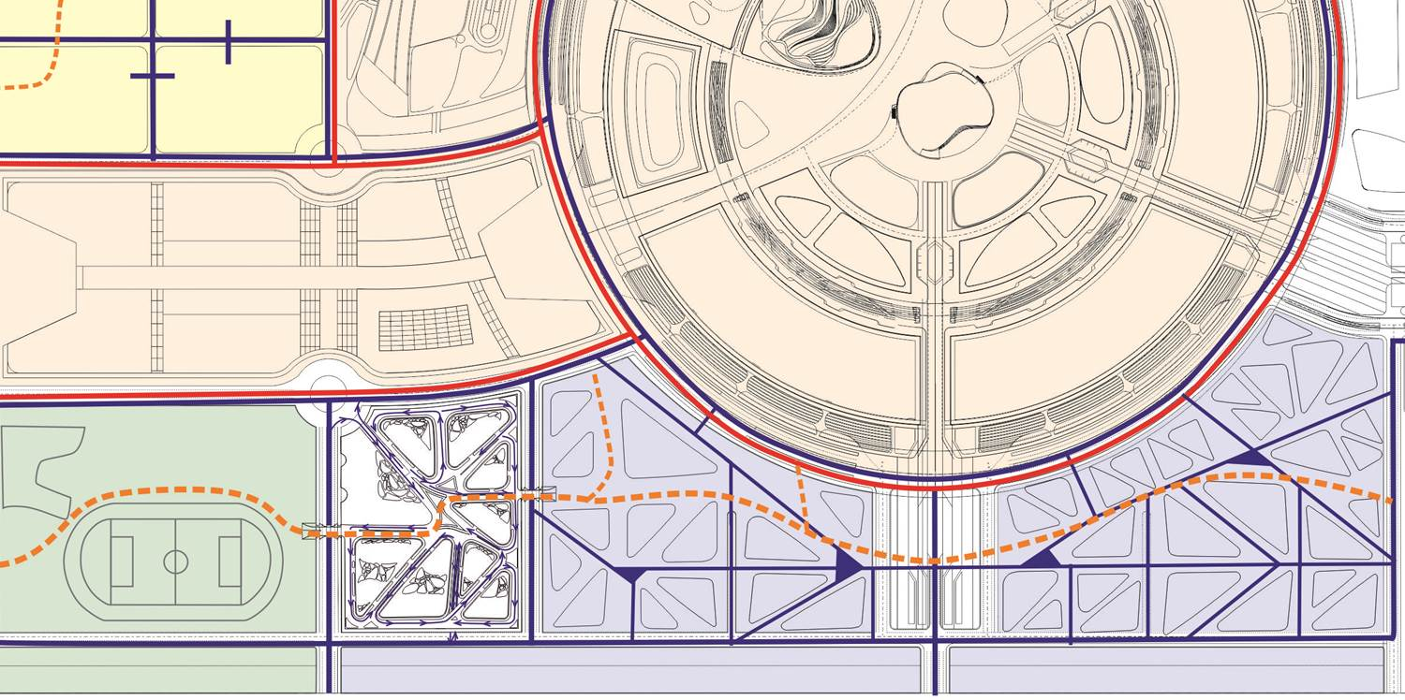
TRANSPORT AND PEDESTRIAN CONECTIONS
BICYCLE PATH (EXPO)
BICYCLE AND PEDESTRIAN PATH

Slide 12
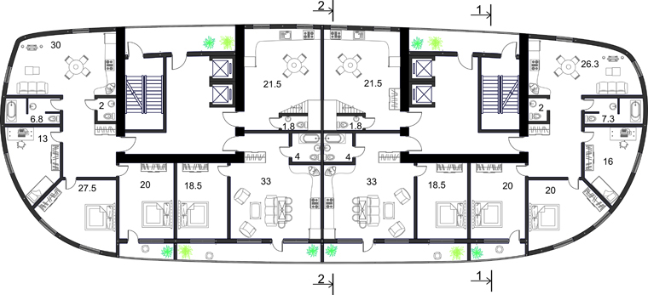
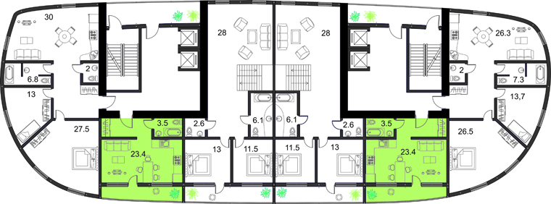
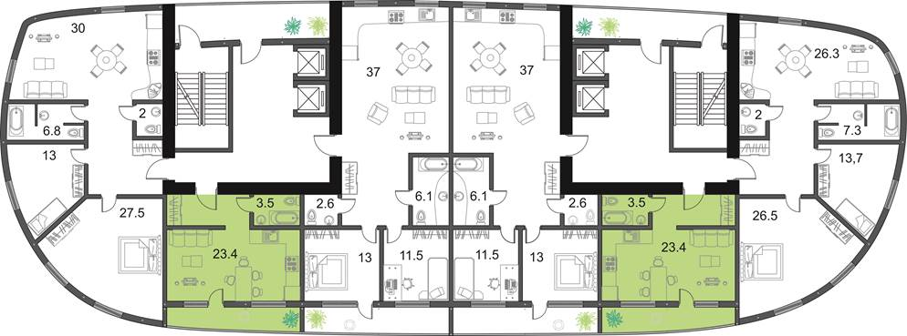
1 BEDROOM APARTMENT
TYPICAL FLOOR PLAN

Slide 13
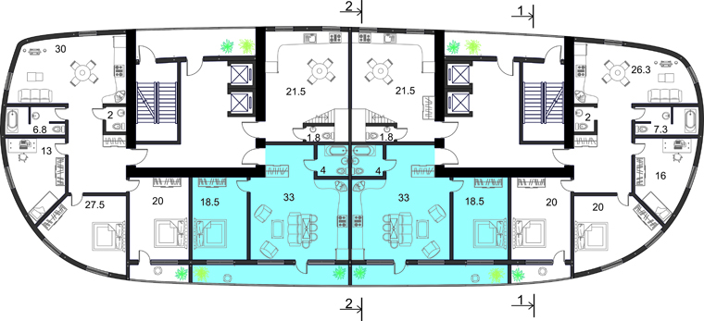
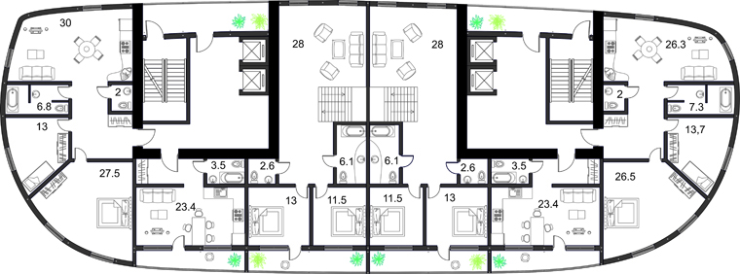
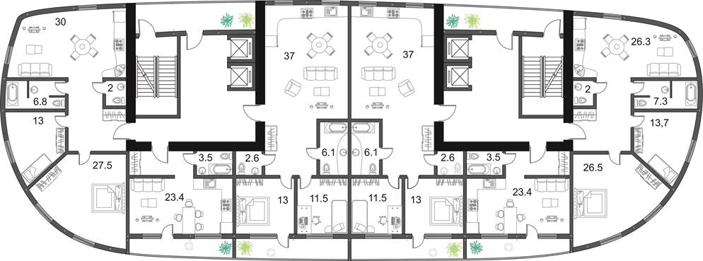
2 BEDROOMS APARTMENT
TYPICAL FLOOR PLAN

Slide 14
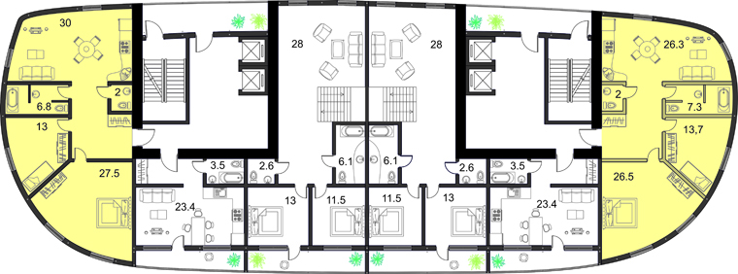
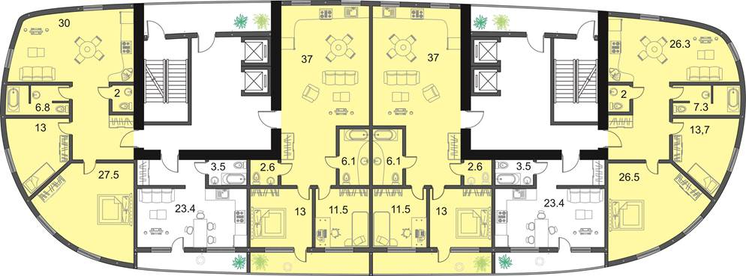
3 BEDROOMS APARTMENT
TYPICAL FLOOR PLAN

Slide 15
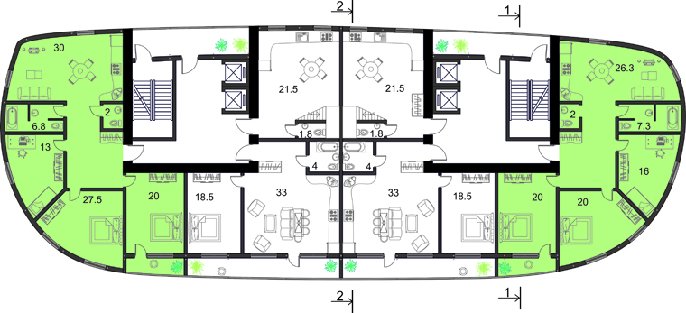
4 BEDROOMS APARTMENT
TYPICAL FLOOR PLAN

Slide 16
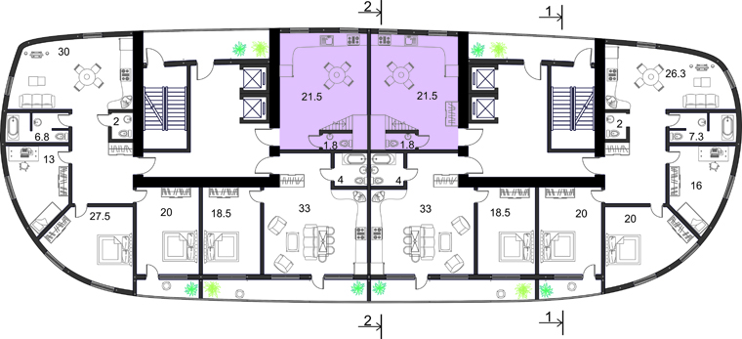
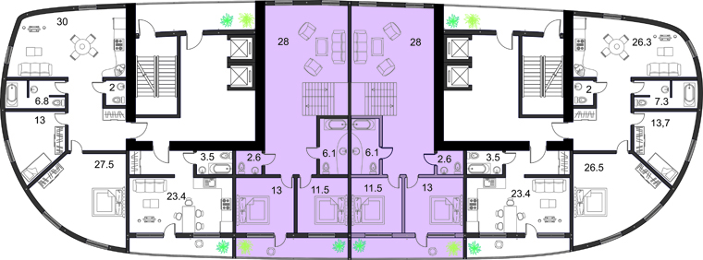
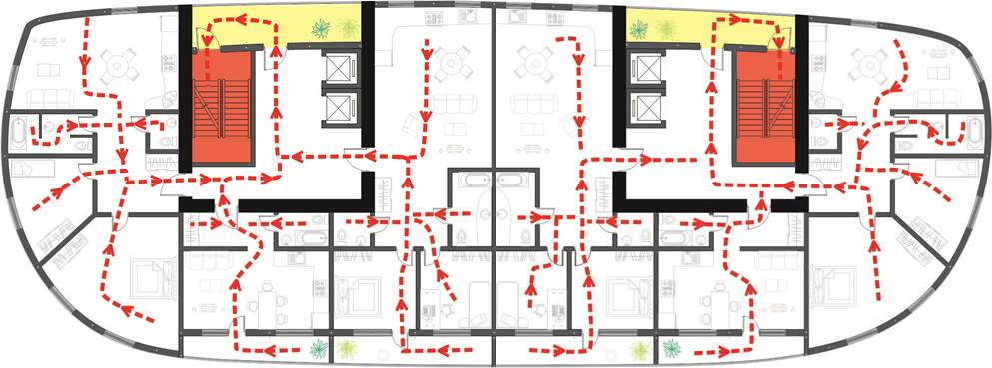
DUPLEX APARTMENT
EVACUATION ROUTES

Slide 17
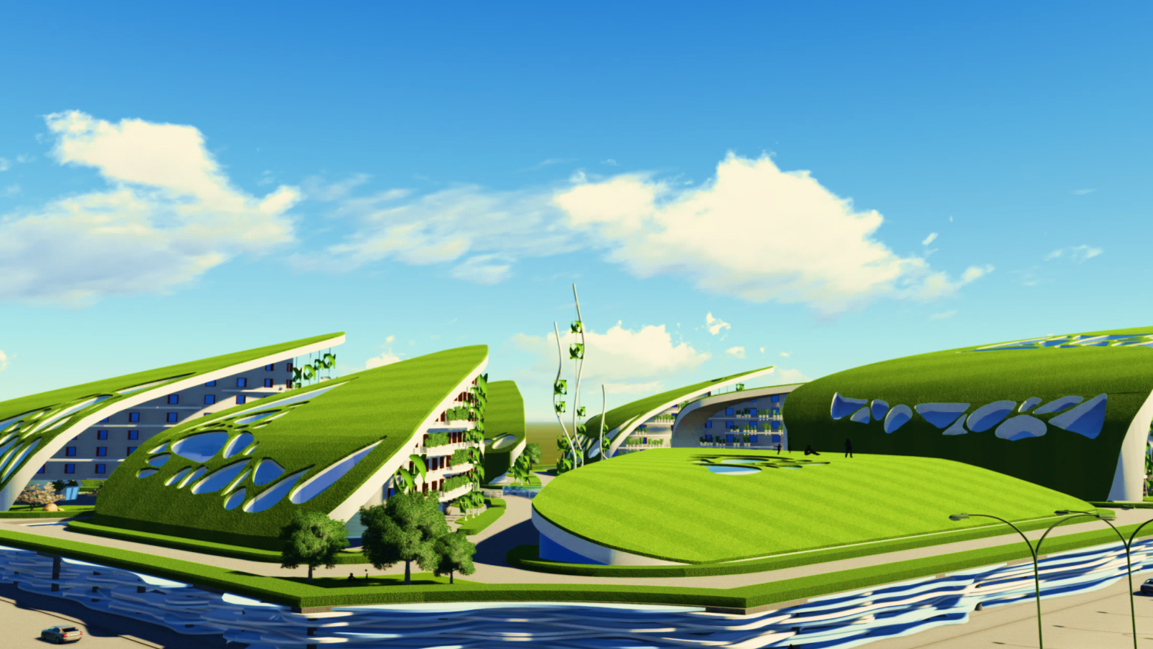
TECHNICAL ASPECTS

Slide 18
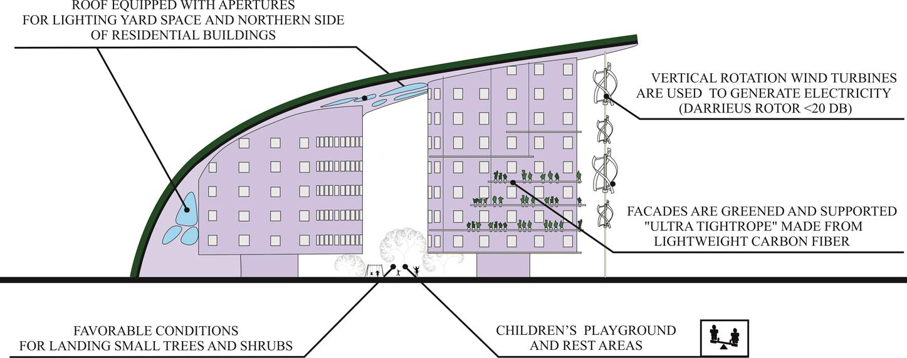
DETAILS

Slide 19
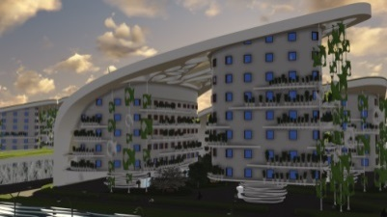
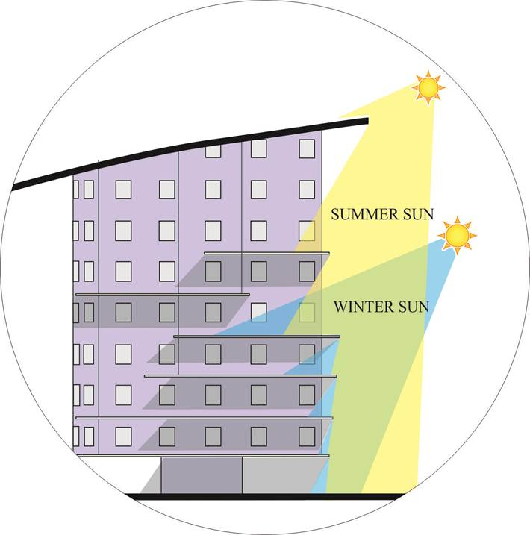
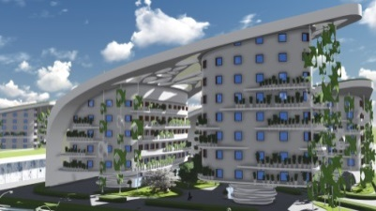
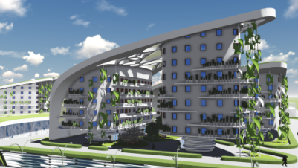
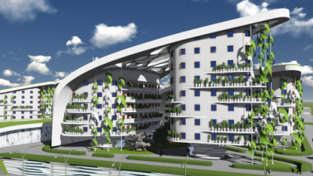
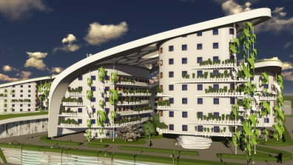
DAYLITHING
6 A.M.
9 A.M.
12 P.M.
3 P.M.
6 P.M.

Slide 20
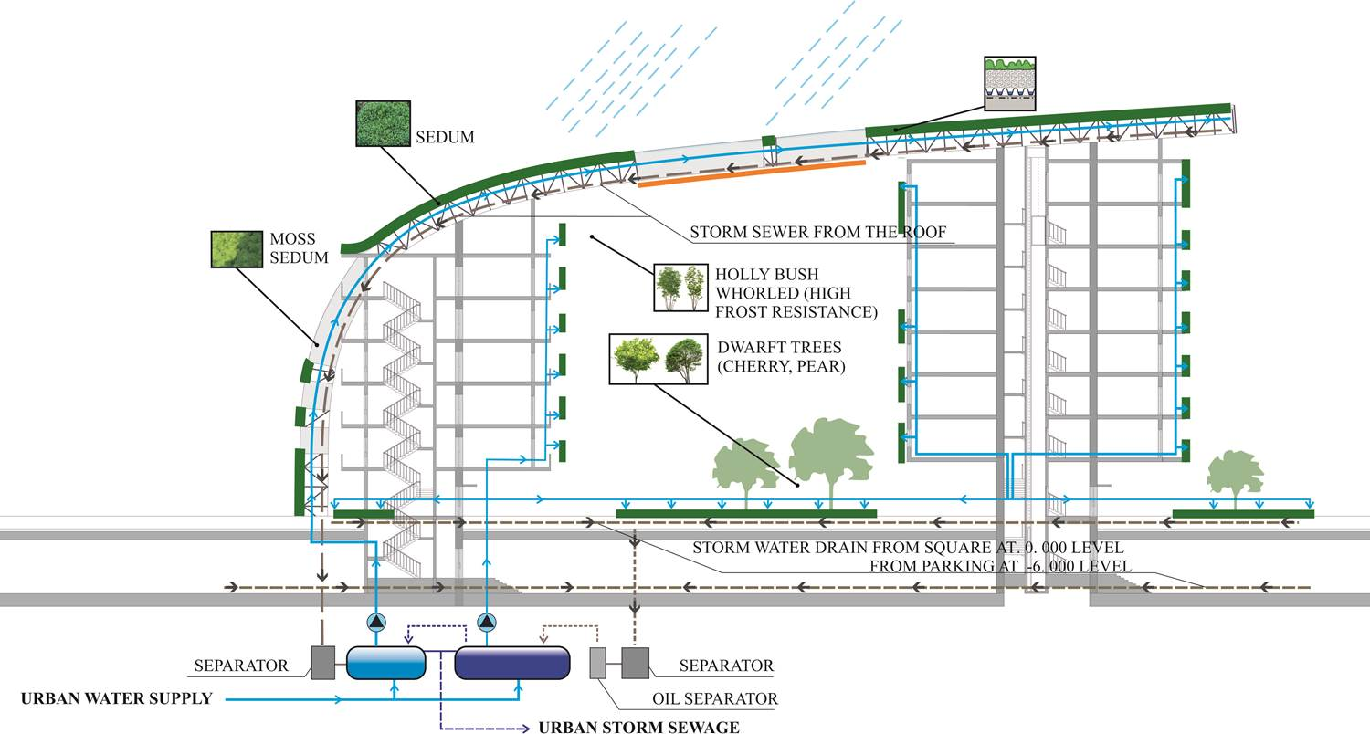
IRRIGATION AND GREENING SYSTEM

Slide 21
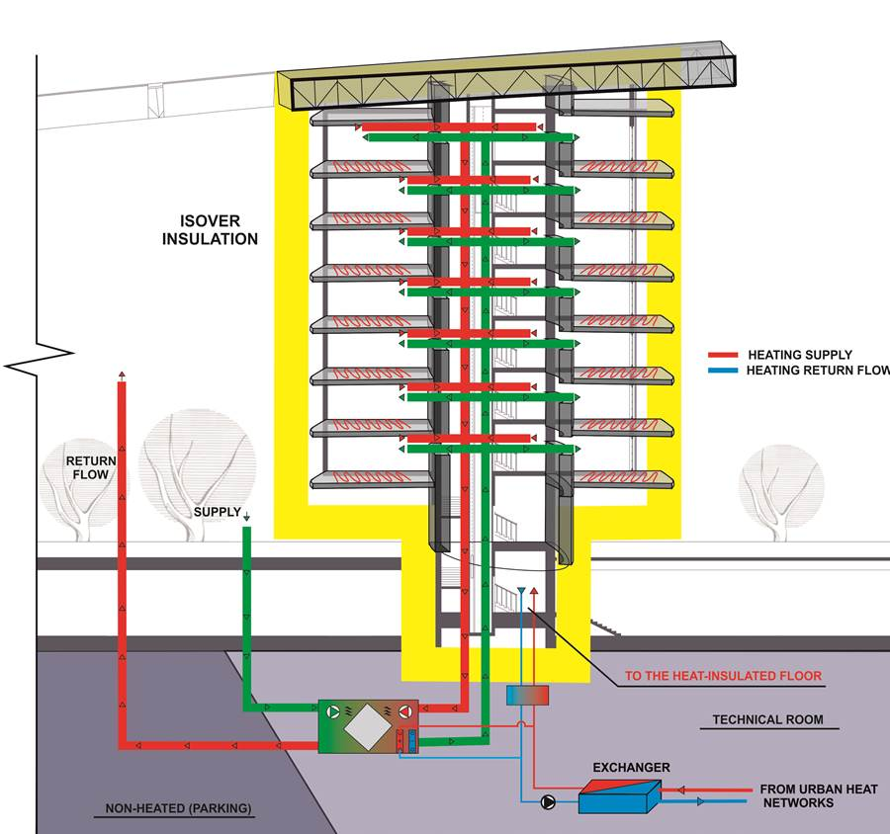
HEATING/COOING SYSTEM
AIRTIGHTNESS 0,6 V/h

Slide 22
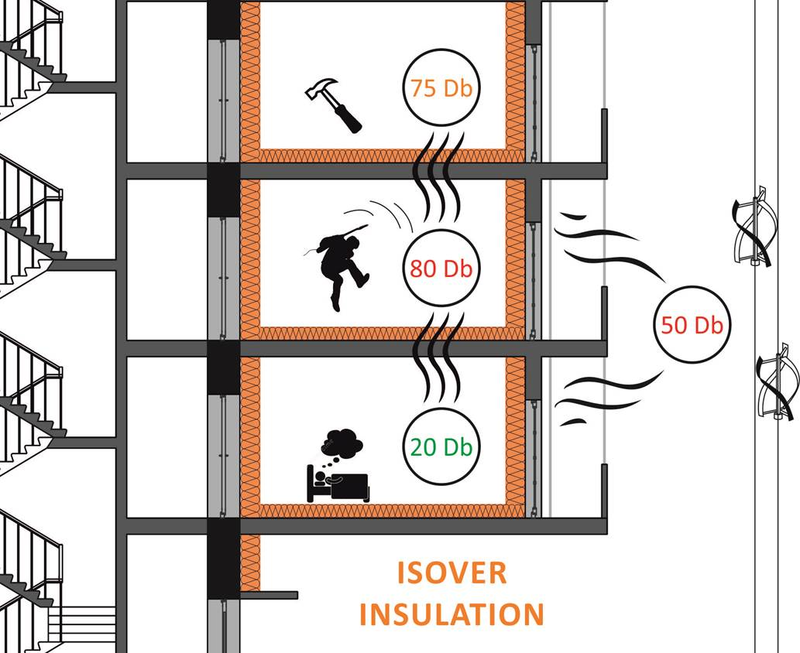
ACOUSTIC
COMFORT
INSULATION
BETWEEN ROOMS 60 Db
EXTERIOR 60 Db
TRIPLE GLAZING SAINT-GOBAIN

Slide 23
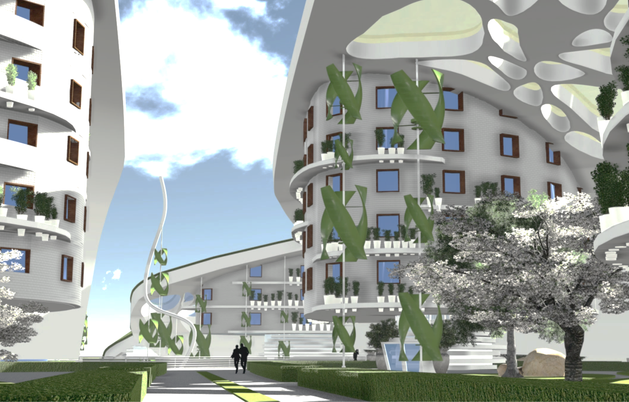
CONSTRUCTION DETAILS

Slide 24
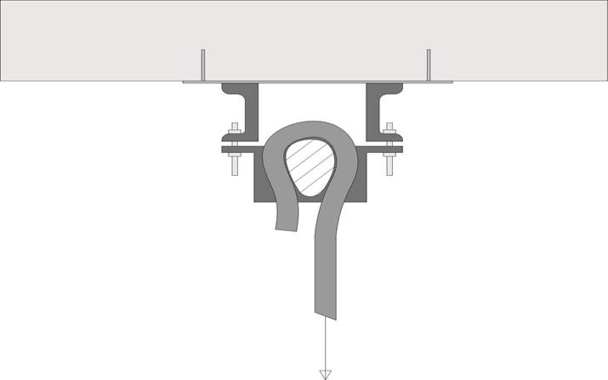
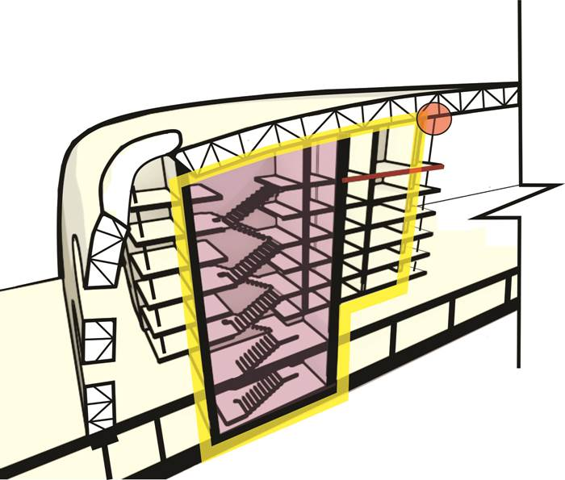
MOUNT SYSTEM

Slide 25
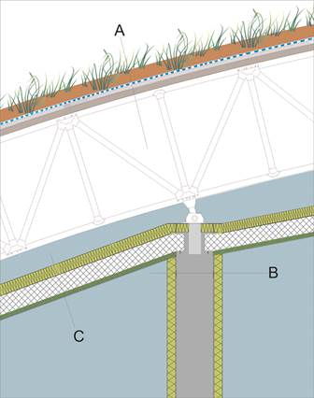
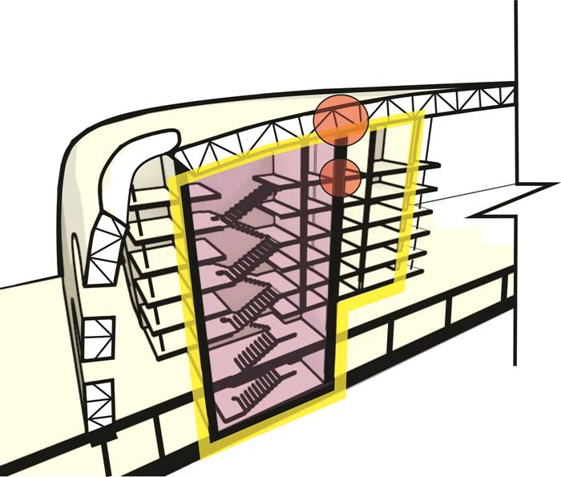
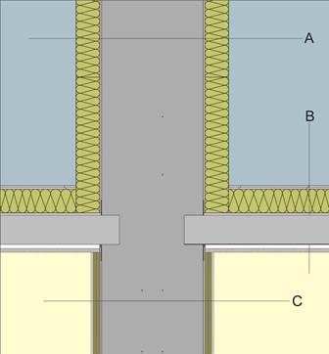
Layer build-up A in cm
20.0 Ground
1.0 Geotextiles
3.0 Drainage membrane
1.0 Geotextiles
10 XPS
2.0 Bitumen-polymer roof membrane
10.0 Roof covering
Space truss
Layer build-up B in cm
15.0 ISOVER Lite
1.0Interior plaster
60.0 Concrete wall
1.0Interior plaster
15.0 ISOVER Lite
Layer build-up С in cm
18.0 ISOVER mineral wool slab
30.0 XPS between concrete rafters
5.0 ISOVER Lite
1.3 Plaster board
MATERIALS
Layer build-up A in cm
15.0 ISOVER Lite
1.0Interior plaster
60.0 Concrete wall
1.0Interior plaster
15.0 ISOVER Lite
Layer build-up B in cm
2.0 Rigips Rigidur screed elements
15.0 ISOVER Topdec Loft
16.0 Concrete ceiling
4.0 Gyproc-Ultra
1,0 GYPROC GN
1,0 GYPROC GN
Layer build-up С in cm
1.0Interior plaster
5.0 ISOVER Akustic
60.0 Concrete wall
5.0 ISOVER Akustic
1.0Interior plaster

Slide 26
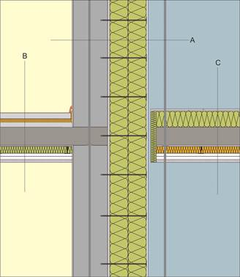
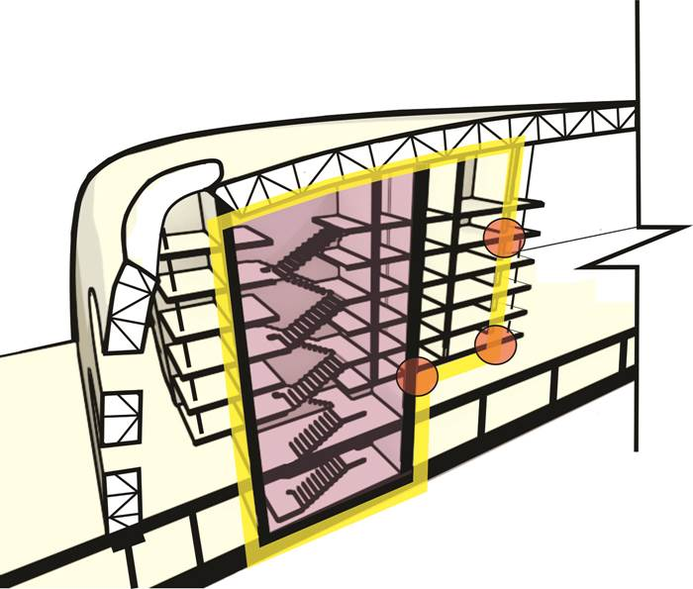
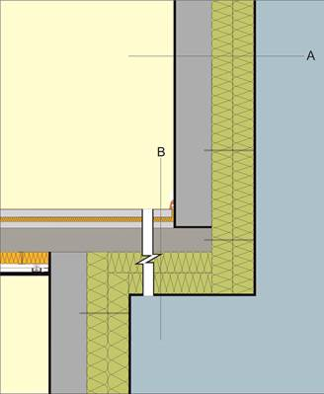
Layer build-up A in cm
1.0Interior plaster
30.0Concrete wall
2.0Exterior plaster
30.0ISOVER Facade (2 x 15 cm)
1.5Thick plaster
Layer build-up B in cm
Floor covering
5.0Cement screed
Separating layer
2.0ISOVER Floating Floor
18.0Concrete ceiling
1.0Interior plaster
5.0 ISOVER Akustic
4.0 Gyproc-Ultra
1,0 GYPROC GN
1,0 GYPROC GN
Layer build-up С in cm
2.0Rigips Rigidur screed elements
20.0ISOVER Floor
16.0Concrete ceiling
1.0Interior plaster
6.0ISOVER Integra UKF 1-032 (bet. Rigips metal
profiles CD 60 with damping)
1.0GYPROC GN
1,0 GYPROC GN
MATERIALS
Layer build-up A in cm
1.0Interior plaster
30.0Concrete wall
2.0Exterior plaster
30.0ISOVER Facade (2 x 15 cm)
1.5Thick plaster
Layer build-up B in cm
Floor covering
5,0Screed
Vapour retarder and separating layers
3,0ISOVER Floating Floor
4,0XPS
16,0Reinforced concrete ceiling
30.0ISOVER Facade (2 x 15 cm)
1,5Thick plaster

Slide 27
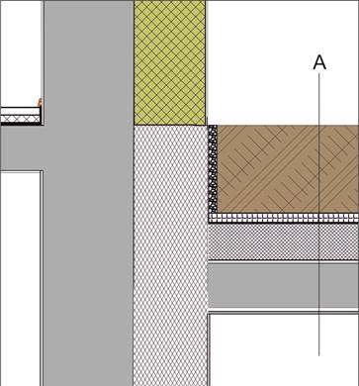
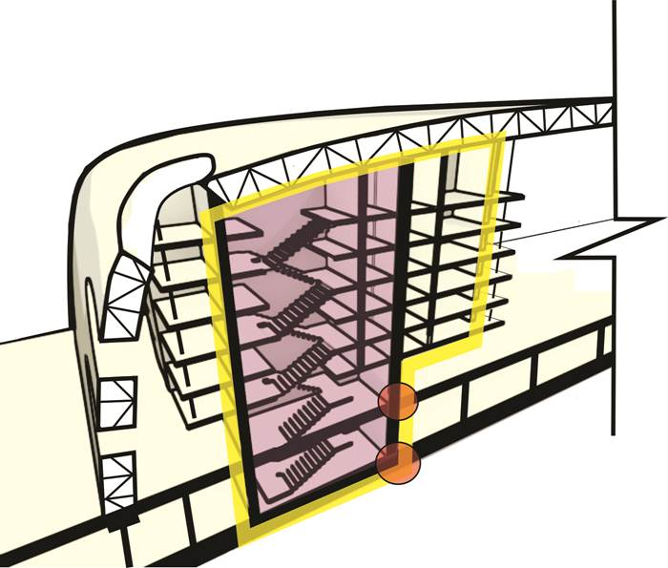
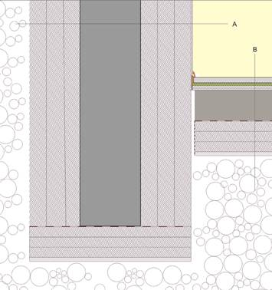
MATERIALS
Layer build-up A in cm
Ground
1.0 Geotextiles
3.0 Drainage membrane
1.0 Geotextiles
30.0 XPS
2.0 Bitumen-polymer roof membrane
30.0 Reinforced concrete ceiling
1.0 Thick plaster
Layer build-up A in cm
1.0 Interior plaster
60.0 ISOVER XPS
60.0 Concrete wall
60.0 XPS
Layer build-up B in cm
Floor covering
5,0Screed
Vapour retarder and separating layer
3,0ISOVER Akustic
4,0 XPS
0,5Sealing against moisture
30,0Concrete foundation slab
Separating layer
30.0 XPS
Granular subbase

Slide 28

Heat Demand Calculations
Transmission Heat Losses: 72367.07 kWh/a
Ventilation Heat Losses: 29408.23 kWh/a
Total Heat Losses: 101775.31 kWh/a
Internal Heat Gains: 26839.21 kWh/a
Available Solar Heat Gains: 38567.55 kWh/a
Total Heat Gains: 62650.41 kWh/a
Annual Heat Demand: 39124.90 kWh/a
Specific Annual Heat Demand: 16.38 kWh/(m²a)
Average U-Values
Flat Roof 0.11 W/(m²K)
Wall against air: 0.11 W/(m²K)
Slab against ground: 0.10 W/(m²K)
Slab against unheated cellar: 0.16 W/(m²K)
Windows 0.73 W/(m²K)
Doors: 0.80 W/(m²K)

Slide 29

THANK YOU!

