Slide 1
Senior Project: entervue
Advisor: Fatih Demirci
Nurzhigit Askaraliyev Arslan Aimenov Ansar Askhat Sergey Kim

Slide 2

introduction
Mock-interview simulating Mobile App Practice questions
Train and Real modes for interview
IT jobs: frontend developer, backend developer, database administration, data science, software engineering
Used tools and applications: FlutterFlow, Firebase, OpenAI API, Flutter TTS and STT packages .

Slide 3
achievements
Sign Up / Login
Multiple-Choice Questions Training Mode (100 questions per section)
AI-Interviewer (via ChatGPT API) Speech-to-Text (for interviewer) Text-to-Speech (for user)
User Evaluation and Feedback Tracking User Progress
Admin Page

Slide 4
demonstration

Slide 5
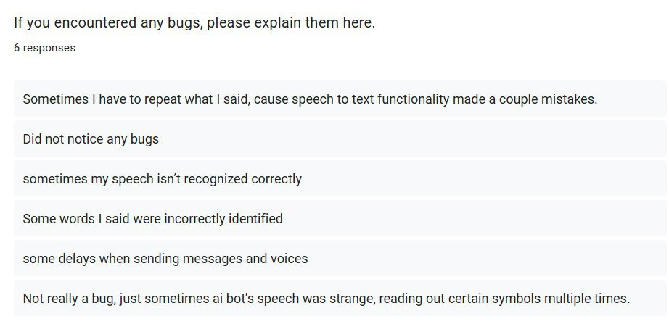
evaluation

Slide 6
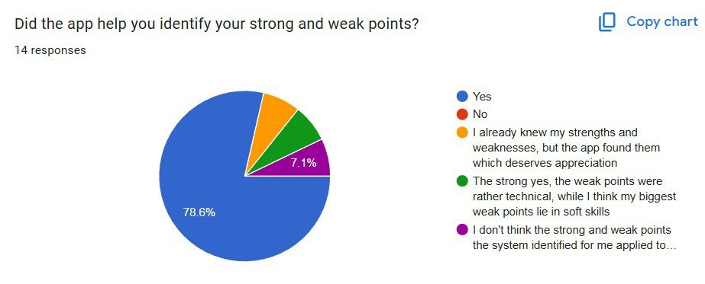
evaluation

Slide 7
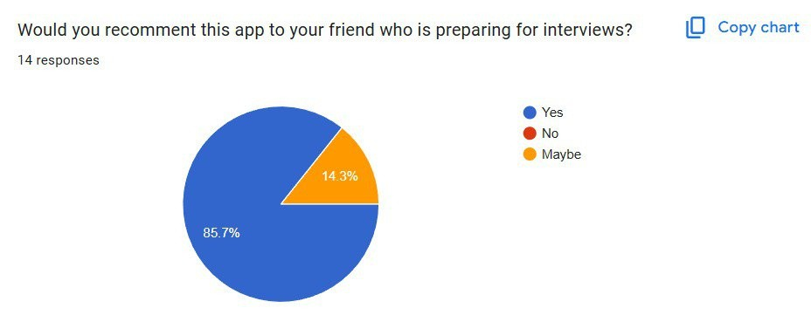
evaluation

Slide 8

future plans
Increase question diversity across all job positions. Optimize AI behavior and response generation during mock interviews.
Conduct additional testing and refinement before launching the app publicly.
Use more advanced TTS and SST libraries
9

Slide 9
conclusion
Key Findings and Contributions
Successfully developed an interview preparation app supporting both technical and soft skill development. Integrated customizable question banks with manual difficulty selection for each question.
Implemented real-time AI feedback and progress tracking features.
Created a realistic environment for job seekers to enhance interview-taking skills.
10

Slide 10
thanks for watching!
prepare for your entervue with us

