Slide 1

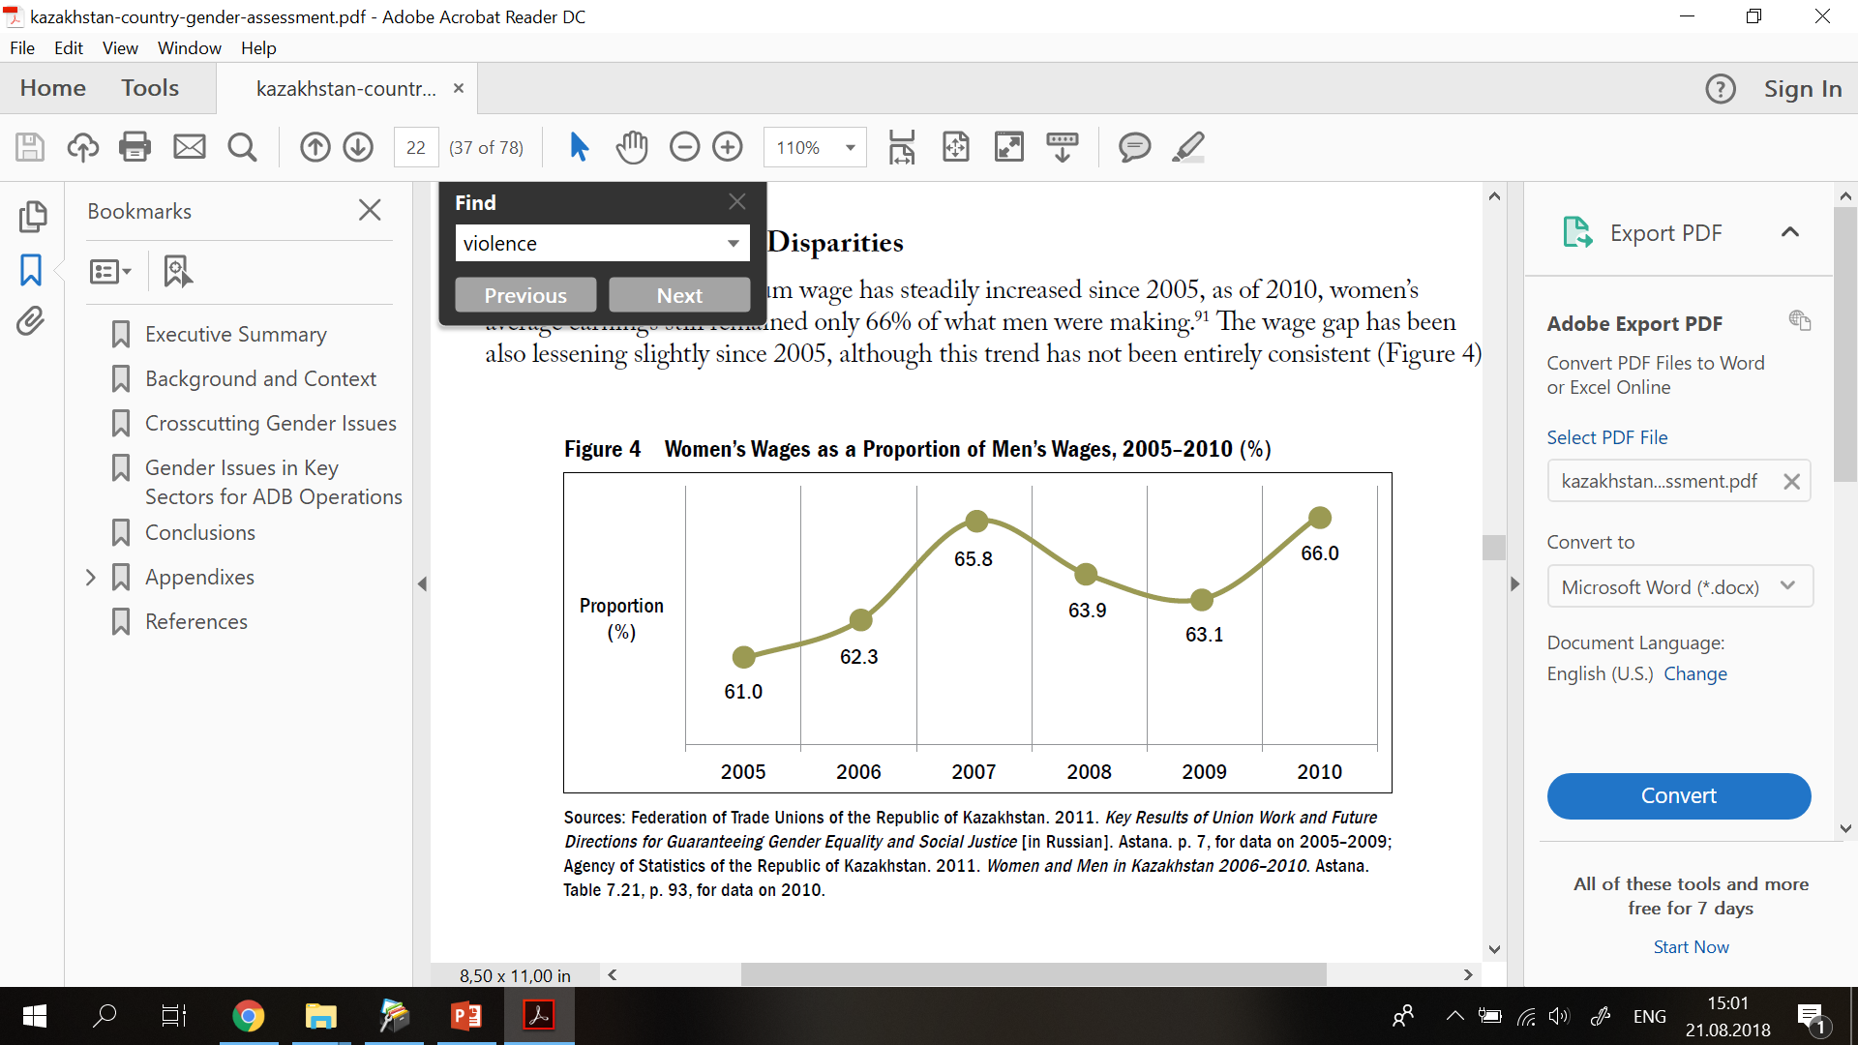
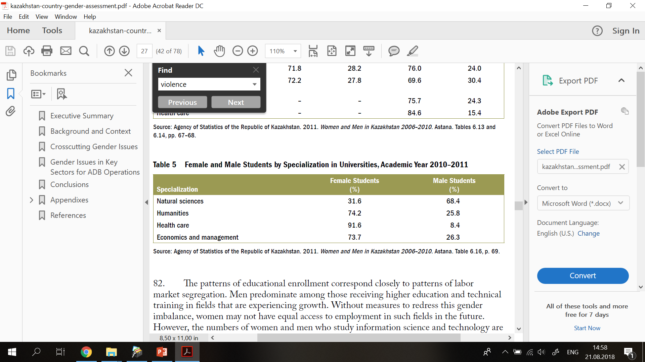
Evolving Gender Issues and Women's Movements in Kazakhstan
Zarina Malik, SeJin Koo
Department of Political Science and International Relations,
School of Humanities and Social Sciences, Nazarbayev University
INTRODUCTION
Despite of women’s legally having equal rights and opportunities, they are still disadvantaged in numerous aspects of life, including education, labor, wage, and marriage. Studies on which and in what context gender issues have been raised in this region are rare. This research addresses these gaps in the literature by focusing on recent women’s movements, especially their origins, strategies, and activities. Particularly, “#НеМолчиKZ” is a new Kazakhstani women’s movement against gender-based violence which encourages women to speak up and fights for women’s rights. We examine Facebook posts with the hashtag content analysis methods.
2. Gender inequality in labor market.
Opportunities for women mainly depend on the informal sector or in self-employment. They are underrepresented in upper managerial positions and are primarily responsible for childcare and unpaid domestic work. It also contributes directly to the gender wage gap.
Table 2 Online users’ responses to posts related to sexual harassment against children, adults, in the workplace, and by family members through likes, comments, and reposts
Variable | 0 – no 1 – yes | Number | Average number of
 |  |  | Likes | Comments | Reposts
childHar | 0 | 157 | 32.22 | 5.48 | 13.89
 | 1 | 42 | 85.80 | 5.04 | 19.71
adultHar | 0 | 138 | 16.11 | 1.55 | 3.97
 | 1 | 61 | 105.57 | 14.06 | 40.34
workHar | 0 | 191 | 43.26 | 4.95 | 15.09
 | 1 | 8 | 50 | 15.87 | 15.75
famHar | 0 | 162 | 48.80 | 5.82 | 17.50
 | 1 | 37 | 20.45 | 3.51 | 4.72
Figure 2 Women’s Wages as a Proportion of Men’s Wages, 2005-2010 (%)
METHODS
The results of this research are based on the subjective analysis of online Facebook posts with “#НеМолчиKZ” hashtag. We have conducted categorization and a numerical coding of 200 post and illustrated the results using STATA programming language.
H1: Cases of sexual harassment against children will receive more responses that that of against adults
H2: Specific content will receive more responses than vague ones
H3: Kazakhstani online users are less likely to pay attention to posts related to laws and addressing the government officials and bodies
Table 3 Online users’ responses to posts related to non-sexual harassment against children and adults through likes, comments, and reposts
Variable | 0 – no 1 – yes | Number | Average number of
 |  |  | Likes | Comments | Reposts
child_nosx | 0 | 160 | 49.20 | 6.00 | 17.59
 | 1 | 39 | 20.28 | 2.87 | 5.00
adult_nosx | 0 | 124 | 55.84 | 5.97 | 17.60
 | 1 | 75 | 23.35 | 4.48 | 11.09
3. Gender-based violence and bride-abduction
The implementation of gender related laws in Kazakhstan are not yet complete. There are no existing workplace policies on sexual harassment. The cases of bride abduction are becoming more frequent in Kyrgyzstan and Kazakhstan. Girls and women rarely disagree to marry because of public shame and social pressure.
Table 4 Online users’ responses to posts related to other issues through likes, comments, and reposts
Variable | 0 – no 1 – yes | Number | Average number of
 |  |  | Likes | Comments | Reposts
org_announ | 0 | 121 | 57.13 | 6.67 | 18.16
 | 1 | 78 | 22.44 | 3.39 | 10.41
edu_prom | 0 | 131 | 58.32 | 7.58 | 21.29
 | 1 | 68 | 15.05 | 1.17 | 3.25
law | 0 | 169 | 47.61 | 5.85 | 16.53
 | 1 | 30 | 20.56 | 2.76 | 7.16
govoff | 0 | 159 | 41.23 | 4.81 | 9.43
 | 1 | 40 | 52.67 | 7.675 | 37.75
4. Categorization of posts
Vagueness (1-4)
Sexual harassment: against children/against adults/in the workplace/by a family member
Non-sexual harassment: against adults/against children
Other issues: organizational activities/educational & promotional/addressing the government/regarding law
RESULTS
Gender stereotypes in education.
Young men in Kazakhstan are more likely to major in technical fields, whereas women predominate in such fields as the humanities, health, and education which traditionally result in lower-wage jobs such as those in the public sector.
Table 1 Online users' responses to the vagueness of the posts
Vagueness | Number of posts | Likes |  | Comments |  | Reposts
 |  | Average | Max. | Average | Max. | Average | Max.
1 | 27 | 5.81 | 20 | 0.07 | 1 | 0.62 | 4
2 | 43 | 7.79 | 54 | 0.55 | 7 | 1.65 | 15
3 | 39 | 36.15 | 701 | 2.05 | 30 | 21.71 | 691
4 | 90 | 75.13 | 2700 | 10.74 | 325 | 23.05 | 668
CONCLUSIONS AND RECOMMENDATIONS
sexual harassment against children does not receive more responses than that against adults (H1 is rejected)
posts with specific content are likely to receive more responses than vague ones (H2 is confirmed)
Kazakhstani online users are less likely to pay attention to posts related to laws and addressing the government officials and bodies (H3 is confirmed)
Figure 1 Female and Male Students by Specialization in Universities Academic Year 2010-2011
Asian Development Bank (2013). Country Gender Assessment: Republic of Kazakhstan.
Ishkanian, A. (2003). VI. Gendered Transitions: The Impact of the Post-Soviet Transition on Women in Central Asia and the Caucasus. Perspectives On Global Development And Technology, 2(3), 475-496.
Werner, C. (2009). Bride abduction in post-Soviet Central Asia: marking a shift towards patriarchy through local discourses of shame and tradition. Journal Of The Royal Anthropological Institute, 15(2), 314-331.

