Slide 1




New roles of libraries in the 21st century: approaches and experiences
Hakan Hilmi KAPUCU
Head of Library and Documentation Department
www.isikun.edu.tr

Slide 2

Generations
Traditionalists borned in between 1900 and 1945
Baby Boomers borned in between 1946 and 1964
Generation X borned in between 1961 and 1981
Generation Y (Digital Immigrants) borned in 1980 and 1990s.
Generation Z (Digital Natives) after 2000’s
Nazarbayev University - Library Connect | May 31 – June 1, 2017

Slide 3
21st Century Skills for Students and Teachers
Learning Skills
  Civic literacy, Global awareness, Financial literacy, Health literacy, Environmental literacy, Visual literacy
Innovation Skills
  Communication and collaboration, Communicate Clearly, Collaborate with Others, Critical thinking and problem solving, Creativity and innovation
Life and Career Skills
  Leadership and responsibility, Productivity and accountability, Social and cross-cultural skills
Information, Media, and Technology Skills
  Media literacy, Information literacy, Technological literacy, Game-Based Learning, Support Systems
Nazarbayev University - Library Connect | May 31 – June 1, 2017

Slide 4
21st Century Skills for Business
Top 10 skills for the successful 21st-century worker
Adaptability
Communication
Global Citizenship
Leadership
Innovation
Critical Thinking
Analyzing Information
Collaboration
Productivity
&
Accountibility
Entrepreneuralism
Nazarbayev University - Library Connect | May 31 – June 1, 2017

Slide 5

The Only Thing That Is Constant Is Change
- Heraclitus
Nazarbayev University - Library Connect | May 31 – June 1, 2017

Slide 6
As a Result of The Change,
Are We Ready for Transformation?
Nazarbayev University - Library Connect | May 31 – June 1, 2017

Slide 7
New Roles of Libraries in 21st Century
Information Literacy
Technology Literacy
Plagiarism Detective
Academic Reference Services
Bibliometric Analysis
Open Access Management
National & International Collaboration
E-resources Management
Nazarbayev University - Library Connect | May 31 – June 1, 2017

Slide 8
New Roles of Libraries in 21st Century
Webinar
Tutorials (Library Services)
Third place
  What do you think about third place?
  Where is your third place?
  Who prefers the library as a third place?
24/7 access
Nazarbayev University - Library Connect | May 31 – June 1, 2017

Slide 9
Web
Social Media
Mobile Apps
Phone
E-Mail
Face to Face
Automation System
Courses
Nazarbayev University - Library Connect | May 31 – June 1, 2017

Slide 10
Where is the user,
the library is there!
Nazarbayev University - Library Connect | May 31 – June 1, 2017

Slide 11
Approaches
E-resources instead of Printed Books
User Friendly
Open Access instead of Non-Open Access
Unlimited Access instead of Limited Access
Distance Education and Off Campus Access
Mobile Applications / Social Media Platforms
User Satisfaction in 21st Century
Integration of Multiple Platforms
Nazarbayev University - Library Connect | May 31 – June 1, 2017

Slide 12
Experiences
Enhanced Automation System
  Quality, Support, Language, Interface, Cloud, Search
Mobile Application
  Barcode, QRCode, Account Management, Search
Social Media Application
Enrichment of metadata of printed materials
Nazarbayev University - Library Connect | May 31 – June 1, 2017

Slide 13

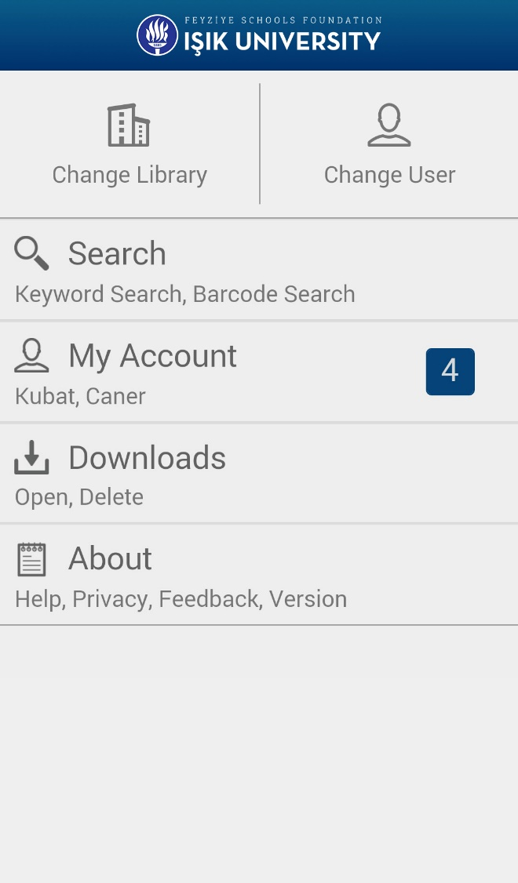
Mobile Library
Account Management
Hold
Renew
Search
ISBN/ISSN Control
Barcode Scan

Slide 14
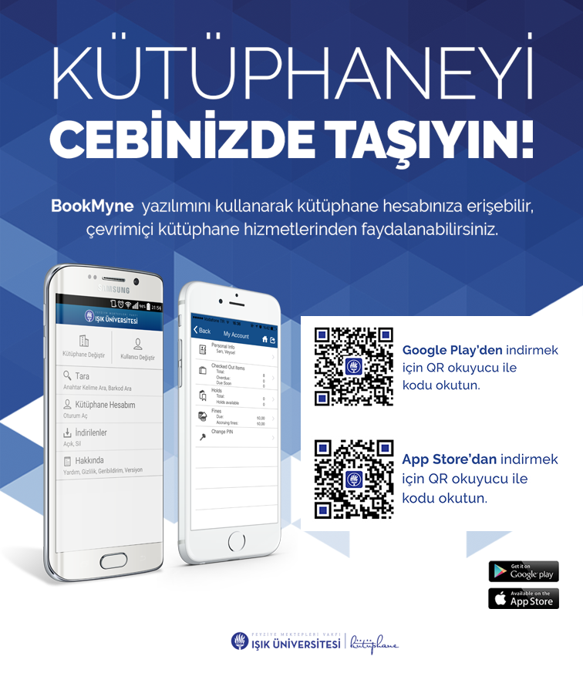
Carry the library in your pocket!
Nazarbayev University - Library Connect | May 31 – June 1, 2017

Slide 15
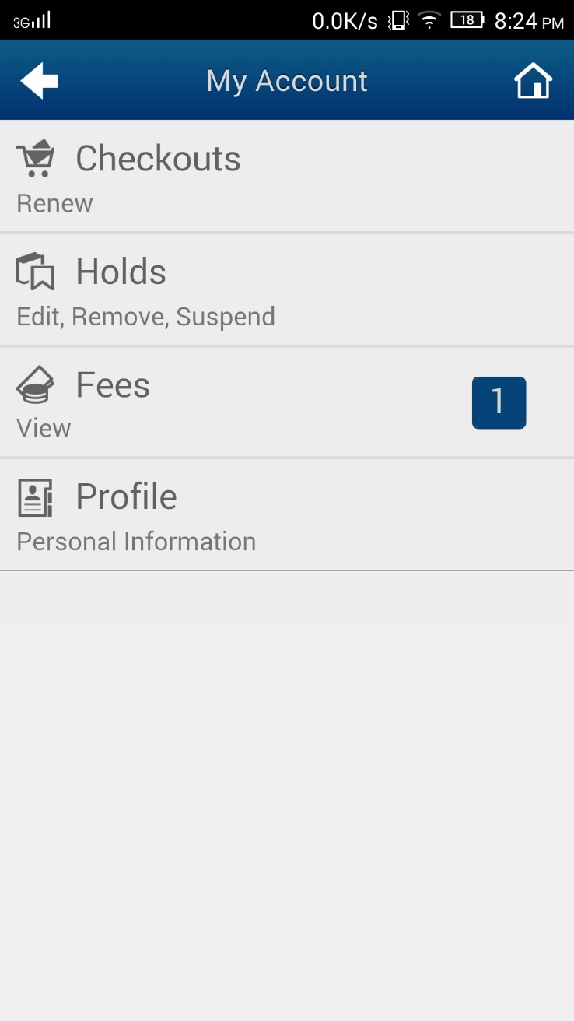
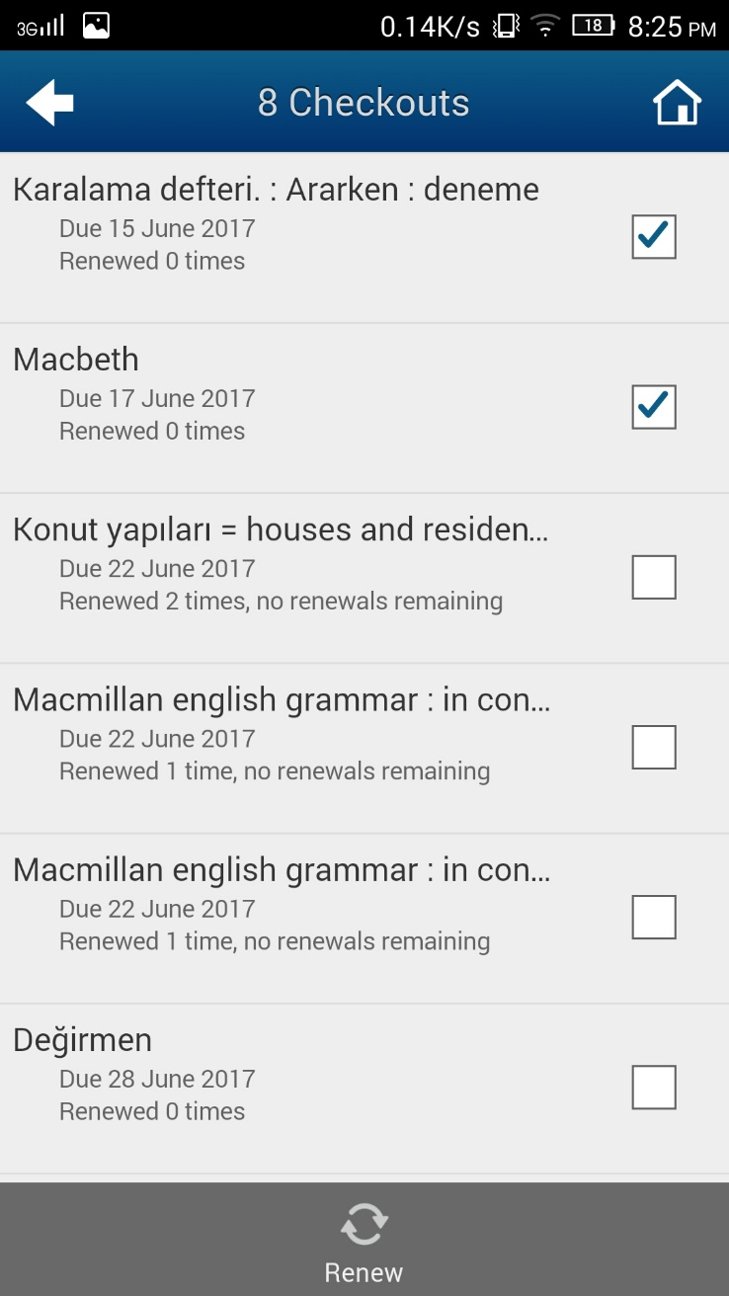
Renew Page
Nazarbayev University - Library Connect | May 31 – June 1, 2017

Slide 16

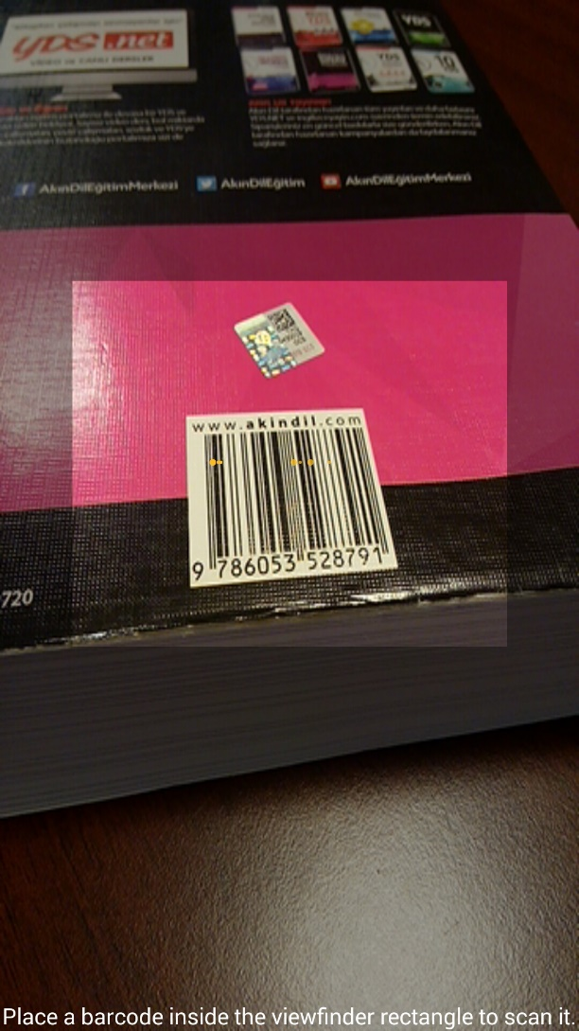
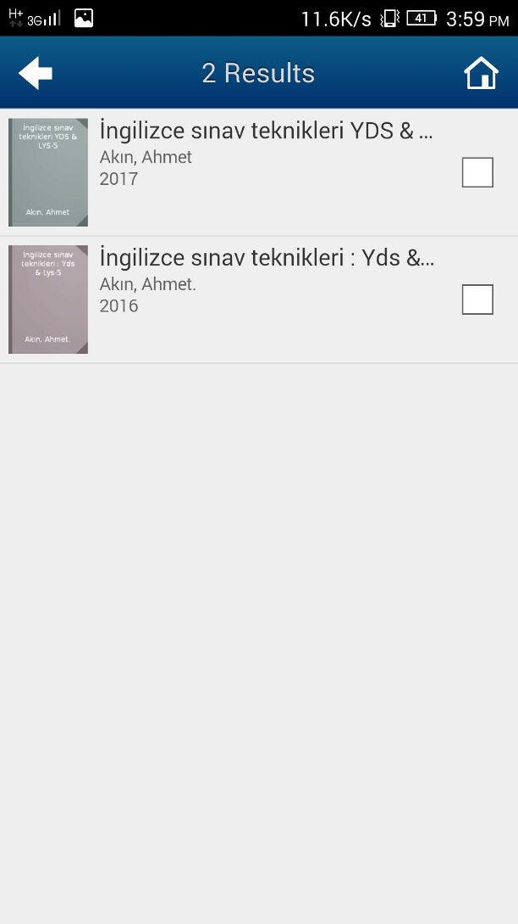
ISBN Scanner
Nazarbayev University - Library Connect | May 31 – June 1, 2017

Slide 17
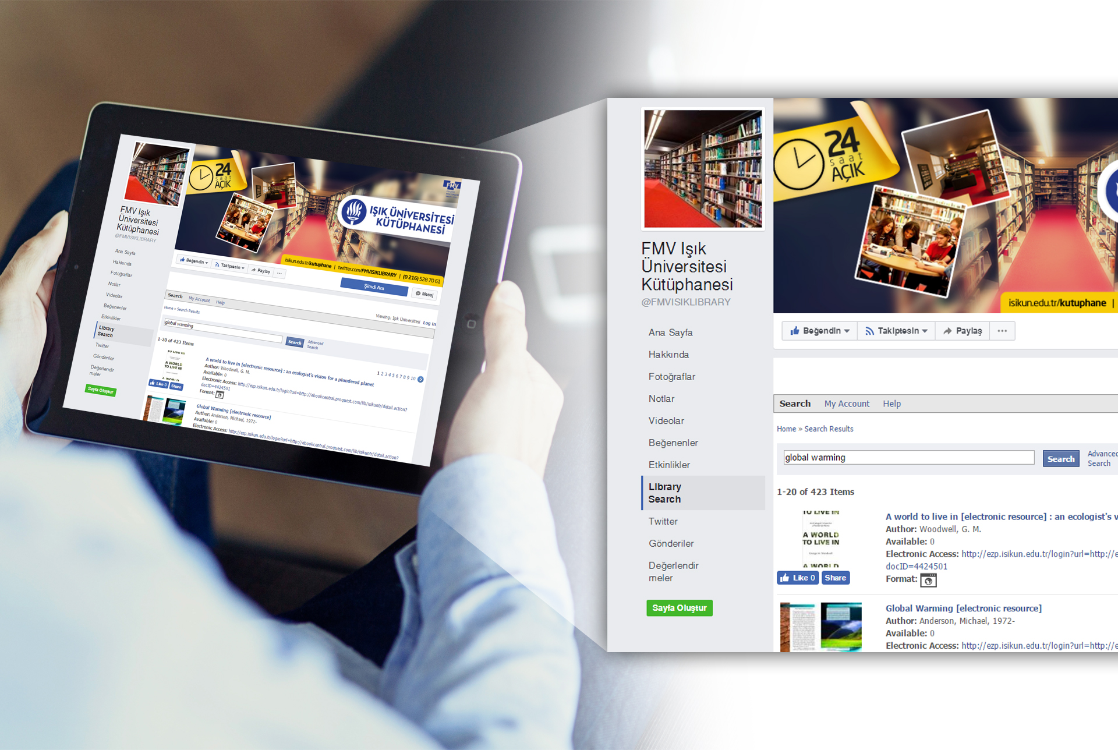
Social Media Entegration (Facebook Page)
Nazarbayev University - Library Connect | May 31 – June 1, 2017

Slide 18
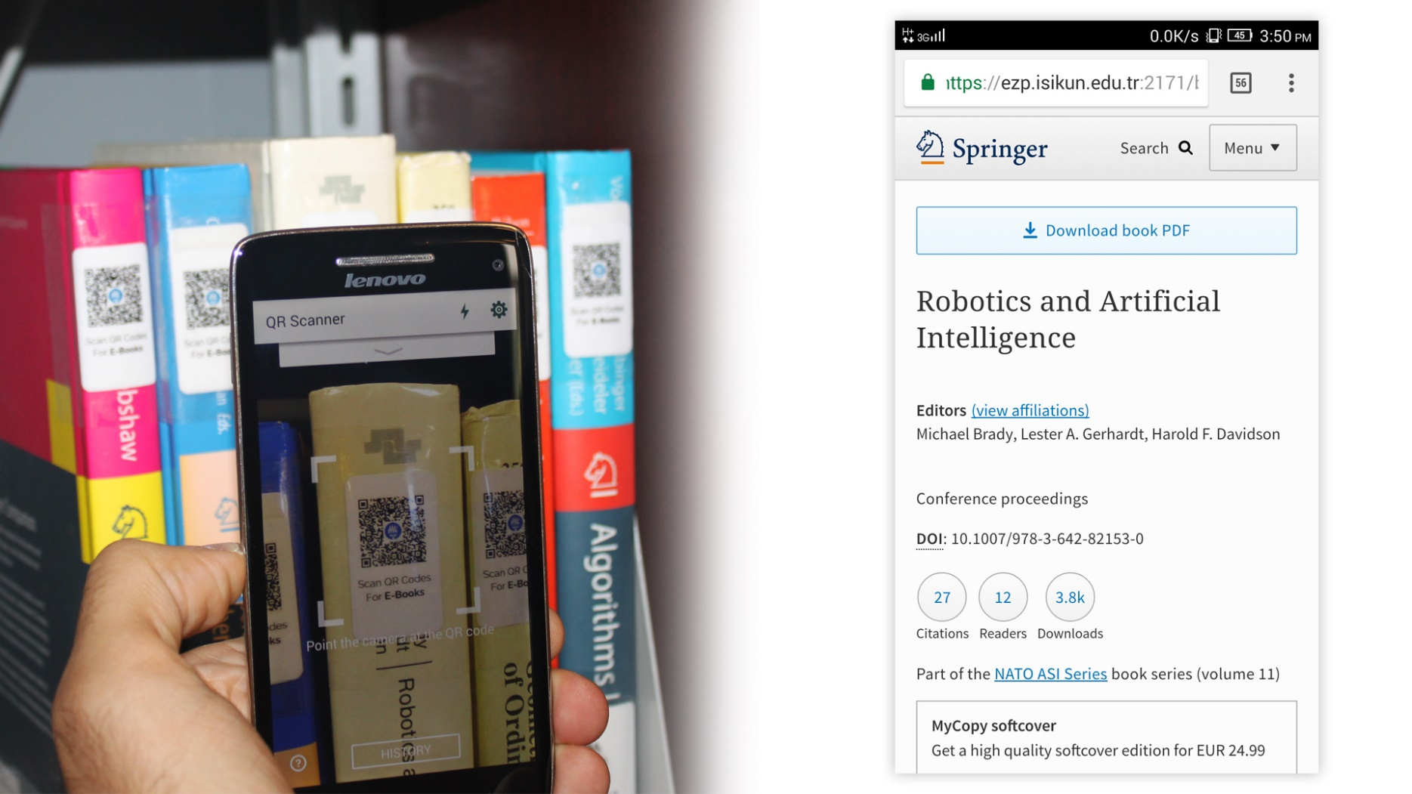
QR Code Scanner
Nazarbayev University - Library Connect | May 31 – June 1, 2017

Slide 19
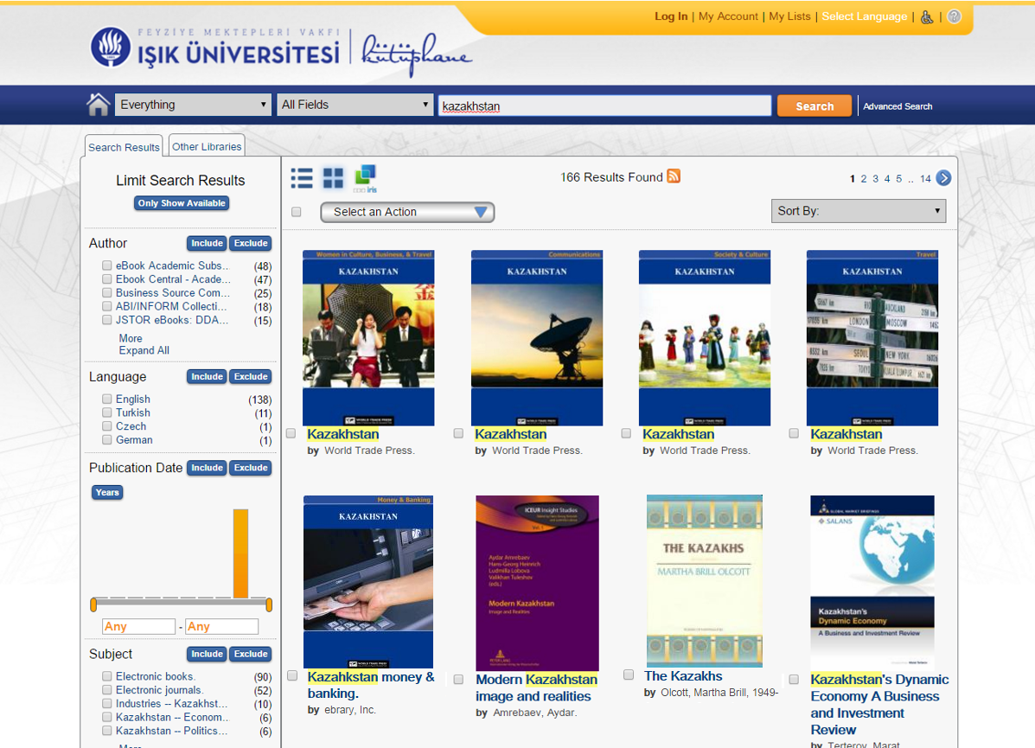
User Friendly Interface
Nazarbayev University - Library Connect | May 31 – June 1, 2017

Slide 20
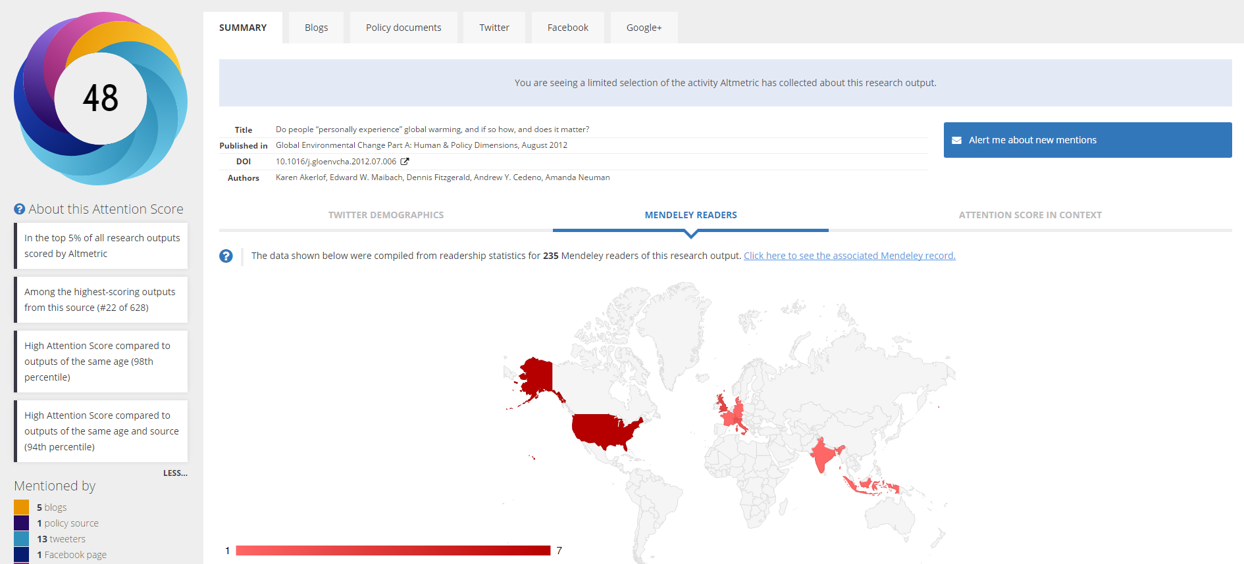
Altmetric
Nazarbayev University - Library Connect | May 31 – June 1, 2017

Slide 21
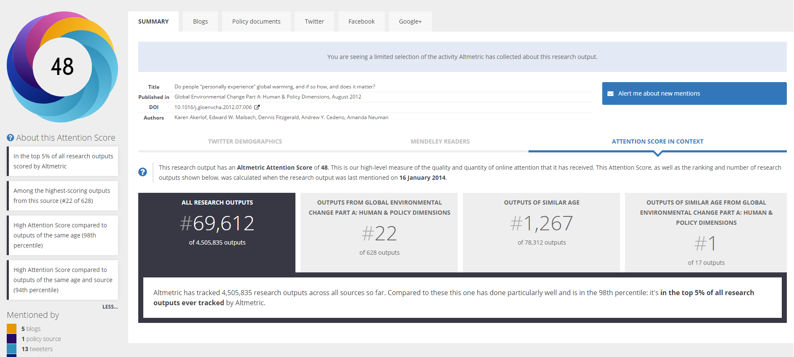
Altmetric
Nazarbayev University - Library Connect | May 31 – June 1, 2017

Slide 22
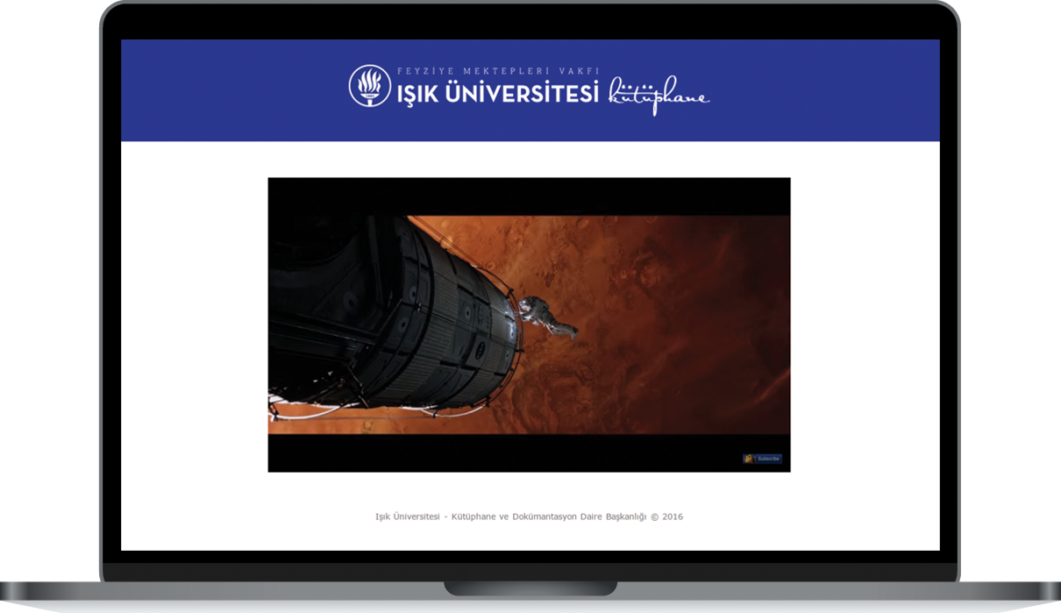
Fragments of Movies
Nazarbayev University - Library Connect | May 31 – June 1, 2017

Slide 23
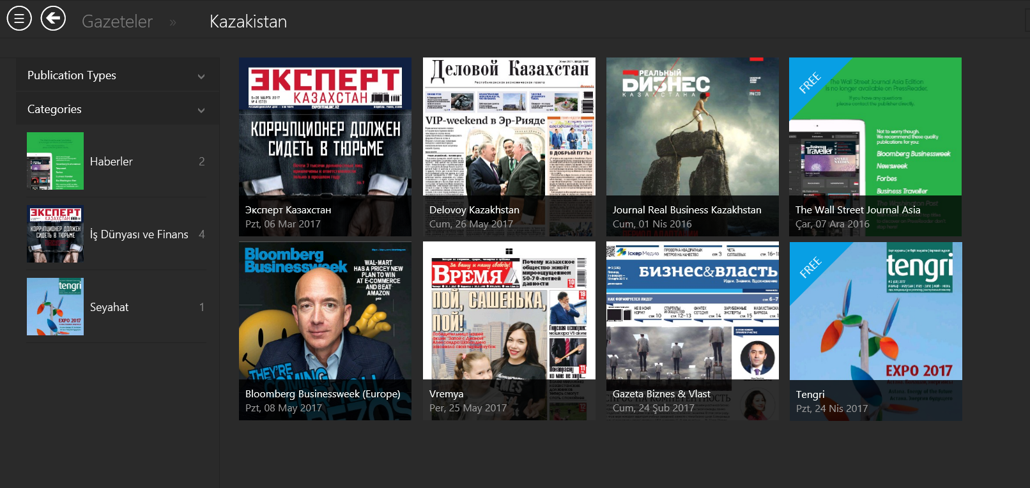
E-Newspapers
Nazarbayev University - Library Connect | May 31 – June 1, 2017

Slide 24
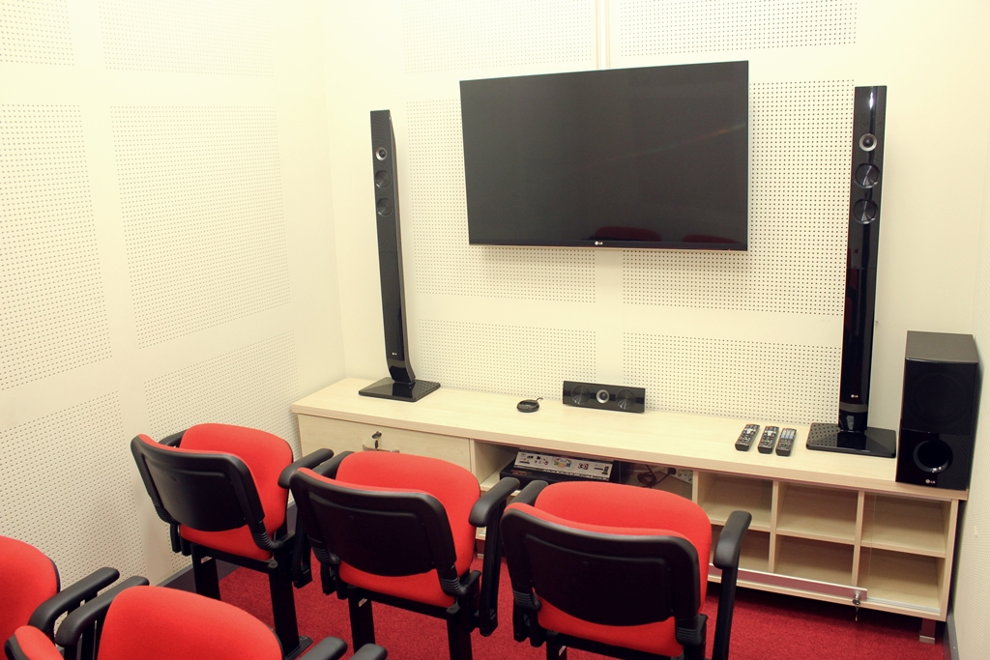
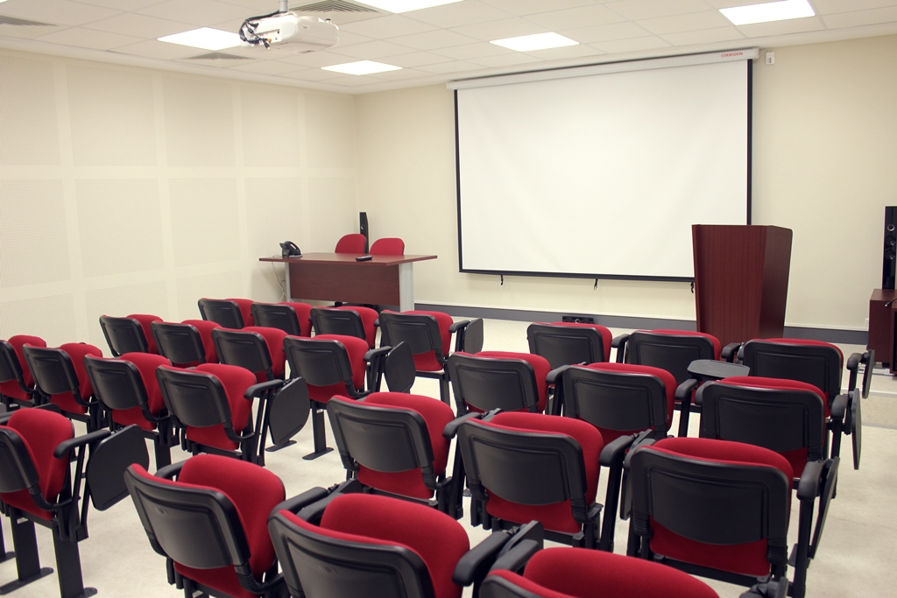
Multimedia Room
Presentation Room
Nazarbayev University - Library Connect | May 31 – June 1, 2017

Slide 25
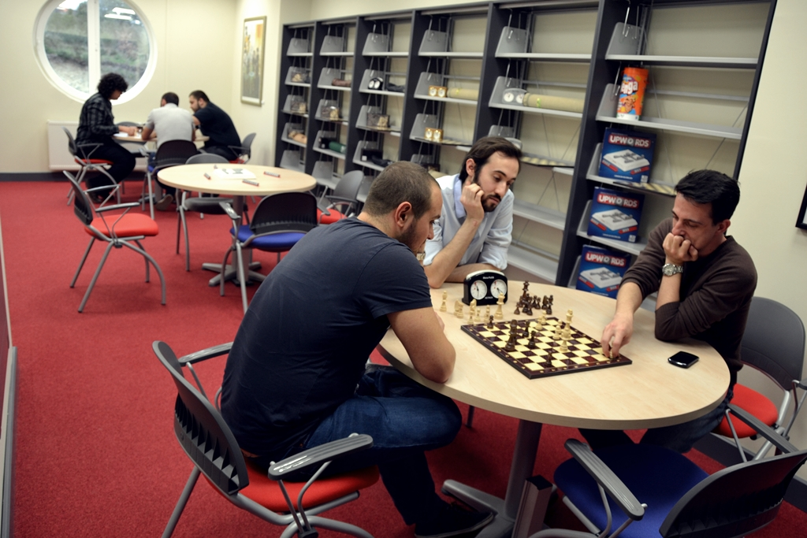
Mind Games Room
Nazarbayev University - Library Connect | May 31 – June 1, 2017

Slide 26
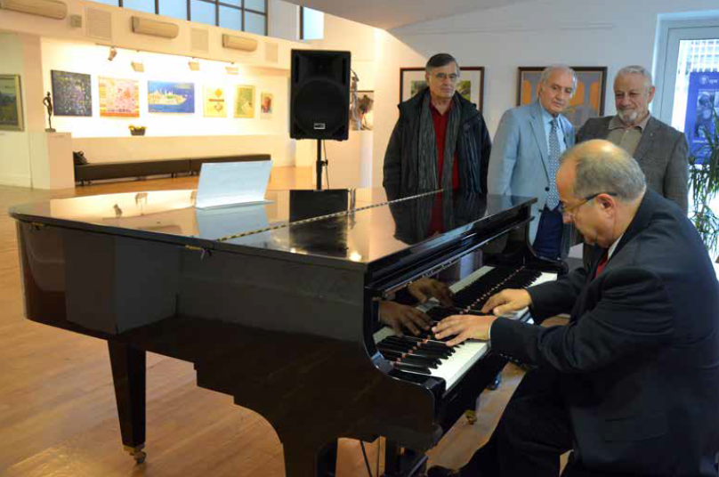
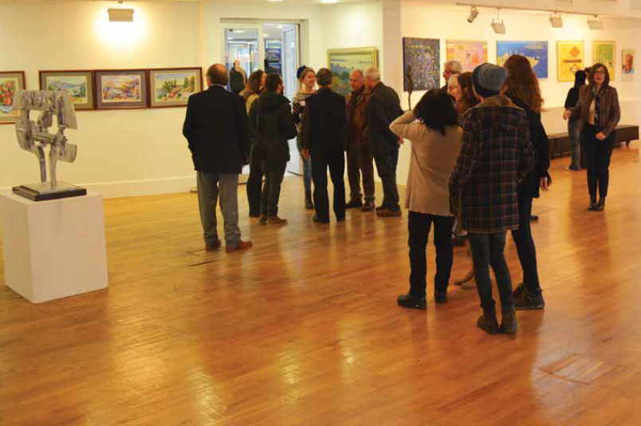
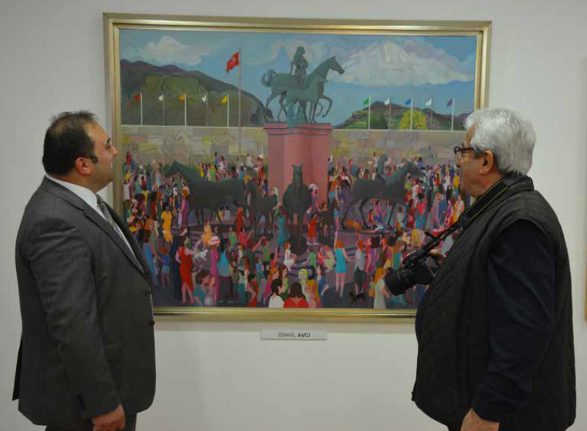
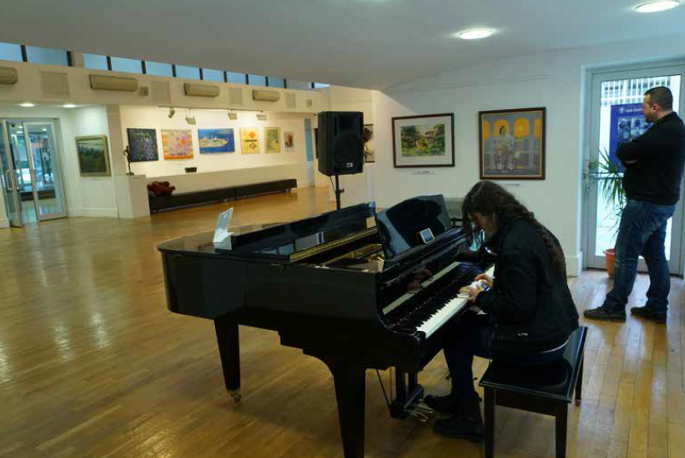
Işık Art Galleries
Nazarbayev University - Library Connect | May 31 – June 1, 2017

Slide 27


About our projects
We have many on going projects. The projects are sometimes small, sometimes large.
Digitization for
All Books’ Contents
Open Access
Academic Archive
Career Training for
Asistant Students
Nazarbayev University - Library Connect | May 31 – June 1, 2017

Slide 28
References
Arabacı, İ. Bakır, Murat Polat (2013), Digital Natives, “Digital Immigrants and Classroom Management”, Volume 12, Issue 47, p.11-20.
Pacific Policy Research Center. (2010). “21st Century Skills For Student and Teachers”, Honolulu: Kamehame Schools, Research & Evaluation Division.
Snyder Gibson, N., & Chester-Fangman, C. (2011). “The librarian's role in combating plagiarism”, Reference Services Review, 39(1), 132-150.
Wiedmer, T. (2015). Generations do differ: Best practices in leading traditionalists, boomers, and generations X, Y, and Z. Delta Kappa Gamma Bulletin, 82(1), 51.
http://acikerisim.isikun.edu.tr/ (Access Date: 20.05.2017)
http://gazetesu.sabanciuniv.edu/tr/y_kusagi_nedir (Access Date: 22.05.2017)
http://www.globalyoungvoices.com/fast-news-blog/2015/11/24/infographics-top-10-skills-for-the-successful-21st-century-worker (Access Date: 24.05.2017)
http://www.isikun.edu.tr/kutuphane (Access Date: 23.05.2017)
http://reports.weforum.org/future-of-jobs-2016/ (Access Date: 26.05.2017)
Nazarbayev University - Library Connect | May 31 – June 1, 2017

Slide 29
Thank You for Valuable Time
Hakan Hilmi KAPUCU
hakan.kapucu@isikun.edu.tr
Nazarbayev University - Library Connect | May 31 – June 1, 2017

