Slide 1




Resource Description and Organization: The Case of an Academic Library in the Philippines
Eurasian Academic Libraries Conference – 2021
“Contemporary Trends in Information Organization in the Academic Library Environment”
June 29-30, 2021
Ana Maria B. Fresnido*
ana.fresnido@dlsu.edu.ph
Jojie A.Gonda*
jojie.gonda@dlsu.edu.ph
Agnes S. Barsaga*
agnes.barsaga@dlsu.edu.ph
*DLSU Libraries
Notes:
Today, I will be sharing with you the experience of my library, the De La Salle University Libraries, on resource description and organization

Slide 2
Outline
Transitioning to RDA
Development of the Institutional Repository
Notes:
I will specifically be sharing our journey in the implementation of RDA and the development of our institutional repository

Slide 3
QUICK FACTS
Notes:
Allow me to first provide you with quick facts about my university and its library

Slide 4
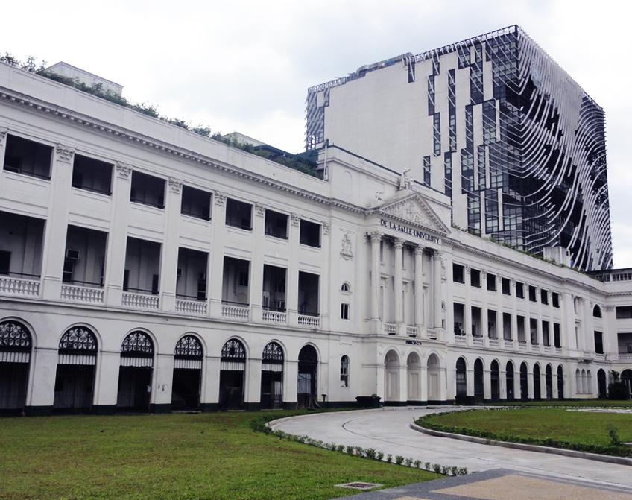
DLSU Facts and Figures
Founded: | 1911 by the Brothers of the Christian Schools
Type: | Private, Catholic university
Academic calendar: | 3 terms per year
Programs offered: | Doctoral, Master’s, Bachelor’s, Senior High School, Diploma, Certificate
Academic Staff: | 1285
Students: | 16,000 average (undergraduate: 11,000; graduate: 5000)
Notes:
DLSU was founded by the Brothers of the Christian Schools in 1911. It is a private, Catholic university which follows a trimestral calendar. It has more than a thousand academic staff and accommodates, on the average, 1600 students

Slide 5
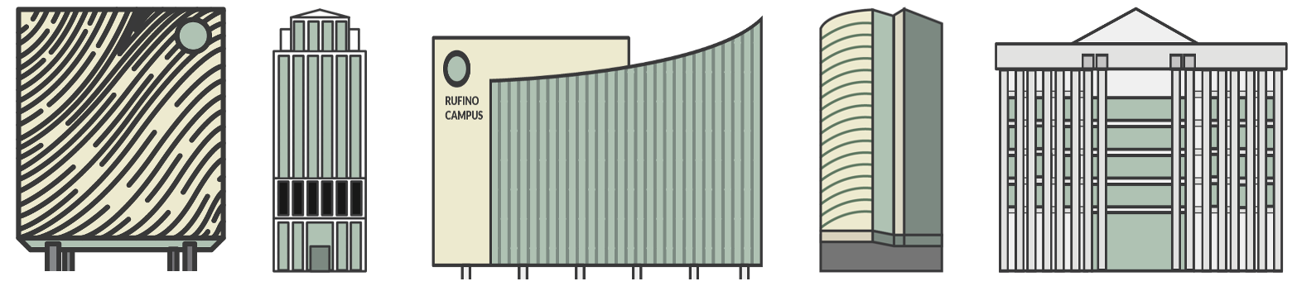
DLSU Libraries: Quick Facts
System of libraries
  main library + 6 satellite libraries
  Located in 3 campuses (Manila, Makati, and Laguna)
Collection
  500,000+ items
  125 databases
Processing of library materials is centralized
4 catalogers (average) assigned to work full time
  are generalists
  Perform both easy and complex tasks
  Handle cataloging of all types of materials
Notes:
The DLSU Libraries, on the other hand, is a system of libraries composed of a main library, which we call the Learning Commons, and 6 other satellite libraries situated in 3 campuses located in Manila, which is the main campus, Makati and Laguna

Slide 6
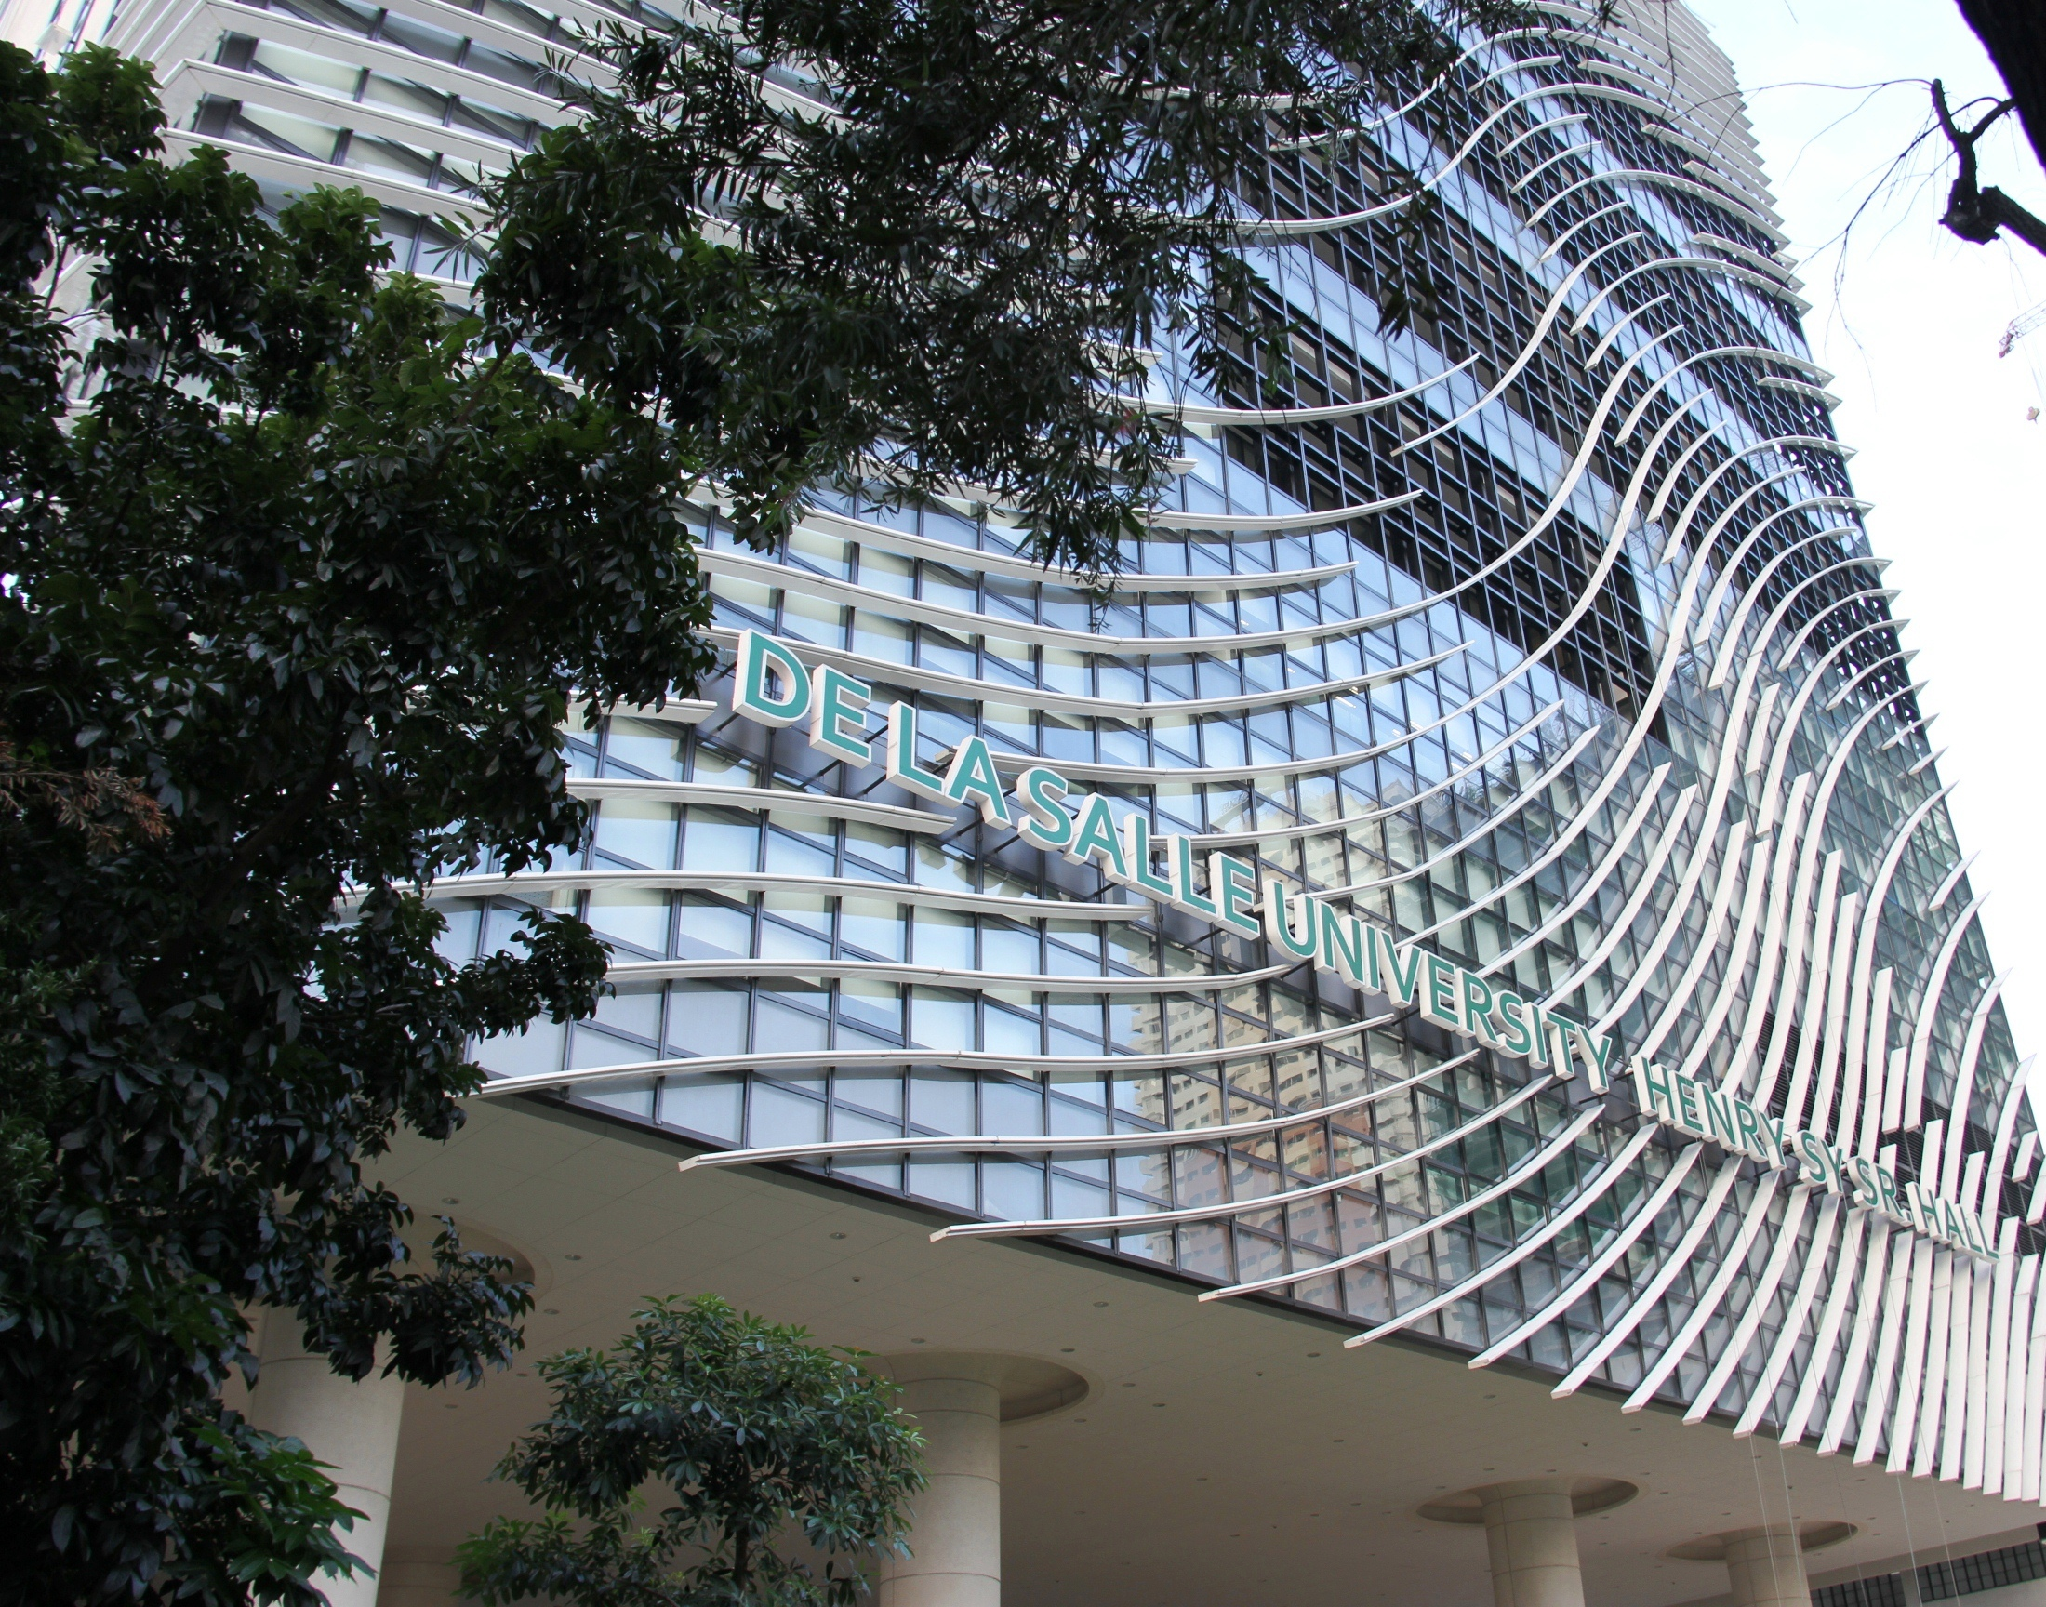
Transitioning to RDA
The DLSU Libraries’ Experience
Notes:
As a backgrounder, I will provide an overview of the Philippines’ experience in the implementation of RDA

Slide 7
Overview of RDA Implementation in the Philippines
  a salon (“What Now for RDA in the Philippines?”) was organized by the Director of the NLP in July
  National Committee on Resource Description and Access (NCRDA) was established
  Major challenge – lack of RDA experts to provide training
  Barbara Tillett, Chief of the Cataloging Policy and Support Office of the Library of Congress in Washington, D.C., was invited to serve as trainer
  3-day Training of Trainers conducted in April
  Select librarians from all over the country were invited to attend the free training
2012
2013
Notes:
RDA was introduced in the Philippines by the late Atty. Antonio M. Santos, the then Director of the National Library of the Philippines (NLP), through the holding of a salon on the topic “What Now for RDA in the Philippines?”
This was attended by cataloging experts from selected academic libraries. Through this meeting of experts, the National Committee on RDA (NCRDA) was established.
This committee was tasked to plan for the implementation of RDA in the country.
One of the very first challenges that the Committee faced was the lack of RDA experts in the country that could be tapped to provide trainings. So what the committee did was to invite no less than the Chief of the Cataloging Policy and Support Office of the Library of Congress in Washington, D.C., Ms. Barbara Tillett, to conduct RDA training to prospective trainers.
Fortunately, Ms. Tillett accepted the invitation, so in April 2013, the 3-day training of trainers was conducted with select librarians from all over the country attending for free.
This training was held at the Learning Commons of the De La Salle University

Slide 8
RDA Trainings Attended by DLSU Catalogers
Training of Trainers facilitated by Ms. Barbara Tillett held in April 2013
In-house training workshop focusing on local materials held in July 2013
Notes:
With the DLSU Libraries providing the venue for the training, a number of its librarians, specifically those assigned to do cataloging and indexing, were given the opportunity to attend the training.
Aside from the training received from Ms. Tillett, the DLSU libraries also conducted an in-house training workshop focusing on local materials or what we call Filipiniana

Slide 9
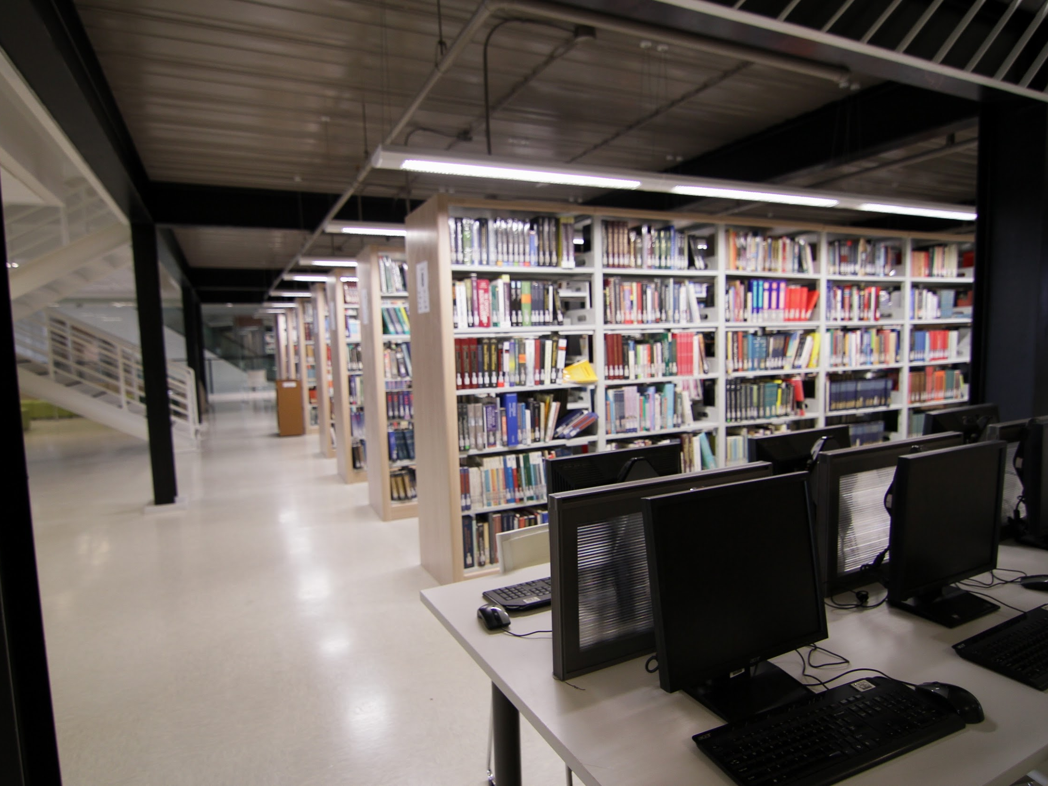
One of the early adopters of RDA in the Philippines
DLSU Libraries
Notes:
Armed with these trainings, the Library started the implementation of RDA in August of 2013, making it one of the early adopters of the new standard in the country

Slide 10
Implementation Strategies
RDA cataloging template devised
245 Title
$a
  Transcribe title as it appears on the source but follow AACR2 rules on capitalization (i.e., DO NOT use all capital letters even if that is what is on the resource, except for acronyms)
$b
  transcribe the statement of responsibility as it appears on the source of information
  For more than 3 authors, transcribe the first name and give bracketed summary about information not transcribed (e.g., Juan de la Cruz [and four others]).
  DO NOT include any affiliations, etc. that are included with the name
  Served as cataloging guide
  Contents: MARC tags, corresponding field, simplified rules (core ones), examples, local practices/in-house policies
  Additions/notations added for “problematic” works
Peer learning
“Learn-as-you go”
Review/revision of works of junior catalogers; mentoring
Notes:
to facilitate the implementation process we tried to strategize
To make it easy for the catalogers to remember the rules and take note of the changes and differences between AACR2 and RDA, we devised a template, which served as our guide during the first few months of the implementation process.
Contained in the template are the MARC tags, their corresponding fields, and simplified rules, usually the core ones, for each of the fields. We also included examples for some of the fields. Local practices and in-house policies were also incorporated in the template. I have provided on the right side of your screen a portion of the template under the title field.
Now, This enabled the catalogers to quickly identify required elements, depending on the format of the materials they are working on.
Peer learning was an approach we also adopted. Whenever we face difficulties cataloging a particular work, we made it a point to consult with one another
Since the Libraries’ integrated system has the capability to import records from other systems like the Library of Congress and OCLC, copy cataloging has significantly facilitated the transition process. our daily encounter with RDA-compliant records from these two systems was instrumental in helping acquire familiarity on the use of the new standard so we were able learn as we go along
Another strategy was to assign one of the senior catalogers to review the works of the junior cataloger and mentor them based on their perceived weakness.

Slide 11
Updating of Old Records
Not included as part of the plan
Updating performed by select catalogers
  add-to-shelf list
  copy catalog from its own records (when working on a different edition and version of existing items)
    To allow related items to collocate
Notes:
Updating of old bibliographic records to conform with RDA was not included as part of the plan from the very start.
However, some of the catalogers revealed that they do update old records whenever they had the chance (i.e., when they do add-to-shelf list or copy catalog from the library’s own records, usually when working on a different edition and version of existing items). These catalogers think that it is important to update old records when a different edition an existing work is acquired to allow related items to collocate.

Slide 12
Issues and Challenges
Difficulty in interpreting rules in the RDA toolkit
  Preferred to use the PowerPoint presentations provided during the training-workshop (simpler, easier to understand and follow)
Subscription to toolkit cancelled after 2 years
  Minimal usage
Difficulty in unlearning AACR2
Difficulty in constructing authorized access points
  conferences
  preferred titles for expressions of work
Notes:
In support of the transition process, the Library subscribed to the RDA toolkit during the first two years of its implementation. However, the catalogers expressed difficulty in interpreting the rules so most of the time, they referred to the PowerPoint presentations provided to them during the training-workshop as they find the instructions there simpler and easier to understand and follow.
Since it is the policy of the university to ensure that subscriptions are used maximally, subscription to the Toolkit was cancelled on the third year due to low usage. The problem though is that since RDA is continually being updated, the rules in the presentation that they are using as reference ,may already be obsolete as this was prepared in 2012
Adaptability persist to be an issue as some catalogers find it difficult to unlearnAACR2. Remembering changes in constructing authorized access points has always been a challenge especially for conferences and preferred titles for expressions of work.

Slide 13
Insights on RDA
RDA is preferred over AACR2
  “take-what-you-see” principle frees them from remembering so many rules
  Terminologies used are easy to understand (use of Latin words and abbreviations were discontinued)
  Improves the discovery of library materials
Construction of authorized access points, particularly for expressions of works, remains to be a challenge
Notes:
Despite the difficulties encountered in learning the new cataloging standard, most of the catalogers prefer RDA over ACCR2 because of its “take-what-you-see” principle which frees them from remembering so many rules.
They also appreciate the fact that the terminologies being used now can be easily understood by the clients, as the use of Latin words and abbreviations had been discontinued.
The catalogers also believe that RDA helps improve the discovery of materials which greatly benefits library clients.

Slide 14
DEVELOPMENT OF THE INSTITUTIONAL REPOSITORY
Notes:
Moving On to the second part of the presentation I will be sharing our experience on the development of the institutional repository

Slide 15
Background
The Archives forms part of the Library
Library decisions impact the Archives
  Automation
  Standardization of descriptive practices
Both used the same system
  1992-1994 - CDS-ISIS (information retrieval system)
  1994-2002 - TINLIB/T-Series (non-MARC-compliant ILS)
  2003-2020 – Millennium/Sierra (MARC-compliant ILS)
Archival metadata created in accordance with library standards (MARC, AACR2, RDA)
Notes:
The DLSU Archives forms part of the Library,. Therefore, some decisions especially those concerning automation and standardization of descriptive practices impact the Archives. This is despite the striking difference in the practice of the two professions.
the Library and the Archives had made use of the same systems to organize its materials ever since. From the time we started automating in 1992 until mid 2020.
As such, metadata description of archival materials, particularly those forming part of the in IR were created in accordance with library standards (MARC, AACR2, RDA). This is despite the fact that we are aware of the systems’ limitations to accommodate the requirements for the description of archival materials

Slide 16
Background
IR direction
  Content acquisition
  Preservation
  Service provision (facilitate deposit and use of the content)
  Increased visibility
Cause of delay
  Lack of expertise
  High staff turnover
  Funding
Solution
  Establishment of Library ICT Committee
  Use separate system for library and archival materials
    Alma ILS for library materials
    Digital Commons for the IR
Notes:
While the Archives has long started collecting the intellectual outputs of the university, the direction as to where such initiative was heading seemed to be unclear. In the 2007 meeting of the AUNILO, where DLSU was a member, the concept of IR was introduced.
And this provided directions as to how the IR should be developed and managed so that it is able to go beyond “content acquisition” and preservation and extend to “service provision,” while at the same time providing wider research visibility of the scholarly outputs of the university
Moving forward has been a struggle due to a number of issues. The lack of expertise has been a major source of delay and so is high staff turnover. Funding was also an issue so for the longest time, the Library had been contemplating on using an open-source platform. Since open-source systems would require heavy reliance on staff expertise, the Library finally decided to scrap the idea altogether.
To resolve the staffing issues, the Library established an ICT Committee tasked to identify a platform that would best respond to the need of university. So after stalling for more than a decade, the Committee proposed the use separate systems for library and archival materials. In mid 2020, the Library replaced Sierra with Alma ILS (for library materials) and subscribed to Digital Commons for the IR.

Slide 17
Digital Commons
Robust platform
large number of installations
Slowly gaining popularity among academic libraries and archives in the Philippines
Notes:
Compared to other commonly used IR platforms, features of the Digital Commons proved to be robust. it also has a large number of installations worldwide and is slowly gaining popularity among academic libraries and archives in the Philippines

Slide 18
Migration
Commenced on Sept 28, 2020
ETDs
Oral history (transcripts and audio files of interviews of prominent personalities conducted by the undergraduate students of the University)
Published works of faculty extracted from Scopus
Total IR papers to date
16,000+
Other contents to be uploaded next
Faculty research and creative works
Diary of the university
Photos
University publications
Notes:
Once the decision was made, available contents were migrated into the Digital Commons. Migration started in September 2020 with 928 electronic theses and dissertations (ETD) initially uploaded. After a month, the number of ETDs uploaded totaled to more than 10,000. Simultaneous with the ETDs, the oral history collection were uploaded. Came next were published faculty works extracted from Scopus which summed up to more than 3,000. To date, the IR has more than 16,000 papers.
In the coming months, the migration of other contents such as faculty research and creative works, diary of the university, photo gallery, and university publications is expected to accelerate the building of IR contents.

Slide 19
Branding
Official name: Animo Repository
  derived from the Latin word “animus”
  Animo means “spirit” (also referred to as “La Salle spirit”)
  battle cry of the Lasallian community, often heard during basketball championships of the University Athletic Association of the Philippines (UAAP)
Notes:
Since it is important for a repository to have its own branding, the repository was named Animo Repository [read slide]

Slide 20
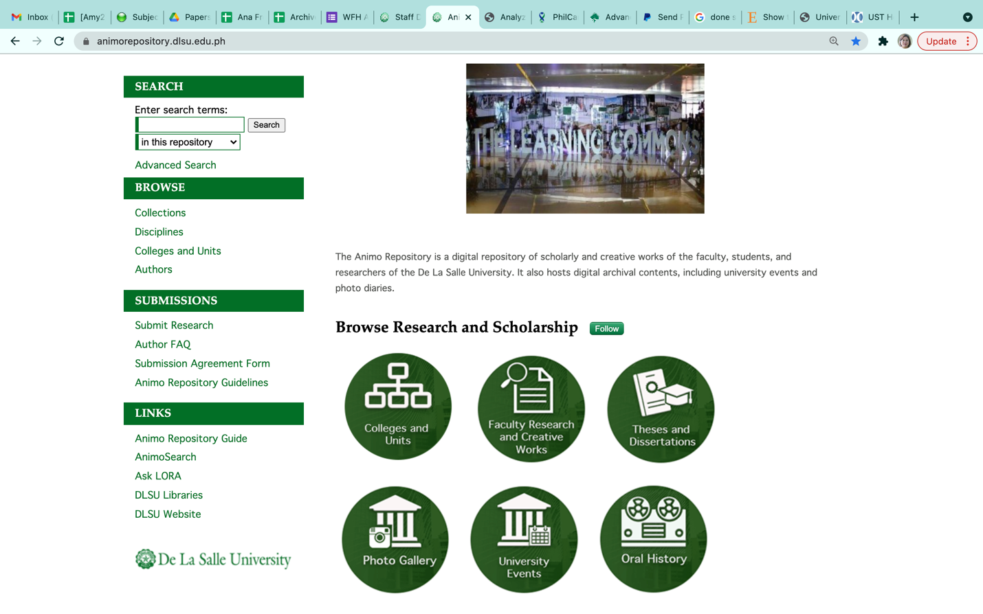
The Launch
Held online on October 28, 2021
Notes:
After a month of migrating to the new platform, the formal launch was held in October 2021. This is how the homepage of the repository looks like

Slide 21
Issues and Challenges
Past metadata creation mistakes hamper the migration process
  Missing required fields
Conversion of extracted data from old ILS
  Distorted special characters
Delays in the approvals of ETDs
Promotion of the IR
Copyright
  Only selected parts of theses may be uploaded and made available (preliminaries, introduction, RRL, methodology)
  Embargo imposed by authors
  content licensing of published works/IP rights
Notes:
Past mistakes in metadata creation hampered the migration process, particularly because a number of records had missing fields, like degree program, name of college and department).Since these are required fields, migration of these records were put on hold. To accurately determine the information needed to be inputted into the missing fields, the staff had to go over the students’ records, which took a lot of time
As records extracted from the old ILS and that of Scopus were initially converted to Excel before they were migrated into the IR, special characters, subscript and superscript, mathematical and chemical formulas, and selected symbols, were distorted and replaced upon conversion. To correct these, we had to refer back to the records in the old system and in Scopus. While these “errors” seem menial, they did cause delay to the migration timetable.
Trainings on how to deposit contents were initially conducted by the Library for graduating students, and to department coordinators who were tasked to “accept” or “approve” student submissions. The role of the coordinators was to make sure that the copy deposited is the approved and final version of the ETD. While students seem eager to deposit their works, some department coordinators had to be reminded, to “accept” the submissions so the Library can do its part of updating and posting the submissions. As the number of deposited contents is expected to increase in the coming months, the coordinators will eventually find it more difficult to manage the number of ETDs for approval.
A big part of the ETDs are already dated. Since the Library has no means of getting permission from the authors to make fulltext of their works available in the IR, only selected chapters (preliminary pages, introduction, review of related literature and methodology) are being uploaded. Editing of fulltext is performed prior to uploading, making use of Adobe Acrobat. What we do is we delete the most important chapters which are results and discussion, conclusion, and all appendices). More than the additional step added to the workflow, this defeats the IR’s open access goal.
The same concern goes for some newly deposited ETDs as some of the authors would opt for a 6-year embargo. By the time the fulltext of these ETDs are made available, the information may already be obsolete, and thus no longer useful.
Copyright and content licensing issues for published works are the major issues. Right now, the Library has partnered with the Intellectual Property (IP) Office of the University to educate its stakeholders on IP rights. But we all know that IP is a complex issue and very technical so we do not expect the authors and librarians as well to fully understand this by attending occasional lectures.
Given this, The Library would need the commitment of the IP Office to help in the drafting of guidelines and policies on the nature of content to be deposited (Should we opt for the pre-prints or post-prints?) and in reviewing the publishers’ copyright policies to help determine what could and could not be deposited into the IR.

Slide 22
Conclusion/Recommendations
The abundance of information in various formats and evolving technologies and standards brought a number of issues/challenges to information organization
  Staff training
  Funding
  Technology selection
  Content and intellectual property rights
Careful planning
Look for best practices
Notes:
The abundance of information in various formats coupled with the evolving technologies and standards have brought a number of issues and challenges to information organization, which include among others, staff training, funding, technology selection, content and intellectual property rights. It is therefore crucial for libraries to carefully plan before embarking on new initiatives. Since every institution is unique, there really is no “one size, fits all” solution to change. However, it would do well for libraires to look at the experiences and best practices of early adopters, be it a new standard or a new platform, as This would greatly aid in drawing out an effective and efficient plan and consequently help avoid committing costly mistakes.

Slide 23
Conclusion/Recommendations
IP issues – major deterrent to content building
  Help faculty better understand their rights as authors
  Forge strong partnership with IP Office of the university
Notes:
As IP issues serve as major deterrents to recruiting contents for the IR, libraries and archives are challenged to find ways to help faculty better understand their rights as authors. Forging a strong partnership with the university’s IP Office is crucial in the attainment of this goal.

Slide 24





THANK YOU FOR LISTENING!
Eurasian Academic Libraries Conference – 2021
“Contemporary Trends in Information Organization in the Academic Library Environment”
June 29-30, 2021
Ana Maria B. Fresnido
De La Salle University
ana.fresnido@dlsu.edu.ph
Notes:
That ends my presentation. Thank you for listening

