Slide 1
Motor/Generator Fault Prognosis using Vibration Signature and Forecasting Techniques
Kuanysh Orynbek
ID: 202062668
Supervisor: Prof. Mehdi Bagheri
Co-supervisor: Prof. Amin Zollanvari
Electrical and Computer Engineering Department
School of Engineering and Digital Sciences
Apr 2022

Slide 2
Outline
1 Background
2 Aims & Objectives
3 Mathematical Model
3.1 Rotor Vibration Model
3.2 Stator Vibration Model
4 Methodology and Experimental Study
4.1 Experimental Setup
4.2 Data Preparation
4.3 Convolutional Neural Network
4.4 Hyperparameter Tuning
4.5 Evaluation Metrics
5 Testing & Results
5.1 Experimental Measurements
5.2 1D CNN model outputs
6 Comparison
7 Conclusion & Future Work
REFERENCES

Slide 3
1 Background
Induction Motors and Generators Importance [1-5]:
  High-performance efficiency
  Reliability & Durability
  Cheapness
Reasons to monitor [6-11]:
  Repair costs decrease
  Repair time reduction
  Reduction of fault numbers

Slide 4
2 Aims & Objectives
To implement a system that can evaluate and analyze a real-time condition of the motor/generator using a signature of vibration signal and machine learning methods.
Objective #1
to perform a literature review to understand the basics of the vibration analysis methods along with indicating state of the art.
Objective #2
to create a mathematical model for motor/generator vibration analysis.
Objective #3
to build an experimental setup and collect vibration signal data.
Objective #4
to develop a code for forecasting the state of induction motors.
Objective #5
to make a model selection based on hyperparameters and come up with a desirable solution in motor/generator prognosis.

Slide 5
3 Mathematical Model
Aims:
  To define vibration patterns dependence on other physical quantities
  To observe the behavior of motor vibration
Considered Models:
  Rotor Vibration Model [12-14]
  Stator Vibration Model [15], [16]

Slide 6
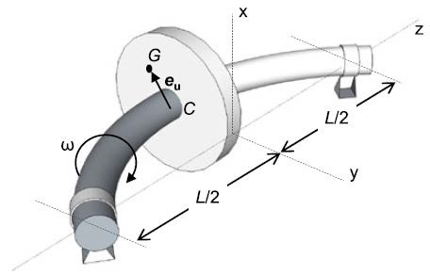
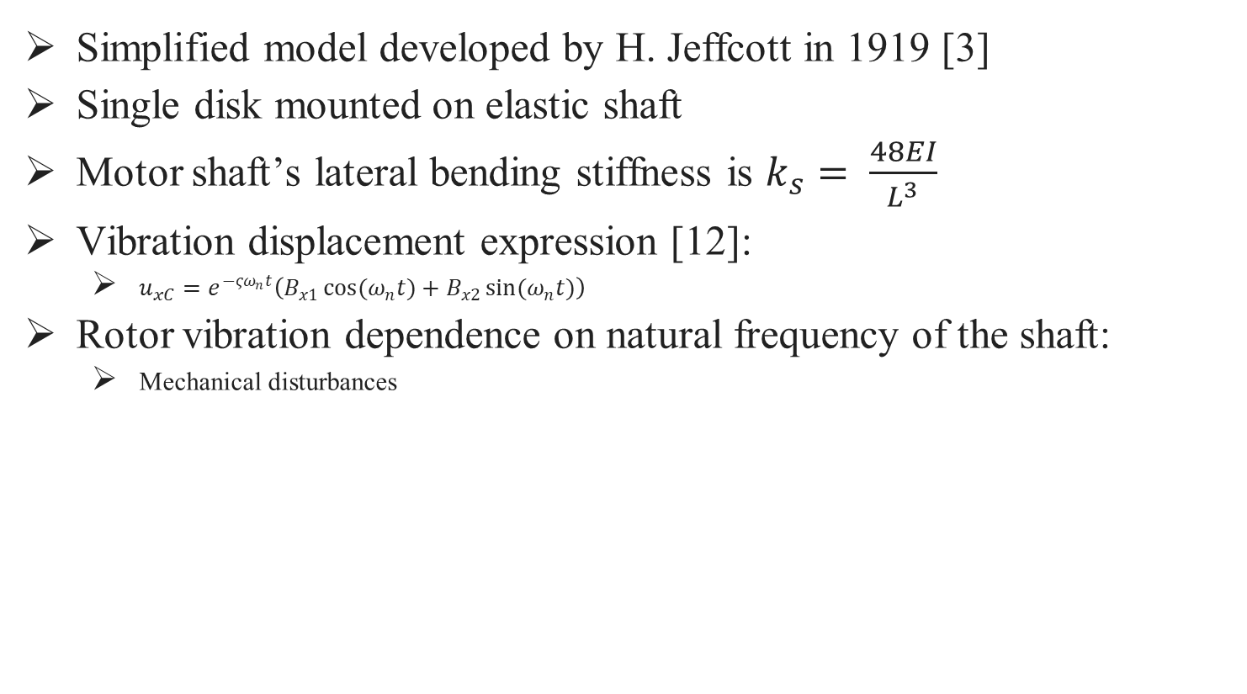
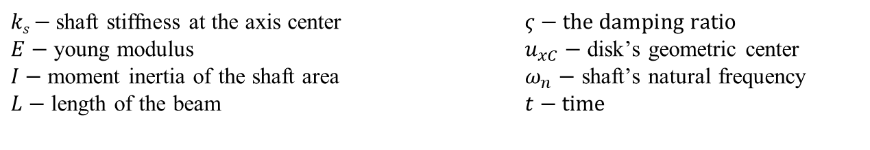
3.1 Rotor Vibration Model
Simplified model developed by H. Jeffcott in 1919 [3]
Single disk mounted on elastic shaft
Motor shaft’s lateral bending stiffness is $k_{s}= \frac{48EI}{L^{3}}$
Vibration displacement expression [12]:
  $u_{xC}=e^{−ςω_{n}t}\left(B_{x1}\cos{{(ω}_{n}t)}+B_{x2}\sin{{(ω}_{n}t)}\right)$
Rotor vibration dependence on natural frequency of the shaft:
  Mechanical disturbances
Figure 1. Jeffcott’s Rotor Model [3]
$ks$ $−$shaft stiffness at the axis center $ς−the damping ratio$ $E−$ young modulus $u_{xC}−$ disk’s geometric center
$I−$ moment inertia of the shaft area $ω_{n}$ $−$ shaft’s natural frequency
$L−$ length of the beam $t−time$

Slide 7
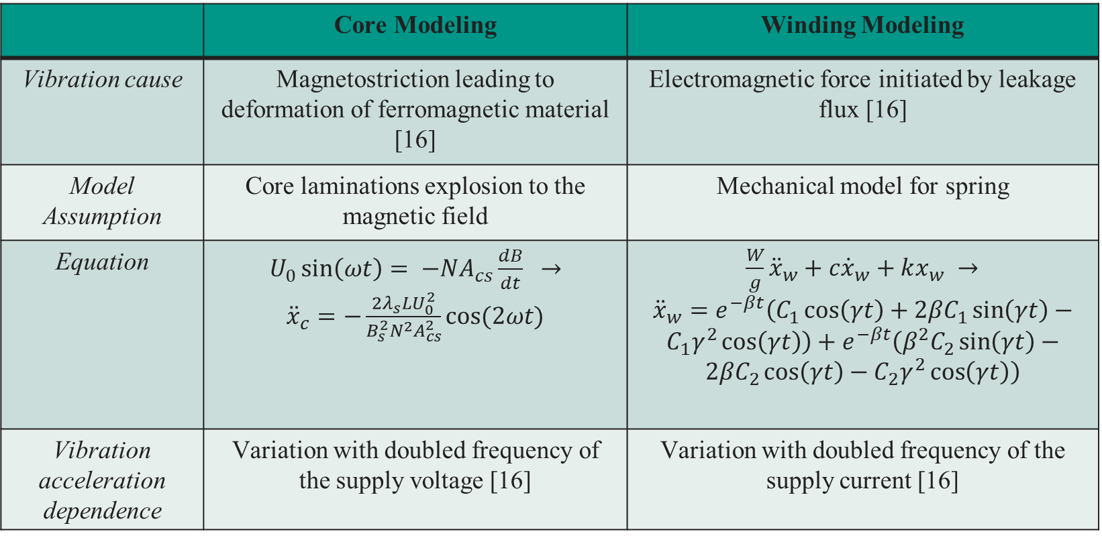
3.2 Stator Vibration Model
Table 1. Stator Vibration Models
 | Core Modeling | Winding Modeling
Vibration cause | Magnetostriction leading to deformation of ferromagnetic material [16] | Electromagnetic force initiated by leakage flux [16]
Model Assumption | Core laminations explosion to the magnetic field | Mechanical model for spring
Equation | $U_{0}\sin\left(ωt\right)= −NA_{cs}\frac{dB}{dt}$ $→$ ${\ddot{x}}_{c}=−\frac{2λ_{s}LU_{0}^{2}}{B_{s}^{2}N^{2}A_{cs}^{2}}cos(2ωt)$ | $\frac{W}{g}{\ddot{x}}_{w}+c{\dot{x}}_{w}+kx_{w}$ $→$ ${\ddot{x}}_{w}=e^{−βt}\left(C_{1}\cos\left(γt\right)+2{βC}_{1}\sin\left(γt\right)−C_{1}γ^{2}\cos\left(γt\right)\right)+e^{−βt}\left({β^{2}C}_{2}\sin\left(γt\right)−2{βC}_{2}\cos\left(γt\right)−C_{2}γ^{2}\cos\left(γt\right)\right)$
Vibration acceleration dependence | Variation with doubled frequency of the supply voltage [16] | Variation with doubled frequency of the supply current [16]

Slide 8
4 Methodology and Experimental Study
Choice of fault type:
  Mechanical
  Electrical
Electrical faults [17], [18]:
  Open circuit
  Unbalanced supply voltage
  Phase reversal
  Under-voltage [19]
  Overvoltage [20]
  Single phasing [21]

Slide 9
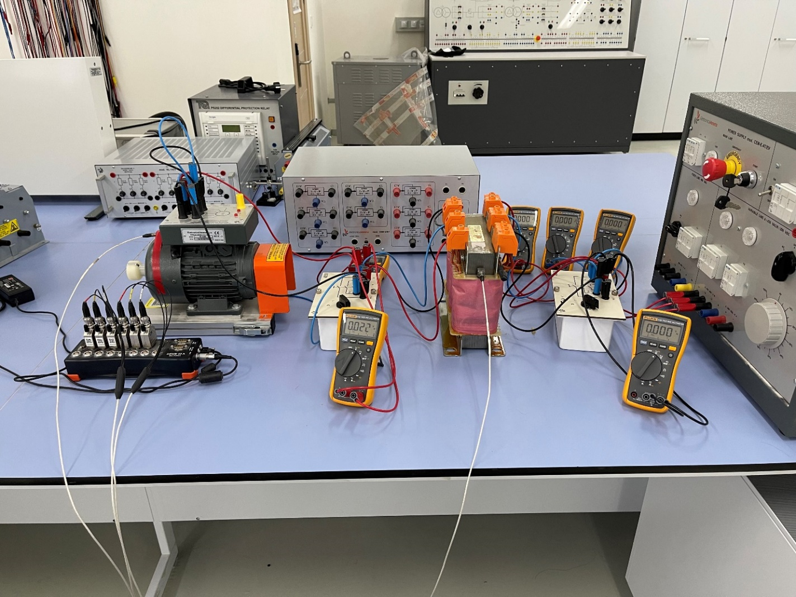

4.1 Experimental Setup
Model M-4 three-phase asynchronous motor:
  $P_{rated}=500 W$
  $V_{rated}=400/230 V$
  $f_{s}=50 Hz$
Transformer
Switches
Kistler vibration sensor
Power supply
DEWE 43 DAQ (data acquisition) system
Figure 2. Experimental setup

Slide 10
4.2 Data preparation
Voltage excitation
60% for Training
20% for Validation
20% for Test
I
II
Single phasing

Slide 11
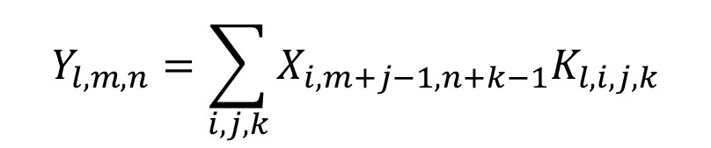
4.3 Convolutional Neural Network
CNN is the architecture that is included in the class of ANN for processing data, which has a grid-like topology, such as time series data or images [22-25].
$$Y_{l,m,n}=\sum_{i,j,k}{X_{i,m+j−1,n+k−1}K_{l,i,j,k}}$$
where the indices are elements of the multidimensional arrays X, K, and Y, and the summation is over all valid indices [26], [27].

Slide 12
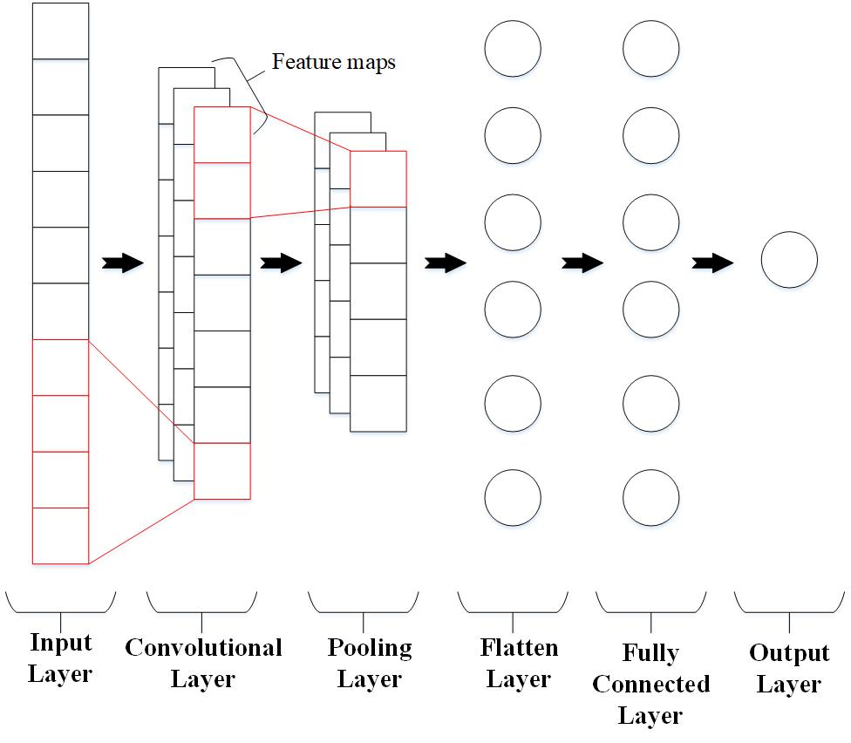
4.3 Convolutional Neural Network
Figure 3. One-dimensional CNN architecture, taken from [28]

Slide 13
4.4 Hyperparameter Tuning
The batch size: 32
Epochs: from 1 to 100 without early stopping
Convolutional layers: 3
The learning rate: 0.001 and 0.0001 with Adam optimizer [29]
The number of filters: 32, 64, 128 for an increasing filter pattern, and 256, 128, 64 for a decreasing filter pattern.
Kernel size: 2 to 5
Activation function: Leaky ReLU
The cardinality of the space of hyperparameters: 4800

Slide 14

4.5 Evaluation Metrics
Error Estimations performed:
  Mean Absolute Error (MAE)
  Mean Squared Error (MSE)
$MAE=\frac{1}{N}\sum_{i=1}^{N}{{(av_{i}−pv_{i})}^{2}}$
$MSE=\frac{1}{N}\sum_{i=1}^{N}{|av_{i}−pv_{i}|}$
Model with the least MSE value is to be chosen

Slide 15
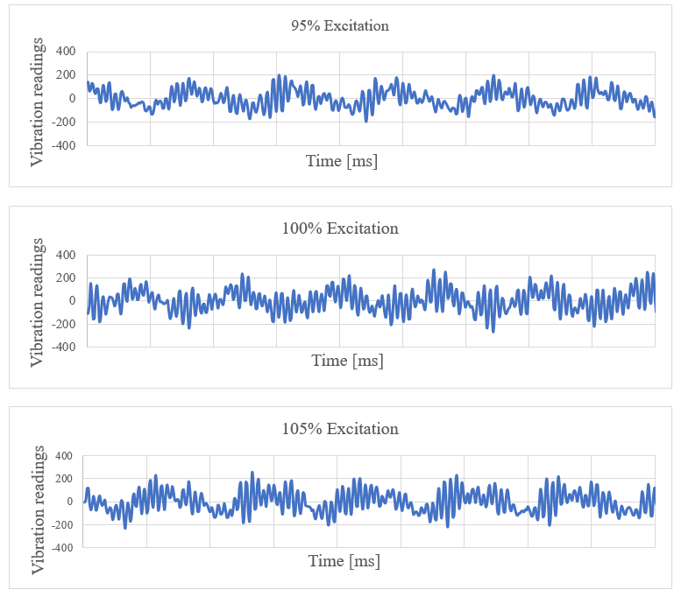
5 Testing & Results (5.1 Experimental measurements)
Supply voltage changed from 80% to 110% with a step of 5%
Table 2. Excitation voltages of experimental motor
Excitation Voltage % | 80 | 85 | 90 | 95 | 100 | 105 | 110
Injected Voltage [V] | 320 | 340 | 360 | 380 | 400 | 420 | 440
Figure 4. Vibration signals for different excitations

Slide 16
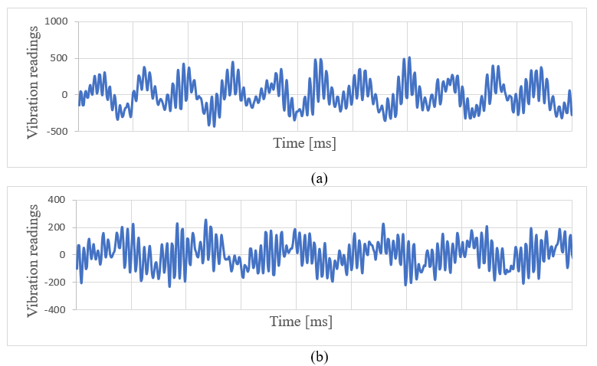
5 Testing & Results (5.1 Experimental measurements)
The single-phase disconnection (two-phase operation). For single-phase disconnection in the supply system of the induction motor, the asynchronous motor will continue to operate with the other two phases. This condition is known as single phasing.
Figure 5. Time-series vibration signals, (a) abnormal state, (b) normal state

Slide 17
5.2 1D CNN model output
Table 3. The selected CNN architecture based on the lowest MSE of voltage excitation prediction with load condition
CNN architectures | Learning rate | MSE | MAE
F[256, 128, 64], K[5] | 0.001 | 0.000426 | 0.014925
F[32, 64, 128], K[5] | 0.001 | 0.000454 | 0.015796
F[256, 128, 64], K[4] | 0.001 | 0.000459 | 0.016186
F[32, 64], K[5] | 0.001 | 0.000468 | 0.016406
F[256, 128], K[5] | 0.001 | 0.000468 | 0.01635
F[32, 64, 128], K[3] | 0.001 | 0.00048 | 0.01617
F[256, 128, 64], K[3] | 0.001 | 0.000513 | 0.017176
F[32, 64, 128], K[4] | 0.001 | 0.00052 | 0.016868
F[256, 128], K[3] | 0.001 | 0.000569 | 0.017961
F[32, 64, 128], K[2] | 0.001 | 0.000602 | 0.018408

Slide 18
5.2 1D CNN model output
Table 4. The CNN model used for the analysis of load condition model F [256, 128, 64], K(5)
Index | Layer type | Output shape | Number of parameters
1 | Conv1D | [86, 256] | 1536
2 | MaxPooling1D | [43, 256] | 0
3 | Conv1D | [39, 128] | 163968
4 | MaxPooling1D | [19, 128] | 0
5 | Conv1D | [15, 64] | 41024
6 | MaxPooling1D | [7, 64] | 0
7 | Flatten | [448] | 0
8 | Dense | [20] | 8980
9 | Dense | [15] | 315
10 | Dense | [1] | 16

Slide 19
5.2 1D CNN model output
Table 5. The selected CNN architecture based on the lowest MSE of voltage excitation prediction with no load condition
CNN architectures | Learning rate | MSE | MAE
F[256, 128], K[5] | 0.001 | 0.001637 | 0.028586
F[256, 128], K[4] | 0.001 | 0.001748 | 0.029672
F[32, 64], K[5] | 0.001 | 0.001754 | 0.030453
F[32, 64], K[4] | 0.001 | 0.001808 | 0.031603
F[256], K[5] | 0.001 | 0.001829 | 0.03071
F[32, 64, 128], K[5] | 0.001 | 0.001844 | 0.031011
F[256], K[4] | 0.001 | 0.001892 | 0.032975
F[256, 128], K[3] | 0.001 | 0.001895 | 0.031669
F[32, 64], K[3] | 0.001 | 0.001902 | 0.032656
F[256, 128, 64], K[3] | 0.001 | 0.001936 | 0.033202

Slide 20
5.2 1D CNN model output
Table 6. The selected CNN architecture based on the highest accuracy of single phasing with load condition
CNN architectures | Learning rate | MSE | Accuracy
F[256, 128], K[5] | 0.001 | 0.003807 | 0.99589
F[32, 64, 128], K[5] | 0.001 | 0.00415 | 0.995205
F[256, 128, 64], K[4] | 0.001 | 0.004002 | 0.993151
F[256, 128, 64], K[5] | 0.001 | 0.004501 | 0.993151
F[32, 64], K[3] | 0.001 | 0.010146 | 0.992466
F[32, 64], K[4] | 0.001 | 0.008963 | 0.992466
F[32], K[5] | 0.001 | 0.011745 | 0.992466
F[256], K[5] | 0.001 | 0.008244 | 0.992466
F[32, 64], K[5] | 0.001 | 0.006903 | 0.991781
F[32, 64, 128], K[3] | 0.001 | 0.007522 | 0.991096

Slide 21
5.2 1D CNN model output
Table 7. The selected CNN architecture based on the highest accuracy of single phasing with no load condition
CNN architectures | Learning rate | MSE | Accuracy
F[256, 128], K[4] | 0.001 | 0.029235397 | 0.96851852
F[256, 128, 64], K[4] | 0.001 | 0.026971309 | 0.96851852
F[256, 128, 64], K[5] | 0.001 | 0.031876623 | 0.96388889
F[256, 128, 64], K[5] | 0.0001 | 0.031008006 | 0.96388889
F[32, 64, 128], K[3] | 0.001 | 0.030320587 | 0.96296296
F[32, 64], K[4] | 0.001 | 0.033742246 | 0.96296296
F[32], K[5] | 0.001 | 0.031903708 | 0.96296296
F[32], K[4] | 0.001 | 0.031805294 | 0.96203704
F[32, 64], K[5] | 0.001 | 0.031429155 | 0.96203704
F[256, 128], K[3] | 0.001 | 0.033781285 | 0.96111111

Slide 22
6 Comparison
Table 8. The comparison of the average accuracy of the proposed method with other approaches
Model | The average accuracy
The proposed 1D CNN model | 98.24%
Long-Short Term Memory (LSTM) [30] | 86.79% [30]
K-nearest Neighbors (KNN) [30] | 33.26% [30]
Multilayer Perceptron (MLP) [30] | 78.59% [30]
Random Forest model [30] | 68.38% [30]
Support Vector Machine (SVM) [30] | 71.05% [30]

Slide 23
7 Conclusion
To summarize the results, objectives are accomplished. Furthermore, system is available to predict under-voltage and overvoltage cases along with single phasing fault. 1D CNN was selected as the model of choice for motor vibrational signal evaluation. Finally, the MSE of voltage excitation prediction with load, and no load conditions were 0.000426 and 0.001637, respectively. Additionally, the fault detection accuracy of single phasing with load and no load conditions were achieved as 99.58% and 96.85%.

Slide 24
7 Future Work
Suggestion 1
Considering bearing fault types, such as inner and outer race and cage faults.
Suggestion 2
Use of IoT to perform monitoring through mobile application.

Slide 25
REFERENCES
[1] D. Mori and T. Ishikawa, “Force and vibration analysis of induction motors,” IEEE Transactions on Magnetics, vol. 41, no. 5, pp. 1948– 1951, 2005.
[2] Z. Fengge, T. Ningze, and W. Fengxiang, “Analysis of vibration modes for large induction motor,” in 2005 International Conference on Electrical Machines and Systems, vol. 1, pp. 64–67 Vol. 1, 2005.
[3] D. K. Soother, J. Daudpoto, and A. Shaikh, “Vibration measurement system for the low power induction motor,” Engineering Science and Technology International Research Journal, vol. 2, no. 4, pp. 53–57, 2018.
[4] A. M. Alturas, “Electrical faults and their effects on induction machines,” vol. 15, pp. 36–46, 12 2019.
[5] T. Van Tung and B.-S. Yang, “Machine fault diagnosis and prognosis: The state of the art,” International Journal of Fluid Machinery and Systems, vol. 2, no. 1, pp. 61–71, 2009.
[6] M. Tsypkin, “Induction motor condition monitoring: Vibration analysis technique - a practical implementation,” in 2011 IEEE International Electric Machines Drives Conference (IEMDC), pp. 406–411, 2011.
[7] M. Tsypkin, “Induction motor condition monitoring: Vibration analysis technique — diagnosis of electromagnetic anomalies,” in 2017 IEEE AUTOTESTCON, pp. 1–7, 2017.
[8] E. G. Strangas, “4 - fault diagnosis and failure prognosis of electrical drives,” in Fault Diagnosis and Prognosis Techniques for Complex Engineering Systems (H. Karimi, ed.), pp. 127–180, Academic Press, 2021.
[9] M. Bagheri, V. Nurmanova, A. Zollanvari, S. Nezhivenko, and B. T. Phung, “Iot application in transformer fault prognosis using vibration signal,” in 2018 IEEE International Conference on High Voltage Engi- neering and Application (ICHVE), pp. 1–5, 2018.
[10] A. Zollanvari, K. Kunanbayev, S. Akhavan Bitaghsir, and M. Bagheri, “Transformer fault prognosis using deep recurrent neural network over vibration signals,” IEEE Transactions on Instrumentation and Measurement, vol. 70, pp. 1–11, 2021.

Slide 26
REFERENCES
[11] S. Korkua, H. Jain, W.J. Lee, and C. Kwan, “Wireless health monitoring system for vibration detection of induction motors,” in 2010 IEEE Indus- trial and Commercial Power Systems Technical Conference-Conference Record, pp. 1–6, IEEE, 2010.
[12] R. Surovec, J. Bocko and J. Šarloši, "Lateral Rotor Vibration Analysis Model", American Journal of Mechanical Engineering, vol. 2, no. 7, pp. 282-285, 2014. Available: 10.12691/ajme-2-7-23.
[13] R. Tiwari, Rotor Systems: analysis and identification. CRC press, 2017.
[14] C.-W. Lee. Vibration analysis of rotors, vol. 21. Springer Science & Business Media, 1993
[15] M. Bagheri and B. T. Phung, "Frequency response and vibration analysis in transformer winding turn-to-turn fault recognition," 2016 International Conference on Smart Green Technology in Electrical and Information Systems (ICSGTEIS), 2016, pp. 10-15, doi: 10.1109/ICSGTEIS.2016.7885758.
[16] M. Bagheri, A. Zollanvari and S. Nezhivenko, "Transformer Fault Condition Prognosis Using Vibration Signals Over Cloud Environment," in IEEE Access, vol. 6, pp. 9862-9874, 2018, doi: 10.1109/ACCESS.2018.2809436.
[17] M. Drif, N. Benouzza, B. Kraloua, A. Bendiabdellah and J. A. Dente, "Squirrel cage rotor faults detection in induction motor utilizing stator power spectrum approach," 2002 International Conference on Power Electronics, Machines and Drives (Conf. Publ. No. 487), 2002, pp. 133-138, doi: 10.1049/cp:20020102.
[18] S. Chauhan and S. B. Singh, "Effects of Voltage Unbalance and Harmonics on 3-Phase Induction Motor During the Condition of Undervoltage and Overvoltage," 2019 6th International Conference on Signal Processing and Integrated Networks (SPIN), 2019, pp. 1141-1146, doi: 10.1109/SPIN.2019.8711753.
[19] M. Proctor and T. Smith, "Application of Undervoltage Protection to Critical Motors," 2019 IEEE IAS Pulp, Paper and Forest Industries Conference (PPFIC), 2019, pp. 1-5, doi: 10.1109/PPFIC43189.2019.9052381.
[20] H. D. Do, A. Anuchin, D. Shpak, A. Zharkov and A. Rusakov, "Overvoltage protection for interior permanent magnet synchronous motor testbench," 2018 25th International Workshop on Electric Drives: Optimization in Control of Electric Drives (IWED), 2018, pp. 1-4, doi: 10.1109/IWED.2018.8321396.

Slide 27
REFERENCES
[21] W. Kersting, "Causes and Effects of Single-Phasing Induction Motors", IEEE Transactions on Industry Applications, vol. 41, no. 6, pp. 1499-1505, 2005. Available: 10.1109/tia.2005.857467.
[22] R. Ribeiro Junior, F. de Almeida and G. Gomes, "Fault classification in three-phase motors based on vibration signal analysis and artificial neural networks", Neural Computing and Applications, vol. 32, no. 18, pp. 15171-15189, 2020. Available: 10.1007/s00521-020-04868-w.
[23] T. Ince, S. Kiranyaz, L. Eren, M. Askar and M. Gabbouj, "Real-Time Motor Fault Detection by 1-D Convolutional Neural Networks", IEEE Transactions on Industrial Electronics, vol. 63, no. 11, pp. 7067-7075, 2016. Available: 10.1109/tie.2016.2582729.
[24] A. Krizhevsky, I. Sutskever and G. Hinton, "ImageNet classification with deep convolutional neural networks", Communications of the ACM, vol. 60, no. 6, pp. 84-90, 2017. Available: 10.1145/3065386.
[25] L. Wen, X. Li, L. Gao and Y. Zhang, "A New Convolutional Neural Network-Based Data-Driven Fault Diagnosis Method", IEEE Transactions on Industrial Electronics, vol. 65, no. 7, pp. 5990-5998, 2018. Available: 10.1109/tie.2017.2774777.
[26] A. Serikbay, M. Bagheri, A. Zollanvari and B. T. Phung, "Accurate Surface Condition Classification of High Voltage Insulators based on Deep Convolutional Neural Networks," in IEEE Transactions on Dielectrics and Electrical Insulation, vol. 28, no. 6, pp. 2126-2133, December 2021, doi: 10.1109/TDEI.2021.009648.
[27] B. Abibullaev and A. Zollanvari, "A Systematic Deep Learning Model Selection for P300-Based Brain–Computer Interfaces," in IEEE Transactions on Systems, Man, and Cybernetics: Systems, vol. 52, no. 5, pp. 2744-2756, May 2022, doi: 10.1109/TSMC.2021.3051136.
[28] E. Chaerun Nisa and Y. Kuan, "Comparative Assessment to Predict and Forecast Water-Cooled Chiller Power Consumption Using Machine Learning and Deep Learning Algorithms", Sustainability, vol. 13, no. 2, p. 744, 2021. Available: 10.3390/su13020744.
[29] D. Kingma and J. Ba, "Adam: A method for stochastic optimization", 2014, arXiv preprint arXiv: 1412.6980.
[30] C. Chen, Z. Liu, G. Yang, C. Wu and Q. Ye, "An Improved Fault Diagnosis Using 1D-Convolutional Neural Network Model", Electronics, vol. 10, no. 1, p. 59, 2020. Available: 10.3390/electronics10010059.

Slide 28
Thank you!

