Slide 1
Balancing of personal and group goals for agents using Multi-Agent reinforcement learning.
by
Maxim Zhabinets
Submitted to the Computer Science Department
in partial fulfillment of the requirements for the degree of
Master of Science in Computer Science at the
NAZARBAYEV UNIVERSITY
Thesis Supervisor:
Martin Lukac
Associate Professor

Slide 2
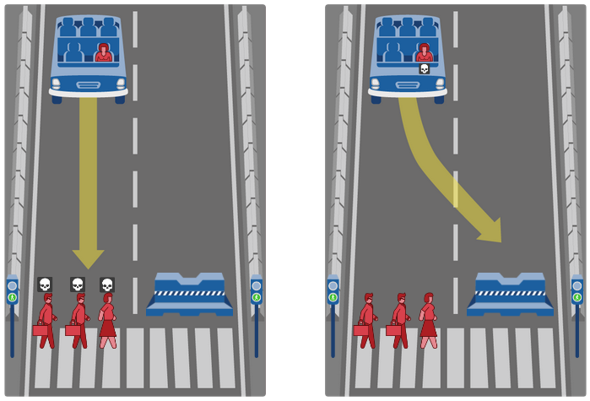
INTRODUCTION
What should the self-driving car do?
In future there will be many agents and they will have to coexist in the shared environment.
Agents will have to take difficult decisions
The goals of one agent may conflict with the goals of another agent.

Slide 3
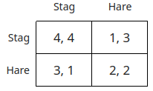
Social Dilemma Environments
Stag Hunt
Two hunters choose the target for hunting separately
It takes two hunters to catch the Stag
Hare can be caught alone

Slide 4
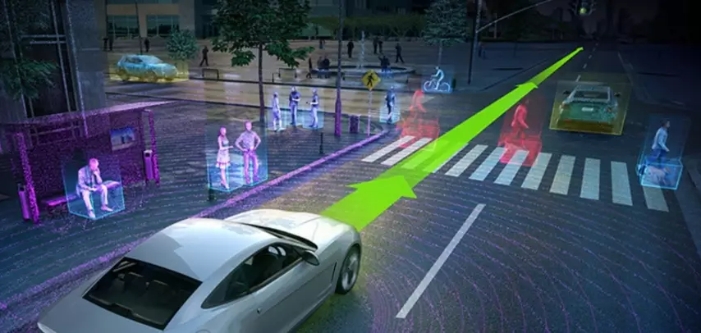
Reinforcement Learning
Training process based on rewarding desired behaviour
Agent
- observes the environment
- takes decisions
- interacts with the environment
- has specific goals
- can learn
Environment
- everything around the agent
Reward
- feedback given to an agent for interacting with the environment
Agent
Environment

Slide 5
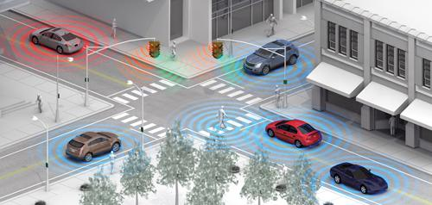
Multi-Agent
Reinforcement Learning (MARL)
The subfield of Reinforcement Learning focused on training multiple agents in a shared environment

Slide 6
Problem Statement. MARL
Nonstationarity
  All agents acting at the same time
  Agents are constantly changing policies
  Slow and not guaranteed convergence
Partial observability
  Changes done by other agents are hard to predict
Notes:
The main problems of Multi-Agent Reinforcement learning field in general are:
Nonstationarity - the result of many agents learning concurrently, constantly changing their policies and adapting to the policies of agents with suboptimal performance.
Partial Observability - as the environment may be changed drastically by the actions of other agents.
Slow and not guaranteed convergence, partially because of nonstationarity
And Poor exploration as the space of possible interaction between agents is huge.
The problems of Multi-Agent reinforcement Learning with agents having personal goals are:
Dominance of personal goals over group goals, as personal goals often require less cooperation and can be achieved easier.
Inequality - when some agents receive more reward than others
Appearance of Free-riders - agents that rely on others to contribute to the public good and only harvesting the benefits themselves.
Poor adaptivity to new situations, for example when encountering agents that were trained differently.

Slide 7
Problem Statement.
MARL with individual goals
Personal goals overshadow group goals
  Agents are not always homogeneous
  Personal goals often easier to achieve
  Agents are struggling to find compromises
Inequality
  Critical for some applications
  Appearance of free-riders
  Important for agent’s owners
Notes:
The main problems of Multi-Agent Reinforcement learning field in general are:
Nonstationarity - the result of many agents learning concurrently, constantly changing their policies and adapting to the policies of agents with suboptimal performance.
Partial Observability - as the environment may be changed drastically by the actions of other agents.
Slow and not guaranteed convergence, partially because of nonstationarity
And Poor exploration as the space of possible interaction between agents is huge.
The problems of Multi-Agent reinforcement Learning with agents having personal goals are:
Dominance of personal goals over group goals, as personal goals often require less cooperation and can be achieved easier.
Inequality - when some agents receive more reward than others
Appearance of Free-riders - agents that rely on others to contribute to the public good and only harvesting the benefits themselves.
Poor adaptivity to new situations, for example when encountering agents that were trained differently.

Slide 8
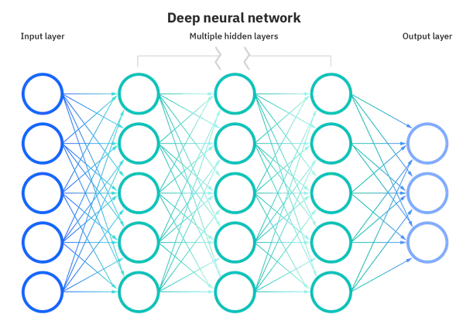
Artificial Neural Network (ANN)
Set of data nodes arranged in layers
Each layer is connected to the next one
Data is modified by weights os the connections during transmission
Learns through Backpropagation

Slide 9
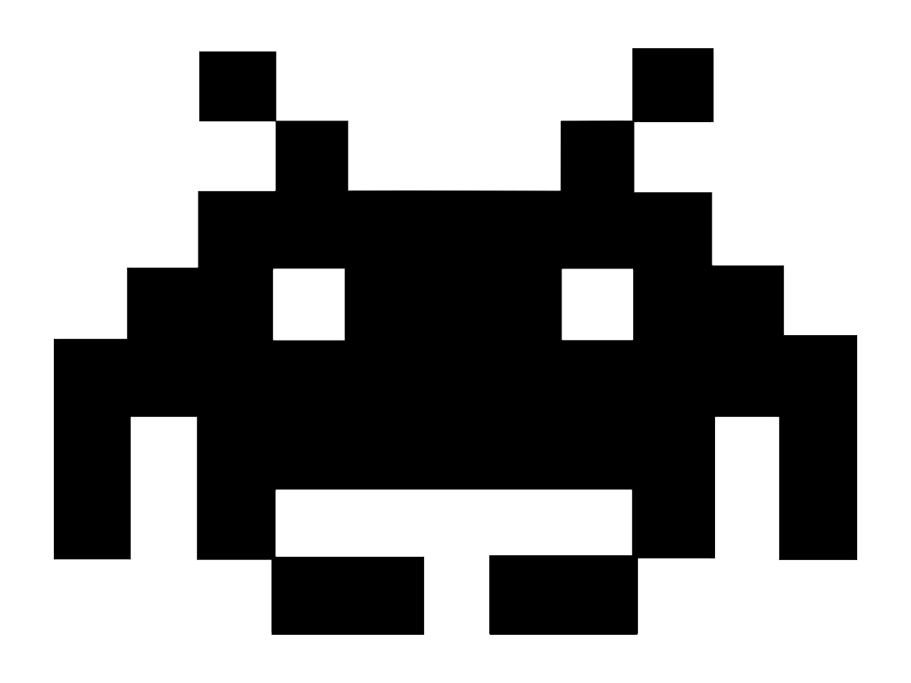
Learning - Execution model
Decentralized Learning
Decentralized Execution
Centralized Learning
Decentralized Execution
Notes:
There are two main paradigms currently used for Multi-Agent reinforcements learning.
The first one is the decentralized learning followed by decentralized execution.
This is the direct extension of single agent reinforcement learning.
All agents are learning independently treating all other agents as the part of the environment.
Despite the simplicity of approach it showed to be capable of solving complex multi-agent tasks and compete with the second approach
Which is Centralized learning followed by decentralized execution.
In this approach during learning all agents are controlled by a central learning network that determines the best set of policies for all agents.
Than this network is decomposed into smaller individual networks that can separately be used by each agent for decentralized execution.

Slide 10
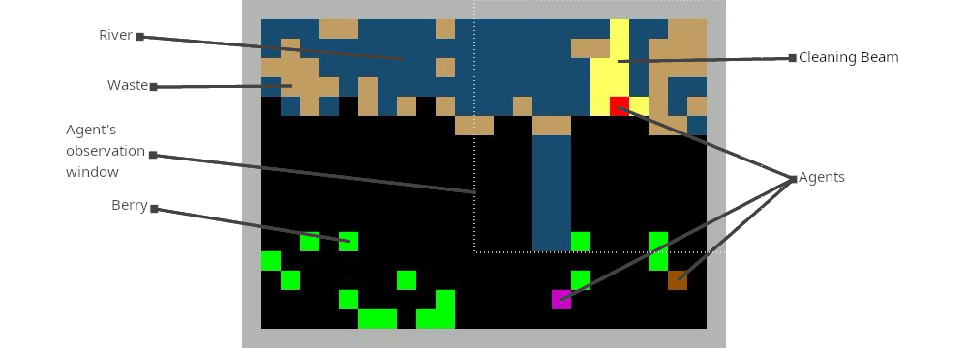
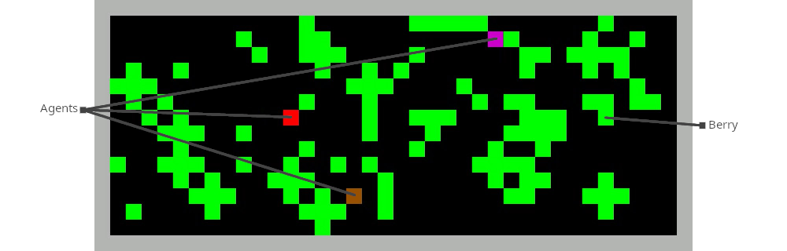
Cleanup environment
Harvest environment
Actions:
Move ← ↑ → ↓
Turn ↶ ↷
Stay (no action)
Launch cleaning beam (Cleanup env. only)
Public goods problems
Free-rider problem
Common-pool resources problem

Slide 11
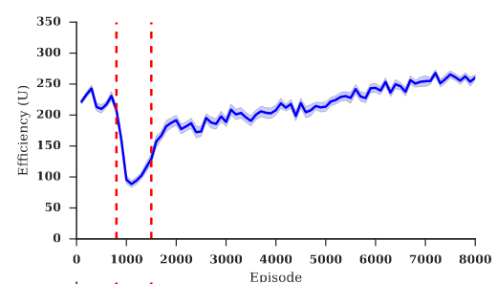
Previous work
A multi-agent reinforcement learning model of common-pool resource appropriation (Perolat, Leibo, Zambaldi et al., 2017)
  Harvest environment in which agents can use stun beam
  Agents prevent resource depletion by stunning each other
[1]

Slide 12
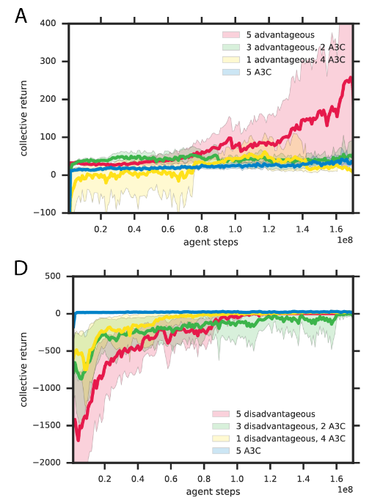
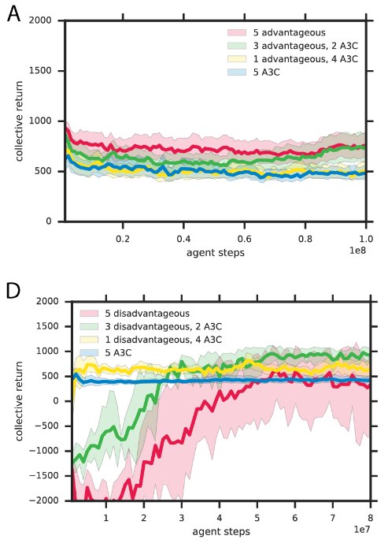
Previous work
Inequity aversion improves cooperation in intertemporal social dilemmas
(Hughes, Leibo Everett et al., 2018)
  Used two types on inequity aversion: Advantageous and Disadvantageous.
Cleanup
Harvest
[2]

Slide 13
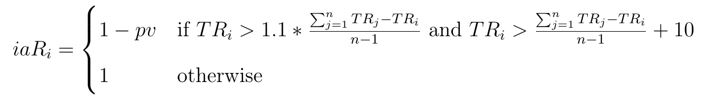
Inequity-Averse penalty
The penalty equal to penalty value (pv) is applied if
The agent has consumed 10% more berries than the average of other agents

Slide 14
Reward Schemes
Individual Reward
Each agent gets reward for the berries that it consumes itself
Stimulates competition
“Consume berry”
Collective reward
Each agent gets reward equal to the sum of individual rewards of all agents, after applying penalty
Stimulates cooperation
“Collect berry”

Slide 15
Thesis goal:
Conduct Reinforcement Learning
In a Multi-Agent social dilemma environments
Using both Centralized and Decentralized learning approaches
Penalize policies that result in inequality
between agents
Chosen Algorithm:
Proximal Policy Optimization
by OpenAI
Study the impact of the chosen method and penalization scheme on the performance of agents
Notes:
So the field lacks a direct comparison between centralized and decentralized learning approaches for the domain of balancing between personal and group goals of agents.
Also there is a lack of research that utilize centralized learning for this task.
My proposed approach is to Conduct Reinforcement Learning
In a Multi-Agent multi-goal environment
Using both Centralized and Decentralized learning approaches to make a direct comparison.
For the policy selector I have chosen QMIX for centralized learning approach and Deep Deterministic Policy Gradient for decentralized learning as it showed good results on one of the environment that I am going to use.
I will analyze both approach on many parameters such as the collective group revard, inequality in the individual rewards, presence of free-riders and convergence speed.

Slide 16
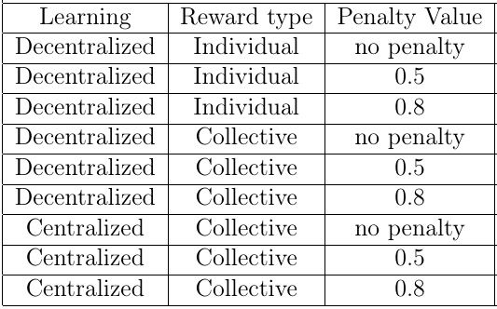
Experimental Setup:
Number of agents: 3
Episode length: 1000
Training Duration: 2000 episodes or 8 * 10^7 simulation steps
Experiments:

Slide 17
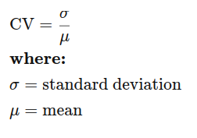
Evaluation
Combined performance of all agents
  Number of collectively consumed berries
Equality in individual performance of agents
  Coefficient of Variation (CV) between individually consumed berries.
Convergence rate
Number of free-riders in Cleanup environment

Slide 18
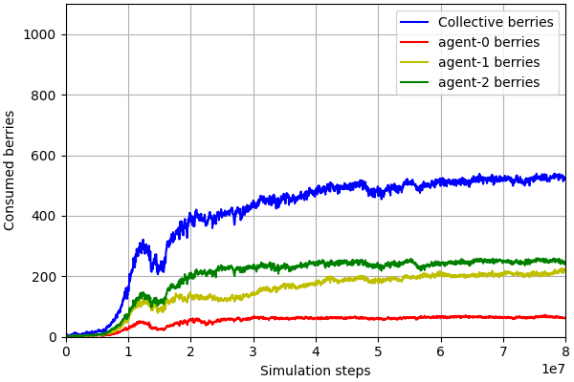
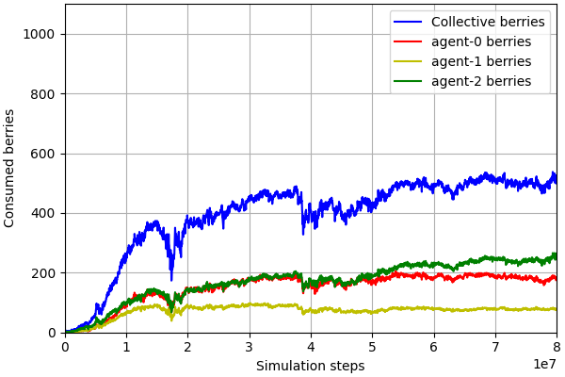
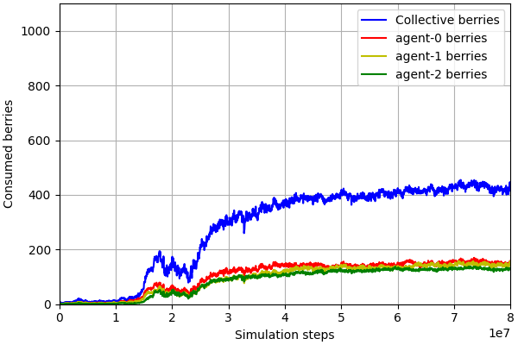
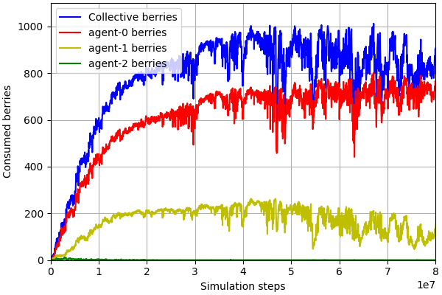
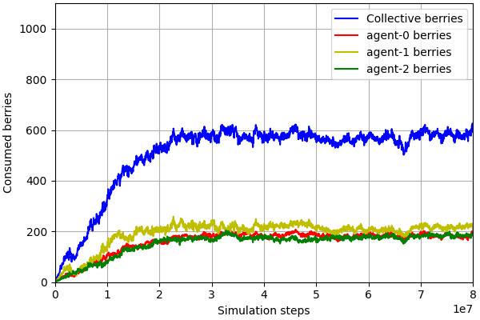
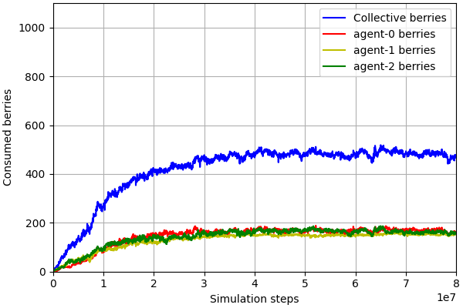
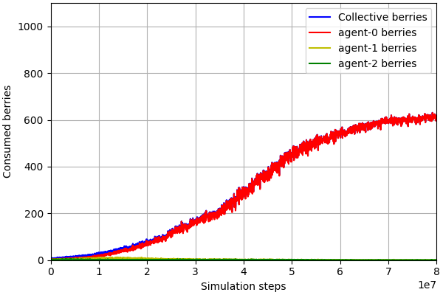
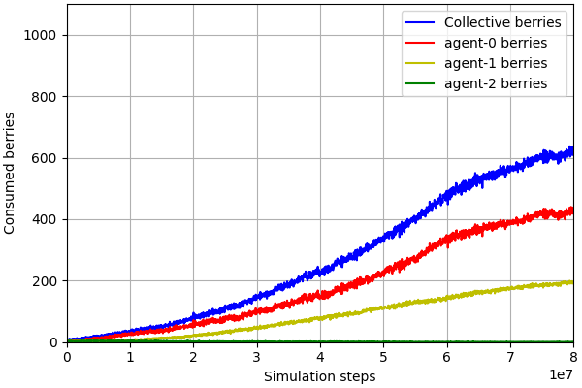
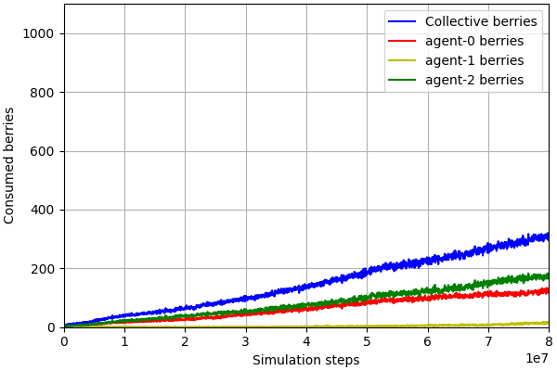
Results. Cleanup environment. All
pv - penalty value
CV - Coefficient of Variation
FR - number of free-riders
Decentralized Learning
Individual Reward
(a) pv = 0 CV = 0.56 FR = 2
(b) pv = 0.5 CV = 0.51 FR = 2
(c) pv = 0.8 CV = 0.11 FR = 2
Decentralized Learning
Collective Reward
(d) pv = 0 CV = 1.36 FR = 1
(e) pv = 0.5 CV = 0.10 FR = 1
(f) pv = 0.8 CV = 0.02 FR = 1
Centralized Learning
Collective Reward
(g) pv = 0 CV = 1.73 FR = 1
(h) pv = 0.5 CV = 1.04 FR = 1
(i) pv = 0.8 CV = 0.78 FR = 2

Slide 19
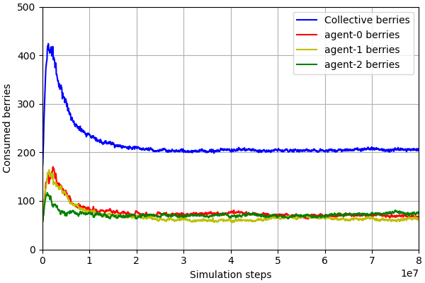
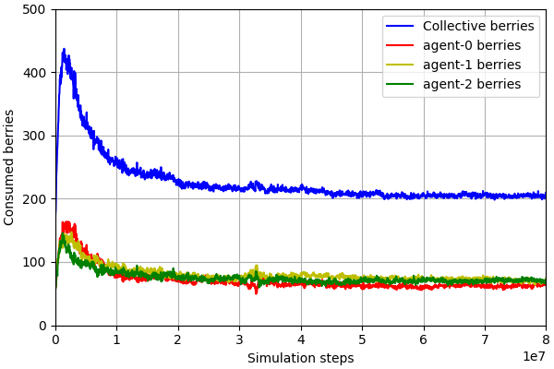
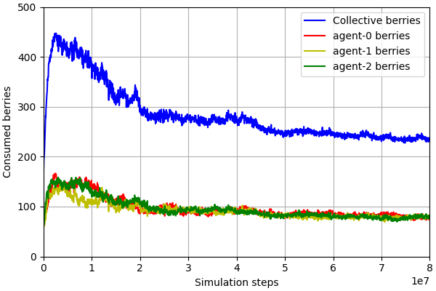
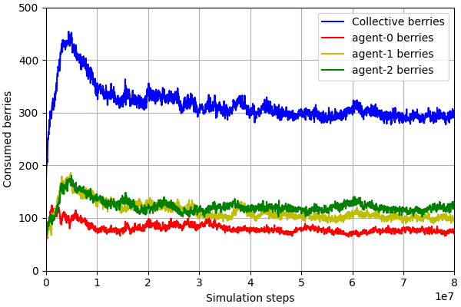
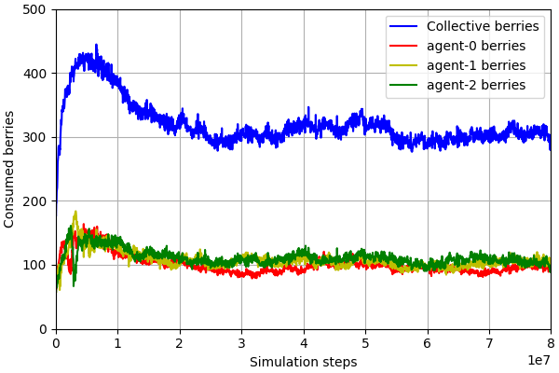
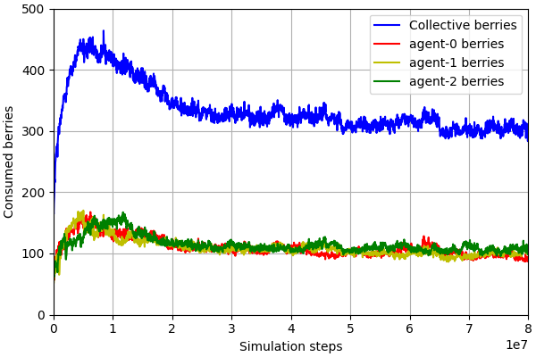
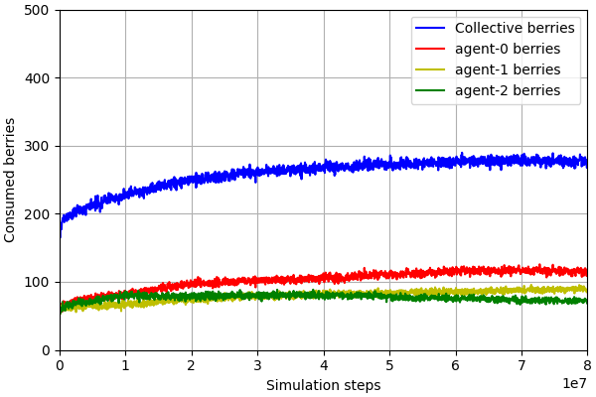
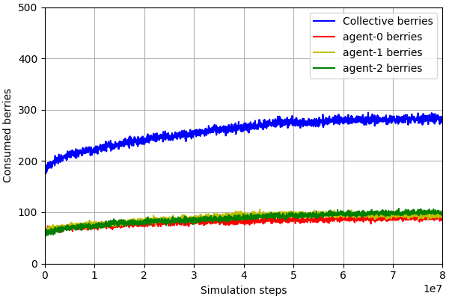
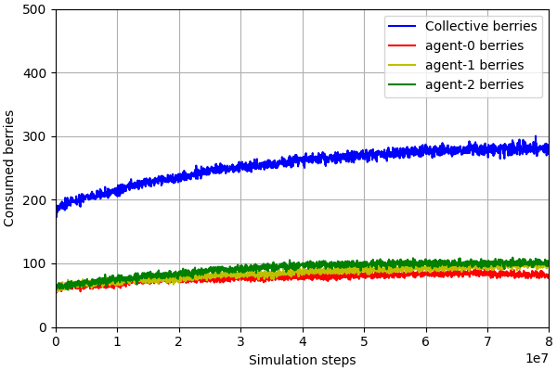
Results. Harvest environment. All
pv - penalty value
CV - Coefficient of Variation
Decentralized Learning
Individual Reward
(a) pv = 0 CV = 0.09
(b) pv = 0.5 CV = 0.04
(c) pv = 0.8 CV = 0.03
Decentralized Learning
Collective Reward
(d) pv = 0 CV = 0.26
(e) pv = 0.5 CV = 0.04
(f) pv = 0.8 CV = 0.08
Centralized Learning
Collective Reward
(g) pv = 0 CV = 0.23
(h) pv = 0.5 CV = 0.06
(i) pv = 0.8 CV = 0.11

Slide 20
Conclusion
Inequity-Averse penalty is an effective technique for reducing inequality between agents
Existence of free riders is possible even when the agents receive equal rewards
Сentral learning leads to smoother learning experience
The best result in the Cleanup environment was achieved using decentralized learning with collective reward scheme and inequity-averse penalty with the value 0.5.

Slide 21
Future Work
Experiment with different exploration strategies
  Actively stimulate agents to search for better policies
Try different learning algorithms
  Centralized learning, decentralized execution algorithms QMIX [3] and VDN [4]

Slide 22
Thank you
for attention

Slide 23
References
[1] Julien Perolat, Joel Z Leibo, Vinicius Zambaldi, Charles Beattie, Karl Tuyls, and Thore Graepel. A multi-agent reinforcement learning model of common-pool resource appropriation. arXiv preprint arXiv:1707.06600, 2017.
[2] Hughes, Edward, Joel Z. Leibo, Matthew G. Phillips, Karl Tuyls, Edgar A. Duéñez-Guzmán, Antonio García Castañeda, Iain Dunning et al. "Inequity aversion improves cooperation in intertemporal social dilemmas." arXiv preprint arXiv:1803.08884 (2018).
[3] Rashid, T., Samvelyan, M., Schroeder, C., Farquhar, G., Foerster, J. and Whiteson, S., 2018, July. Qmix: Monotonic value function factorisation for deep multi-agent reinforcement learning. In International Conference on Machine Learning (pp. 4295-4304). PMLR.
[4] Sunehag, P., Lever, G., Gruslys, A., Czarnecki, W.M., Zambaldi, V., Jaderberg, M., Lanctot, M., Sonnerat, N., Leibo, J.Z., Tuyls, K. and Graepel, T., 2017. Value-decomposition networks for cooperative multi-agent learning. arXiv preprint arXiv:1706.05296.

