Slide 1
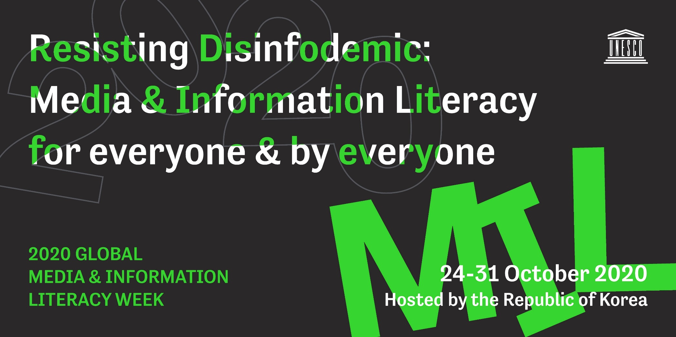
Global Media and Information Literacy Week 2020

Slide 2
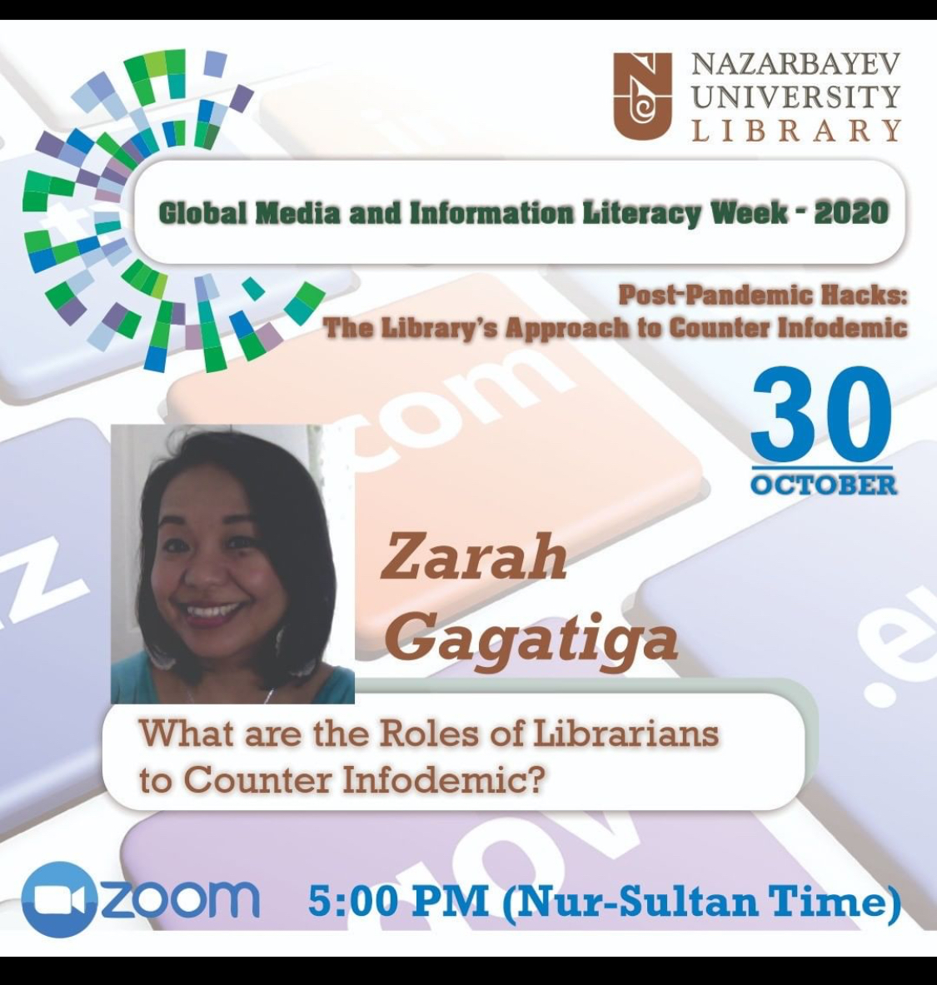
Talking Points
Libraries and Disasters
When libraries change lives
Libraries and Librarians in the Time of COVID-19
  Embedded Librarianship
  Roles of Librarians
  Resources for Sharing

Slide 3
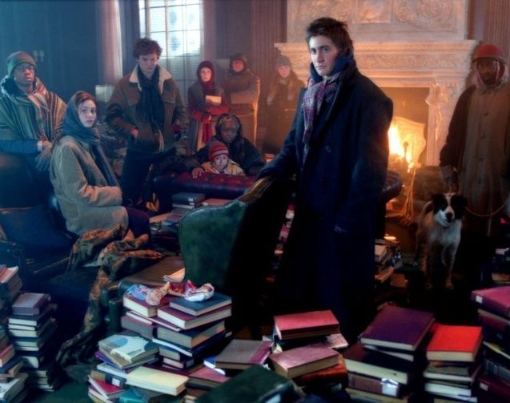
The Day After Tomorrow
Emmerich and Nachmanoff, 2004
Climate Change
Young people, youth leaders and scientists have an understanding of the changes in climate and global warming.
Politicians are politicians.
The community takes refuge in the New York Public Library.

Slide 4

Libraries Change Lives

Slide 5
Libraries & Librarians in COVID-19 Times
The Library
Community Center
Information Hub
Safe Space
IP, refugees, marginalized, LGBTQ+i
Guardians of Traditions
Cultural Organization
(process of creation)
Embedded Librarianship
* Move and integrate community services and programs in the library and vice versa
* Do not stop at collection development and reference services.

Slide 6
Libraries & Librarians in COVID-19 Times
Instructional Leader
Community Developer and Cultural Worker
Program Coordinator or Program Manager
Embedded Librarianship
Deeper integration of both library resources and personnel into course management systems is essential to ensure students gain information literacy skills.
Cox, 2020

Slide 7
Ideas! Ideas! Ideas!
As an Instructional Leader
Create MIL resources packs, learning packages and training modules
Open safe spaces for the discussion of pedagogy in light of new media and technology
Community Developer and Cultural Worker
Build partnerships with local and national agencies, cultural institutions, help desks and resource persons
Provide avenues for communities and cultures to create and make sense of chaos
Program Coordinator or Program Manager
Develop inclusive and diverse resources
Design programs and services that address socio-emotional learning

Slide 8
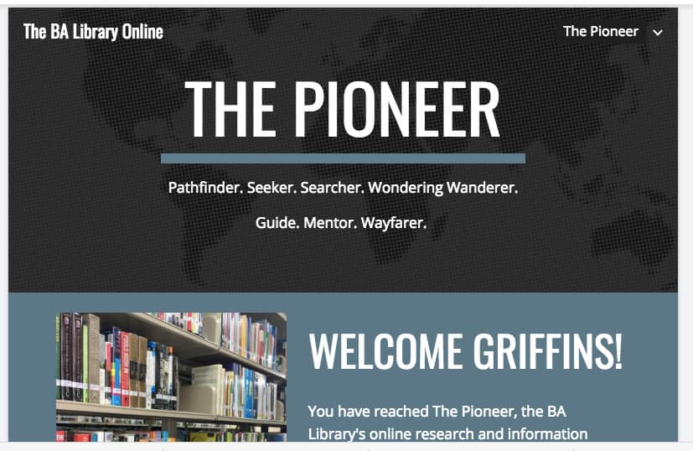
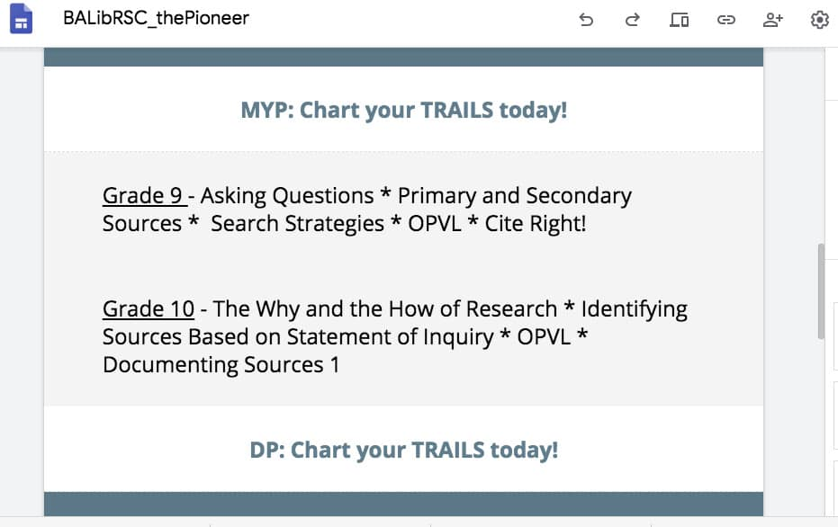
MIL Module and Research Center

Slide 9
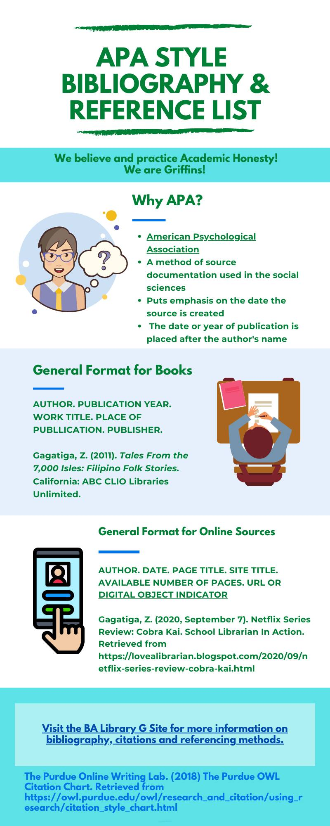
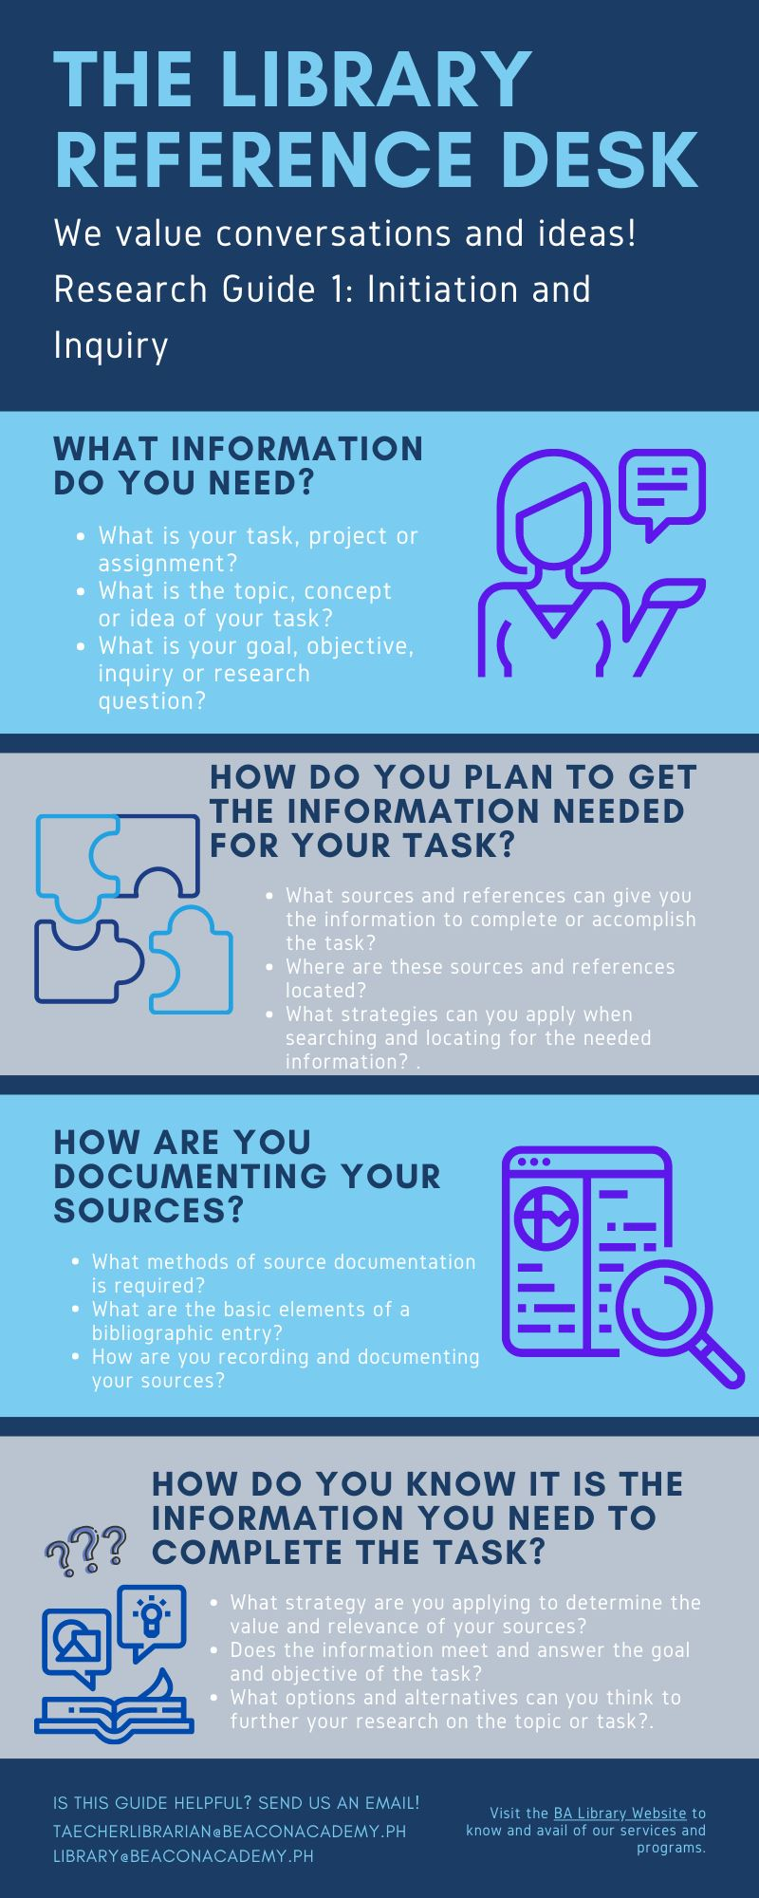

Slide 10
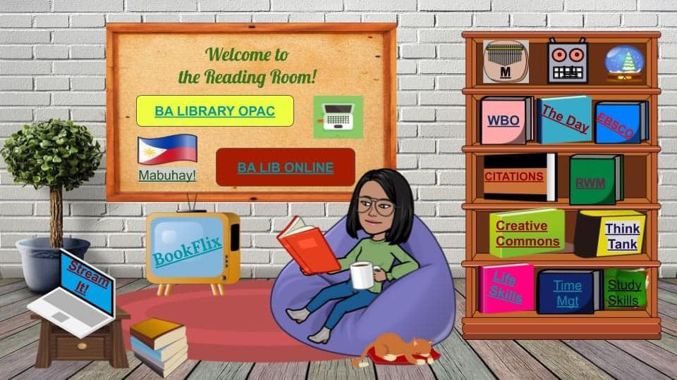
Online or Virtual Reading Room

Slide 11
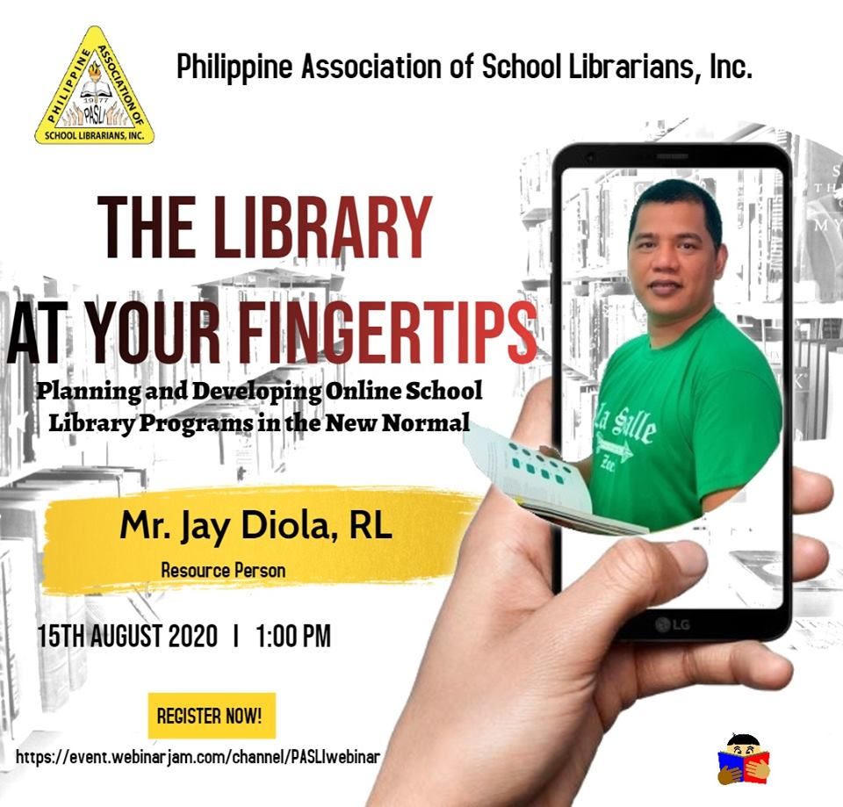

PASLI and Filipinas Heritage Library

Slide 12
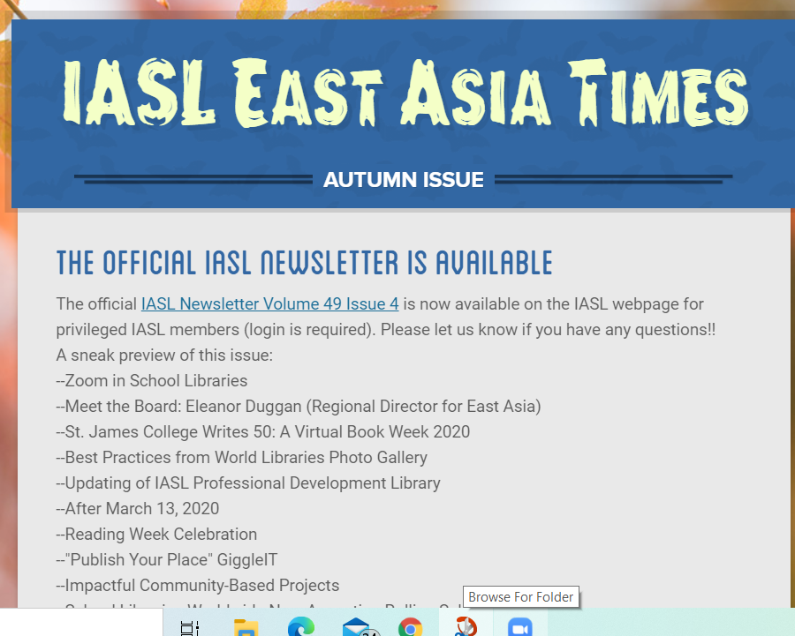
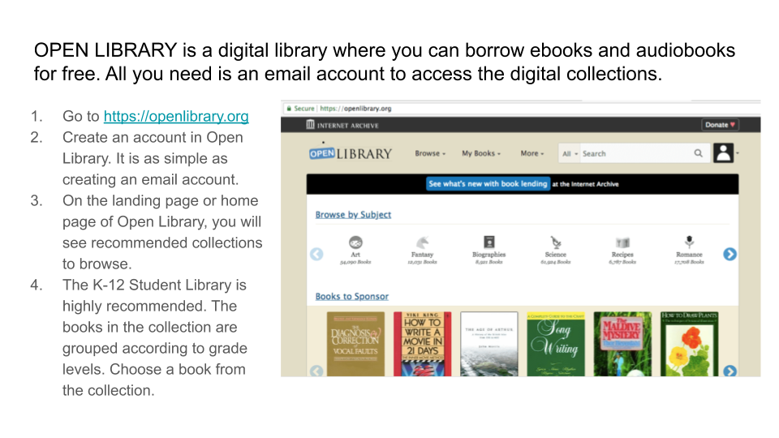
IASL and Open Library

Slide 13
Resource Sharing
Wakelet: Curating Online Content
Post Pandemic Hacks: Dealing with Disinformation and Infodemic
School Libraries Are Essential in the New Normal
Everything COVID-19
My YouTube Channel Series
Author Chat and Book Talk
Children’s Literature
School Librarian’s Lounge: Blog and Vlog

