Slide 1
The New Age of Truth:
Media Literacy in a Digital Context

Slide 2
Some Key Definitions:
Media Literacy:
Practices that allow people to access, evaluate and create media (Leaning, 2017).
Applies to the general population of a country (high vs. low literacy rate)
Four Aspects of Media Literacy:
Accessing content: being able to use technological advances (such as computers)
Analyzing content: being able to distinguish between media sources
Evaluating Messages: being able to ascertain intent and meaning
Creating Content: being able to utilize media for personal or professional ends
“Social media is something of a double-edged sword. At its best, social media offers unprecedented opportunities for marginalized people to speak and bring much needed attention to the issues they face. At its worst, social media also offers 'everyone' an unprecedented opportunity to share in collective outrage without reflection.” --Roxane Gay

Slide 3

MEDIA
Any technology used to transmit information that has cultural value
  Example: Turn off your cell phone and place it face down. The phone is a technology.
  Example: Pick up your phone, turn it on and check your mail. The phone is media.

Slide 4
“With the arrival of electric technology, man has extended, or set outside himself, a live model of the central nervous system itself. ”
― Marshall McLuhan, Understanding Media: The Extensions Of Man

Slide 5
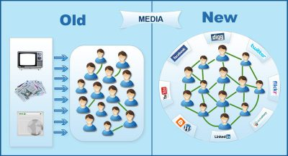
From Media To “Social Media”
ONE TO MANY VS. MANY TO MANY

Slide 6
Classic Media Literacy (One to Many)
Limited information sources
Professionalized media environment
Limited audiences (depending on medium)
Relies on experts and expertise
Simple rule of “three”: do not believe information unless it can be verified from at least three different reputable information sources

Slide 7
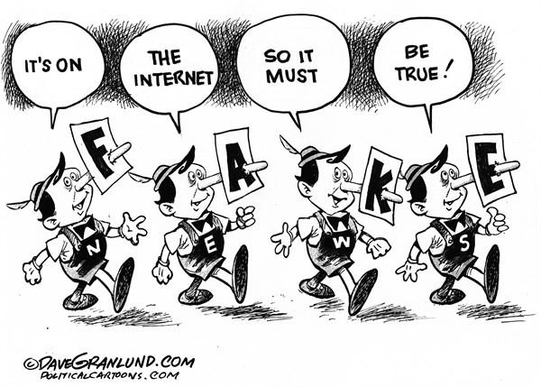
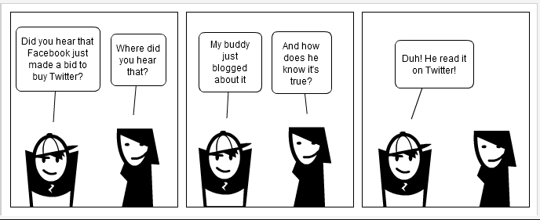
From verifiable truths to...
“The internet is just the world passing notes around a classroom” -- Jon Stewart

Slide 8
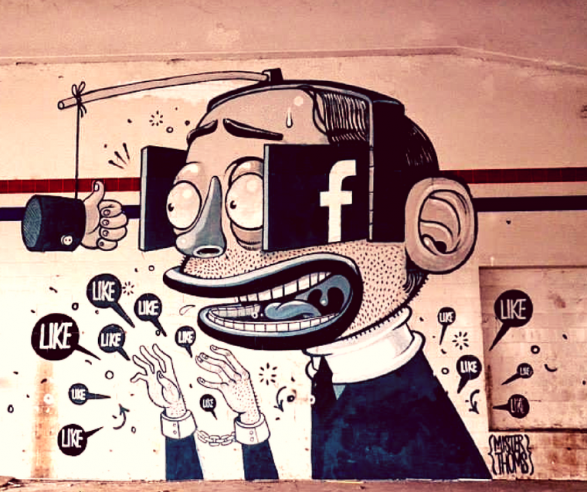
Analyzing the “Echo Chamber”
Echo Chamber:
Social debates are amplified by repetition within a closed system. People seek out only information they agree with, reinforcing their existing beliefs. In order to gain social capital, they will share this information with others who agree. This cycle creates and sustains social extremism and polarization (Barberá, Pablo, et al., 2015).

Slide 9
Changing concepts of trust...
Trust in Friends
Media trust is dropping, while people are more likely to trust their friends when they share news (Singal, 2017)
Trust in Family
Loyalty to family makes a person more likely to share that information regardless of truth (New York Times Study, 2011)
Trust in Community
Shared culture and beliefs motivate people to believe some information sources over others (Konnikova, 2017)

Slide 10
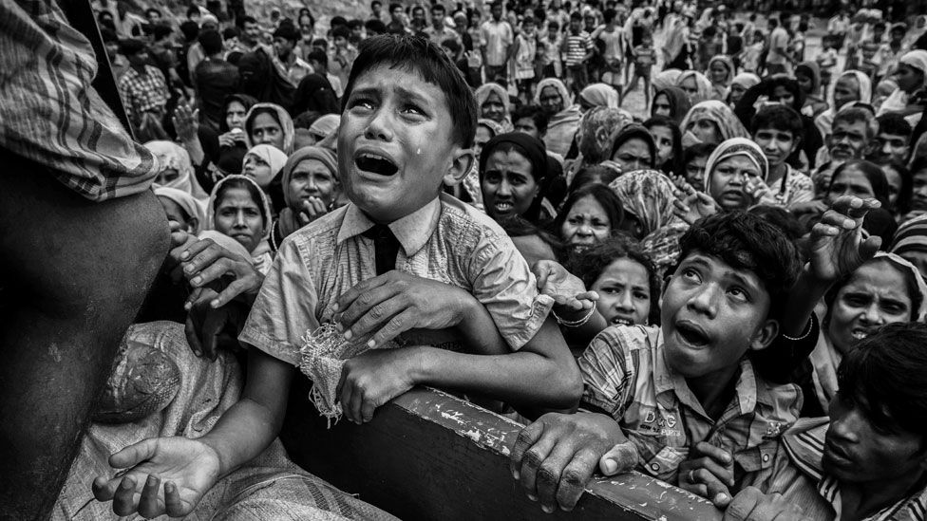
Issues with truth and trust in social media...
In Malaysia, 2018, a popularly-supported ethnic cleansing of the Rohingya was largely driven by social media support for Government policy...

Slide 11
Facebook and Hate Speech in Malaysia
Popular support for the cleansing began with Facebook
Key false-news tweets by a respected Buddhist monk received large circulation
Large numbers of Maylaysians now have access to the internet and Facebook, so much so that the words “Facebook” and “Internet” are interchangeable
Facebook
Rohingya

Slide 12
1,000,000+
Refugees...truth matters

Slide 13
Who Controls the “Truth”?
Governments
Corporations
Users
This solution requires a government to heavily regulate internet and media content. Not advisable due to the fact that technology changes too rapidly. Censorship decreases trust in government: this process is counter-productive. Also, governments have a vested interest in “spinning” news in their favor.
This solution requires corporation to manage sharing across their platforms to ensure truthfulness. Currently, this is the tactic being pursued in the U.S.A. Corporations have no “real” incentive to limit sharing, and can be slow to act (such as Facebook in Malaysia).
The only option left for promoting and enforcing “truthfulness” is with the media users themselves. In other words, in the age of social media, we need to be teaching ETHICS.

Slide 14
Full-Circle : Media Literacy and Media Ethics
Critical Thinking
Users must learn to be critical of all information. Never accept facts at first glance unless you saw it yourself.
Verification
Users must be taught how to fact-check and identify professional, accredited sources.
Self-Awareness
Users must be self-aware of their media sources, ensuring that they access a variety of media, rather than simply what they agree with.
Questioning Tradition
Traditional sources of “truth” such as religious leaders, politicians or popular educators can also spread falsehood knowingly or unknowingly
Patience
Social media causes people to become reactionary, favoring immediate (often unwise) responses over measured thinking
ETHICS
Users have to understand the damage they do when they share unverified information, even if it may cost them followers or likes

Slide 15
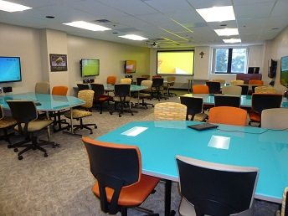
Literacy requires education...
Currently NU teaches courses in: Writing for Digital Media, Media History, Public Relations, Public Communication of Science and Technology and many others...
Place your screenshot here

Slide 16
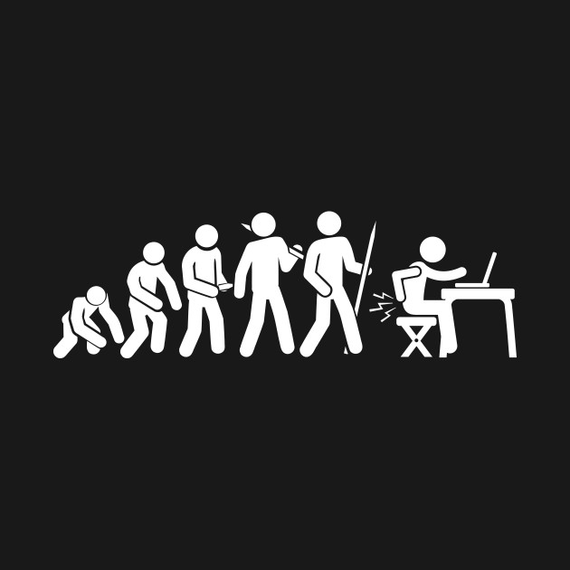
THANKS!
Any questions?
You can find me at
nathan.hulsey@nu.edu.kz

Slide 17
CREDITS
Leaning, Marcus (2017), "Integrating Media and Information Literacy", Media and Information Literacy, Elsevier, pp. 3–14, ISBN 9780081001707, retrieved 2018-10-01
Barberá, Pablo, et al. "Tweeting from left to right: Is online political communication more than an echo chamber?." Psychological science 26.10 (2015): 1531-1542.
Singal, Jesse (2017), Fake News Spreads Because People Trust Their Friends Too Much. New York Magazine. Online: http://nymag.com/intelligencer/2017/03/fake-news-spreads-because-people-trust-their-friends-too-much.html
Konnikova, Maria (2014) The Six Things That Make Stories Go Viral Will Amaze, and Maybe Infuriate, You. The New Yorker. Online: https://www.newyorker.com/tech/annals-of-technology/the-six-things-that-make-stories-go-viral-will-amaze-and-maybe-infuriate-you

Slide 18
SlidesCarnival icons are editable shapes.
This means that you can:
Resize them without losing quality.
Change line color, width and style.
Isn’t that nice? :)
Examples:

