Slide 1





Rare Ephemera from Both Sides: Russia/Soviet Union and Asia
A Digital Collections and Curation Case Study
Eurasian Academic Libraries Conference – 2021
“Contemporary Trends in Information Organization in the Academic Library Environment”
June 29-30, 2021
George Andrew Spencer
Distinguished Bibliographer for
Slavic, East European, Central Asian and Middle Eastern Studies
Memorial Library
University of Wisconsin - Madison
Madison, Wisconsin
U.S.A.

Slide 2
Development and Curation of a Special Collections/Rare Books Topical Collection
Partnership between subject specialist Bibliographers and Special Collections Librarians
Authorization and ability to acquire rare or unique items during buying trips (example: a visit by a UW-Madison librarian to a rare books auction in Tokyo)
Constant monitoring of antiquarian vendor web-sites and catalogs and ability to react quickly to acquire items for which there is usually a single copy being offered
Develop a collection theme/policy

Slide 3
Planning
Collaboration with faculty in determining the potential research value and use cases for the materials
Establish plan for preservation / conservation of original materials and whether or not the materials are candidates for digitization, either limited access to campus users or Open Access
Copyright status of materials

Slide 4
Develop workflow
Initial processing of physical originals via established Rare Books procedures
Evaluation by Digital Collection specialists for viability to be digitized (brittleness, binding, reflectivity, etc.)
Metadata/Cataloging
Research historical context of materials

Slide 5
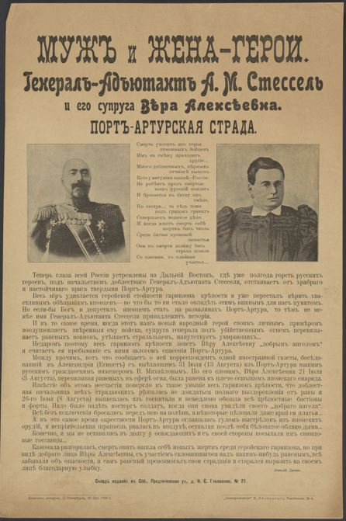

Slide 6
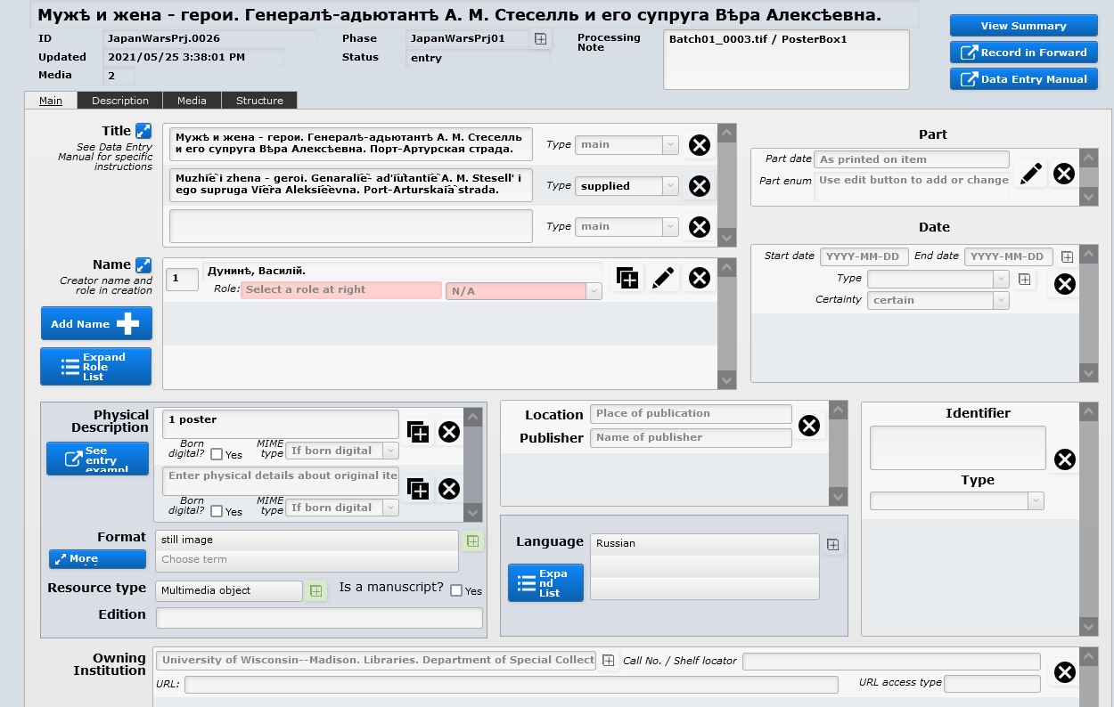

Slide 7
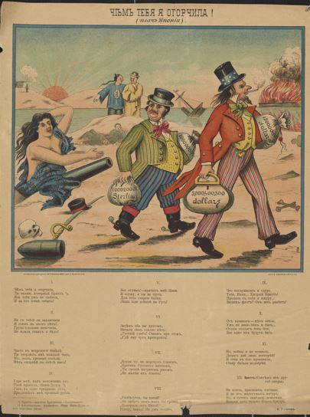

Slide 8
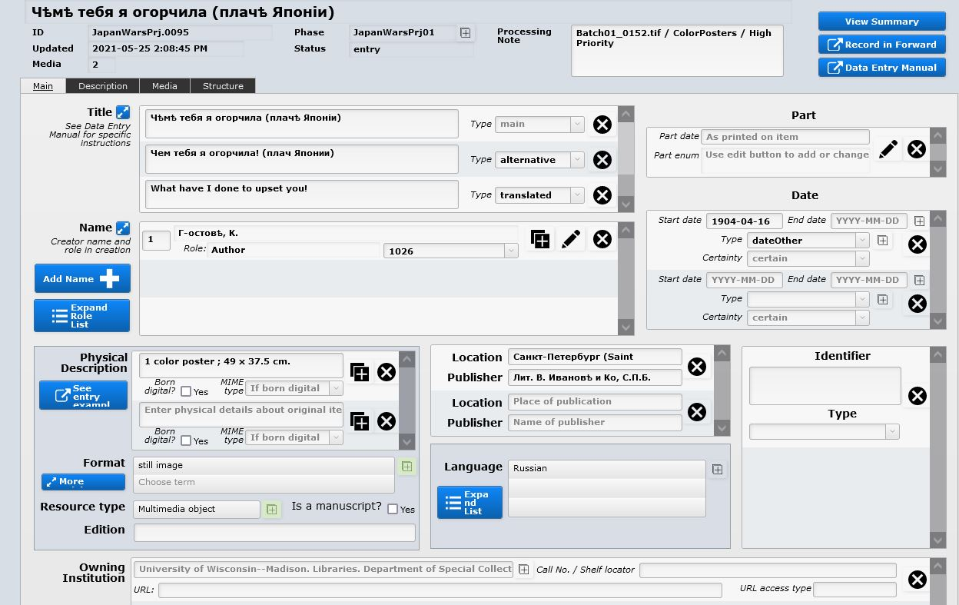

Slide 9
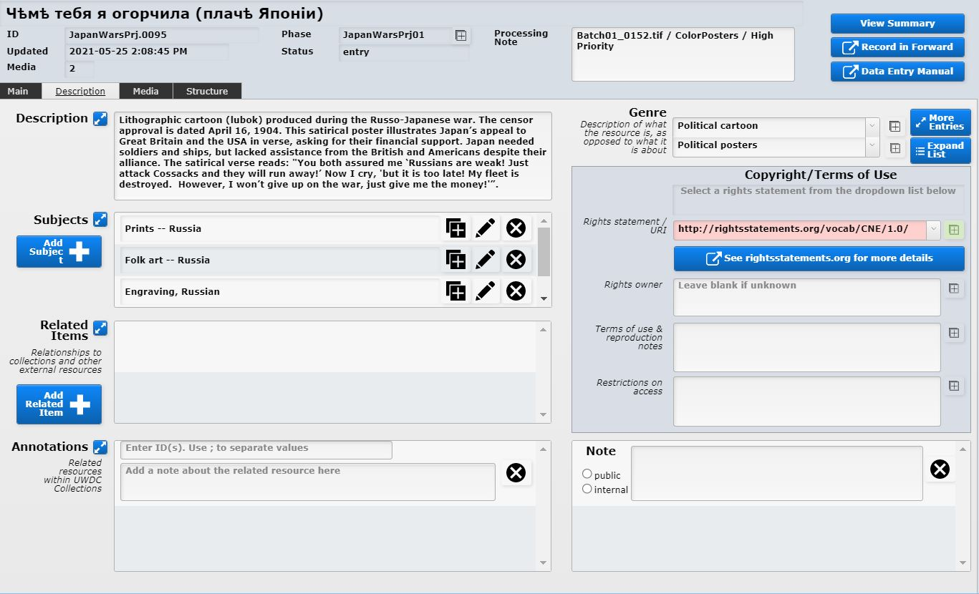

Slide 10
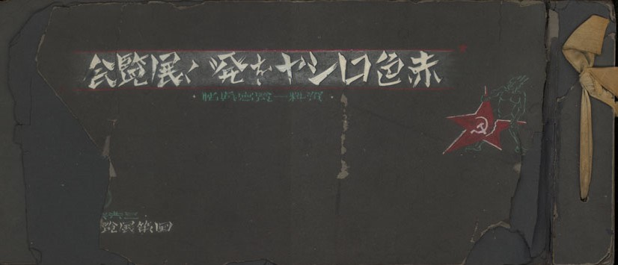

Slide 11
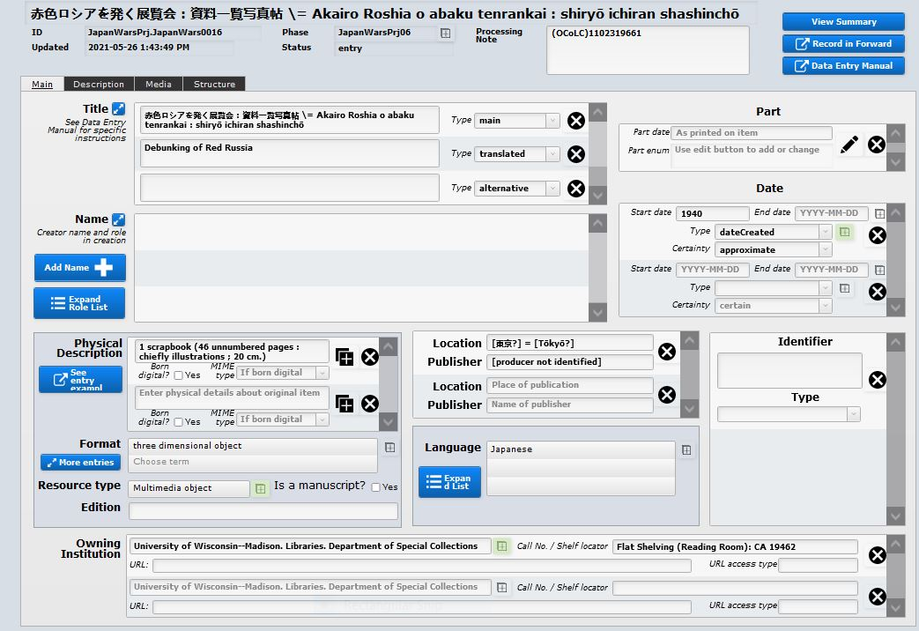

Slide 12
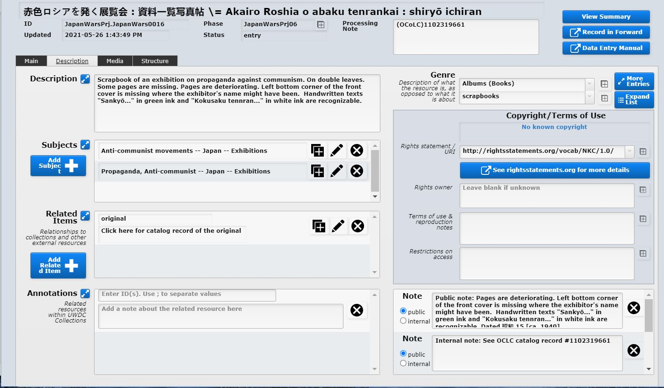

Slide 13
Current Collection Overview
60 original Russian patriotic placards from the Russo-Japanese War era as well a set of propagandistic chromolithographs of battle scenes of the Russo-Japanese War. In addition, we have recently acquired an original Russian colored print in the lubok (лубок) style also from the Russo-Japanese War period.
A very rare complete run of an illustrated Ottoman Turkish magazine about the Russo-Japanese War. This magazine demonstrates the great interest among the Turkish people of the time in the Russo-Japanese War and its outcome.
A scrapbook of photographs documenting an anti-Soviet exhibition held in Japan circa 1938. "赤色ロシヤを発く展覧会" (Akairo roshiya o abaku tenrankai = Debunking of Red Russia). This exhibition gives unique insight into the state of Japanese-Soviet relations in the period immediately before World War II.
An Open Access digital surrogate of an 18th century Kazakh dictionary lexicon for which the original unique manuscript is held by the Department of Manuscripts and Rare Books (Отдел рукописей и редких книг) of the Russian National Library in St. Petersburg, Russia. This dictionary lexicon was compiled during the period of gradual expansion of Russian influence in the northeastern Kazakh steppe in the late 18th Century.

Slide 14
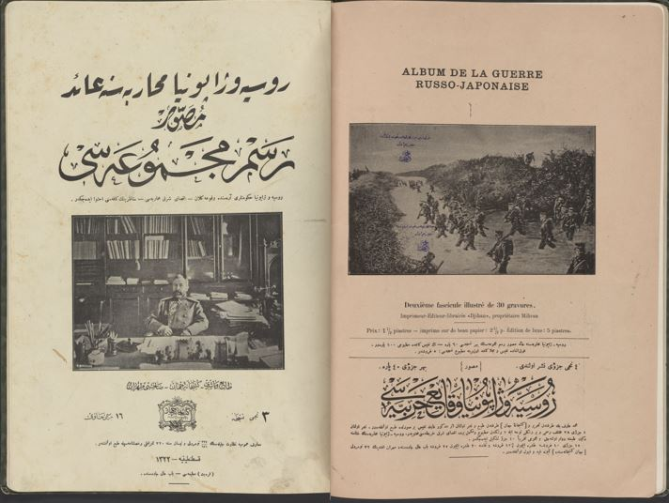

Slide 15
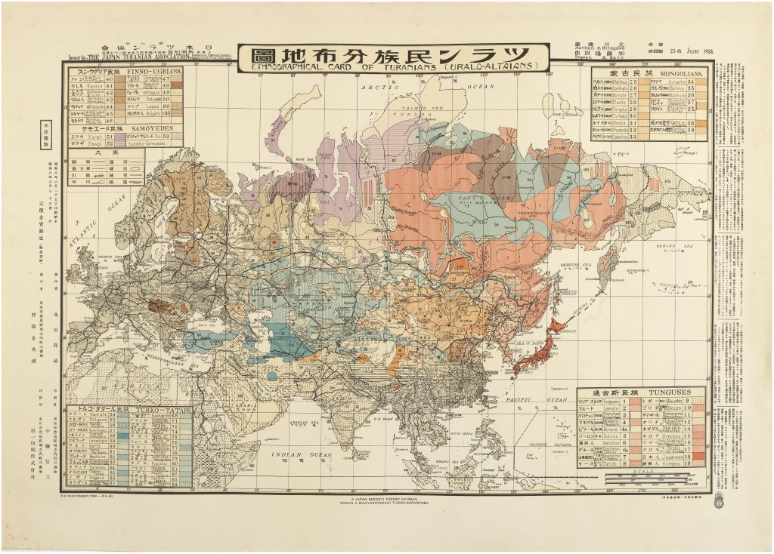

Slide 16
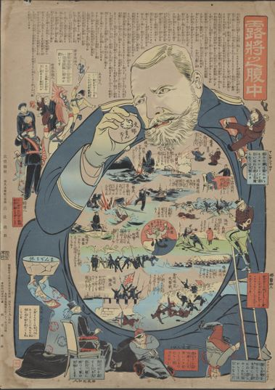

Slide 17
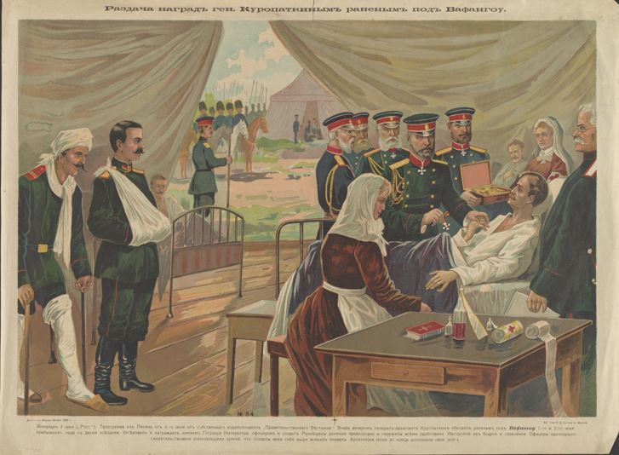

Slide 18
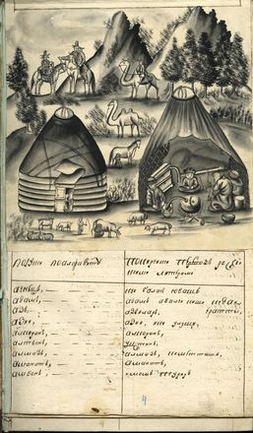

Slide 19
Publicity
Collection curation does not end with the acquisitions and cataloging process
As noted earlier, it is important to liaison with on-campus faculty to not only alert them to use cases for the materials, not only for research but also for teaching and outreach
Creating publicly accessible videos highlighting the collection

Slide 20
Kaltura Collection Video
http://cfvod.kaltura.com/pd/p/1660902/sp/166090200/serveFlavor/entryId/1_3hhlkyxv/v/1/ev/5/flavorId/1_5mm5u92m/name/a.mp4

Slide 21
THANK YOU FOR LISTENING!
Eurasian Academic Libraries Conference – 2021
“Contemporary Trends in Information Organization in the Academic Library Environment”
June 29-30, 2021

