Slide 1
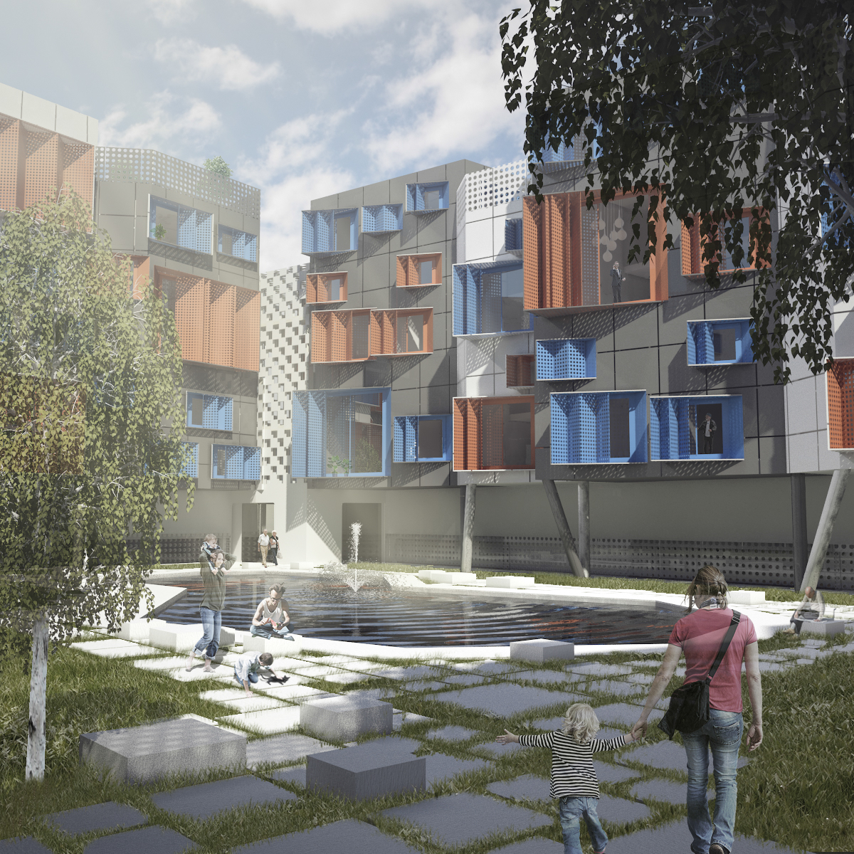



SLOVENIA 3rd PRIZE
Primož Černelč & Žaklin Križaj
Faculty of Architecture, University of Ljubljana

Slide 2
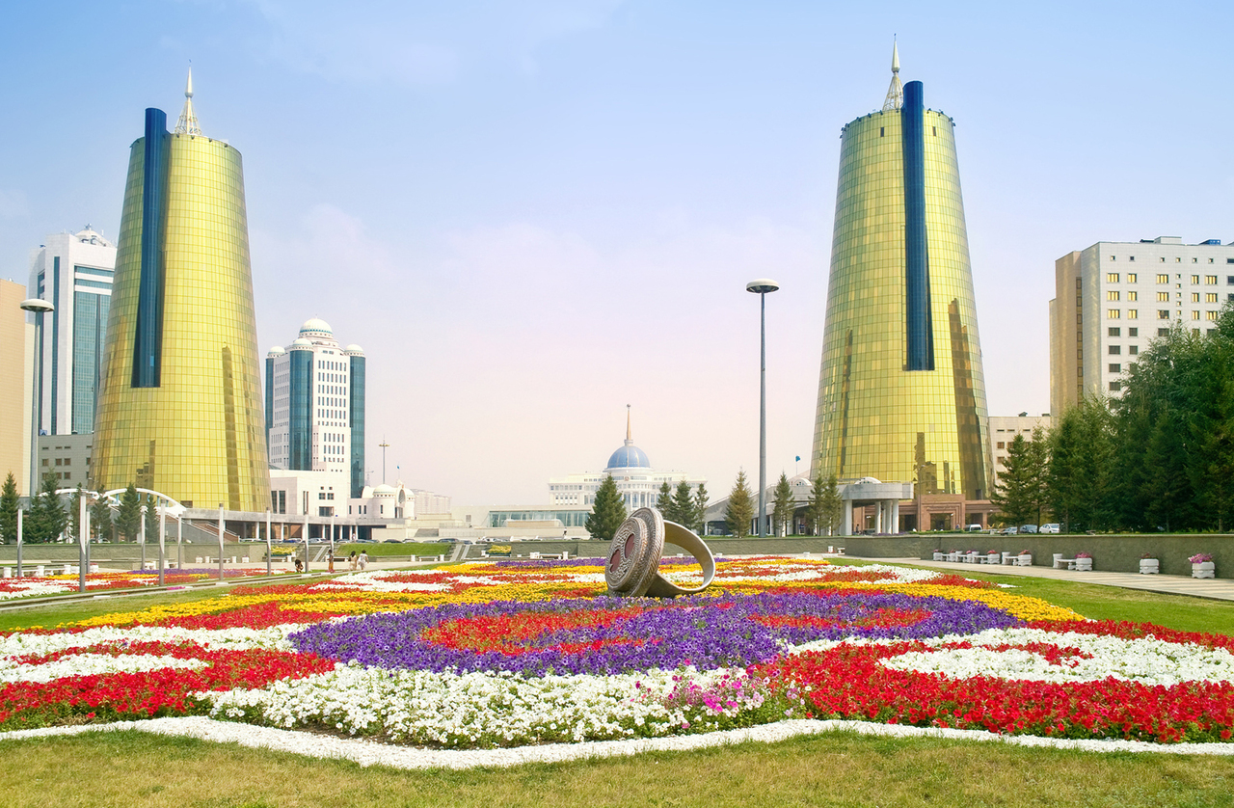
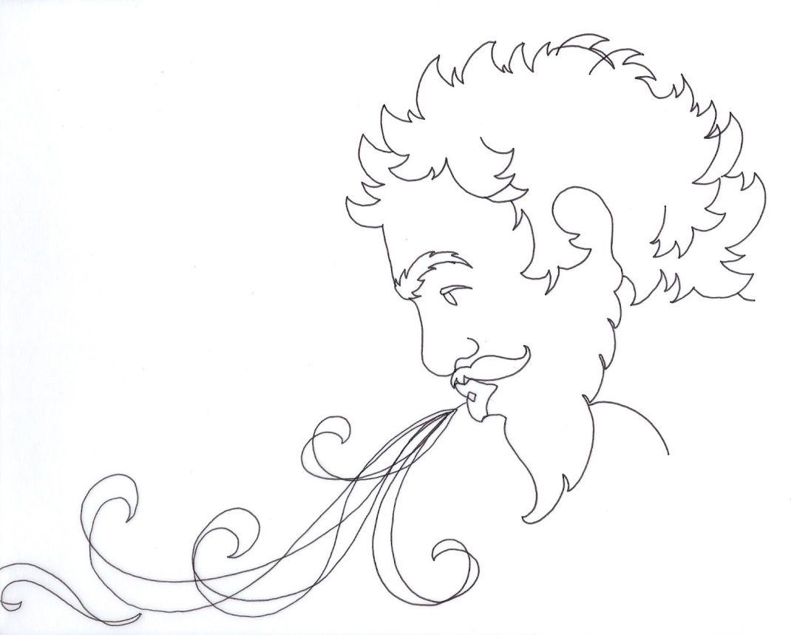
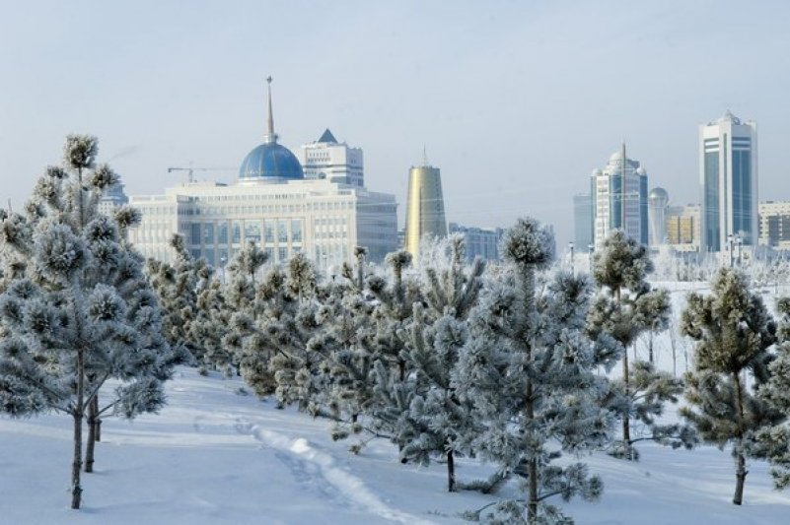

Slide 3
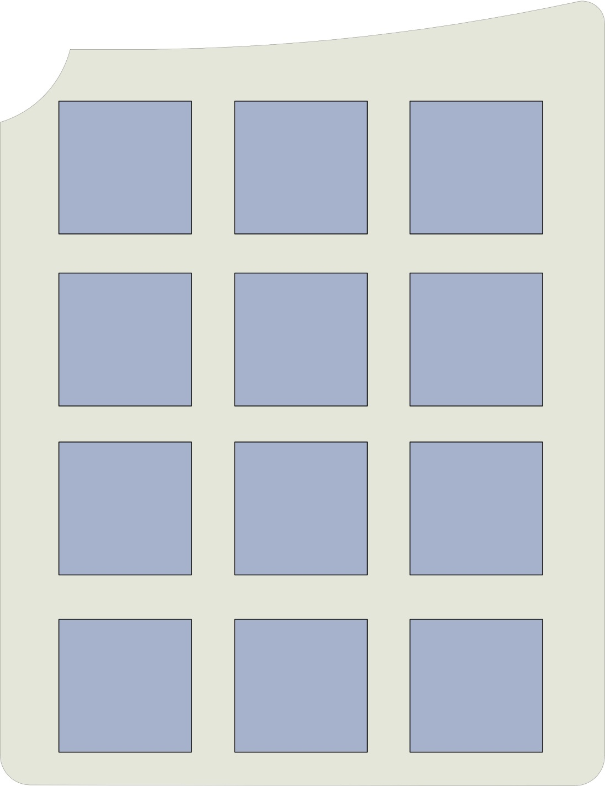

Slide 4


Slide 5


Slide 6
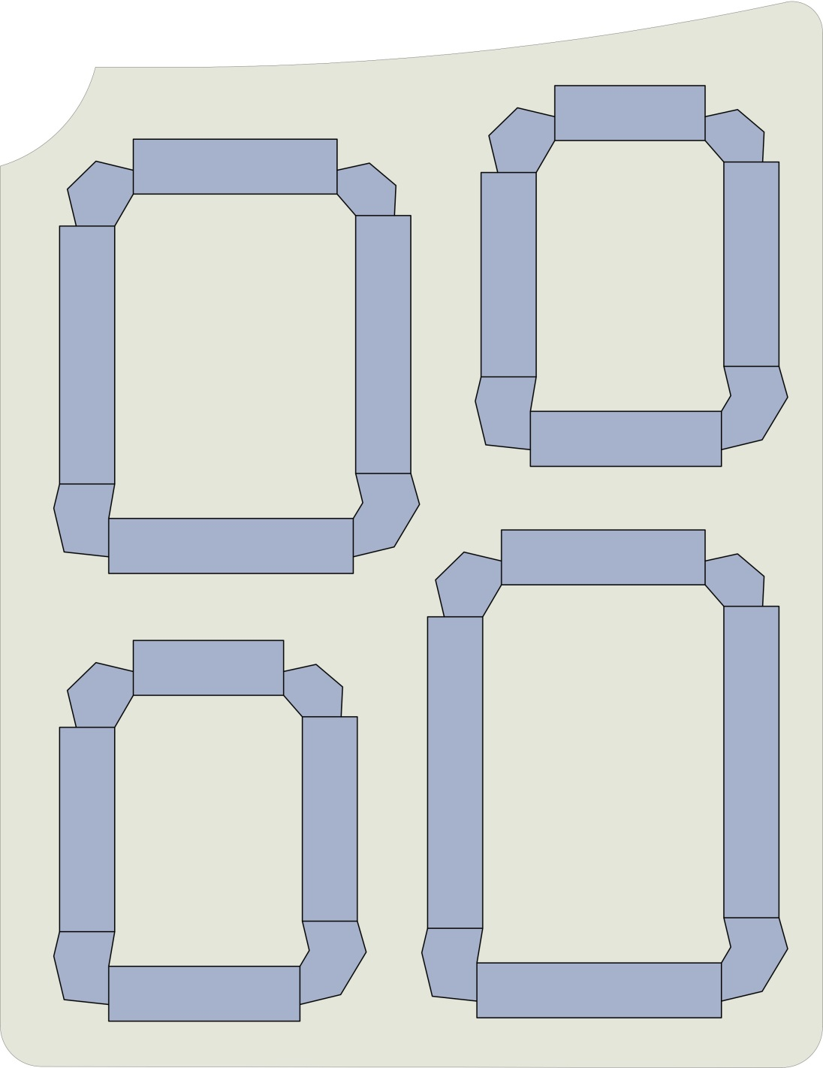

Slide 7
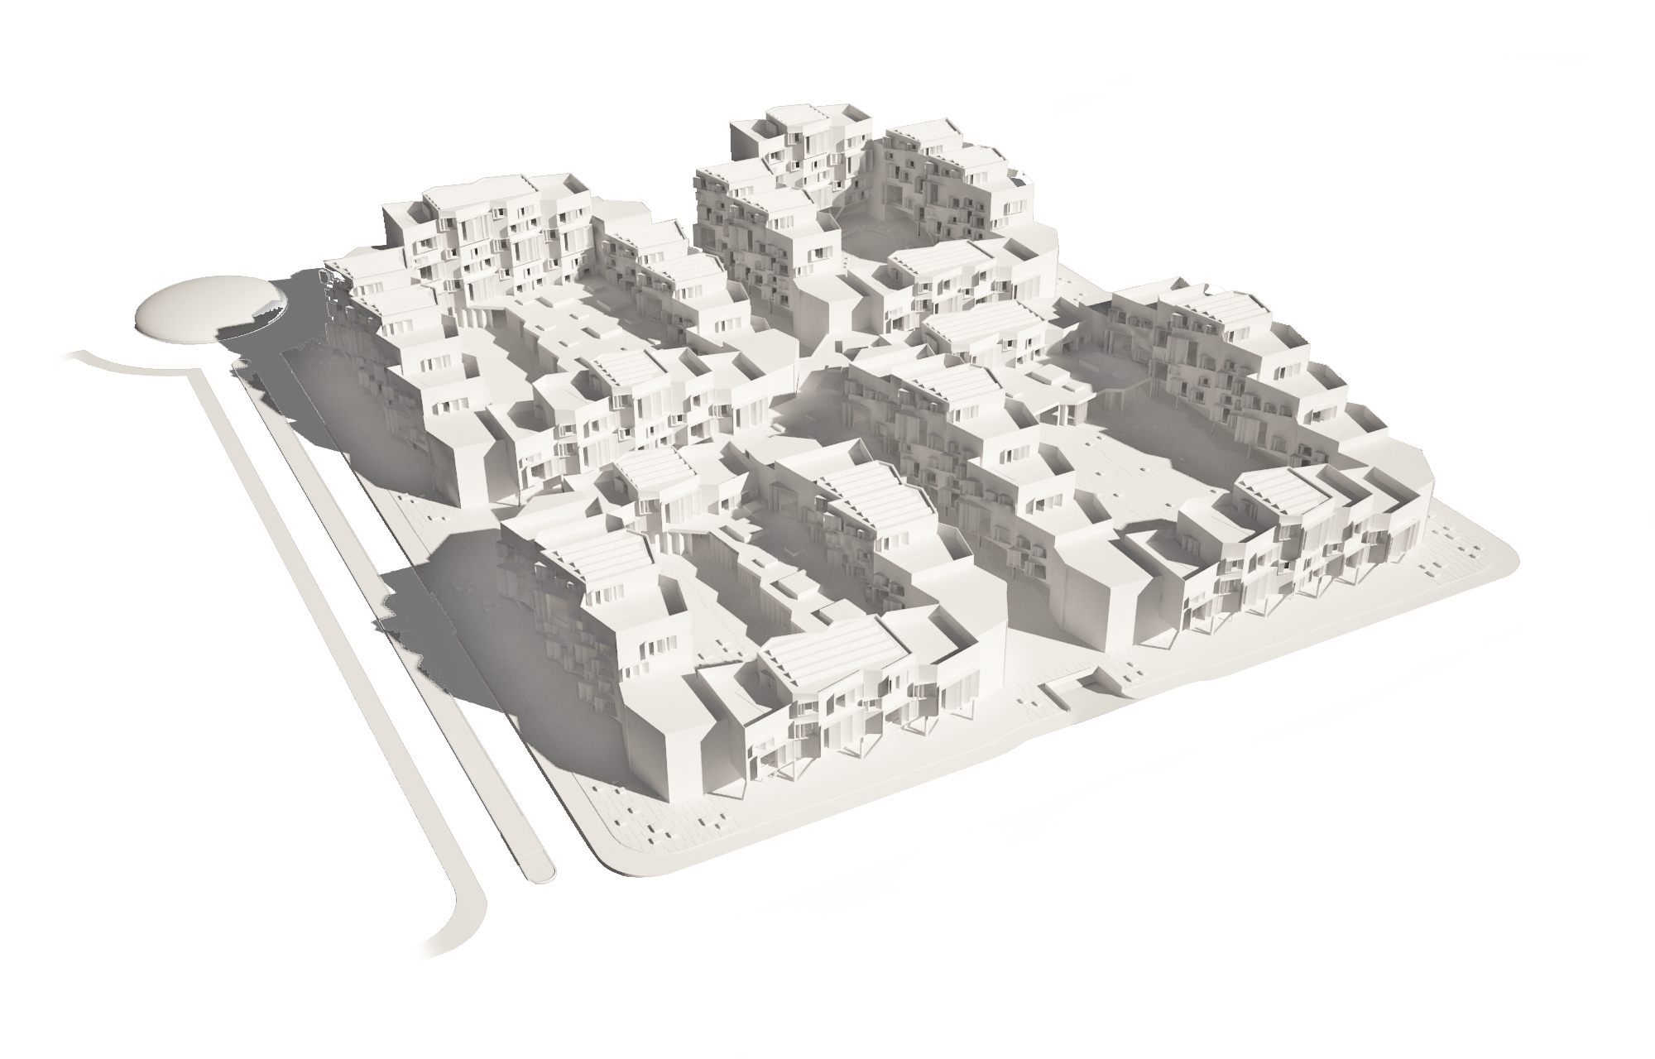

Slide 8
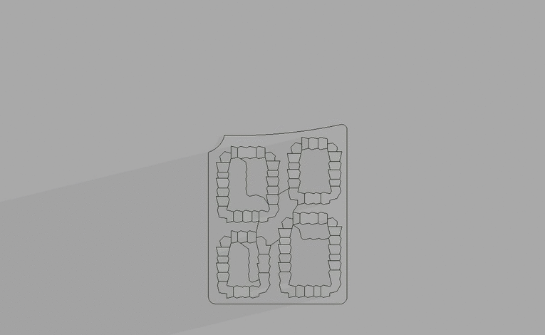
21.3

Slide 9




N
N-S duplex

Slide 10
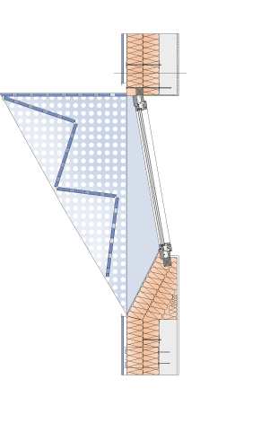
Window plan detail
N

Slide 11
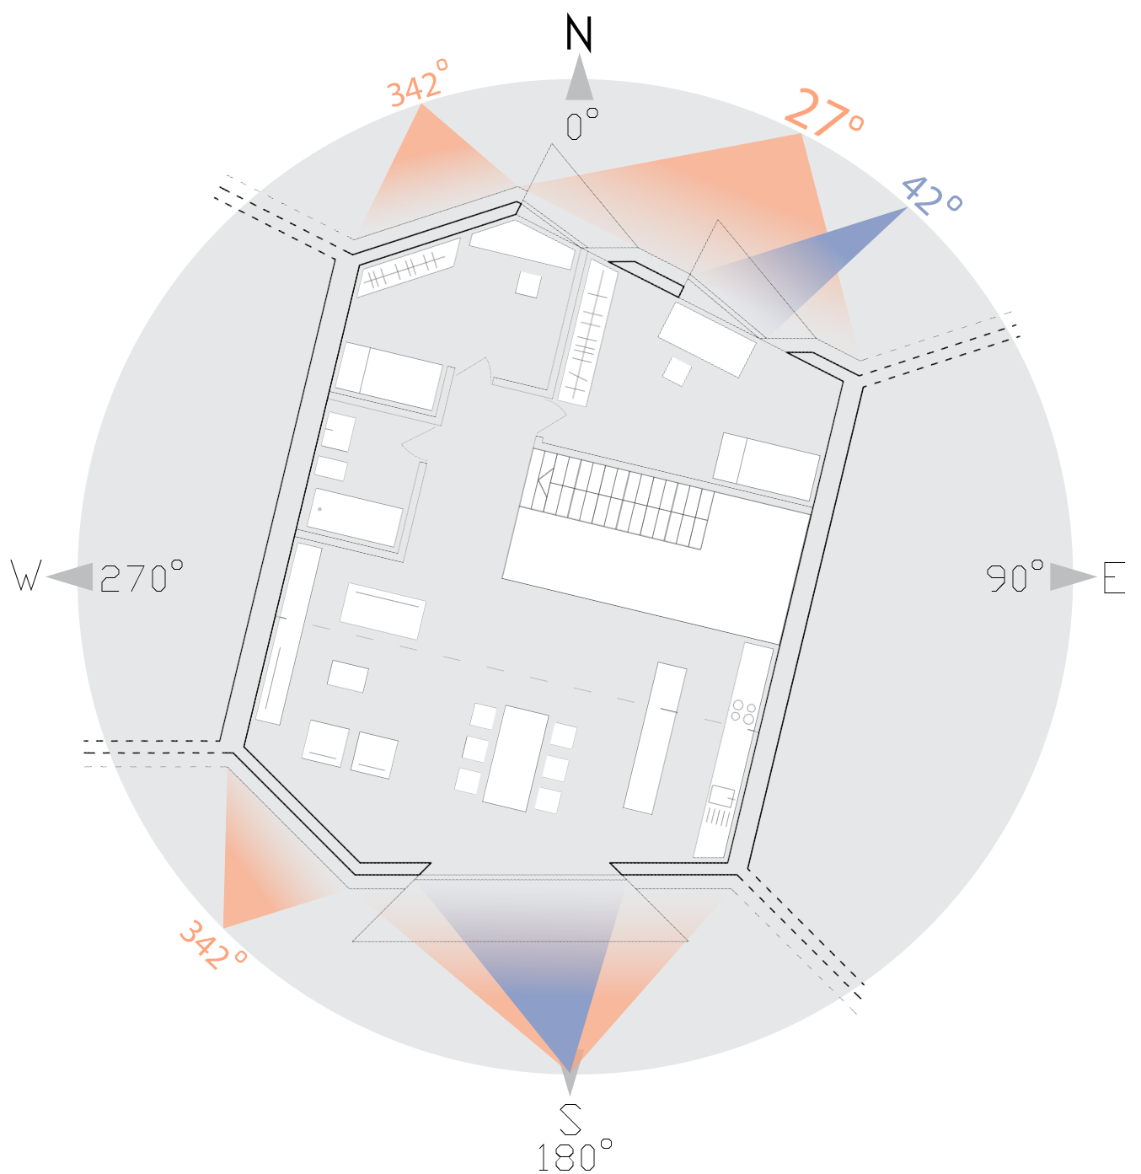
windows
walls
Orientation of N-S duplex

Slide 12
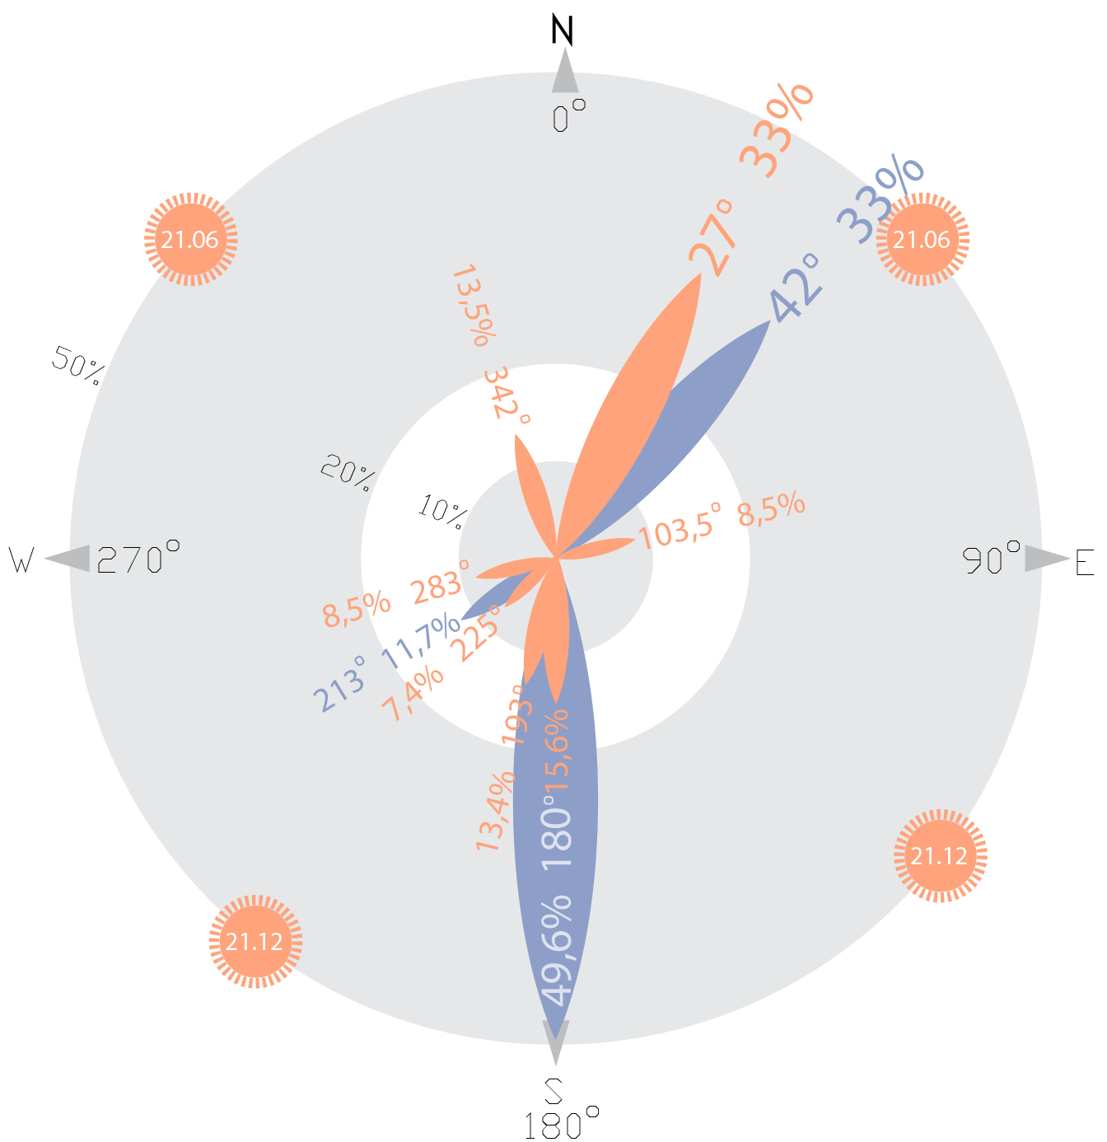
windows
walls
Orientation of N-S duplex [%]

Slide 13
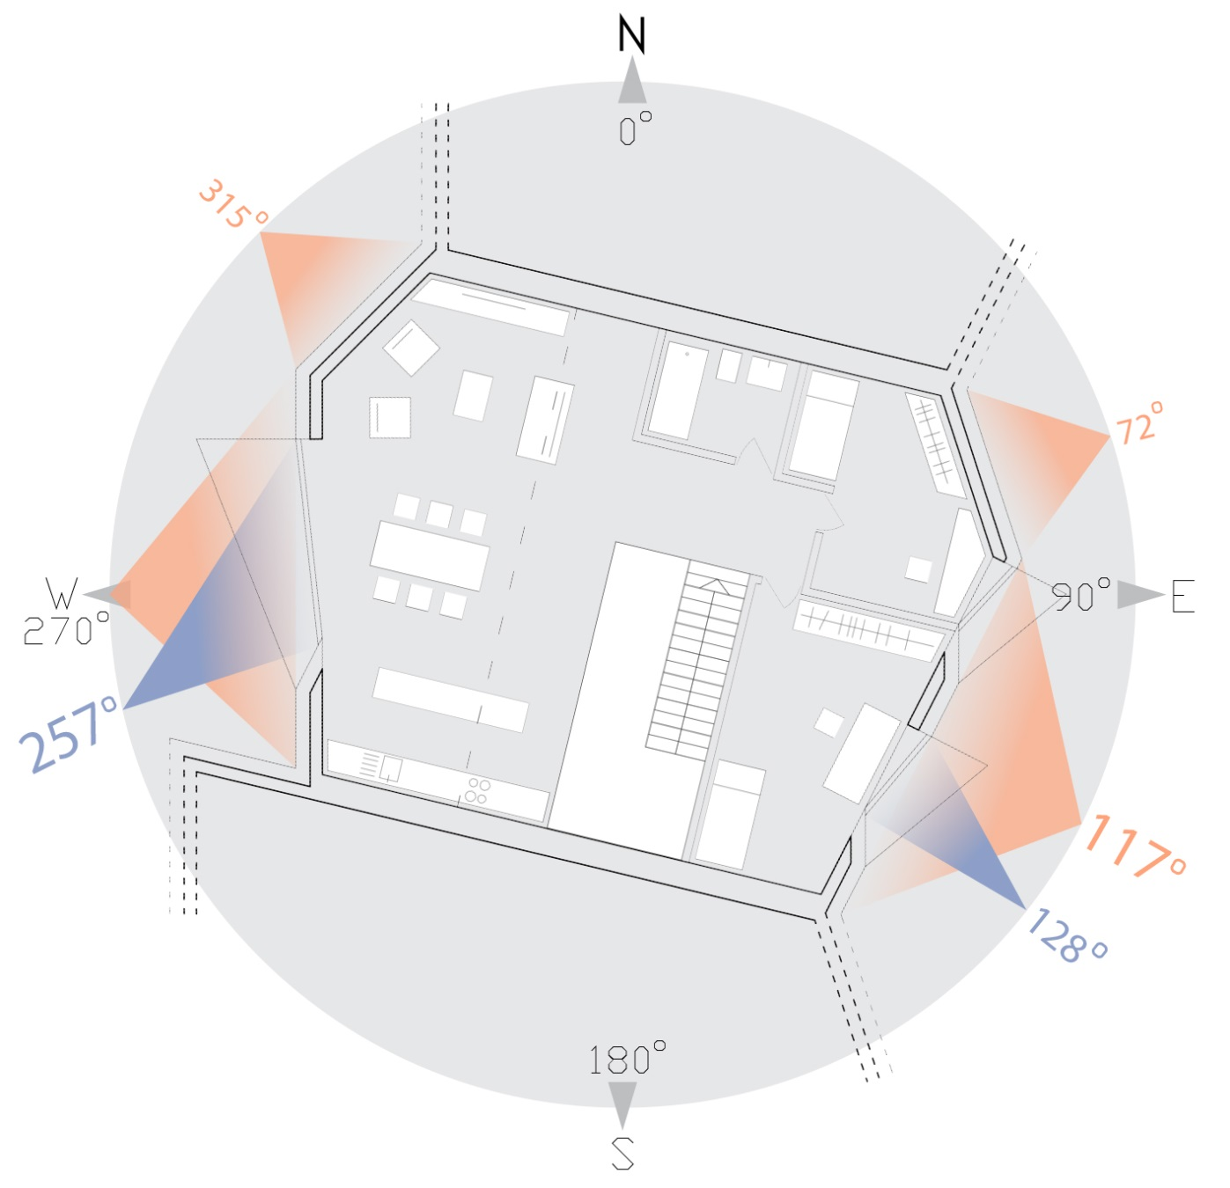
windows
walls
Orientation of E-W duplex

Slide 14
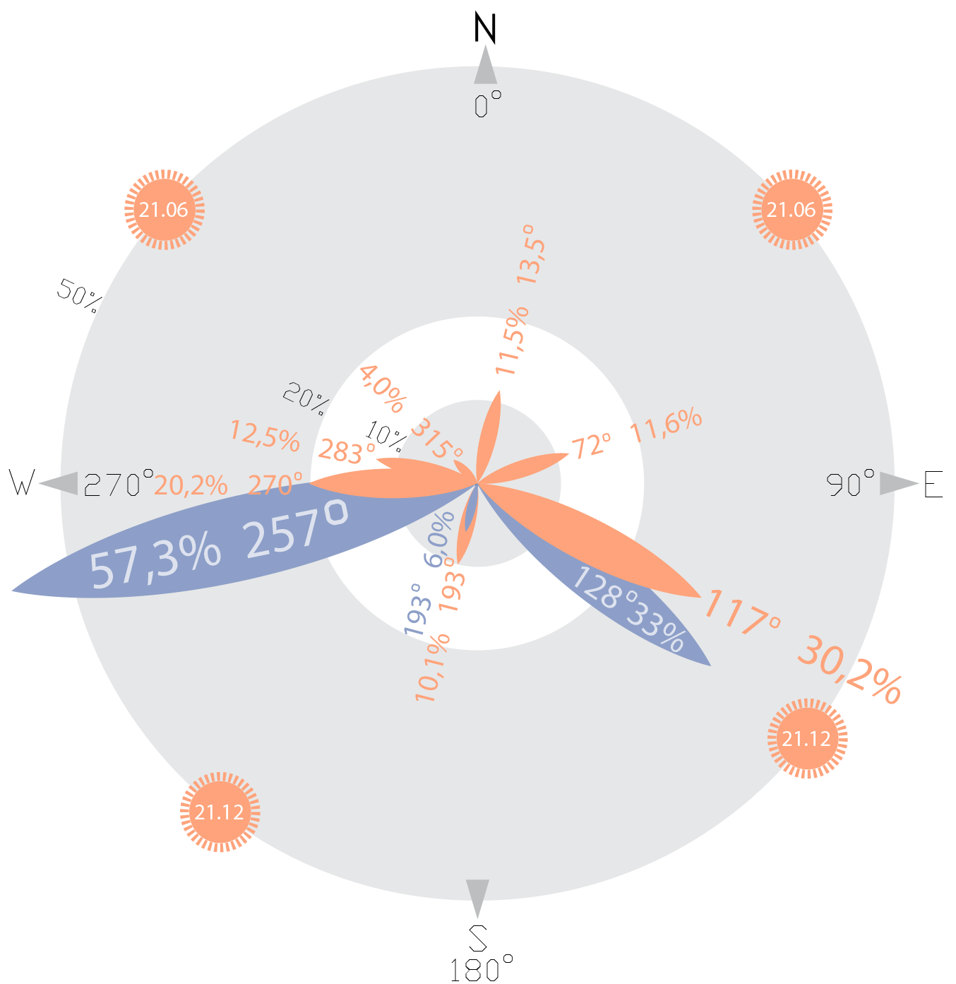
windows
walls
Orientation of E-W duplex [%]

Slide 15
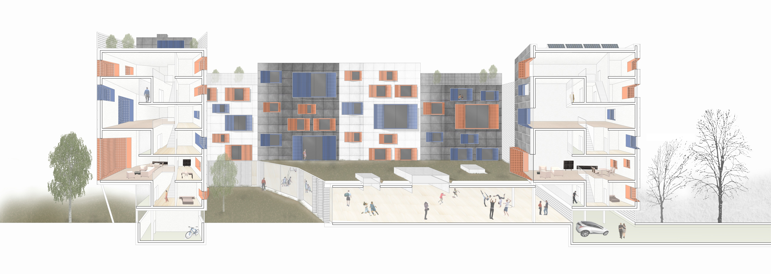
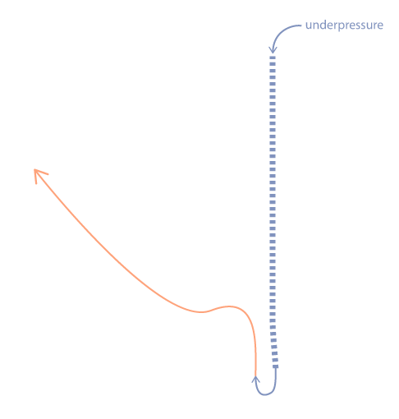


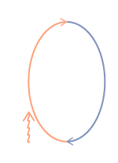

Slide 16


Slide 17
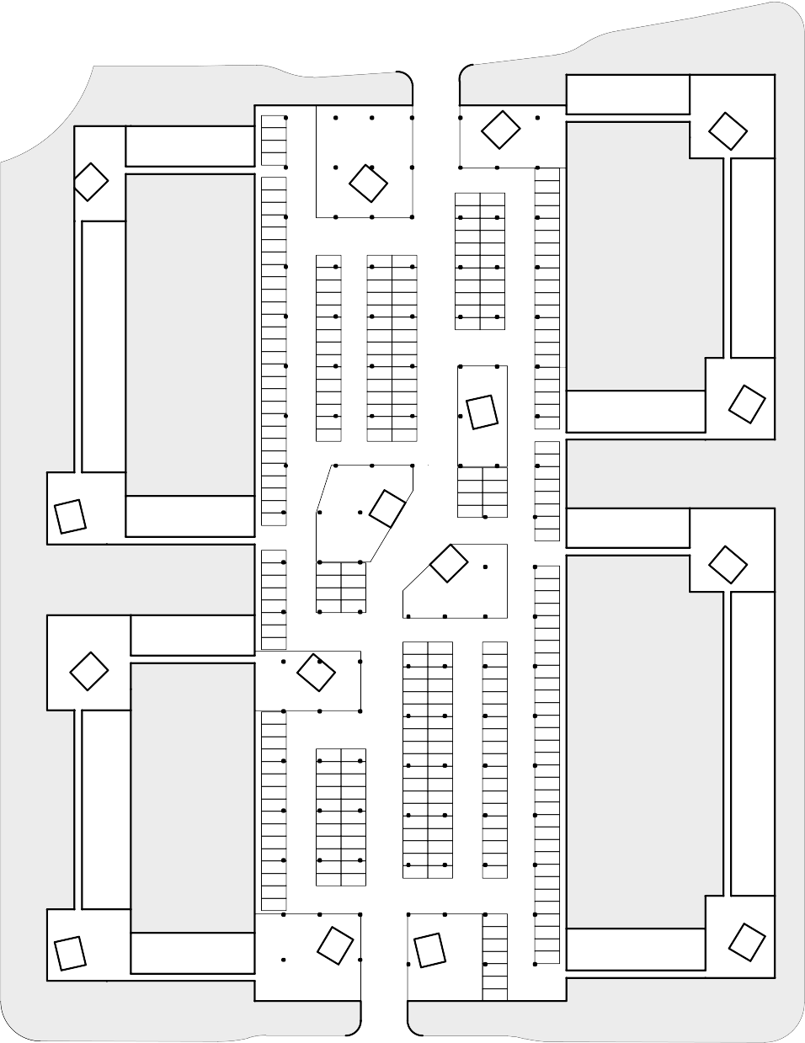
garage floor

Slide 18
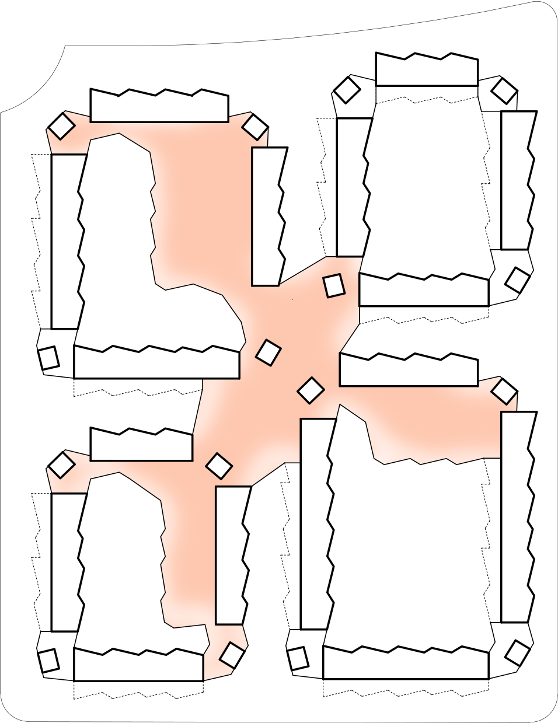
0 ground floor: public space

Slide 19
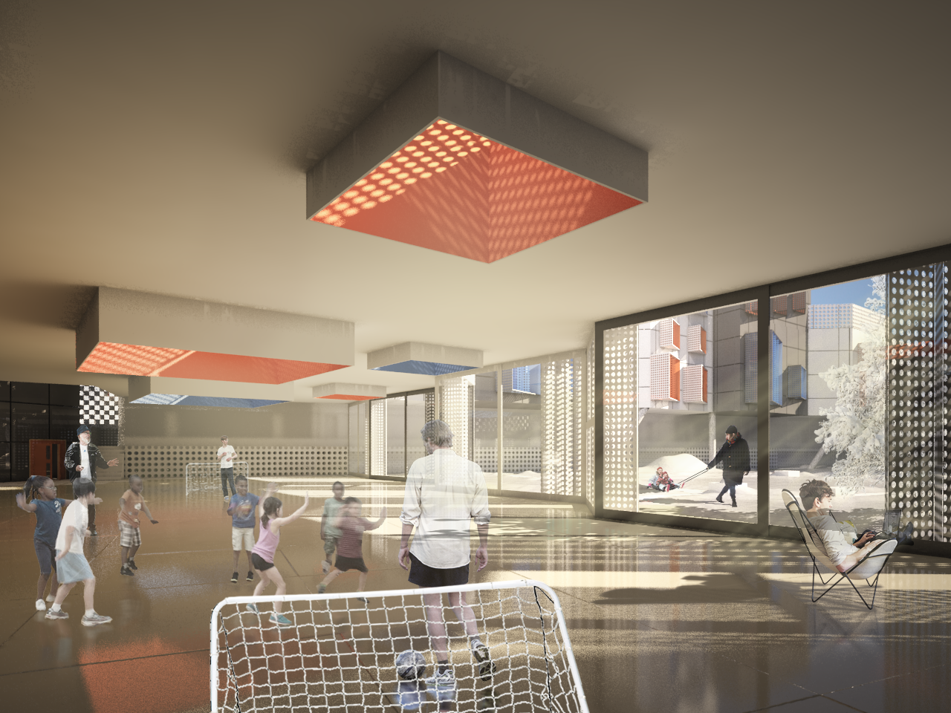
Thank you for your attention!

