Slide 1


Academic Integrity
Avoiding Plagiarism

Slide 2
What is Integrity?
integrity, n. \in-ˈte-grə-tē\
“the quality of being honest and fair”, and
“the state of being complete or whole.” (“Integrity,” n.d.)
Source: Future Learn
Notes:
Doing the Right thing even when nobody is watching

Slide 3
What is Academic Integrity?
Academic integrity means acting with the values of honesty, trust, fairness, respect and responsibility in learning, teaching and research. It is important for students, teachers, researchers and professional staff to act in an honest way, be responsible for their actions, and show fairness in every part of their work. All students and staff should be an example to others of how to act with integrity in their study and work. Academic integrity is important for an individual’s and a school’s reputation.
(Exemplary Academic Integrity Project, 2013)
Notes:
Академическая целостность означает действовать со значениями честности, доверия, справедливости, уважения и ответственности в обучении, преподавании и исследованиях. Для студентов, преподавателей, исследователей и профессиональных сотрудников важно действовать честно, отвечать за свои действия и проявлять справедливость во всех аспектах своей работы. Все учащиеся и сотрудники должны быть примером для других, как действовать честно в своих исследованиях и работе. Академическая целостность важна для репутации личности и школы.

Slide 4
What is Academic Dishonesty?
Scholastic dishonesty, also known as academic dishonesty or misconduct, is the defined by the DCCCD Student Code of Conduct as acting in an unethical, dishonest manner. It includes, but is not limited to:
cheating;
plagiarism;
falsifying or fabricating information;
misrepresentation;
facilitating scholastic dishonesty;
collusion.

Slide 5
What is Plagiarism?
Plagiarism is the act of copying someone else’s work, borrowing someone else’s ideas, or reusing your own ideas verbatim.
Merriam-Webster Online Dictionary (2010)

Slide 6
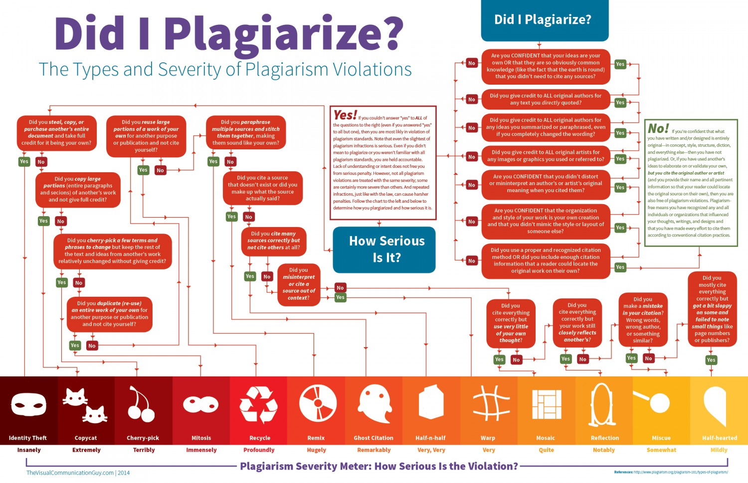

Slide 7
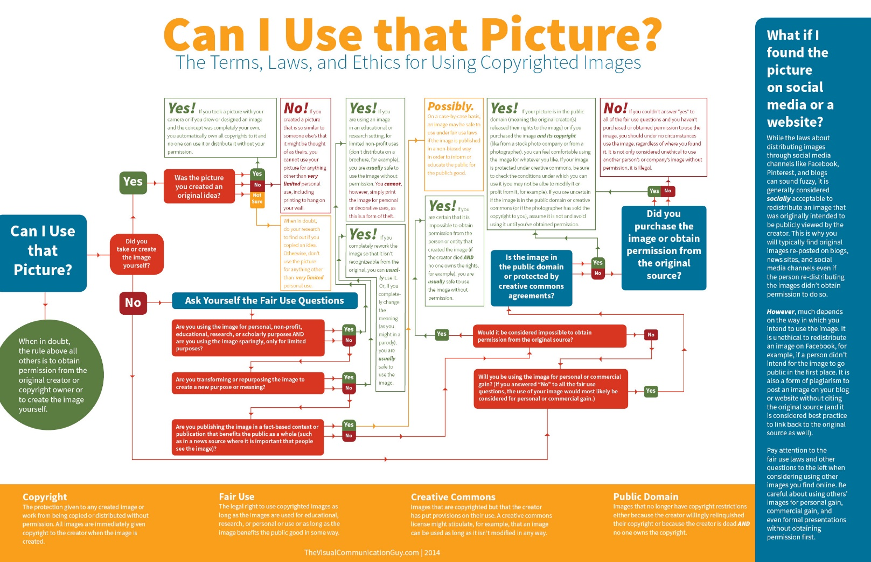
The Visual Communication Guy.

Slide 8
TOP 10
Types of Plagiarism

Slide 9
#1. Clone
Submitting another's work, word for word as one’s own
Original work | Plagiarized work
Source – A study on satirical internet memes Memes can be considered as cultural analogues to genes. The funny or witty language used in satirical memes implicitly mock some so called existed cultural notions and contemporary situations. | A study on satirical internet memes Memes can be considered as cultural analogues to genes. The funny or witty language used in satirical memes implicitly mock some so called existed cultural notions and contemporary situations.
Source: myassignmenthelp.com

Slide 10
#2. CTRL- C
a particular portion of the text is copied from a single source without any alteration. It is also a common form of plagiarism.
Original work | Plagiarized work
Source – A study on Saussure’s contribution to the field of semiotics A dyadic model of sign has been introduced by Ferdinand De Saussure. According to him, sign refers to the whole that results from the association of signified and signifier. | Saussure’s dyadic model of sign Ferdinand De Saussure is a Swiss semiotician and linguist. He introduced dyadic model of sign. According to him, sign refers to the whole that results from the association of signified and signifier.
Source: myassignmenthelp.com

Slide 11
# 3. FIND-REPLACE
It refers to the act of changing phrases and keywords but copying the essential content (word to word) from the source. It is one of the most common types of plagiarism.
Original work | Plagiarized work
Source – Internet memes and their role Now-a-days the term ‘meme’ has gained much popularity. This term was coined by the revolutionary biologist Richard Dawkins in his first book ‘The Selfish gene’ in 1976. ‘Meme’ basically functions as a fundamental cultural unit of transmission of cultural ideas, practices or symbols from one mind to another. | The role of internet memes In contemporary world, the term ‘meme’ has gained much popularity. This term was introduced by the great revolutionary biologist Richard Dawkins in his first book ‘The Selfish gene’ in 1976. ‘Meme’ generally functions as a unit of transmission of cultural notions, practices or symbols from one mind to another.
Source: myassignmenthelp.com

Slide 12
#4. REMIX
When one paraphrases from multiple sources and make the content fit together, it is known as remix.
Original work | Plagiarized work
Source-1. An analysis on Roland Barthes’s Mythologies In his famous book, “Mythologies”, Roland Barthes introduces a second level of signs. He uses several examples to explain this. Source-2. A study on Roland Barthes Roland Barthes, a famous literary critic, introduced a second level of signs. In this level, a sign itself becomes a signifier and a new connotation is added to it. . For example, we can say that the sign rose (signifier+ signified) becomes a signifier in the second level and it represents love as a new meaning is added to it. | Roland Barthes’s contribution In his work next “Mythologies”, Roland Barthes discusses about the second level of signs. He explains this with several examples. According to him, a sign itself becomes a signifier and a new meaning is added to it. Let us discuss this with an example. The sign rose (signifier+ signified) becomes a signifier in the second level and it symbolizes love as a new connotation is added to it.
Source: myassignmenthelp.com

Slide 13
#5. RECYCLE
It is a form of self-plagiarizing. It refers to the act of borrowing from one’s own previous write-up. Let us take an instance.
Original work | Plagiarized work
Source – An analysis on Richard Dawkin’s The Selfish Gene Richard Dawkins proposed his revolutionary theory on memes in his famous book “The Selfish Gene”. According to him, memes are analogues to gene. | Richard Dawkins and his theory on memes Richard Dawkins, an evolutionary biologist, discussed his theory on memes in his great work “The Selfish Gene”. According to him, memes are analogues to gene.
Source: myassignmenthelp.com

Slide 14
#6. MASHUP
materials copied from multiple sources are mixed together without proper citation.
Original work | Plagiarized work
Source-1. Charles Sanders Peirce and his contribution Charles Sanders Peirce was an American philosopher. His contribution to the field of semiotics is noteworthy. Source-2. A study on Charles Sanders Peirce’s triadic model of sign American philosopher, C.S.Peirce introduced a triadic model of sign. This model includes three levels – represntamen, an interpretant and an object. According to Peirce, signs can be grouped into three categories; icon, index, symbol. | Triadic model of sign Charles Sanders Peirce was an American philosopher. His contribution to the field of semiotics is noteworthy. He introduced a triadic model of sign. This model includes three levels – represntamen, an interpretant and an object. According to Peirce, signs can be grouped into three categories: icon, index, symbol.
Source: myassignmenthelp.com

Slide 15
#7. HYBRID
copied passages (without citation) are combined with perfectly cited sources.
Original work | Plagiarized work
Source-1. Theory on Carnivalesque The root of the concept ‘Carnivalesque’ can be traced back to the medieval festival ‘Feast of Fools’ of sub-deacons of the cathedral. This concept of carnival was introduced by Bakhtin. Source.2- Mikhail Bakhtin’s view on Carnivalesque According to Mikhail Bakhtin, Carnival is a kind of syncretic, ritualized pageantry, which highlights a specific aspect. It is that precise moment in which, life escapes its official furrows and enacts utopian freedom. | Mikhail Bakhtin was a Russian philosopher. The concept of carnival was introduced by him. The root of the concept ‘Carnivalesque’ can be traced back to the medieval festival ‘Feast of Fools’ of sub-deacons of the cathedral. This concept of carnival was introduced by Bakhtin. According to him, “Carnival is a kind of syncretic, ritualized pageantry, which highlights a specific aspect. It is that precise moment in which life escapes its official furrows and enacts utopian freedom” 1. James. A, 2005,“Mikhail Bakhtin’s view on Carnivalesque”, The New Yorker, p.6
Source: myassignmenthelp.com

Slide 16
#8. 404 ERROR
When a paper incorporates citation to inaccurate or non-existent information about the sources, it is known as 404 error.
Original work | Plagiarized work
Source – A critical analysis of Milton’s Paradise lost In his great epic poem Paradise Lost, John Milton portrays the character of Satan from a completely different angle. The plot is takes from Bible. Satan and his followers challenge the supremacy of God. Samuel Anderson, a literary critic says, “the basic plot line is not developed properly”. | A study on Milton’s Paradise Lost In his great epic poem Paradise Lost, John Milton portrays the character of Satan from a completely different angle. The plot is takes from Bible. Satan and his followers challenge the supremacy of God. Samuel Anderson, a literary critic says, “the basic plot line is not developed properly”. ¹ For a detailed analysis on Milton’s Paradise Lost, see Anderson’s article “A critical review of Milton’s Paradise Lost” May 10, 1993
Source: myassignmenthelp.com

Slide 17
#9. AGGREGATOR
In this type of plagiarism, the text includes proper citation but it does not contain original work.
Original work | Plagiarized work
Source-1. A study on Riders to the Sea “Riders to the sea” is a one-act play by J.M. Synge. This masterpiece chronicles the lives of the inhabitants of Aran island. This play revolves around the binary of life and death. Source-2. Interplay of symbols in Synge’s Riders to the Sea The main theme is beautifully conveyed through the clusters of multi-layered symbols in Synge’s Riders to the sea. The central symbol is the Sea. “The Sea” is the symbol of life and at the same time it is the destroyer of life. | “Riders to the sea” is a one-act play by J.M. Synge. This masterpiece chronicles the lives of the inhabitants of Aran island. This play revolves around the binary of life and death.¹ The main theme is beautifully conveyed through the clusters of multi-layered symbols in Synge’s Riders to the sea. The central symbol is the Sea. “The Sea” is the symbol of life and at the same time it is the destroyer of life.²¹ Johnson. P, 2008, A Study On The Riders To The Sea, Applewood Books, p.18 ² Brown. G,2005, Interplay of symbols in Synge’s Riders to the Sea, Allison and Busby, p. 5
Source: myassignmenthelp.com

Slide 18
#10. RE-TWEET
the paper incorporates proper citation but it resembles the original text’s structure or wordings.
Original work | Plagiarized work
Source – Saussure’s Structuralism Ferdinand De Saussure, a Swiss semiotician and linguists, analyzed the language system from a different aspect. His contribution to the development of the theory “structuralism” is noteworthy. According to him, language is system of sign and signifier. The elements of a language system can only be defined in relation to each other and to the entire system. | Saussure and structuralism Ferdinand De Saussure, who was a Swiss linguist,described the language system from a totally different perspective. He contributed a lot to the development of the theory of structuralism. From his viewpoint, language can be defined as a system of sign and signifier. The elements of this system can be comprehended in relation to the whole system and to each other. ¹O’Conner. M, 2004, Saussure’s Structuralism, Austin Macauley Publishers, p.12
Source: myassignmenthelp.com
Source: myassignmenthelp.com

Slide 19
How to avoid plagiarism
Proper use of quotes, paraphrases and summaries
Understanding when to cite
Using citation software and consistent citation style

Slide 20
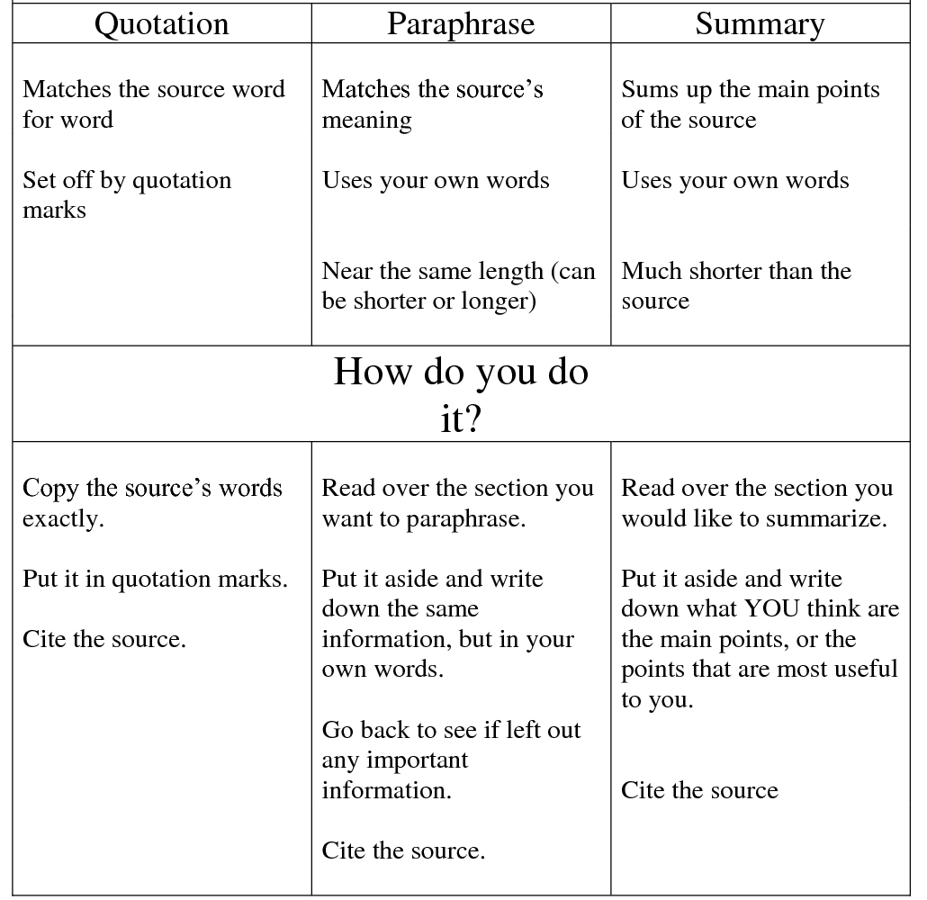
What is it?
Source: http://thevisualcommunicationguy.com

Slide 21
To Cite or Not to Cite?
CITE: | DO NOT need to CITE:
If you’re quoting from, paraphrasing, or summarizing another author's work, in any format including: web pages, books, songs, television programs and anything else you can think of that someone else created. If using an image, chart, or diagram created by someone else. | If you're using your own thoughts, ideas, opinions, observations, or experimental results. If you're using common knowledge.
Source: myassignmenthelp.com

Slide 22
Common Knowledge
Common knowledge generally refers to information that most people know.
Examples:
George Washington was the first president of the United States.
Orange juice is a good source of vitamin C.
1 is less than 10.
China is a country in Asia.
Be Careful!
The criteria for determining what is and what is not common knowledge can be somewhat unclear.
Source: myassignmenthelp.com

Slide 23
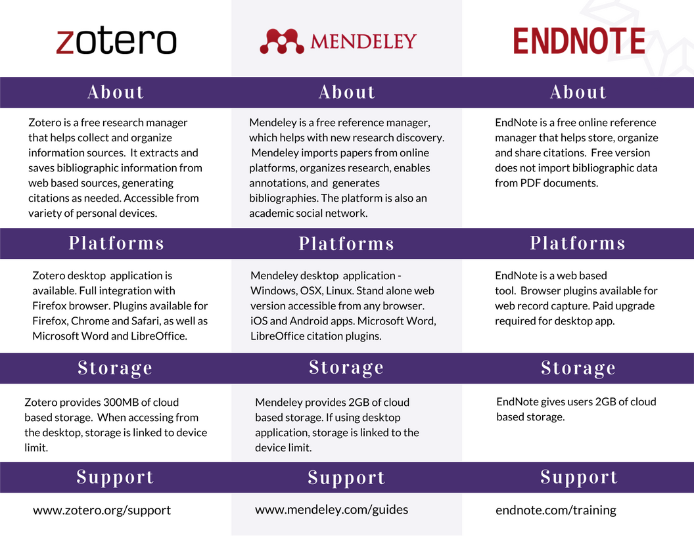
Reference Help

Slide 24
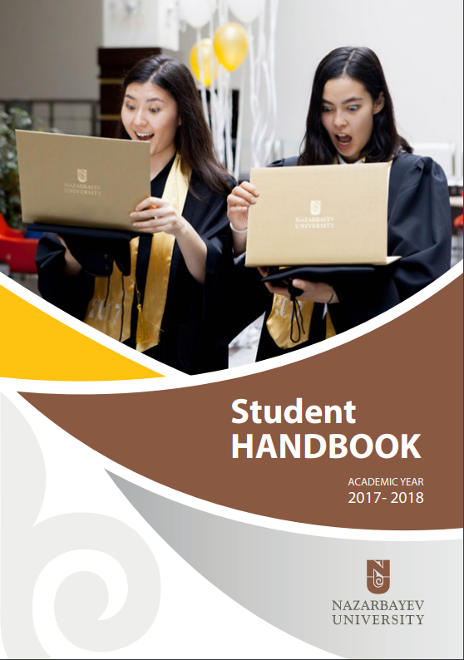
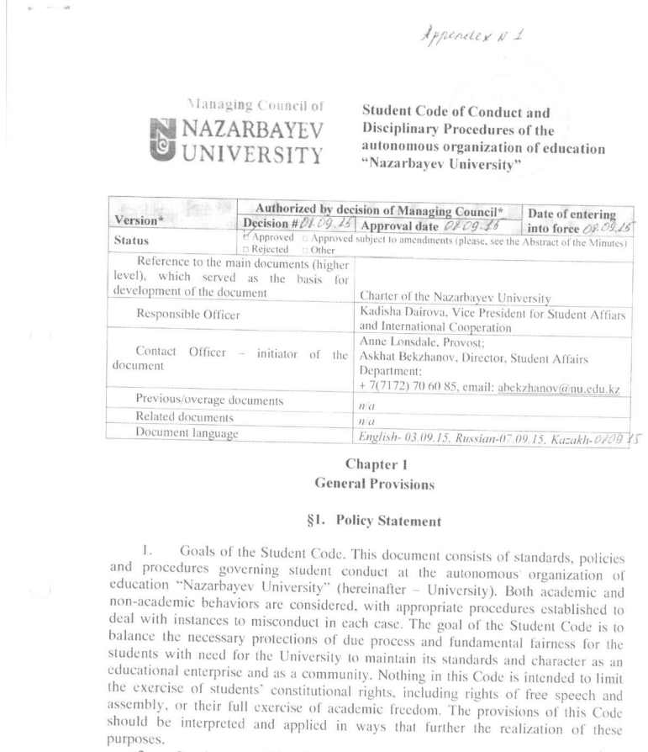

Academic Integrity in Nazarbayev University
Student Code of Conduct
Turnitin.com
https://nu.edu.kz/wp-content/uploads/2017/08/Student-Handbook-2017.pdf
https://seng.nu.edu.kz/wp-content/uploads/2015/06/Student-Code-of-Conduct.pdf

Slide 25
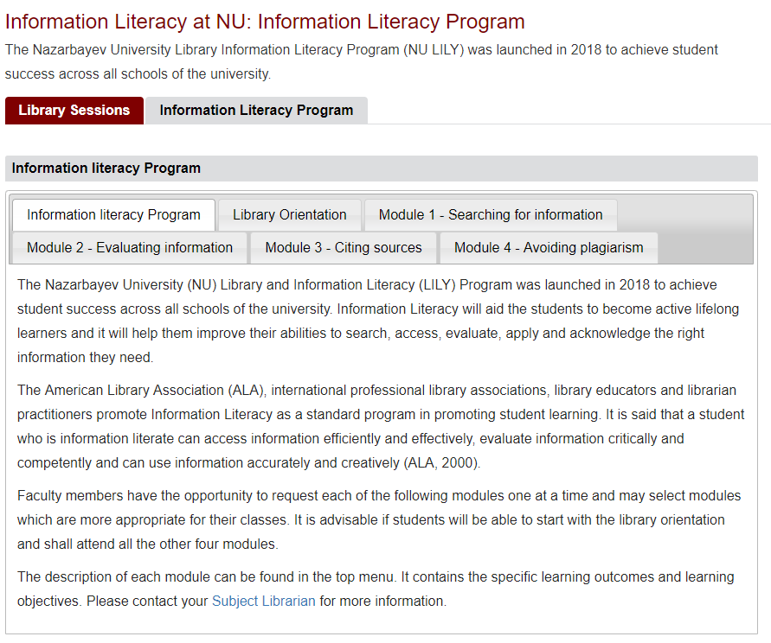
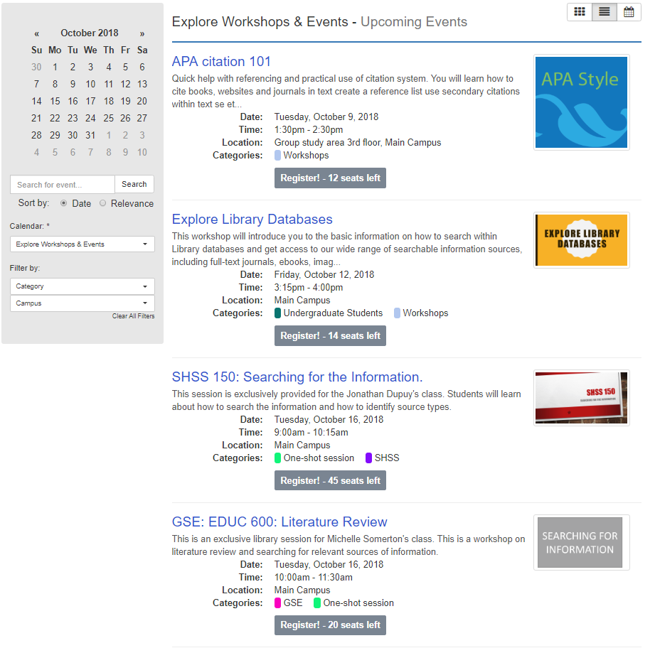
Academic Integrity in Nazarbayev University Library
library.nu.edu.kz

Slide 26
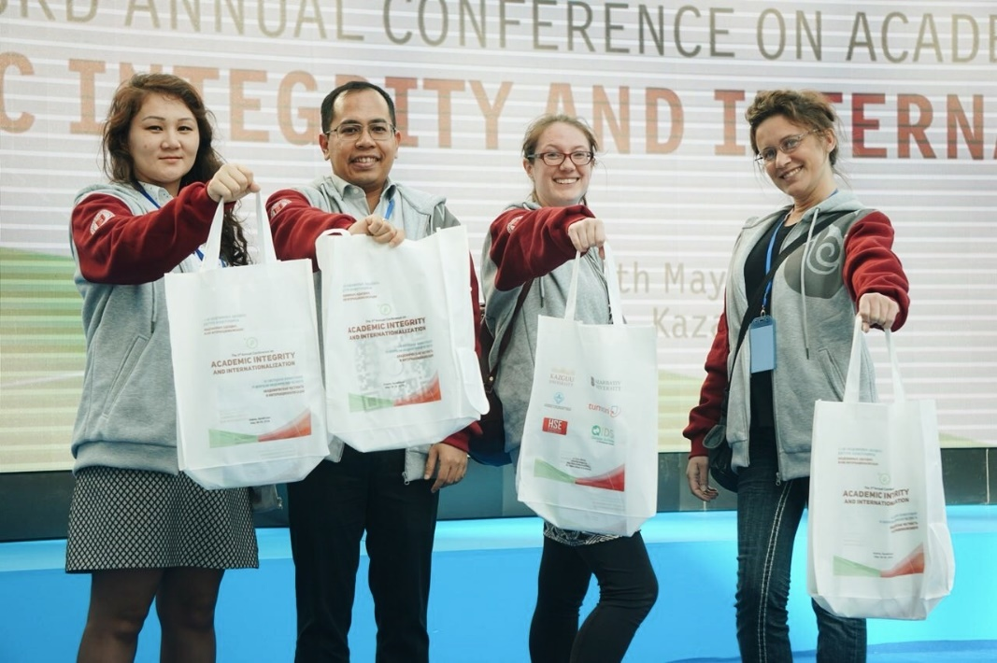
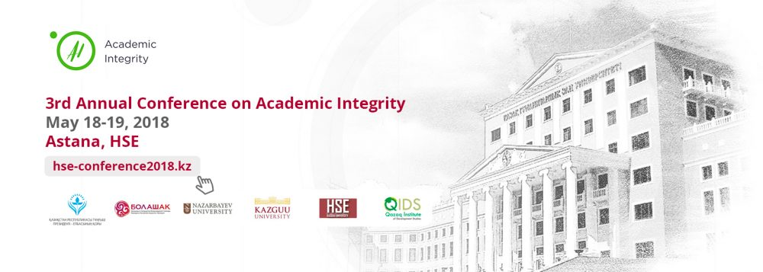
NU Librarians Study
Akademialyq adaldyq ligasy
References:
Alenzuela, R., Groen, C., Kamilova, Y., Terzi, P., & Zvonareva, D. (2017). Building a Culture of Integrity through Library Initiatives, Academic Collaboration and Administrative Support. KAZGUU University. Nazarbayev University. Retrieved from http://ezproxy.nu.edu.kz:2048/login?url=http://search.ebscohost.com/login.aspx?direct=true&db=ir01052a&AN=nur.123456789.2380&site=eds-live&scope=site
2. Joseph Marmol Yap, Carlene Groen, Yelizaveta Kamilova, Paschalia Terzi & Darya Zvonareva (2018) What Went Wrong? A Five-School Review of Master’s Theses Reference List,The Reference Librarian, 59:4, 225-234, DOI: 10.1080/02763877.2018.1503989

Slide 27
5 minute activity!!!
Kahoot.it

Slide 28

Questions?
Yelizaveta Kamilova, MLIS
Reference Librarian,
Subject Librarian for SHSS
Coordinator for ILL
Tel: 8(7172) 70 6581 ,
Email: yelizaveta.kamilova@nu.edu.kz

