Slide 1
RESEARCH AND INNOVATION IN CHINA:
DOMESTIC AND INTERNATIONAL CHALLENGES
RICHARD P. SUTTMEIER
UNIVERSITY OF OREGON
petesutt@uoregon.edu

Slide 2
QUESTIONS
CONTROVERSIAL INTERPRETATIONS OF WHAT IS HAPPENING WITH CHINESE RESEARCH AND INNOVATION
WHAT IS CHINA DOING RIGHT?
WHAT IS CHINA DOING WRONG?
IMPLICATIONS FOR ARGUMENTS ABOUT A “CHINESE MODEL” OF SCIENTIFIC AND TECHNOLOGICAL DEVELOPMENT
INTERNATIONAL IMPLICATIONS

Slide 3
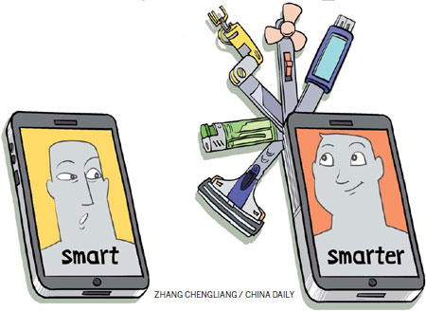
A FIRST LOOK
大聪明? 小聪明?

Slide 4
NOTABLE STATISTICAL INDICATORS
R&D SPENDING –
  2.12 GERD in 2017(WAN GANG)
NUMBERS OF SCIENTISTS AND ENGINEERS
  “China graduates more engineers annually than currently reside in the U.S” (R&D Magazine)
PUBLICATIONS
PATENTS
HIGH TECH EXPORTS
“MAGNETISM”

Slide 7
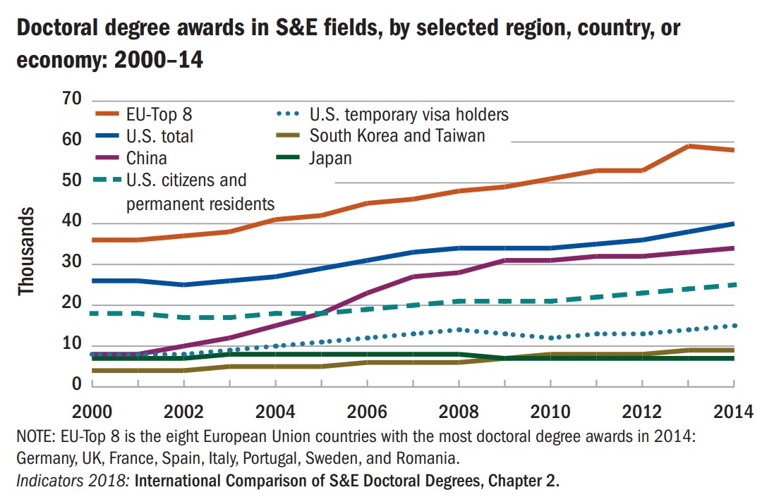
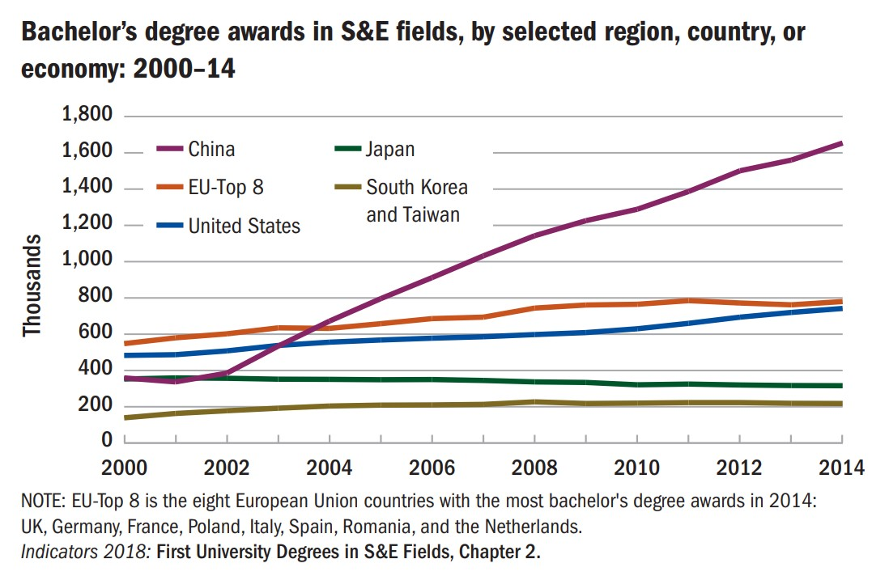

Slide 8
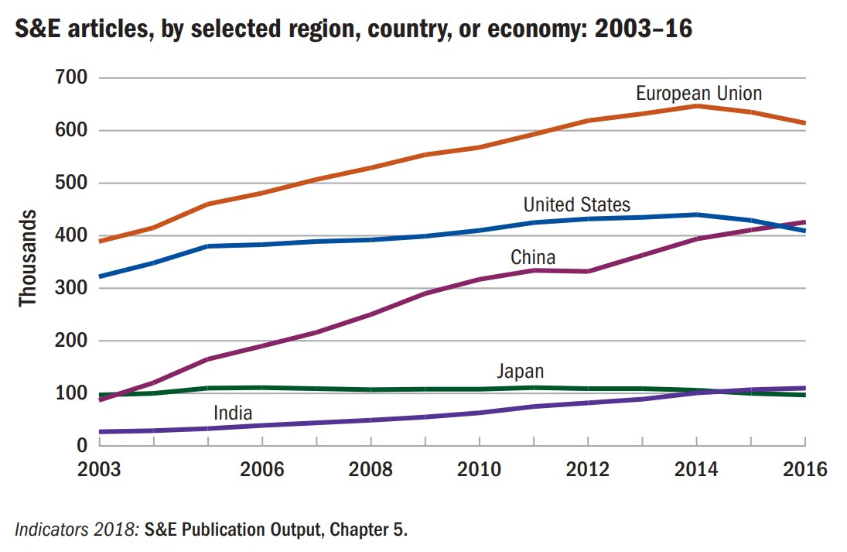

Slide 9
Source: Qingnan Xie and Richard B. Freeman. “Bigger Than You Thought: China’s Contribution to Scientific Publications,” NBER Working Paper 24829

Slide 10
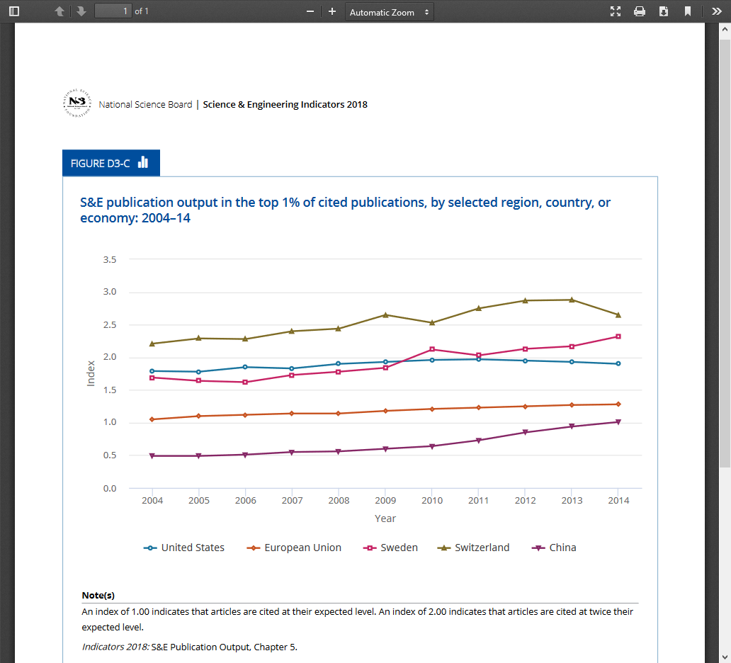

Slide 11
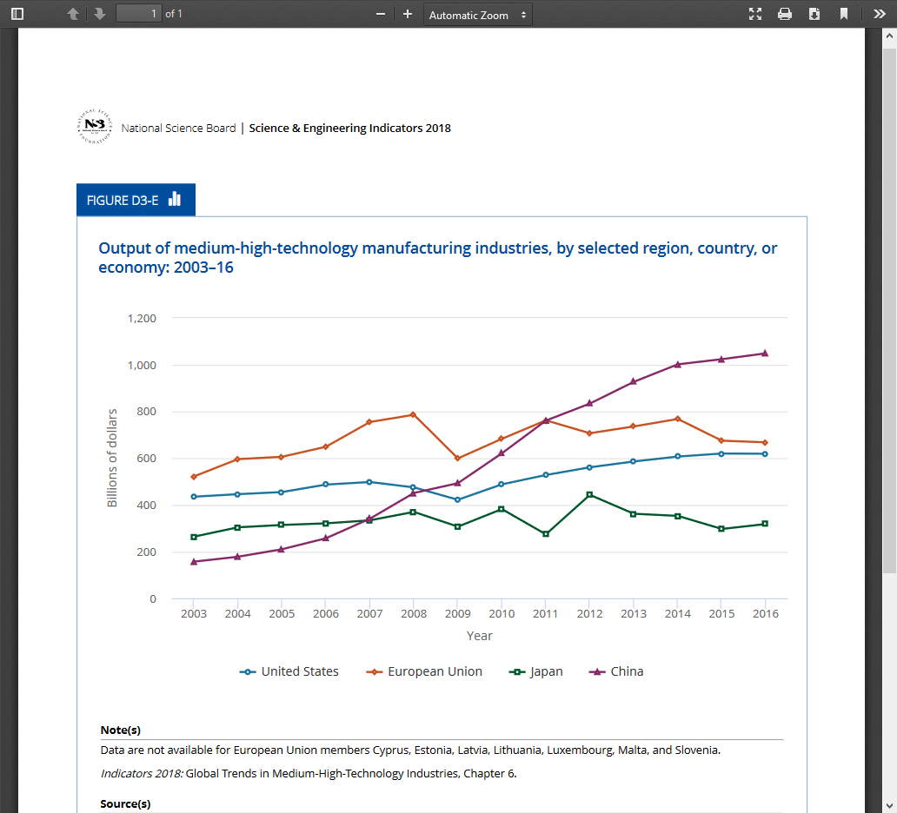

Slide 12
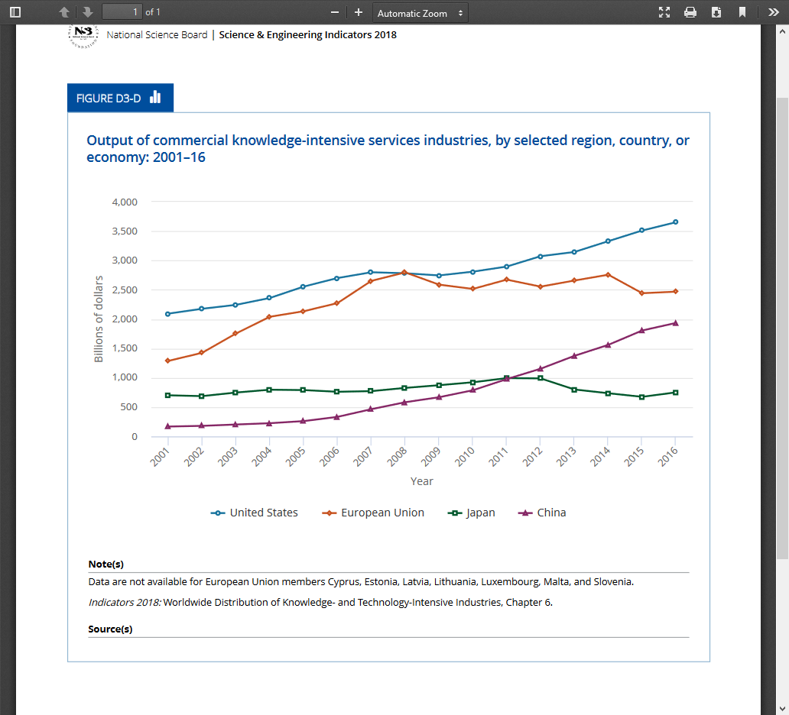

Slide 13
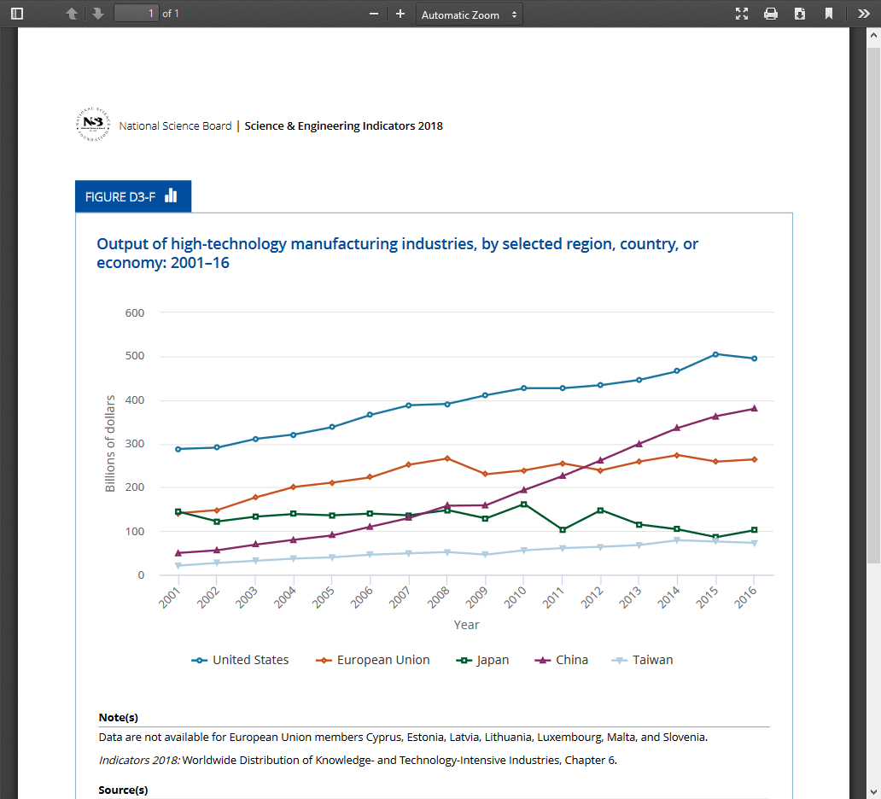

Slide 14
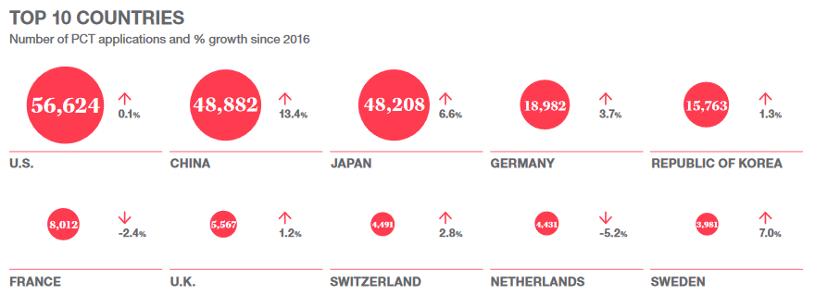
Source: “China Drives International Patent Applications to Record Heights; Demand Rising for Trademark and Industrial Design Protection.” http://www.wipo.int/export/sites/www/ipstats/en/docs/infographic_pct_2017.pdf

Slide 15
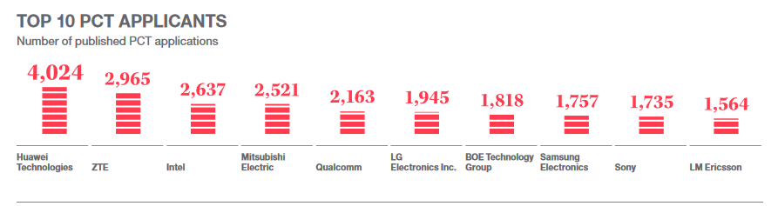
Source: “China Drives International Patent Applications to Record Heights; Demand Rising for Trademark and Industrial Design Protection.” http://www.wipo.int/export/sites/www/ipstats/en/docs/infographic_pct_2017.pdf

Slide 16
THE ENVIRONMENT
ELITE COMMITMENT – POLICY ENERGY
TALENTED, HARDWORKING, VERY LARGE, AND RELATIVELY INEXPENSIVE TECHNICAL COMMUNITY
VAST DEVELOPMENTAL POSSIBILITIES
  MARKET SIZE
  GEOGRAPHIC DIVERSITY
  URBANIZATION
  ENVIRONMENTAL CHALLENGES
THE PLANNING MODEL: DEFINING CHARACTERISTIC OF A “CHINESE WAY”?
  THE PLANNING TRADITION
  LIANGDAN YIXING - JUGUO TIZHI

Slide 17
OTHER CONSIDERATIONS
INSTITUTIONS AND POLICY STYLES
  CENTRALIZED MANDATES AND MONITORING
  ROLE OF LOCAL GOVERNMENTS
  WIDESPREAD EXPERIMENTALISM
  INTENSE COMPETITION
“TOP DOWN” MEETS “BOTTOM UP”
LIMITS TO PLANNING MODEL
EVIDENCE OF GREAT INSTITUIONAL DIVERSITY AND VITALITY
BUT…

Slide 18
DO “LEGACY” & “NON-LEGACY” PARTS CONSTITUTE A “SYSTEM”?
ACADEMIC INSTITUTIONS
  CAS
  UNIVERSITIES
THE SPACE/DEFENSE SECTORS
SOE EXPERIENCE
ENTREPRENEURSHIP
  ZHONGGUANCUN MODEL
  SOUTHERN MODELS – ZHEJIANG, JIANGSU
FDI/MNC R&D

Slide 19
SIGNS OF TROUBLE
RESOURCES OUTPACING MANAGEMENT?
  RAPID EXPANSION OF FUNDING
  MANAGEMENT OF NATIONAL PROJECTS
PROBLEMS AT THE MACRO-LEVEL?
  ROLE OF MOST, NDRC, KEJIAO XIAOZU, MOF, MIIT
  CAS MISSION AND MANAGEMENT
PROBLEMS AT THE MICRO-LEVEL
  COMPETITION AND EVALUATION
  GRANT ADMINISTRATION
DERIVATIVE WORK, WASTE, CORRUPTION, INEFFICIENCY
“CORE TECHNOLOGIES?”

Slide 20
NET ASSESSMENT
IMPRESSIVE “CATCH-UP,” BUT…
CONTROVERSIES OVER ORIGINALITY AND INNOVATION
IPR REGIME
THE TALENT ISSUE
ISSUES OF SCIENTIFIC INTEGRITY
PROBLEMS WITH INSTITUTIONAL ARRANGEMENTS

Slide 21
REFORM AGENDA
FINANCIAL MANAGEMENT
  CONSOLIDATION OF NATIONAL PROGRAMS
  DECISION MAKING BY “PROFESSIONAL ORGANIZATIONS”
INSTITUTIONAL REFORM
  LIU HE’S ROLE
  LINKING OF S&T BUDGETING WITH ECONOMIC POLICY
PROJECT MANAGEMENT REGULATIONS
INCENTIVIZING TECHNOLOGY TRANSFER
EVALUATION
BASIC RESEARCH

Slide 22
CHALLENGES FOR THE INTERNATIONAL COMMUNITY: THE U.S. CASE
THE SOCIO-POLITICAL ENVIRONMENT
THE HUMAN RESOURCE DIMENSION
EXTENSIVE COLLABORATION
THE COMMERCIAL DIMENSION
  GLOBAL SUPPLY CHAINS - ZTE/QUALCOMM
  GLOBALIZATION OF INNOVATION – CISCO-INSPUR, GOOGLE, ETC.

Slide 23
WELCOME TO CHINA?
NOMINALLY, A WELCOMING ENVIRONMENT
  R&D CENTERS
  RESEARCH COLLABORATION
SHAKEOUT FROM GOVERNMENT REORGANIZATION?
“TOP DOWN DESIGN”
POLITICAL ENVIRONMENT
  ROLE OF THE PARTY
  DATA MANAGEMENT
  SURVEILLANCE/RIGHTS
  “SQUARING THE CIRCLE” (?)
“WESTERN KNOWLEDGE AS MEANS, CHINESE KNOWLEDGE AS ESSENCE”

Slide 24
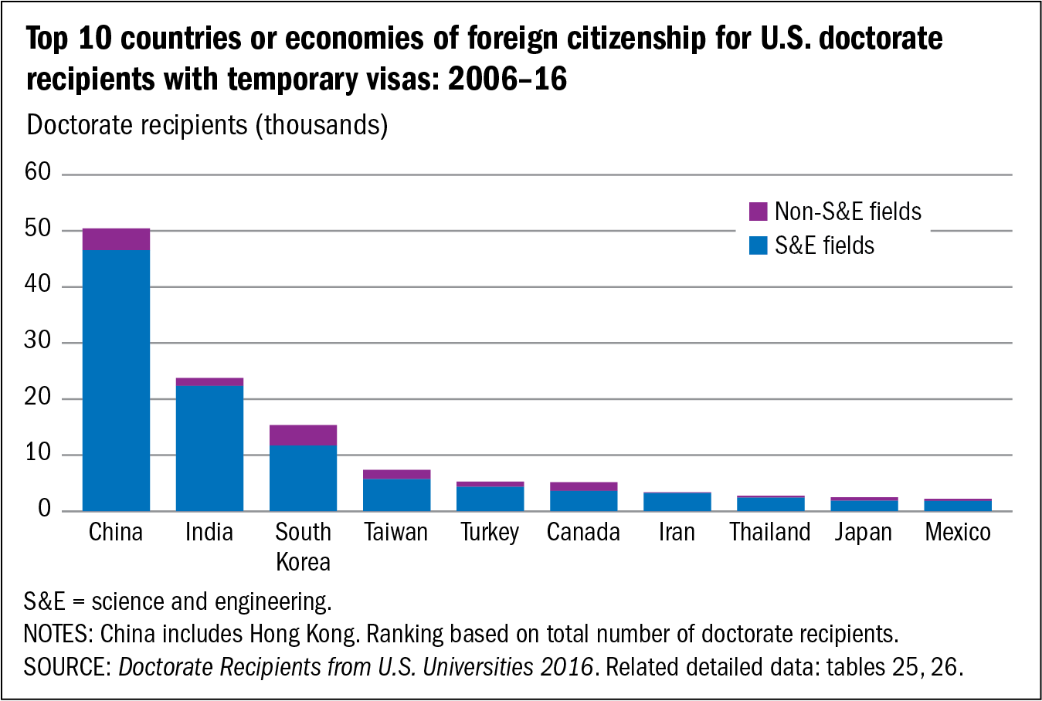

Slide 25
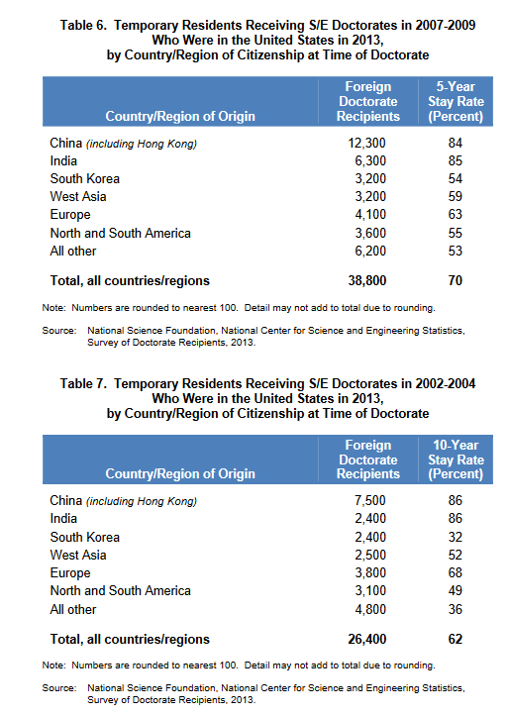

Slide 26
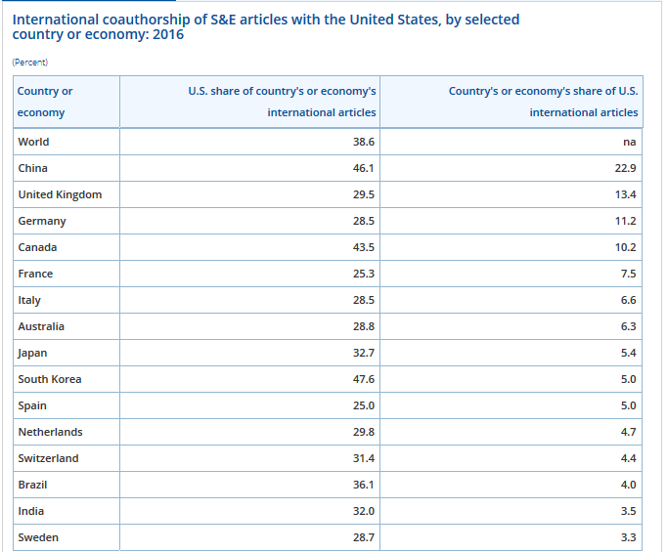

Slide 27
GOING FORWARD
GIVEN THE CHINESE TRAJECTORY, THE INTERNATIONAL COMMUNITY CAN’T AFFORD NOT TO BE ENGAGED
THE CENTRAL QUESTION: HOW TO EXPLOIT NEW OPPORTUNITIES TO SERVE NATIONAL INTERESTS WHILE AVOIDING OPPORTUNITIES THAT SERVE ONLY CHINESE INTERESTS?
NATIONAL STRATEGIES?
  GOVERNMENT DELIBERATIONS
  CORPORATE DELIBERATIONS
  UNIVERSITIES
  PROFESSIONAL SOCIETIES
INSTITUTIONAL INADEQUACIES – IN U.S., OSTP (?), S&T AGREEMENT, CONGRESSIONAL HOSTILITY

Slide 28

尊重发展规律，立足中国国情“RESPECT OBJECTIVE LAWS OF DEVELOPMENT, OBSERVE CHINESE NATIONAL CONDITIONS”

Slide 29
THANKS!
petesutt@uoregon.edu
http://china-us.uoregon.edu/

