Slide 1


Leadership
Research
Resource Sharing
Components of Dynamic Academic Libraries

Slide 2
Objectives
Share updates about top trends in libraries around the world.
Provide insights on leadership essentials needed to cope with issues and trends in library and information science.
Share ideas on how research can serve as a tool to enhance library services.
Explain the importance of resource sharing to address issues and emerging trends.
Gather input from participants on how leadership, research and resource-sharing will be integrated in strategic plans.
Notes:
Photo credit: http://youthvoices.net/discussion/thinking-outside-box

Slide 3
Top 2016 Trends in Academic Librarianship for Higher Education
A
Research data services
Digital scholarship
C
Collection Assessment trends
Content provider mergers
R
Evidence of learning
New direction for Information Literacy
L
Emerging staff positions
Open educational resources
Notes:
Photo credit: http://youthvoices.net/discussion/thinking-outside-box

Slide 4
CILIP KEY AREAS OF EMPHASIS
C
Information Literacy
Freedom of information
I
International copyright
Ebooks
L
Evidence of learning
New direction for Information Literacy
I
Emerging staff positions
P
Sustainable development goals

Slide 5
IFLA Strategic Directions and
Key Initiatives
I
Libraries and Society
F
Information and Knowledge
L
Cultural Heritage
A
Capacity building

Slide 6
Leadership Beyond
the Competency Model
PARENT INSTITUTION MISSION, VISION & GOALS
Library Mission & Vision
Library Goals & Plans
Library Programs

Slide 7
Library and Information Professionals
Emerging Roles
∞ Learning and Research
∞ Collaboration with Faculty

Slide 8
Library and Information Professionals
Emerging Roles
PARENT INSTITUTION MISSION, VISION & GOALS
Library Mission & Vision
Library Goals & Plans
Library Programs

Slide 9
Leadership Beyond
the Competency Model
Transformation
Innovation & Creativity
ICT Adoption
Succession Management
Notes:
transformational aspect (Bass, 1990) leading innovative and creative library workforce and adopting to the digital age (Marcum, 2016)and preparing succession management

Slide 10
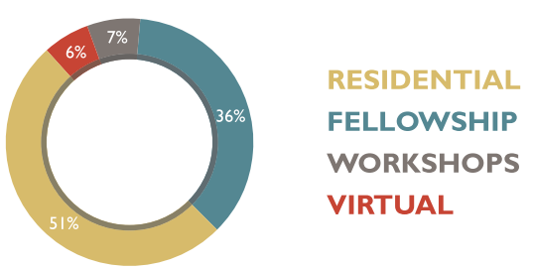
International Activities
Cultivating Critical Leadership
Notes:
transformational aspect (Bass, 1990) leading innovative and creative library workforce and adopting to the digital age (Marcum, 2016)and preparing succession management

Slide 11
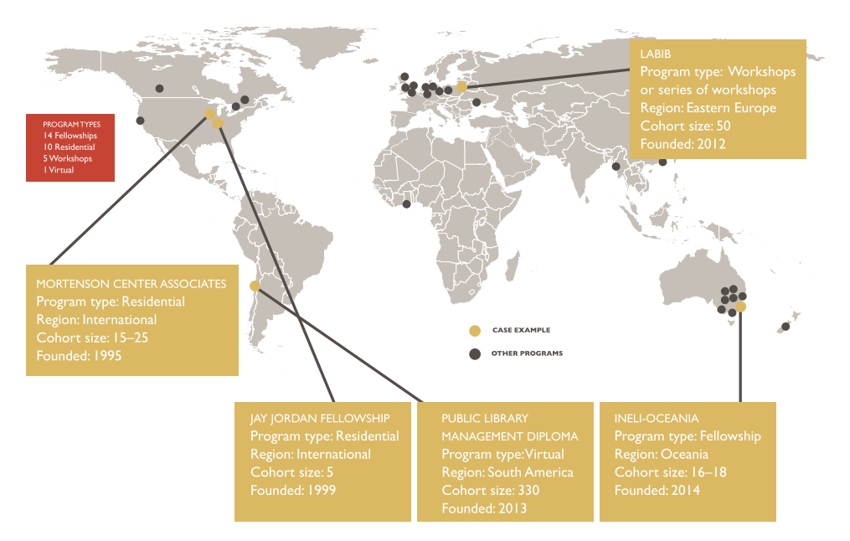
Library Leadership Programs
Around the World

Slide 12
Research as a Tool
Research is a continuous objective exploration of knowledge and practices.

Slide 13
Research as a Tool
Rethink/ redesign roles
ICT
User needs
Budget

Slide 14
Essential library researches
utilization studies
Library quality (LibQual) Service measures
impact assessment
study of human- computer interaction
information retrieval patterns
user behavior can enhance services.
altmetrics and bibliometrics

Slide 15
Kickstart
Develop research interest of team
Create a research agenda
Collaborate

Slide 16
Resource Sharing
Resource sharing “means making available to other libraries the library resources, the information contained in those resources and the staff expertise required to locate and make available the information or the library resources” (Alberta Public Library Boards, 2009)
Notes:
https://open.alberta.ca/dataset/775ab421-0a68-4d10-9f19-8bcf4c4ae1c3/resource/8f352f02-6db3-4f81-bc23-56d5e6495068/download/65543042009Provincial-Resource-Sharing-Network-Policy-for-Alberta-Public-Library-Boards2009-01.pdf

Slide 17
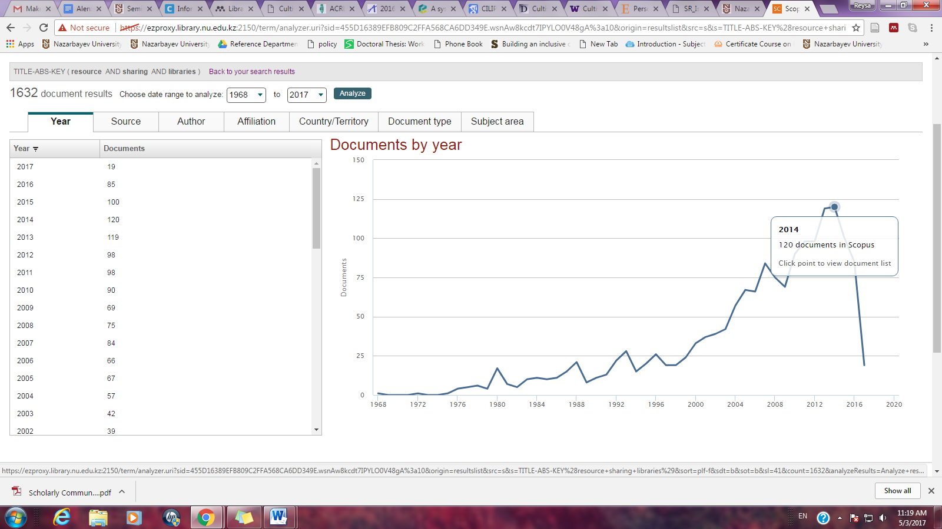
Resource Sharing
in Libraries by Year
Notes:
https://open.alberta.ca/dataset/775ab421-0a68-4d10-9f19-8bcf4c4ae1c3/resource/8f352f02-6db3-4f81-bc23-56d5e6495068/download/65543042009Provincial-Resource-Sharing-Network-Policy-for-Alberta-Public-Library-Boards2009-01.pdf

Slide 18
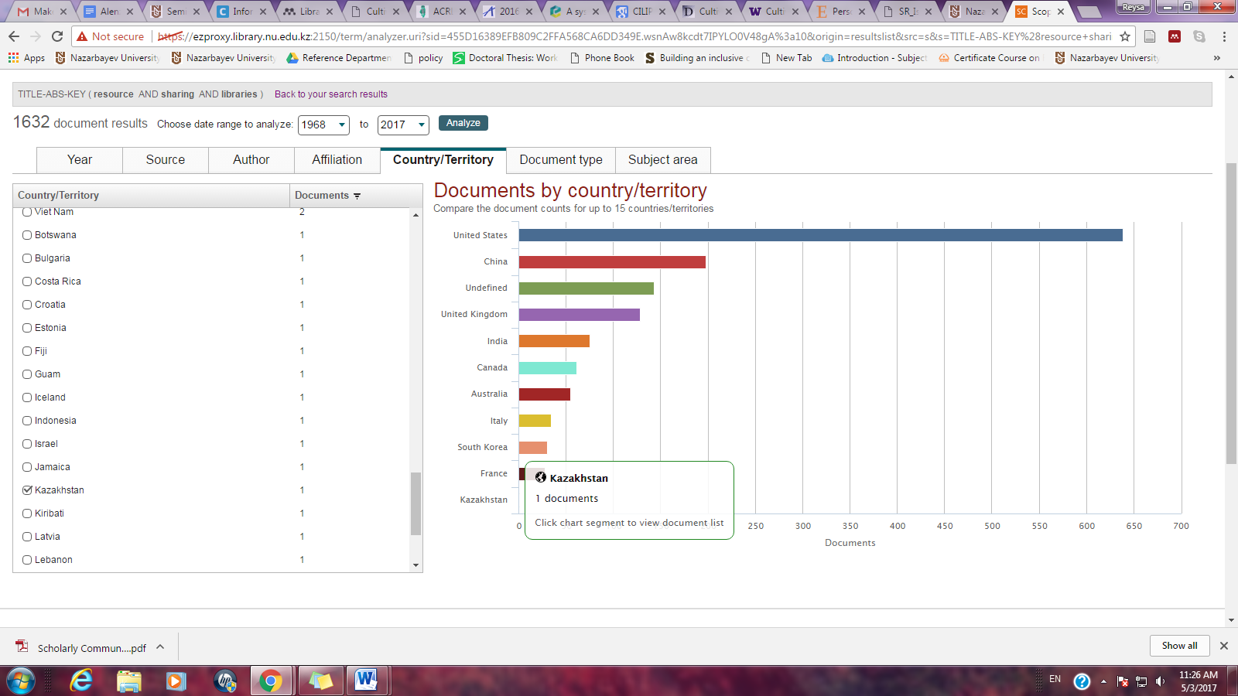
Resource Sharing in Libraries by Country
Notes:
https://open.alberta.ca/dataset/775ab421-0a68-4d10-9f19-8bcf4c4ae1c3/resource/8f352f02-6db3-4f81-bc23-56d5e6495068/download/65543042009Provincial-Resource-Sharing-Network-Policy-for-Alberta-Public-Library-Boards2009-01.pdf

Slide 19
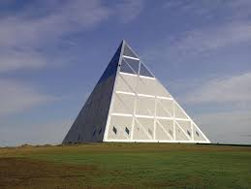
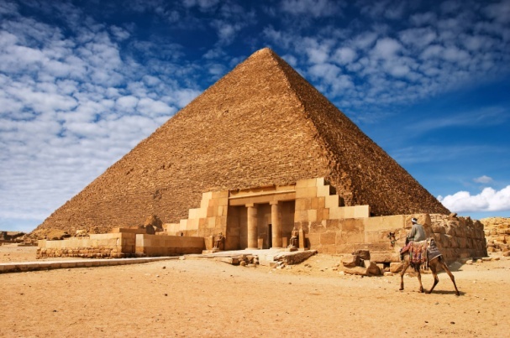
Leadership
R e s e a r c h
Resource Sharing
Notes:
Image Sources:
http://wallpapercave.com/giza-pyramids-wallpaper
Palace of Peace and Recociliation- http://www.aqnb.com/2014/02/27/palace-of-peace-and-reconciliation-arcadia-missa-feb-28-mar-8/

Slide 20
End of Presentation
Reysa C. Alenzuela, MLIS, PhD
Nazarbayev University Library
Phone: +7(7172)705945
Email: reysa.alenzuela@nu.edu.kz
Website: www.library.nu.edu.kz

Slide 21

Activity:
Thinking out of the Box
Notes:
Photo credit: http://youthvoices.net/discussion/thinking-outside-box

