Slide 1
BATTERY STATE OF HEALTH DETERMINATION THROUGH VARIOUS TECHNIQUES
Lead supervisor: Prof. Zhumabay Bakenov
Co-supervisor: Dr. Berik Uzakbaiuly

Slide 2
Outline
Goal and importance
Flow process work chart
Experimental part
Results and Discussion
  LiSOCl2 -entropy
  NCR - entropy
  NCR AI technique
2

Slide 3
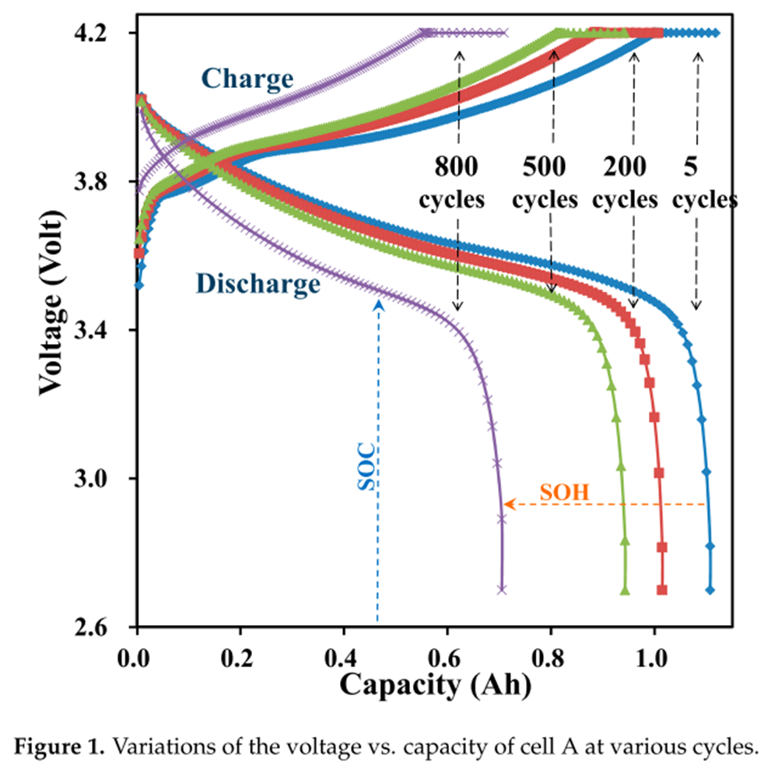


Goal and Importance
- Lithium ion batteries problems
  Longevity
  Safety
Current technology:
Machine learning(AI), Electrochemical model,
Mathematical model, EIS
2. Goal
  Non-invasive
  Quick
  Precise
  Entropymetry and ML
3

Slide 4
SOH
SOC
SOH = Q/Q(init)
Q - actual maximum capacity
Q(init) - initial maximum capacity
SOC = Q_{rem}/Q(full)
Q_{rem} – remaining capacity
Q(full) – full charged capacity
4

Slide 5
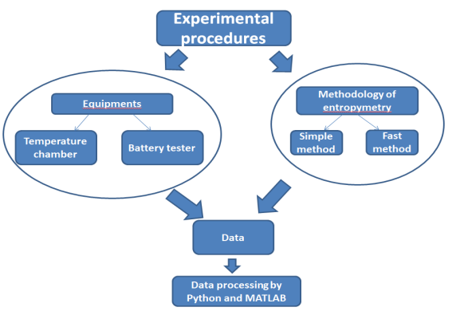
Experimental part
5

Slide 6
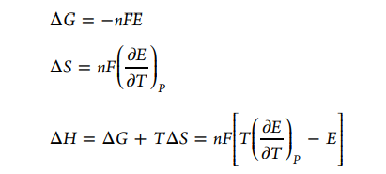
Basic equations
Equations for thermodynamics parameter calculation
E - open circuit voltage of the battery
F – Faraday’s constant
T – temperature
n – number of electrons
6

Slide 7

Mathematical model of SOC estimation
Mathematical model of SOH estimation
SOH = f(α, β, γ)
7

Slide 8
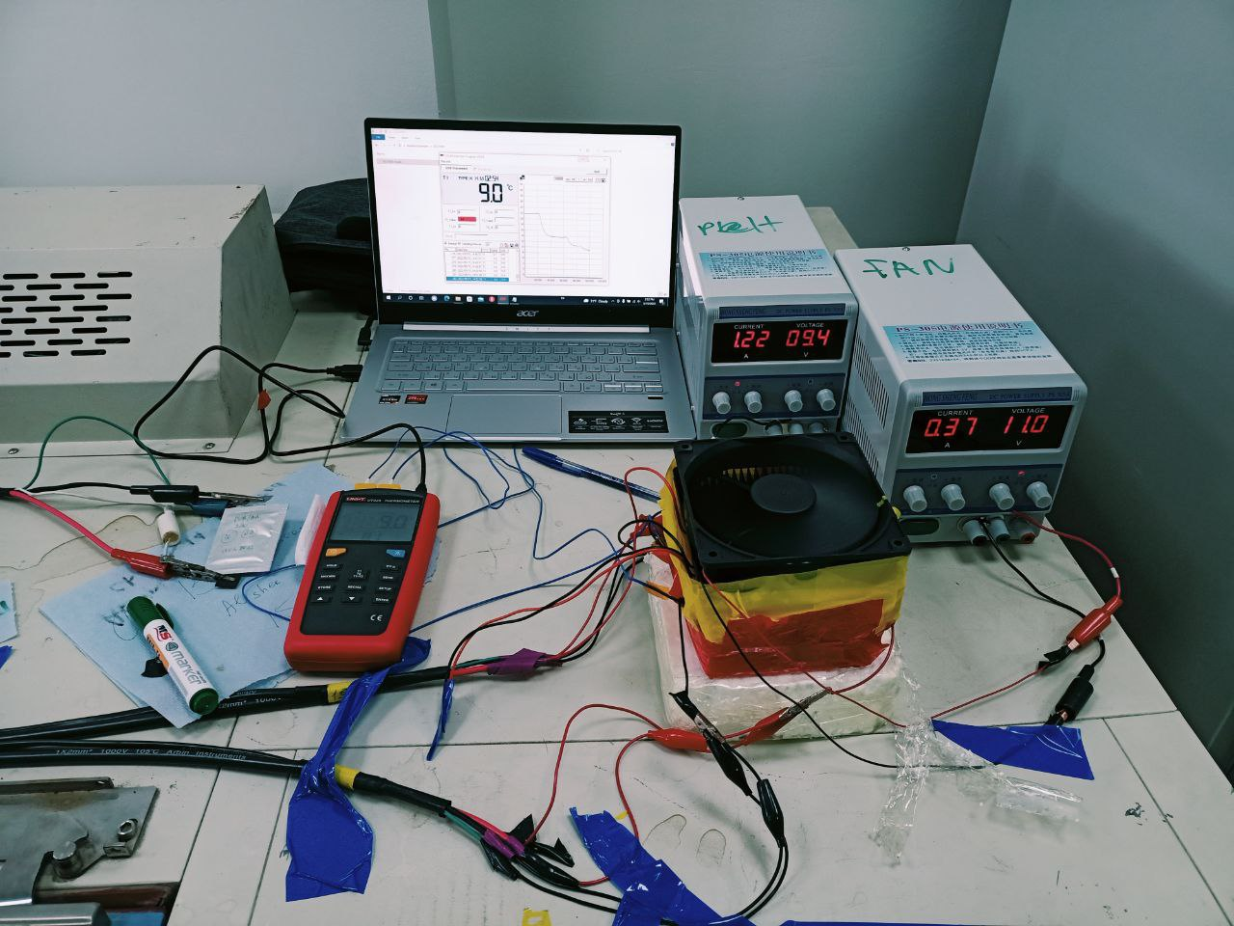
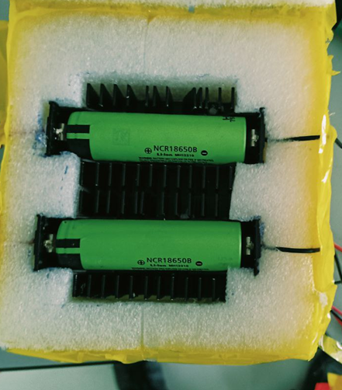
Thermal chamber
8

Slide 9
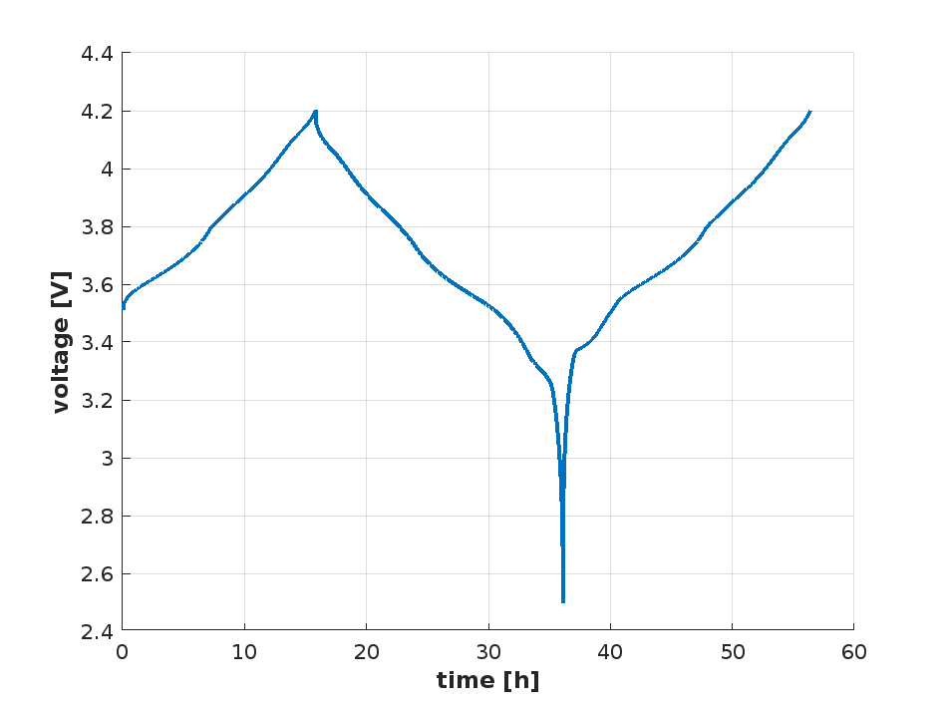
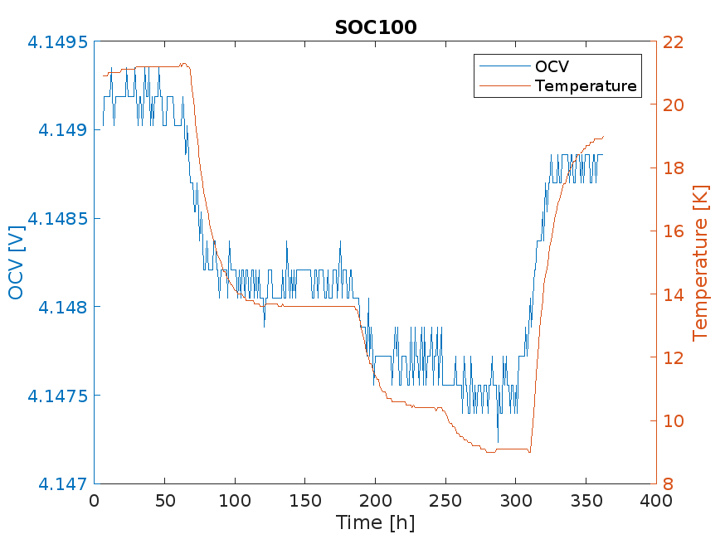
Methodology of entropy calculation at various SOC (slow method)
1 . Determining the discharge capacity of the battery at 0,05 C-rate
2. Full charging of the battery at 0.05C and set as 100% state of charge
3. And discharging to appropriate SOC, waiting for equilibrium (12 h)
4. Determining the voltage of battery at various temperatures (0 - 30) and SOC.
9

Slide 10
Methodology for new approach (fast method)
1 . Determining the discharge capacity of the battery at 0,05 C
2. Full charging of the battery at CCCV mode
And discharging of battery for 11 % SOC change
Charging of battery for 1 % SOC change
5. Waiting for equilibrium (20 min)
6. Determining the voltage of battery after eq. at various temperatures
Previous method: 18 h / (10% SOC step)
New method: 4,5 h/ (10% SOC step)
10

Slide 11

Results
LiSOCl₂ Primary battery
Nominal voltage 3,5 V
Capacity 1000 mah
11

Slide 12
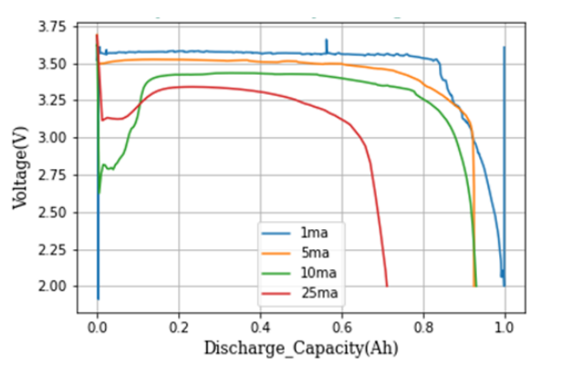
Charge discharge profile of LiSOCl2 battery at various C-rate.
12

Slide 13
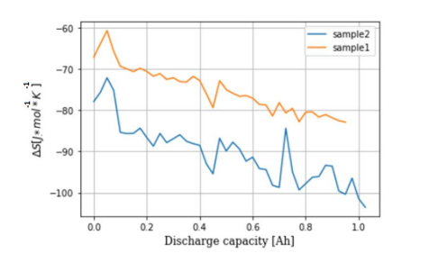

Entropy profile of the lithium thionyl battery at various SOC.
13

Slide 14
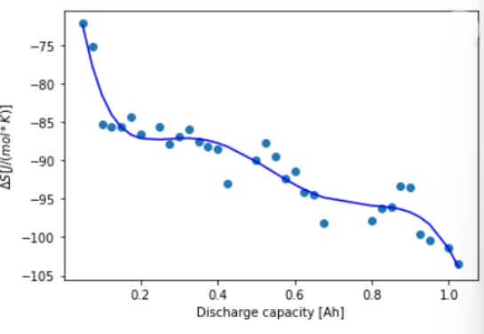

SOH estimation model for lithium thionyl battery
14

Slide 15

Results
NCR battery
Nominal voltage 3,7 V
Capacity 3200 mah
15

Slide 16
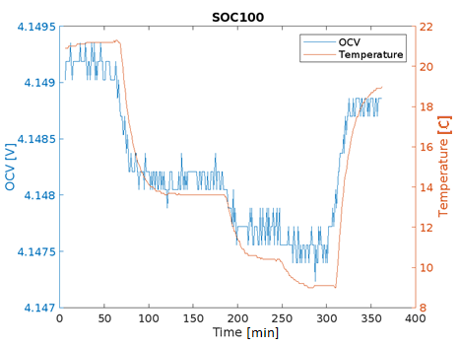
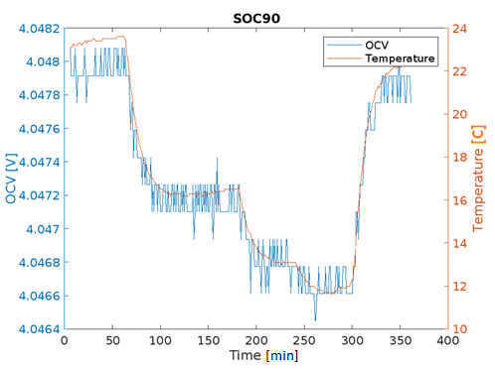
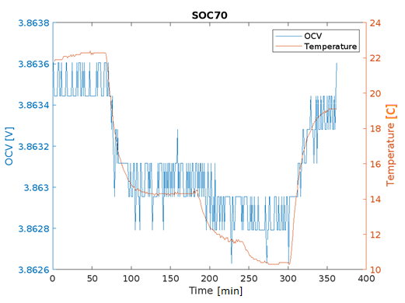
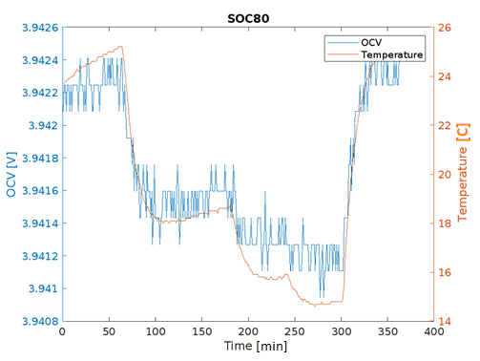
Sample1 – NCR18650
16

Slide 17
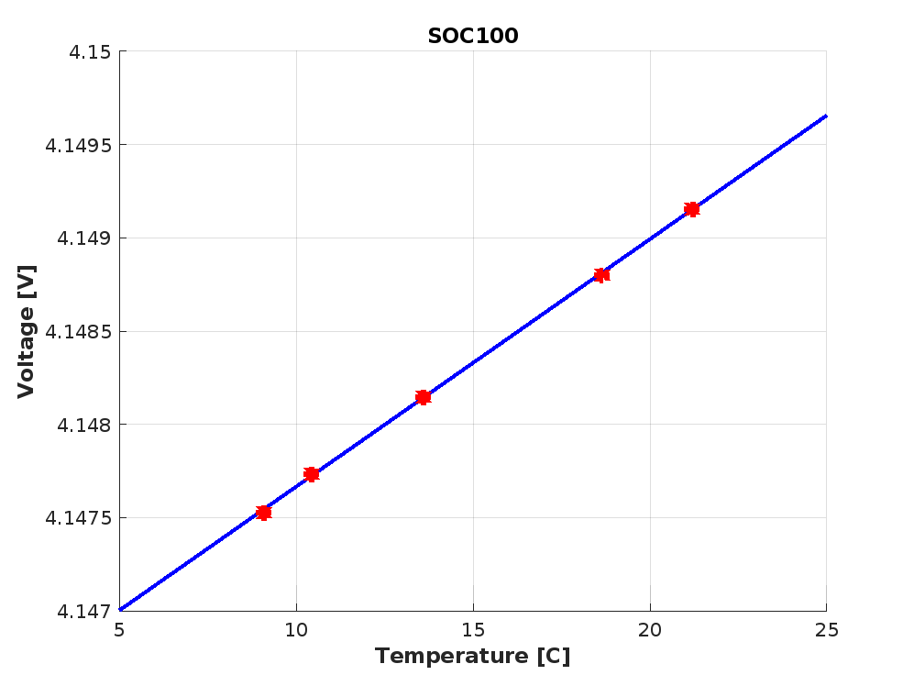
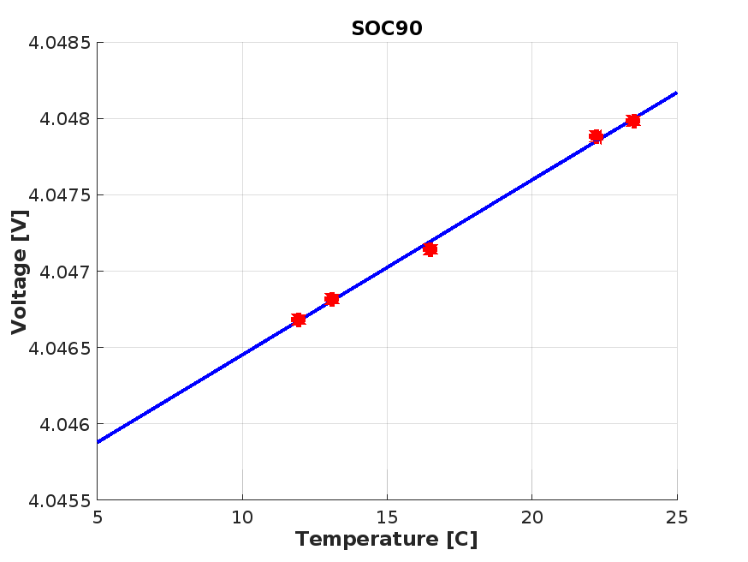
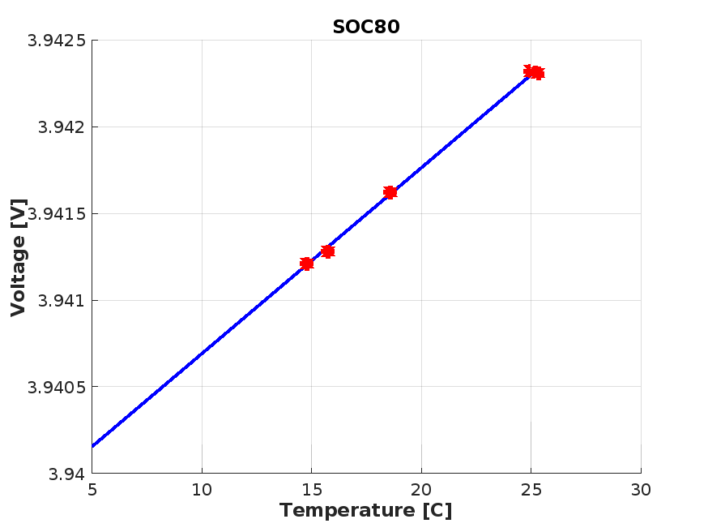
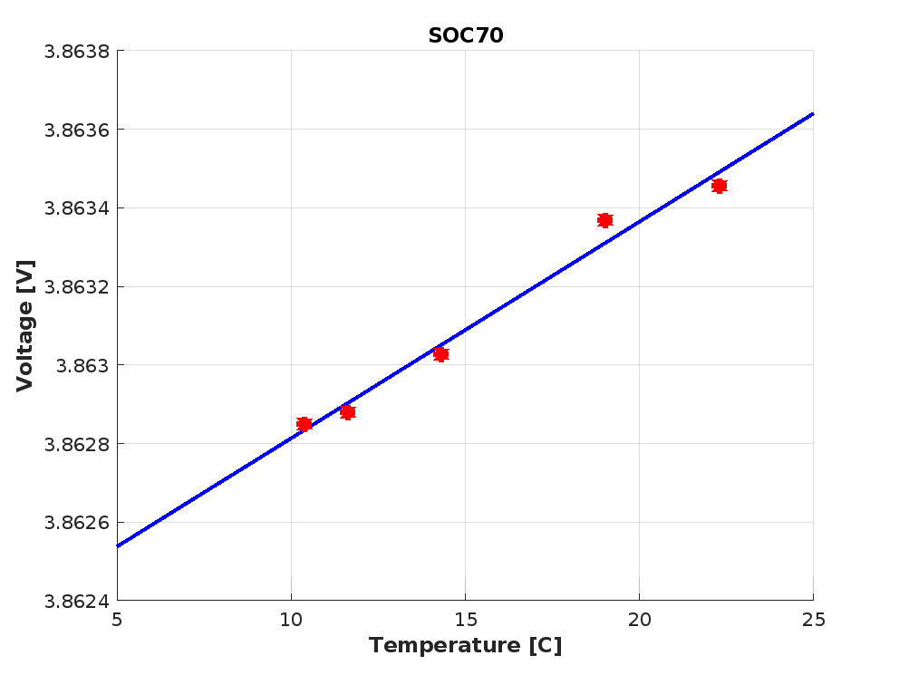
Sample1 – NCR18650
17

Slide 18
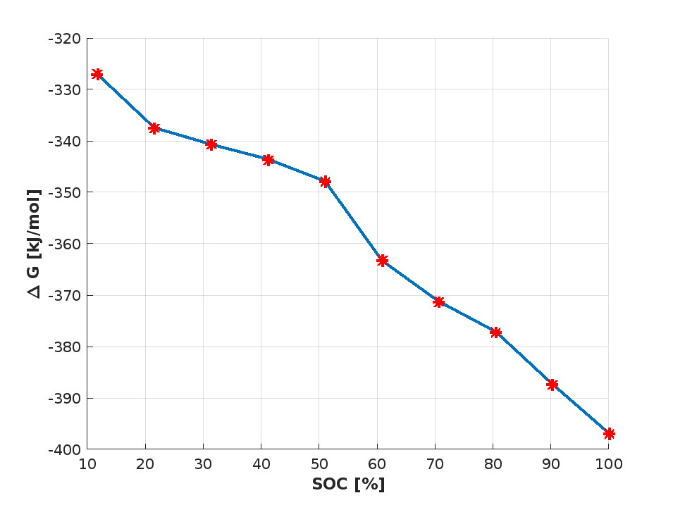
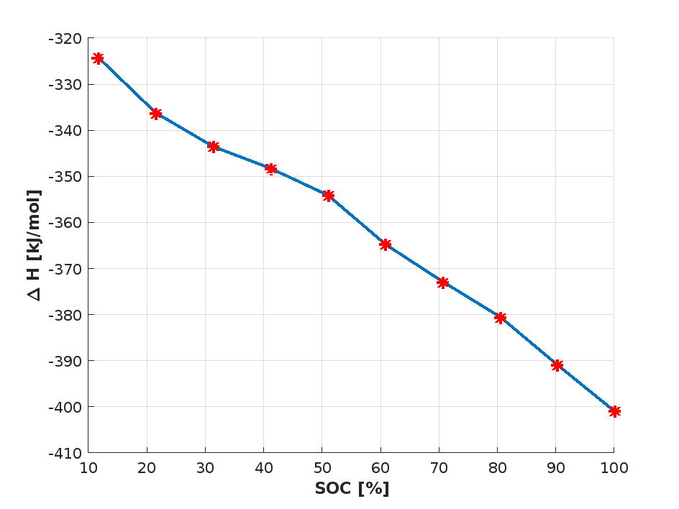
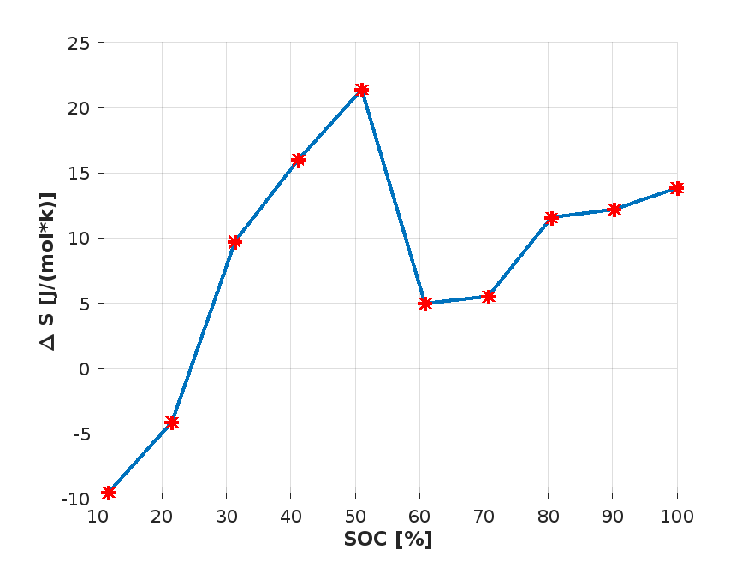
G, H, S vs SOC of Sample1 – NCR18650
18

Slide 19
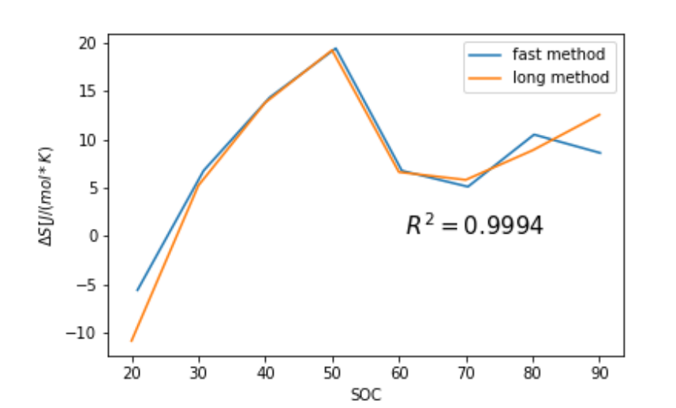
Entropy measurement with various approach
19

Slide 20
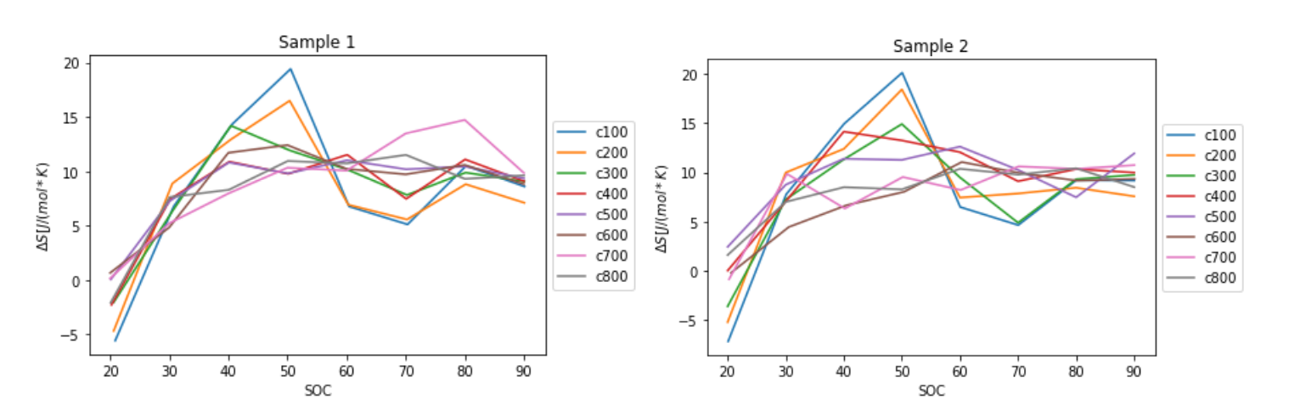
Entropy profile of NCR18650 parameters at various cycle numbers
20

Slide 21
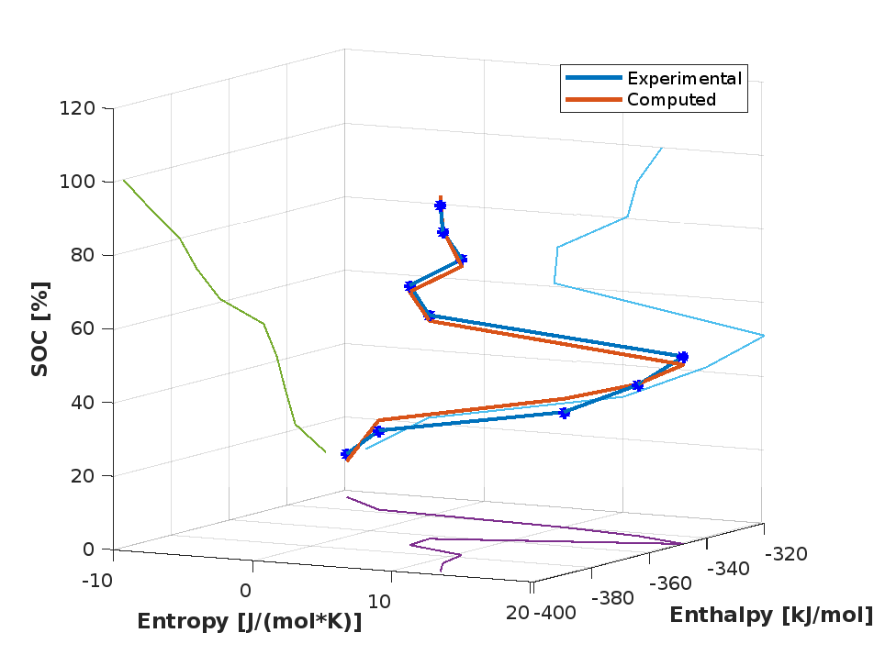
NCR18650
α | β | γ | R^2
- 371,2985 | 0,4789 | -1,1788 | 0,99428
21

Slide 22
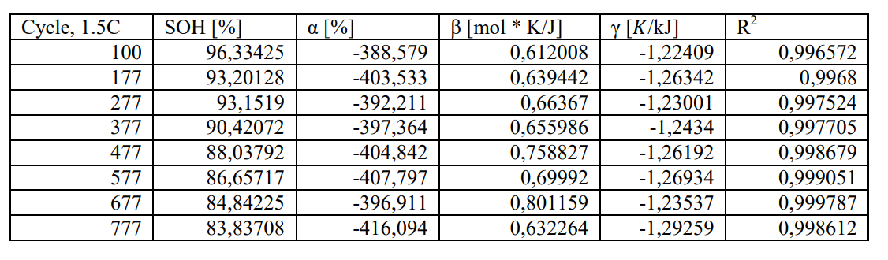

Linear regression coefficients at various state of health of the battery
SOH = f(α, β, γ)
22

Slide 23
Results
Artificial Intelligence
23

Slide 24

24

Slide 25
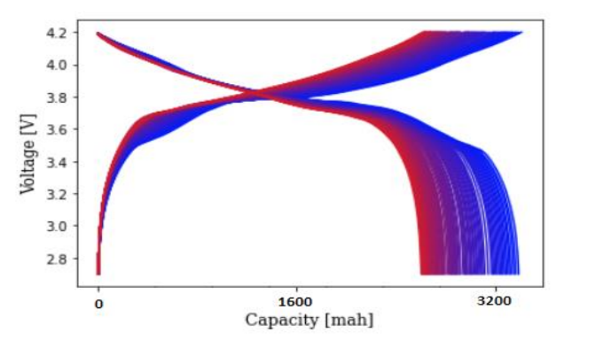
Charge discharge profile of NCR 18650 at 1,5 C
25

Slide 26
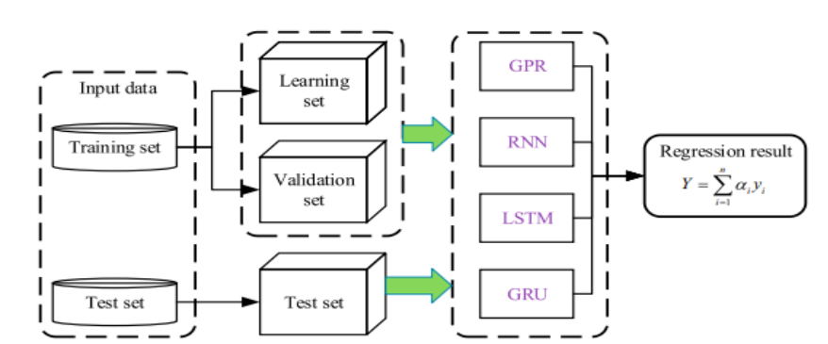
26

Slide 27
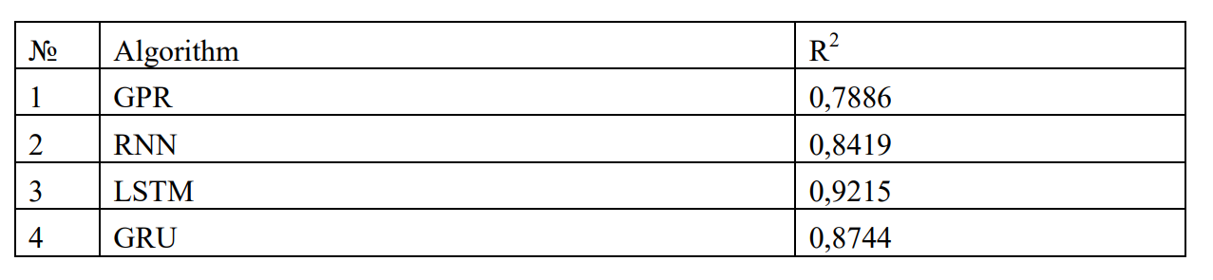
. The precision of each machine learning algorithm
- The model can be applied at the following condition: 1,5 C rate, T = 25 C, DOD = 100%
- Need more data to apply for other conditions
27

Slide 28
Conclusion
Mathematical model in which entropy depends on state of charge of the battery by 6th order polynomial function was suggested, showed R2 higher than 0.95 (LiSOCl₂)
New Entropy measurement technique is developed
The change of entropy profile at various state of health was indicated
The machine learning method was proposed for SOH estimation of NCR18650 battery
LSTM technique has high accuracy of the estimation among algorithms
28

Slide 29
Thanks

