Slide 1

Design and Modelling of RF GaN Class-E Power Amplifier for Broadband Applications
Student Name/s: Dmitriy Kupreyev
Supervisor Name/s: Dr. Mohammad Hashmi
Co-Supervisor Name/s: Dr. Galymzhan Nauryzbayev
Nur-Sultan, Kazakhstan
27/04/20

Slide 2
Outline
Introduction
Motivation
Research objectives
Background
  PAs and PAs classes
State of the art
Thesis details
Design and modelling of PA
Results
Conclusion and future work

Slide 3
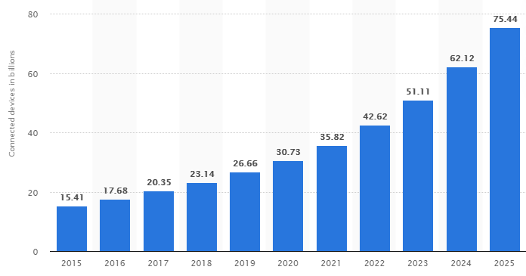

Introduction (1/2)
Communication systems: high development rate
Reasons: various sectors (business, health, teaching, security, etc.) require constant updates
IoT devices number rises exponentially
Notes:
https://www.statista.com/statistics/471264/iot-number-of-connected-devices-worldwide/

Slide 4

Introduction (2/2)
Communication system devices: phones , tablets, RFID, computers, antennas.
Important design considerations: power dissipation, efficiency, energy consumption, heating, radiation, etc.
Made up of integrated devices
PA defines:
  Bandwidth
  Efficiency
  Output power
PA is bottleneck in
communication systems
Notes:
https://www.afterschoolnetwork.org/post/application-extended-california-expanded-learning-communication-systems-work-group

Slide 5


Motivation
The progress of a digital world
Constantly increasing demands for devices performance:
  Higher data exchange rate
  Broader utilization bandwidth
  Longer battery lifetime
  Device ergonomics
PA consumes the most power of the circuit
Seek for low – cost solutions

Slide 6
Research objectives
Literature review on the current state of the art .
To research and to apply PA design steps and methods.
To develop and model Class E PA for broadband applications.

Slide 7
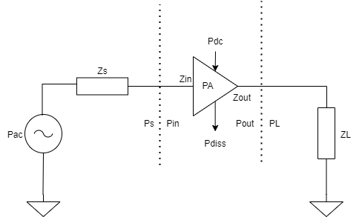



Background (1/5)
Power amplifier – most power-hungry circuit
Areas of application: radar, biomedicine, comm. systems, etc.
Performance assessment parameters: gain, drain efficiency, power added efficiency
$G=Pout/Pin$
$$η=P_{L}/P_{DC}$$
$$PAE=\left(Pout −Pin\right)/P_{DC}$$

Slide 8
Background (2/5)
PA Topologies
Conventional Classes:
Class A
Class B
Class AB
Class C
Switch-mode:
Class E
Class F
Class D
Class S
Class of PA is defined by operating conditions and circuitry

Slide 9
Background (3/5)
Conventional PAs
Switch – mode PAs
Key factors:
Linear mode of operation
Transistor: current source
Low design difficulty
Efficiency Limit
Driven with sinusoidal signal
Good choice for Amplitude Modulation, single – sideband modulation, quadrate AM
Key factors:
Non-linear mode of operation
Transistor: switch
Highly Efficient
Operates in saturation region
Good choice for low power, WPT systems.

Slide 10
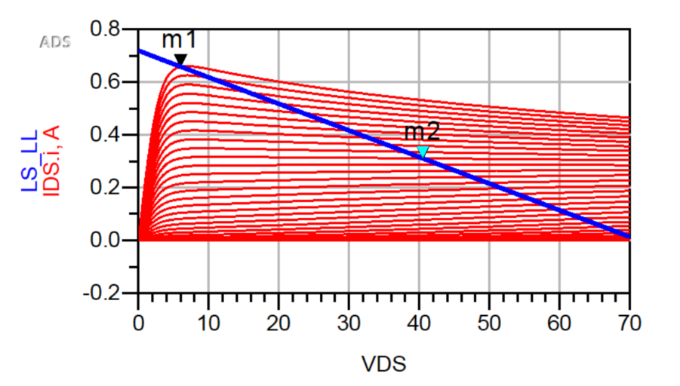
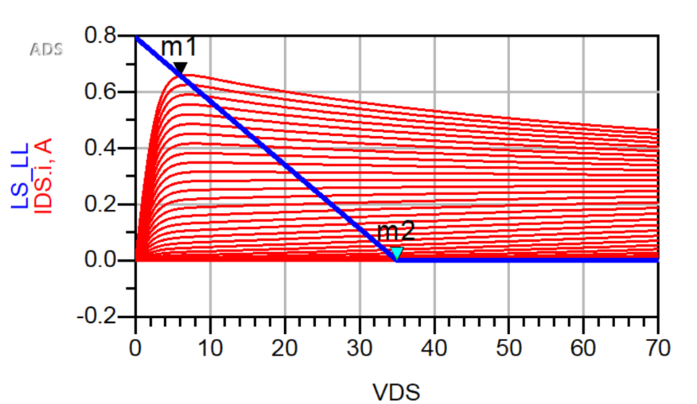
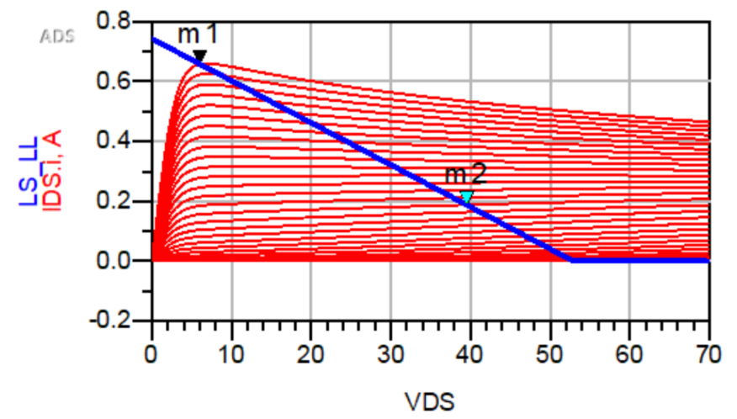
Background (4/5)
Fig. 1 Class A Biasing
Fig. 2 Class B Biasing
Fig. 3 Class AB Biasing

Slide 11
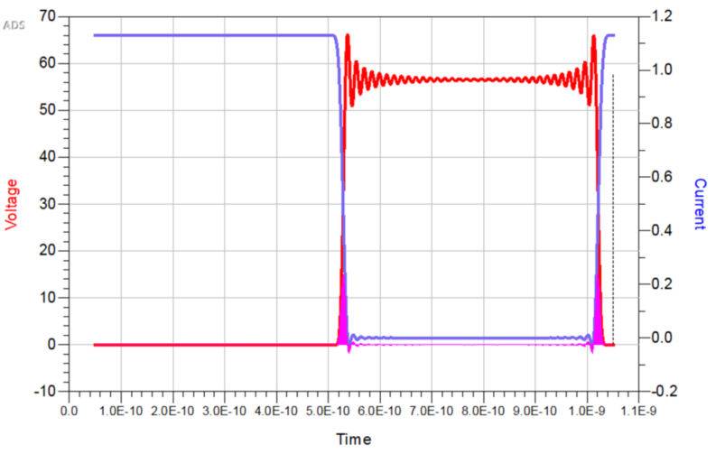
Background (5/5)
Class E PAs are preferred for high efficiency
Possible efficiency: 100%
Switch – mode: less affected by frequency and components variation
Nonlinear
Challenge: parasitics at
higher frequencies
Fig. 4 Switch-mode PA waveform example

Slide 12
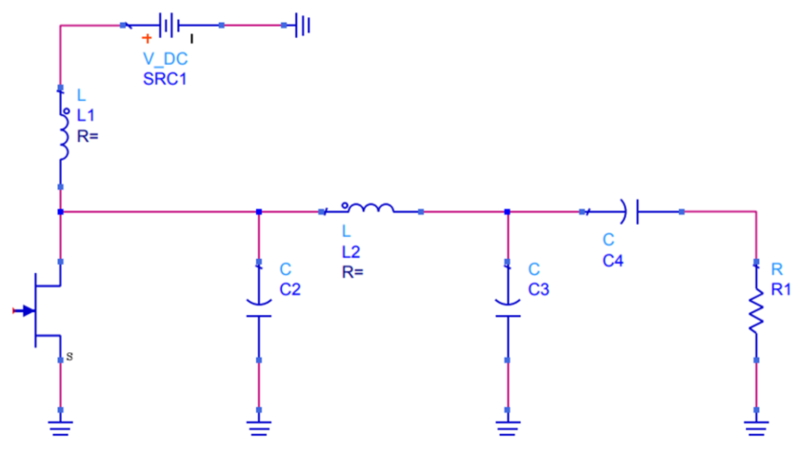
State of the Art (1/3)
Class E is biased in saturation region
Class E is defined by the load network
Parasitics made as a part of the system
Fig. 5 Class E load network

Slide 13
State of the Art (2/3)
Source | Frequency | PAE | Pout | Topology | Year
[1] | 250 MHz | 79.58% | 32.71 dBm | LDMOS | 2008
[2] | 300 MHz | 87% | 20.58 dBm | CMOS | 2018
[3] | 6.78 MHz | 87% | 10 - 30 W | ---- | 2017
[4] | 1.72/2.14 GHz | 74.9/75.9% | 40.5/40.9 dBm | GaN | 2018
[5] | 1.8-2.7 GHz | >48% | 29 W | GaN | 2018
[6] | 1.8 GHz | 60% | 20.1 dBm | CMOS | 2018
[7] | 2.6 GHz | 74.7% | 39.6 dBm | GaN | 2014
[8] | 1.7-2.8 GHz | 60% | 40.3 - 42.3 dBm | GaN | 2020
[9] | 2.14 GHz | 70% | 43 dBm | GaN | 2007
[10] | 2.85 GHz | 73% | 41.2 dBm | GaN | 2009
[11] | 1.8 GHz | 79% | 39 dBm | GaN | 2019

Slide 14
State of the Art (3/3)
GaN HEMT:
  Most frequent device used in switch-mode PA design
  Commercial availability
  Available active device model
  Tolerant to high temperatures
  Tolerant to high breakdown voltage
Designed frequencies are usually below 6 GHz, with the most focus on 0 to 4 GHz range.
PAE ranges from 50% to 85%

Slide 15
Thesis details
Design specifications
Frequency range: 1.3 – 2.15 GHz
Transistor type: 10W GaN from Cree
Expected efficiency: >40%
Gain & Power variations: <3dB
Primary contributions of the thesis
The study of waveform engineering to address the problems of power dissipation
The utilization of Class E power amplifier circuits in RF
The design, modelling and measurement of class E Power Amplifier

Slide 16
Design and Modelling of PA
Design Resources
Biasing
Stability
Load – Pull
Matching

Slide 17
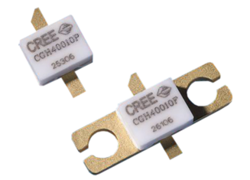

Design Resources
Substrate
  Rogers RO3003
  Dielectric constant 3.0
  Copper 35 micron
Active device
  GaN HEMT
  10 W
  < 6 GHz
Lumped elements
  Resistors: 100, 10 Ohm
  Capacitors: 8.5 pF, 50 nF, 10 uF,

Slide 18
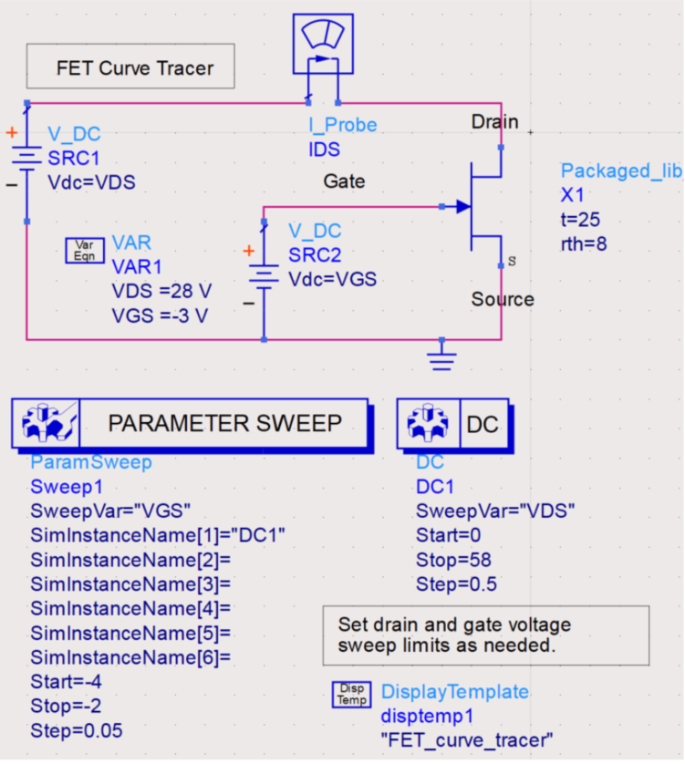
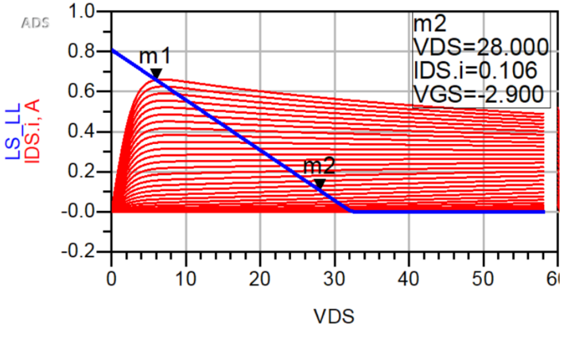
Biasing
Fig. 7 Biasing point of proposed PA
Fig. 6 PA DCIV analysis setup

Slide 19
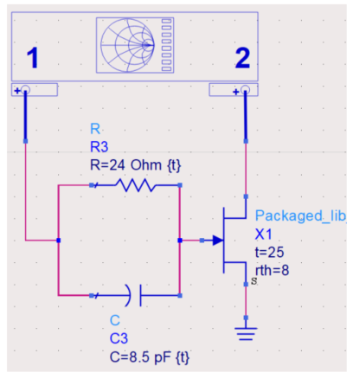
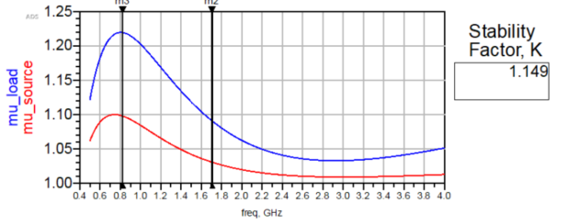

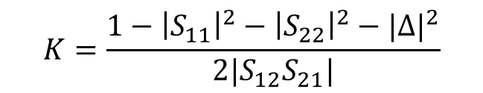
Stability
$$K=\frac{1−{\left|S_{11}\right|}^{2}−{\left|S_{22}\right|}^{2}−{|∆|}^{2}}{2|S_{12}S_{21}|}$$
$∆=S_{11}S_{22}$ - $S_{12}S_{21}$
Fig. 9 Stability setup
Fig. 10 Stability analysis

Slide 20
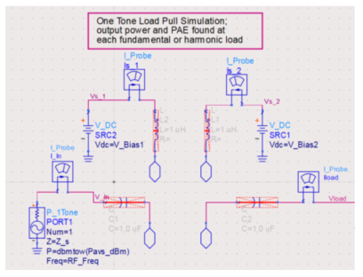
Load – Pull (1/2)
Conditions for optimum device performance
Impedance variation
Fig. 10 Load-pull setup

Slide 21
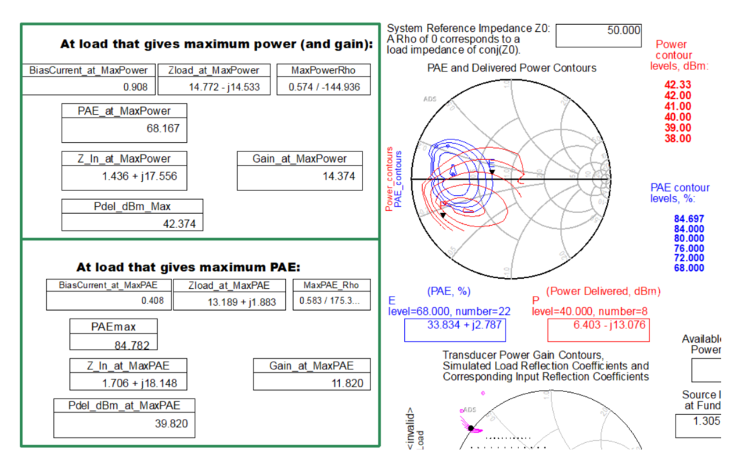
Load – Pull (2/2)
Fig. 10 Load-pull contours

Slide 22
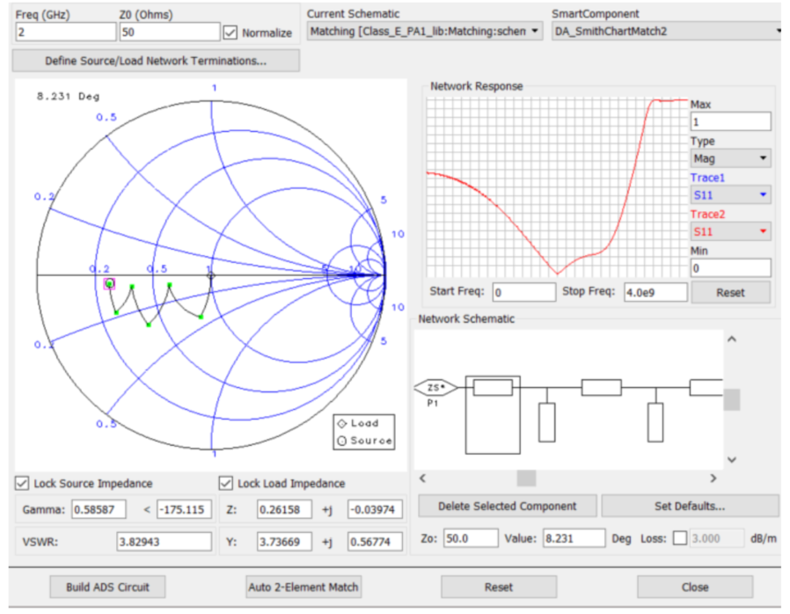
Matching (1/2)
Distributed matching network: less parasitics
Broader bandwidth
Fig. 11 Matching setup

Slide 23
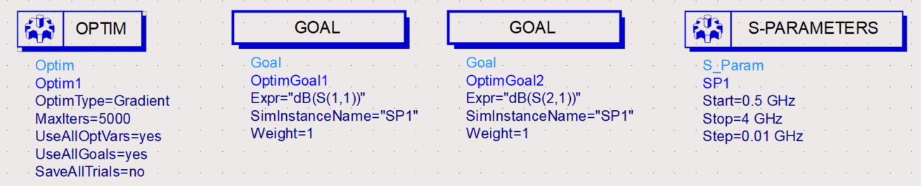
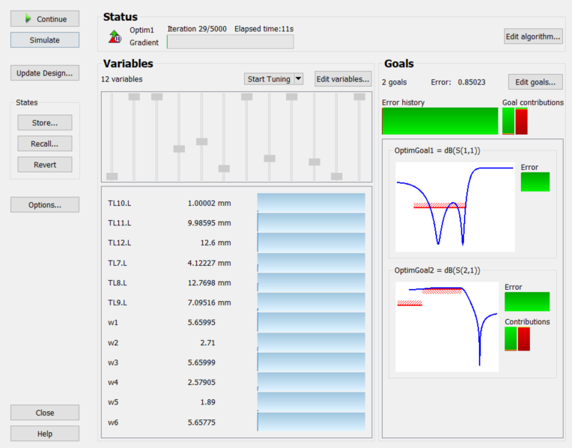
Matching (2/2)
Fig. 12 Matching network optimization

Slide 24
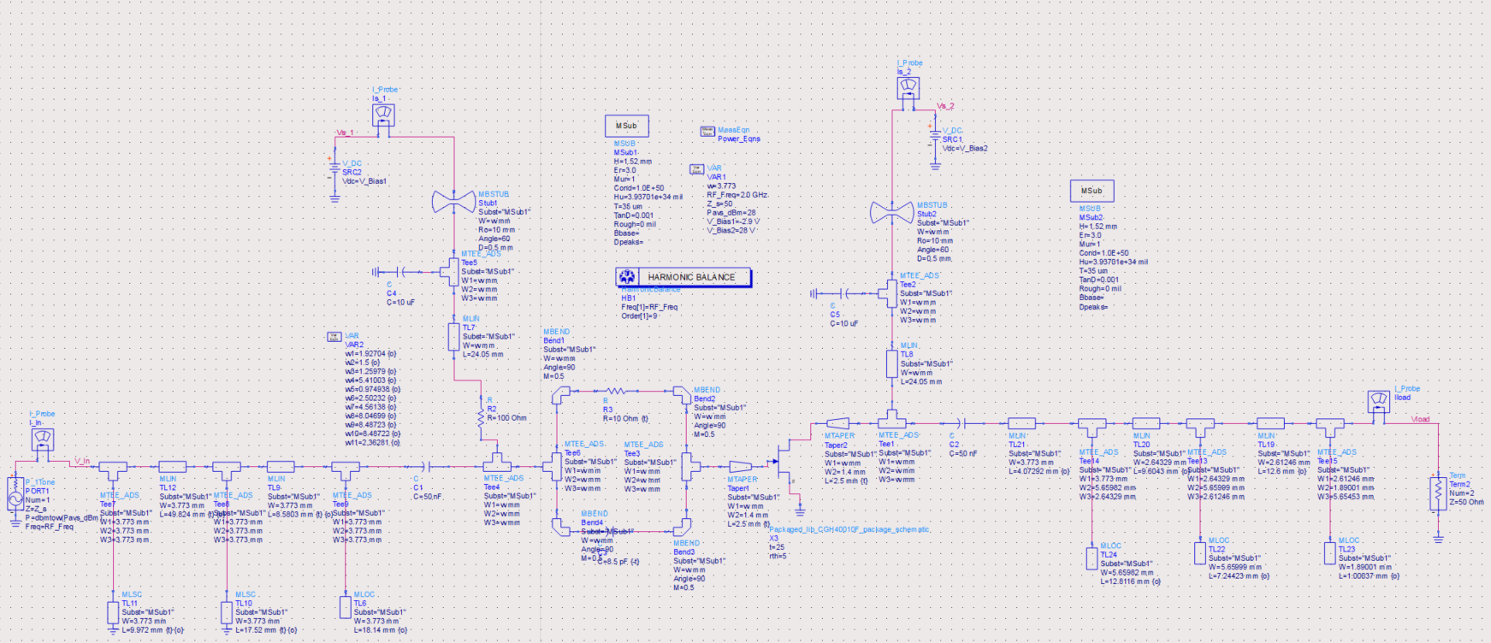
Results (1/5)
Fig. 13 Schematics of the designed model

Slide 25
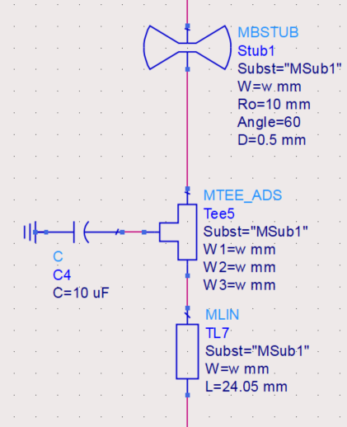
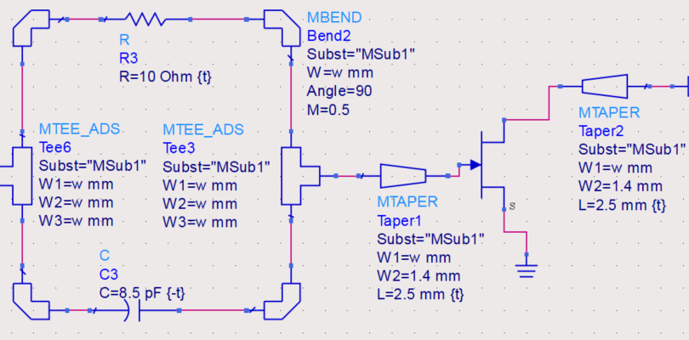
Results (2/5)
Biasing tee
Stability network and transistor connection

Slide 26
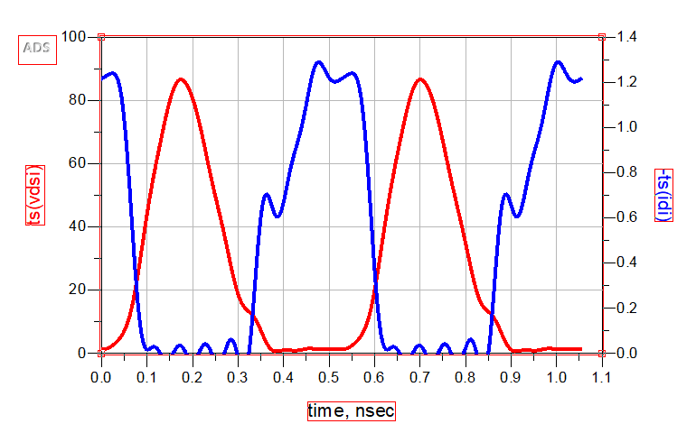
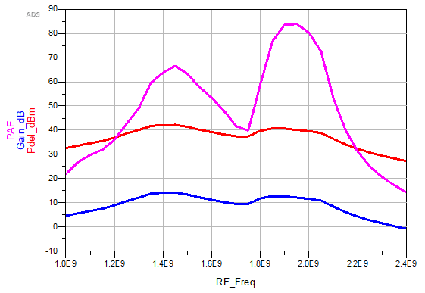
Results (3/5)
Peak PAE – 84%
Gain range – 11-14 dB
Peak power output – 42.2 dBm
Fig. 13 I-V
Fig. 14 PAE, Gain, Pout

Slide 27
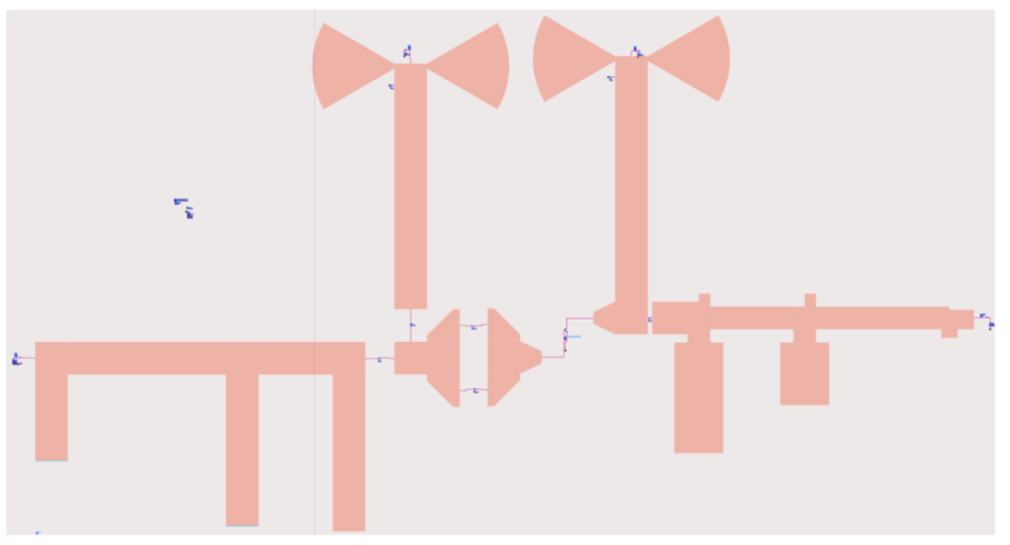
Results (4/5)
Fig. 15 Layout of the designed model

Slide 28
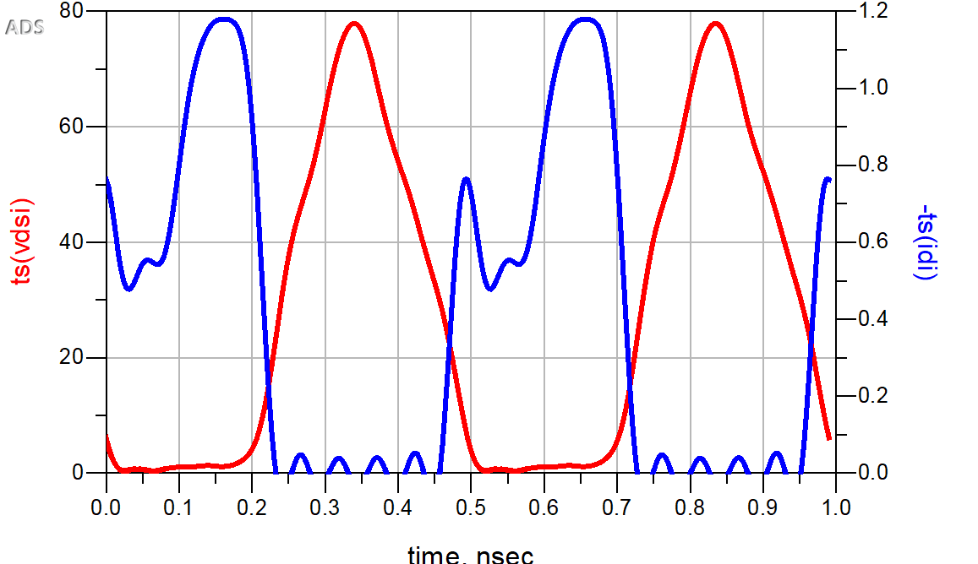
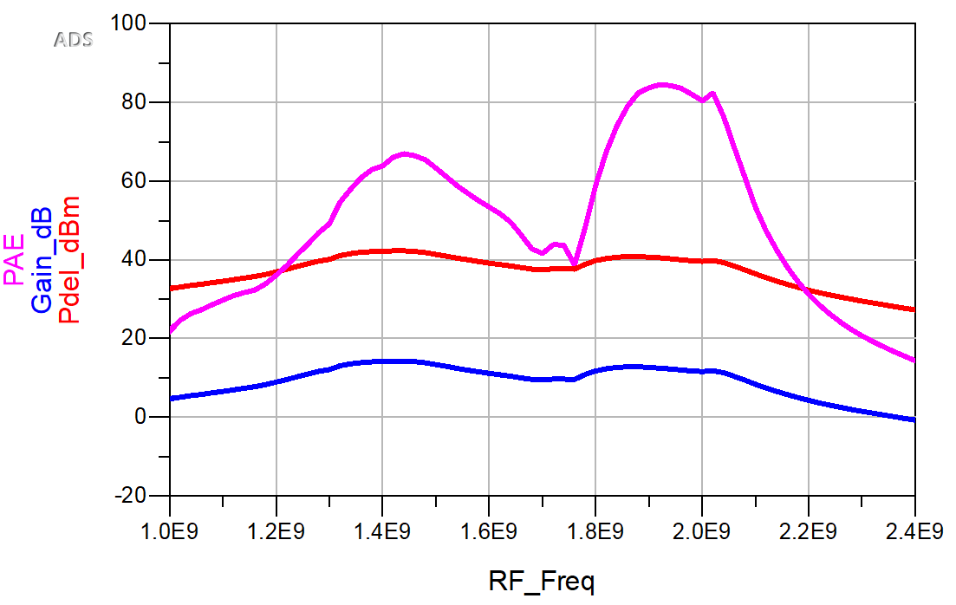
Results (5/5)
Peak PAE – 82%
Gain range – 11-14 dB
Peak Power output – 42 dBm
Fig. 16 I-V
Fig. 17 PAE, Gain, Pout

Slide 29
Conclusion and Future Work
Class E PA based on GaN HEMT
Rogers RO3003
Center frequency: 2.0 GHz
Maximum PAE: 82%
More than 40% PAE on the range of 1.3 GHz to 2.15 GHz
Gain: 11-14 dB
Validation of the design
Apply techniques to address PAE drop b/w 1.5 to 1.8 GHz
Future Work

Slide 30
References
[1] F. You, S. He, X. Tang and T. Cao, "Performance Study of a Class-E Power Amplifier With Tuned Series-Parallel Resonance Network," in IEEE Transactions on Microwave Theory and Techniques, vol. 56, no. 10, pp. 2190-2200, Oct. 2008, doi: 10.1109/TMTT.2008.2003530.
[2] D. De Venuto, G. Mezzina and J. Rabaey, "Automatic 3D Design for Efficiency Optimization of a Class E Power Amplifier," in IEEE Transactions on Circuits and Systems II: Express Briefs, vol. 65, no. 2, pp. 201-205, Feb. 2018, doi: 10.1109/TCSII.2017.2765249.
[3] S. Liu, M. Liu, S. Yang, C. Ma and X. Zhu, "A Novel Design Methodology for High-Efficiency Current-Mode and Voltage-Mode Class-E Power Amplifiers in Wireless Power Transfer systems," in IEEE Transactions on Power Electronics, vol. 32, no. 6, pp. 4514-4523, June 2017, doi: 10.1109/TPEL.2016.2600268.
[4] C. Liu and Q. Cheng, "A Novel Compensation Circuit of High-Efficiency Concurrent Dual-Band Class-E Power Amplifiers," in IEEE Microwave and Wireless Components Letters, vol. 28, no. 8, pp. 720-722, Aug. 2018, doi: 10.1109/LMWC.2018.2842686.

Slide 31
References
[5] T. Sharma, P. Aflaki, M. Helaoui and F. M. Ghannouchi, "Broadband GaN Class-E Power Amplifier for Load Modulated Delta Sigma and 5G Transmitter Applications," in IEEE Access, vol. 6, pp. 4709-4719, 2018, doi: 10.1109/ACCESS.2017.2789248.
[6] A. Ghahremani, A. Annema and B. Nauta, "Outphasing Class-E Power Amplifiers: From Theory to Back-Off Efficiency Improvement," in IEEE Journal of Solid-State Circuits, vol. 53, no. 5, pp. 1374-1386, May 2018, doi: 10.1109/JSSC.2017.2787759.
[7] X. Du, J. Nan, W. Chen and Z. Shao, "'New' solutions of Class-E power amplifier with finite dc feed inductor at any duty ratio," in IET Circuits, Devices & Systems, vol. 8, no. 4, pp. 311-321, July 2014, doi: 10.1049/iet-cds.2013.0405.
[8] P. Afanasyev, A. Grebennikov, R. Farrell and J. Dooley, "Broadband Operation of Class-E Power Amplifier with Shunt Filter," 2020 18th IEEE International New Circuits and Systems Conference (NEWCAS), Montréal, QC, Canada, 2020, pp. 54-57, doi: 10.1109/NEWCAS49341.2020.9159806.

Slide 32
References
[9] Y. Lee and Y. Jeong, "Applications of GaN HEMTs and SiC MESFETs in High Efficiency Class-E Power Amplifier Design for WCDMA Applications," 2007 IEEE/MTT-S International Microwave Symposium, 2007, pp. 1099-1102, doi: 10.1109/MWSYM.2007.380285.
[10] G. W. Choi, H. J. Kim, W. J. Hwang, S. W. Shin, J. J. Choi and S. J. Ha, "High efficiency Class-E tuned Doherty amplifier using GaN HEMT," 2009 IEEE MTT-S International Microwave Symposium Digest, 2009, pp. 925-928, doi: 10.1109/MWSYM.2009.5165849.
[11] F. You and J. Benedikt. “An optimized-load-impedance calculation and mining method based on I-V curves: Using broadband class-E power amplifier as example.” IEEE Transactions on Industrial Electronics, 66(7): 5254-5263, 2019

Slide 33
Thank you for your attention

