Slide 1

What are the roles of faculty to counter Infodemic?
Information Literacy Handbook to Foster Inf-competencies
3rd MIL Day: “Post-Pandemic Hacks: The Library’s Approach to Counter Infodemic”.
Global Media and Information Literacy Week,
Nazarbayev University (NU).
Kazakhstan – Almaty - October 30, 2020
5:00 AM Mexico / 5 PM Kazakhstan
Jesus Lau
Professor
jlau@uv.mx / jesuslau@gmail.com / www.jesuslau.com.mx
FB, Twitter, LinkedIn, Etc – jesuslau
Facultad de Pedagogía /DSAE
Universidad Veracruzana, Región Veracruz
Boca del Río, Veracruz, México
(1) A larger versions presented at other events

Slide 2
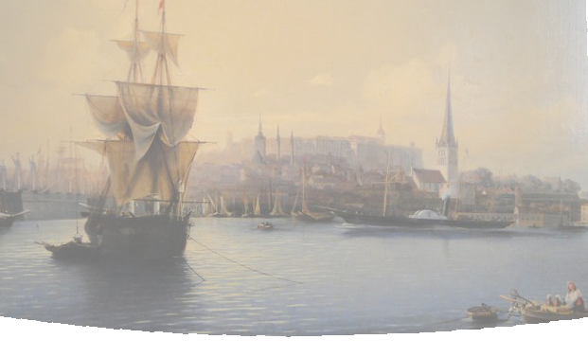
Topics
What are the roles of faculty to counter Infodemic?
Information culture as part of a university strategic plan
Process of creating an information literacy learning activity handbook
Learning exercises by IL competences

Slide 3
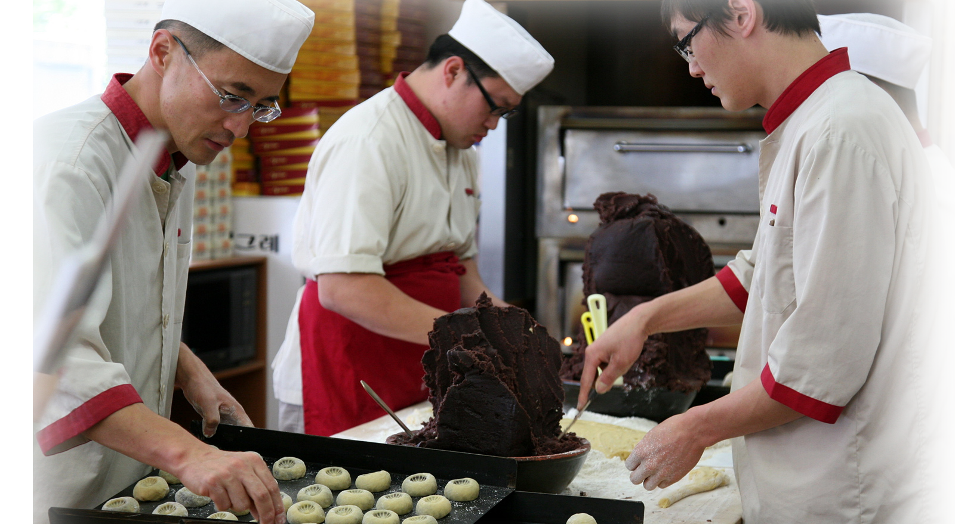
Bakery - University
https://upload.wikimedia.org/wikipedia/commons/f/f9/Korea-Gyeongju-Making_Gyeongju_bread-01.jpg

Slide 4
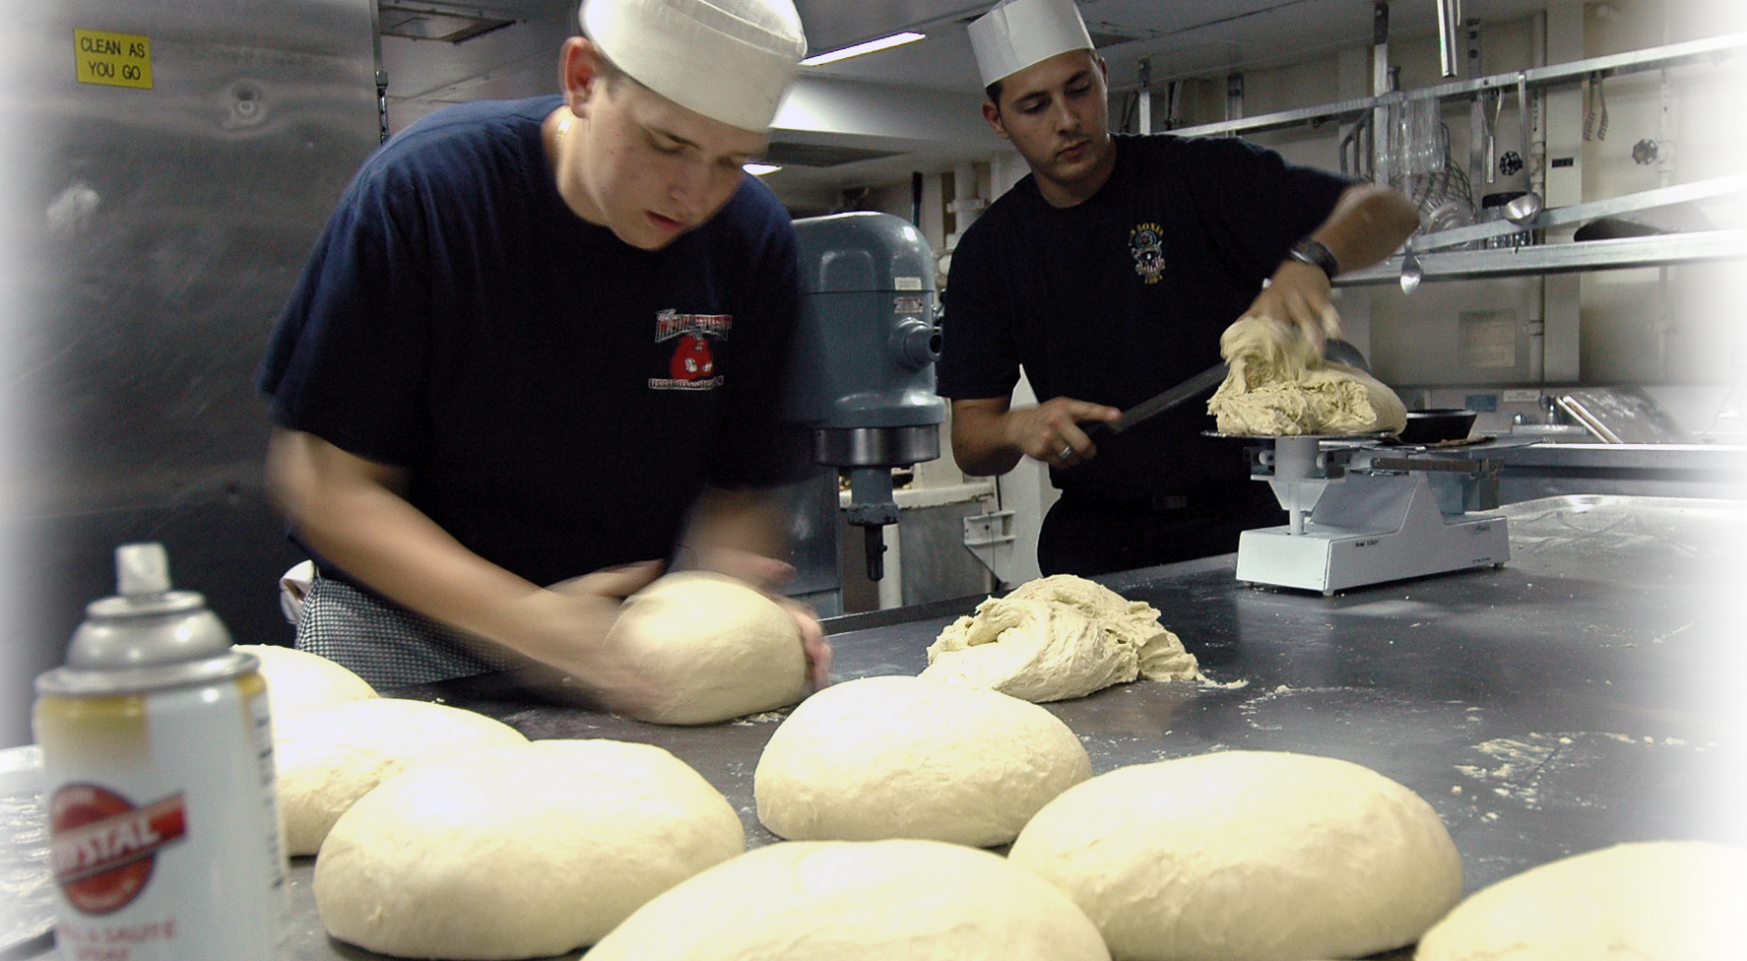
Bread - Learning
https://upload.wikimedia.org/wikipedia/commons/1/16/US_Navy_060812-N-5914D-002_Culinary_Specialist_Seaman_Douglas_Markusson,_and_Aviation_Boatswain's_Mate_Fuels_Airman_John_Faulds,_assigned_to_the_amphibious_assault_ship_USS_Boxer_(LHD_4)_ prepare_to_bake_bread_for_the_next_day's.jpg

Slide 5
Handbook Background

Slide 6

Exercise Handbook
(Work in Process)
A set of IL standards-based exercises for higher education students
Aimed for Spanish-speaking faculty from Mexico
Benefits learners, so that they can be active persons who are responsible of their own learning

Slide 7
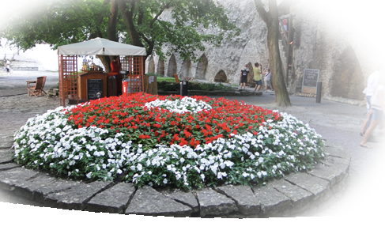
Need for the Handbook
Joint university project between CETYS University and Universidad Veracruzana, México
Universities need to suggest and provide tools, such as classroom models of IL learning and teaching that enable students to face misinformation, such Infodemic
Part of a set of IL-related handbooks, first two, cover essay writing and paper style (APA)

Slide 8

Exercise Structure
70 learning activities, so far, based on Mexican IL standards
Each IL learning activity aims to be discipline neutral, includes a few media literacy exercises.
Supports core IL skills development for searching, evaluation, use, and communication of information; using international and Spanish language information repertories

Slide 9
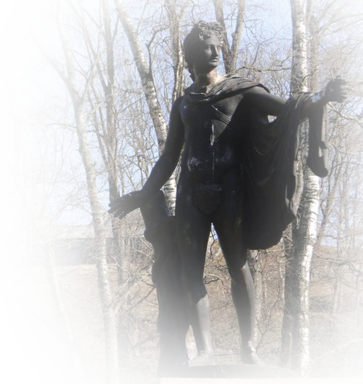
Exercise Template – A simple Approach
Part 1:
  Title
  Type of competence to develop
Part 2:
  Learning objective of the exercise
  Instructions on how to do the activity
  Example or a template for completing the task

Slide 10
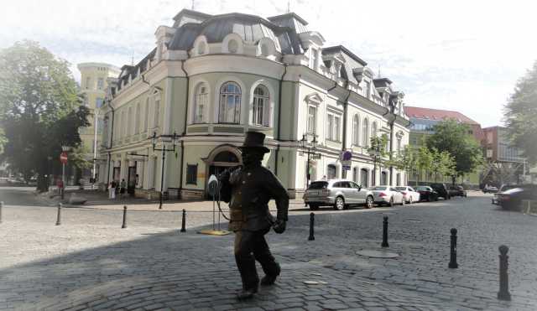
Conclusions
Faculty roles to counter Infodemic: Information use must be a the core of learning (Like a baker, students need to use the best flour)
Faculty benefits from library information literacy guidance
The handbook introduce them to create effective IL strategies in the classroom
It also helps librarians who are in the teaching frontline

Slide 11
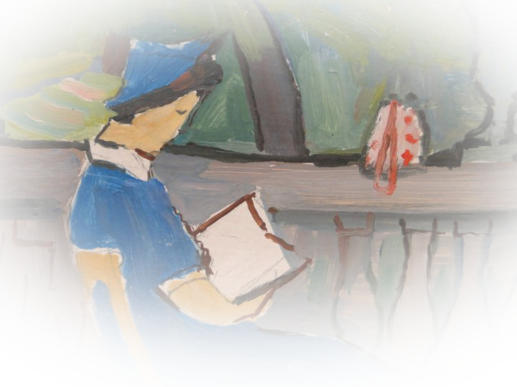
References
Lau, J and Bonilla, JL. (2020). Praxis: Facilitando infohabilidades en estudiantes universitarios - Manual para docents. Mexicali, Baja California, México: CETYS Universidad.
Alarcon Leiva, J., Hill, B. & Frites, C. (2014). Educación basada en competencias: Hacia una pedagogía sin dicotomías. Educacao & Sociedades, 35(127), 569-586. Retrieved fromhttp://www.scielo.br/pdf/es/v35n127/v35n127a13.pdf
Burkhardt, J. M. & MacDonald, M. C. (2010). Teaching information literacy: 50 standards-based exercises for college students. Chicago: American Library Association.
Detlor, B., Booker, L., Serenko, A. & Julien, H. (2012). Student perceptions of information literacy instruction: The importance of active learning. Education For Information, 29(2), 147-161.

