Slide 1
Measures of corruption

Slide 2
Corruption
Is defined as the use of public authority or resources for personal or political gain

Slide 3
Types of corruption
Petty corruption
Grand corruption
Systemic corruption

Slide 4
Petty Corruption
Petty corruption refers to distortions in implementing laws, policies and regulations. In its most common form, civil servants demand small bribes, from the public to receive a service to which they are entitled, receive a service to which they are not entitled, or simply to speed up a bureaucratic procedure.

Slide 5
Systemic corruption
Systemic corruption, which is also defined as either endemic or environmental corruption, occurs when corrupt practices are common, consuetudinary type of behavior

Slide 6
Grand Corruption
Grand corruption occurs at the higher level of government whenever elected officials change national policies to favor their own interests even at the cost of hurting the interests of the citizens
Common under dictatorial rule

Slide 7
Causes of corruption
Socio-economic underdevelopment
Ethnic fragmentation
Lack of proper institutionalization
Lack of accountability
Role of state in the market
Are all known to create a fertile soil for corruption

Slide 8
Costs of corruption
Corruption is costly
It erodes the legitimacy of the state and of the political institutions
It has a destabilizing effect on the political system
It deters foreign investments
It slows down economic growth
It is an obstacle for socioeconomic development

Slide 9
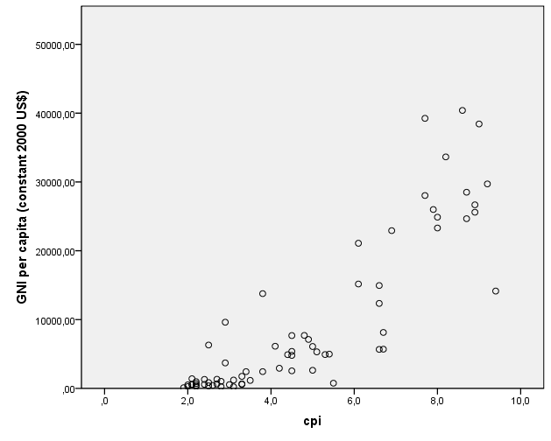
Corruption and wealth

Slide 10
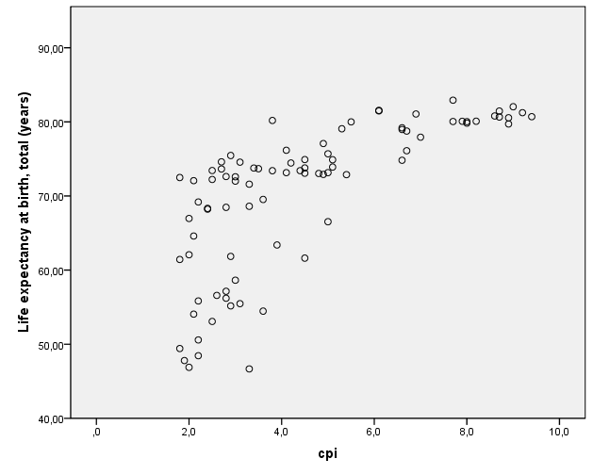
Corruption and life expectancy

Slide 11
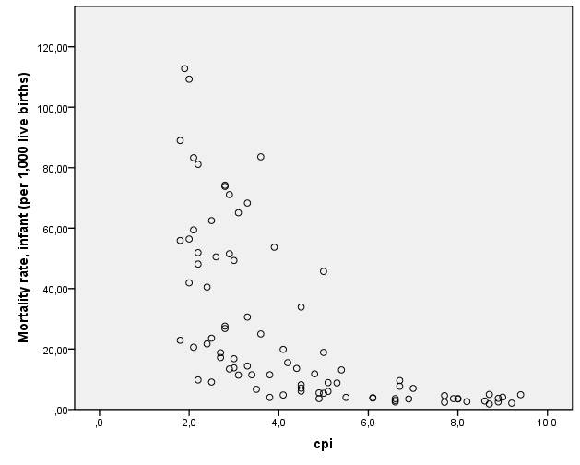
Corruption and infant mortality

Slide 12
Preliminary conclusion
No matter how you measure socio-economic development (life expectancy, infant mortality, gni per capita,…), the result is always that corruption is costly as it is an obstacle for development

Slide 13
Measures
To analyze the costs of corruption
To track governments’ success in curbing corruption it is necessary to have a measure of corruption that can be used to track corruption over time

Slide 14
Measures-2
There are 2 broad types of measures
Corruption perception measures (Global Integrity, Worldwide Governance Indicators, Transparency international, Global Competitiveness Report, BEEPS, WBES)
Objective, output-based measures of corruption (Goldman and Picci, 2005)

Slide 15
‘objective’ measures

Slide 16
Goel and Nelson (1998)
Measure corruption on the basis of the number of convictions of public officials for corrupt practices

Slide 17
Golden and Picci (2005)
This method measures corruption as the difference between the amount of public money spent for capital stock and the quantity of physical infrastructure. This method assumes that higher levels of corruption are associated with larger differences between the amount of public expenditures and existing physical infrastructure.

Slide 18
‘subjective’ measures

Slide 19
Worldwide governance indicators
Aggregates into a single measure the information from four types of sources
1) surveys of households and firms such as Gallup World Poll, Afrobarometer, and the Global Competitiveness Report;
2) Commercial Business Information Providers such as Political Risk Services, Economist Intelligence Unit,
3) NGOs such as Freedom House and Global Integrity
4) Public Sector Organizations such as the European Bank for Reconstruction and Development transition reports and the World Bank’s CPIA (Country Policy and Institutional Assessment) assessments.

Slide 20
Worldwide governance indicators-2
Specifically WGI aggregates the estimates from 32 data sources (belonging to the four mentioned types)
4 of which were Commercial Business Information Providers,
8 were Public Sector Organizations,
9 were surveys of Households and Firms
11 were NGOs

Slide 21
Worldwide governance indicators-3
WGI is expressed in a 5 point scale ranging from -2.5 to + 2.5
Negative values indicate high corruption, while positive values indicate low corruption

Slide 22
CPI
CPI is also an aggregate measure of corruption
It relies upon 12 data sources

Slide 23
CPI-2
African Development Bank Governance Ratings, Bertelsmann Foundation Sustainable Governance Indicators, Bertelsmann Foundation Transformation Index, Economist Intelligence Unit Country Risk Ratings, Freedom House Nations in Transit, Global Insight Country Risk Ratings, IMD World Competitiveness Yearbook, Political and Economic Risk Consultancy Asian Intelligence, Political Risk Services International Country Risk Guide, World Bank - Country Policy and Institutional Assessment, World Economic Forum Executive Opinion Survey (EOS) and the World Justice Project Rule of Law Index

Slide 24
CPI-3
Used to be expressed in a 10 point scale
Now expressed in a 100 point scale, where low values indicate high corruption and high values indicate low corruption

Slide 25
WBES/BEEPS
World Business Environment Survey (WBES), later replaced by the Business Environment and Enterprise Performance Survey (BEEPS), asked respondents to say whether and how much they paid in bribes.
These data were collected at the micro (firm) level, could be aggregated to generate national averages, and provided some evidence about one facet of corruption (bribery).

Slide 26
Global Competitiveness
Provides information on 4 issues/dimension related to corruption
  Ethics and corruption
  Favoritism in decisions by the government
  Diversion of public funds
  Irregular payments and bribes

Slide 27
Global competitiveness-2
Values for each country are expressed in a 1-7 scale where 7 means best

