Slide 1




KEYNOTE SPEECH
Why RDA?
Organizing bibliographic information in the 21st century
Eurasian Academic Libraries Conference – 2021
“Contemporary Trends in Information Organization in the Academic Library Environment”
June 29-30, 2021
Chris Oliver
Chair, RDA Board
Head, Metadata and Processing, University of Ottawa Library
Ottawa, Canada
christine.oliver@uottawa.ca

Slide 2
Organizing bibliographic information
Context for our work in the 21st century:
  users interact with bibliographic data in a broad, global context
  bibliographic data is managed inside and outside traditional catalogues
  no library is an island – everyone’s data is interconnected
  metadata supports linking to and aggregating with data from other communities
  metadata can be harvested, re-used, and mined

Slide 3
RDA: Resource Description and Access
RDA is a package of:
                data elements
                guidelines and instructions
→ for creating library and cultural heritage resource metadata
→ metadata that can be used in traditional catalogues
→ metadata that is ready for use in linked data applications

Slide 4
2 significant facets of RDA
RDA as a standard for the 21st century
RDA as an international standard

Slide 5

Creator: ipopba -- Credit: Getty Images/iStockphoto
RDA as a standard for the 21st century

Slide 6
A standard for the 21st century
recording data, not strings
a shared element set
suitable for wide range of technological environments
optimized for linked data environments
machine processing
data interoperability
flexibility
ready for the future

Slide 7
RDA is a package of data elements
data elements that can be understood by humans and processed by computers
  current reality = vast amounts of bibliographic data
  no longer practical to think that the management of bibliographic data will be manually curated
  reality of reliance on machine processing
  but machines need good data to produce useful results

Slide 8
RDA is a package of data elements
RDA = a set of precisely defined data elements (and controlled vocabularies)
  each data element contains only one type of data – unambiguous data
  RDA has elements for recording data about 13 entities
  RDA has over 3,000 elements

Slide 9
RDA data designed for interoperability
clearly defined element set
different types of RDA users all share the same element set
openly published controlled vocabularies to increase interoperability
definition and structure make it easier to map to non-RDA data
recognizable structure for the data elements
explicit and widely accepted structure –
based on the internationally accepted bibliographic conceptual model: IFLA Library Reference Model (IFLA LRM)

Slide 10
Designed for flexibility
Four recording methods
    options according to the technological environment in which one operates:
          unstructured description
          structured description
          identifier
          IRI – internationalized resource identifier
      “The methods are listed in order of increasing utility in general applications of RDA data, from low utility to high utility or smart data.”
        IRI → for linked data

Slide 11
One standard -- many ways to use it
an unstructured description
transcribe the name of the author from the title page
or automated data capture of information on a title page
result = a string of characters
a human can decipher and understand
a computer cannot process effectively – only good enough for keyword searching

Slide 12
One standard -- many ways to use it
IRI – internationalized resource identifier
an Internet standard
a globally unique identifier, for example, use it to record the name of a person
result = a machine-readable string
  a human cannot easily decipher and understand
  a computer can process very effectively in a linked data application
  a computer can retrieve a large amount of information using the IRI and may also link to other information connected to that IRI
  expands the potential for exploration

Slide 13
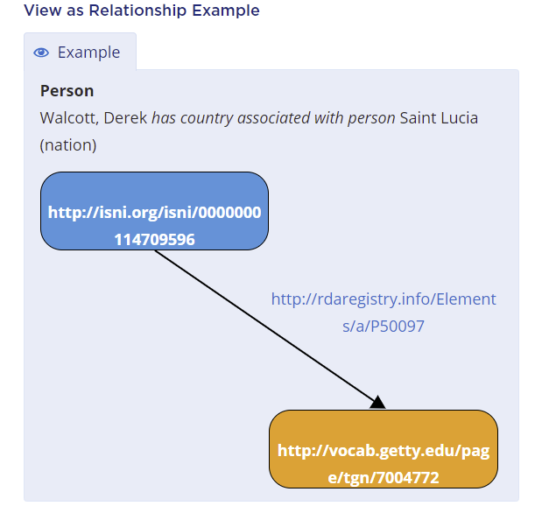
Metadata statement using IRIs
subject, object and predicate all recorded using IRIs
Screen image from the RDA Toolkit (www.rdatoolkit.org) used by permission of the Copyright Holders for RDA (American Library Association, Canadian Federation of Library Associations, and CILIP: Chartered Institute of Library and Information Professionals).

Slide 14
Metadata standard for the 21st century
  ready for the future
  flexible
  data that can be used effectively for automated processing
  promotes data interoperability
create metadata that can be used in traditional catalogues and also for the web and linked data environments
precise and unambiguous data in well-defined data elements with an articulated structure

Slide 15

Flags globe at shutterstock (vector) ID: 111655109 by Alhovik
RDA as an international standard

Slide 16
An international standard
aligned with international standards
accommodating different local traditions
translations are an integral part of the standard
in use in countries around the globe
sound theoretical framework
responsive to local needs
different language versions for use in communities around the globe
governance to reflect international participation

Slide 17
RDA aligned with international standards
RDA is aligned with:
IFLA’s International Cataloguing Principles
IFLA’s bibliographic conceptual model: IFLA LRM
also includes a statement of relationship to other international standards
for example, metadata that can be stored in different encoding schemes, such as MARC 21 and RDF

Slide 18
RDA: implementation of IFLA LRM
IFLA LRM = IFLA Library Reference Model
the bibliographic conceptual model that consolidates and supersedes the three previous IFLA models:
FRBR Functional Requirements for Bibliographic Records
FRAD Functional Requirements for Authority Data
FRSAD Functional Requirements for Subject Authority Data

Slide 19
Alignment with IFLA LRM
RDA based on an internationally accepted understanding of the structure of bibliographic data
IFLA LRM provides:
  the basic structure and organization for the content of RDA
  a recognized theoretical framework that was developed through international cooperation and consensus
  built-in focus on the needs of the end-user through the user tasks

Slide 20
Not “one size fits all”
  RDA is designed so that metadata can be created to meet the interests of local communities within a global framework for interoperability.
  – Gordon Dunsire, Accommodating local cataloguing traditions in a global context, 2018
  basis for data interoperability → the shared element set
  → data shares the same structure from IFLA LRM
  focus on the common ground we share

Slide 21
Internationalization – a design objective
data harmonization
“RDA is designed for an international audience with the expectation that cataloguing agents will make application decisions when desirable”
…
“Given the flexibility of the guidance and recording methods, the metadata provided by different agents will not necessarily be identical, but as well-formed data it will be understood by any agent when shared. The emphasis is on data harmonization rather than strict compatibility.”
RDA > Introduction to RDA > Objectives and principles governing RDA

Slide 22
Accommodation of variations
IFLA LRM provides the basic structure for bibliographic data
→ RDA provides:
option to use any of a large number of precise data elements
choices on how to record the data
options for which instructions to use
options for sources of controlled vocabularies
options on how to punctuate and order elements
→ a cataloguing community makes the choices that suit their needs

Slide 23
Cataloguing community’s choice
For example, when using controlled vocabulary (vocabulary encoding scheme) to record data:
  Structured description
  Instruction to use one of the RDA vocabulary encoding schemes
  Followed by instruction to use another suitable vocabulary encoding scheme
  Examples in RDA also show use of RDA vocabularies and external vocabularies

Slide 24
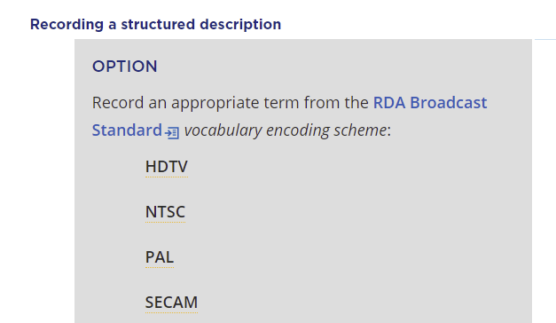
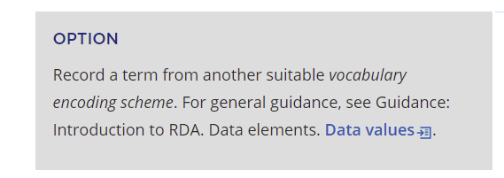
Instructions for broadcast standard
Screen image from the RDA Toolkit (www.rdatoolkit.org) used by permission of the Copyright Holders for RDA (American Library Association, Canadian Federation of Library Associations, and CILIP: Chartered Institute of Library and Information Professionals).

Slide 25
Cataloguing community’s decisions
Places within RDA Toolkit for a community to record and share its decisions:
policy statements
application profiles and other documents (shared or not)
community resources

Slide 26
A multilingual standard
RDA an international standard
8 – full translations integrated into the original RDA Toolkit
14 – language versions integrated in the RDA Registry
(partial translations = names of elements and controlled vocabularies)
a standard that places equal value on all its language versions
    English is treated as one of the language versions
    English is the version used as starting point for translations, but deliberately called a “version”

Slide 27
A multilingual standard
  seamless integration of all language versions in the one RDA Toolkit and RDA Registry
  visibility of all the different language communities using RDA
  all using the same element set and vocabularies

Slide 28
RDA, a global metadata standard
  designed to be easy to use by metadata creators around the globe
  a standard to be maintained and developed jointly with representatives from all regions of the globe
  RDA governance internationalizes decision-making and management

Slide 29
RDA, a framework for interoperability
cataloguing communities around the globe operate in different contexts
  different technological environments
  conventions and practices differ
  different needs in linguistic, national, and cultural cataloguing communities
our common interest
-- providing metadata that fulfills the needs of our end-users
-- data that can be processed accurately by computers
-- compatibility of bibliographic data across communities

Slide 30





THANK YOU FOR LISTENING!
Eurasian Academic Libraries Conference – 2021
“Contemporary Trends in Information Organization in the Academic Library Environment”
June 29-30, 2021
Chris Oliver
Chair, RDA Board
Head, Metadata and Processing, University of Ottawa Library
Ottawa, Canada
christine.oliver@uottawa.ca

