Slide 1
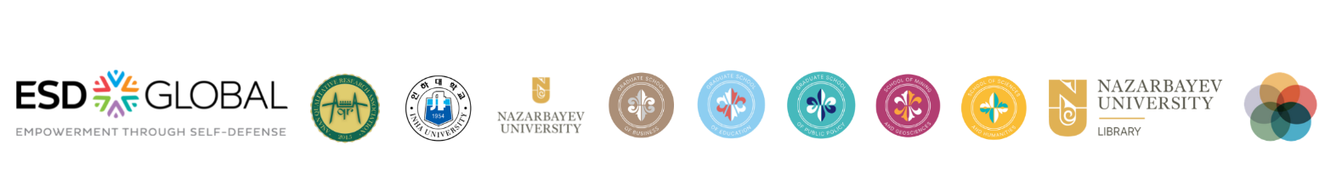


2nd Annual
Opportunities and Challenges for Gender Equity in Central Asia: Bridging Researchers, Policy Makers, and Practitioners
#genderforumNU2022

Slide 2

2nd Annual GenCon
#genderforumNU2022
Literature on corruption in Kazakhstan and Central Asia
Danagul Nurmukhamed

Slide 3






2nd Annual GenCon
#genderforumNU2022
According to Transparency International (2021), the Corruptions Perception Index (CPI) of all Central Asian countries was the lowest one among 180 countries.
Introduction

Slide 4
2nd Annual GenCon
#genderforumNU2022
Suleimenova et al. (2018)
face-to-face interviews with 500 representatives of small and medium-sized enterprises and 500 civil servants
there are clear corruption issues in Kazakhstan
“but they are not ready to talk about their own experience in this regard”
Literature review

Slide 5
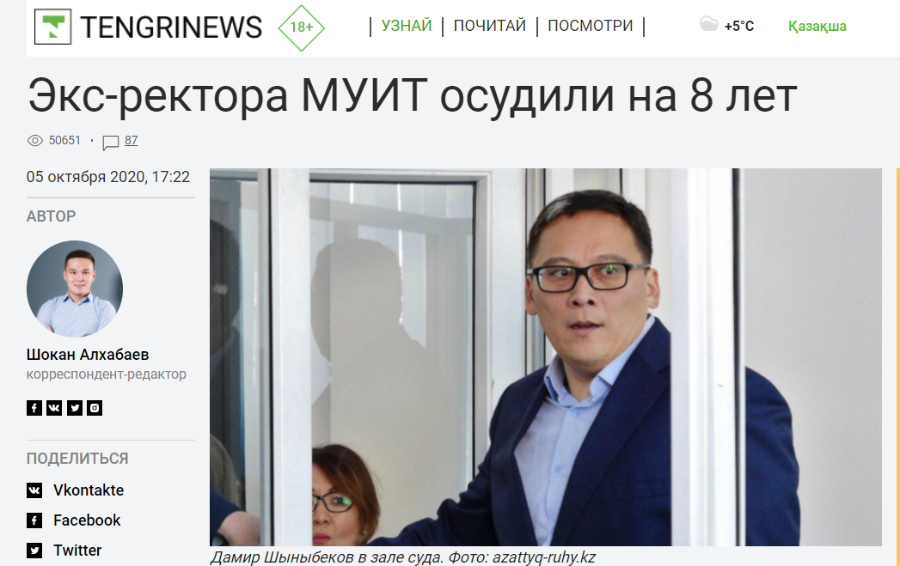
2nd Annual GenCon
#genderforumNU2022
Nurkey et al. (2021)
ICT in Kazakhstani anti-corruption reforms can benefit society
less human involvement in government activities can decrease cases of corruption
case study of the International University of Information Technologies in Kazakhstan
Literature review

Slide 6

2nd Annual GenCon
#genderforumNU2022
Sheryazdanova and Butterfield (2017)
focused on online forums, news, and third-party reports
e-government somehow reduces petty corruption
platform should “be part of a larger package of anti-corruption measures”
Literature review

Slide 7
2nd Annual GenCon
#genderforumNU2022
Nezhina (2014)
focuses on the evolutionist approach, the functionalist approach, and the ethnocentric approach (Van Roy 1970) to show causes of corruption NOT consequences:
  - transition from socialist to capitalist ideology and economy (evolutionist approach)
  - desire to quickly achieve wealth as the economic end (functionalist approach)
  - persistent tradition of clan and family obligations (ethnocentric approach)
Cultural variables should be used rather than only economic perspectives
The experience of Kazakhstan can be extrapolated to other countries in transition.
Literature review

Slide 8
2nd Annual GenCon
#genderforumNU2022
Urinboyev and Svensson (2013)
interviewing guests (participant observation, informal interviews and semi-structured interviews) of the wedding ceremonies in Uzbekistan’s Fergana region
The main findings:
(a) informal transactions should be considered as a part of cultural practices;
(b) thus, we shouldn’t consider all transactions as corrupt ones;
(c) social aspects of local cultures shouldn’t be ignored in corruption analysis.
Literature review

Slide 9
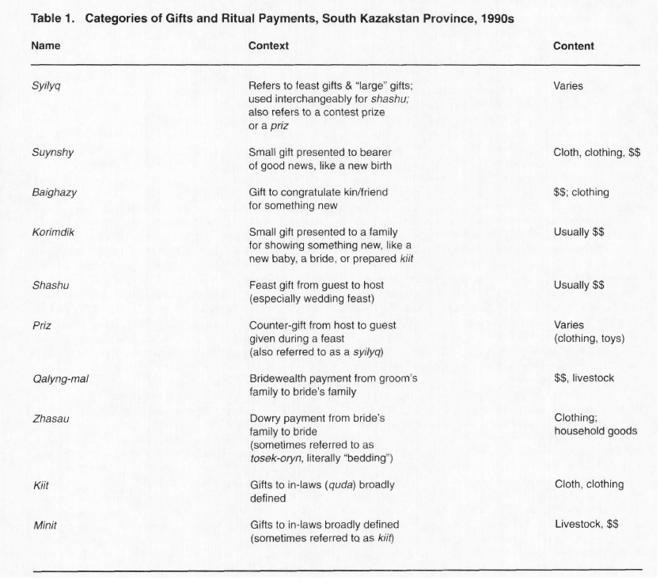
2nd Annual GenCon
#genderforumNU2022
Werner (2000)
Literature review

Slide 10
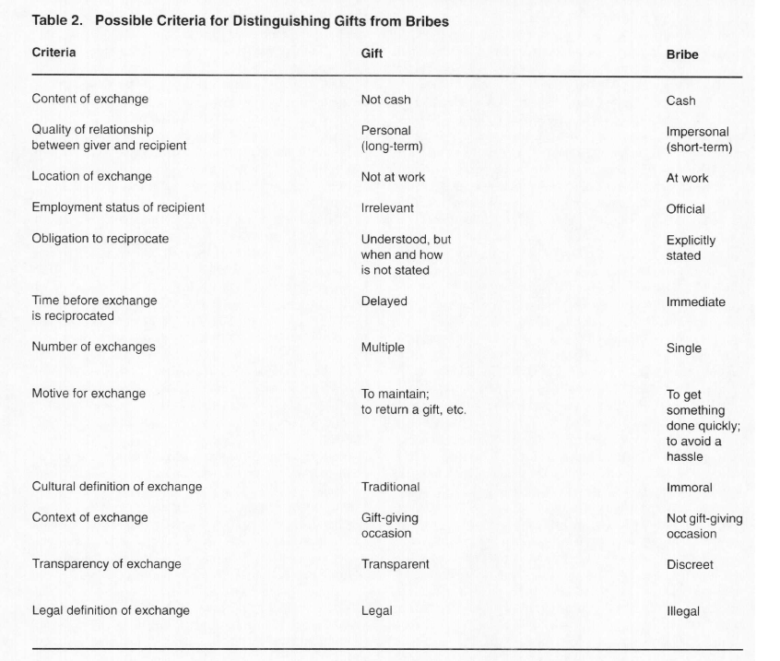
2nd Annual GenCon
#genderforumNU2022
Werner (2000)
Literature review

Slide 11
2nd Annual GenCon
#genderforumNU2022
Corcoran-Nantes (2017)
gift-giving during various life cycle events is an opportunity to “access certain goods and services”
in most of the life cycle events such as weddings, birthdays and promotions the main actors are women who organize these events
Literature review

Slide 12
2nd Annual GenCon
#genderforumNU2022
Reference list
Corcoran-Nantes, Y. (2017). Engendering Corruption: Gender and the Culture of Exchange in Central Asia. Geo. J. Int'l Aff., 18, 18.
Nezhina, T. (2014). Examining the causes of systemic corruption: The Case of Kazakhstan. Higher School of Economics Research Paper No. WP BRP, 23.
Nurkey, A., Kosherbayeva, A., Yedilkhan, D., & Kuandykov, N. (2021). Corruption prevention based on the principal-agent approach and game theory using ICT: the Case study of KazaKhstan.
Sheryazdanova, G., & Butterfield, J. (2017). E-government as an anti-corruption strategy in Kazakhstan. Journal of Information Technology & Politics, 14(1), 83-94.
Suleimenova, G., Sadvokassova, A., Rakisheva, B., & Nurmaganbetov, A. (2018). Smes development and corruption: case of Kazakhstan. Business: Theory and Practice, 19, 1-8.
Transparency International. 2021. Corruption Perception Index. Retrieved February 20, 2022, from https://www.transparency.org/en/cpi/2021/index/civ
Urinboyev, R., & Svensson, M. (2016). Corruption in a culture of money: Understanding social norms in post-Soviet Uzbekistan. In Social and legal norms (pp. 267-284). Routledge.
Werner, C. (2000). Gifts, bribes, and development in post-Soviet Kazakstan. Human Organization, 59(1), 11-22.

