Slide 1
Master Thesis
Triaxial Test Behavior of Cemented-treated Sand with High Confining Pressure
James Innocent Ocheme
2nd year Master’s Student
Supervisor: Jong Ryeol Kim, Professor
Co - Supervisor: Sung-Woo Moon, Assistant Professor
26/4/2023

Slide 2
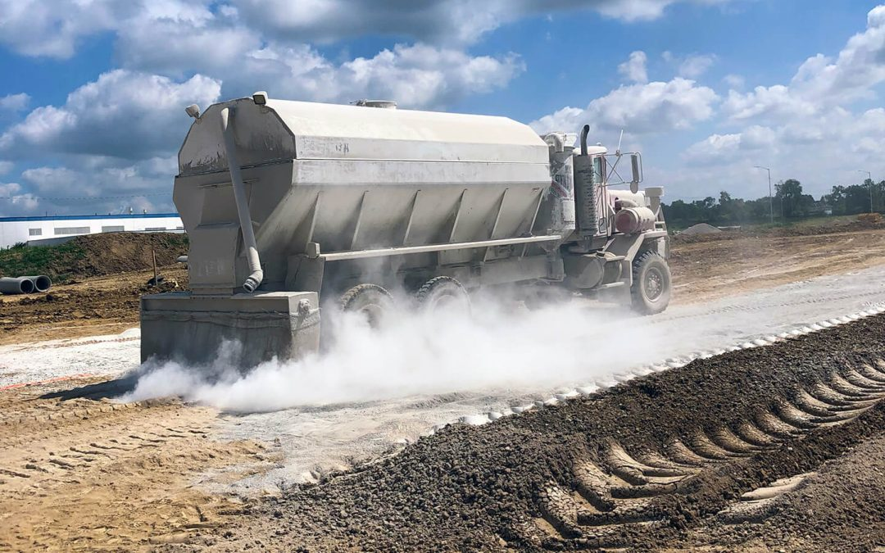
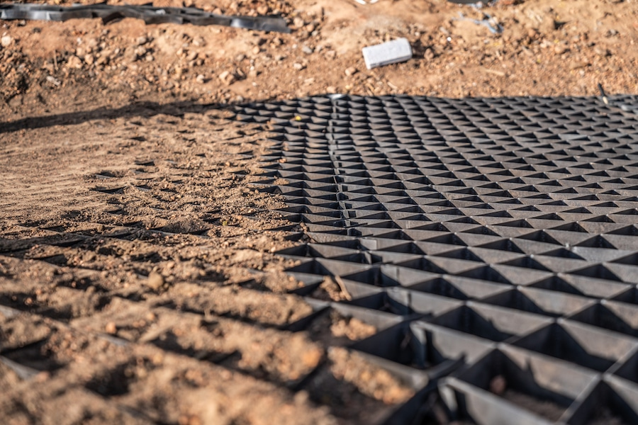
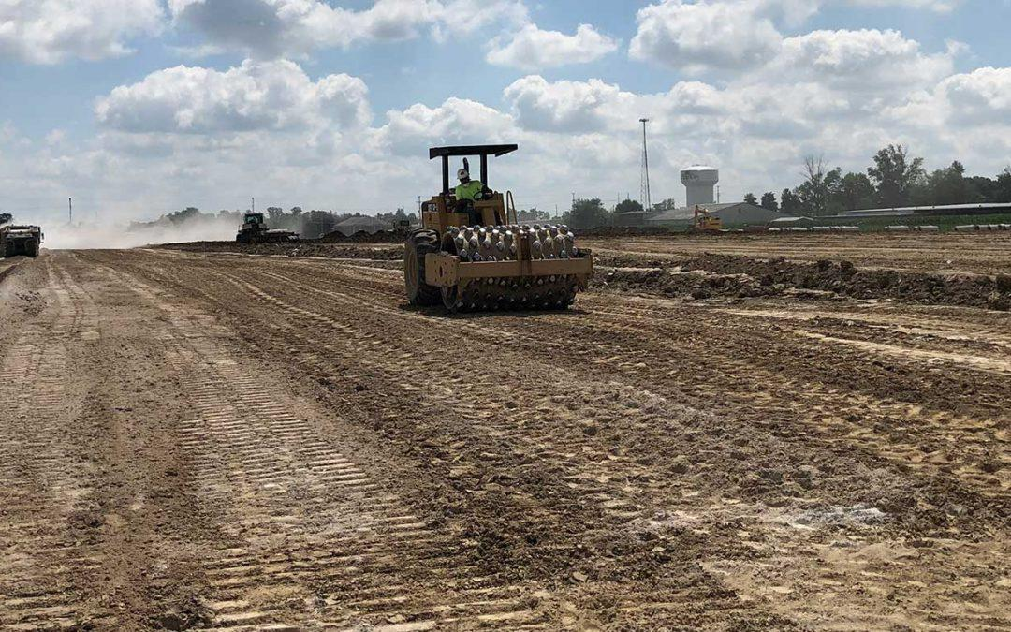
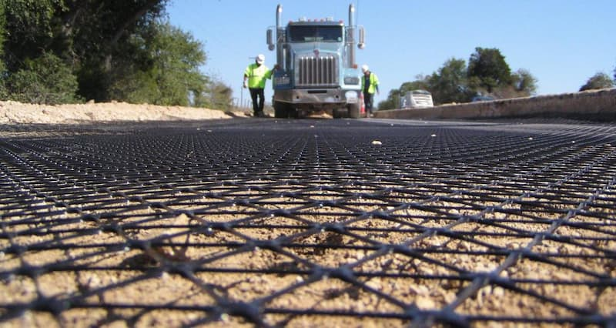
OUTLINE
Introduction
Literature Review
Research Aim and Objectives
Problem Statement
Experimental Work
Results and Discussion
Conclusions
References

Slide 3
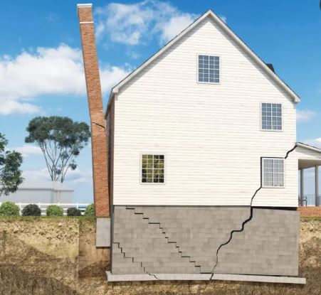
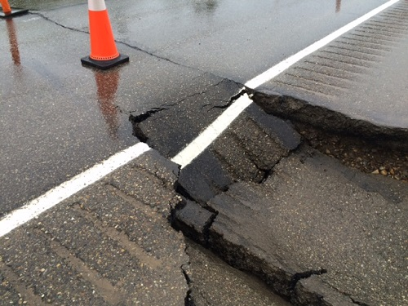
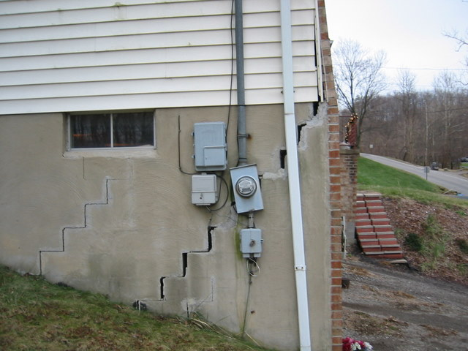
INTRODUCTION
Failure in foundation in either building or pavement structures can be attributed mostly to expanding soil cycle, weak soil, soil settlement and consolidation, poorly compacted soil among others.
The effect of building on weak and problematic soil
Figure 1: Foundation failure in built structure

Slide 4
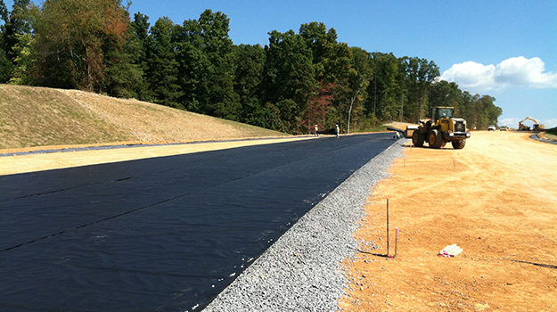
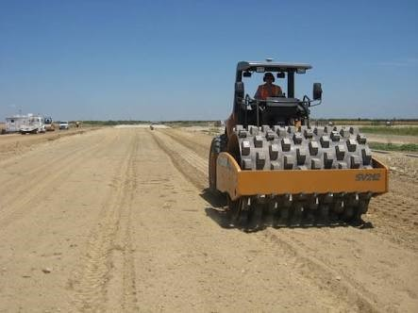
Soil Stabilization / Soil Improvement Method
INTRODUCTION
The mechanical properties of soils can significantly improved with the addition of cementitious materials such as cement, lime, fly ash and bitumen (Chang et al., 2016, Subramanian et al., 2018).
Other forms of Soil stabilization includes;
Mechanical Soil Stabilization - Compaction of the soil
Geo-textile and Fabrics
Figure 2: Types of soil stabilization

Slide 5
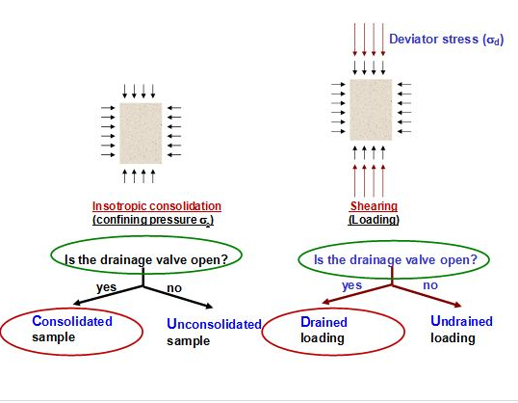
INTRODUCTION
Triaxial Test : Consolidated Drained (CD)
Why do we conduct a triaxial test?
A triaxial test is conducted to determine the shear strength and stiffness of a cylindrical core soil or rock sample which is used in geotechnical design.
The benefit of the triaxial test over other methods for determining the shear strength of a specific test sample is the ability to control specimen drainage and measure pore pressure. The test also allows for the determination of cohesion (c'), internal angle of friction ('), and shear strength.
Where Shear Strength τ=c+σ’tanφ
Figure 3: Triaxial Test

Slide 6
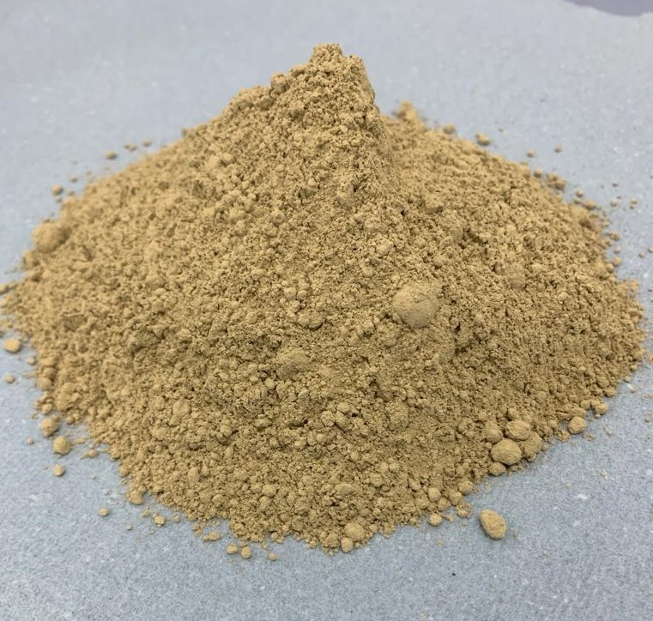

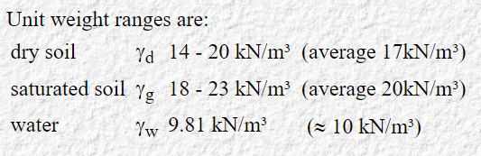
LITERATURE REVIEW
Benefits of CSA cement over OPC
Reduced CO2 emission
Low shrinkage
High-speed bonding
Rapid strength development Test
Calcium sulfoaluminate cement (CSA), is a more environmental friendly binder compare to Ordinary Portland cement (OPC) (Jumassultan et al., 2021; Moon et al., 2020).
Figure 4: CSA cement
Stress in the ground
Total stress increases with depth and with unit weight: Vertical total stress at depth z,

Slide 7
AIM AND OBJECTIVES
This research aims to investigate the shear strength and mechanical behavior of cement-treated sand under high confining pressure using an Environmental Triaxial Automated System.
To achieve the aim of the research, below are the objectives of the study;
• To conduct a consolidated drained (CD) triaxial test on a CSA cement-treated sand with high confining pressure.
• To examine the microstructure of the sheared CSA cement-treated sand samples from the triaxial using scanning electron microscopy.
Scope: Performing consolidated drained (CD) triaxial tests on a Cemented-treated sand with high confining pressure using the Environmental Triaxial Automated System

Slide 8

PROBLEM STATEMENT
With the increasing rate of foundation failures in construction projects due to problematic and weak soil, there is a need to enhance soil engineering properties for construction activities.
Furthermore, with the increasing rate of carbon emissions into the environment, it is crucial to develop an alternative eco-friendly binder for construction activities and soil stabilization. Hence, reducing the risk of global warming and its ramifications resulting from the current CO2 levels in the atmosphere.

Slide 9
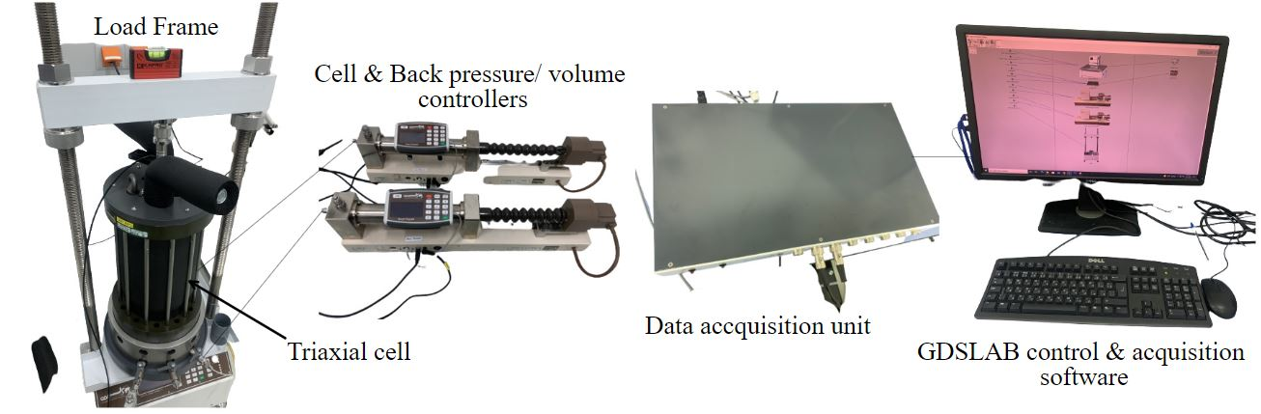
EXPERIMENTAL WORK
Materials:
Quartz sand
CSA Cement
Gypsum
Equipments:
GDS Triaxial Automated System
DPVC (Digital Pressure and Volume Control for Cell Pressure and Back Pressure)
Figure 5: The Environmental Triaxial Automated System (ETAS) components.

Slide 10
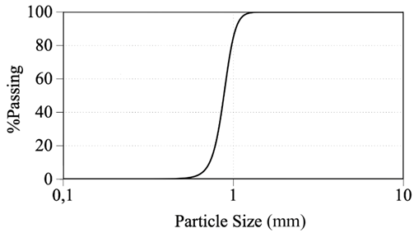
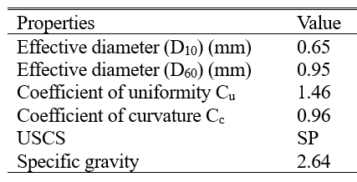
EXPERIMENTAL WORK
Table 1. Quartz Sand Physical Properties
Figure 6: The quartz sand particle distribution curve (ASTM D6913-04)
Gradation is used to classify soils for engineering purposes since particle size influences how fast or slow water or other fluid moves through the soil.

Slide 11
Sample Preparation
EXPERIMENTAL WORK
Table 2. Standard Proctor Test results.
The sample were prepared by mixing the dry quartz sand, and 3%, 5%, 7% of CSA cement by weight of dry sand.
Water was added to the mixture in accordance with the OMC.
The sample were the compacted in into a 38mm x 76mm mould in 3 layers with 25 blows for each layer using a hand rammer.
The samples were then cured for 7 and 14 days before testing.
Cement content | Optimum moisture content (%) | Maximum dry density (kN/m3)
0% | 19.00 | 1.56
3% | 17.25 | 1.59
5% | 16.75 | 1.61
7% | 15.75 | 1.65
ASTM/D698, 2012

Slide 12
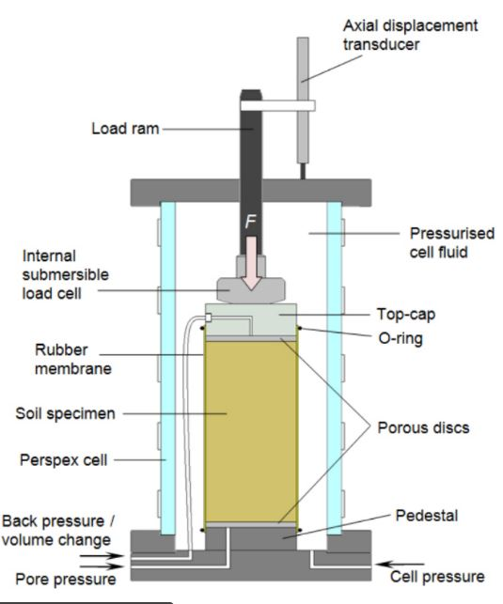
EXPERIMENTAL WORK
Triaxial Test - Specimen preparation and testing procedures ASTM D7181 − 11
Saturation Stage:
The aim of this stage is to fill all voids in the specimen with water without prestressing of the specimen in other to measure the pore pressure.
Consolidation Stage:
The specimen is consolidated to a stress condition representative of its in-situ condition.
Shearing Stage:
This is done to evaluate the failure behavior of the specimen.
Figure 8: Sandcrete Block Walls model
Figure 7: General set-up of a soil specimen inside a triaxial cell.

Slide 13
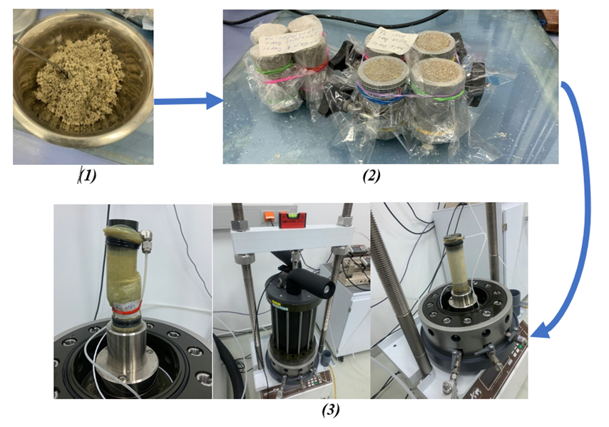
Test Description
EXPERIMENTAL WORK
Figure 8: (1) Sample Preparation (2) Curing of Test Samples (3) Triaxial Test using the ETAS

Slide 14
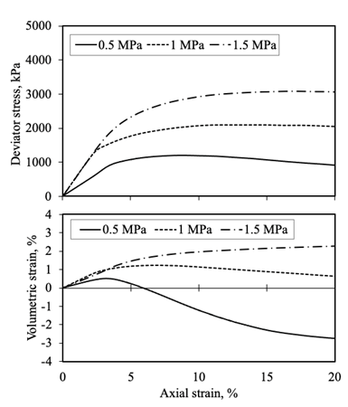
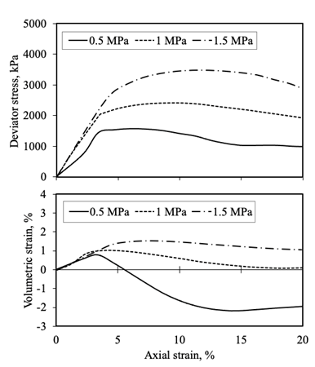
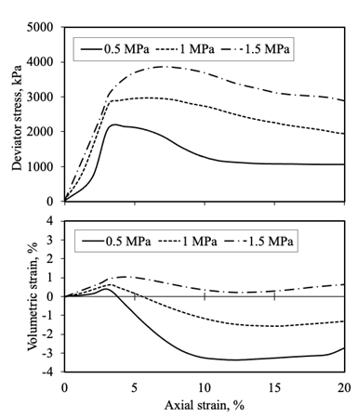
Stress-strain behavior
RESULTS & DISCUSSIONS
a
b
c
Figure 9: Stress-strain and volumetric change behavior of treated sand with CSA: (a) 3% CSA; (b) 5% CSA; (c) 7% CSA; for 7 days of curing

Slide 15

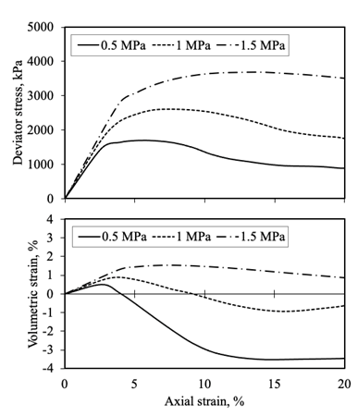
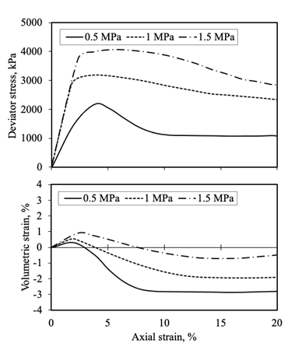
CD Triaxial test - 14 days curing
RESULTS & DISCUSSIONS
a
b
c
Figure 10: Stress-strain and volumetric change behavior of treated sand with CSA: (a) 3% CSA; (b) 5% CSA; (c) 7% CSA; for 14 days of curing

Slide 16
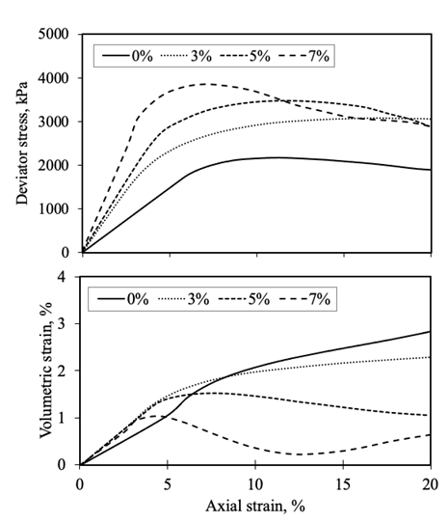
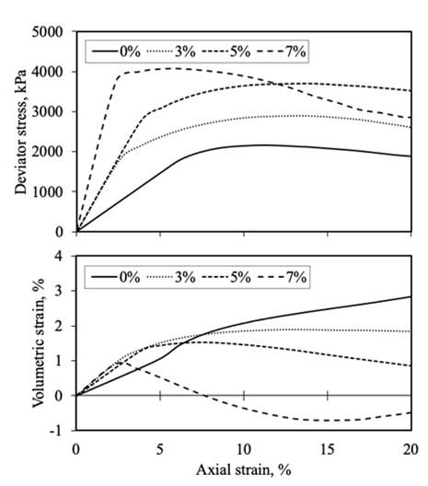
CD Triaxial test - Effect of high confining pressure
RESULTS & DISCUSSIONS
a – 7 days curing
b – 14 days curing
a
b
Figure 11: Stress-strain and volumetric change behavior of treated sand with CSA: for σ3' = 1.5 MPa (a) 7 days curing (b) 14 days curing

Slide 17
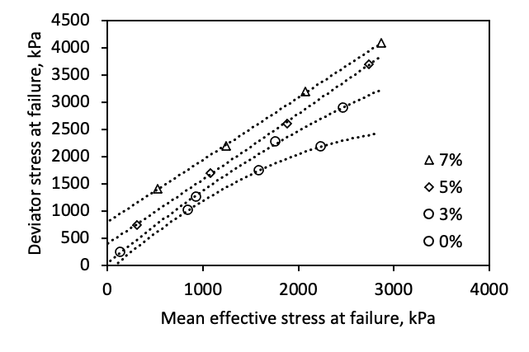
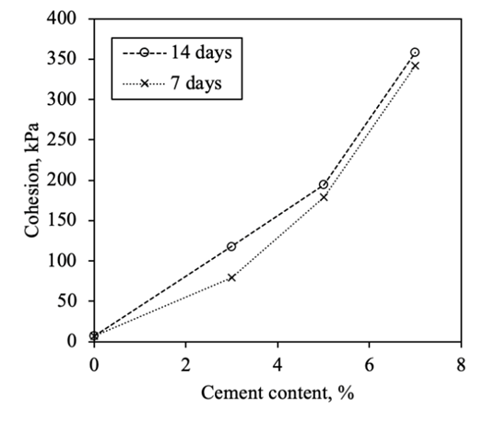
Failure characteristics
RESULTS & DISCUSSIONS
Figure 12: Failure envelopes of CSA-treated and untreated samples
Figure 13: Influence of CSA cement content on cohesion intercept

Slide 18
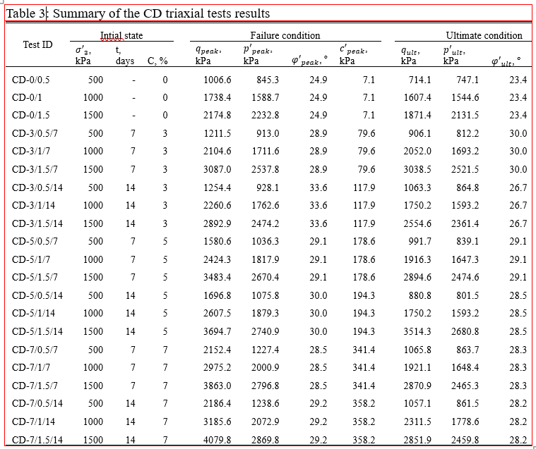
RESULTS & DISCUSSIONS
Table 3: Summary of the CD triaxial tests results
The Triaxial test results shows similar trend with the research conducted by (e.g Marri et al., 2012, Schnaid et al., 2001).

Slide 19
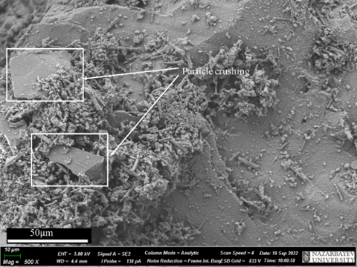
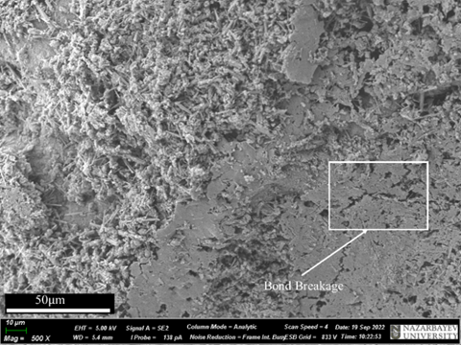
RESULTS & DISCUSSIONS
Scanning Electron Microscopy (SEM) - Effect of Cement Content
Figure 14: SEM photographs of cemented sand samples after shearing at 1 MPa confining Pressure (a) 3% (b) 7%

Slide 20
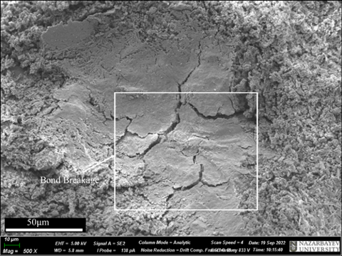
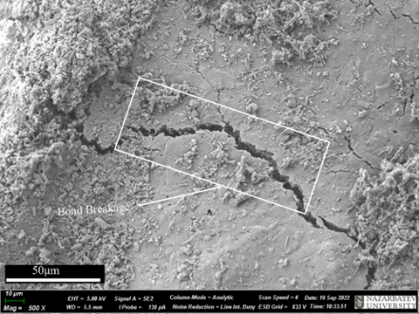
RESULTS & DISCUSSIONS
Scanning Electron Microscopy (SEM) - Effect of Confining Pressure
Figure 15: SEM photographs of cemented sand samples (7%) after shearing at high pressures (a) 0.5 MPa (b) 1.5 MPa.
The SEM results is in conformity with the research done by (e.g Marri et al., 2012, Schnaid et al., 2001).

Slide 21
CONCLUSION
This research was conducted to examine the shear strength and mechanical behavior of CSA-treated quartz sand samples by performing consolidated drained triaxial tests with high confining pressures.
The following conclusions were drawn from the experimental results:
The CSA cement content and confining pressure significantly influence the stress-strain and volumetric behavior of the CSA-treated sand samples. As the CSA cement content increases, the initial stiffness and peak deviatoric stress increases, which increases dilation during shearing. However, with an increase in confining pressure, there is an increase in the peak deviator stress and amount of compression during shearing.
The degree of cementation and the confining pressure also influences the stress-dilatancy of samples. There was increased cohesion and bonding between sand particles when CSA cement increases. Consequently, the maximal deviatoric stress increases as the CSA cement content and confining pressure increases.

Slide 22
CONCLUSION
With an increase in the CSA cement content, the failure envelopes move to higher stress, indicating that the cohesion intercept of the sand will increase. Also, with an increase in confining pressure, the slope of the failure envelopes reduces, meaning that confining pressure influences the curvature of the failure envelopes.
The SEM analysis revealed that the degree of cementation and confining also affected the sand particles' crushing level and the cement bond's rupture during shearing.

Slide 23
REFERENCE
Chang, I., Im, J., & Cho, G.-C. (2016). Geotechnical engineering behaviors of gellan gum biopolymer treated sand. Canadian Geotechnical Journal, 53(10), 1658-
1670.
Clough, G. W., Sitar, N., Bachus, R. C., & Rad, N. S. (1981). Cemented sands under static loading. Journal of the Geotechnical Engineering Division, 107(6), 799-817.
Jumassultan, A., Sagidullina, N., Kim, J., Ku, T., & Moon, S.-W. (2021). Performance of cement-stabilized sand subjected to freeze-thaw cycles. Geomechanics and
Engineering, 25(1), 41-48.
Marri, A., Wanatowski, D., & Yu, H. (2012). Drained behaviour of cemented sand in high pressure triaxial compression tests, Geomechanics and Geoengineering, vol. 7, no. 3, pp. 159-174, doi: 10.1080/17486025.2012.663938
Moon, S. W., Vinoth, G., Subramanian, S., Kim, J., & Ku, T. (2019). Effect of fine particles on strength and stiffness of cement treated sand. Granular Matter, 22(1). https://doi.org/10.1007/s10035-019-0975-6

Slide 24
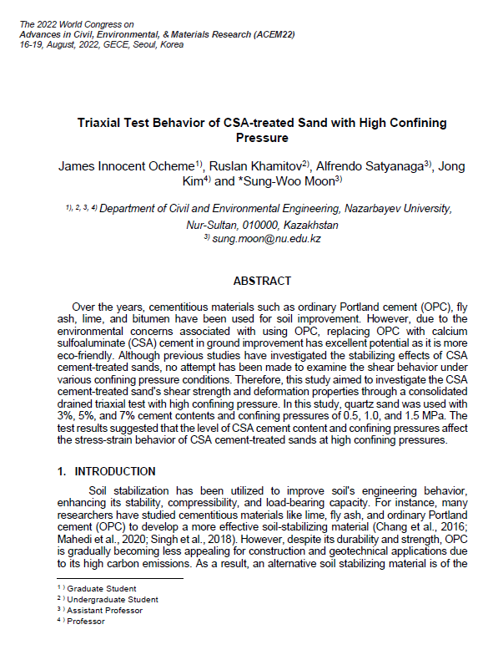
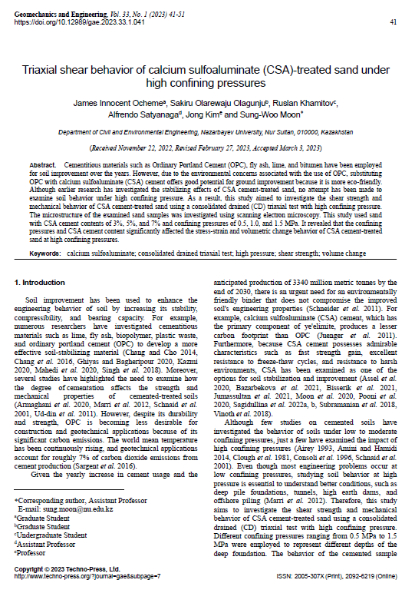
Thank you for your attention!
Q & A

