Slide 1
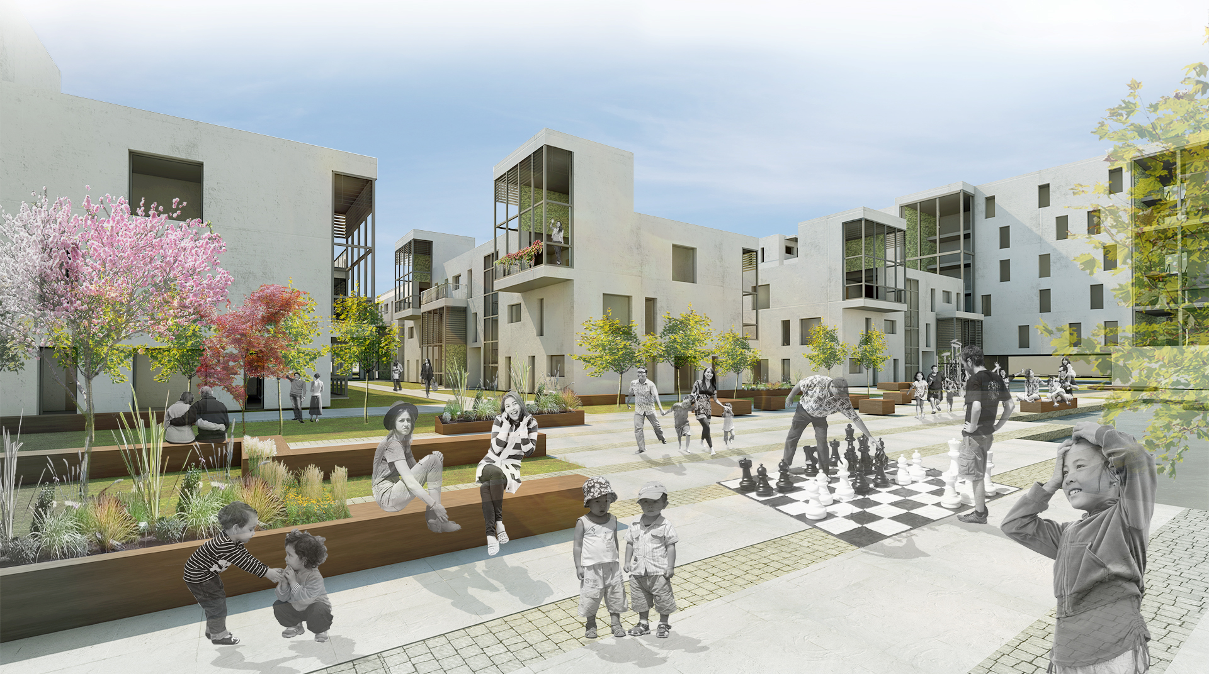

GREEN GARDENS OF ASTANA
ISOVER MULTI-COMFORT HOUSE STUDENT CONTEST 2015
RESIDENTIAL FUNCTION IN COLD CLIMATE - ASTANA, KAZAKHSTAN
Estonia, Tallinn University of technology
Team: LIISI SOOMANN, KATERINA VEERDE
National stage prize: i prize

Slide 2
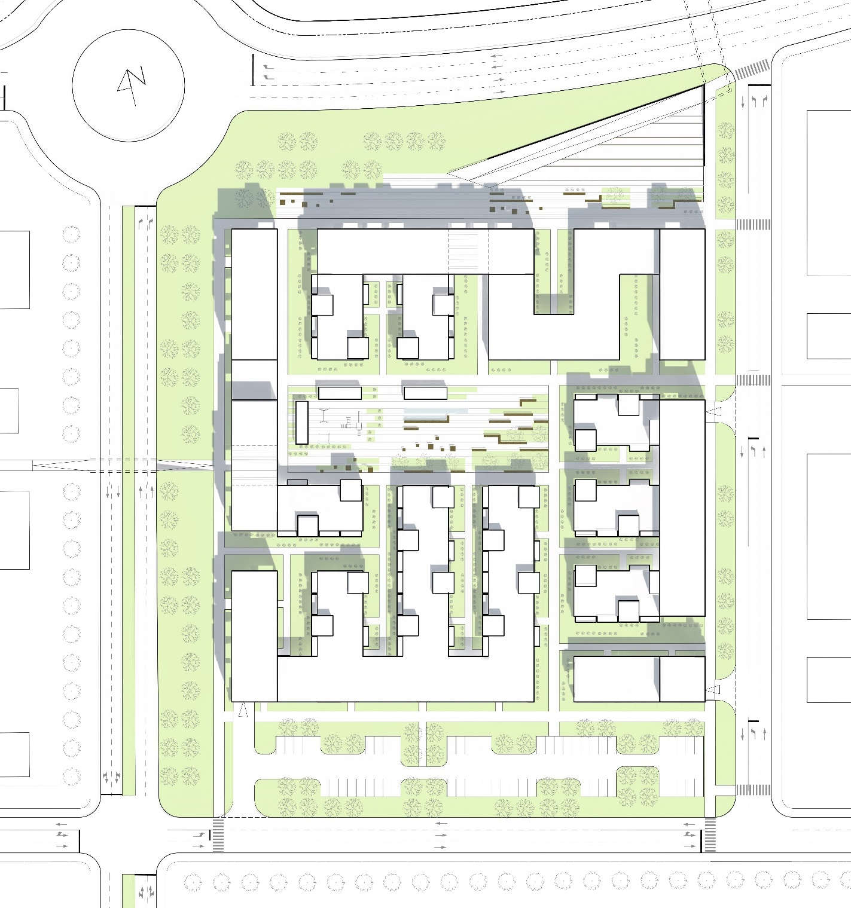
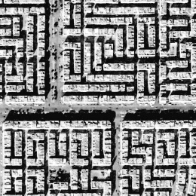
MASTERPLAN
URBAN PATTERN

Slide 3

MASTERPLAN
NUMBER OF FLOORS

Slide 4

MASTERPLAN
GROUND FLOOR ZONING

Slide 5
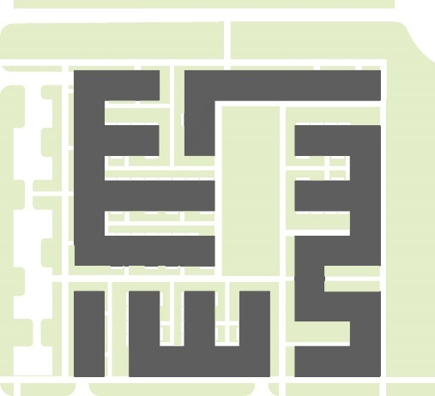
MASTERPLAN
GREEN ZONES OUTSIDE

Slide 6
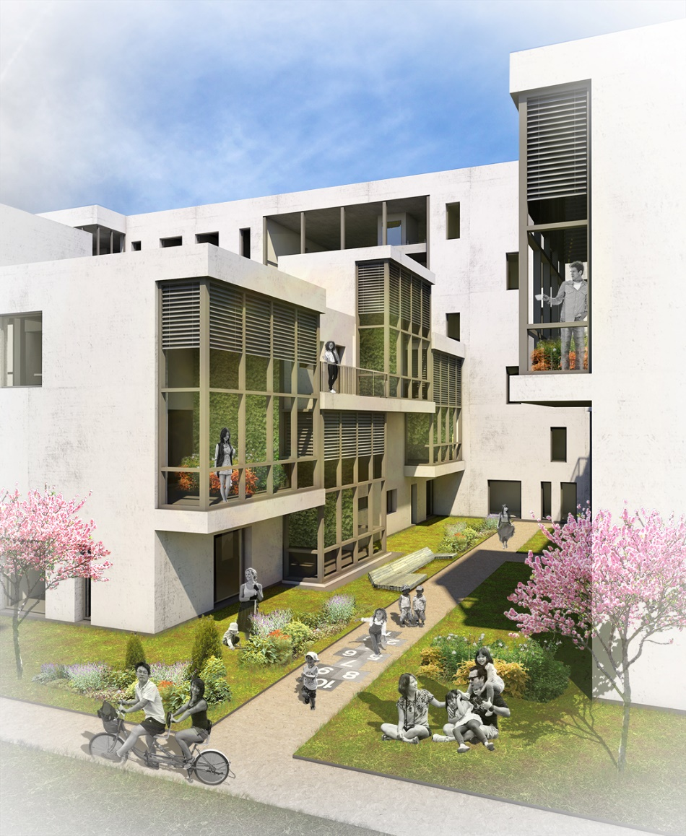
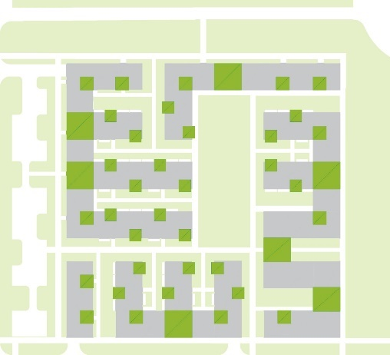
MASTERPLAN
GREEN ZONES INSIDE

Slide 7
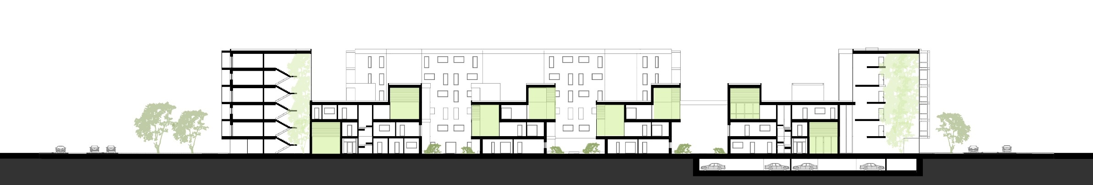
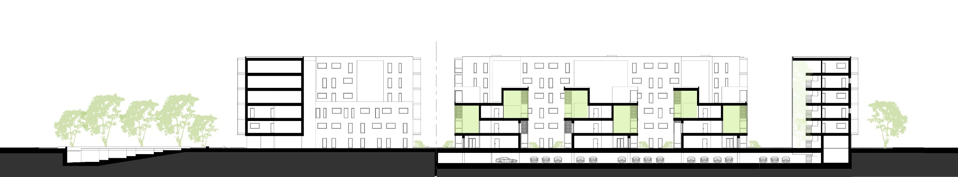
URBAN SECTIONS

Slide 8
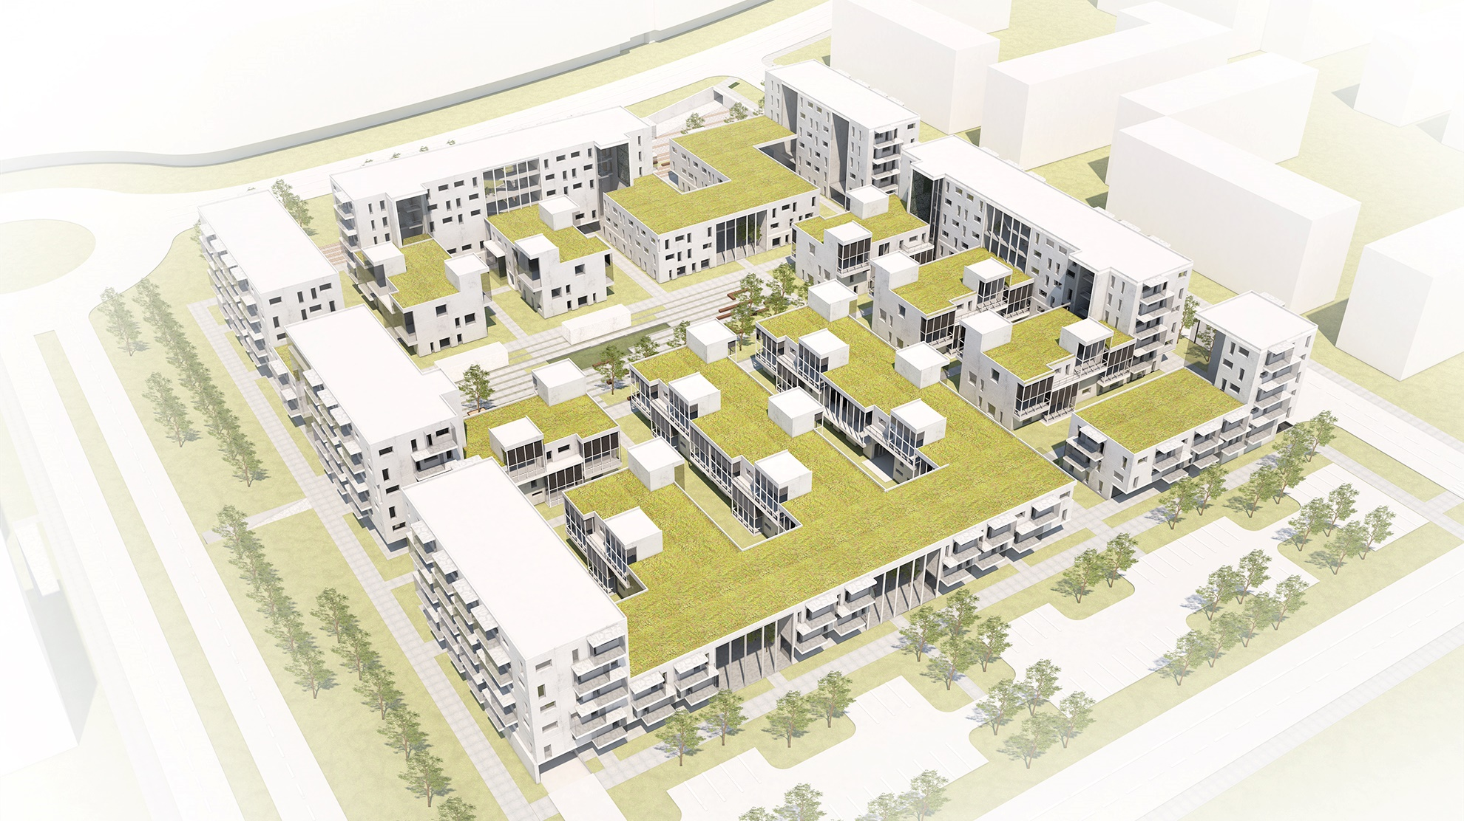

Slide 9
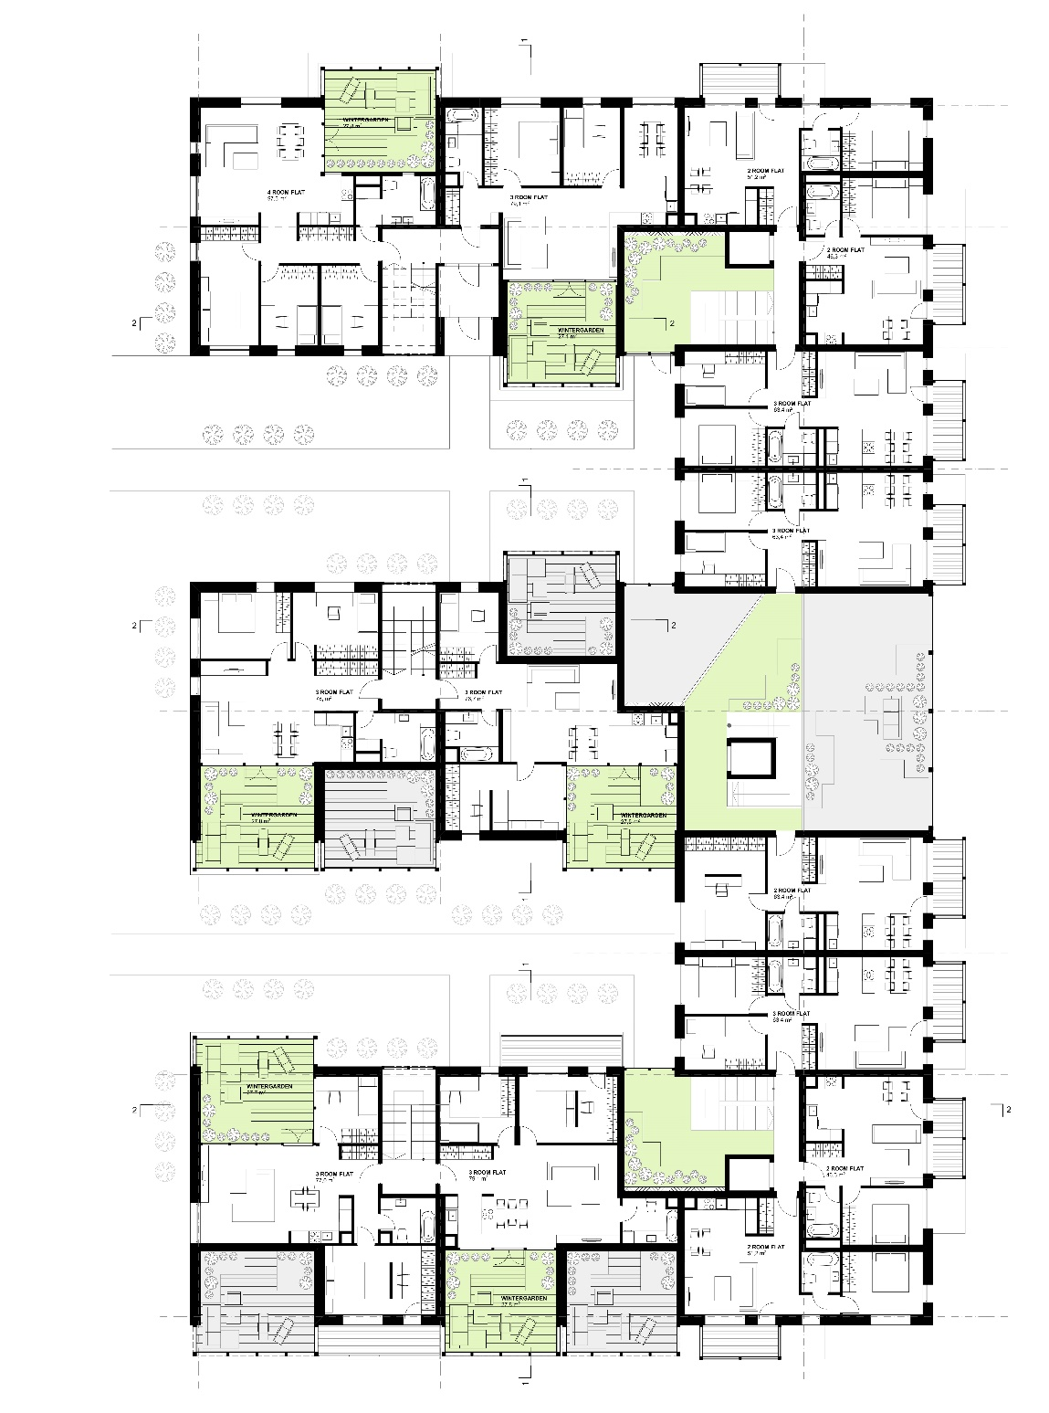
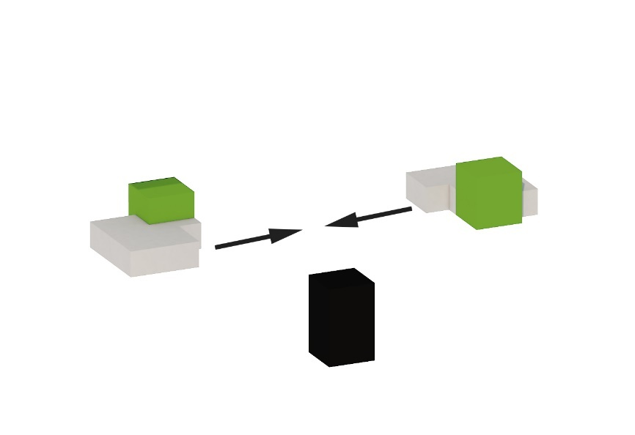
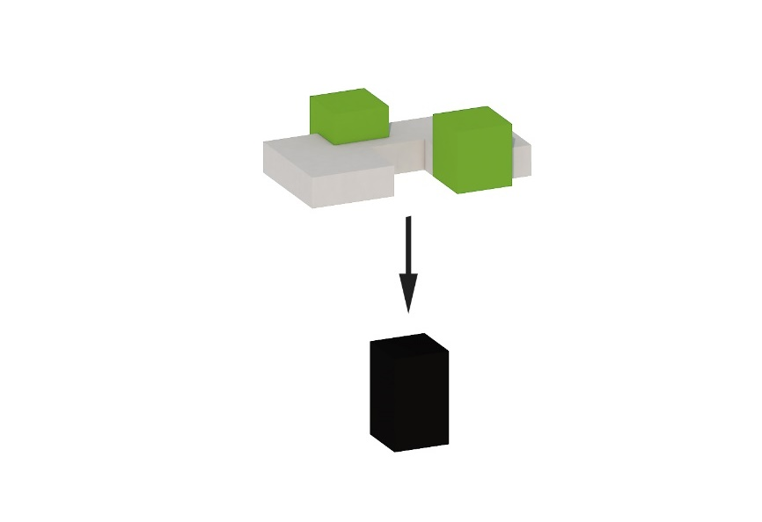
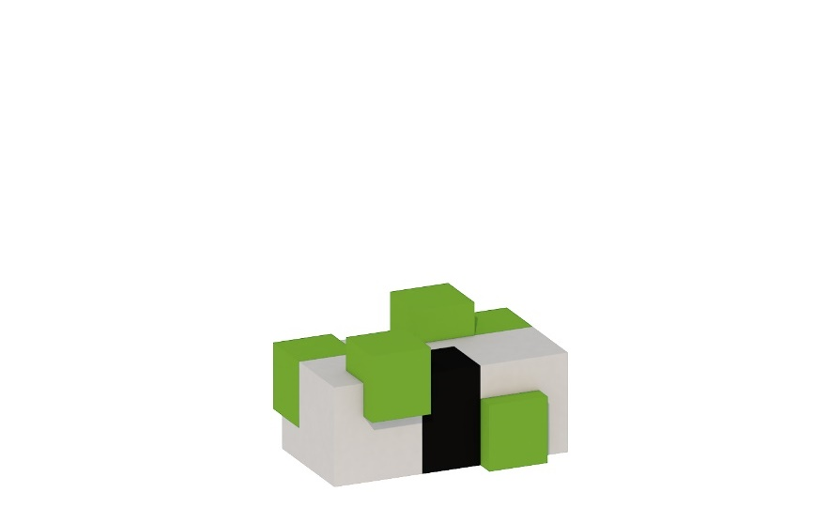
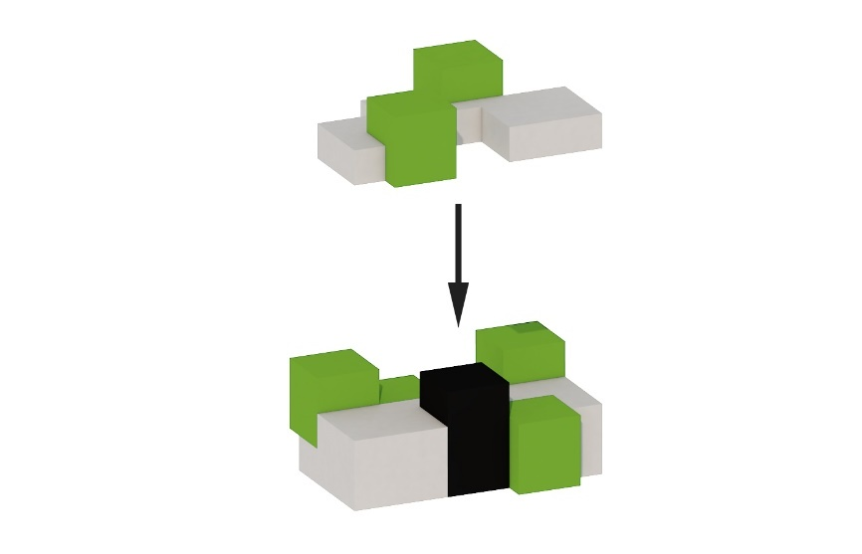
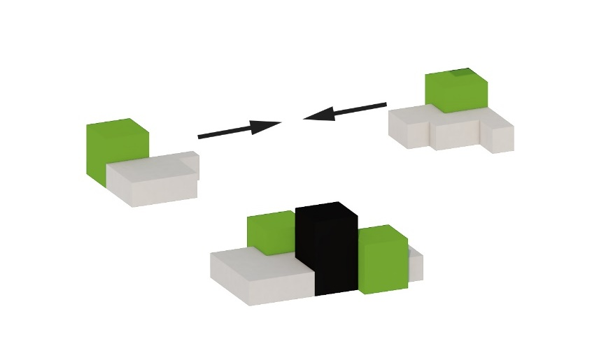
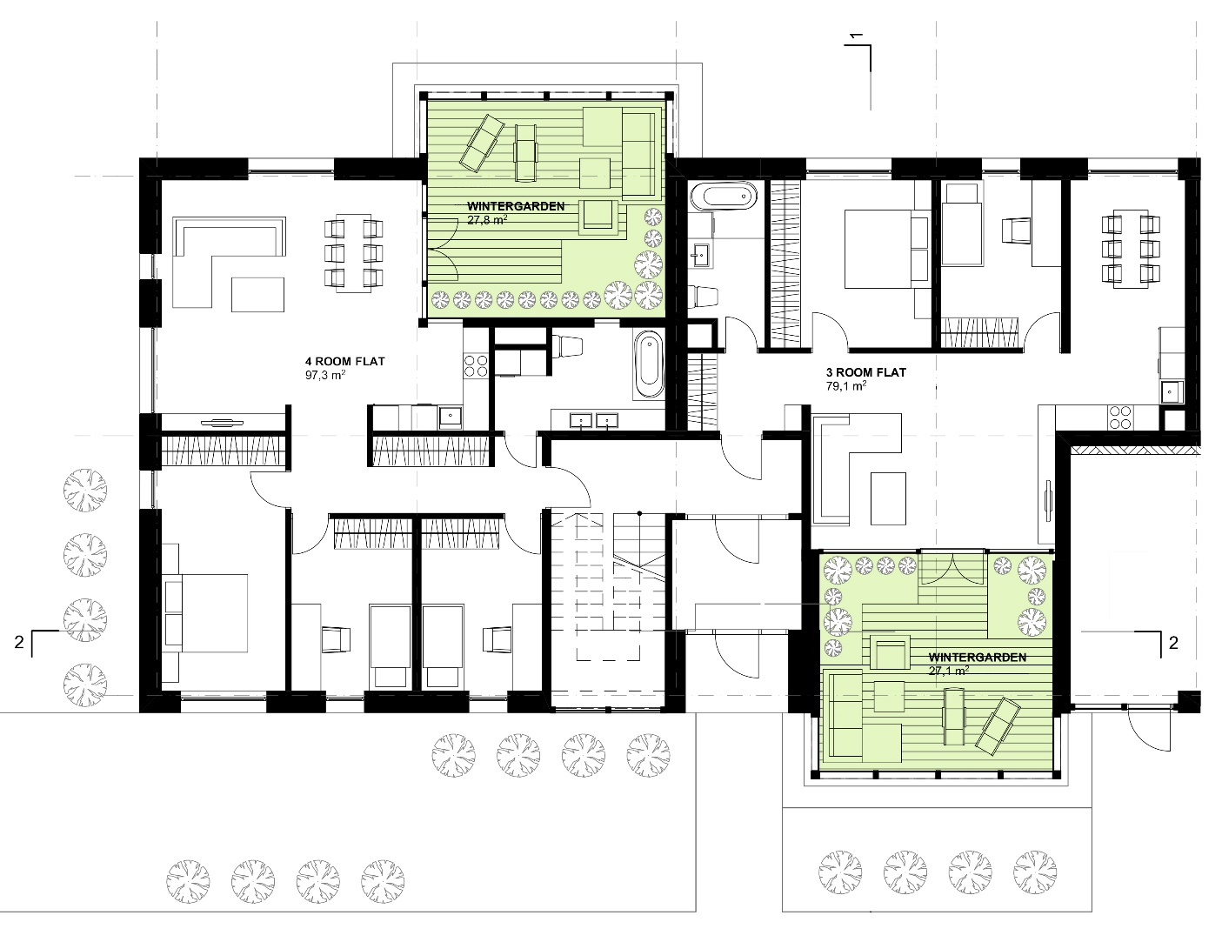
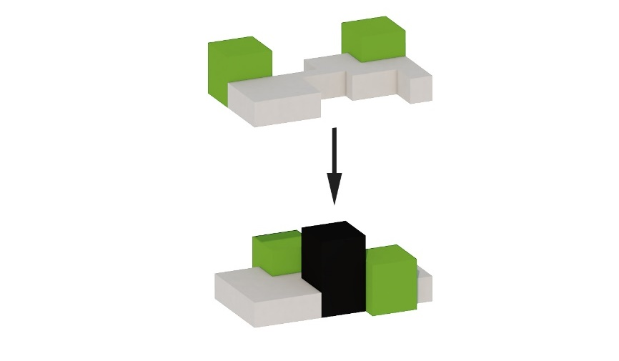
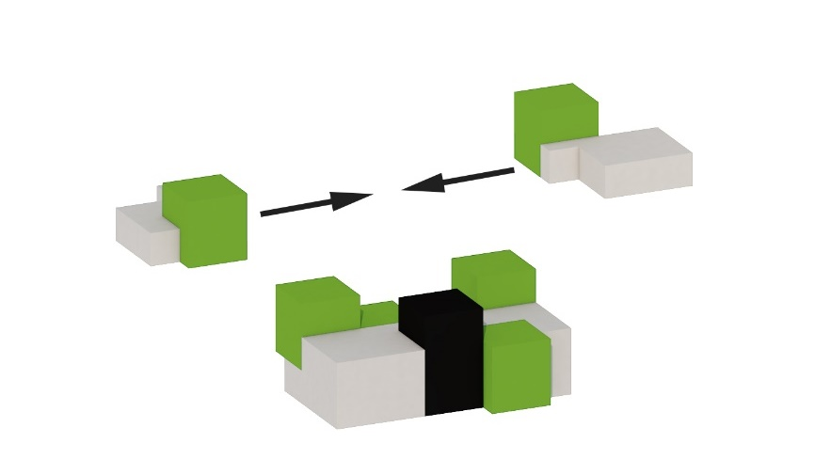
APARTMENT TYPOLOGY
SECOND FLOOR
FIRST FLOOR
GROUND FLOOR
3-STOREY HOUSE MODULE

Slide 10
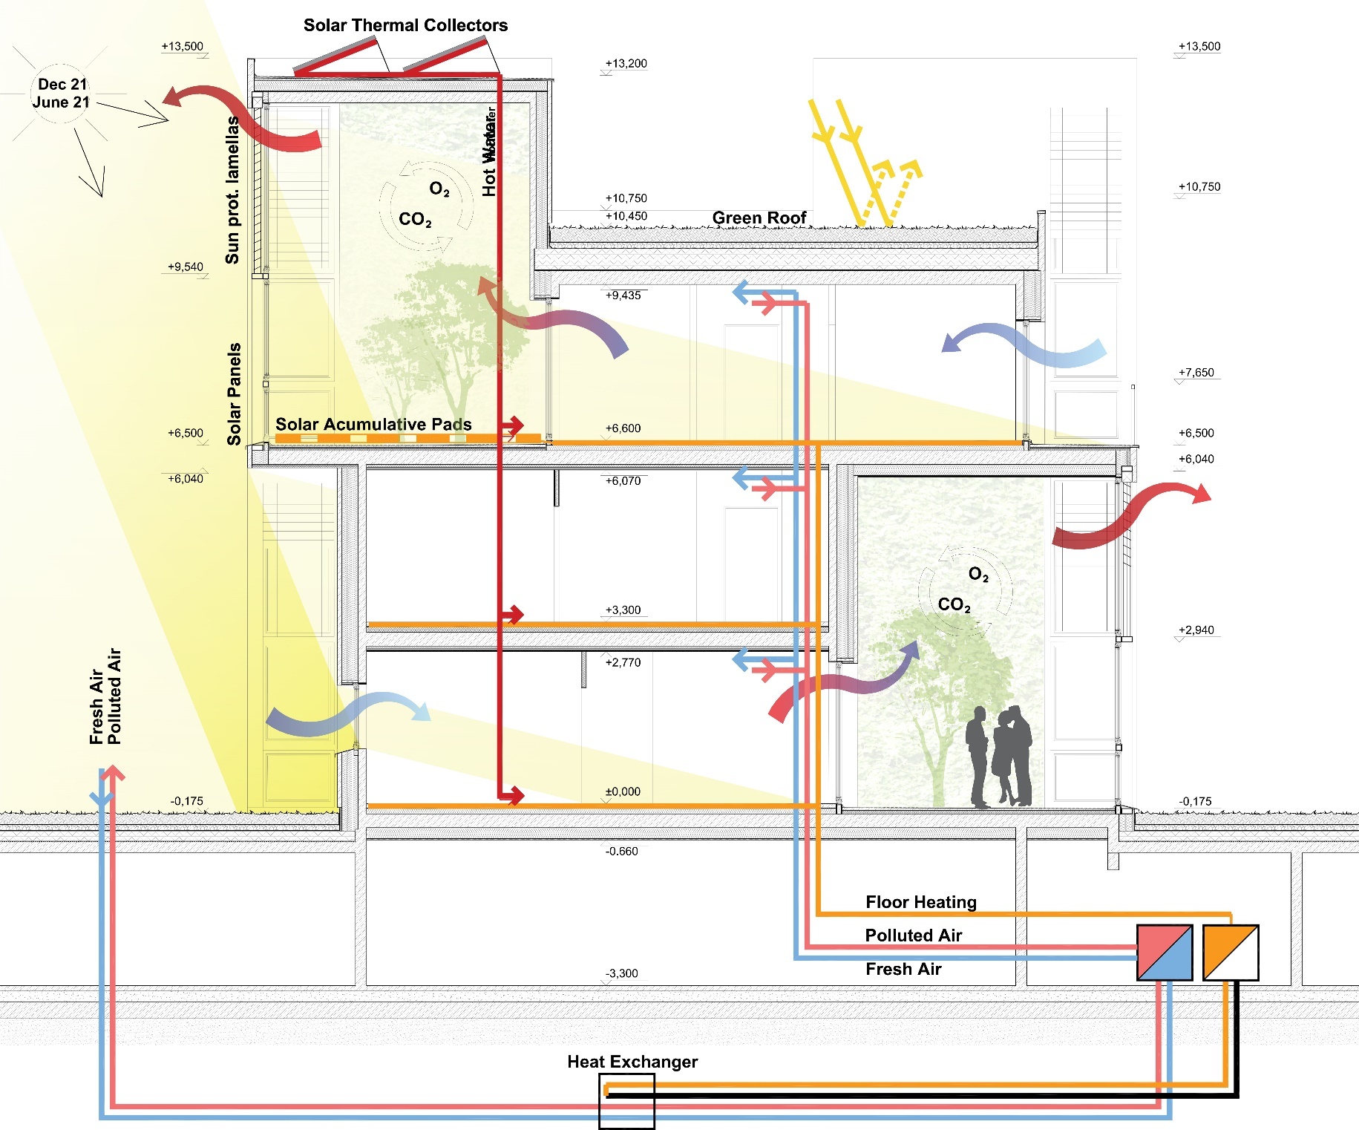
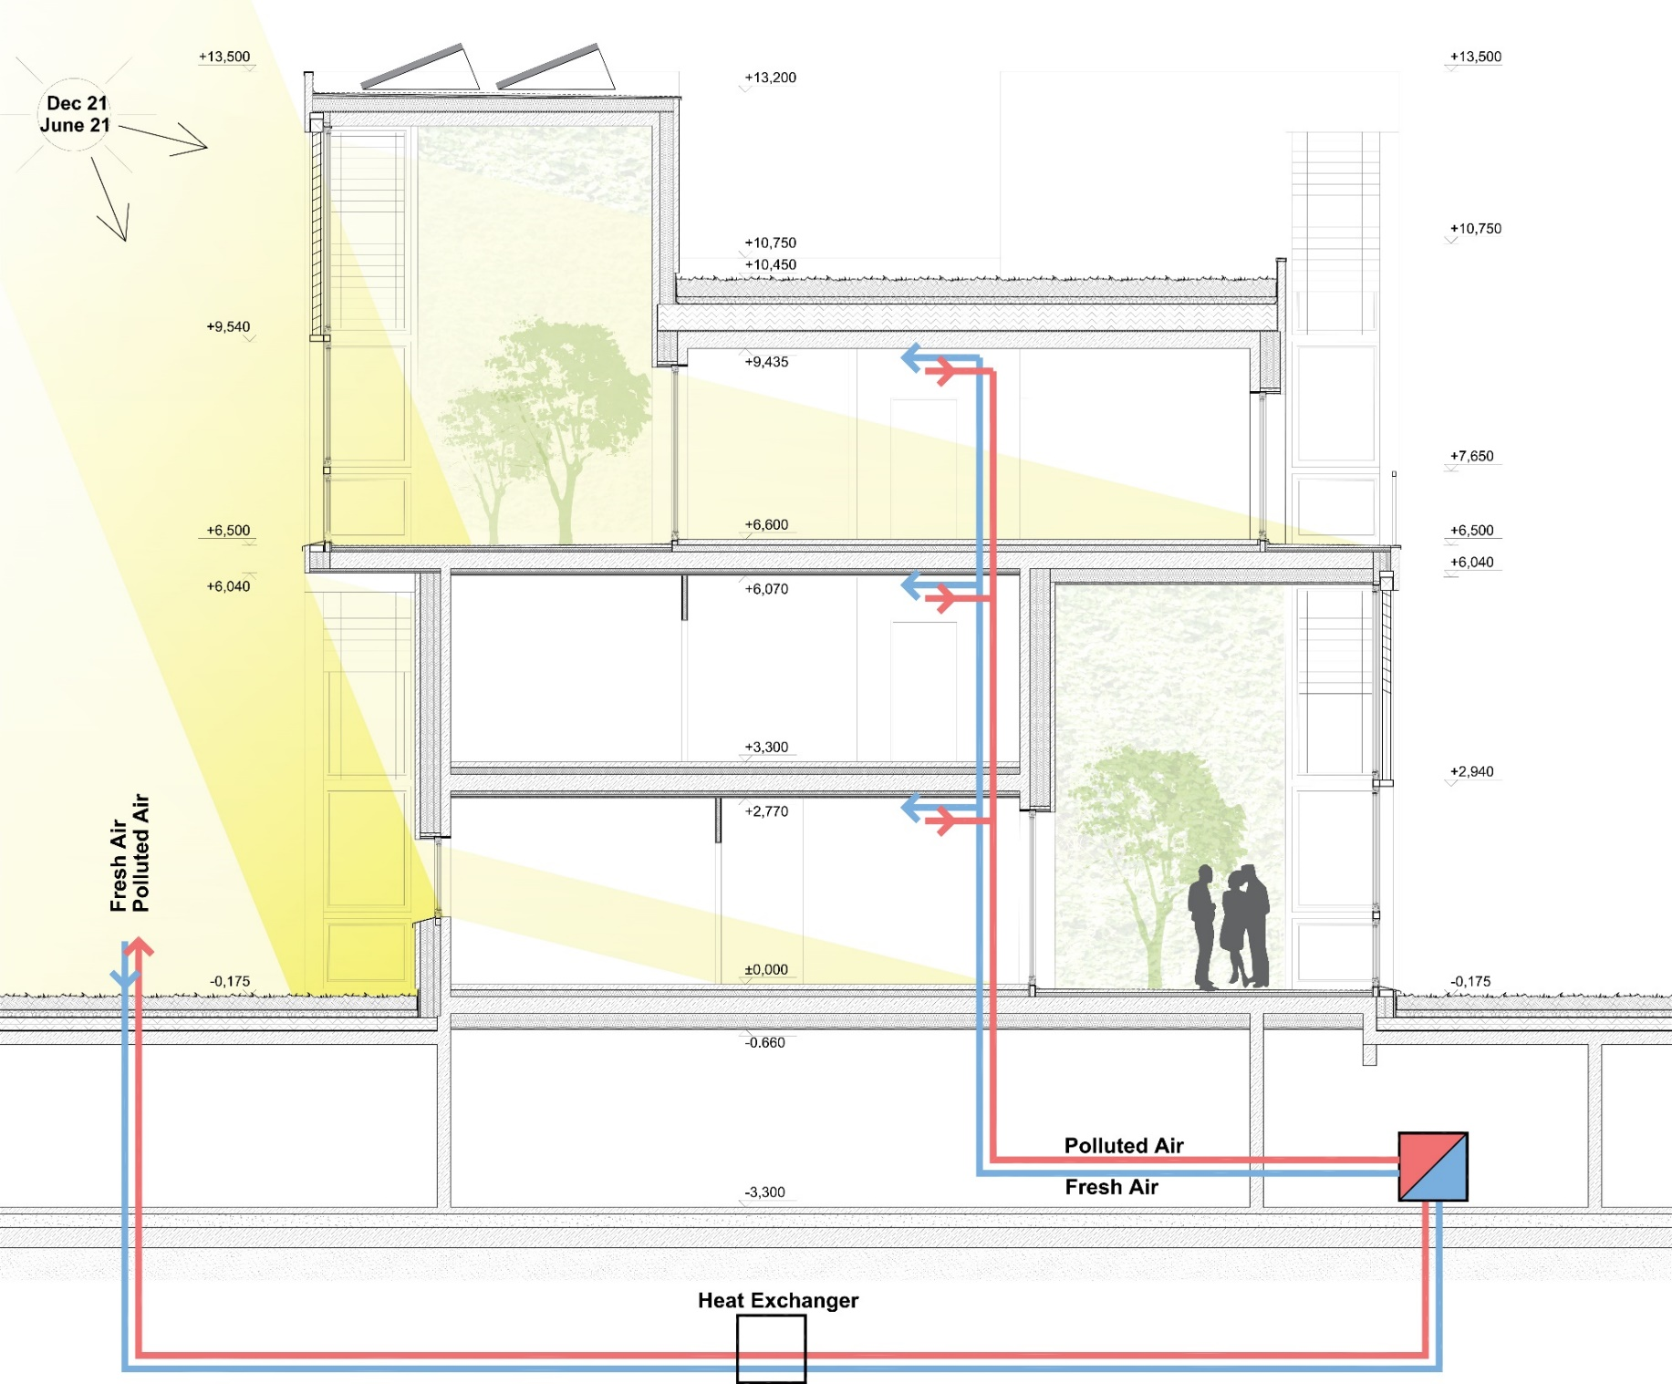
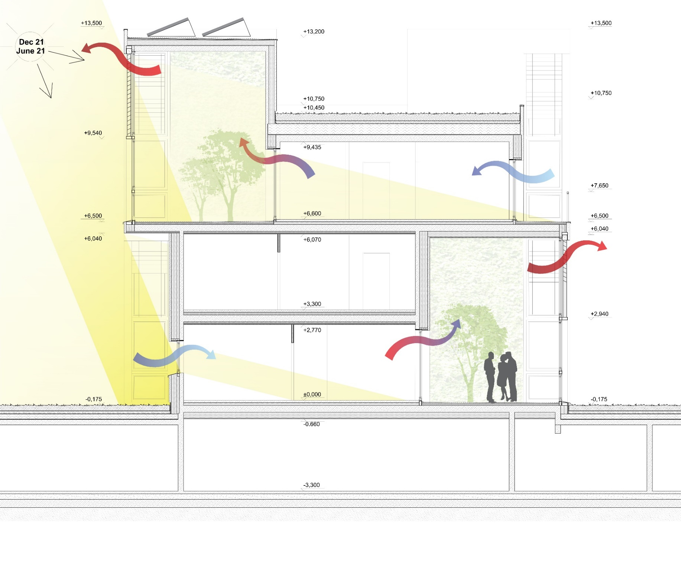
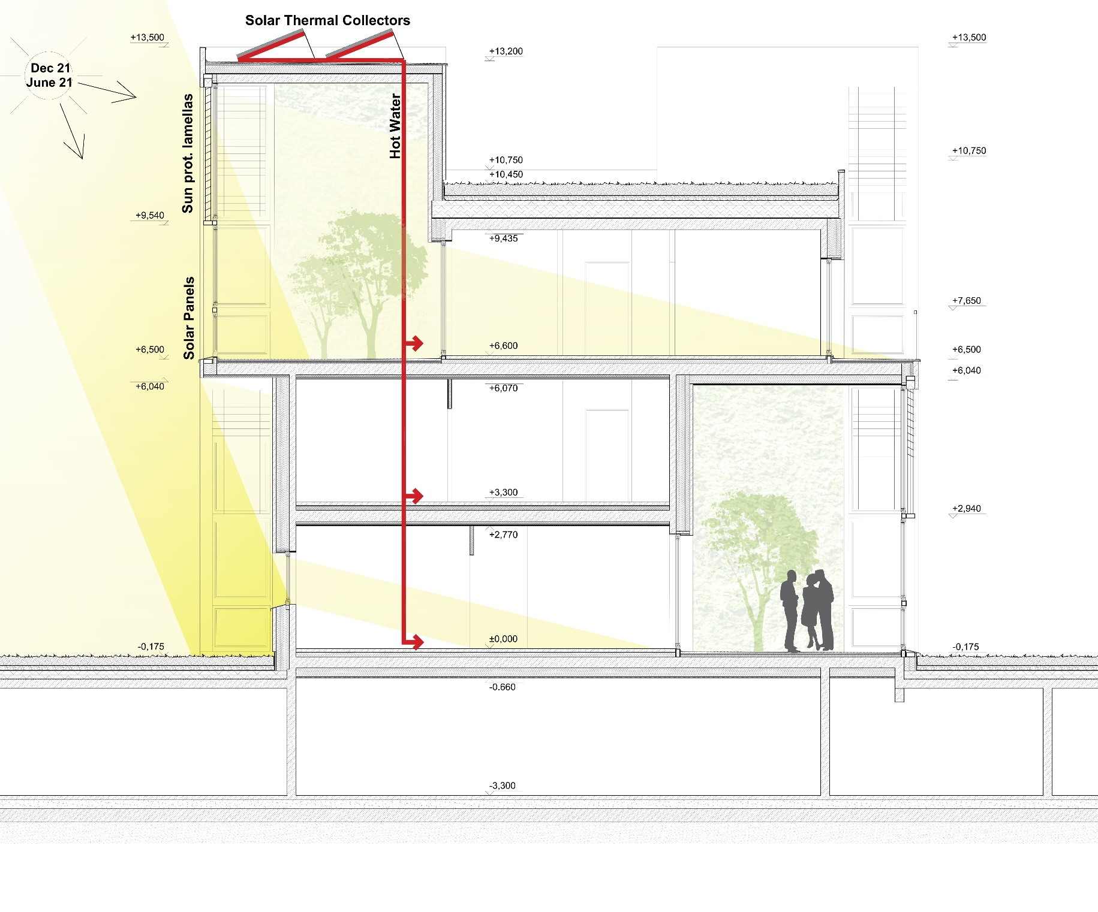
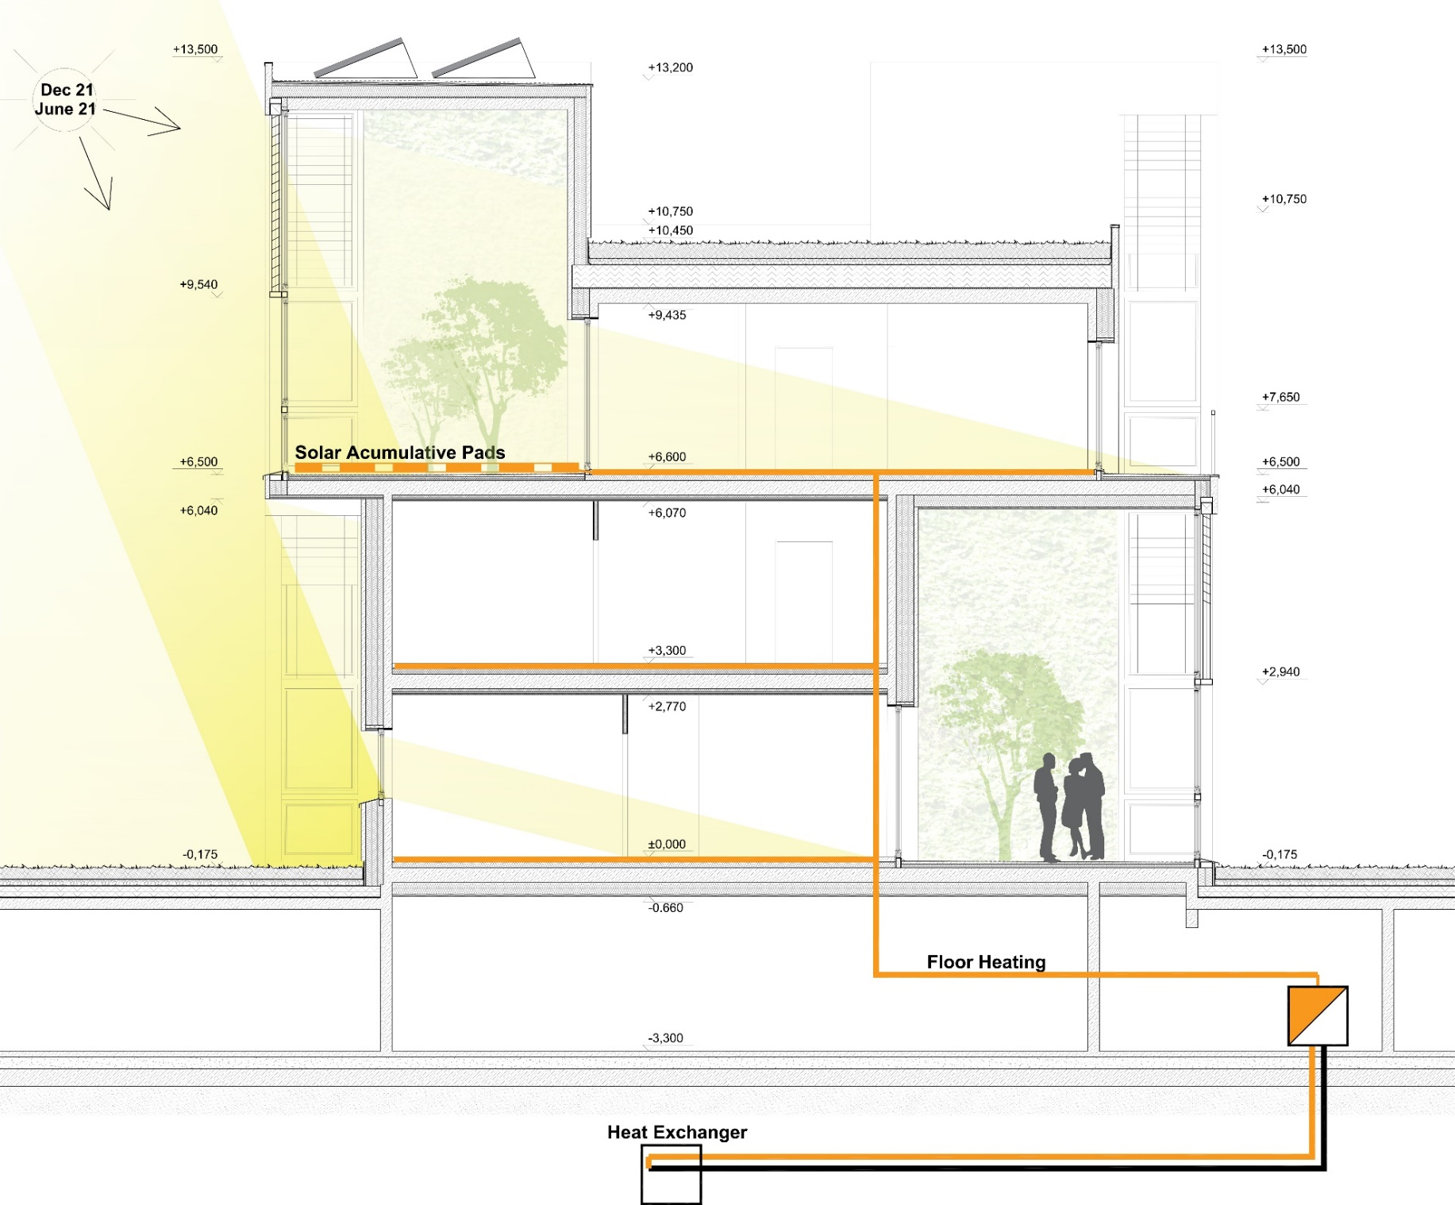
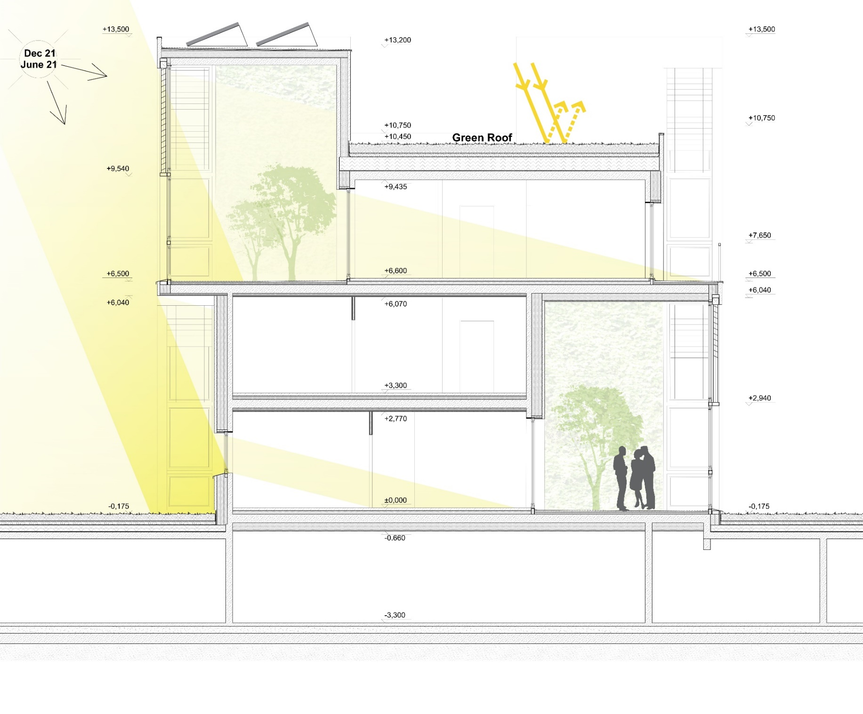
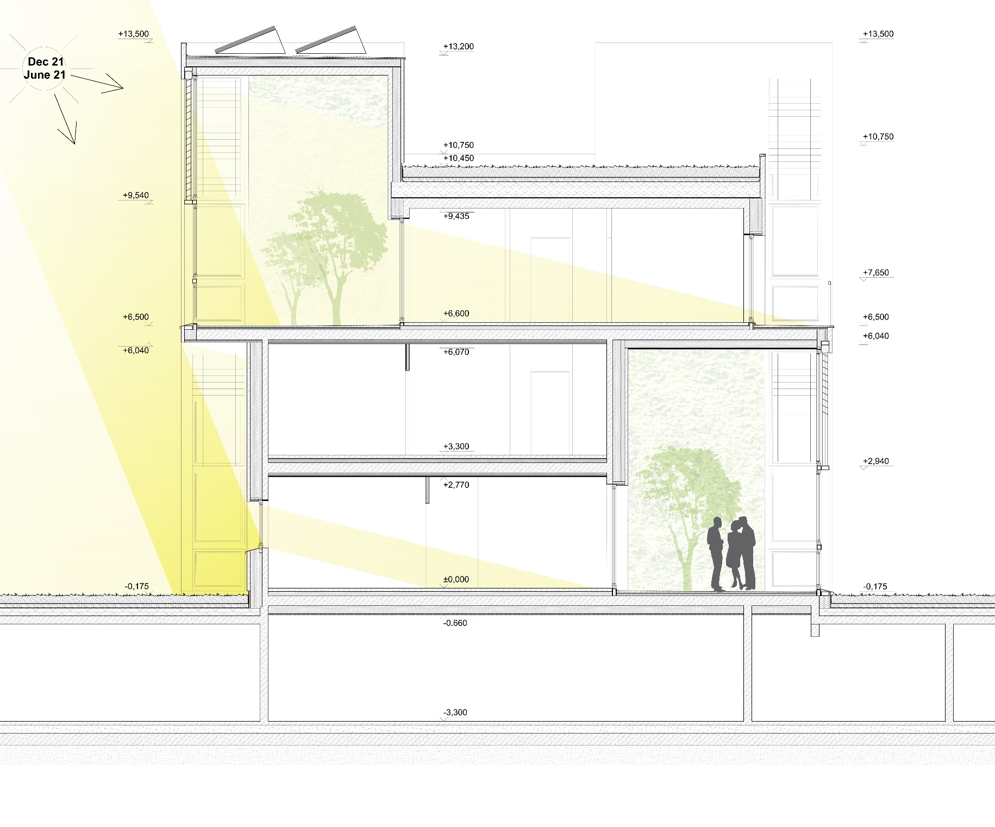
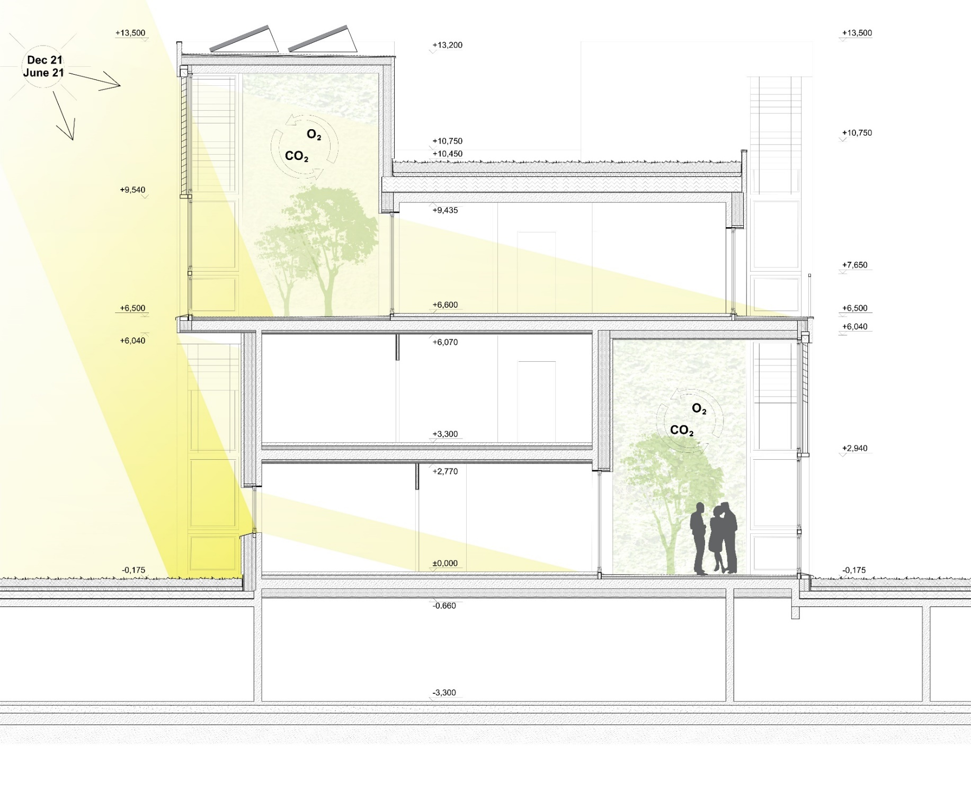
ENERGY CONCEPT
Heat Demand Calculations
Transmission Heat Losses: 238030.22 kWh/a
Ventilation Heat Losses: 50750.46 kWh/a
Total Heat Losses: 288780.68 kWh/a
Internal Heat Gains: 67053.07 kWh/a
Available Solar Heat Gains: 165325.64 kWh/a
Total Heat Gains: 211358.66 kWh/a
Annual Heat Demand: 77422.02 kWh/a
Specific Annual Heat Demand: 12.98 kWh/(m²a)
Notes:
Rohelised aiad – hapnik
Roheline katus
Päikeseenergia
Põrandaküte
Loomulik ventilatsioon
Mehhaaniline vent
Kõik

Slide 11
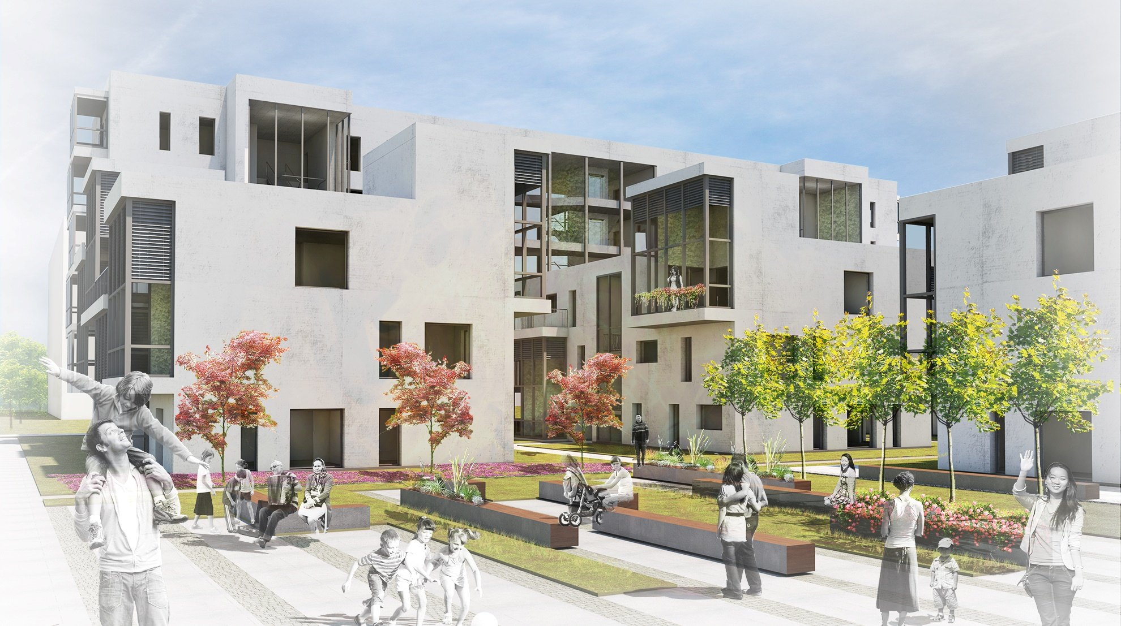
THANK YOU!

